Slide 1
ASP.NET Core 3 Building Apps & Services - Whats New? K. Scott Allen @OdeToCode

Slide 2
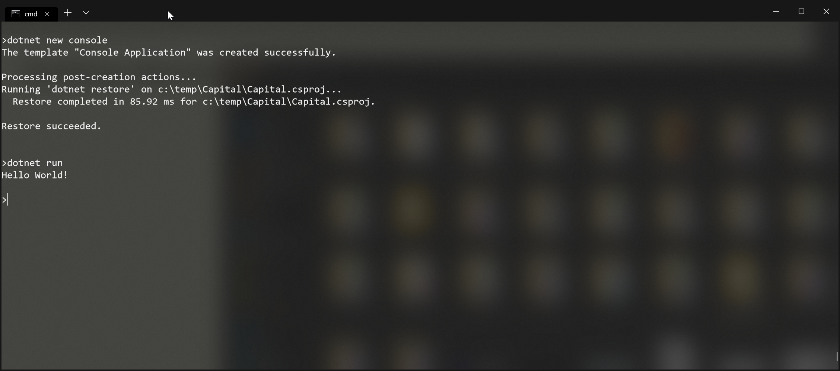
Getting Started with ASP.NET Core

Slide 3
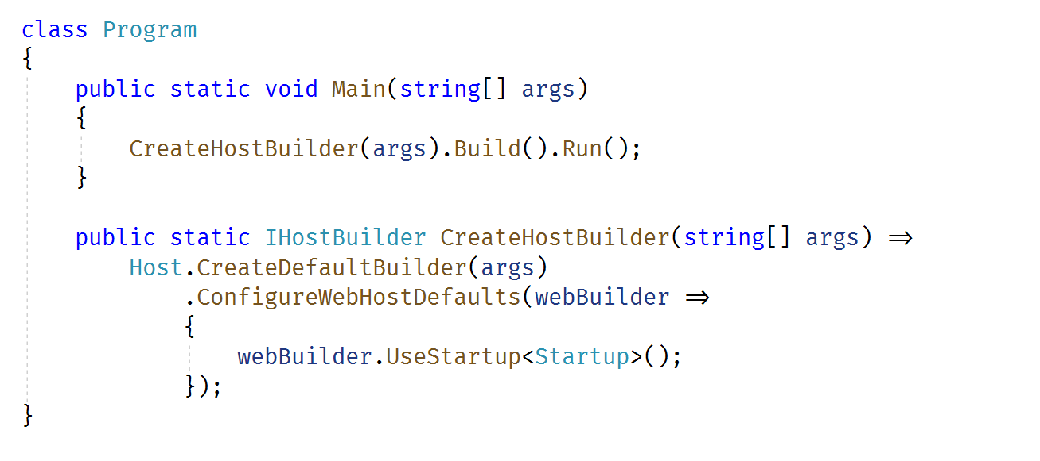
Creating a Host
Not necessarily a web server …

Slide 4
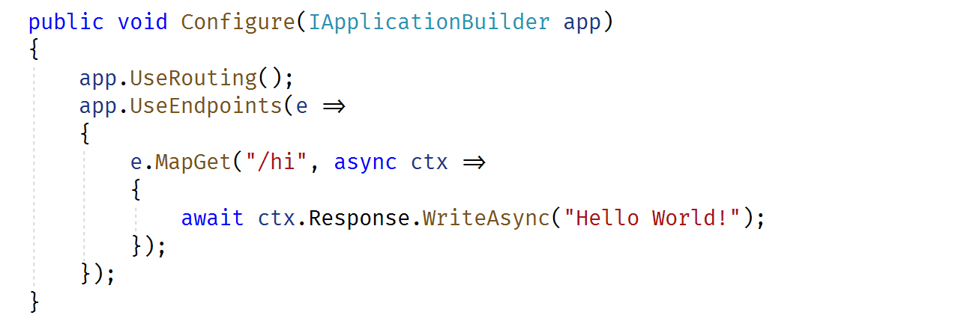
Configure Middleware

Slide 5
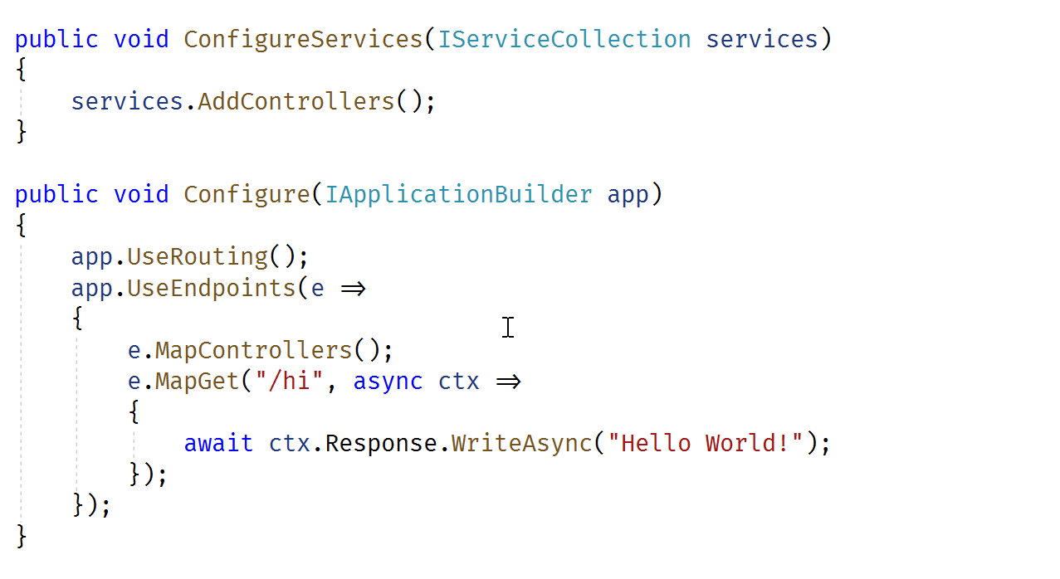
Controllers for APIs

Slide 6
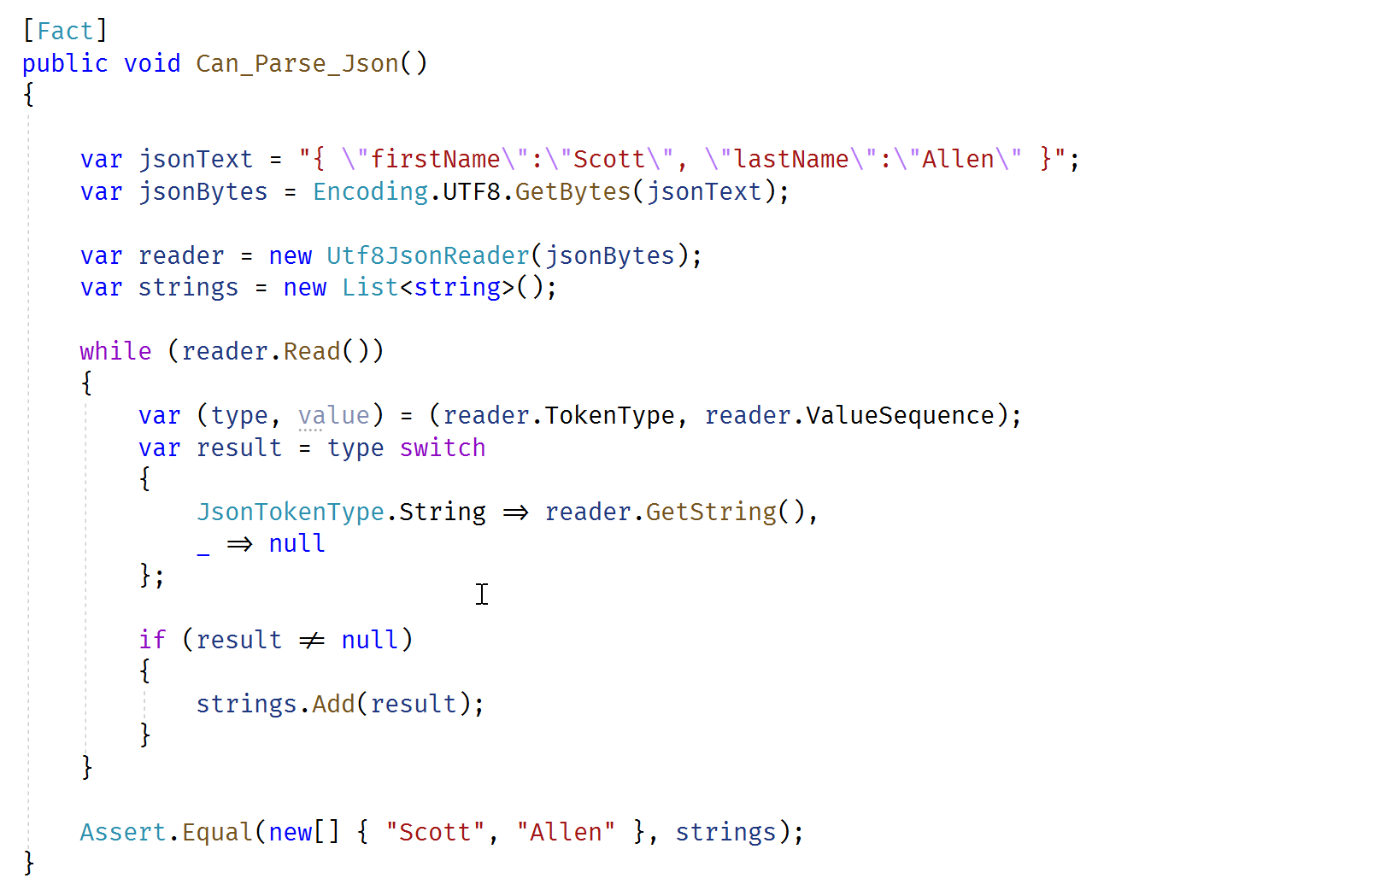
New: System.Text.Json

Slide 7
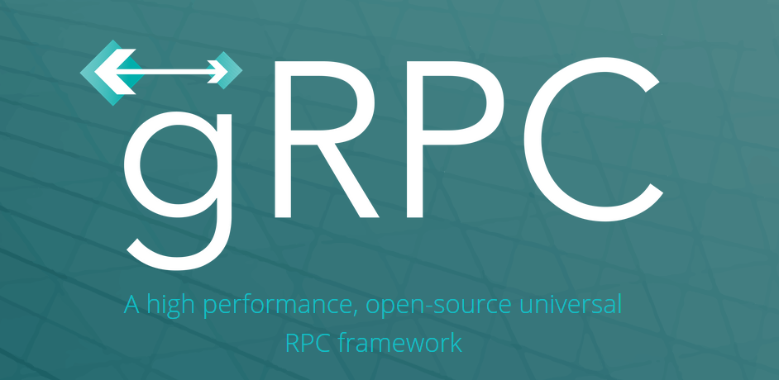
New: gRPC

Slide 8
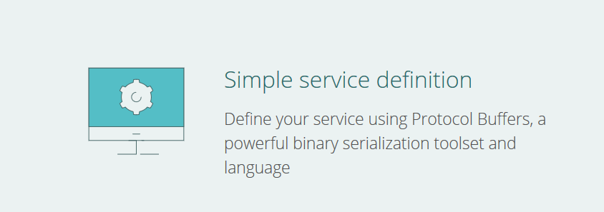
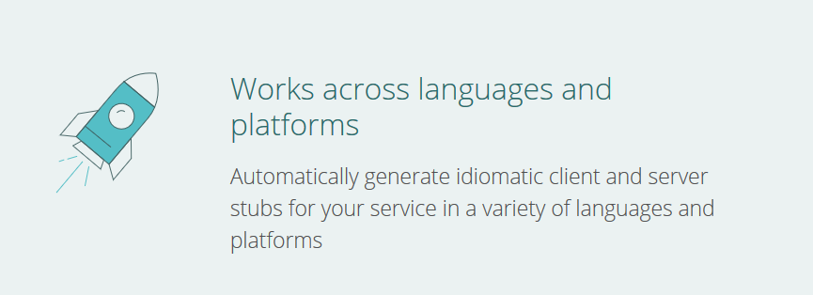
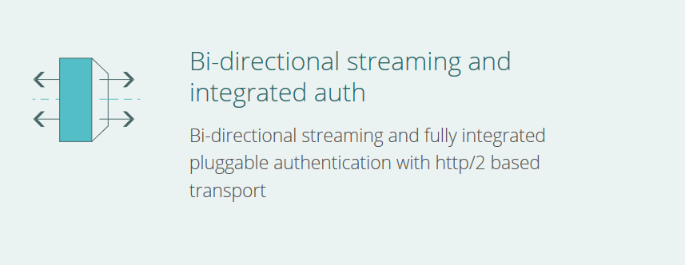

Slide 9
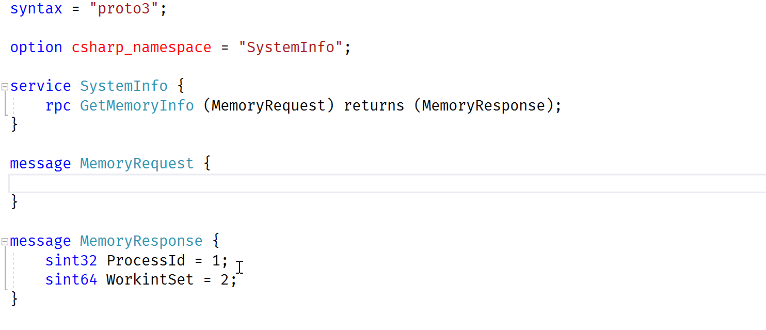
Protocol Buffers

Slide 10
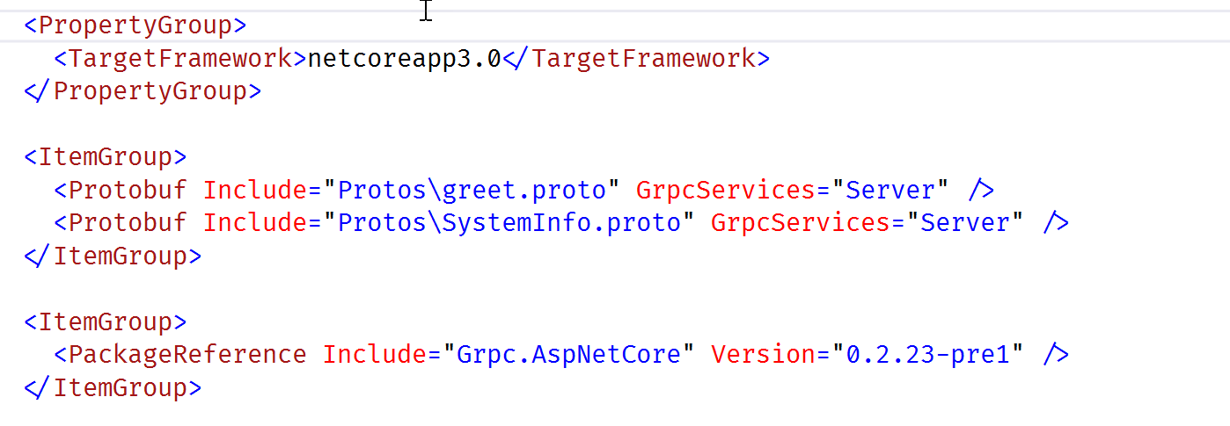
gRPC in an ASP.NET Core Project

Slide 11
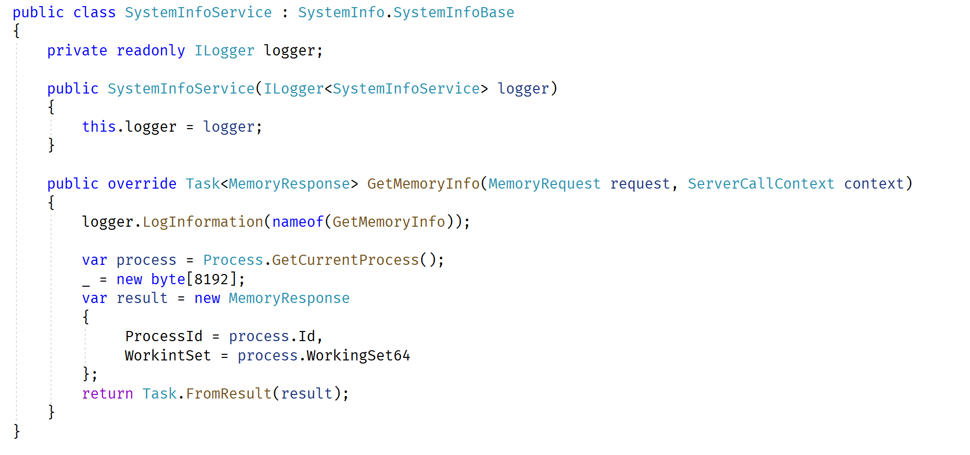
Service Implementation

Slide 12
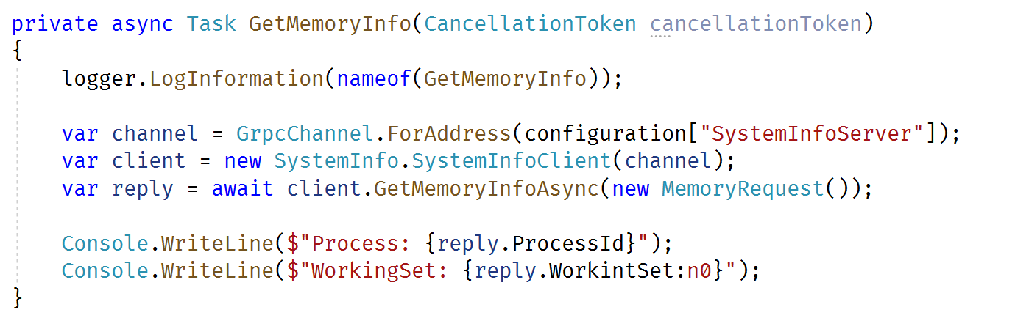
Client Implementation

Slide 13
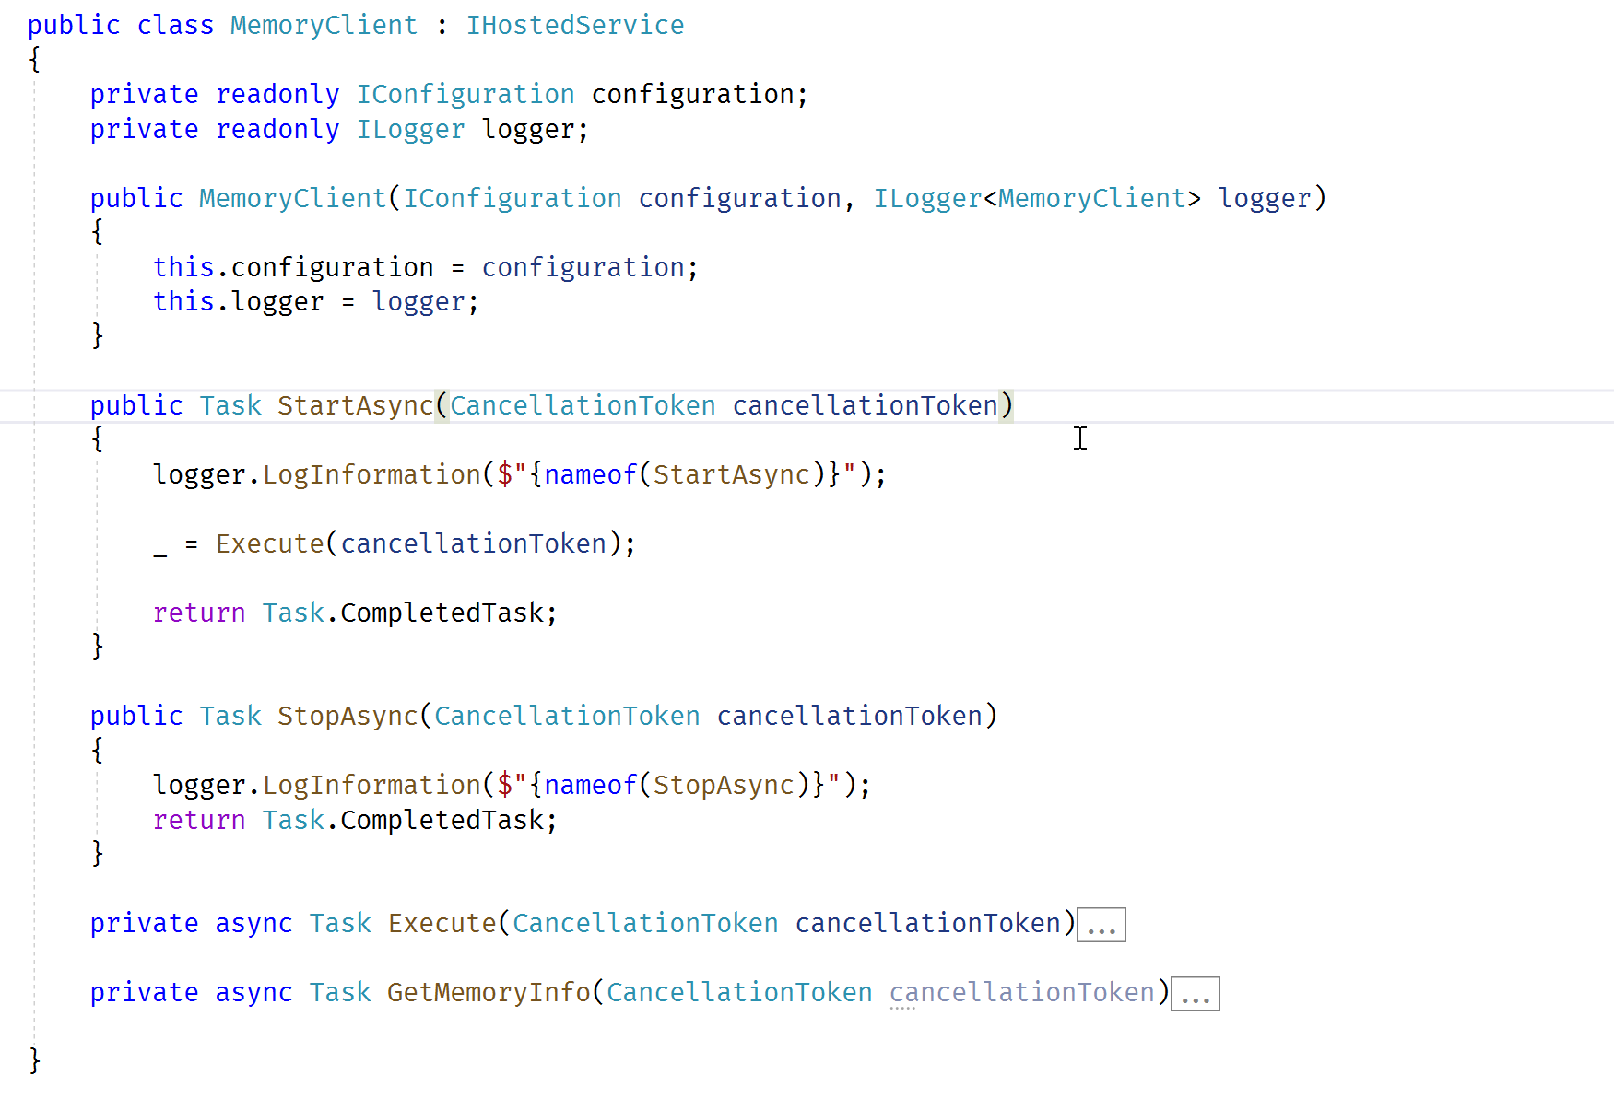
New: Hosting Long Running Tasks

Slide 14
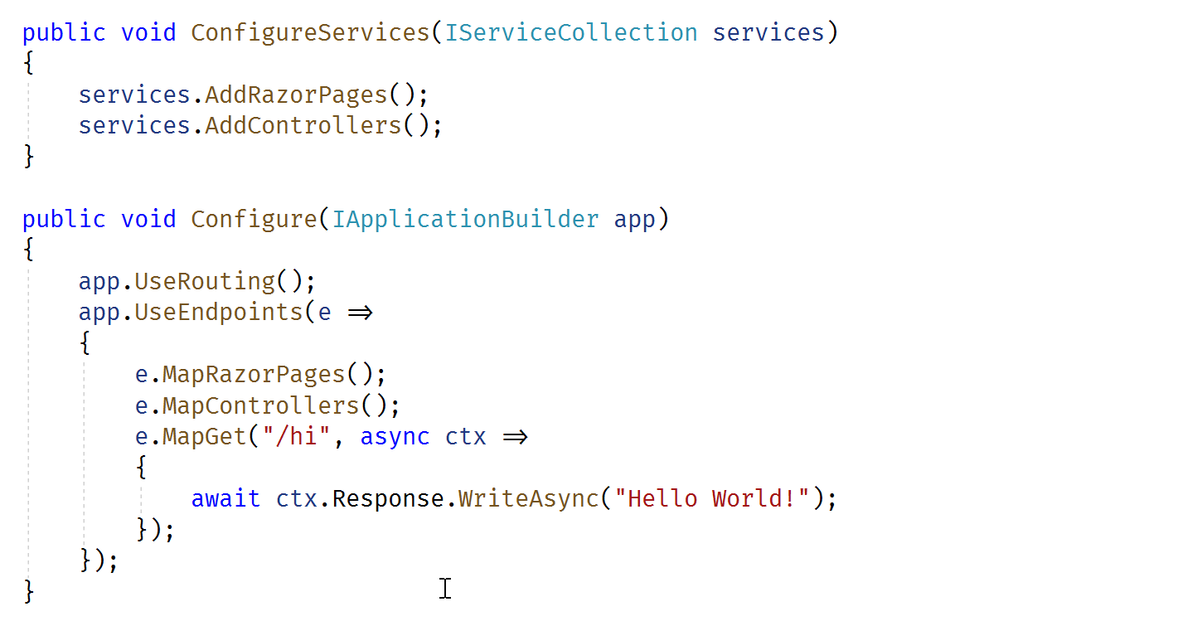
Razor Pages for HTML

Slide 15
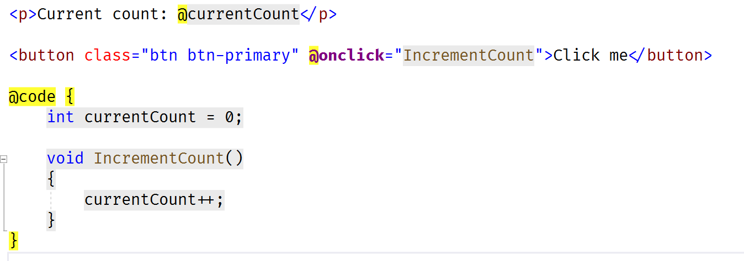
Blazor for Components

Slide 16
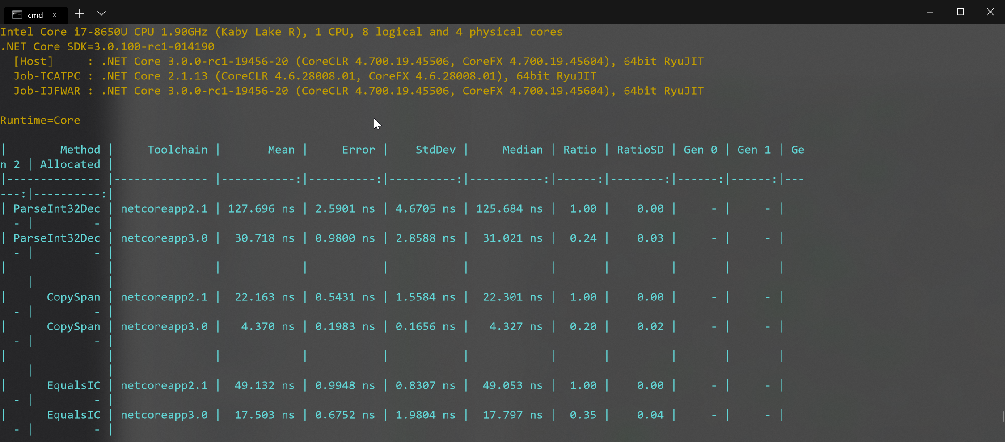
.NET Core - Performance is a Feature

Slide 17
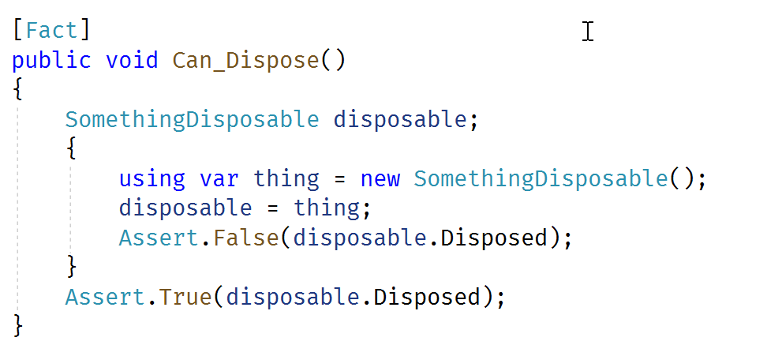
.NET Core Builds on C# - using declaration

Slide 18
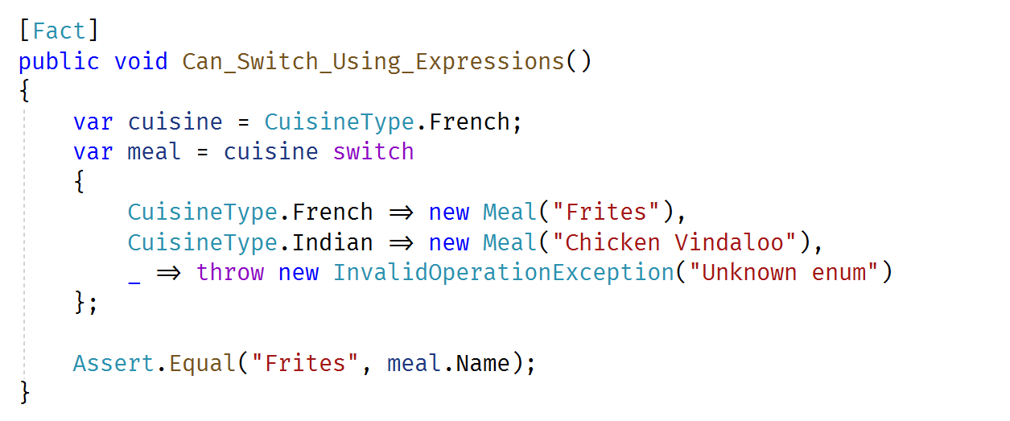
.NET Core Builds on C# - better switch statements

Slide 19
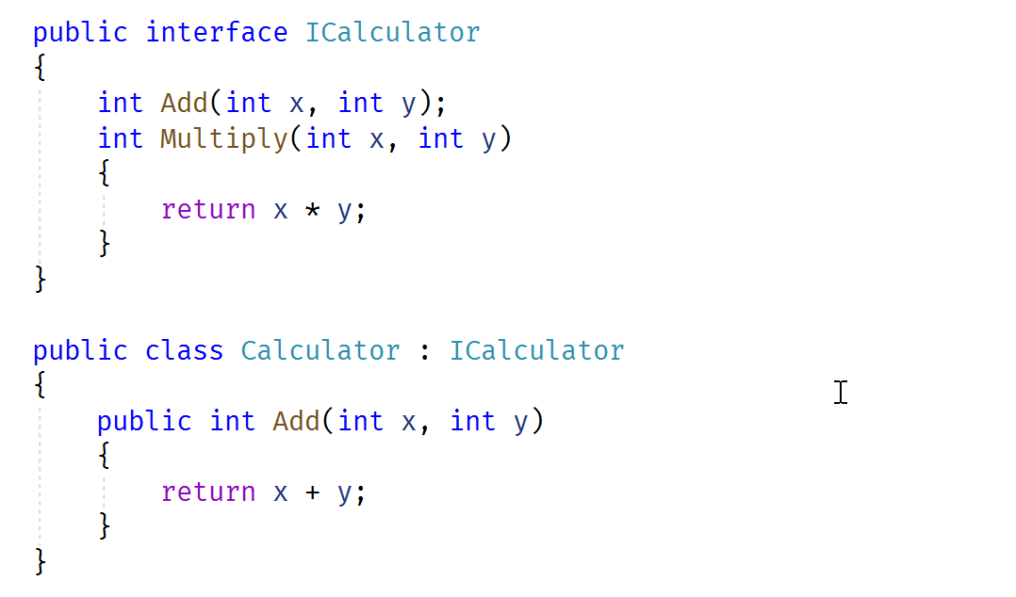
.NET Core Builds on C# - default interface impl

Slide 20
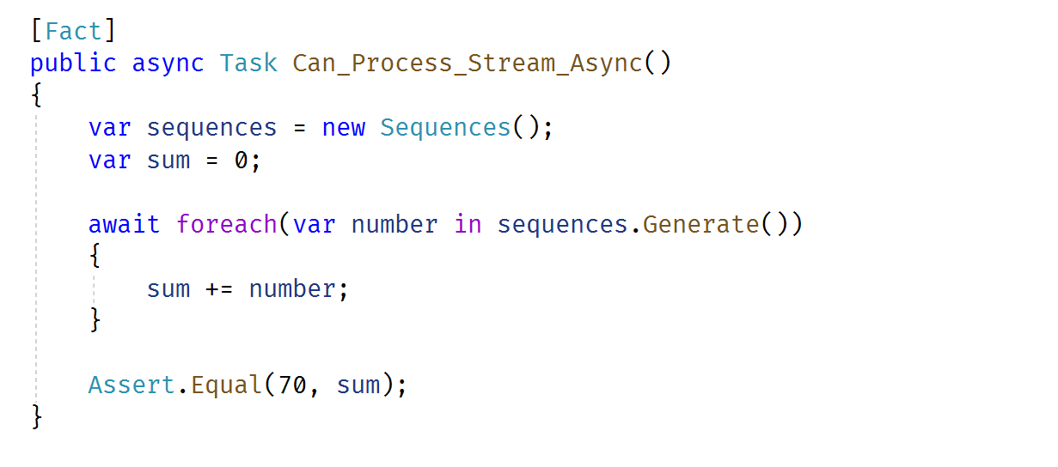
.NET Core Builds on C# - async streams

Slide 21
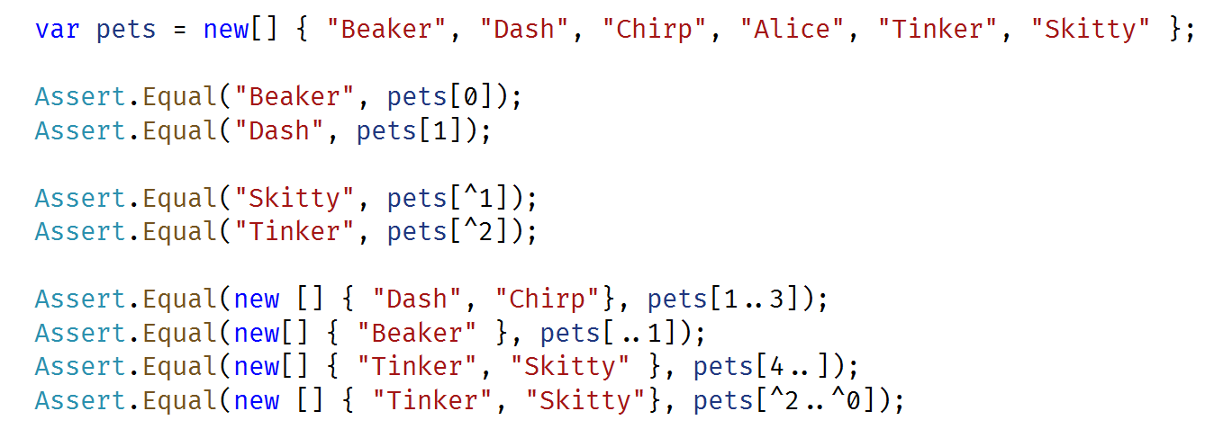
.NET Core Builds on C# - Range and Index

Slide 22
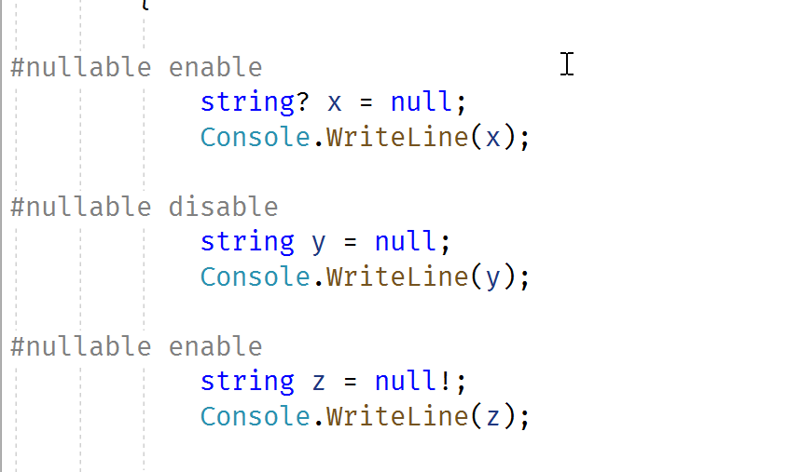
.NET Core Builds on C# - Nullable References

Slide 23
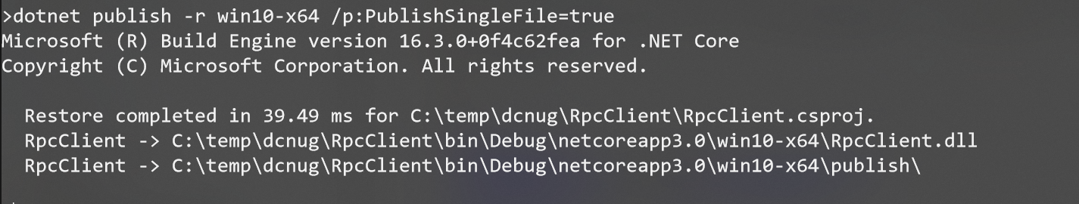
Publishing - SingleFileExecutable

Slide 24
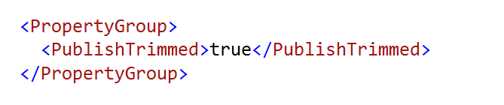
Publish – Linking and Trimming

Slide 25
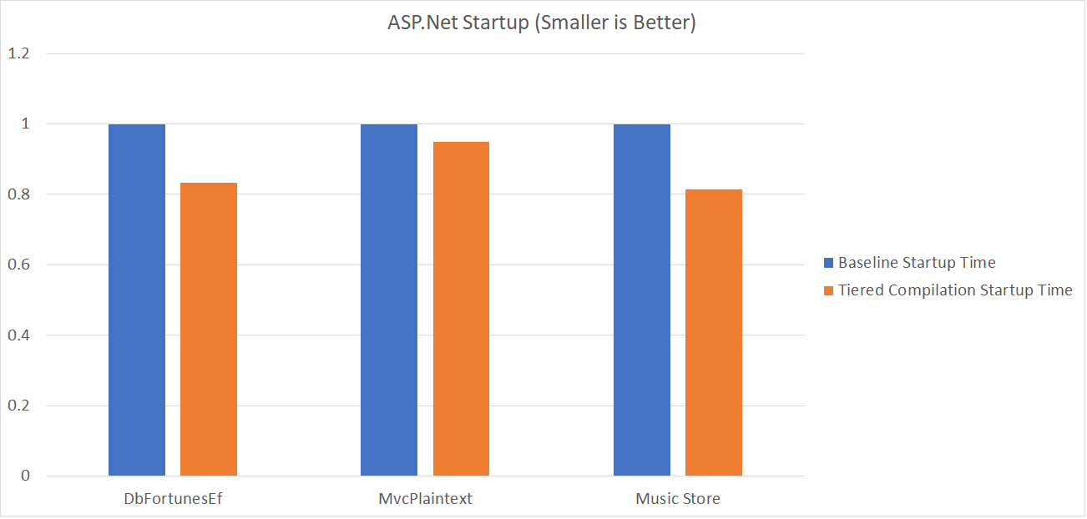
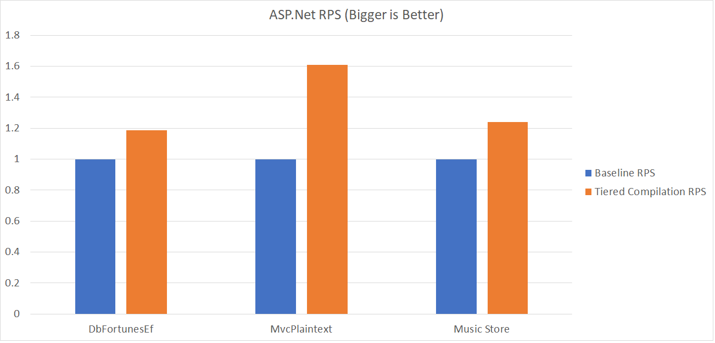
Runtime – Tiered Compilation

Slide 26
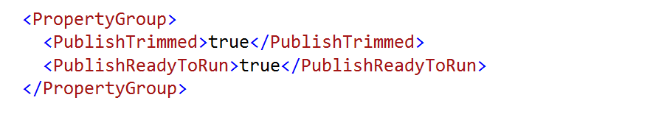
Publish – Ready to Run

Slide 27
The End
scott@OdeToCode.com
https://odetocode.com/

