Slide 1
Building APIs

Slide 2
HTTP API Refresher
Resources identified by URI
Standard interface – GET, PUT, POST, DELETE, PATCH
Stateless
Headers for metadata
Resource representation is negotiable
Status codes communicate type of response

Slide 3
Use Hierarchies
/api/movies
/api/movies/10720/directors
/api/movies/10720/directors/625
/api/movies/10720/directors/625/awards

Slide 4

If Not a Resource, It’s a Parameter
/api/movies/name/Star
/api/movies/orderby/rating
/api/movies/get
/api/movies?name=Star
/api/movies?orderby=rating&name=Star
/api/movies

Slide 5
Use Status Codes
2×× Success
200 OK
201 Created
202 Accepted
204 No Content
205 Reset Content
206 Partial Content
4×× Client Error
400 Bad Request
401 Unauthorized
402 Payment Required
403 Forbidden
404 Not Found
405 Method Not Allowed
406 Not Acceptable
408 Request Timeout
409 Conflict
410 Gone
415 Unsupported Media Type
429 Too Many Requests

Slide 6
Safe and Idempotent
Method | Safe | Idempotent
GET | true | true
OPTIONS | true | true
HEAD | true | true
POST | no | no
DELETE | no | yes
PUT | no | yes
PATCH | no | no

Slide 7
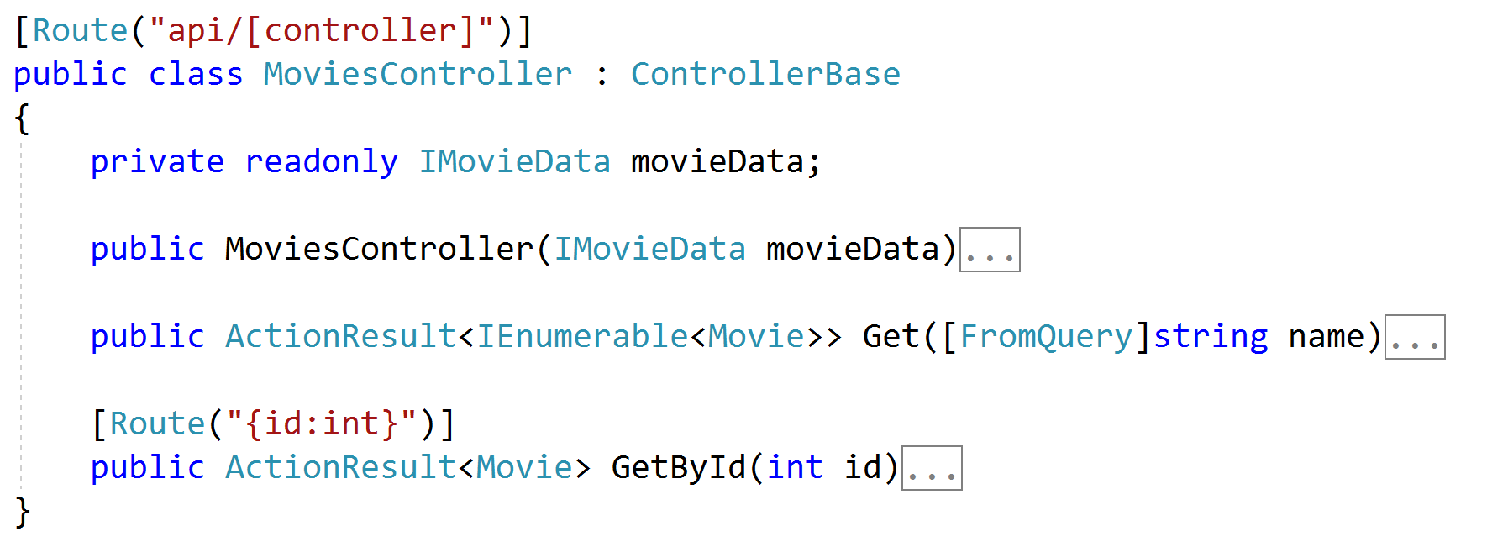
Controller versus ControllerBase
Controller supports Razor views
ControllerBase does not use views

Slide 8
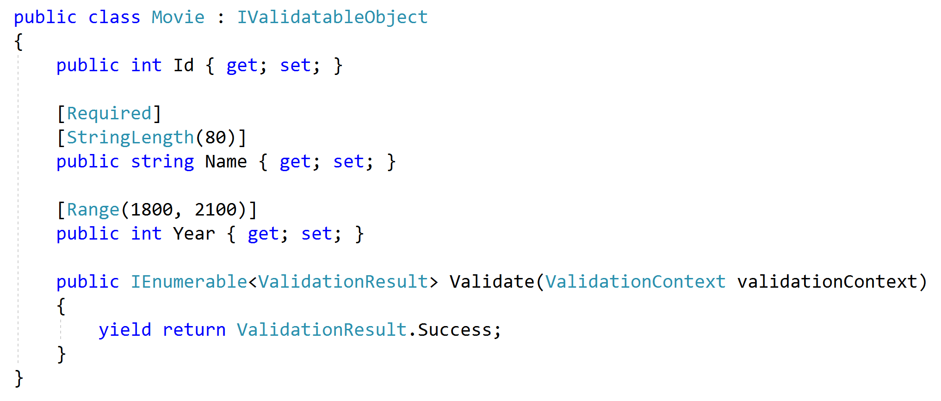
Validation
Through data annotations
Custom data annotations
Through IValidatableObject
Custom controller code

Slide 9
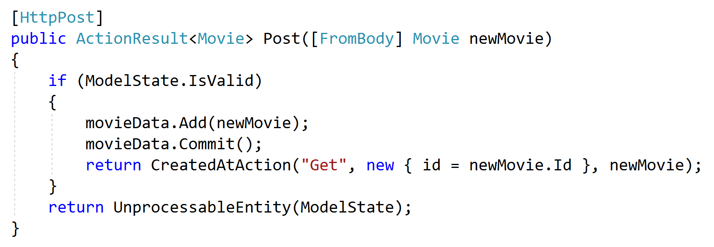
Enforcing Validation
Check model state
Use [ApiController]

Slide 10
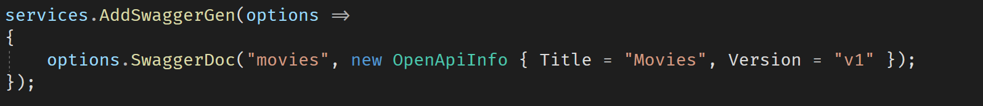
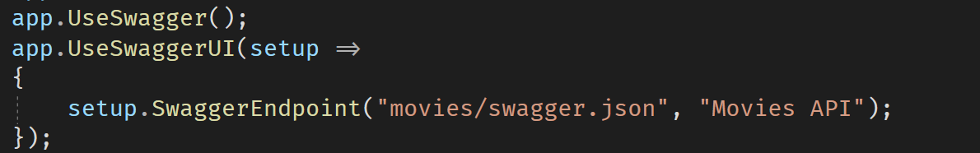
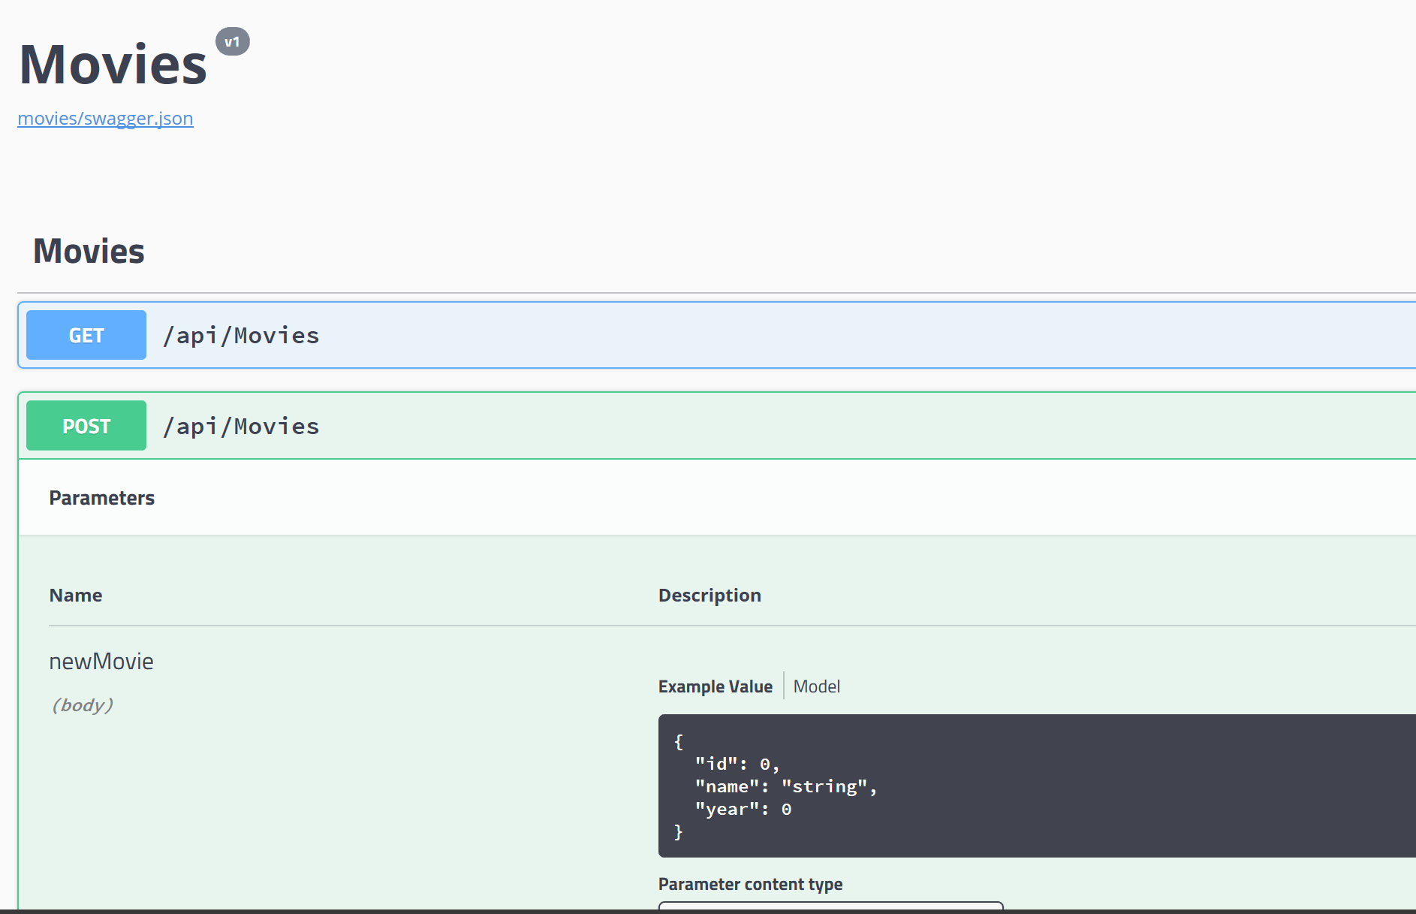
Documentation with OpenAPI
Formerly known as Swagger
Use NSwag or Swashbuckle

Slide 11
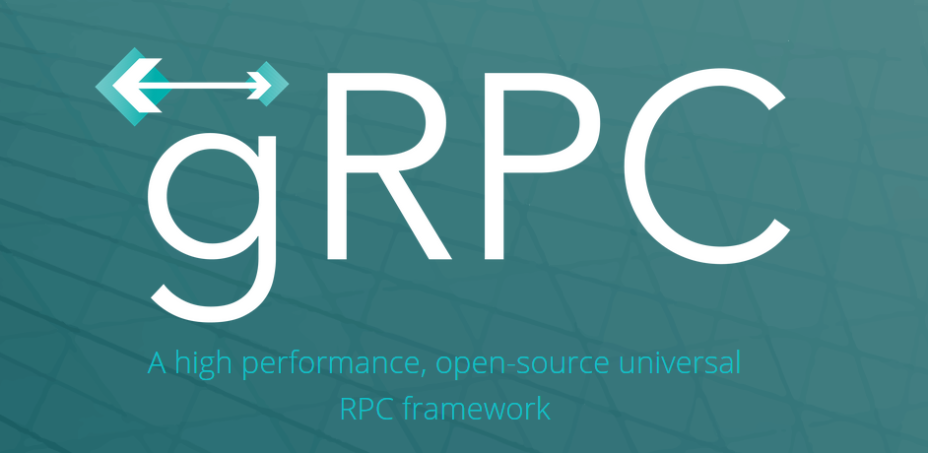
New: gRPC

Slide 12
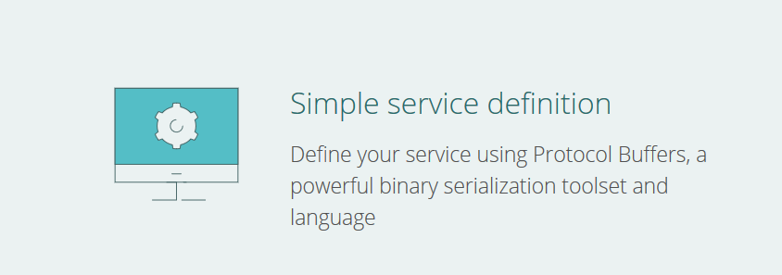
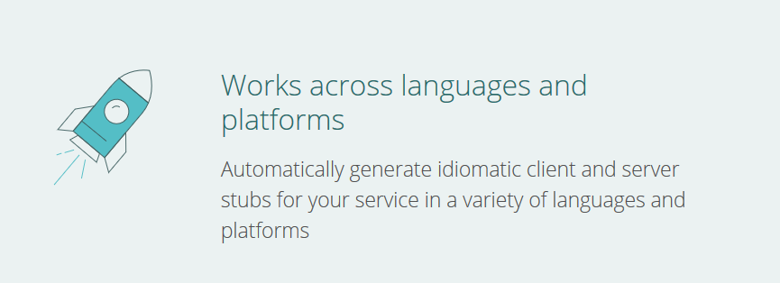
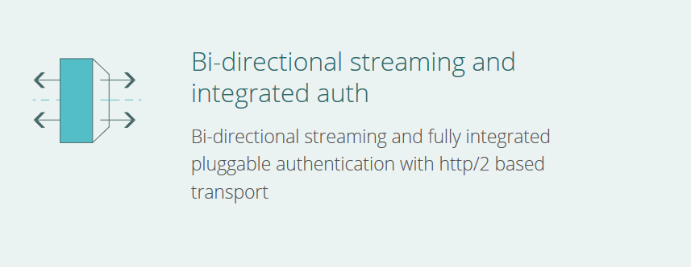

Slide 13
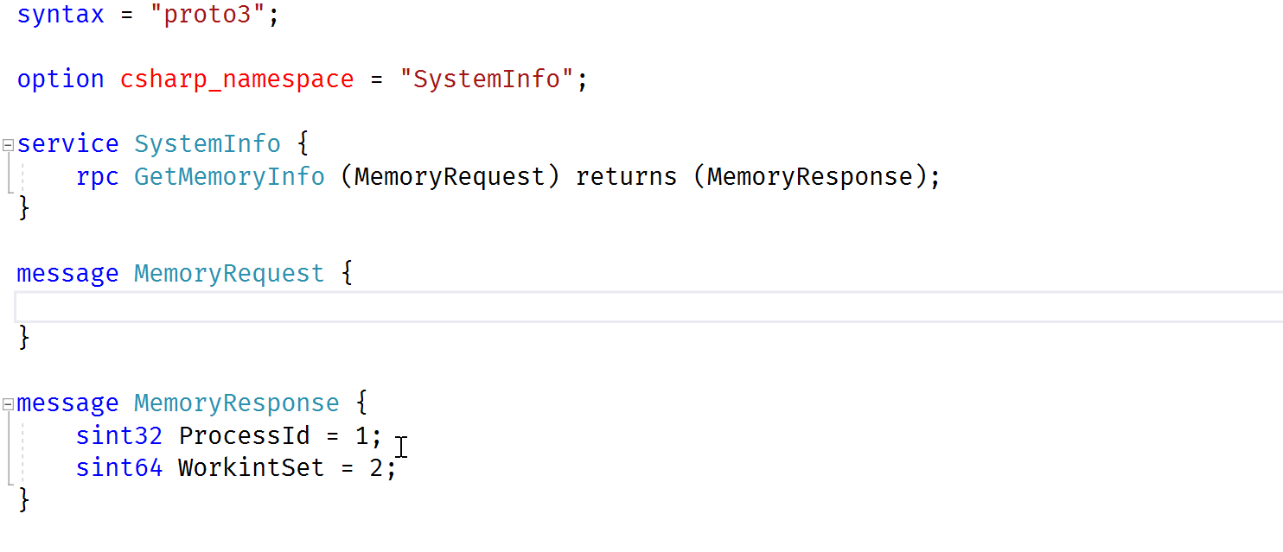
Protocol Buffers

Slide 14
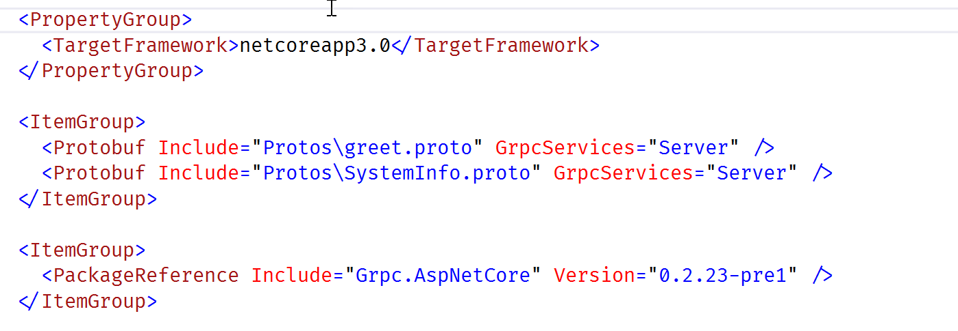
gRPC in an ASP.NET Core Project

Slide 15
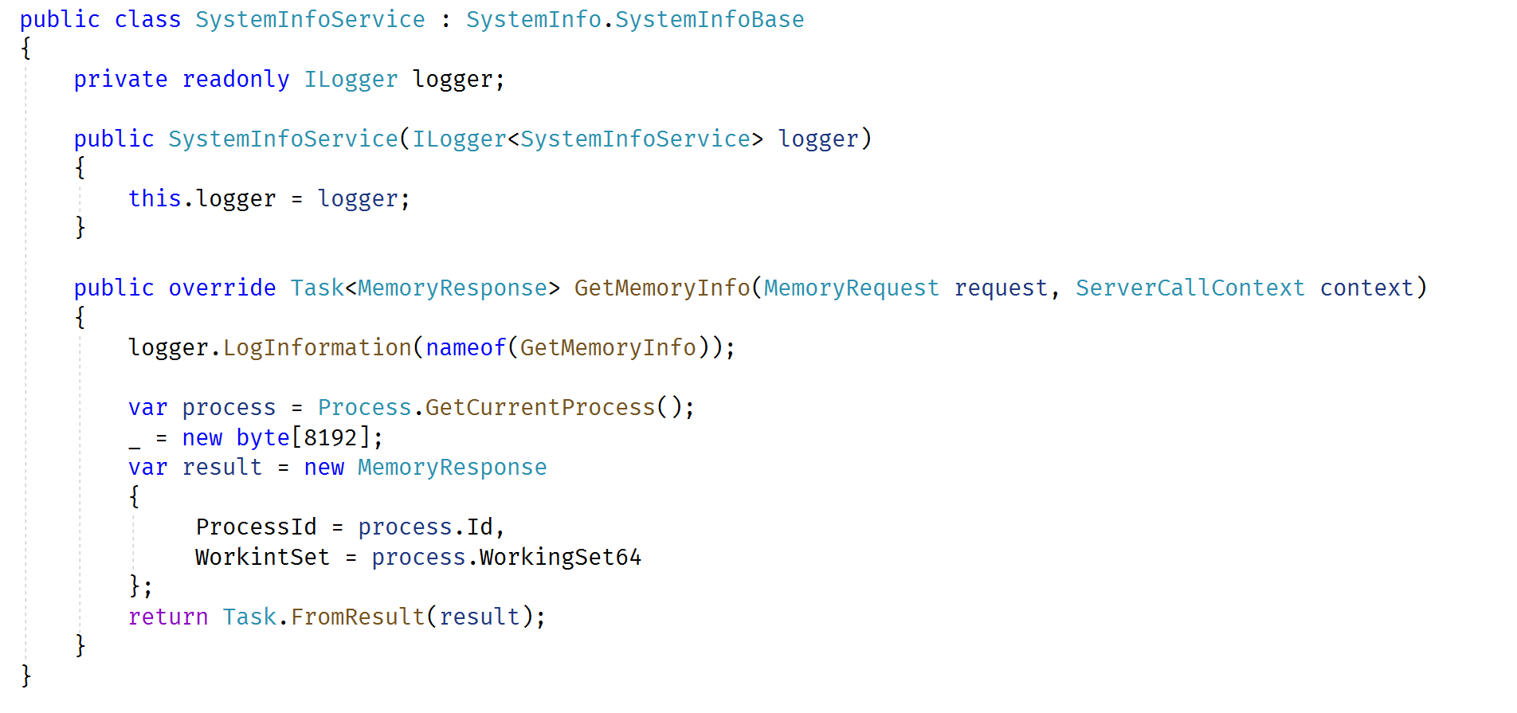
Service Implementation

Slide 16
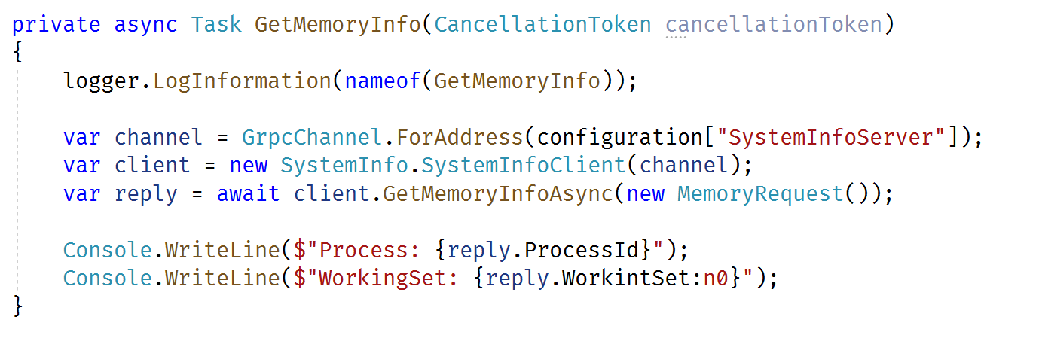
Client Implementation

Slide 17
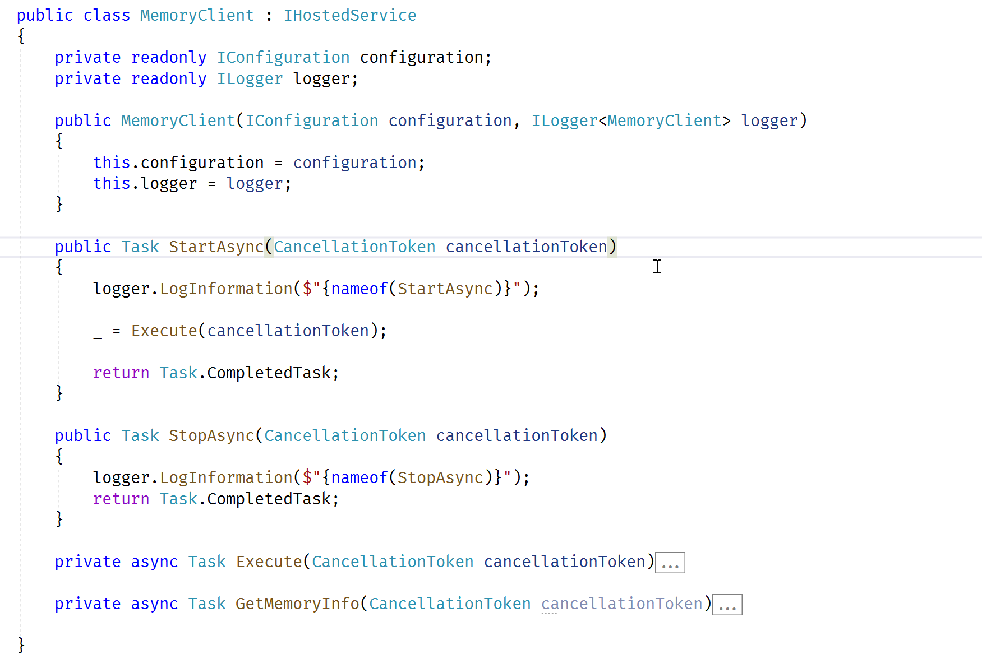
New: Hosting Long Running Tasks

Slide 18
Summary
Controller
Model
View

