Slide 1
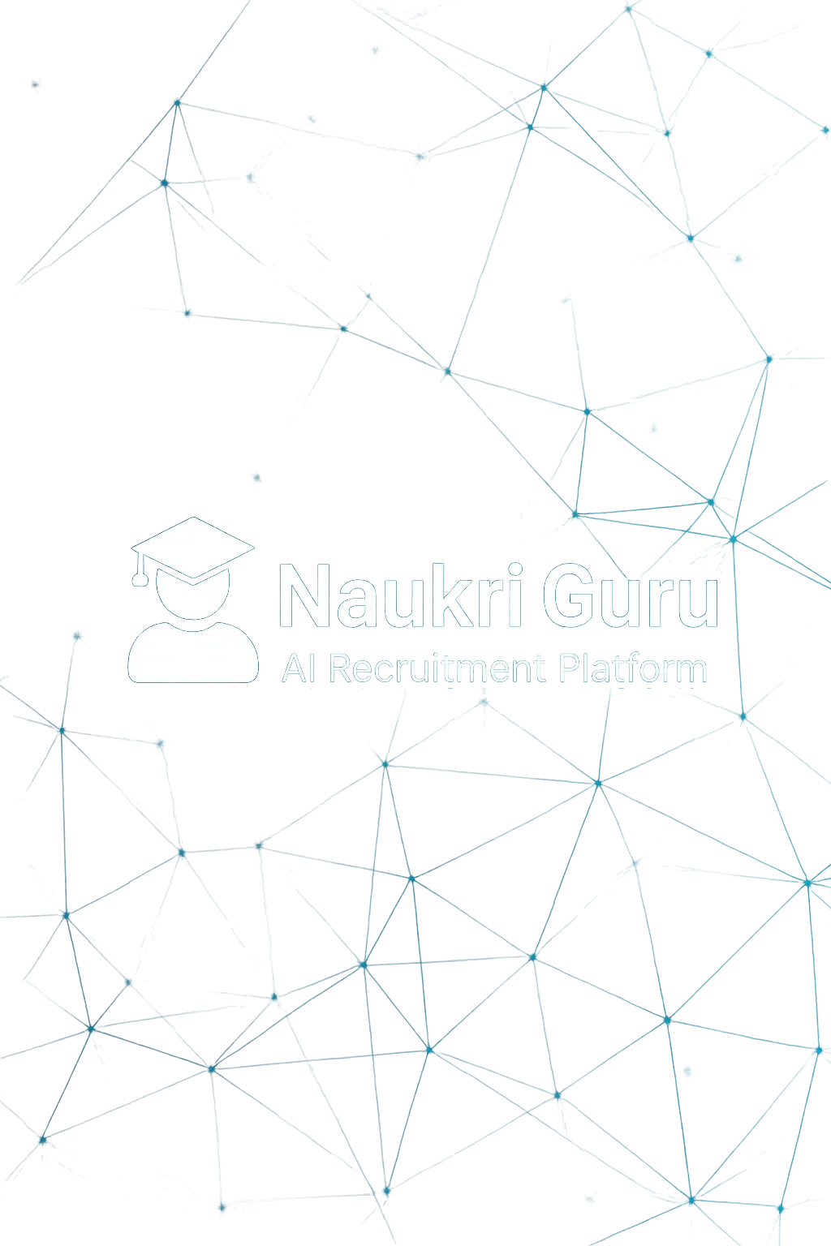

Team
Syed Ahmad Mujtaba (42945)
Kazim Raza (42952)
Supervisor
Dr. Adnan

Slide 2



Project Objective
• Build an AI-powered recruitment platform
• Automate resume analysis and interviews
• Localized support (e.g., Urdu)

Slide 3



Problem Statement
• Manual hiring is slow and inefficient
• Recruiters face bias and overload
• Job seekers lack AI-based preparation tools

Slide 4




Key Features
• AI Resume Screening (GPT-4)
• Interview Simulation (STT/TTS)
• Decision Agent for ranking
• Real-time Notifications

Slide 5
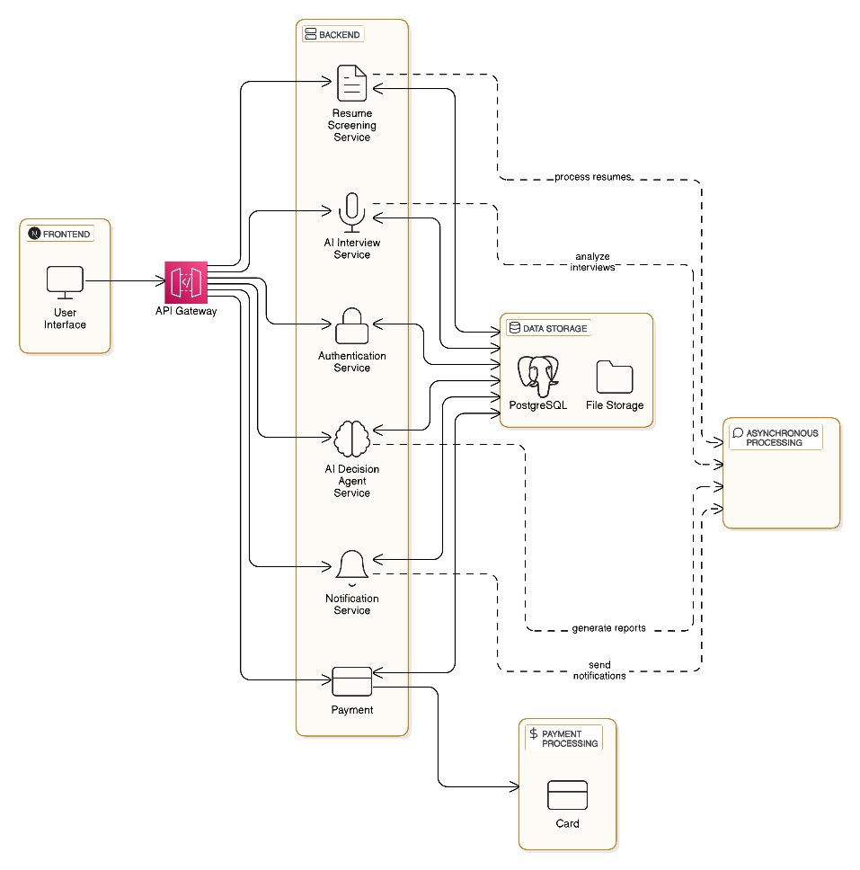
System Architecture

Slide 6





Tech Stack
Frontend: Next.js + Tailwind
Backend: FastAPI + Microservices
AI: GPT-4,Gemini,Deepseek R1, LangChain
DB: PostgreSQL
Messaging Queue: Kafka

Slide 7



Core Modules
• Job Seeker Panel: Resume, Interview Simulation
• Recruiter Panel: Post Jobs, Analyse Candidates
• Admin Panel: System Management

Slide 8
UML Diagrams
All of the UML diagrams are placed in this presentation, usually considered as an SDP (software design Phase). The diagrams in this presentation are made on StarUML.
Use Cases
Class
Sequence
Activity

Slide 9
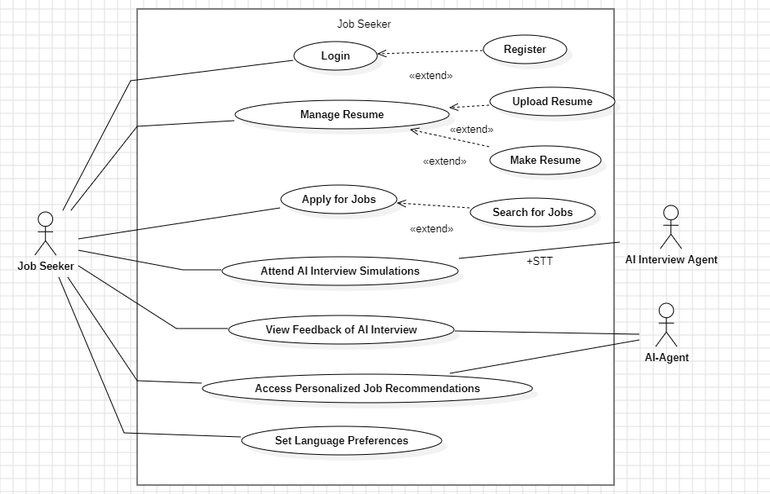
Use Case 1

Slide 10
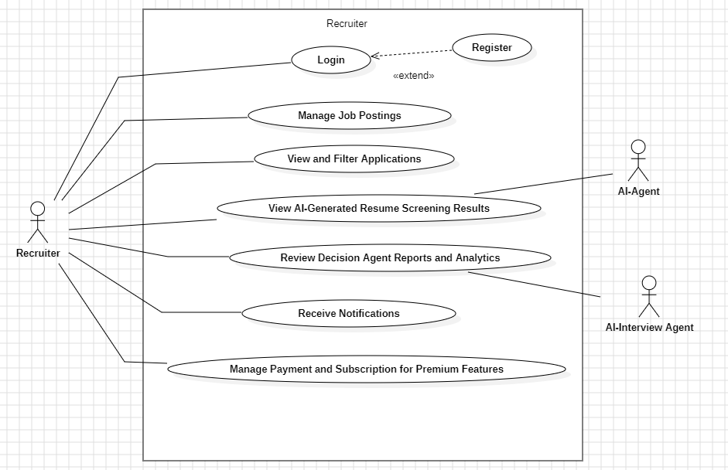
Use Case 2

Slide 11
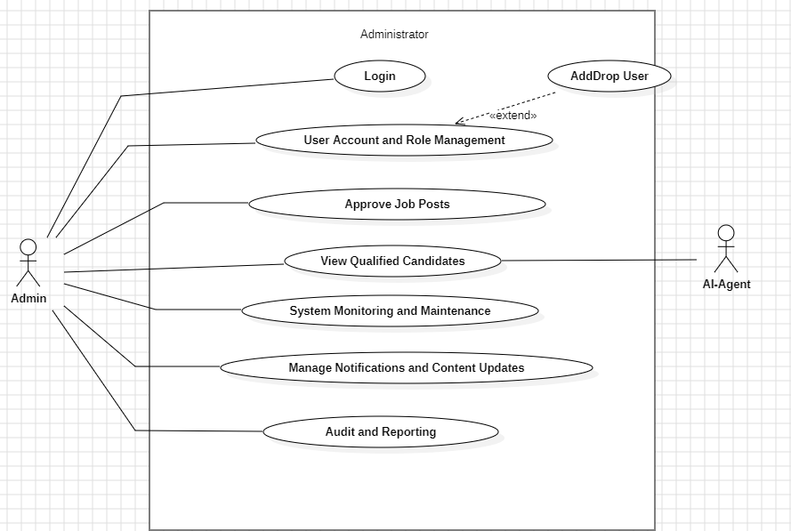
Use Case 3

Slide 12
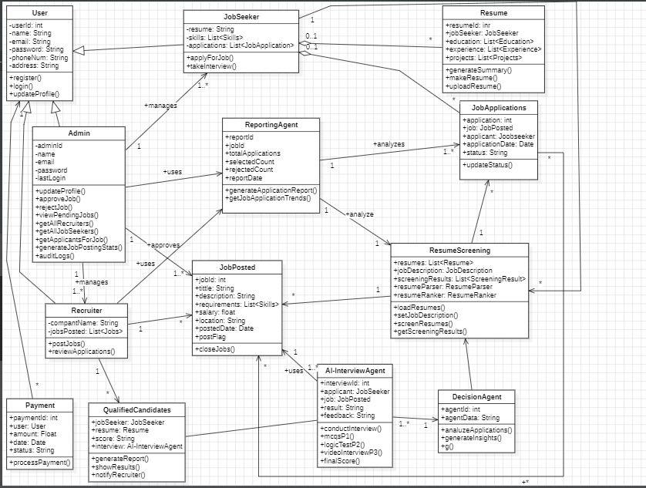
Class Diagram

Slide 13
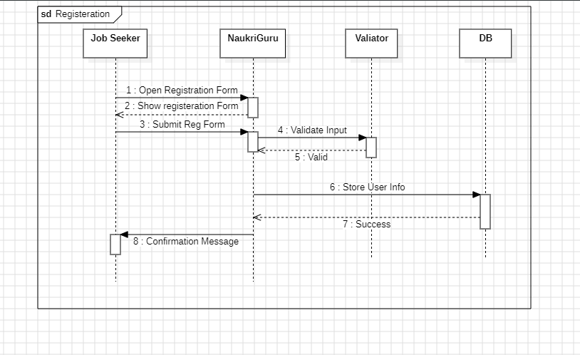
Registeration Sequence

Slide 14
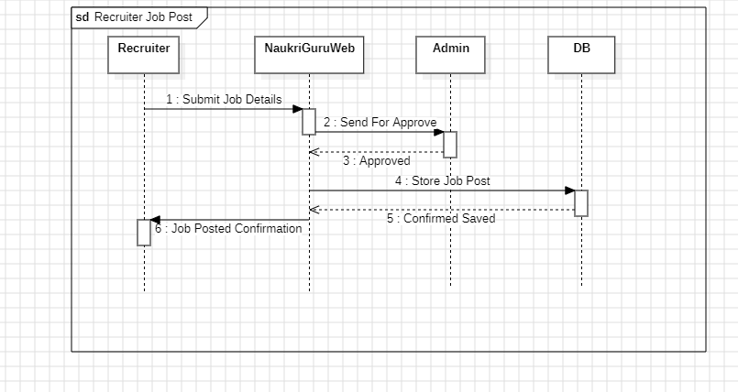
Job Post Sequence

Slide 15
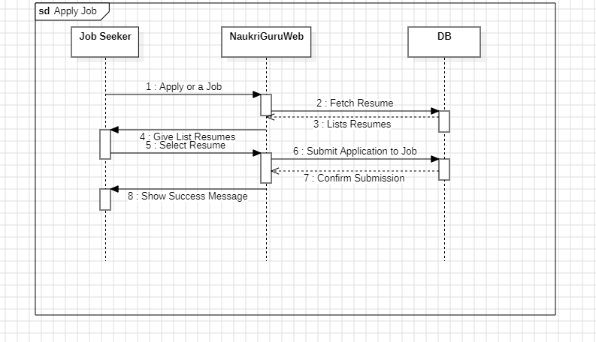
Apply Job Sequence

Slide 16
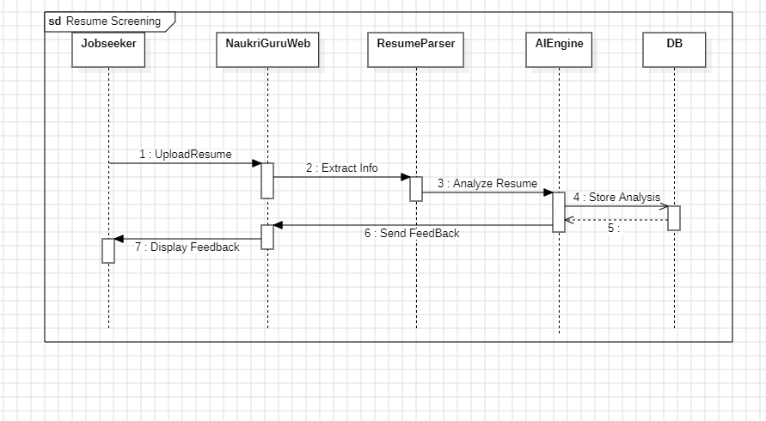
Resume Screening Sequence

Slide 17
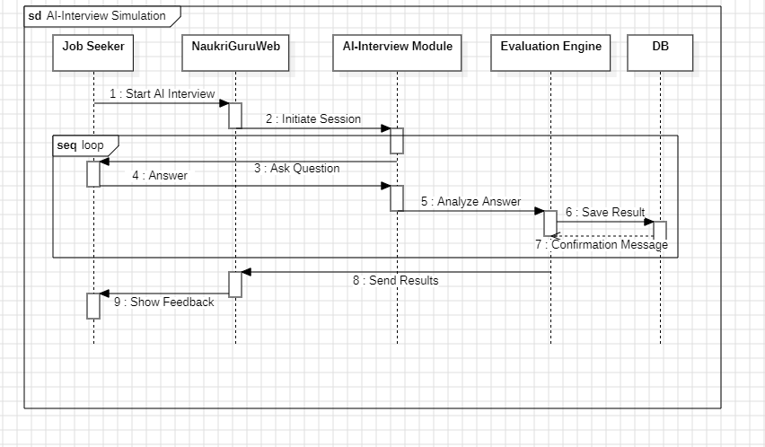
AI-Interview Sequence

Slide 18
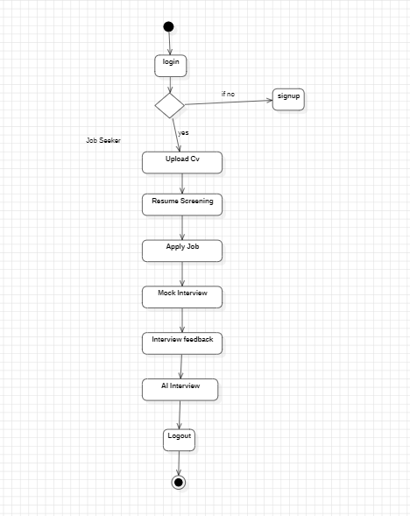
job Seeker Activity

Slide 19
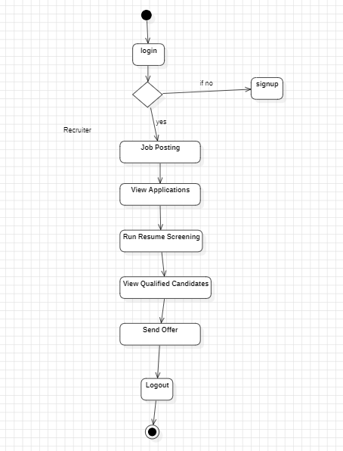
Recruiter Activity

Slide 20
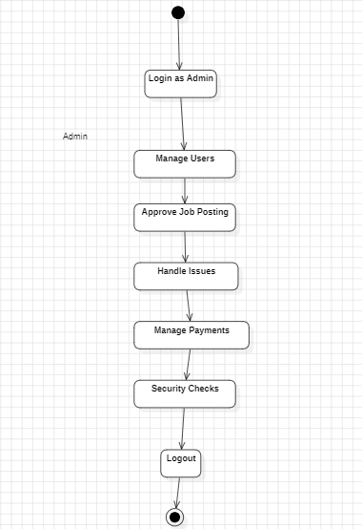
Admin Activity

Slide 21
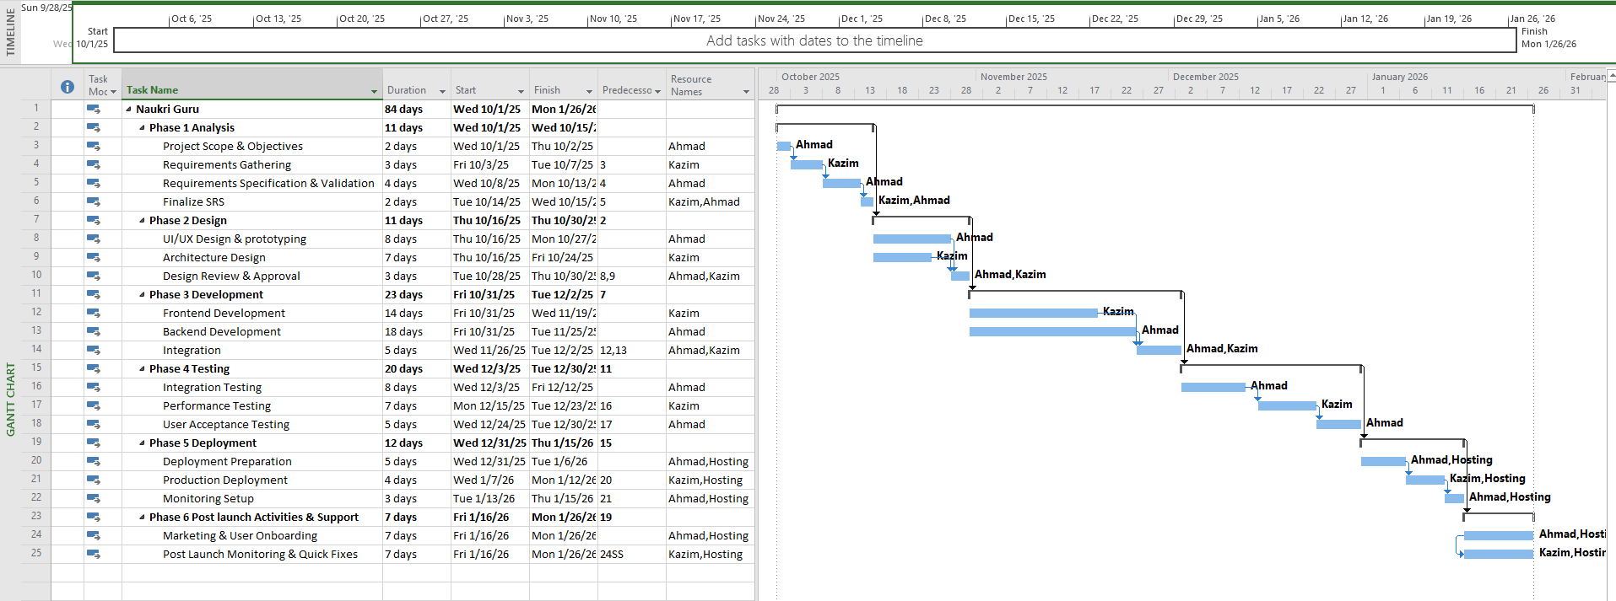
Gantt Chart

Slide 22








Functional Requirements
• Resume Upload , Resume Screening
• Job Posting + Search , AI Interview
• Decision Agent , Reporting
• Payment , Notifications

Slide 23





Non-Functional Requirements
• 1000+ users, <4s AI response
• TLS, AES encryption, OAuth
• 95% uptime
• Well documented code
• User friendly interface

Slide 24


AI & ML Integration
• Resume: Uses semantic understanding of CV’s
• Interviews: STT + TTS
• Ranking: Multi-factor scoring

Slide 25
User Roles
Job Seeker: Apply for Jobs, Mock Interview
Recruiter: Post Jobs, View Reports
Admin: Manage Users + System

Slide 26




Challenges Faced
• AI response time
• Real-time voice AI integration
• Multilingual support
• Handling async microservices communication

Slide 27
Conclusion
Transforming recruitment with AI, empowering job seekers and recruiters alike. Future work includes expanding language support and integrating more advanced AI features.

Slide 28
Thank You!

