Slide 1
Amazon Lumberyard
Pristatymą parengė
Kazimieras Jasaitis
MIF, VU, Bioinformatika IV k.

Slide 2
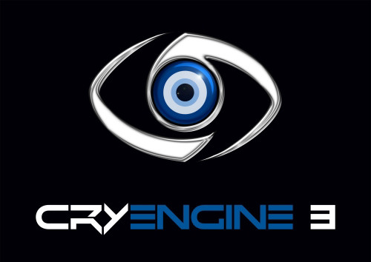
Introduction to Amazon Lumberyard
Cross-platform
Freeware
Developed by Amazon
Based on CryEngine
Supersession by the Open 3D Engine

Slide 3
Key Features of Lumberyard
Integration with Amazon Web Services,
Support for Twitch livestreaming and Twitch ChatPlay
Restrictions on source code usage.
Compatibility with platforms like Microsoft Windows, PlayStation 4, Xbox One, and limited support for iOS, Android, and plans for macOS.

Slide 4
Unique Systems and Development Tools
Unique custom-developed systems within Lumberyard, such as the Component Entity System, Fur Shader, Modular Gems, and the Script Canvas.

Slide 5
Updates and Enhancements
Cover major updates like the addition of Audiokinetic Wwise, support for mobile devices, FBX importer, integration with Allegorithmic's texturing software Substance, and the introduction of virtual reality support.

Slide 6
Open Source Transition and Open 3D Foundation
Discuss the release of Lumberyard's source code on GitHub, the partnership with the Linux Foundation, and the formation of the Open 3D Foundation leading to the rebranding to Open 3D Engine.

Slide 7
Notable Games Developed Using Lumberyard
Shatterline
Squadron 42
Star Citizen
New World
The Grand Tour Game

Slide 8
Conclusion and Future Prospects
Lumberyard's impact on game development and its evolution into the Open 3D Engine, touching on its legacy and potential future impacts in the gaming industry.

