Slide 1
Examining Food Locations and Population in Houston

Slide 2
Identifying Food Deserts is valuable Governments, Nonprofits and event Homebuyers
Houston has a population of about 2.326 million people and covers 637.4mi²
Food Desert is an area where there is limited access to nutritious food
Food Swamp is an area where there are more fast food and restaurants than nutritious food
Identifying Food Deserts will help improve equality among populations
Can help identify if a certain demographic is affected
Work to reduce Food Deserts
Useful to determine whether you want to move to a neighborhood ( everybody has to eat)

Slide 3

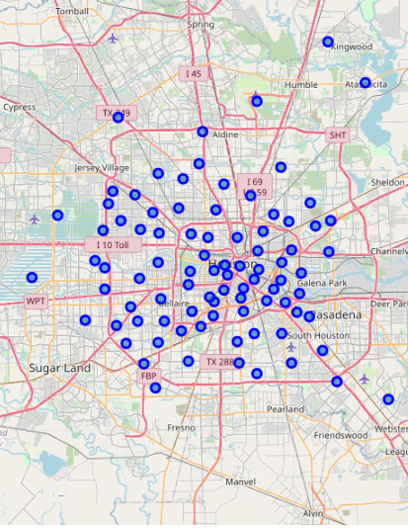
Data acquisition and cleaning
Neighborhood data scrapped from Houston GIS database
SuperNeighborhood census data
88 neighborhoods identified
Venues queried from Foursquare
Search method
Radius of 3218meters from neighborhood point
2570 venues acquired

Slide 4
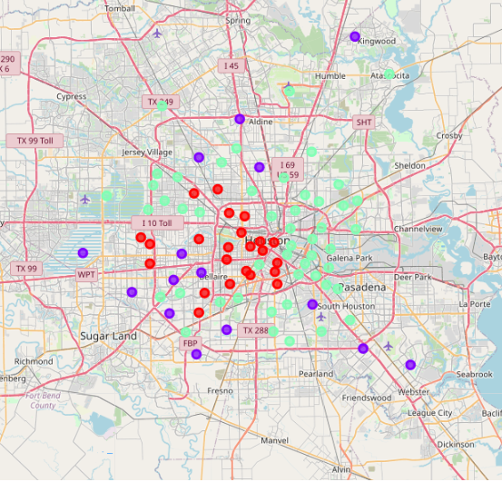
K-means Clustering
Data used to calculate
Neighborhood Population
Restaurant Count
Food Market Count
Bar Count
Group 0
Group 1
Group 2

Slide 5
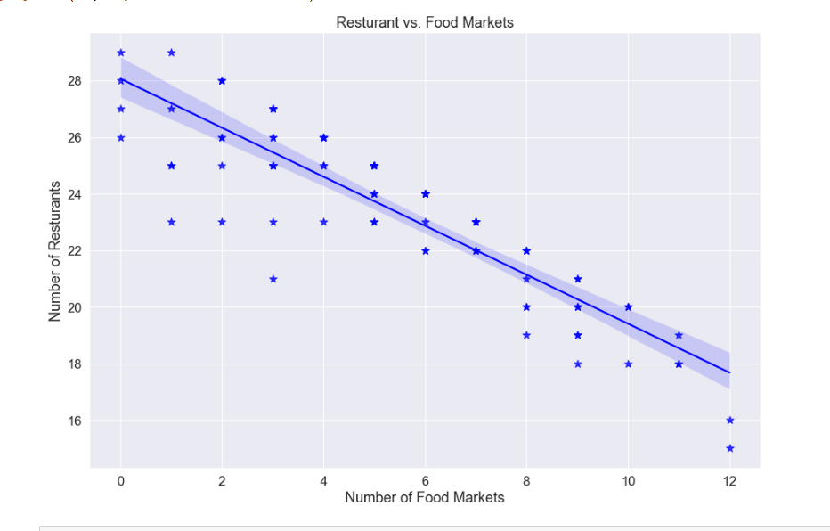
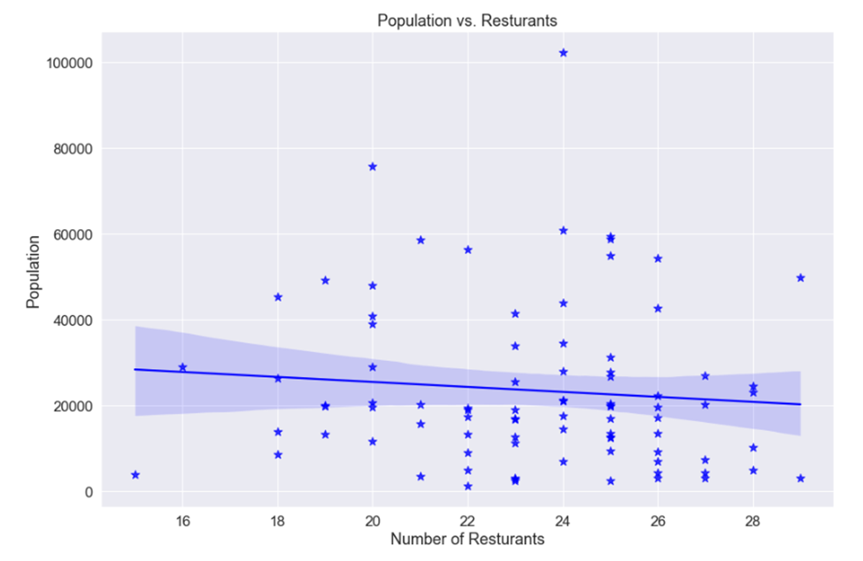
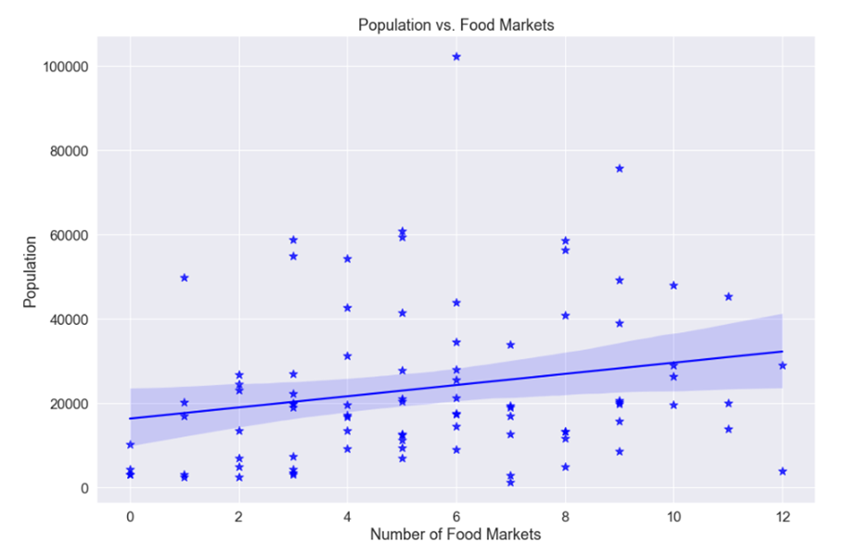
Less Food Markets, more Restaurants
Negative correlation between Restaurants and Food Markets ( -0.89 )
The more Food markets the lest Restaurants
The more Restaurants the less Food Markets
No correlation between Population and Restaurants or Food Markets ( -0.09 & 0.09)

Slide 6
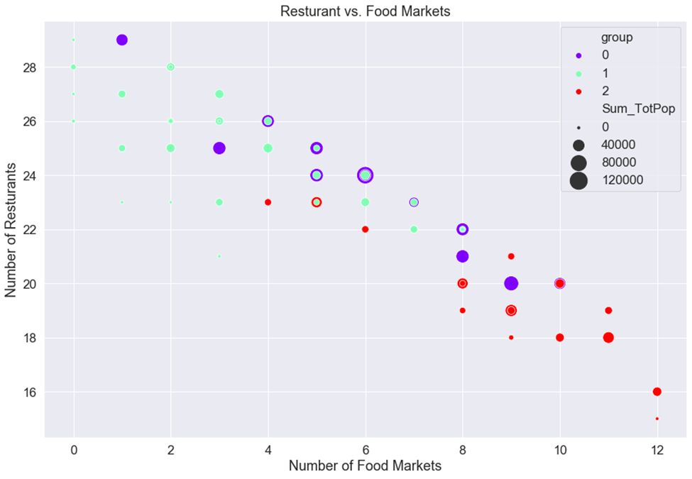
Neighborhood Idenification
Group 0 : Neighborhoods with mix of Restaurants and Food Markets
Group 1: Food Desert Neighborhoods
Group 2: Food Market Neighborhoods ( healthy)

Slide 7
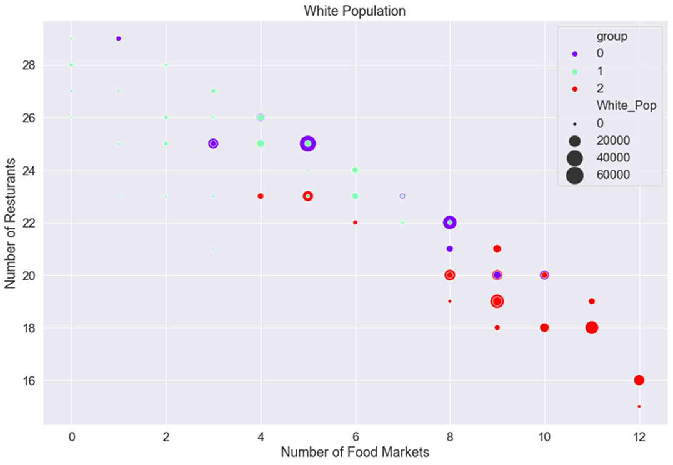
Cluster Population Demographics
White populations reside more in Food Market Havens
Group 0 : Neighborhoods with mix of Restaurants and Food Markets
Group 1: Food Desert Neighborhoods
Group 2: Food Market Neighborhoods ( healthy)

Slide 8
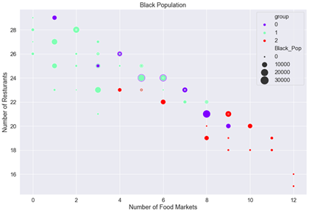
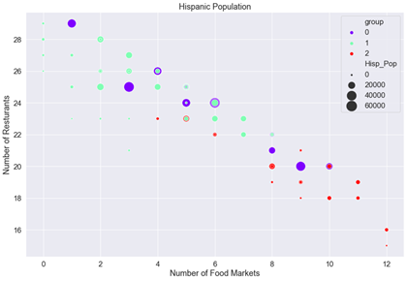
Cluster Population Demographics
Black and Hispanic populations appear to reside more in Food Deserts and Mixed areas
Group 0 : Neighborhoods with mix of Restaurants and Food Markets
Group 1: Food Desert Neighborhoods
Group 2: Food Market Neighborhoods ( healthy)

Slide 9
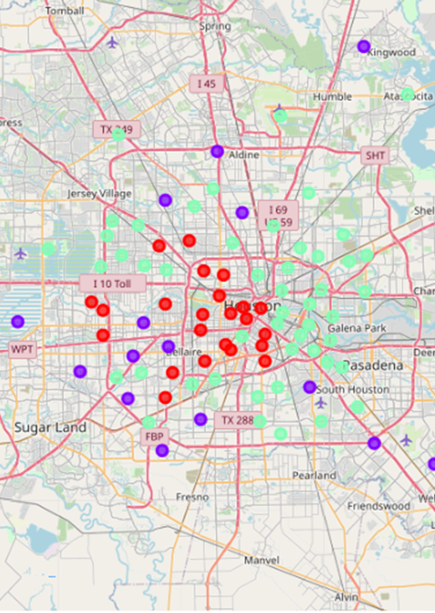
Conclusion and future directions
Decently Clustered Neighborhoods based on Restaurant and Food Market density
Need to look more into demographics and clusters
Limited data
Find better side to access more venues
Add in food bank data
Locate venues only in polygon
Housing info ( house value affect cluster and density in relation to Food Market and Restaurants)
Group 0 : Neighborhoods with mix of Restaurants and Food Markets
Group 1: Food Desert Neighborhoods
Group 2: Food Market Neighborhoods ( healthy)

