Slide 1
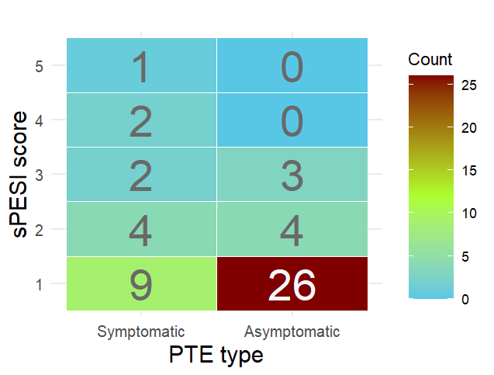
Figure S1. sPESI Score distribution across Symptomatic and Asymptomatic PTEs
Cochran-Armitage test, p = 0.0069
Mann-Whitney U test, p = 0.0246
Footnote: Trend significance was assessed using the Cochran-Armitage test. Weights were assigned as the sPESI score itself. Data with missing vital signs were excluded from the analysis (n = 21). Notably, the Mann-Whitney U test also indicated a significant difference between the two groups (p = 0.0246), although multiple comparison using Fisher’s exact test adjusted by the Holm method did not reach statistical significance (data not shown).

Slide 2
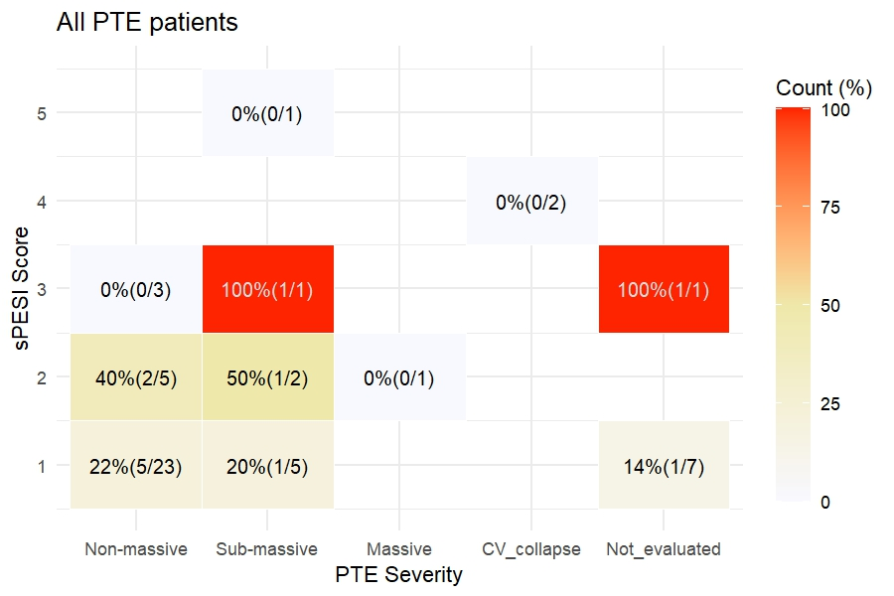
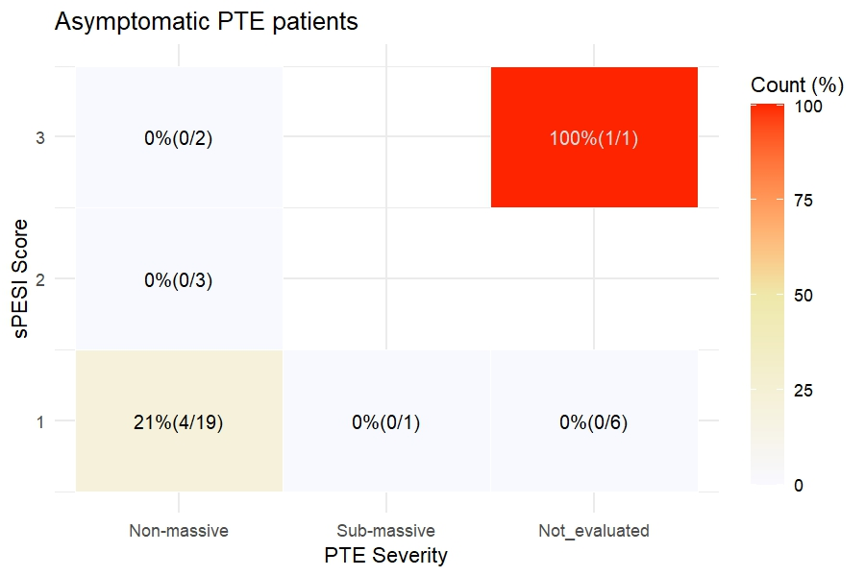
Figure S2. sPESI score versus death counts within 30 days in all PTE
p = 0.219
p = 0.046
Footnote: As in Figure 2, Cochran-Armitage trend tests were performed to evaluate the relationship between sPESI score and 30-day prognosis in all PTE patients (left panel) and in asymptomatic PTE patients (right panel).Unlike Figure 2, patients who were not evaluated for right ventricular (RV) strain using ECG or TTE were included in this analysis. Notably, some patients were not assessed for RV strain due to either low clinical suspicion - based on normal respiratory status and vital signs - or poor general condition with limited life expectancy.

Slide 3
Table S1. Harmonization scheme for cancer site, histology, and clinical stage used in the Cox regression analysis
Cancer site group | ICD-O-3 code
Adrenal gland | C740, C749
Bone and soft tissue | C400, C402, C403, C410, C411, C412, C414, C490, C491, C492, C493, C494, C496, C499
Breast | C500, C501, C502, C503, C504, C505, C506, C508, C509
Bronchus and lung | C340, C341, C342, C343, C349
Colorectal | C180, C181, C182, C183, C184, C185, C186, C187, C189, C199, C209, C211
Esophagus | C150, C151, C152, C159
Female genital organ | C510, C511, C512, C519, C529, C539, C540, C541, C542, C543, C549, C569, C570, C579, C589
Hepatobiliary and pancreas | C239, C240, C241, C249, C250, C251, C252, C259
Kidney | C649
Liver and bile duct | C220, C221
Male genital organ | C601, C602, C609, C619, C621
Nervous system | C471, C710, C711, C712, C713, C714, C715, C716, C719, C725
Others | C269, C383, C384, C750, C751, C760, C809
RES and lymphatic system | C420, C421, C422, C770, C772, C773, C774, C778, C779
Retroperitoneum and peritoneum | C480, C481, C482
Skin | C440, C441, C442, C443, C444, C445, C446, C447, C449, C695, C696
Stomach and small intestine | C160, C161, C162, C163, C164, C165, C169, C170, C171, C172, C179
Stomatopharynx | C004, C019, C020, C021, C022, C029, C030, C031, C040, C041, C049, C050, C051, C052, C059, C060, C062, C079, C080, C081, C091, C099, C100, C101, C102, C103, C109, C111, C112, C119, C129, C130, C132, C139, C142, C300, C310, C311, C319, C320, C321, C322, C329
Thymus | C379
Thyroid gland | C739
Urinary tract | C659, C669, C670, C671, C672, C673, C674, C675, C676, C677, C679, C680
Clinical cancer stage | 0 | 1 | 2 | 3 | 4
Alive | 6590 | 1052 | 6 | 8 | 27
Death | 793 | 71 | 1 | 0 | 22
Footnote: To address the issue of complete separation caused by the absence of death events in stage 3, clinical cancer stages 2 and 3 were combined in the multivariable Cox regression analysis.

Slide 4
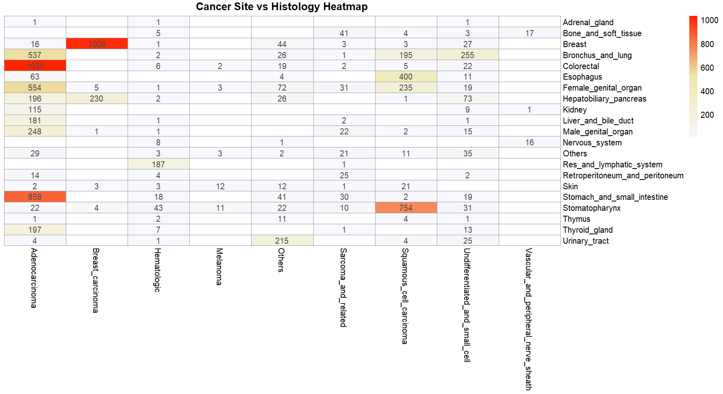
Figure S3. Cross-tabulated heatmap of cancer site and histology

Slide 5
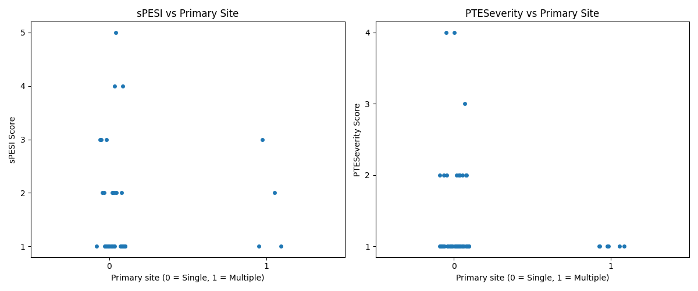
Figure S3. Comparison between sPESi or PTE Severity and Cancer Multiplicity
PTE Severity score
1: Non-massive
2: Sub-massive
3: Massive
4: Cardiovascular collapse
sPESI within 7days | Single | Multi
1 | 30 | 5
2 | 7 | 1
3 | 4 | 1
4 | 2 | 0
5 | 1 | 0
Not evaluated | 17 | 4
PTE Severity | Single | Multi
Non-massive | 38 | 6
Sub-massive | 10 | 0
Massive | 1 | 0
Cardiovascular collapse | 2 | 0
Not evaluated | 10 | 5
Footnote: Neither the comparison between sPESI score nor PTE severity with the multiplicity of primary cancer sites reached statistical significance. In particular, the p-values were 0.570 and 0.603, respectively in the Mann-Whitney test, and 0.808 and 0.781, respectively in the Cochran-Armitage trend test. The table shows the number of patients diagnosed with single-primary and multi-primary cancer (double or triple).

Slide 6
Table S3. ■■■
Treatment | McNemar_p | HR |  | Cox_p
Chest Radiation | NA | 0.597 | (0.069 - 5.164) | 0.639
Pelvic Radiation | 0.131 | 2.555 | (0.683 - 9.558) | 0.164
ICI | 1.000 | 1.049 | (0.348 - 3.159) | 0.932
VEGF / VEGFR inhibitor | 0.006 | 0.571 | (0.222 - 1.468) | 0.245
Other chemotherapy | 0.002 | 1.508 | (0.661 - 3.441) | 0.329
Chest radiation |  | Post PTE dx
 |  | (-) | (+)
Pre PTE dx | (-) | 65 | 0
 | (+) | 7 | 0
Pelvic radiation |  | Post PTE dx
 |  | (-) | (+)
Pre PTE dx | (-) | 65 | 1
 | (+) | 6 | 0
ICI |  | Post PTE dx
 |  | (-) | (+)
Pre PTE dx | (-) | 57 | 6
 | (+) | 7 | 2
VEGF / VEGFR inhibitor |  | Post PTE dx
 |  | (-) | (+)
Pre PTE dx | (-) | 58 | 1
 | (+) | 12 | 1
Other chemotherapy |  | Post PTE dx
 |  | (-) | (+)
Pre PTE dx | (-) | 18 | 6
 | (+) | 24 | 24

