Slide 1
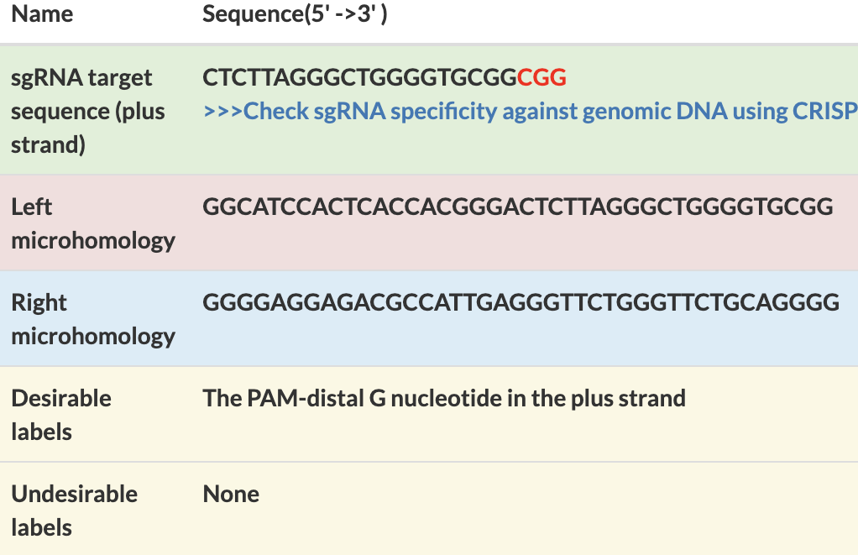
PITCh designer 2.1 can Add Efficiency Annotations to the Knock-in Designs
*
p=0.186
Example of PITCh designer result
Experimentaly Measured Efficiency of Precise Knock-in [%]
Knock-in Designs including “Desirable” labels (n=11)
Knock-in Designs without any labels (n=12)
Knock-in Designs including “Undesirable” labels (n=17)
: paired t-test, p<0.05
*
Annotation

