Slide 1
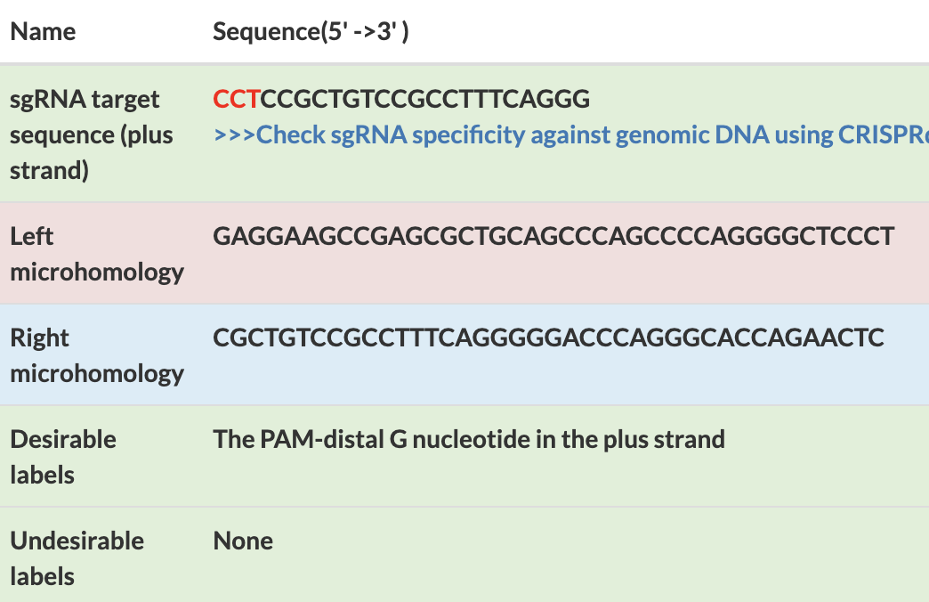
Notes:
Based on the previous our research, we updated the PITCh designer so that it analyzes the knock-in design and adds efficiency annotations to the knock-in design.
When we compare the annotations with knock-in efficiencies, the annotation significantly detects the efficient knock-in designs.

Slide 2
*
p=0.186
Knock-in Designs including “Desirable” labels (n=11)
Experimentaly Measured Efficiency of Precise Knock-in [%]
Knock-in Designs without any labels (n=12)
Knock-in Designs including “Undesirable” labels (n=17)
*
: paired t-test, p<0.05
Annotation

