Slide 1
Quick start
Giteki pre-test automation tool
Date 2024/12/06
Name ZHANG ZIXUAN
Position, Department application engineer
Unit Rel/conn/A&c/lic/aceng
Renesas Electronics Corporation

Slide 2
content
Overview and preparation Page 03
Launch up Page 07
Supported commands Page 10
Results saving Page 08

Slide 3
Overview and preparation

Slide 4
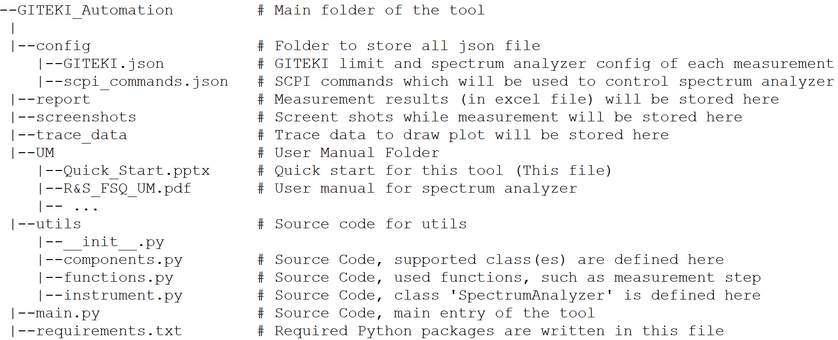
Overview: file structure Giteki pre-test Automation tool
File Structure
Description of each folder / file

Slide 5
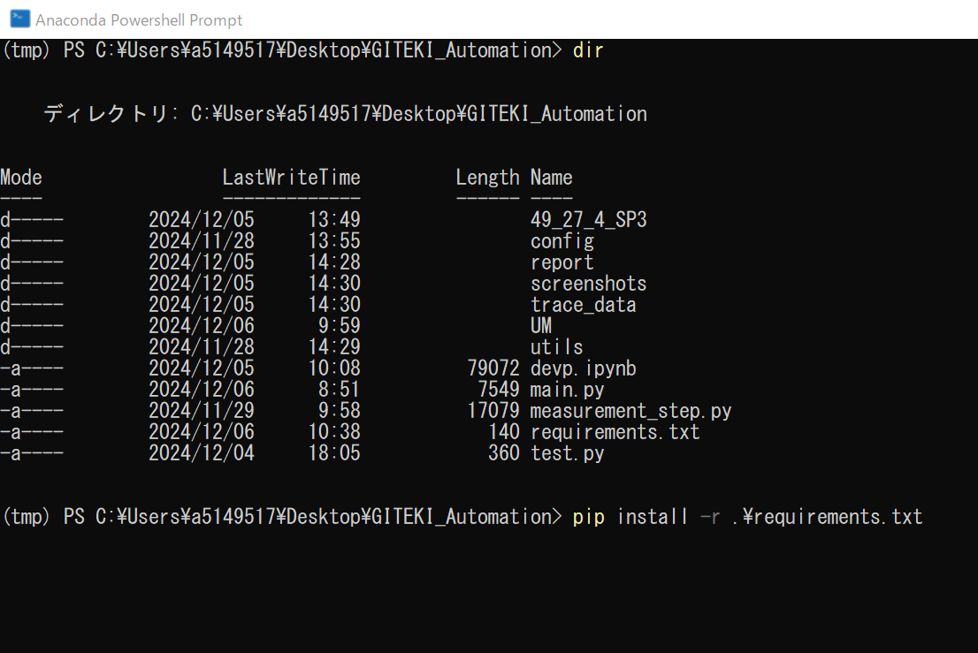
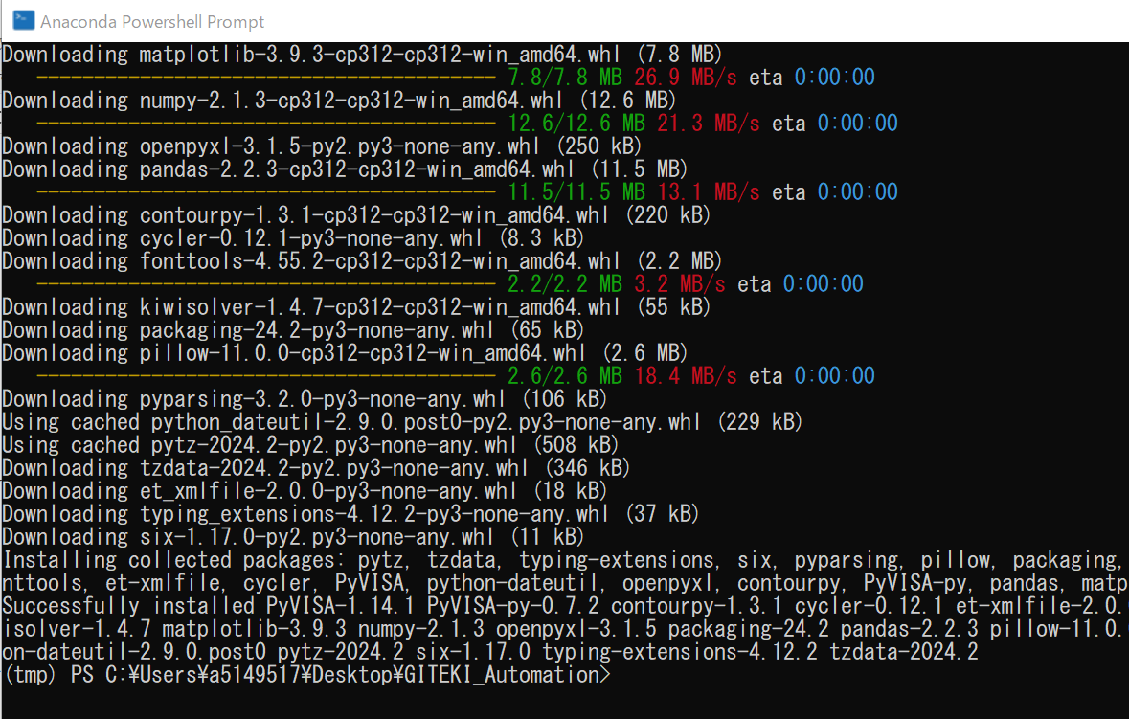
Software setup install python and required packages
To use this tool, user needs to install Python and required packages.
Python installation
How to install python on a PC is not included in this quick start, please refer to internet.
Required python packages installation
After installed python, open terminal at Main Folder.
Type: “pip install –r .\requirements.txt” and press enter.
Waiting for installation finished.
Install successful message

Slide 6
Hardware setup connect to spectrum analyzer
To use the tool, user needs to connect their PC and spectrum analyzer in a same local area network (LAN).
Connect spectrum analyzer with a networking cable.
Networking cable usually with 8P8C / RJ45 connector.
Check the IP address of spectrum analyzer.
IP address of a spectrum analyzer is usually defined in the network configuration.
For FSQ26 spectrum analyzer, press physical button in the following order should be able to view the IP address:
[Setup]->[General Setup]->[Configure Network]->[Protocols]
For other spectrum analyzer models, please refer to their user manual.
Spectrum Analyzer @ Musashi (FSQ26): 192.168.0.1
Spectrum Analyzer @ DE (FSW43): 10.226.78.94

Slide 7
Launch up

Slide 8
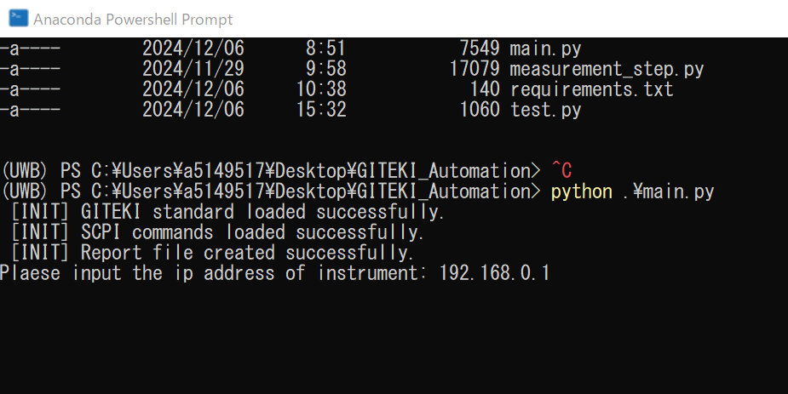
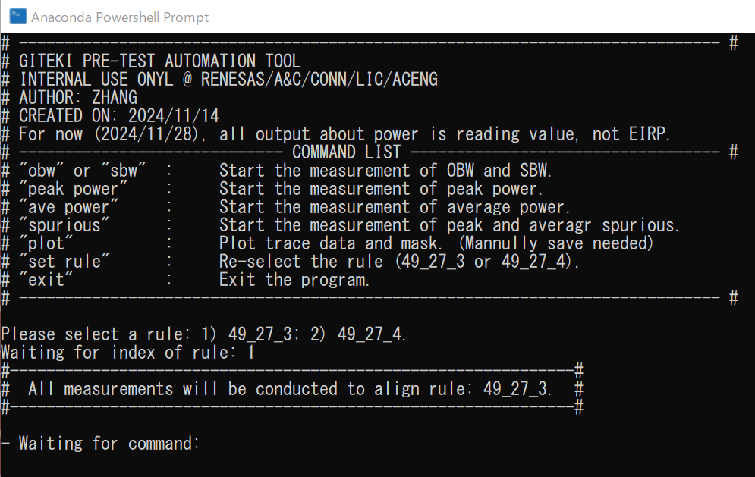
How to use the tool execute main script
To run the tool, users needs to open terminal at Main Folder and type “python .\main.py” then press enter.
The program will start to do some initialization.
Loading JSON file.
Creating “report”, “screenshots”, “trace_data” folder.
After initialized, program will require user to input the IP address of spectrum analyzer.
If IP address is correct, the terminal will be cleared, and a menu will be displayed.
If IP address is incorrect, an error will occur, and program will be terminated.
About how to acquire the IP address of a spectrum analyzer, please refer to Page 6.
Even these 3 folders are not existed at first, the program will create them automatically.

Slide 9
How to use the tool welcome menu and rule selection
After connected to spectrum analyzer, a menu will be displayed.
Some basic information of the program
Supported commands list
The program now will instruct user to input the index of a rule
“1” stands for rule “49_27_3” and “2” stands for rule “49_27_4”.
Difference about 2 rules please refer to Page 11.
After the rule is selected, program will start to listen user’s input.
During this status, user can input any command to perform corresponding operations.
This status will not end, unless user input “exit” or “ctrl + z”.
Basic information
Supported commands
Rule selection
User input listening

Slide 10
Supported commands

Slide 11
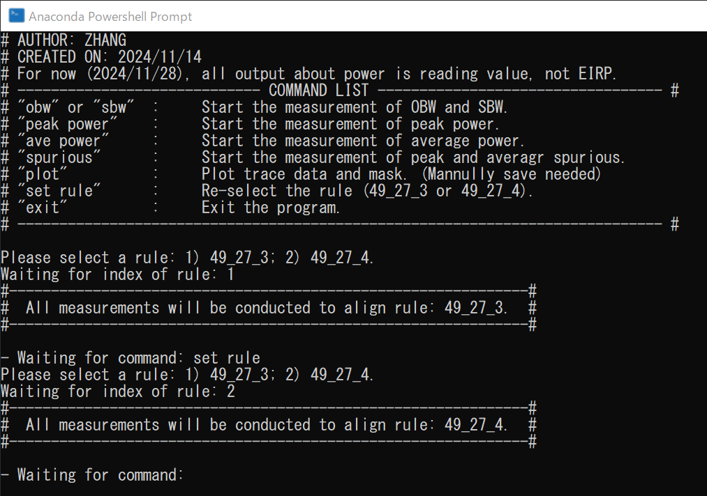
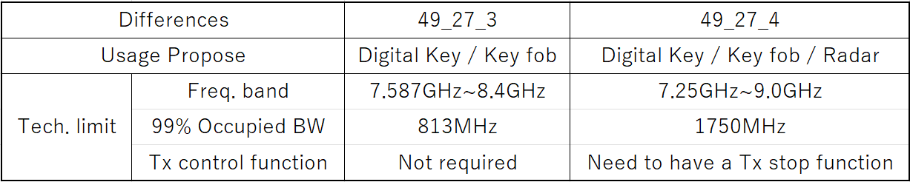
Supported commands set rule
User can re-select a rule at any time by input “set rule” command.
After input “set rule” command, the program will instruct user to input the index of a rule.
All measurements will be conducted to align to current rule.
Difference of 2 rules (“49_27_3” and “49_27_4”)
Rule is reselected by “set rule” command

Slide 12
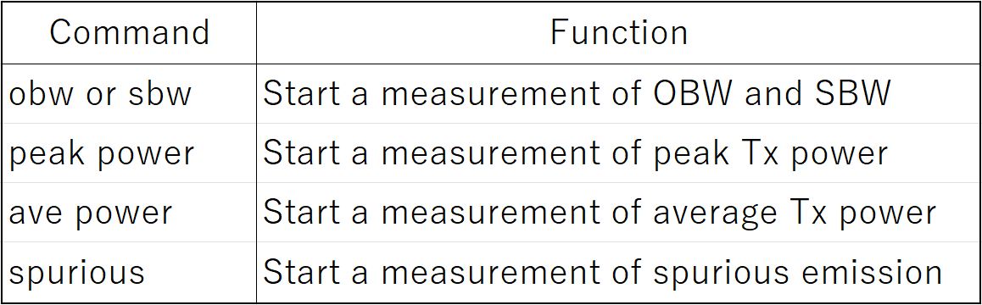
Supported commands measurement items
The program supports several measurement related commands.
After inputting a command, the program will display clear instructions on terminal and user should follow them.
Instruction type 1: “Waiting for board launch up. Press enter to start measurement.”
Instruction type 2: “Waiting trace to stabilize. Press Enter to stop sweep.”
The details of measurement step of each measurement item is not included in this file.
The only thing user needs to do during a measurement is to press ‘Enter’ at right time
Supported measurement commands

Slide 13
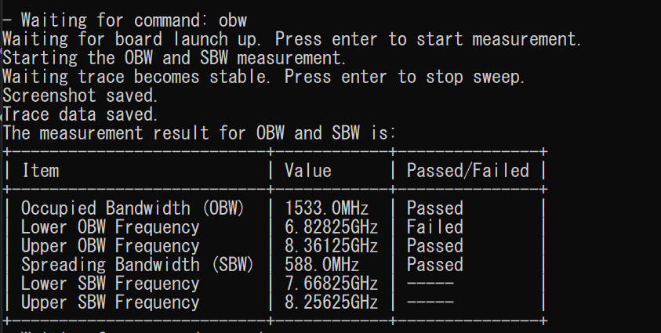
Supported commands OBW and sbw
User can start a measurement of peak power by inputting “obw” or “sbw” command.
measurement command
User needs to press ‘Enter’ according to the instruction displayed on the terminal .
measurement result

Slide 14
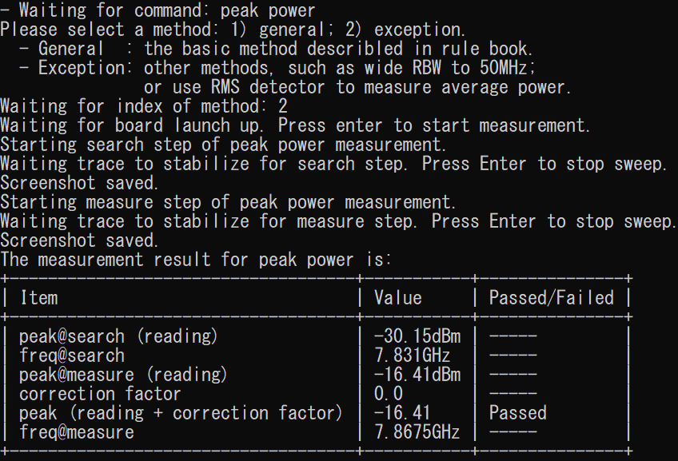
Supported commands peak power
User can start a measurement of peak power by inputting “peak power” command.
measurement command
The program will ask user to chose a measurement method.
General: while ‘measure’ step, RBW equals to 3MHz.
Exception: while ‘measure’ step, set RBW to 50MHz. (easier to pass test)
User needs to press ‘Enter’ according to the instruction displayed on the terminal.
For peak power measurement, we only use ‘peak (reading + correction factor)’ to determine pass / fail.
measurement result

Slide 15
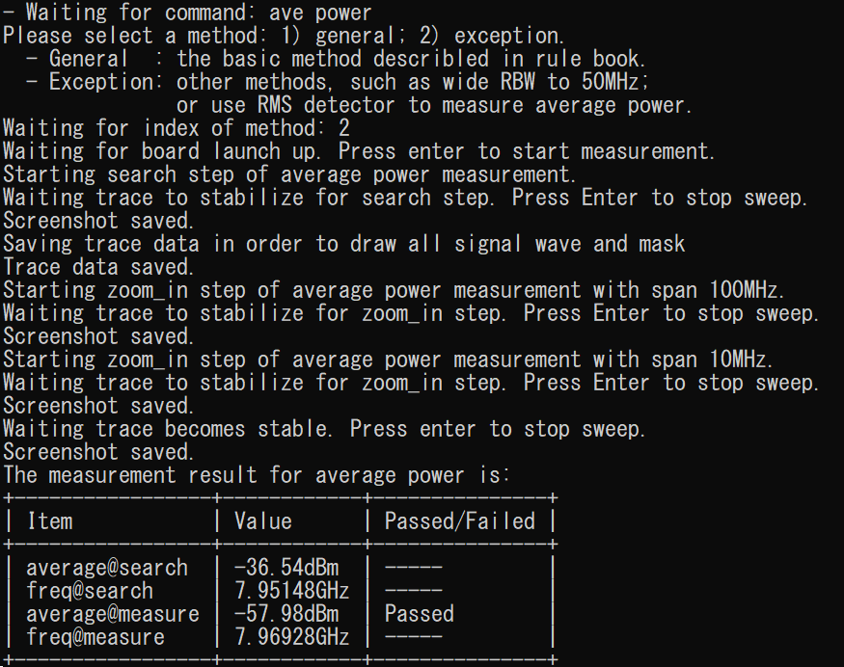
Supported commands ave power
User can start a measurement of average power by inputting “ave power” command.
measurement command
The program will ask user to chose a measurement method.
General: while ‘measure’ step, use ‘Sample’ detector and only sweep once.
Exception: while ‘measure’ step, use ‘RMS’ detector and sweep continuously.
User needs to press ‘Enter’ according to the instruction displayed on the terminal.
For peak power measurement, we only use ‘average @ measure’ to determine pass / fail.
measurement result

Slide 16
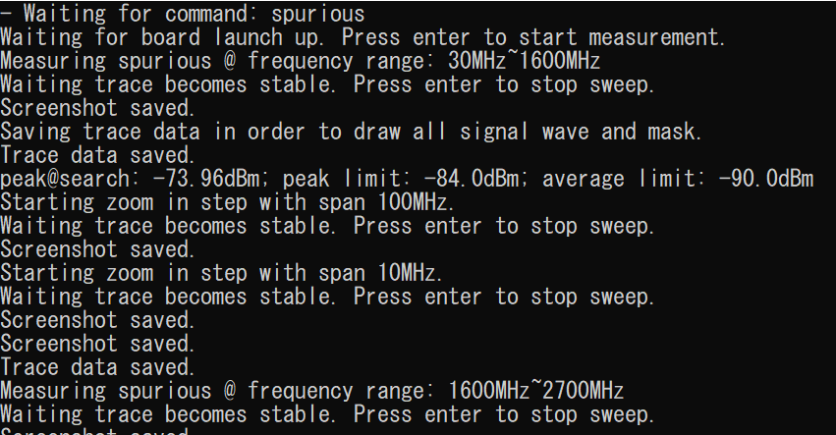
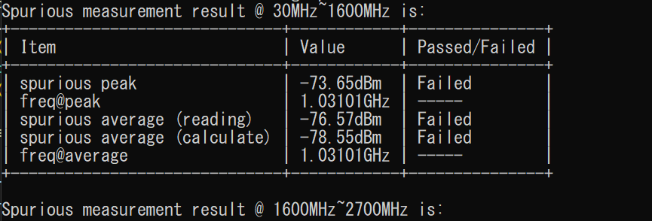
Supported commands spurious
User can start a measurement of spurious emission by inputting “spurious” command.
The program will measure peak / average power of spurious emission at each frequency interval. (frequency interval is defined by rule)
During the measurement of spurious, the program will save trace data to draw the whole waveform and mask.
After all frequency interval be measured, results of each interval will be displayed on terminal.
For spurious measurement, we use ‘spurious average (reading)’ and ‘spurious average (calculate)’ (option) to determine pass / fail.
‘spurious average (calculate)’ is calculated from trace data while ‘measure’ step, only if trace data is saved during measure step. (‘spurious average (calculate)’ is default to ‘None’, and it is easier to pass test.)
measurement result

Slide 17
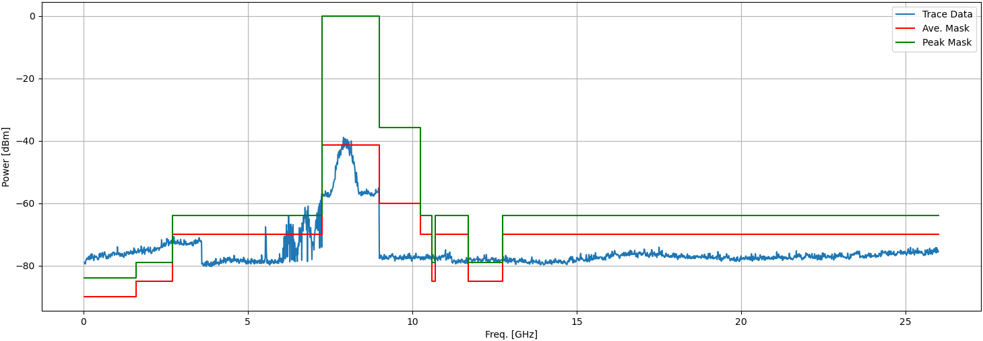
Supported commands plot
User can plot a figure of trace and limit mask by inputting “plot” command.
User needs to save this figure manually.
By inputting “plot” command, a figure as shown above will be displayed. Figure including the whole trace data from 30MHz to 26GHz and the mask.

Slide 18
results saving

Slide 19
Results saving screen shot / trace data / report
The program will save all screen shots to folder “screenshots”; “csv” format trace data to folder “trace_data”; and an excel report will be generated in folder “report”.
Naming rule
Screen shot
obw, sbw, average / peak power: {measurement_item}_{measurement_step}_{rule}.png
spurious: spurious_{measurement_step}_{frequency_interval}.png
Trace data
obw, sbw: obw_and_sbw_{rule}.csv
trace data to draw plot: trace_data_interval{index}({frequency_interval}).csv
average spurious measuring (if necessary): ave_spurious_measure_{rule}_{frequency_range}.csv
Report
{measurement_start_time}_report.csv

Slide 20
Renesas.com

