Slide 1
CODING
Presented By: Himanshu

Slide 2
Introduction
The coding is the process of transforming the design of a system into a computer language format (code). This coding phase of software development is concerned with software translating design specification into the source code by using programming language.
Coding is done by the coder or programmers. The cost of testing and maintenance can be significantly reduced with efficient coding.
Coding some times called computer programming, is how we communicate with computer. Code tells a computer what action to take, writing code is like creating a set of instruction.

Slide 3
Goals of Coding
The aim of the coding is to produce high quality system which can be performed in any situation.
To translate the design of system into a computer language format: The coding is the process of transforming the design of a system into a computer language format.
To reduce the cost of later phases: The cost of testing and maintenance can be significantly reduced with efficient coding.
Making the program more readable: Program should be easy to read and understand.

Slide 4
Coding Standards
Indentation: Proper and consistent indentation is essential in producing easy to read and maintainable programs. Indentation should be used to
Emphasize the body of a control structure such as a loop or a select statement.
Emphasize the body of a conditional statement.
Inline comments: Commenting involves placing Human Readable Descriptions inside of computer programs detailing what the Code is doing. Proper use of commenting can make code maintenance much easier, as well as helping make finding bugs faster.

Slide 5
Rules for limiting the use of global: These rules file what types of data can be declared global and what cannot.
Structured Programming: Structured (or Modular) Programming methods shall be used. "GOTO" statements shall not be used.
Naming conventions: A possible naming convention can be that global variable names always begin with a capital letter, local variable names are made of small letters, and constant names are always capital letters.

Slide 6
Characteristics of Programming Language
Readability
Portability
Modularity
Widely Available
Error checking
Cost
Brevity

Slide 7
Brevity: Language should have the ability to implement the algorithm with less amount of code. Programs mean in high-level languages are often significantly shorter than their low- level equivalents.
Widely Available: Language should be widely available, and it should be feasible to provide translators for all the major machines and all the primary operating systems.

Slide 8
Coding Guidelines
Line Length: It is considered a good practice to keep the length of source code lines at or below 80 characters. Lines longer than this may not be visible properly on some terminals and tools. Some printers will truncate lines longer than 80 columns.
Spacing: The appropriate use of spaces within a line of code can improve readability.
The code should be well-documented: As a rule of thumb, there must be at least one comment line on the average for every three-source line.

Slide 9
Function should not very lengthy: A very lengthy function is generally very difficult to understand and produce more errors. Use modular way to write code.
Do not use goto statements: Use of ‘GOTO’ statements makes a program unstructured and very tough to understand.
Inline Comment: Inline comment Promote readability. And make code easy to understand.
Error Messages: Error handling is an essential aspect of computer programming. This does not only include adding the necessary logic to test for and handle errors but also involves making error messages meaningful.

Slide 10
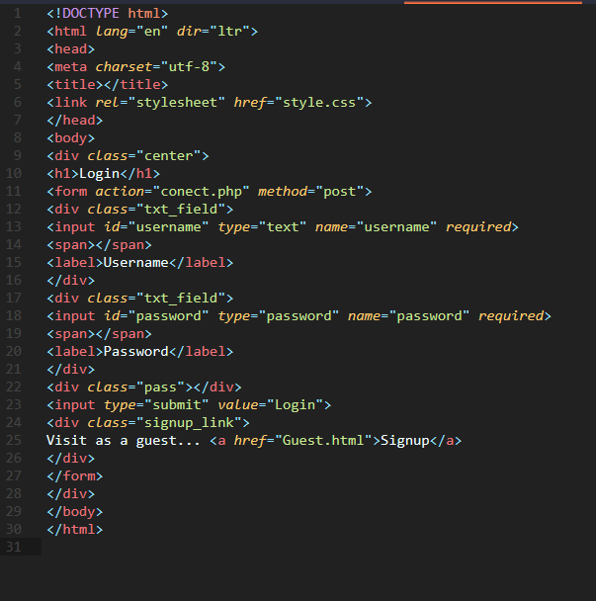

Slide 11
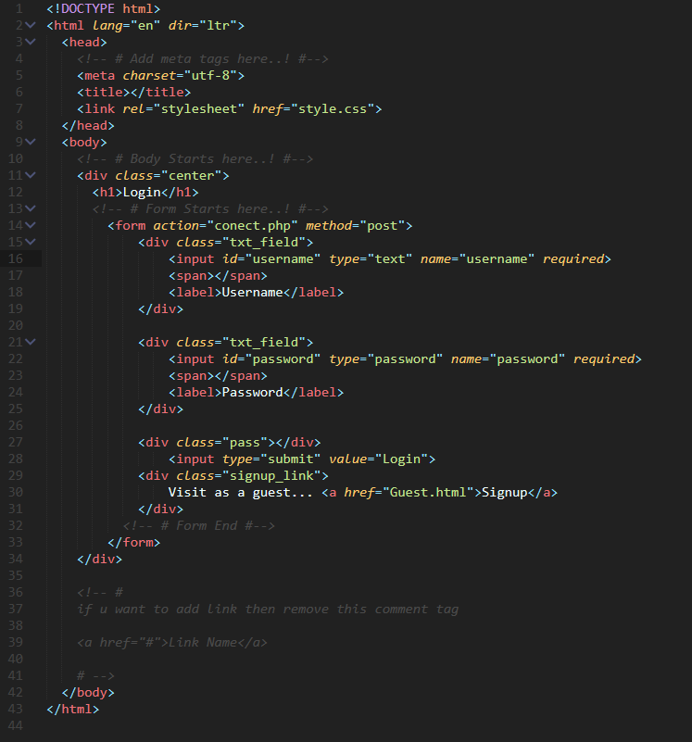

Slide 12
That’s all..! If You have any query related to Coding then ask freely.

Slide 13
Discussion
In which Language we write coding
High-level language
What is the length of a line in coding?
80 or less than 80
How to add comment in html and c++
<!-- --> and */
Name any three programing languages.
Html, c, CSS, c++
What are the guidelines of coding?

