Slide 1
H T M L SERVER CONTROLS IN ASP .NET

Slide 2
What is ASP.NET?
ASP .Net is an approach of Net to develop websites.
We can use it to develop web pages
An ASP .Net websites consist of web pages which are actually .aspx files
One ASP.NET pages consists of two files.
. +
Aspx file contains the presentable layout (HTML/CSS) of the web page
Vb file contains the server side code of the web page.
.aspx file
.vb Or .cs File

Slide 3
HTML Server Control
The HTML server controls are HTML elements that include a runat=serverattribute. The HTML server controls have the same HTML output and the same properties as their corresponding HTML tags. In addition, HTML server controls provide automatic state management and server-side events.

Slide 4
Some basic html server control tags are :
<A runat="server">
<button runat="server>
<form runat=server">
<img runat=server>
<input type="button" runat="server">
<input type="reset" runat="server“>
<input type="submit" runat=server">
<input type="checkbox" runat="server">
<input type="file" runat=server >
<input type="hidden" runat=server >
<input type="image" runat="server">

Slide 5
<A runat="server"> :- An anchor control is used to create a hyperlink between web pages. You can create hyperlink to another location on the same page or you create hypertink to another Web page.
SYNTAX : <a href=" - url - " runat="server">text</a>
<asp:hyperlink />
<form runat="server"> :- An HTML Form Server control is represented by an Html Form object. So, it is also called as Html Form control. The Html Form control is used to control an HTML form element. It allows you to create a container for elements in a Web page.
SYNTAX : <form runat=server“>
-- here you add form elements –
</form>
<form method="post/get" runat="server">
-- here you add form elements –
</form>

Slide 6
<button runat=“server”> :- The Button control is used to create a push button on the Web page. You can create either a Submit button or a Command button. By default, a Button control is a Submit button.
SYNTAX : <asp:Button ID="Button1"runat="server" Text="Button" />
<input type="Button" ID=“Button1” runat=“server” Text="Button" />
<input type="textbox" runat="server"> :- The TextBox control is an input control that allows user to enter a text.
SYNTAX : <asp: TextBox ID-"textbox1" runat-"server"/>
<input type "text" runat="server"/>
<input type "password" runat="server"/>

Slide 7
<imagebutton runat="server">:- The Image Button control is used to display an image thatresponds to mouse clicks.
SYNTAX : <asp:ImageButton />
<asp:ImageButton ID="ImageButton1"runat="server"
Height="25px"ImageUrl="/image/button.png">

Slide 8
<input type=“radio” runat=‘’server’ <input type=“text” runat=“server <input type=“password” runat=“server”> <select runat=“server”> <table runat=“server>, <td runat=“server”>, <th runat=“server”> <textarea runat=“server”>

Slide 9
Questions arive.
What is The work <runat=“sever”> ?
Why we use html server controls ?
What is state management/sever-side controls ?
What is <method> attribute ?
How a Server dispaly a ASP. NET page ?

Slide 10
http://example.com
<form method=“post/get” runat=“server”>
<input type “text” runat=“server”/>
<input type “password” runat=“server”/>
<button type=submit runat=“server”>submit</button>
</form>

Slide 11
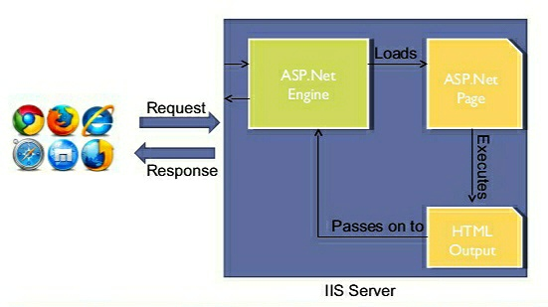
How a asp.net document will show to end user.

