Slide 1
A thread is a flow of execution through the process code, with its own program counter, sy stem registers and stack. A thread is also called a light weight process. Threads provide a way to improve through parallelism Application performance Each thread belongs to exactly one process and no thread can exist outside a process.
What is Thread ?

Slide 2
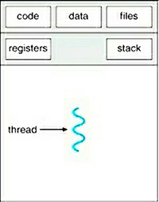
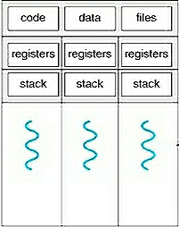
Single threaded Process and Multi-threaded Process

Slide 3
Difference between Process and Threads:
Process
Thread is light weight taking lesser resources than a process.
Thread switching does not need to interact with operating system.
All threads can share same set of open files, child processes.
While one thread is blocked and waiting, second thread in the same task can run.
Multiple threaded processes use fewer resources.
One thread can read, write or change another thread's data.
Threads
Process is heavy weight or resource intensive.
Process switching needs interaction with operating system
In multiple processing environments each process executes the same code but has its own memory and tile resources.
If one process is blocked then no other process can execute until the first process is unblocked.
Multiple processes without using threads use more resources.
In multiple processes each process operates independently of the others.

Slide 4
Advantages of Threads:
Thread minimizes context switching time. Use of threads provides concurrency within a process. Efficient communication. Economy. It is more economical to create and context switch threads. Utilization of multiprocessor architectures to a greater scale and efficiency.

Slide 5
Disadvantages of Threads:
Blocking of parent threads will stop all child thread. Security.

Slide 6
Types of Threads:
Threads are implemented in following two ways :
User Level Threads (ULT)
Kernel Level Threads (KLT)

Slide 7
User Level Threads (ULT):
User level thread implement in user level libraries, so thread switching does not need to call operating system and to causeinterrupt to the kernel.
In fact, the kernel knows nothing about user level threads and manages them as if they were single-threaded process.

Slide 8
Kernel Level Threads (KLT):
In this method, the kernel knows about and manages the threads. No runtime sy stem is needed in this case.
Operating system kernel provides system call to create and manage threads.

Slide 9
Difference between ULT and KLT:
User Level Thread
Kernel Level Thread
User level thread are faster to create and manage.
Implementation is by a thread library at the user level.
ULT is generic and can run on any operating system.
Multi-Threaded can not take advantages of multiprocessing.
Kernel level thread are slower to create and manage.
Operating system supports creation of kernel level threads.
KLT is specific to the operating system.
Kernel routines themselves can be multithreaded

