Slide 1
CHAPTER-1 OPERATING SYSTEM
Fri, 8 Jan 2021
Presented by : Himanshu

Slide 2
Flow of Presentation
Introduction
Structure of Operating System
Types of Operating System
Functions of Operating System
Kernel
Architecture of Operating System
Conclusion
Discussion

Slide 3
Operating System
Operating system is an System software.
An Operating System (OS) is an interface between a computer user and computer hardware.
An operating system is a software which performs all the basic tasks like file management, memory management, process management, handling input and output, and controlling peripheral devices.
It allow to run Application software on it. Some popular Operating Systems include Linux , Windows, VMS, AS/400, etc.

Slide 4
User/Client
Input devices
Operating system
CPU
Memory
Hardware resources

Slide 5
Types of Operating System
Batch Operating System Multitasking/Time Sharing OS Multiprocessing OS Real Time OS Distributed OS Network OS Mobile OS

Slide 6
Batch Operating System
Some computer processes are very lengthy and time-consuming. To speed the same process, a job with a similar type of needs are batched together and run as a group. The user of a batch operating system never directly interacts with the computer. In this type of OS, every user prepares his or her job on an offline device like a punch card and submit it to the computer operator.

Slide 7
job4
job3
job2
job1
CPU

Slide 8
Time Sharing OS
Time-sharing operating system enables people located at a different terminal(shell) or Multiple jobs to use a single computer system(CPU) at the same time. The processor time (CPU) which is shared among multiple users or Jobs is termed as time-sharing.

Slide 9
user1
Time Quantum
Round-Robin
user6
user2
CPU
user5
user3
user4

Slide 10
Multiprocessing Operating System
In a Multiprocessing OS , it deals with one or more than Two CPU’s to do multiple tasks simultaneously. These OS are capable of running many programs at a same time.
A multiprocessing system used more than one Processors to process any given workload, increasing the performance of a system’s application environment beyond that of a single processor.

Slide 11
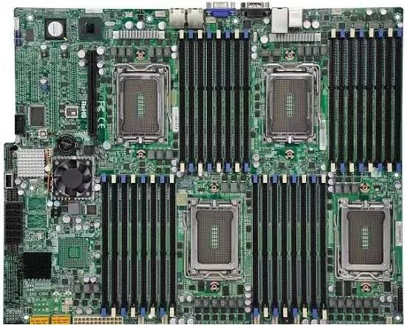

Slide 12
Real time OS
A real time os is a special purposes OS used in computer that has strict time constraints defined for any job to performed.
Microsoft Windows, MacOS, Unix, and Linux are not “real-time.” They are often completely unresponsive for seconds at a time. Real-time operating systems are operating systems that will always respond to an event in a guaranteed amount of time, not in seconds or milliseconds, but in microseconds or nanoseconds.
Example : Ticket reservation System, Air Traffic Control Systems LynxOS (Lynx Software Technologies), MQX (Philips NXP / Freescale), Neutrino (BlackBerry), ThreadX (Microsoft Express Logic), Zephyr (Linux Foundation)

Slide 13
Network Operating System
Network Operating System runs on a server. It provides the capability to serve to manage data, user, groups, security, application, and other networking functions.
Some examples of network operating systems include Microsoft Windows Server 2003, Microsoft Windows Server 2008, UNIX, Linux, Mac OS X, Novell NetWare, and BSD.

Slide 14
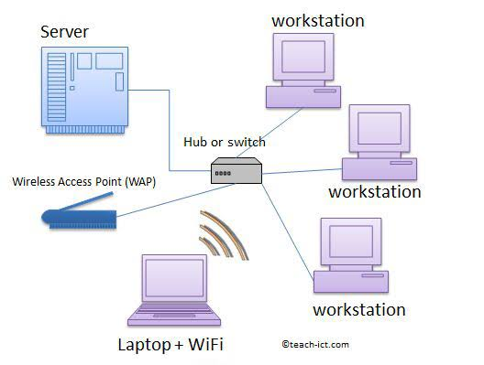

Slide 15
Mobile OS
Mobile operating systems are those OS which is especially that are designed to power smartphones, tablets, and wearables devices. Some most famous mobile operating systems are Android and iOS, but others include BlackBerry, and watch OS.

Slide 16
Functions of an Operating System.
Memory Management Processor Management Device Management File Management Security Control over system performance Job accounting Error detecting aids Coordination between other software and users

Slide 17
Memory Management
Keeps tracks of primary memory, i.e., what part of it are in use by whom, what part are not in use. In multiprogramming, the OS decides which process will get memory when and how much. Allocates the memory when a process requests it to do so. De-allocates the memory when a process no longer needs it or has been terminated.

Slide 18
Processor Management
Keeps tracks of processor and status of process. The program responsible for this task is known as traffic controller. Allocates the processor (CPU) to a process. De-allocates processor when a process is no longer required.

Slide 19
Device Management
Keeps tracks of all devices. Program responsible for this task is known as the I/O controller. Decides which process gets the device when and for how much time. Allocates the device in the efficient way. De-allocates devices.

Slide 20
File Management
Keeps track of information, location, uses, status etc. The collective facilities are often known as file system. Decides who gets the resources. Allocates the resources. De-allocates the resources.

Slide 21
Security − By means of password and similar other techniques, it prevents
unauthorized access to programs and data.
Control over system performance − Recording delays between request for a
service and response from the system.
Job accounting − Keeping track of time and resources used by various jobs
and users.
Error detecting aids − Production of dumps, traces, error messages, and
other debugging and error detecting aids.
Coordination between other software and users − Coordination and assignment of compilers, interpreters, assemblers and other software to the various users of the computer systems.

Slide 22
What is a Kernel?
The kernel is the central component of a computer operating systems. The only job performed by the kernel is to the manage the communication between the software and the hardware. A Kernel is at the nucleus of a computer. It makes the communication between the hardware and software.

Slide 23
Architecture of Operating System
There are some common Architecture’s of an Operating System
8-bit operating system 16-bit operating system
32-bit operating system
64-bit operating system

Slide 24
Conclusions
Without operating system the computer is a box filled by silicon.
Without operating system the computer cannot run the application and we cannot do work in the computer.
Select your operating system according to your need.
Therefore operating system is very important in a computer.

Slide 25
Discussion

