Slide 1


A Dimensional Data Warehouse for Geospatial Monitoring of Municipal Public Works
with an Evolution Path Toward a Lakehouse Architecture
Uriel González Casiano · Marco Tulio Maldonado Mejía · Gabriel Hurtado Avilés
Escuela Superior de Cómputo (ESCOM) · Instituto Politécnico Nacional · Mexico City
ICOKG 2026 · SPRINGER
Session: Data Warehousing and Geospatial Modeling (virtual)
Thursday, September 24, 2026 · 14:00–14:20
Notes:
[0:20] Good afternoon. I am presenting joint work with Uriel González Casiano and Marco Tulio Maldonado Mejía, from ESCOM at the Instituto Politécnico Nacional: a dimensional data warehouse for the geospatial monitoring of municipal public works — and, deliberately, only an evolution path toward a lakehouse, not a lakehouse.

Slide 2
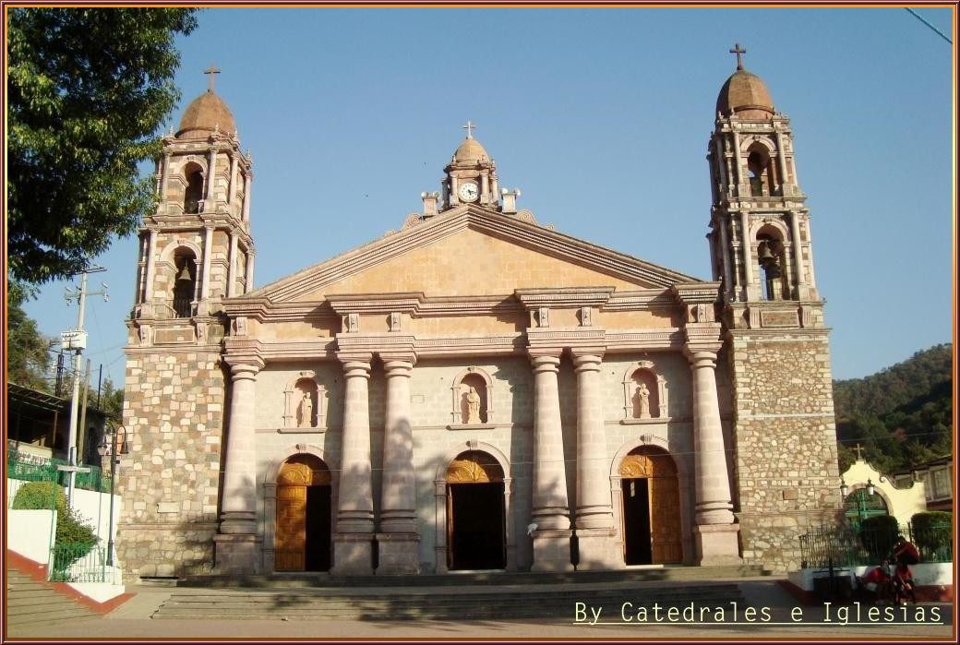
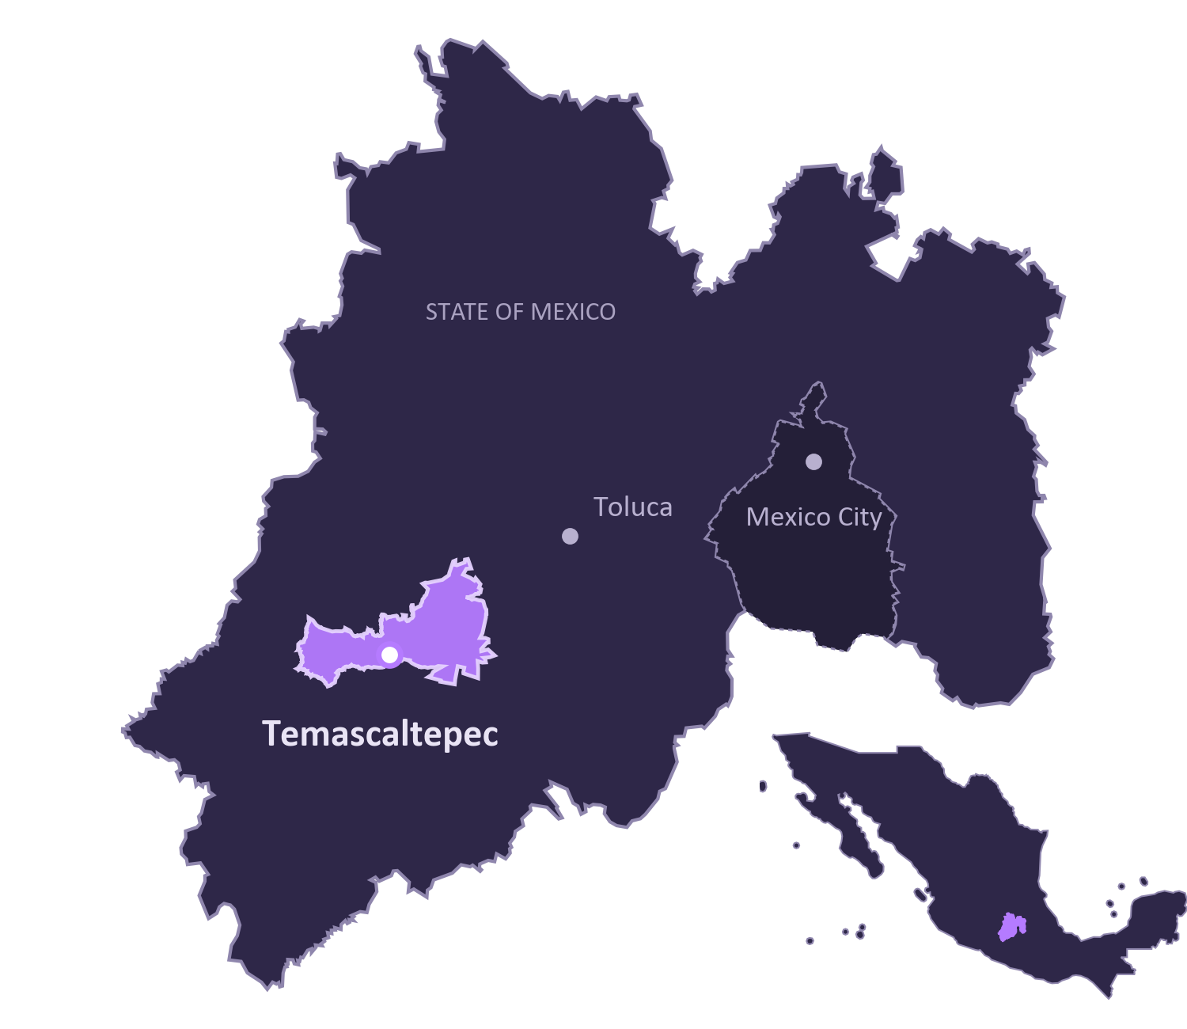





The problem: public-works data without history
CONTEXT
What the office works with today
Spreadsheets and isolated transactional systems
Progress photos and PDFs detached from the record
A modified budget simply overwrites the old one
Citizens get, at best, a static download portal
Temascaltepec de González, municipal seat
Photo: Catedrales e Iglesias · CC BY 2.0 · Wikimedia Commons
Boundaries © OpenStreetMap contributors (ODbL)
64,844
55
Result: no historical analysis, no early delay detection, no informed citizen participation.
inhabitants
communities
2 / 19
Notes:
[0:50] The setting is Temascaltepec, in the State of Mexico: about 65 thousand inhabitants spread over 55 communities in a mountainous area. A public-works office there juggles contractors, budgets, field supervisors, progress photographs and hand-over records — usually in spreadsheets, shared folders or isolated transactional systems. Photos and PDFs are detached from the record, and when a budget changes the old value is simply overwritten. The result: no historical analysis, no early detection of delays, and citizens who at best get a static download portal.

Slide 3




Three research questions
RESEARCH QUESTIONS
RQ1 Traceability
RQ2 Dimensional design
RQ3 Detection
Can a low-cost warehouse preserve auditable history at municipal scale?
Which fact grains, SCD types and views support one analytical schema?
Which anomalies does the rule recover or miss compared with Isolation Forest?
SCD architecture, S3 evidence and REST API
A map for exploring relationships among entities
Evaluation against latent causes and failure analysis
AI-generated conceptual illustrations
3 / 19
Notes:
[0:50] Three questions drive the work. RQ1: can a dimensional warehouse on commodity managed services give auditable history at this scale, without enterprise lakehouse platforms? RQ2: which design decisions — fact grain, slowly changing dimension type per entity, view strategy — let delay detection, budget alerts and participation share one schema? RQ3: how good is a simple threshold rule over the warehouse at recovering anomalies, compared with an unsupervised baseline, and where does it fail? The three contributions map onto them: a reference architecture, a geospatial exploration interface, and a non-circular evaluation.
RQ1
Can a dimensional DW on commodity managed services (PostgreSQL/Supabase + S3-compatible storage) give auditable history of public works at rural-municipality scale — without enterprise lakehouse platforms?
→ Architecture · warehouse · cost
RQ2
Which design decisions — fact grain, SCD type per entity, view materialisation — let delay detection, budget alerts and citizen participation share one analytical schema?
→ Grain · SCD · views
RQ3
How well does a threshold rule over the warehouse views recover execution anomalies, compared with an unsupervised baseline — and which anomaly classes does it miss?
→ Detection evaluation
CONTRIBUTIONS
1
Reference architecture: warehouse with SCDs + S3-compatible evidence + REST API
2
Geospatial map as a graph-like exploration interface
3
Non-circular evaluation against latent causes, with per-class failure analysis
Fuente / Source: paper/main_camera_ready.tex and paper/main_camera_ready.pdf.
Conceptual illustrations generated with the built-in OpenAI image generation tool. They do not represent real municipal records or measured results.

Slide 4
Where this work sits
RELATED WORK
Geospatial knowledge graphs
KnowWhereGraph · Zaragoza
formal semantic layer — but no record “as of” an audit date
OC4IDS
Open Contracting Partnership · CoST
Temporal auditability
entity state at audit granularity (SCD 2)
Evidence linkage
binary field evidence ↔ analytical store
what to disclose — not how a small municipality produces and historises it
This work
municipal scale
Geospatial lakehouse
Databricks
far greater scale, at enterprise-platform cost
OGD download portals
Latin American municipalities
documents referenced by URL, no managed lifecycle
Spatial OLAP (SOLAP)
Rivest et al.
A position, not a claim of vacancy: no systematic review was carried out.
our map is a SOLAP client in all but name
4 / 19
Notes:
[0:45] How does this relate to knowledge-graph work, the home of this conference? Geospatial knowledge graphs such as KnowWhereGraph or Zaragoza's municipal graph give a formal semantic layer that we do not have. OC4IDS defines what to disclose about infrastructure, not how a small municipality produces and historises it. Geospatial lakehouses offer far greater scale, at enterprise cost. Our position is the intersection of two things: temporal auditability — the record as it was on a given date — and binary evidence linked back to the analytical store, at municipal scale. That is a position, not a claim that nobody else does it: we did not run a systematic review.

Slide 5









Warehouse-centric architecture, four layers
ARCHITECTURE
L1
Ingestion
Actors: director · supervisor · secretary · planner · citizen
Role-specific web application · HTML5 / CSS3 / JS
L2
REST API
Flask / Python REST API · 9 blueprints · 56 routes · 11 unauthenticated read-only · role check + signed session token
L3
Storage
INSERT / UPDATE
S3 PutObject
triggers
(SCD 2)
Data Warehouse
10 dims · 2 facts · 6 views
Object store
Cloudflare R2 · binary evidence
Operational schema (OLTP)
public read endpoints
evidence URLs
L4
Presentation
OLAP views · ad-hoc SQL
Detection module
delay & alert rules · C1–C3
Geospatial viewer
published with the artefact
structured data
binary evidence
Redrawn from Fig. 1 of the paper
5 / 19
Notes:
[1:00] The architecture has four layers. Actors use role-specific web pages. A Flask REST API — nine blueprints, 56 routes, eleven of them public and read-only — routes structured data to the operational schema and binary files to Cloudflare R2. Database triggers, not an external ETL job, populate the warehouse: ten dimensions, two fact tables, six views. The presentation layer is OLAP queries, the detection module, and the geospatial viewer, which reads the public endpoints and the evidence URLs. Solid arrows are structured data; dashed arrows are binary evidence.

Slide 6
Star schema: 2 facts, 10 dimensions
DATA WAREHOUSE
dim_work
dim_time
SCD 2
fact_audit_events
grain: one audit event
17 event types · range-partitioned by year
SCD 0
dim_region
dim_event_type
SCD 2
SCD 0
dim_company
dim_source
SCD 2
SCD 1
dim_staff
fact_work_monthly
grain: one work × month (snapshot)
29,928 rows in the seeded warehouse
dim_citizen
SCD 2
SCD 1
dim_budget
dim_proposal
SCD 2
SCD 1
5 × SCD 2
full history: effective / expiration / is_current
3 × SCD 1
overwrite
2 × SCD 0
fixed catalogue
Redrawn from Fig. 2 of the paper
6 / 19
Notes:
[0:55] The core is a star schema. Two fact tables: audit events, at the grain of one immutable action — 17 event types, partitioned by year — and a monthly snapshot of each work. Stating the grain matters: because the monthly table is a snapshot, aggregating cost over months means taking the last snapshot, not a sum, and the views encapsulate that rule. Ten dimensions: the five on the left are SCD Type 2 — works, regions, contractors, staff and budget — and carry the history. On the right, time and event type are fixed catalogues, and source, citizen and proposal are Type 1.

Slide 7




SCD Type 2: the record as it was, on any date
SLOWLY CHANGING DIMENSIONS
“What did this record look like the day the budget was modified?”
Why Type 2 for five entities
Budget-modification audit
which amount was in force when a payment was authorised
key | work | amount | effective_date | expiration_date | is_current
101 | OBR-001 | $4,250,000 | 2025-02-03 | 2025-06-14 | false
187 | OBR-001 | $4,600,000 | 2025-06-15 | 9999-12-31 | true
Contractor reassignment
earlier progress stays attributed to the original contractor
dim_budget · illustrative values
Territorial reorganisation
merged or renamed communities do not rewrite investment history
payment authorised 20 May → joins v1 ($4.25 M)
Deliberately Type 1: citizens and proposals — superseded names and national ID codes would be a personal-data liability.
v1 · $4.25 M
v2 · $4.60 M (current)
Feb
Mar
Apr
May
Jun
Jul
Aug
Sep
2025
Closing v1 and opening v2 is a trigger, not an application rule.
scripts/verificar_scd.py checks the schema against the declared types
7 / 19
Notes:
[0:50] Why Type 2? Because it answers the auditor's question: what did this record look like the day the budget was modified? When a budget changes, a trigger closes the current version and opens a new one, so a payment authorised in May joins the version that was in force in May. The same mechanism keeps earlier progress attributed to the original contractor after a reassignment, and prevents a merged community from rewriting the investment history. Citizens and proposals are deliberately Type 1: keeping superseded names and national identity codes would be a personal-data liability with no analytical return. A script checks the schema against these declared types, so they cannot drift apart. The values in the table are illustrative.

Slide 8




No ETL job: triggers feed the warehouse
PIPELINE
Operational write
12 database triggers
Two fact tables
6 live SQL views
/api/analitica
progress report · cost · image · vote
8 dimension-sync (SCD 2) · 4 audit-emitting
audit events (by year) · work × month
standard views, no refresh job
read-only, public by design
The six analytical views
Why standard, not materialised, views?
v_delayed_works
v_audit_alerts
~10⁴ fact rows → the views run in milliseconds
alerts must be actionable the moment a report is uploaded
no refresh job to schedule — or to fail
works with a schedule slip and days late
HIGH_AMOUNT · CANCELLED_WORK · BUDGET_CHANGE · LATE_EVENT · REVIEW
v_work_traceability
v_citizen_participation
full SCD 2 version history of a work
votes and proposals by region
v_budget_executed
v_anomalies_detection
Scale-out path: REFRESH MATERIALIZED VIEW CONCURRENTLY for the budget and participation views; alert views stay live.
execution by funding source
C1–C3 per work and month
8 / 19
Notes:
[0:45] There is no ETL job. Twelve triggers do the work: eight keep the dimensions in sync, applying SCD 2 where needed, and four emit audit rows when a progress report, a cost, an image or a vote is registered. Six standard — not materialised — views sit on top. At around ten thousand fact rows they run in milliseconds; alerts must be actionable the moment a supervisor uploads a report; and there is no refresh job that can fail. If this scales to several municipalities, the aggregation-heavy views can be materialised and refreshed concurrently after each nightly load, keeping the alert views live.

Slide 9
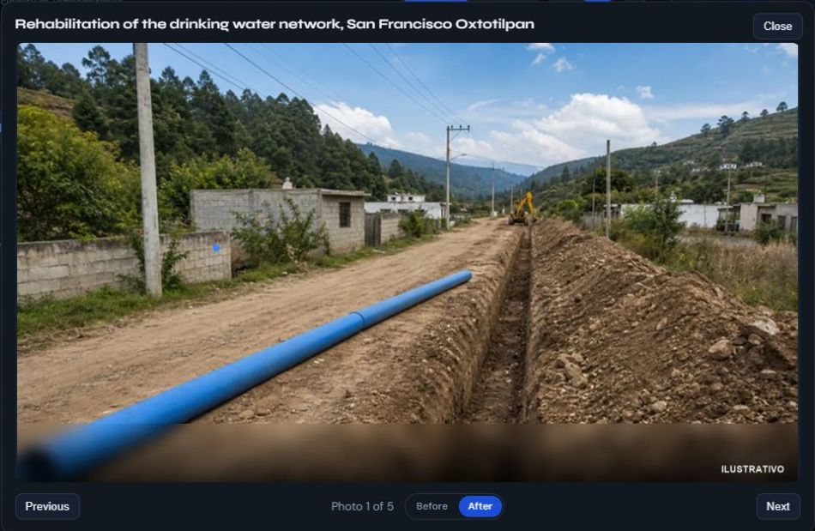
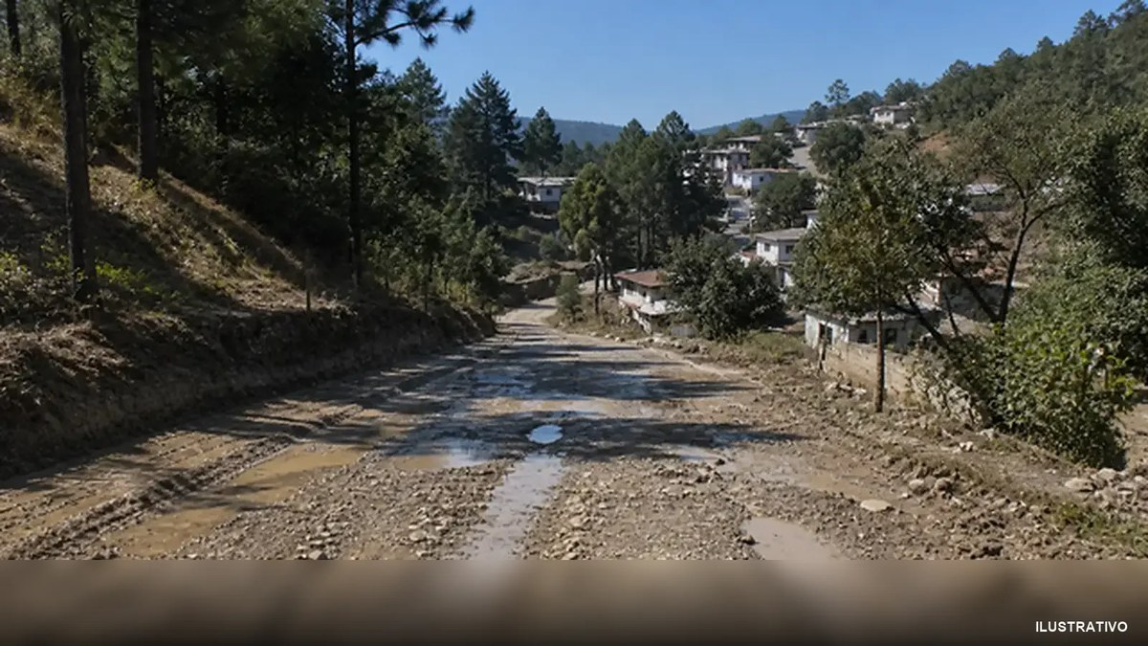
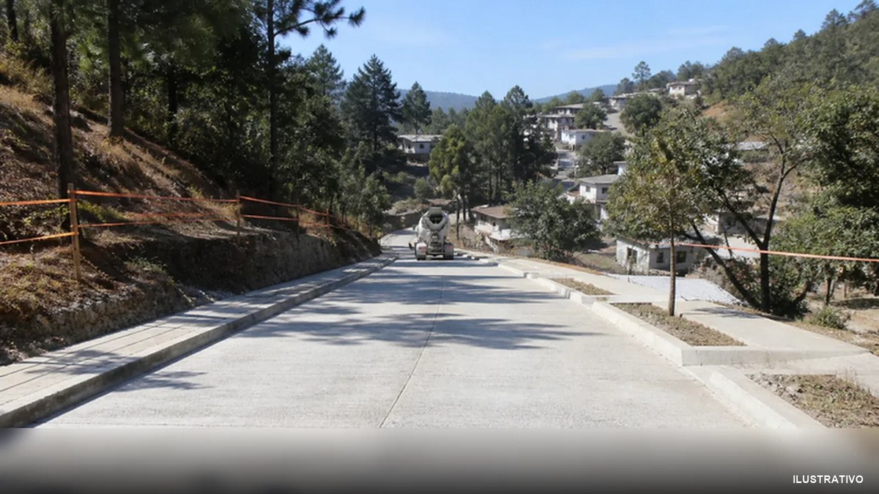


Object storage: evidence linked both ways
EVIDENCE LAYER
01
The supervisor attaches photos or PDFs.
02
The API builds the object key.
03
R2 stores the binary file.
04
The warehouse records metadata and URL.
Link by work and period
works/{work_id}/reports/
{year}-{month}/{ts}_{slug}.{ext}
URL, name, MIME, bytes and upload date
Compensated upload, not atomic
An intermediate failure can leave orphan files.
Published gallery. Synthetic data and images marked ILUSTRATIVO.
9 / 19
Notes:
[0:40] Evidence lives in Cloudflare R2, S3-compatible, with zero egress cost. Keys follow a hive-partitioned convention by work and period, and every object's metadata is persisted in the warehouse, so the link goes both ways. The images on the left are the artefact's gallery for one work — AI-generated illustrations, each stamped ILUSTRATIVO in the file, not municipal evidence. One honest caveat: the upload is compensated, not atomic. If the database fails, the API deletes what it just uploaded, best effort; a crash in between can still leave an orphaned object.
BEFORE
AFTER
Work OBR-001 in the artefact's gallery — AI-generated illustrations, each stamped ILUSTRATIVO; not municipal evidence
Hive-partitioned object keys
works/
{work_id}
/reports/
{year}-{month}
/
{ts}_{slug}
.{ext}
explore by work and by period, straight from the bucket
…and one warehouse-side metadata row per object:
public URL
original name
MIME type
size (bytes)
upload date
1
Supervisor attaches photos / PDFs to a progress report
2
The API computes the object key
3
Uploads through the S3 SDK to Cloudflare R2 (zero egress cost)
4
Records the metadata in the warehouse, returns the public URL
Compensated, not atomic.
On a database failure the API deletes what it just uploaded (best effort); a crash in between can leave an orphan — no reconciliation sweep yet.
Fuente / Source: paper/main_camera_ready.tex and paper/main_camera_ready.pdf.
Captura del sitio publicado / Published site screenshot, 2026-09-17: https://gabrielhuav.github.io/PublicMunicipalWorks_DWH/director/director.html . Synthetic demonstration. Gallery work photographs are AI-generated illustrations, not municipal evidence.

Slide 10
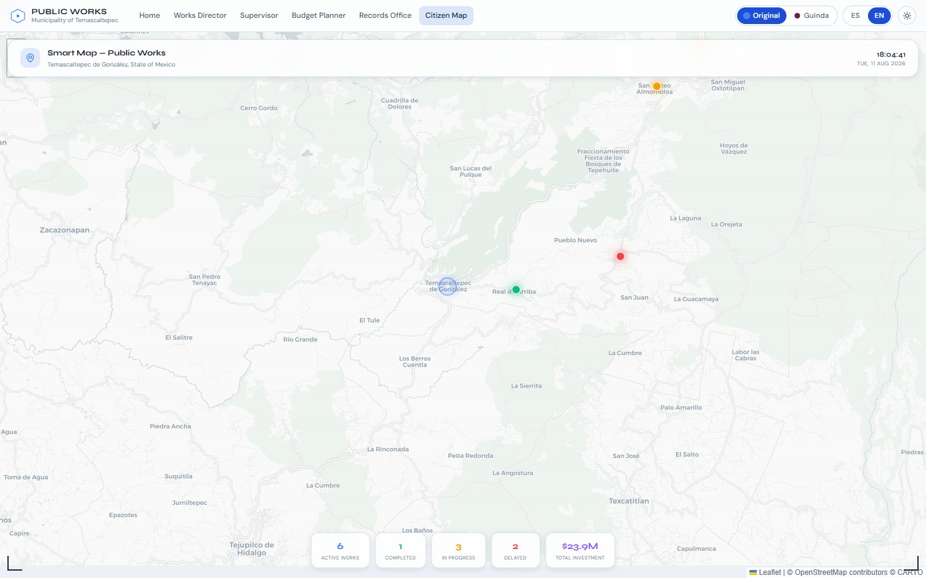
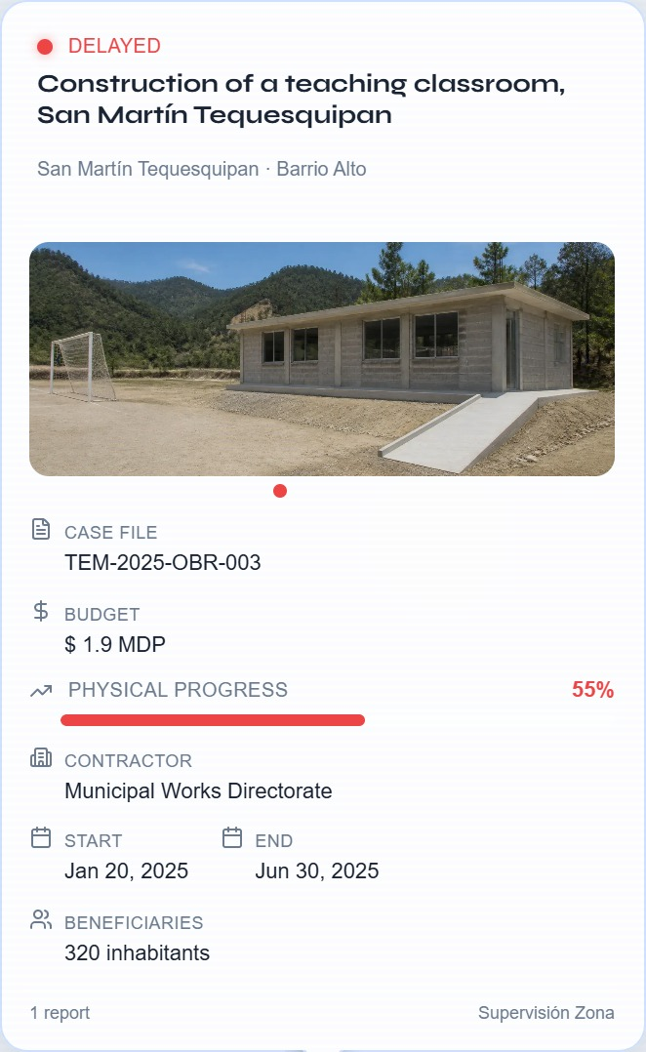
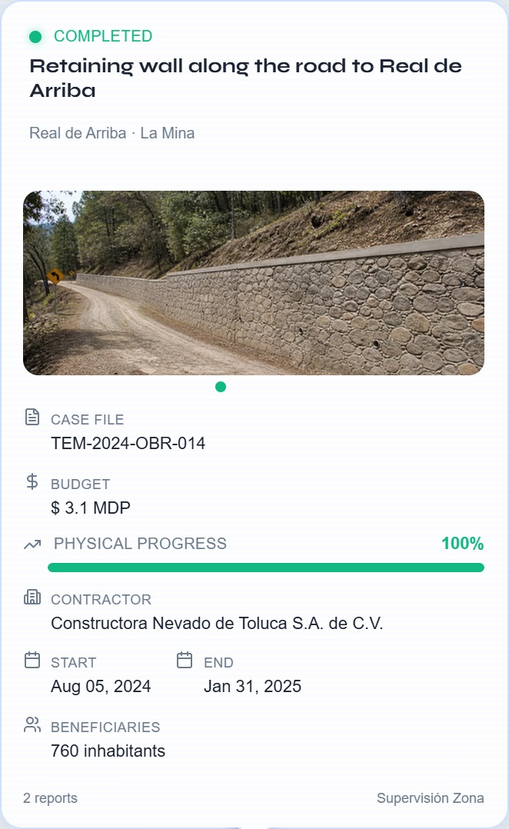
Geospatial viewer: an implicit graph
INTERFACE
Status
Location
Evidence
Budget
Progress
Foreign-key relationships. OWL/RDF remains future work.
Fig. 3 and artifact records. Synthetic data. © OpenStreetMap, © CARTO, Leaflet.
10 / 19
Notes:
[0:45] The geospatial viewer is Figure 3 of the paper. Markers are colour-coded by state — green completed, amber in progress, red delayed — and sit on the real coordinates of each community, resolved from OpenStreetMap, with a small deterministic offset. Selecting a work opens its technical card: case file, budget, contractor, dates, physical progress and images from the object store — here, a delayed classroom and a completed retaining wall. The analysis layer surfaces days of slippage and the physical-versus-financial gap. It is an implicit graph derived from the foreign keys of the dimensional model — not an OWL knowledge graph; publishing the vocabulary is future work.
Fig. 3 of the paper · base map © OpenStreetMap contributors, © CARTO · Leaflet
●
●
●
Markers by state: completed · in progress · delayed
Technical card:
case file, budget, contractor, dates, physical progress, images from R2
Analysis layer:
days of slippage (C2) · physical vs financial progress (C3)
Relations derive from foreign keys — not an OWL/RDF graph (future work)
Fuente / Source: paper/main_camera_ready.tex and paper/main_camera_ready.pdf.
Source: Figure 3 and work-detail screenshots embedded in the original supplied deck. OpenStreetMap contributors, CARTO and Leaflet. Synthetic dataset.

Slide 11
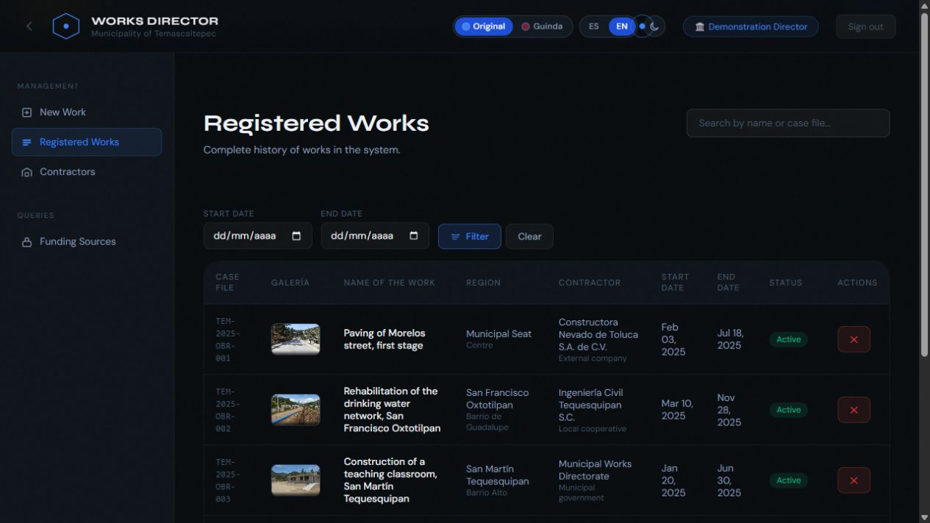

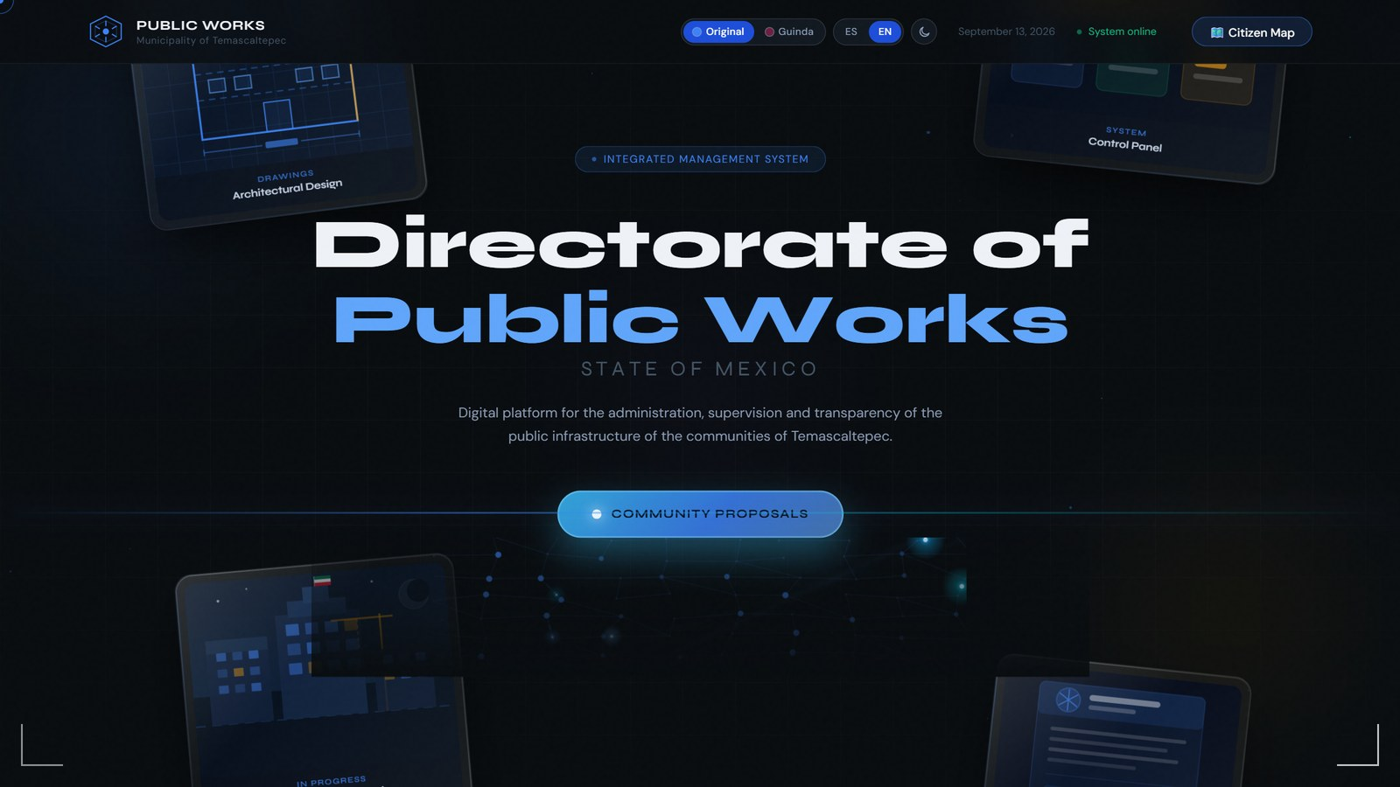



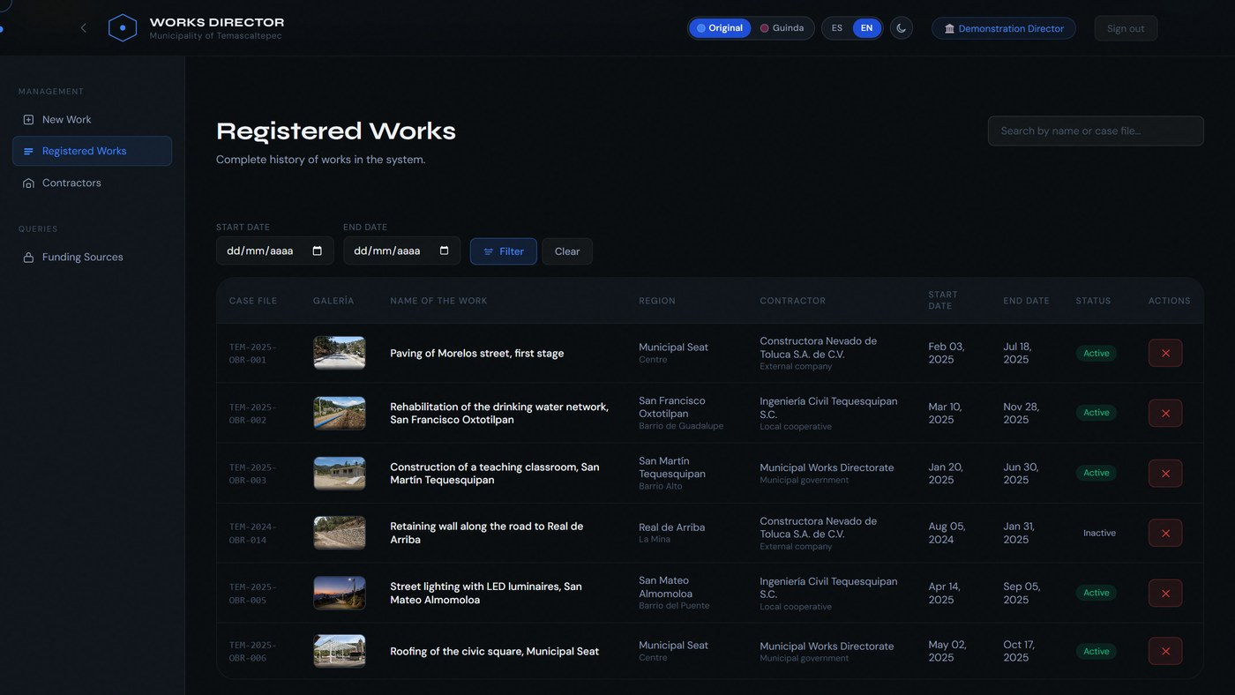
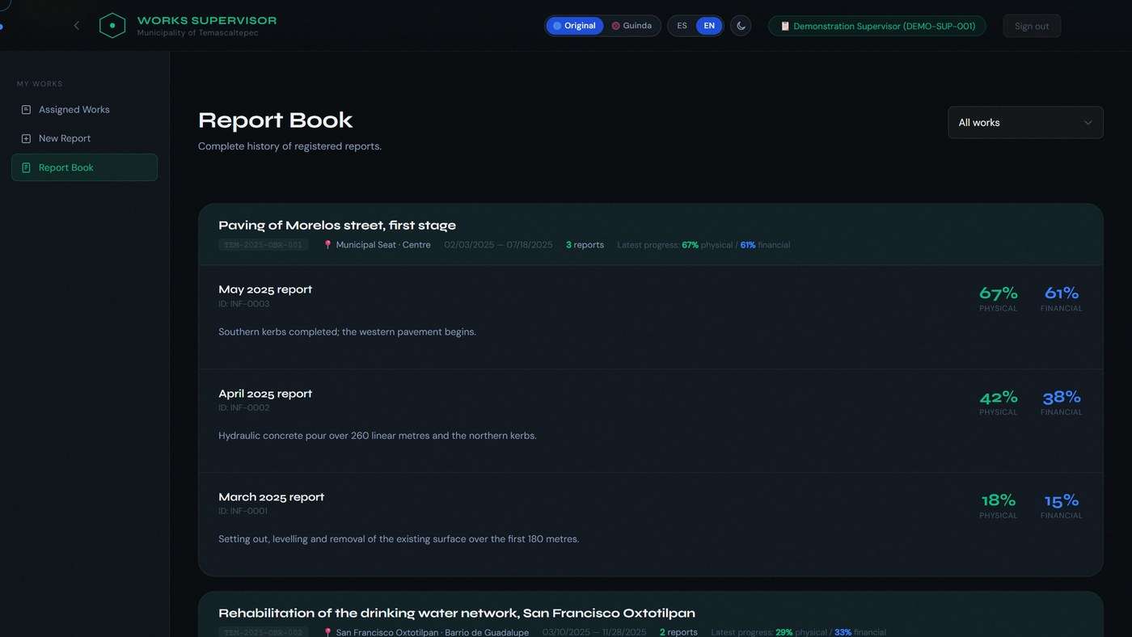
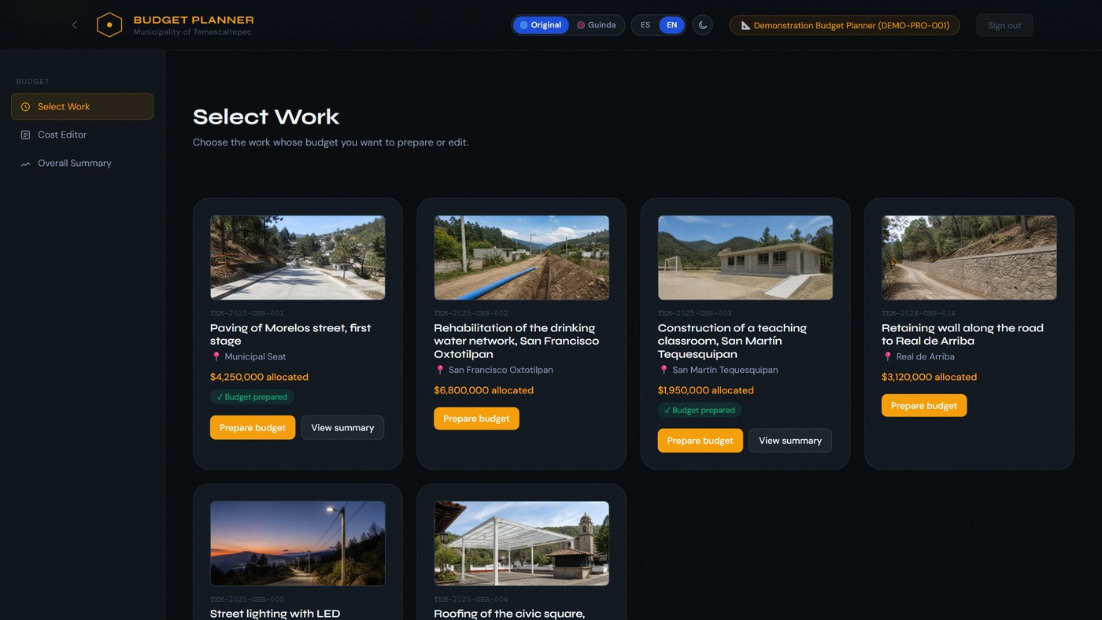
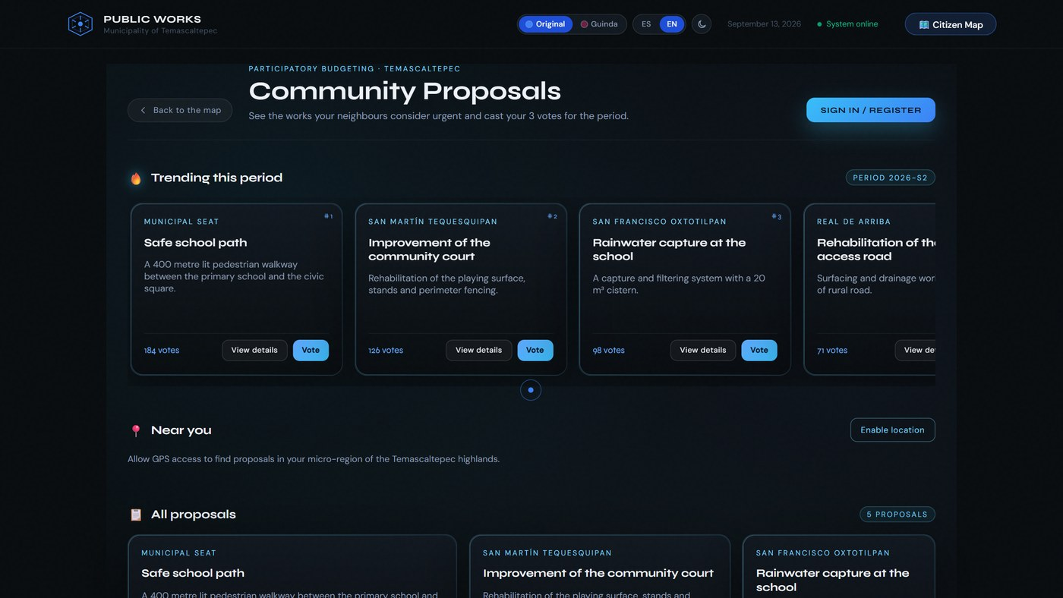
The artefact is live — and static on purpose
DEMO
Open access
6 synthetic works
in the visitor’s tab
Director, supervisor, planner and records office
Citizen participation
Spanish and English
2 themes, light and dark
Try the demo
gabrielhuav.github.io/
PublicMunicipalWorks_DWH/
Flask API + PostgreSQL: run locally with Docker.
Published website screenshot, 17 Sep 2026.
11 / 19
Notes:
[0:50] Everything is live as a static site on GitHub Pages — static on purpose, so it keeps working with no backend running. It preserves the prototype's interface: the four role workspaces — works director, supervisor, budget planner and records office — plus citizen proposals and the map, in Spanish and English, with two themes in light and dark. Credentials are printed on the page, the form accepts anything, and all data is synthetic and lives only in your own browser tab, so nobody can affect anybody else. Scan the code to try it. The Flask API and the PostgreSQL warehouse are distributed as a Docker stack you can run from the repository.
No backend: synthetic data in your tab
Spanish / English
2 themes × light / dark
Open access: demo credentials on the page
Works director · registered works
Supervisor · report book
Budget planner
Community proposals
Try it now
gabrielhuav.github.io/PublicMunicipalWorks_DWH
Flask API + PostgreSQL: runnable with Docker from the repository
Fuente / Source: paper/main_camera_ready.tex and paper/main_camera_ready.pdf.
Captura del sitio publicado / Published site screenshot, 2026-09-17: https://gabrielhuav.github.io/PublicMunicipalWorks_DWH/director/director.html . Synthetic demonstration. Gallery work photographs are AI-generated illustrations, not municipal evidence.

Slide 12

Three synthetic populations, never conflated
RESULTS · SCOPE
Published site
Seeded warehouse
Detection dataset
6
1,247
≈2,580
works, held in the visitor's browser tab
works across 55 communities
work–period records per seed
the only population a visitor ever sees
$127.4 M
budget
8,934
audit events
3,421
photo evidence
10 seeds × 4 prevalences
5 %, 10 %, 15 %, 20 % latent anomalies
2,156
proposals
8,723
votes
29,928
monthly rows
supports → interface claims · Lighthouse audit
supports → structural claims · latencies
supports → the detection table only
Measured vs projected are kept apart. No number in this talk is a measurement on real municipal data.
12 / 19
Notes:
[0:35] Before the numbers, their scope. There are three synthetic populations and we never mix them. The published site holds six works in the visitor's browser tab and supports only interface claims and the Lighthouse audit. The seeded warehouse — 1,247 works in 55 communities, 127.4 million pesos, almost nine thousand audit events — supports the structural claims and the latencies. And a separate detection simulation, about 2,580 work-period records per seed, supports the detection table and nothing else. No number here is a measurement on real municipal data.

Slide 13




Detection: a rule an operator can actually run
DETECTION MODULE
C1 Cost outlier
C2 Extreme delay
C3 Progress inconsistency
|b − μ| / σ > 3
dᵢ > 120 days
Physical < 30%
Financial > 80%
Executed amount against the period mean
Recorded slippage against the schedule
Low physical progress with high payment
C1–C3 criteria on each work–month record. Read-only SQL view and API.
AI-generated conceptual illustrations. Score formula in speaker notes.
13 / 19
Notes:
[0:45] The detection module flags a work-month if any of three operational criteria holds: C1, a cost more than three standard deviations from the mean; C2, a recorded delay over 120 days; C3, physical progress below 30 percent with financial progress above 80 — paid for, but not built. The score takes the maximum of the three terms and flags above 3; we also use it for ranking metrics. Importantly, the rule is implemented as a SQL view over the monthly fact table and served read-only, so the rule we evaluate is exactly the rule an operator runs.
C1
Cost outlier
|b
i
− μ
b
| / σ
b
> 3
executed budget more than 3 σ from the mean
C2
Extreme delay
d
i
> 120 days
recorded slippage beyond 120 days
C3
Progress inconsistency
physical < 30 % ∧ financial > 80 %
paid for, but not built
ANOMALY SCORE
flag if s
i
> 3
s
i
= max( |b
i
− μ
b
| / σ
b
, (d
i
/ 120) · 𝟙[d
i
> 120] , 3.5 · 𝟙[C3] )
v_anomalies_detection
SQL view over the monthly fact
/api/analitica/anomalias
served read-only
the rule evaluated = the rule an operator runs
Fuente / Source: paper/main_camera_ready.tex and paper/main_camera_ready.pdf.
Conceptual illustrations generated with the built-in OpenAI image generation tool. They do not represent real municipal records or measured results.

Slide 14
Results against latent causes
EVALUATION
5 latent causes overlapping the normal range
10 seeds × 4 prevalences (5–20 %)
≈2,580 records / seed · 17.2 % anomalous
Baseline: Isolation Forest (default + matched)
0.46 precision
at 0.35 recall
As a scoring function: Isolation Forest ranks better on both AUCs, at every prevalence.
At the operating point: with the same alert budget the rule is more precise (.462 vs .387) and recovers more (.351 vs .294).
An office reviews a fixed number of files per period, not a ranking.
Mean over 10 seeds, error bars = 95 % CI · Table 2 of the paper
14 / 19
Notes:
[1:00] The evaluation is designed not to be circular. Anomalies are latent process states — an inflated price, an unproductive contractor, payments ahead of execution, a stopped work, a ghost work — whose observable magnitudes overlap the normal range, so some are undetectable and some healthy works look irregular. Ten seeds, four prevalences, and an Isolation Forest baseline, also evaluated at a matched alert budget. The rule reaches 0.46 precision at 0.35 recall. It does not dominate: Isolation Forest ranks better on both AUCs. Its advantage is the operating point: with the same number of alerts it is more precise and recovers more — which is what matters to an office that reviews a fixed number of files per period. Both improve with prevalence.

Slide 15
Where it fails — and why
FAILURE ANALYSIS
Recall per latent cause · 15 % prevalence · mean ± 95 % CI
C1 compares an absolute amount with its period mean
→ it flags large works, not overpriced ones.
“A school inflated by 30 % is still cheaper than an honest road.”
No criterion looks at the physical–financial gap
unless physical progress falls below 30 % → steady over-payment passes if the work eventually finishes.
A schedule-failure filter with a narrow ghost-work check — not a cost-anomaly detector.
Next: recompute C1 per work type and re-evaluate on the same ground truth.
15 / 19
Notes:
[0:50] Per cause, the failures are diagnostic. The rule recovers unproductive contractors, ghost works and stopped works reasonably, but overpricing only 9 percent of the time and payments ahead of execution 6 percent. The reason is structural, not a matter of tuning. C1 compares an absolute amount with the mean of its period, so it flags big works, not overpriced ones: a school inflated by 30 percent is still cheaper than an honest road. And no criterion looks at the physical-financial gap unless physical progress falls below 30 percent, so a work paid steadily ahead of its execution passes if it eventually finishes. It is a schedule-failure filter with a narrow ghost-work check — not a cost-anomaly detector.

Slide 16

Measured: the warehouse is not the bottleneck
PERFORMANCE
warehouse (SQL execution)
API end-to-end (HTTP)
mean, log scale
Lighthouse · published site
Landing page
85
100
96
90
Perf.
Access.
Best pr.
SEO
Map
72
100
93
100
Perf.
Access.
Best pr.
SEO
Throughput: 3.4 req/s (10 clients, 2 sync workers) — the unpaginated 753 kB portfolio response. Remedy: pagination + more workers; the dimensional design is untouched.
0 ms blocking time · CLS 0 · FCP 3.2 s / 3.6 s
median of 3 runs · Lighthouse 12.8.2 · mobile · 11 Aug 2026
Docker reference stack: PostgreSQL 16.14 + Flask/gunicorn · 1,247 works · Table 1
16 / 19
Notes:
[0:50] Latency, measured on the Docker reference stack with the seeded population. The warehouse answers in single-digit milliseconds: the delayed-works view in 2 ms, an insert that fires the SCD 2 trigger in 0.1 ms. The time goes into delivery: the public works endpoint serialises the whole portfolio, 753 kB, in 566 ms, and sustained throughput is 3.4 requests per second with two synchronous workers. Pagination and more workers fix that without touching the dimensional design. On the right, the static front end: 100 in accessibility on both pages — reached by fixing what the audit reported, not by restating it. Performance is limited by delivery weight inherited from the prototype.

Slide 17

Answers to the research questions
CONCLUSIONS
RQ1 Feasibility
RQ2 One schema
RQ3 Rule capability
10 / 2 / 6
5 SCD 2
0.46 / 0.35
dimensions / facts / views
entities with auditable history
precision / recall
Analytical queries in milliseconds. The observed limit lies in API delivery.
An event fact and a work × month snapshot serve alerts, budgets and participation.
An advantage at the same alert budget. Isolation Forest achieves better AUCs.
Validated under synthetic load on a reference stack. No validation against real municipal records.
17 / 19
Notes:
[0:45] So, answering the questions. RQ1: yes — and in this version measured, on commodity services, with the analytical layer answering in milliseconds; the caveat is a reference stack under synthetic load, not a production installation. RQ2: an event-grain transaction fact plus a work-month snapshot, with SCD 2 restricted to the five audit-relevant entities, serves all three uses from one schema. RQ3: partly — 0.46 precision at 0.35 recall, out-ranked by Isolation Forest, with failures concentrated in cost anomalies, whose criterion is mis-specified. Overall: transparency with analytical capability, georeferenced evidence and participation, without enterprise-platform costs.
RQ1
Yes — and measured
10 dimensions (5 SCD 2), 2 facts and 6 views on commodity managed services; the analytical layer answers in single-digit ms and the limit is the delivery layer. Caveat: a reference stack under synthetic load, not a production municipality.
RQ2
One schema serves all three uses
An event-grain transaction fact plus a work × month snapshot, with SCD 2 restricted to the five audit-relevant entities, serves delay detection, budget alerting and participation analytics.
RQ3
Partly
0.46 precision at 0.35 recall against latent causes; out-ranked by Isolation Forest; failures concentrate in cost anomalies, whose criterion is mis-specified.
Transparency with analytical capability, georeferenced evidence and citizen participation — without enterprise-platform costs.
Fuente / Source: paper/main_camera_ready.tex and paper/main_camera_ready.pdf.

Slide 18










Limitations, and the road to a lakehouse
FUTURE WORK
TODAY Warehouse + evidence
NEXT Lakehouse
LATER Interoperability
PostgreSQL and binaries in R2.
No analytical queries over object storage yet.
Iceberg or Parquet with transactional metadata on R2. DuckDB or Trino.
An OWL vocabulary and data publication aligned with OC4IDS.
Current limitations
Further validation and improvements
Synthetic data and static demo. Map reads separate from the DW. Lightweight access control and simple voting.
Cost by work type, security and municipal validation. Computer vision, forecasting and quadratic voting.
Proposed path. AI-generated conceptual illustrations.
18 / 19
Notes:
[0:40] Limitations: there is no hosted dynamic deployment, all data is synthetic, the object store is not queried analytically, the map reads the operational schema, and access control is lightweight. The main road ahead is a real lakehouse: an open table format — Iceberg, or Parquet with transactional metadata — on R2, queried by a lightweight engine such as DuckDB or Trino, without Spark; then the schema as an OWL vocabulary and an OC4IDS-conformant projection, so the data becomes comparable with other jurisdictions. Also: computer vision on progress photos, quadratic voting, completion forecasting, a per-work-type cost criterion, and validation in more municipalities.
TODAY
Dimensional DW + evidence store
PostgreSQL warehouse · R2 holds binaries, not queried
NEXT
Open table format on the lake
Iceberg or Parquet + transactional metadata on R2, queried by DuckDB / Trino — no Spark
THEN
Linked, comparable data
schema as an OWL vocabulary · OC4IDS-conformant projection
Limitations
No hosted dynamic deployment: permanence rests on the static artefact
All analytical results come from synthetic data
The object store holds evidence but is not queried analytically
Public map endpoints read the operational schema, not the views
Lightweight access control: header role, session token without expiry
Simple voting may under-represent minorities
Also next
Computer vision on progress photos
Quadratic voting for minority proposals
Time-series forecasts of completion dates
Cost criterion per work type, re-evaluated
More municipalities, pre/post measurement
Harden auth: expiry, rotation, no header role
Fuente / Source: paper/main_camera_ready.tex and paper/main_camera_ready.pdf.
Conceptual illustrations generated with the built-in OpenAI image generation tool. They do not represent real municipal records or measured results.

Slide 19

Thank you — questions?
Live demo
GitHub Pages
Code, data & scripts
GitHub
gabrielhuav@gmail.com · ghurtadoa@ipn.mx
U. González Casiano · M. T. Maldonado Mejía · G. Hurtado Avilés — ESCOM, IPN
Notes:
[0:15] Thank you. The live demo and the repository — code, data generators and evaluation scripts — are behind these two QR codes. I am happy to take questions.
Backup answers:
• Why not a knowledge graph? The relations already live in the foreign keys; publishing the schema as an OWL vocabulary is the first step of future work, and OC4IDS alignment the second.
• Why not a lakehouse now? At municipal scale (~10^4 fact rows) PostgreSQL answers in milliseconds; the open-table-format step is planned without Spark (DuckDB/Trino over R2).
• Is any number real? No — three synthetic populations; no claim about Temascaltepec's actual public works is made.

