Slide 1
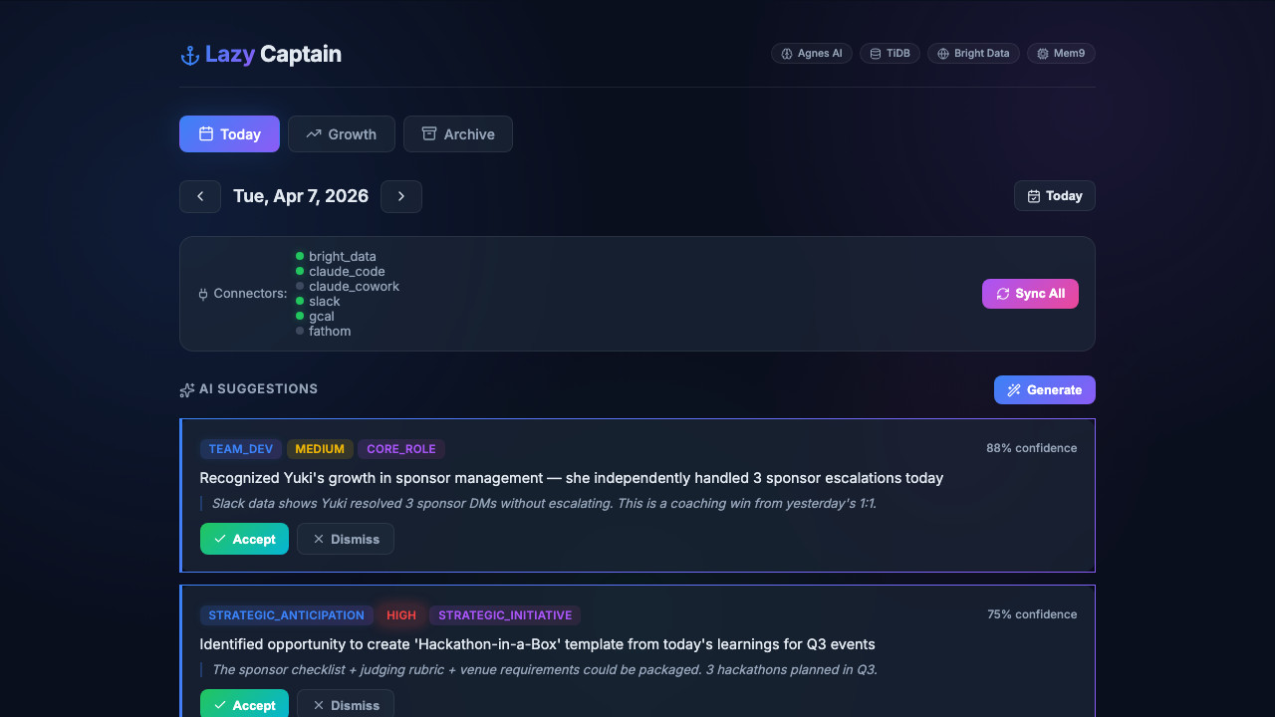
Lazy Captain
Your AI copilot for managerial impact
TEAMZ AI Hackathon 2026 | Tokyo

Slide 2

Your best work has no proof
You unblocked 3 teams today. Where's the receipt?
Decisions, coaching, alignment none leave an artifact.
Review time comes around: "What did I even do last quarter?"

Slide 3
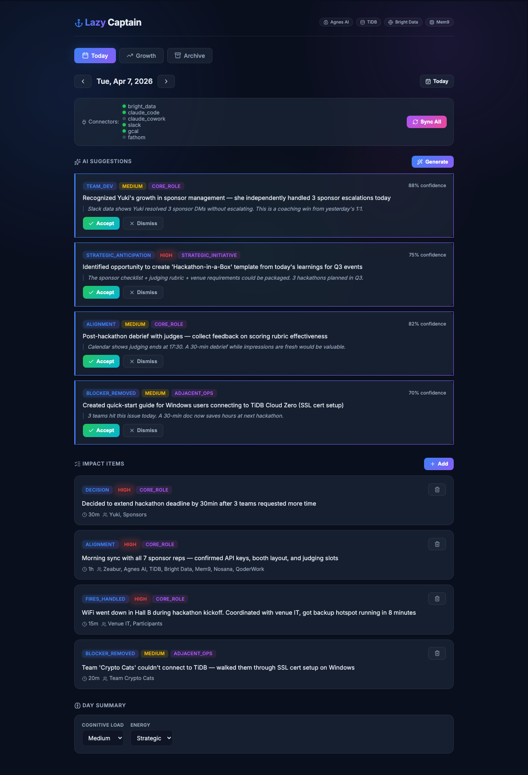
One place for everything you did
AI reads your tools
Calendar, Slack, web activity
Suggests impact items
You just approve, edit, or dismiss
7 categories
Decision | Blocker Removed | Alignment Structure | Team Dev | Strategic | Fires

Slide 4
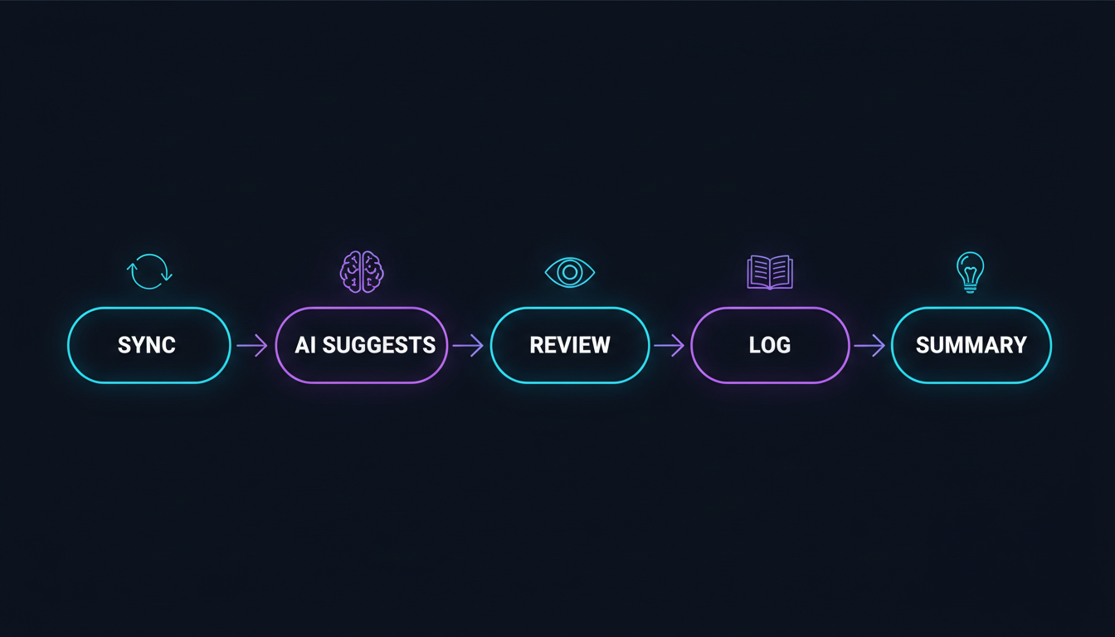
5 minutes. Done.
The daily workflow that runs itself
Connectors pull your data > AI analyzes patterns > You review suggestions > Impact log builds > Day summary auto-generated

Slide 5
It learns you
Accept
AI nailed it. One tap.
Edit
Close but not quite. Fix and save.
Dismiss
Not relevant. AI learns to skip next time.
Mem9 stores your preferences.
Suggestions sharpen over time.

Slide 6
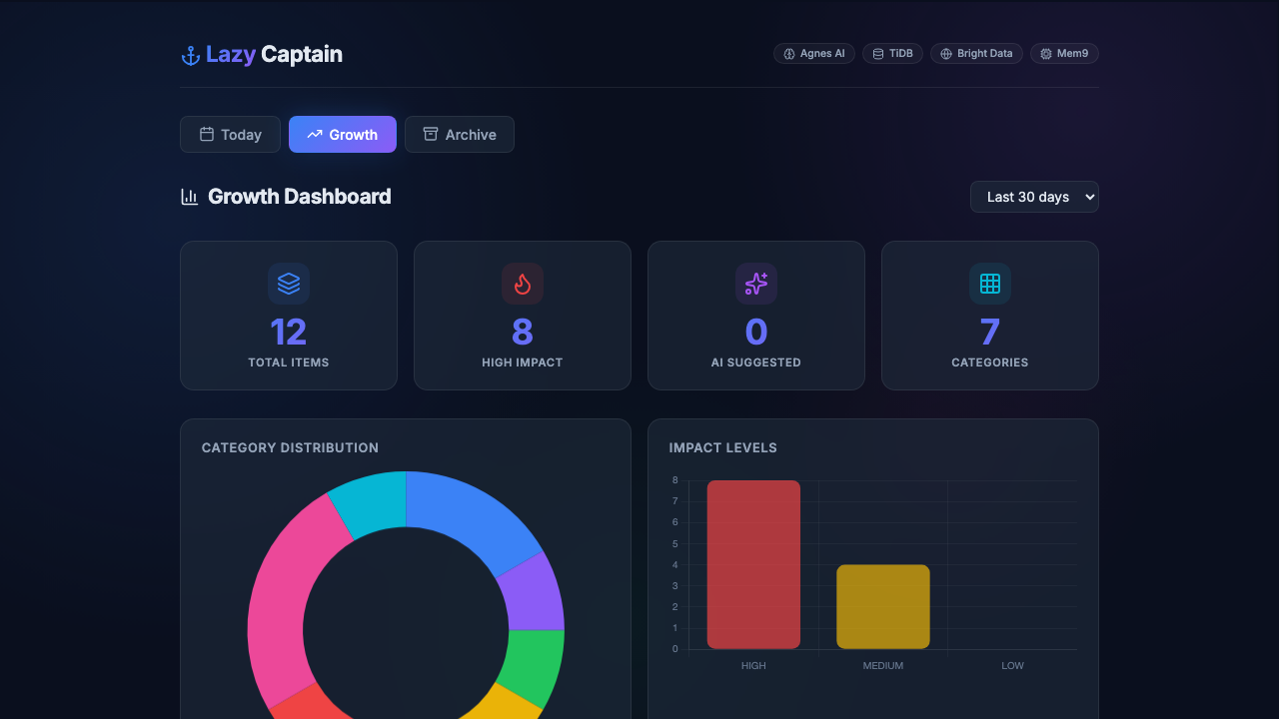
See your patterns
Category distribution | Impact trends | Scope tracking | Delegation scores

Slide 7
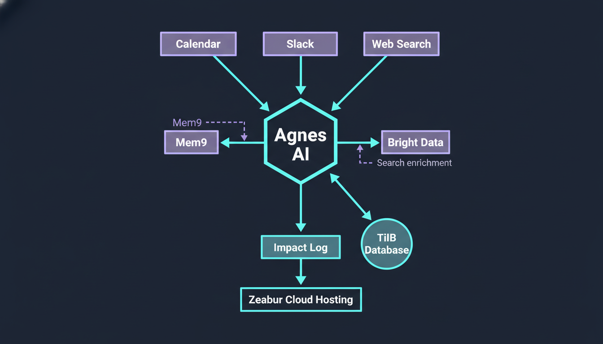
Built with 5 sponsor technologies
Agnes AI
LLM suggestion engine
TiDB Cloud Zero
Serverless MySQL database
Bright Data
SERP enrichment API
Mem9
Persistent learning memory
Zeabur
Cloud deployment platform
FastAPI + Vanilla JS + Python

Slide 8
Lazy Captain
Your AI copilot for managerial impact
Built at TEAMZ AI Hackathon 2026 | Tokyo
Agnes AI | TiDB | Bright Data | Mem9 | Zeabur

