Slide 1
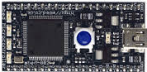
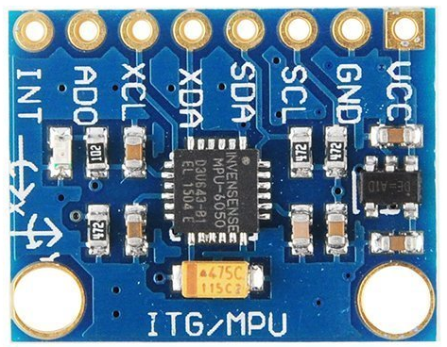
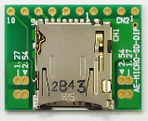
IMU sampling system
IMU Sampling System
MBED LPC1768
Power Source
5V
PC
I2C
SPI
MPU6050
Micro SD Card

Slide 2
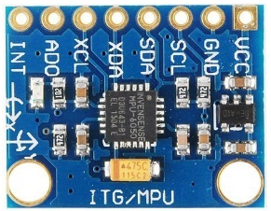








Coordinate System
Coordinate System
Inertial coordinate system { $i$ }
Object coordinate system { $b$ }
$$i_{2}$$
$$b_{2}$$
$$i_{1}$$
$$b_{1}$$
$$i_{3}$$
$$b_{3}$$

Slide 3
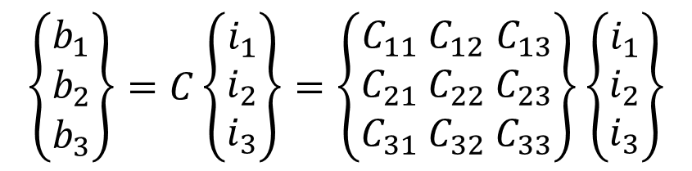

DCM : Direction Cosine Matrix
DCM
I define DCM $C$ as a transformation matrix from { $i$ } to { $b$ }
$$\left\{\begin{aligned}b_{1} \\ b_{2} \\ b_{3}\end{aligned}\right\}=C\left\{\begin{aligned}i_{1} \\ i_{2} \\ i_{3}\end{aligned}\right\}=\left\{\begin{aligned}C_{11} &C_{12}& C_{13} \\ C_{21} &C_{22}& C_{23} \\ C_{31} &C_{32}& C_{33}\end{aligned}\right\}\left\{\begin{aligned}i_{1} \\ i_{2} \\ i_{3}\end{aligned}\right\}$$
$$C^{−1}=C^{T}$$

