Slide 1
Program
Processing Flow
1. 100Hzでサンプリングした加速度と角速度のデータを読み取る.
2. ある時刻tにおける加速度・角速度の値を取得する.
3. バイアスを除いて, ローパスフィルタで平滑化する.
4. カルマンフィルタを適用してクオータニオンを計算する.
5. クオータニオンを正規化する.
6. クオータニオンからDCM, オイラー角を計算する.
7. 計算した姿勢データをファイルに出力する.

Slide 2
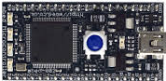
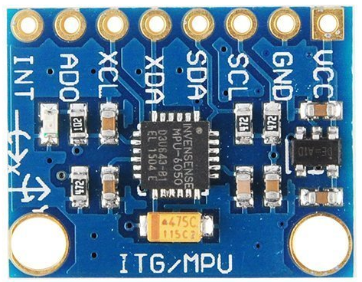
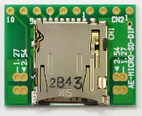
IMU sampling system
IMU Sampling System
MBED LPC1768
Power Source
5V
PC
I2C
SPI
MPU6050
Micro SD Card

Slide 3
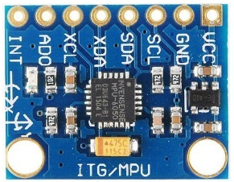









Coordinate System
Coordinate System
Inertial coordinate system { $i$ }
Object coordinate system { $b$ }
$$i_{2}$$
$$b_{2}$$
$$g$$
$$i_{1}$$
$$b_{1}$$
$$i_{3}$$
$$b_{3}$$

Slide 4
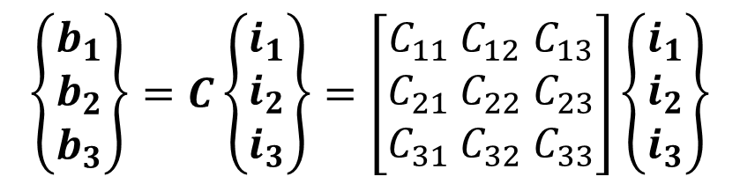

DCM : Direction Cosine Matrix
DCM
I define DCM $C$ as a transformation matrix from { $i$ } to { $b$ }
$$\left\{\begin{aligned}b_{1} \\ b_{2} \\ b_{3}\end{aligned}\right\}=C\left\{\begin{aligned}i_{1} \\ i_{2} \\ i_{3}\end{aligned}\right\}=\left[\begin{aligned}C_{11} &C_{12}& C_{13} \\ C_{21} &C_{22}& C_{23} \\ C_{31} &C_{32}& C_{33}\end{aligned}\right]\left\{\begin{aligned}i_{1} \\ i_{2} \\ i_{3}\end{aligned}\right\}$$
$$C^{−1}=C^{T}$$

Slide 5

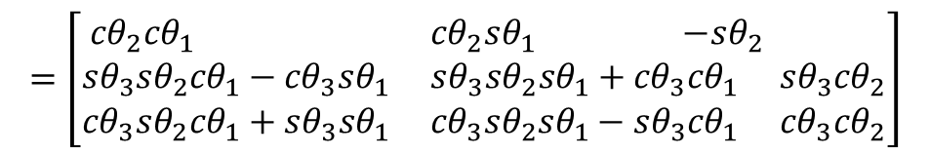



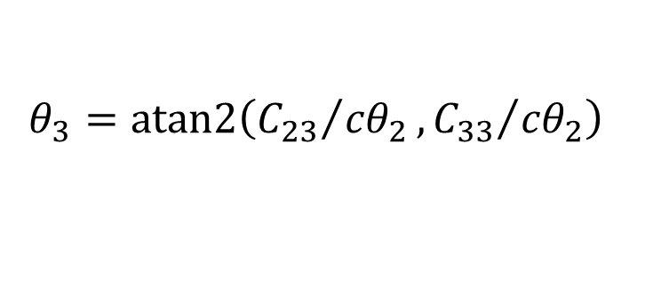

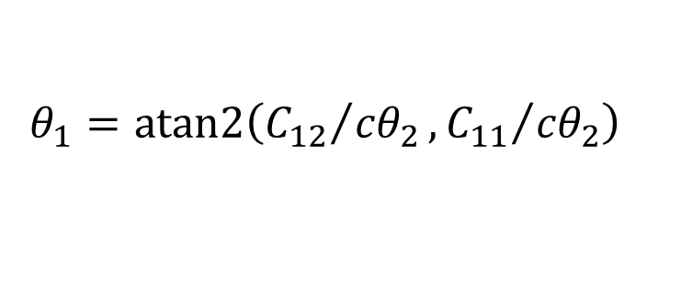


Euler angles ⇔ DCM
Euler angles DCM
I assume 3-2-1 system
$${sθ}_{i}=sinθ_{i}$$
$$C=C^{1}\left(θ_{3}\right)C^{2}\left(θ_{2}\right)C^{3}\left(θ_{1}\right)$$
$${cθ}_{i}=cosθ_{i}$$
$${cθ}_{2}{sθ}_{1}$$
$$=\left[\begin{aligned}{cθ}_{2}{cθ}_{1} &{cθ}_{2}{sθ}_{1} {−sθ}_{2} \\ {sθ}_{3}{sθ}_{2}{cθ}_{1}−{cθ}_{3}{sθ}_{1} &{sθ}_{3}{sθ}_{2}{sθ}_{1}+{cθ}_{3}{cθ}_{1} &{sθ}_{3}{cθ}_{2} \\ {cθ}_{3}{sθ}_{2}{cθ}_{1}+{sθ}_{3}{sθ}_{1} &{cθ}_{3}{sθ}_{2}{sθ}_{1}−{sθ}_{3}{cθ}_{1} &{cθ}_{3}{cθ}_{2}\end{aligned}\right]$$
$${cθ}_{2}{cθ}_{1}$$
$${−sθ}_{2}$$
Pitch :
$$θ_{2}=\sin^{−1}\left({−C}_{13}\right)$$
Yaw :
$$θ_{1}=atan2\left({C_{12}}/{{cθ}_{2}},{C_{11}}/{{cθ}_{2}}\right)$$
Roll :
$$θ_{3}=atan2\left({C_{23}}/{{cθ}_{2}},{C_{33}}/{{cθ}_{2}}\right)$$

Slide 6















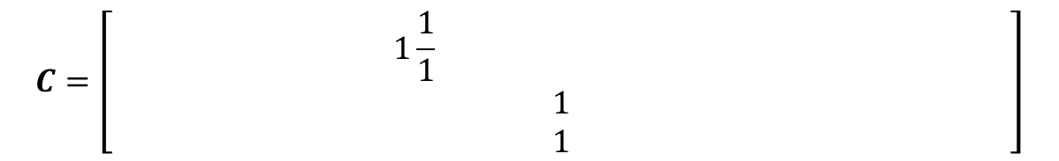

Quaternion ⇔ DCM
Quaternion DCM
I define Quaternion $q_{1}\sim q_{4}$ as bellow
$$q_{1}=λ_{1}sin\frac{θ}{2}$$
$$q_{2}=λ_{2}sin\frac{θ}{2}$$
$$q_{3}=λ_{3}sin\frac{θ}{2}$$
$$q_{4}=cos\frac{θ}{2}$$
$λ_{1}$: unit vector of direction of rotation
$θ$: rotation angle
$$C=\left[\begin{aligned} 1\frac{1}{1} \\ 1 \\ 1\end{aligned}\right]$$
$${q_{1}}^{2}−{q_{2}}^{2}−{q_{3}}^{2}+{q_{4}}^{2}$$
$$2\left(q_{1}q_{2}+q_{3}q_{4}\right)$$
$$2\left(q_{3}q_{1}−q_{2}q_{4}\right)$$
$$2\left(q_{1}q_{2}−q_{3}q_{4}\right)$$
$${q_{2}}^{2}−{q_{3}}^{2}−{q_{1}}^{2}+{q_{4}}^{2}$$
$$2\left(q_{2}q_{3}+q_{1}q_{4}\right)$$
$$2\left(q_{3}q_{1}+q_{2}q_{4}\right)$$
$$2\left(q_{2}q_{3}−q_{1}q_{4}\right)$$
$${q_{3}}^{2}−{q_{1}}^{2}−{q_{2}}^{2}+{q_{4}}^{2}$$
DCM to Quaternion : please refer [1]

Slide 7

















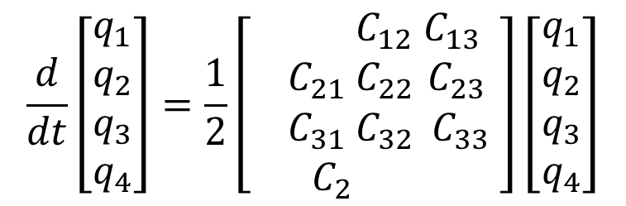





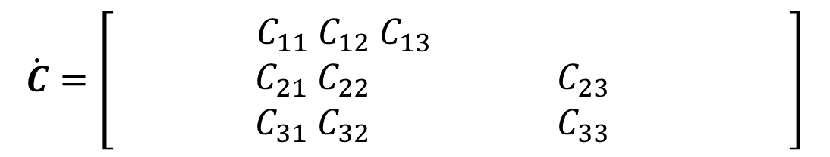





Angular velocity
Angular velocity DCM and Quaternion
I define Angular velocity $ω_{1}\sim ω_{3}$ and $\dot{C}$ as bellow
$$ω={\left\{b\right\}}^{T}\left[\begin{aligned}ω_{1} \\ ω_{2} \\ ω_{3}\end{aligned}\right]$$
$$\dot{C}=\left[\begin{aligned}\dot{C_{11}} &\dot{C_{12}}&\dot{C_{13}} \\ \dot{C_{21}} &\dot{C_{22}}&\dot{C_{23}} \\ \dot{C_{31}} &\dot{C_{32}}&\dot{C_{33}}\end{aligned}\right]$$
$$\dot{C}=\left[\begin{aligned}{ C}_{11} &C_{12}& C_{13 } \\ C_{21} &C_{22}& C_{23} \\ C_{31} &C_{32}& C_{33}\end{aligned}\right]$$
$$C_{21}ω_{3}−C_{31}ω_{2}$$
$$C_{22}ω_{3}−C_{32}ω_{2}$$
$$C_{23}ω_{3}−C_{33}ω_{2}$$
$$C_{31}ω_{1}−C_{11}ω_{3}$$
$$C_{32}ω_{1}−C_{12}ω_{3}$$
$$C_{33}ω_{1}−C_{13}ω_{3}$$
$$C_{11}ω_{2}−C_{21}ω_{1}$$
$$C_{12}ω_{2}−C_{22}ω_{1}$$
$$C_{13}ω_{2}−C_{23}ω_{1}$$
$$\frac{d}{dt}\left[\begin{aligned}q_{1} \\ q_{2} \\ q_{3} \\ q_{4}\end{aligned}\right]=\frac{1}{2}\left[\begin{aligned} &C_{12}& C_{13} \\ { C}_{21} &C_{22}& C_{23} \\ C_{31} &C_{32}& C_{33} \\ C_{2}\end{aligned}\right]\left[\begin{aligned}q_{1} \\ q_{2} \\ q_{3} \\ q_{4}\end{aligned}\right]$$
$$0$$
$$ω_{3}$$
$${−ω}_{2}$$
$$ω_{1}$$
$${−ω}_{3}$$
$$0$$
$$ω_{1}$$
$$ω_{2}$$
$$ω_{2}$$
$${−ω}_{1}$$
$$0$$
$$ω_{3}$$
$${−ω}_{1}$$
$${−ω}_{2}$$
$${−ω}_{3}$$
$$0$$

Slide 8
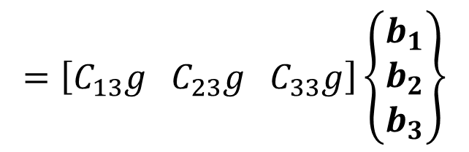
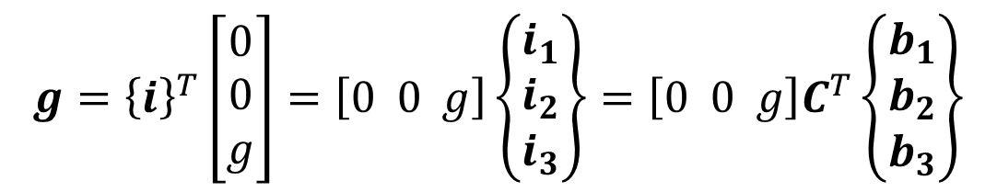
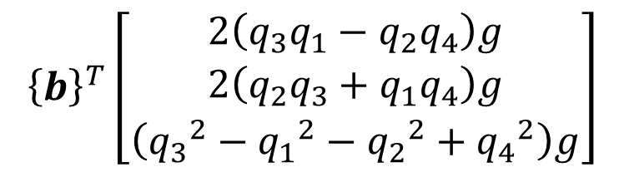

Gravity Vector in { b }
Gravity Vector in { b }
$$g={\left\{i\right\}}^{T}\left[\begin{aligned}0 \\ 0 \\ g\end{aligned}\right]=\left[0 0 g\right]\left\{\begin{aligned}i_{1} \\ i_{2} \\ i_{3}\end{aligned}\right\}=\left[0 0 g\right]C^{T}\left\{\begin{aligned}b_{1} \\ b_{2} \\ b_{3}\end{aligned}\right\}$$
$$=\left[C_{13}g C_{23}g{ C}_{33}g\right]\left\{\begin{aligned}b_{1} \\ b_{2} \\ b_{3}\end{aligned}\right\}$$
$$={\left\{b\right\}}^{T}\left[\begin{aligned}C_{13}g \\ C_{23}g \\ C_{33}g\end{aligned}\right]$$
$${\left\{b\right\}}^{T}\left[\begin{aligned}2\left(q_{3}q_{1}−q_{2}q_{4}\right)g \\ 2\left(q_{2}q_{3}+q_{1}q_{4}\right)g \\ \left({q_{3}}^{2}−{q_{1}}^{2}−{q_{2}}^{2}+{q_{4}}^{2}\right)g\end{aligned}\right]$$
or

Slide 9




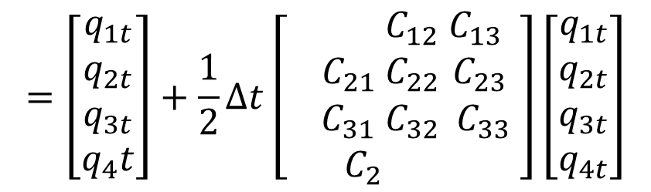



























Discretization of Quaternion
Discretization of Quaternion
$$q_{t+1}=q_{t}+\dot{q_{t}}×∆t$$
$$=\left[\begin{aligned}q_{1t} \\ q_{2t} \\ q_{3t} \\ q_{4}t\end{aligned}\right]+\frac{1}{2}∆t\left[\begin{aligned} &C_{12}& C_{13} \\ { C}_{21} &C_{22}& C_{23} \\ C_{31} &C_{32}& C_{33} \\ C_{2}\end{aligned}\right]\left[\begin{aligned}q_{1t} \\ q_{2t} \\ q_{3t} \\ q_{4t}\end{aligned}\right]$$
$$0$$
$$ω_{3}$$
$${−ω}_{2}$$
$$ω_{1}$$
$${−ω}_{3}$$
$$0$$
$$ω_{1}$$
$$ω_{2}$$
$$ω_{2}$$
$${−ω}_{1}$$
$$0$$
$$ω_{3}$$
$${−ω}_{1}$$
$${−ω}_{2}$$
$${−ω}_{3}$$
$$0$$
$$={\left[\begin{aligned}\begin{aligned} &C_{12}& C_{13} \\ { C}_{21} &C_{22}& C_{23} \\ C_{31} &C_{32}& C_{33} \\ C_{2}\end{aligned} \\ \end{aligned}\right]q}_{t}$$
$$1$$
$$\frac{1}{2}∆tω_{3}$$
$${−\frac{1}{2}∆tω}_{2}$$
$${\frac{1}{2}∆tω}_{1}$$
$${−\frac{1}{2}∆tω}_{3}$$
$$1$$
$${\frac{1}{2}∆tω}_{1}$$
$${\frac{1}{2}∆tω}_{2}$$
$${\frac{1}{2}∆tω}_{2}$$
$${−\frac{1}{2}∆tω}_{1}$$
$$1$$
$${\frac{1}{2}∆tω}_{3}$$
$${−\frac{1}{2}∆tω}_{1}$$
$${−\frac{1}{2}∆tω}_{2}$$
$${−\frac{1}{2}∆tω}_{3}$$
$$1$$

Slide 10
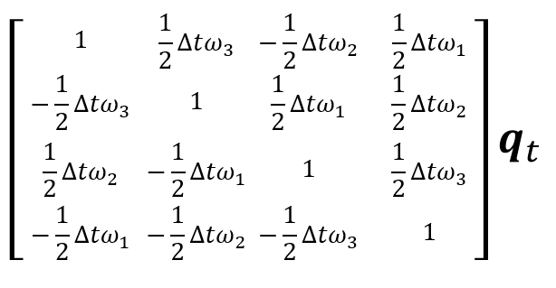



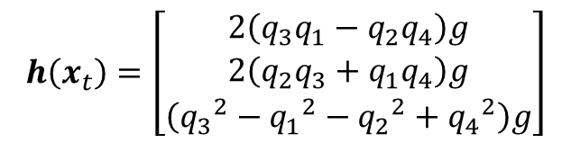






Equation of State
Equation of State
$$x_{t+1}=f\left(x_{t}\right)+w_{t}$$
$$E\left[{w_{t}}^{2}\right]=Q$$
$$y_{t}=h\left(x_{t}\right)+ν_{t}$$
$$E\left[{ν_{t}}^{2}\right]=R$$
$$x_{t}=\left[\begin{aligned}q_{1t} \\ q_{2t} \\ q_{3t} \\ q_{4}t\end{aligned}\right]$$
$$y_{t}=\left[\begin{aligned}a_{xt} \\ a_{yt} \\ a_{zt}\end{aligned}\right]$$
$$Q=\left[\begin{aligned}Q_{1}& 0 & 0 & 0 \\ 0 & Q_{2}& 0 & 0 \\ 0 & 0 & Q_{3}& 0 \\ 0 & 0 & 0 & Q_{4}\end{aligned}\right]$$
$$R=\left[\begin{aligned}R_{1}& 0 & 0 \\ 0 & R_{2}& 0 \\ 0 & 0 & R_{3}\end{aligned}\right]$$
$$h\left(x_{t}\right)=\left[\begin{aligned}2\left(q_{3}q_{1}−q_{2}q_{4}\right)g \\ 2\left(q_{2}q_{3}+q_{1}q_{4}\right)g \\ \left({q_{3}}^{2}−{q_{1}}^{2}−{q_{2}}^{2}+{q_{4}}^{2}\right)g\end{aligned}\right]$$
$$f\left(x_{t}\right)=$$

Slide 11
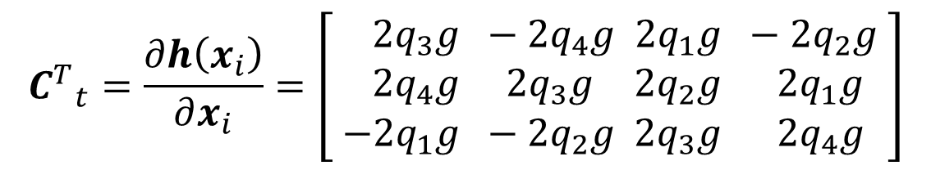

Jacobian Matrix
Jacobian Matrix
$$A_{t}=\frac{∂f\left(x_{i}\right)}{∂x_{i}}=$$
$${C^{T}}_{t}=\frac{∂h\left(x_{i}\right)}{∂x_{i}}=\left[\begin{aligned}2q_{3}g & −2q_{4}g & 2q_{1}g & −2q_{2}g \\ 2q_{4}g & 2q_{3}g & 2q_{2}g & 2q_{1}g \\ −2q_{1}g & −2q_{2}g & 2q_{3}g & 2q_{4}g\end{aligned}\right]$$

Slide 12










EKF Algorithm
EKF Algorithm
$$t=1, 2, 3 … N$$
Prediction Step :
$${\hat{x^{−}}}_{t}=f\left({\hat{x}}_{t−1}\right)$$
$$A_{t−1}=\frac{∂f\left(x\right)}{∂x}$$
$${C^{T}}_{t}=\frac{∂h\left(x\right)}{∂x}$$
$${x=\hat{x}}_{t−1}$$
$$x={\hat{x^{−}}}_{t}$$
$${P^{−}}_{t}=A_{t−1}P_{t−1}{A^{T}}_{t−1}+Q$$
Filtering Step :
$$g_{t}={P^{−}}_{t}C_{t}{\left({C^{T}}_{t}{P^{−}}_{t}C_{t}+R\right)}^{−1}$$
$${\hat{x}}_{t}={\hat{x^{−}}}_{t}+g_{t}\left\{y_{t}−h\left({\hat{x^{−}}}_{t}\right)\right\}$$
$$P_{t}=\left\{I−g_{t}{C^{T}}_{t}\right\}{P^{−}}_{t}$$

Slide 13




Initial Values
Initial Values
$${\hat{x}}_{0}=\left[\begin{aligned}0 \\ 0 \\ 0 \\ 1.0\end{aligned}\right]$$
$$P=\left[\begin{aligned}0.01& 0 & 0 & 0 \\ 0 & 0.01& 0 & 0 \\ 0 & 0 & 0.01& 0 \\ 0 & 0 & 0 & 0.01\end{aligned}\right]$$
$$Q=\left[\begin{aligned}0.01& 0 & 0 & 0 \\ 0 & 0.01& 0 & 0 \\ 0 & 0 & 0.01& 0 \\ 0 & 0 & 0 & 0.01\end{aligned}\right]$$
$$R=\left[\begin{aligned}1.0& 0 & 0 \\ 0 & 1.0& 0 \\ 0 & 0 & 10.0\end{aligned}\right]$$

