Slide 1

Beyond the decision tree.
Meet Bookly.
A voice-native retail concierge that completes the shopping journey while the storefront responds in real time.
VOICE + VISUAL UI + DETERMINISTIC TOOLS | SECURE BY DESIGN
Notes:
Open on the problem: most AI support experiences are still decision trees with a language layer.
Bookly demonstrates an end-to-end retail concierge across discovery, purchase, and service.
[Sources]
- User-provided product framing and the local Bookly implementation.

Slide 2

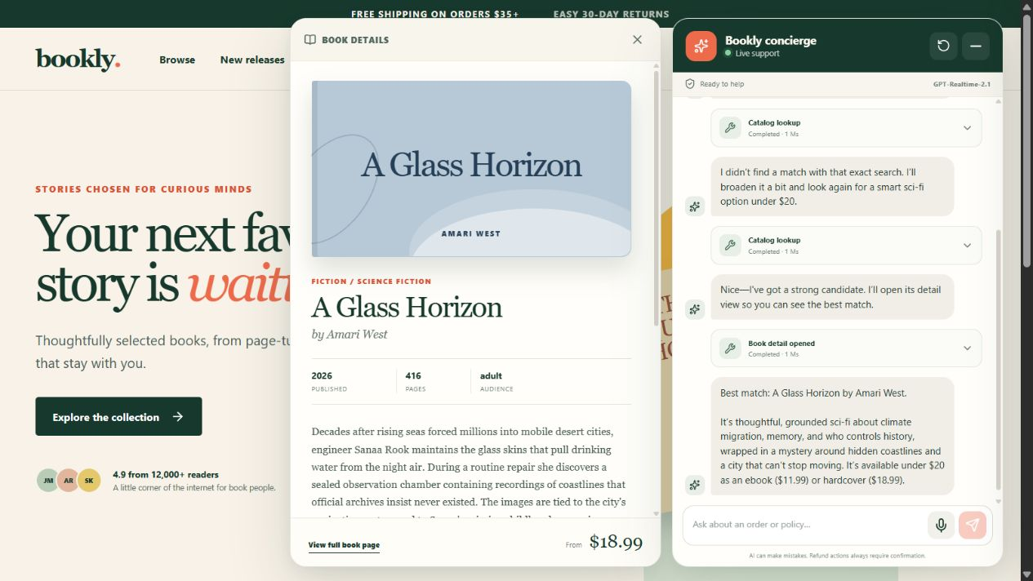
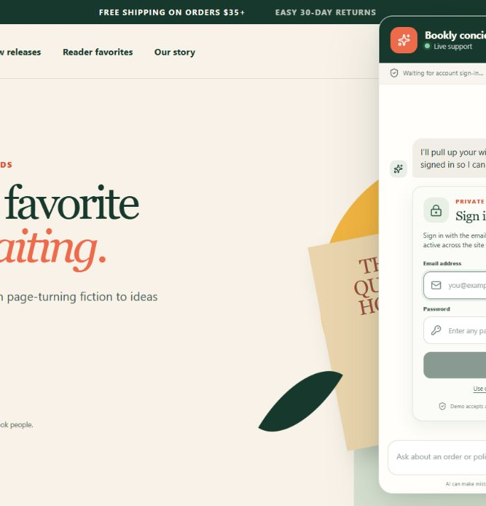
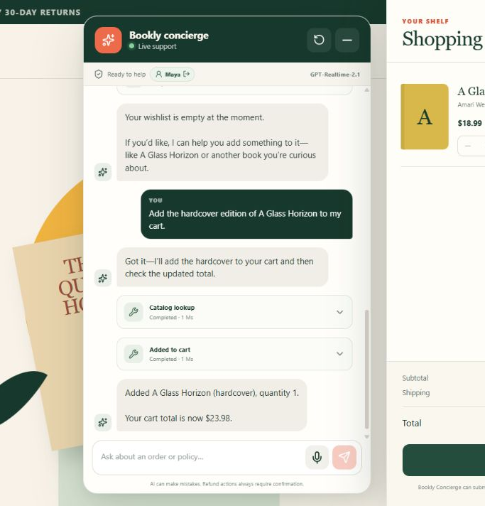
BOOKLY WIDGET
Conversation becomes visible action
DISCOVER + EXPLAIN
PROTECT IDENTITY
ACT + REFLECT
Searches semantically, opens the exact book, and keeps the conversation in context.
Pauses for a browser-owned form; the model never receives the password.
Executes the cart mutation, then updates the visible bag and total.
DECAGON
02
Notes:
Walk left to right: multimodal discovery, private account access, and a visible transactional result.
Voice and text share the same typed tool surface; the page provides visual confirmation for every action.
[Sources]
- First-party screenshots captured from the local Bookly application on 2026-08-14.

Slide 3
RUNTIME ARCHITECTURE
Natural conversation. Deterministic execution.
CUSTOMER EXPERIENCE
REALTIME ORCHESTRATION
SERVER CONTROL PLANE
STATE + RETRIEVAL
signed session
Domain executors
LanceDB
Private inline sign-in
/api/realtime
commerce · resolution · support
RAG
prefiltered policy + catalog RAG
credentials never enter chat
server key · SDP answer
Guarded action engine
transaction
SDP
ownership · policy · quote · revalidation
History + trace writer
SQLite
Bookly widget
Session contract
input/output · status · latency
trace
customers · orders · carts · quotes
history · audit · refunds · cases
UI · event relay · tool cards
prompt · 29 schemas · semantic VAD
Session resolver
WebRTC
signed HttpOnly cookie + sessionId
Customer
GPT-Realtime-2.1
/api/tools
same contracts
Production adapters
text · voice · interruption
dialogue · tool choice · arguments
widget relay
Zod envelope · callId · safe errors
identity · OMS · payments · fulfillment
DECAGON
03
Notes:
The model selects a tool and produces arguments; the current browser widget relays the request to /api/tools.
The server resolves the signed browser session, validates the envelope, executes deterministic domain logic, and writes the trace.
[Sources]
- Local Bookly application architecture and repository.
- https://developers.openai.com/api/docs/guides/realtime-conversations

Slide 4
TOOL CALL LIFECYCLE
GPT requests; Bookly executes.
WebRTC keeps the conversation live while deterministic server code owns trust and consequences.
01
02
03
04
Connect
Request
Execute
Respond
Browser posts SDP
WebRTC carries audio + events
GPT-Realtime emits
name · args · call_id
Widget relays to /api/tools
server validates + runs
function_call_output returns
voice + UI update
DECAGON
04
Notes:
Clarify the responsibility split: GPT-Realtime proposes the tool call; it does not execute Bookly's HTTP endpoint.
The widget is the current event bridge. The server is the trust and execution boundary.
[Sources]
- Local Bookly ChatWidget and /api/tools implementation.
- https://developers.openai.com/api/docs/guides/realtime-conversations

Slide 5
ENTERPRISE TOOL SURFACE
One agent spans the customer journey
08
Discover + navigate
search_catalog / get_book / open_book / navigate
05
Identify + personalize
authenticate_customer / wishlist CRUD / stock alerts
10
Transact + resolve
cart CRUD / checkout / orders / returns / refunds
06
Learn + escalate
policy RAG / cases / handoff / service recovery
DECAGON
05
Notes:
The point is not the individual tools; it is one agent applying the same conversation, identity, and policy context across the journey.
The 29 typed tools are grouped into customer outcomes rather than separate task-specific bots.
[Sources]
- Local Bookly tool registry and existing L200 deck.

Slide 6
GUARDED ACTION + PII PATTERN
Deterministic code owns every action
Private UI, typed schemas, and server checks constrain every consequential action.
01
02
03
04
Authenticate
Prepare
Confirm
Commit
Private form → signed session
No credentials in chat
Schema + server identity
Ownership · policy · quote
Exact action is rendered
Customer approves next turn
Revalidate token + state
Execute · trace · audit
DECAGON
06
Notes:
Sensitive input belongs in browser-owned forms, like a password field. The agent sees only the resulting authenticated session.
Schemas constrain shape; server-side identity, ownership, policy, state, and explicit confirmation constrain authority.
[Sources]
- Local Bookly authentication, tool schema, and guarded-action implementation.

Slide 7
PRODUCTION PATH
Server-side control comes first
Why it matters
1
Today
Browser owns the WebRTC media path and currently relays function calls. The server already owns bootstrap, authorization, tools, and state.
enforcement plane
Production target
Keep WebRTC direct for media. Add a sideband connection to the same Realtime session so the server handles tool calls end to end.
Auth · schemas · approvals · traces · rate limits · PII · idempotency
DECAGON
07
Notes:
This preserves the lowest-latency browser media path while moving orchestration to a durable control plane.
The sideband server connection can receive model tool calls, run business logic, and return tool outputs to the same session.
[Sources]
- https://developers.openai.com/api/docs/guides/realtime-server-controls
- Local Bookly /api/realtime and /api/tools implementation.

Slide 8
NEXT EVOLUTION
Every interaction improves the next
What compounds
1
CRM + account layer
Connect identity, orders, service history, loyalty, and preferences through production CRM and richer account pages.
evolving customer model
Knowledge graph
Link customer ↔ genre ↔ theme ↔ author ↔ format ↔ inventory to turn search into guided discovery.
Consent-aware memory · cross-channel continuity · recommendations that improve over time
DECAGON
08
Notes:
The next step is not another single-purpose tool. It is a governed customer context layer that compounds across discovery, purchase, and care.
CRM and account integrations supply durable enterprise context; the knowledge graph connects customer taste to the available catalog and inventory.
[Sources]
- User-provided roadmap direction and local Bookly implementation.

