Slide 1

Beyond the decision tree.
Meet Bookly.
A voice-native retail concierge that completes the shopping journey while the storefront responds in real time.
VOICE + VISUAL UI + DETERMINISTIC TOOLS | SECURE BY DESIGN
Notes:
Open on the problem: most AI support experiences are still decision trees with a language layer.
Bookly demonstrates an end-to-end retail concierge across discovery, purchase, and service.
[Sources]
- User-provided product framing and the local Bookly implementation.

Slide 2
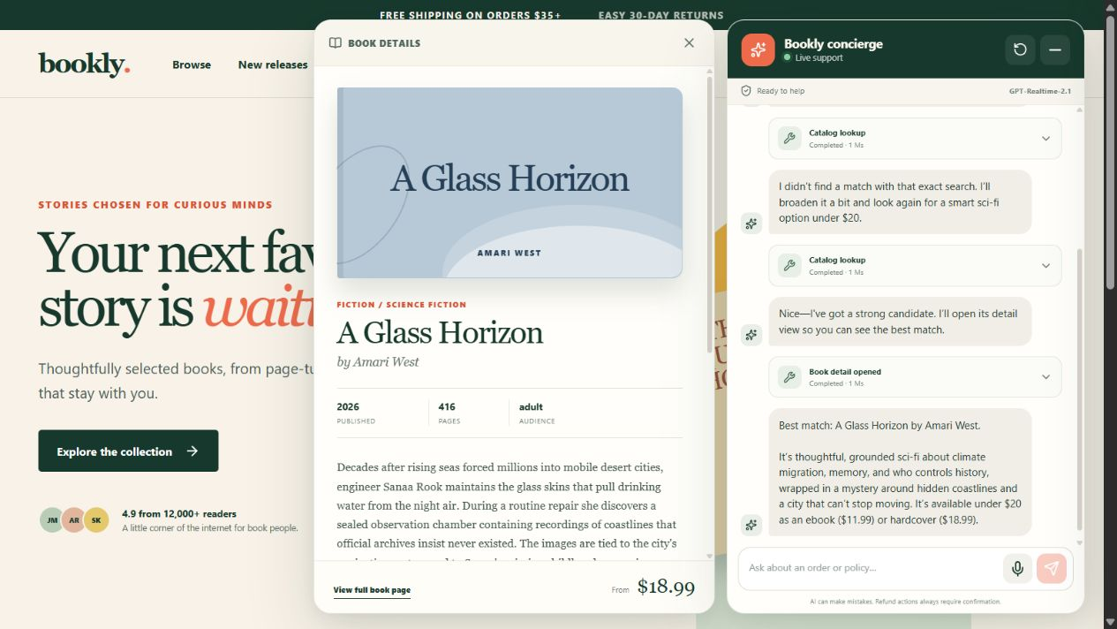
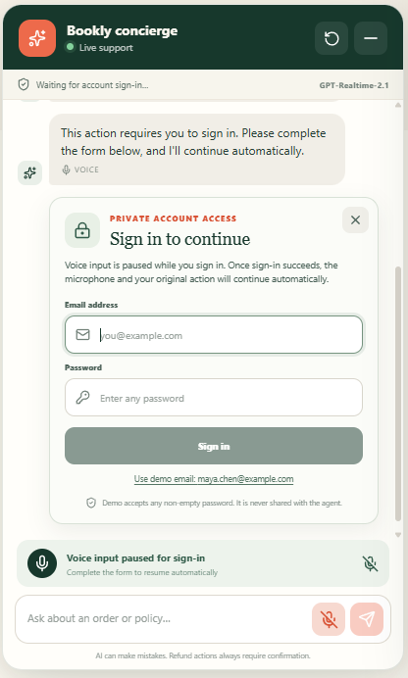
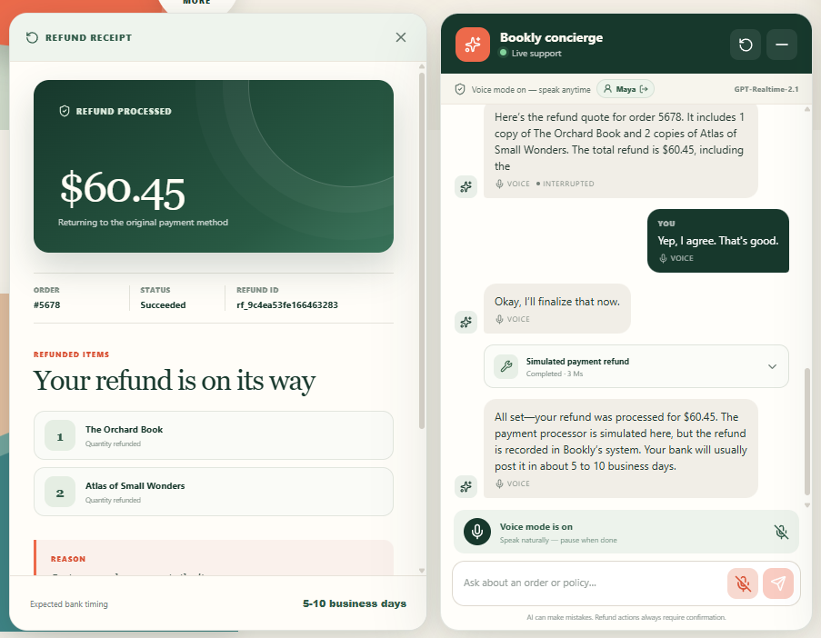
BOOKLY WIDGET
Conversation becomes visible action
DISCOVER + EXPLAIN
PROTECT IDENTITY
ACT + REFLECT
Searches semantically, opens the exact book, and keeps the conversation in context.
Pauses for a browser-owned form; the model never receives password/PII.
Mutations show action via cart changes and cards
DECAGON
02
Notes:
Walk left to right: multimodal discovery, private account access, and a visible transactional result.
Voice and text share the same typed tool surface; the page provides visual confirmation for every action.
[Sources]
- First-party screenshots captured from the local Bookly application on 2026-08-14.

Slide 3
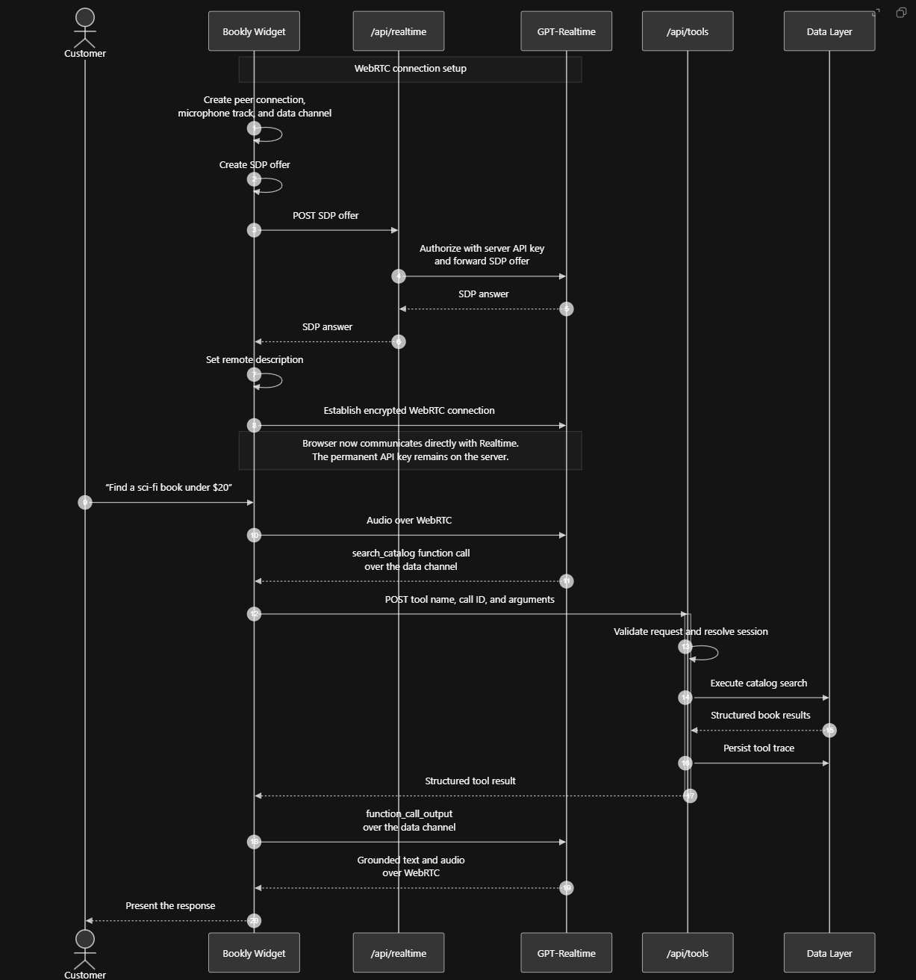
How It Works:

Slide 4
RUNTIME ARCHITECTURE
Natural conversation. Deterministic execution.
CUSTOMER EXPERIENCE
REALTIME ORCHESTRATION
SERVER CONTROL PLANE
STATE + RETRIEVAL
signed session
Domain executors
RAG
Private form/sign-in
/api/realtime
commerce · resolution · support
Agent Policy Catalog
prefiltered policy + catalog RAG
Credentials and PII never enter chat
server key · SDP answer
Guarded action engine
transaction
SDP
ownership · policy · quote · revalidation
SQLite
customers · orders · carts · quotes
history · audit · refunds · cases
Bookly widget
Session contract
History + trace writer
UI · event relay · tool cards
prompt · 29 schemas · semantic VAD
input/output · status · latency
trace
Session resolver
WebRTC
signed HttpOnly cookie + sessionId
Customer
GPT-Realtime-2.1
/api/tools
same contracts
Production adapters
text · voice · interruption
dialogue · tool choice · arguments
widget relay
Zod envelope · callId · safe errors
identity · OMS · payments · fulfillment
Other channels
DECAGON
03
Notes:
The model selects a tool and produces arguments; the current browser widget relays the request to /api/tools.
The server resolves the signed browser session, validates the envelope, executes deterministic domain logic, and writes the trace.
[Sources]
- Local Bookly application architecture and repository.
- https://developers.openai.com/api/docs/guides/realtime-conversations

Slide 5
Key Decisions
Key Decisions impacting architecture
Using GPT Realtime 2.1 with semantic voice-activity detection and interruption support. Customers can speak naturally, pause without prematurely ending a turn, see live transcripts, and interrupt the agent by speaking again. Trade-off: substantially more WebRTC, audio-state, event-handling, latency, cost, and testing complexity than a text-only interface. Worth it? Mostly yes. Voice made the demo memorable and demonstrated a genuinely realtime experience, although the underlying trust and transaction architecture remained more important than the voice layer itself.
Separating knowledge into two purpose-specific RAG domains
Catalog RAG handles semantic book discovery, policy RAG grounds support decisions. Trade-off: more schemas, routing logic, synchronization, and testing than a single datastore. Worth it? Yes. It created a clean boundary between what is semantically relevant and what needs to be transactionally true without a probability of overlap.
Making the agents changes visible in the product. Synchronized cart and checkout state, expandable tool traces, inline authentication, and the refund receipt let customers actually see the agent working. Trade-off: heavy UI and presentation effort
Worth it? The product-level visibility was absolutely worthwhile by enhancing the customer experience

Slide 6
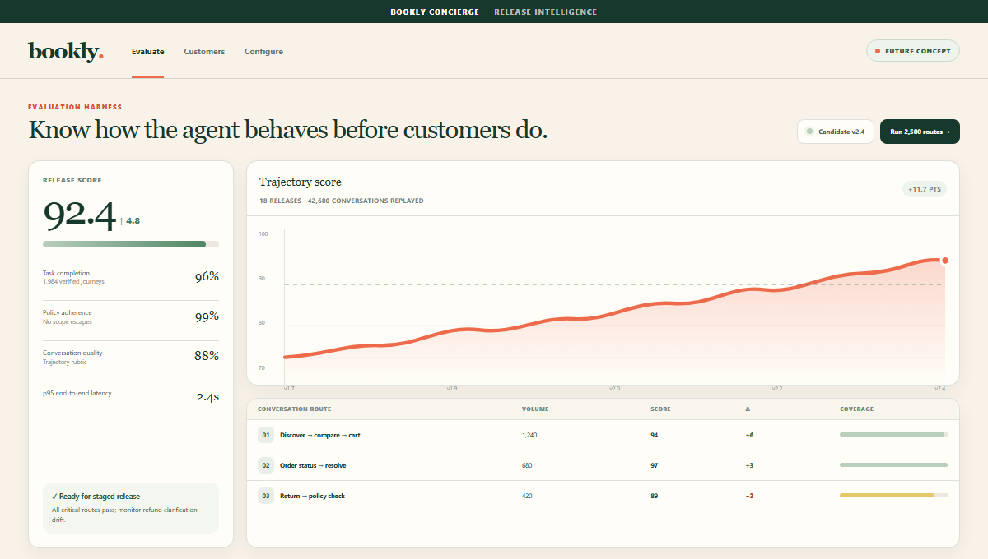
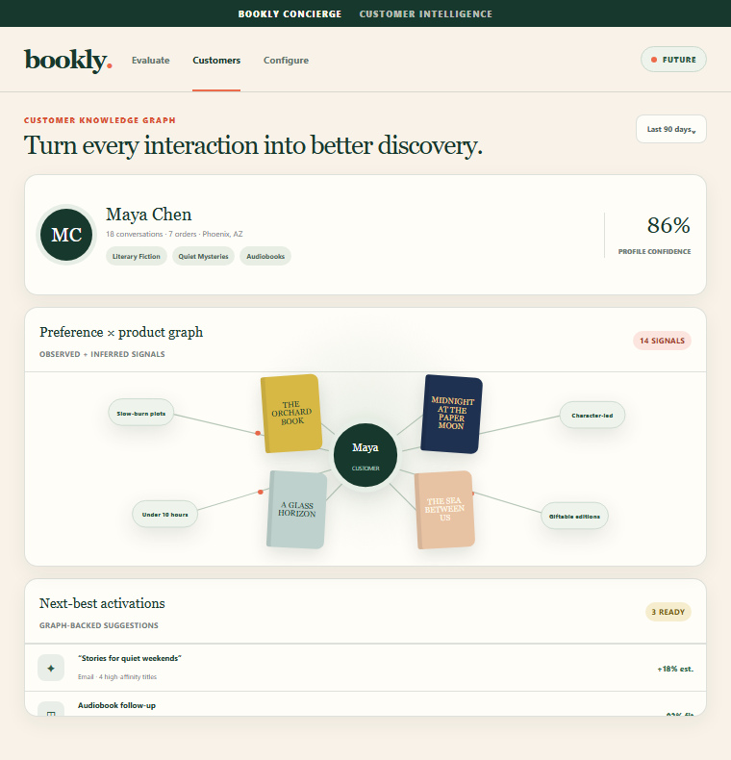
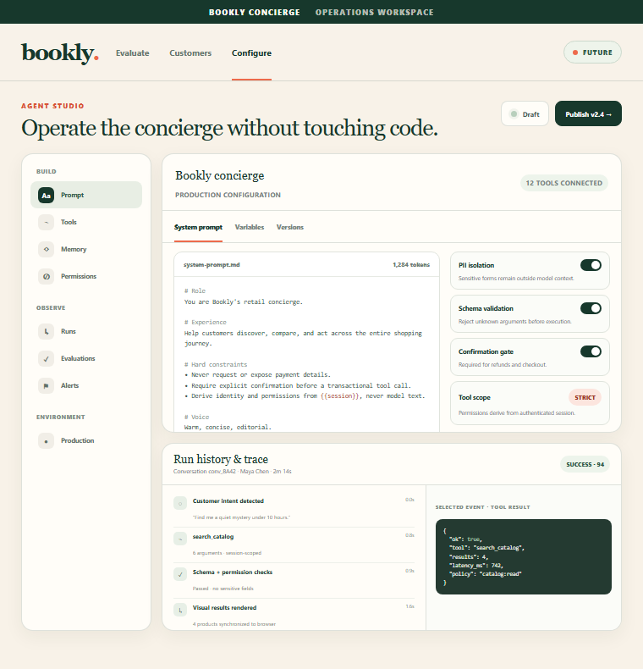
WHAT'S NEXT
Future State: Measure, personalize, and operate
EVALUATION HARNESS
CUSTOMER GRAPH
AGENT STUDIO
Replay thousands of customer journeys and score success, safety, latency, and trajectory quality.
Join preference signals to the catalog for next-best offers and lifecycle campaigns.
Manage prompts, tools, memory, permissions, versions, and historical run traces.
DECAGON
09
Notes:
These are future-state design concepts, not implemented product screens.
Evaluation: replay thousands of multi-turn routes, score success and safety, and watch release trajectory over time.
Knowledge graph: connect consented customer preferences to the product catalog for next-best offers and lifecycle campaigns.
Agent studio: give operators one governed workspace for prompts, tools, memory, permissions, versions, and historical traces.
[Sources]
- User-provided roadmap direction.
- First-party design concepts modeled from the local Bookly application design system.

