Slide 1

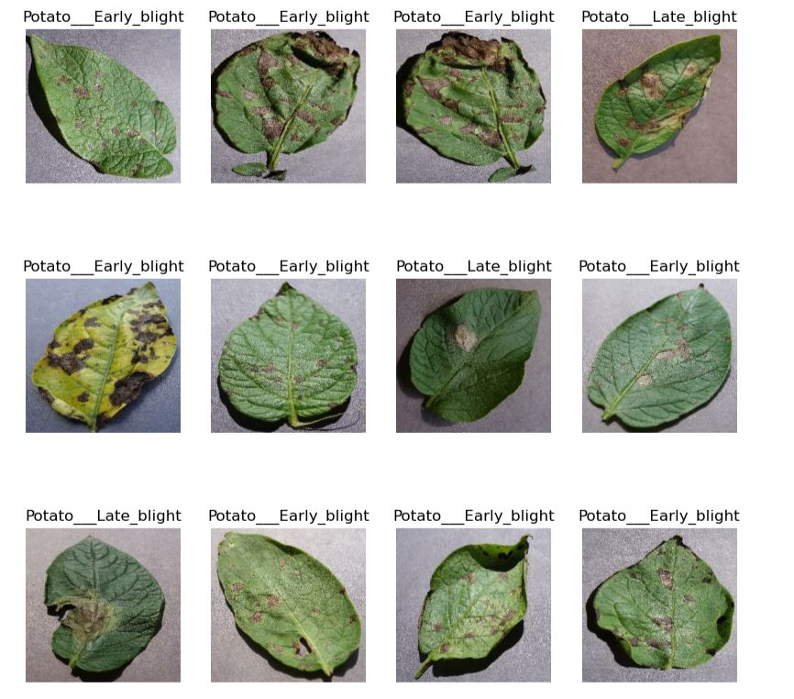
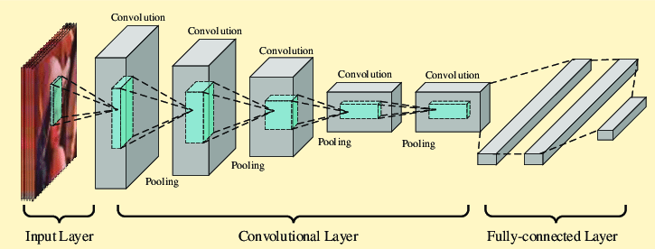
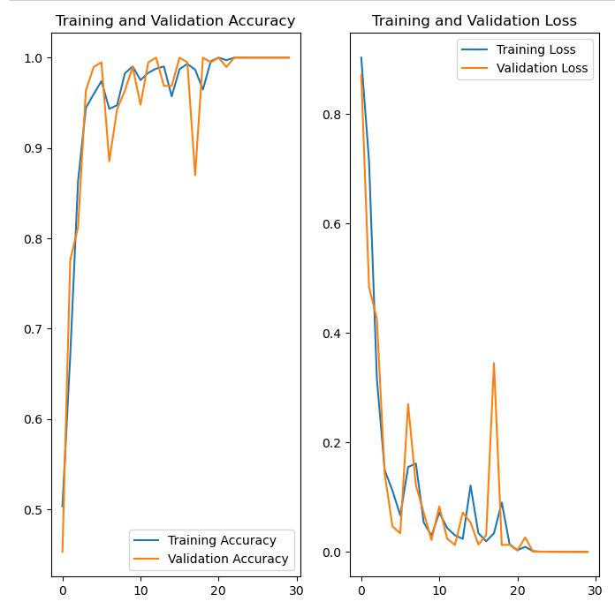
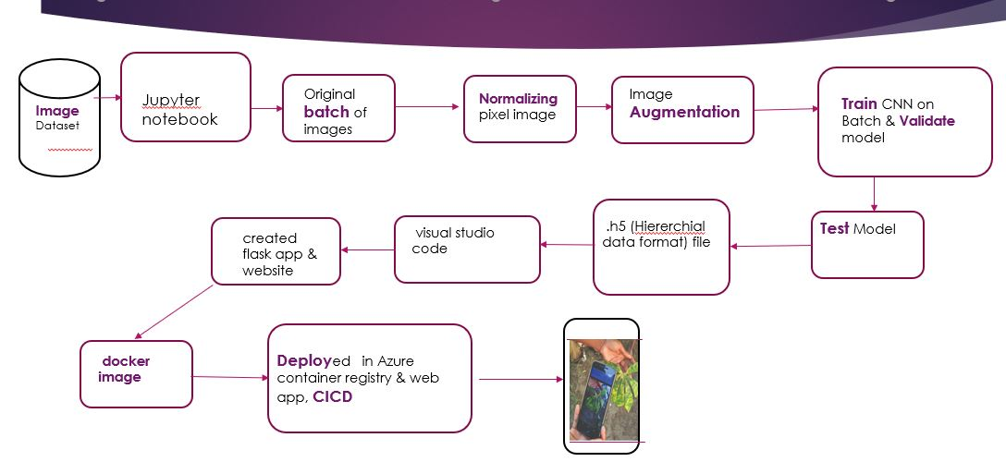







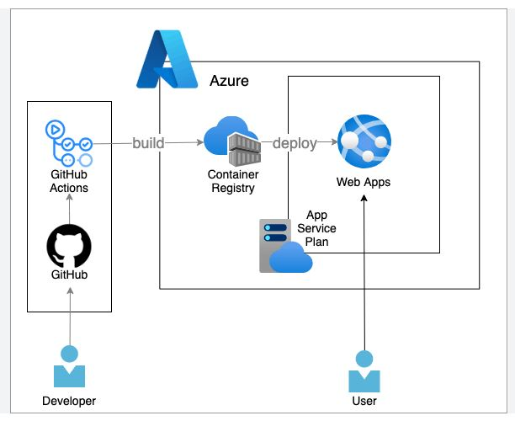

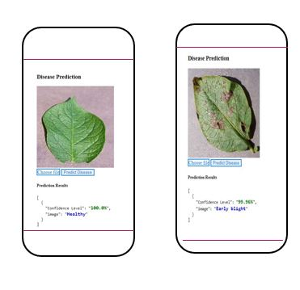
Bridging Agriculture and AI: Using ML for Potato Plant Disease Detection from Leaves.
-NirajKC- DataScience / AITC
Introduction:
CNN ARCHITECTURE:
Why AI/ML ?
Early Detection
Accurate Diagnosis
Real-Time Monitoring.
Reduced Manual Labor.
Data-Driven Insights
Scalability
Cost-Efficiency: Initially require investment but later save cost.
Environmental Benefits: reduce excessive pesticide and chemical use through more targeted treatments.
(https://www.kaggle.com/datasets/arjuntejaswi/plant-village)
Dataset has 2152 files belonging to 3 classes: Early blight, Late blight & Healthy.
Data source:
Accuracy rate- 99%, 30-epoch
Flow Diagram:
Tools Used:
URL : https://potatoapp1.azurewebsites.net/
References:
https://www. Datta Meghe College of Engineering, Airoli, New Mumbai, Maharashtra, India, & Students, Computer Engineering, Datta Meghe College of Engineering, Airoli, New Mumbai, Maharashtra, India. (2022). Plant Disease Detection using Convolution Neural Network (CNN). International Research Journal of Engineering and Technology (IRJET), 09(05), 1309.
https://www.ers.usda.gov/data-products/ag-and-food-statistics-charting-the-essentials/ag-and-food-sectors-and-the-economy.aspx
https://www.researchgate.net/publication/331442449_A_business_application_of_RTLS_technology_in_Intelligent_Retail_Environment_Defining_the_shopper's_preferred_path_and_its_segmentation
https://www.kaggle.com/datasets/arjuntejaswi/plant-village)kaggle.com/datasets/arjuntejaswi/plant-village)

