Slide 1
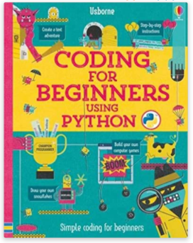
Note to user
The following book was very helpful in formulating this Python course.
https://www.amazon.co.uk/Coding-Beginners-Using-Python/dp/1409599345/ref=sr_1_19?crid=21MCPE5YA16RO&dchild=1&keywords=python+for+kids&qid=1599228943&sprefix=python%2Caps%2C148&sr=8-19

Slide 2
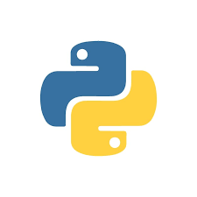
Coding with Python
Asking for user inputs

Slide 3
Recap
Last week…
You typed sentences in Python.
You calculated sums in Python.
You wrote and saved a Python program.
Notes:
Recap over key terms, syntax and debugging

Slide 4
In this week’s tutorial, we will
This week…
Use variables to store information.
Write code that asks the user to input information.
Combine these skills in new Python programs.

Slide 5
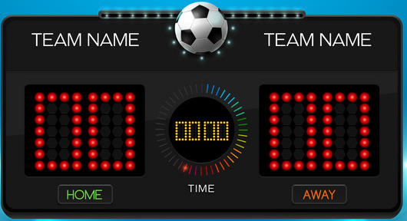
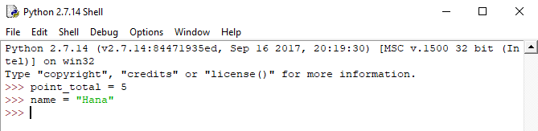
Key term: Variables
Variables are a way of storing information and giving it a label.
They are useful for keeping track of information, such as game scores.
To make a Python, variable you need to assign a value using the = sign.

Slide 6
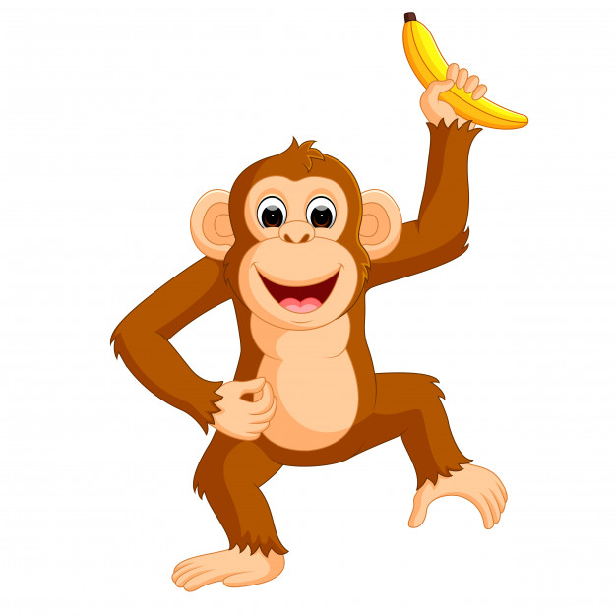
Assigning variables
A monkey has 10 bananas.
bananas = 10
She eats 2 bananas.
bananasEaten = 2
How many are left?
bananas - bananasEaten
Quick calculation
bananas = bananas - bananasEaten
Or, update the bananas variable using the = sign
She finds 4 bananas.
bananasFound = 4
How many bananas are left?
bananas = bananas + bananasFound

Slide 7

Another example: football
Two teams start a football match. (Team A and Team B)
1. In a new program, assign a variable for each team showing the start scores of zero.
2. Print the start scores.
3. Update the variables to show the scores:
Team A scores 1 goals,
then Team B scores a goal.
Finally, Team B scores an own goal
4. Print the final score.

Slide 8
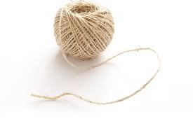
Key term: Strings
In Python, a word – or any collection of letters and symbols – is called a string.
“Hello World” is a string.
print(“Hello World!”)
name = “<your name>”
print(“Hello”, name)

Slide 9

Key term: Functions
A function is a group of statements that perform a specific task.
They help break our programs into smaller tasks.
print() is an example of a function.

Slide 10
Asking questions
You can use the input() function to ask for someone’s name
Write a program to ask the user for their name and print it to the screen
name = input(“What is your name?”)
print(“Hello”, name)

Slide 11
Think of a character
You can use variables and the print() and input() functions to describe a character
print(“Think of a character!”)
name = input(“What is your character called?”)
age =
strengths =
print(“Your character’s name is”, name)
print(“Your character is”, age, “years old”)
print(“Strengths:”, strengths)

Slide 12
Key terms: integers and floats
There are two types of number in coding: integers and floats
An integer is always a whole number, such as 2
A float can be any number, including numbers with a decimal point, such as 2.5

Slide 13
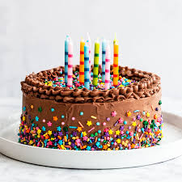
Combining numbers and strings
When you use the input() function, Python automatically stores the return value as a string.
Try this:
age = input(“How old are you?”)
ageNextYear = age + 1
print(“You will be”, ageNextYear, “next birthday.”)
Python thinks that the “age” input is a string. You need
to tell Python that it is a number.
age = input(“How old are you?”)
ageNextYear = int(age) + 1
print(“You will be”, ageNextYear, “next birthday.”)

Slide 14
Examples to try
1. Make a program that asks the user to name a city they’ve visited. Get the program to print “Wow! I would like to go to <city>”
2. Make a program that asks the user for two whole numbers, adds them together and writes the answer
Hint: you will need the input(), int() and print() functions
3a. Make a program that asks for the user’s age. Calculate how old the user will be in the year 2035 and print this to the screen.
3b. Try asking the user to input their current age and a year of their choice. Calculate and print their age in their chosen year.

Slide 15
Recap
This week…
Used variables to store information.
Wrote code that asks the user to input information.
Combined these skills in new Python programs.

Slide 16
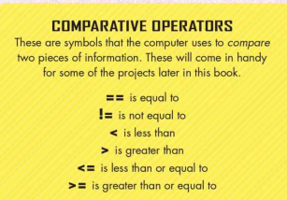
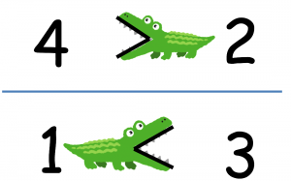
Extension: Making decisions
To write a program that allows you to make decisions, the computer needs to react differently to different answers. To do this you need conditions.
A condition is a bit of code that compares two pieces of information.
Type this in the shell:
age == 12
age == 10
age < 12
age > 8
age != 9
age!= 10
Test these conditions →
age = 10

Slide 17
Key terms
Functions
print()
input()
int()
Python shell
Python editor
Syntax
Debugging
Variable
String
Function
Integer
Float

