Slide 1
Embedded Programming and Robotics
Lesson 14
Introduction to Python Programming

Slide 2
General Information
Unlike C/C++ or Java, Python statements do not end in a semicolon
In Python, indentation is the way you indicate the scope of a conditional, function, etc.
Look, no braces!
Python is interpretive, meaning you don’t have to write programs.
You can just enter statements into the Python environment and they’ll execute
For the most part, we’ll be writing programs

Slide 3
The Python Shell
Because Python is interpretive, you can do simple things with the shell
In the graphical shell on Linux, double-click on LXTerminal
At the prompt, type Python
You should have a >>> prompt
Type in:
print(“hello, world”)
You have written your first Python program
Keep the shell up; we’ll be using it

Slide 4
The Python Shell
This is good for simple calculations but not for real programming
For programming, we’ll use Idle
There are two versions: Idle for Python 2.7 and Idle3 for Python 3.2
For most of what we do, we’ll have to use 2.7 because Bluetooth doesn’t seem to work with 3.2
You’ll run as the “superuser” because otherwise you won’t have access to the GPIO pins
Idle will give you access to a shell but also to an IDE for writing and saving programs

Slide 5
Python Modules
In practice, only the simplest programs are run in the shell
You can create a module by going to the File->New Window menu option
This brings up a text editor that lets you create a Python program and run it
Write your first “Hello World!” program thus:
print(“Hello, World!”)

Slide 6
Python Modules
Press F5
It will ask you to save the file before you run it
Save it to your home directory as HelloWorld.py
You must provide the .py extension
If you want to run it outside of the development environment simply type:
python HelloWorld.py
Note that Linux is case sensitive

Slide 7
Variables
As in every language, a variable is the name of a memory location
Python is weakly typed
That is, you don’t declare variables to be a specific type
A variable has the type that corresponds to the value you assign to it
Variable names begin with a letter or an underscore and can contain letters, numbers, and underscores
Python has reserved words that you can’t use as variable names

Slide 8
Variables
At the >>> prompt, do the following:
x=5
type(x)
x=“this is text”
type(x)
x=5.0
type(x)

Slide 9
Printing
You’ve already seen the print statement
You can also print numbers with formatting
These are identical to Java or C format specifiers

Slide 10
Comments
All code must contain comments that describe what it does
In Python, lines beginning with a # sign are comment lines
On American English keyboards, this is over the 3 key; I don’t know where it is on British English keyboards
You can also have comments on the same line as a statement
# This entire line is a comment
x=5 # Set up loop counter

Slide 11
Operators
Arithmetic operators we will use:
+ - * / addition, subtraction/negation, multiplication, division
% modulus, a.k.a. remainder
** exponentiation
precedence: Order in which operations are computed.
* / % ** have a higher precedence than + - 1 + 3 * 4 is 13
Parentheses can be used to force a certain order of evaluation. (1 + 3) * 4 is 16

Slide 12
Expressions
When integers and reals are mixed, the result is a real number.
Example: 1 / 2.0 is 0.5
The conversion occurs on a per-operator basis.
7 / 3 * 1.2 + 3 / 2
2 * 1.2 + 3 / 2
2.4 + 3 / 2
2.4 + 1
3.4

Slide 13
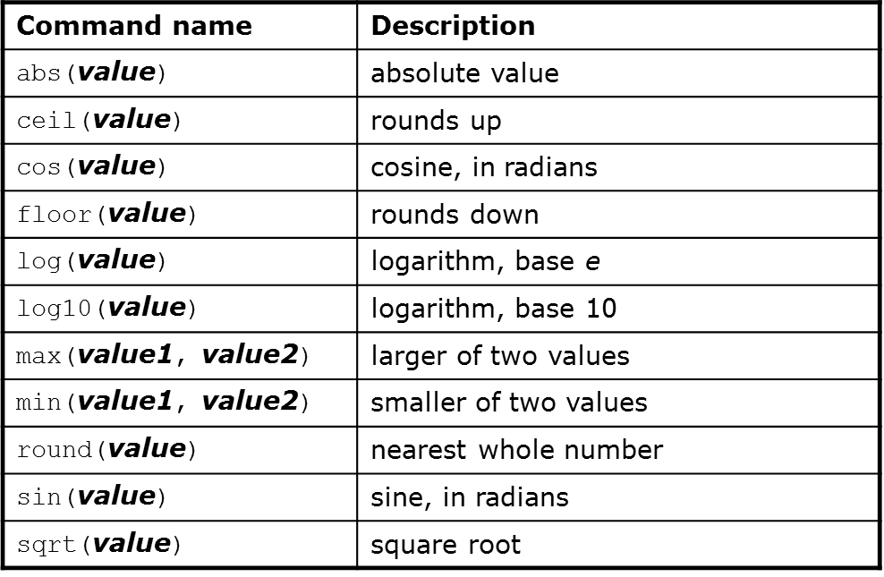
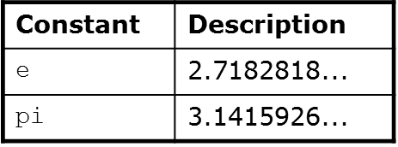
Math Functions
Use this at the top of your program: from math import *

Slide 14
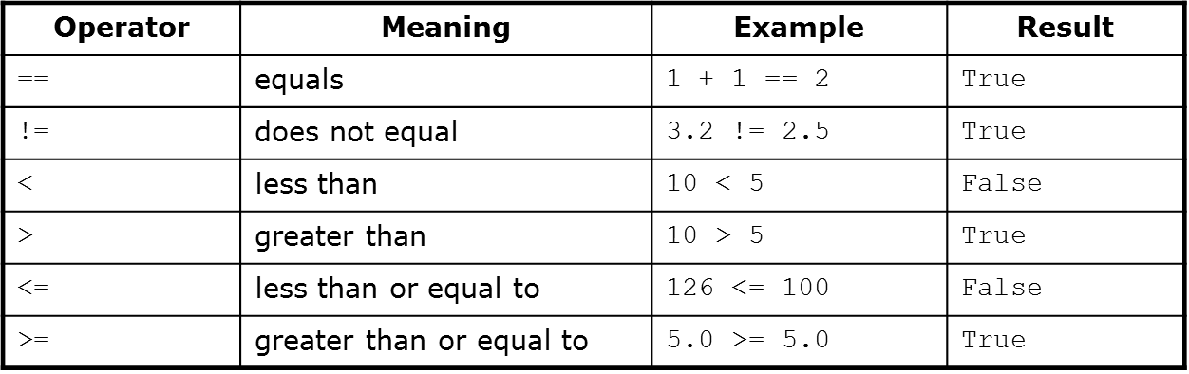
Relational Operators
Many logical expressions use relational operators:

Slide 15
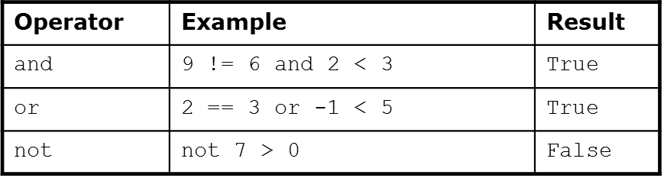
Logical Operators
These operators return true or false

Slide 16
The if Statement
Syntax:
if <condition>:
<statements>
x = 5
if x > 4:
print(“x is greater than 4”)
print(“This is not in the scope of the if”)

Slide 17
The if Statement
The colon is required for the if
Note that all statement indented one level in from the if are within it scope:
x = 5
if x > 4:
print(“x is greater than 4”)
print(“This is also in the scope of the if”)

Slide 18
The if/else Statement
if <condition>:
<statements>
else:
<statements>
Note the colon following the else
This works exactly the way you would expect

Slide 19
The for Loop
This is similar to what you’re used to from C or Java, but not the same
Syntax:
for variableName in groupOfValues:
<statements>
variableName gives a name to each value, so you can refer to it in the statements.
groupOfValues can be a range of integers, specified with the range function.
Example:
for x in range(1, 6):
print x, "squared is", x * x

Slide 20
Range
The range function specifies a range of integers:
range(start, stop) - the integers between start (inclusive)
and stop (exclusive)
It can also accept a third value specifying the change between values.
range(start, stop, step) - the integers between start (inclusive)
and stop (exclusive) by step

Slide 21
The while Loop
Executes a group of statements as long as a condition is True.
Good for indefinite loops (repeat an unknown number of times)
Syntax:
while <condition>:
<statements>
Example:
number = 1
while number < 200:
print number,
number = number * 2

Slide 22
Exercise
Write a Python program to compute and display the first 16 powers of 2, starting with 1
Do this in the Python shell

Slide 23
Strings
String: A sequence of text characters in a program.
Strings start and end with quotation mark " or apostrophe ' characters.
Examples: "hello" "This is a string" "This, too, is a string. It can be very long!"
A string may not span across multiple lines or contain a " character. "This is not a legal String."
"This is not a "legal" String either."

Slide 24
Strings
A string can represent characters by preceding them with a backslash.
\t tab character
\n new line character
\" quotation mark character
\\ backslash character
Example: "Hello\tthere\nHow are you?"

Slide 25
Indexing Strings
As with other languages, you can use square brackets to index a string as if it were an array:
name = “Arpita Nigam”
print(name, “starts with “, name[0])

Slide 26
String Functions
len(string) - number of characters in a string
str.lower(string) - lowercase version of a string
str.upper(string) - uppercase version of a string
str.isalpha(string) - True if the string has only alpha chars
Many others: split, replace, find, format, etc.
Note the “dot” notation: These are static methods.

Slide 27
Byte Arrays and Strings
Strings are Unicode text and not mutable
Byte arrays are mutable and contain raw bytes
For example, reading Internet data from a URL gets bytes
Convert to string:
cmd = response.read()
strCmd = str(cmd)

Slide 28
Other Built-in Types
tuples, lists, sets, and dictionaries
They all allow you to group more than one item of data together under one name
You can also search them

Slide 29
Tuples
Unchanging Sequences of Data
Enclosed in parentheses:
tuple1 = (“This”, “is”, “a”, “tuple”)
print(tuple1)
This prints the tuple exactly as shown
Print(tuple1[1])
Prints “is” (without the quotes)

Slide 30
Lists
Changeable sequences of data
Lists are created by using square brackets:
breakfast = [ “coffee”, “tea”, “toast”, “egg” ]
You can add to a list:
breakfast.append(“waffles”)
breakfast.extend([“cereal”, “juice”])

Slide 31
Dictionaries
Groupings of Data Indexed by Name
Dictionaries are created using braces
sales = {}
sales[“January”] = 10000
sales[“February”] = 17000
sales[“March”] = 16500
The keys method of a dictionary gets you all of the keys as a list

Slide 32
Sets
Sets are similar to dictionaries in Python, except that they consist of only keys with no associated values.
Essentially, they are a collection of data with no duplicates.
They are very useful when it comes to removing duplicate data from data collections.

Slide 33
Writing Programs
Bring up the Idle3 IDE
The first line of your code should be this: #!/usr/bin/env python 3.1
Write the same code you wrote for the exercise of powers of 2 using the IDE’s editor
Press the F5 key to run the program
It will ask you to save the program. Give it a name like PowersOf2.py
The program will run in a Python shell from the IDE
If there are errors, the shell will tell you

Slide 34
Writing Functions
Define a function:
def <function name>(<parameter list>)
The function body is indented one level:
def computeSquare(x)
return x * x
# Anything at this level is not part of the function

Slide 35
Error Handling
Use try/except blocks, similar to try/catch:
fridge_contents = {“egg”:8, “mushroom”:20, “pepper”:3, “cheese”:2,
“tomato”:4, “milk”:13}
try:
if fridge_contents[“orange juice”] > 3:
print(“Sure, let’s have some juice!”)
except KeyError:
print(“Awww, there is no orange juice.”)

Slide 36
Error Handling
Note that you must specify the type of error
Looking for a key in a dictionary that doesn’t exist is an error
Another useful error to know about:
try:
sock = BluetoothSocket(RFCOMM)
sock.connect((bd_addr, port))
except BluetoothError as bt
Print(“Cannot connect to host: “ + str(bt))

Slide 37
Using the GPIO Pins
The Raspberry Pi has a 40-pin header, many of which are general-purpose I/O pins
Include the library:
import RPi.GPIO as GPIO
Set up to use the pins:
GPIO.setmode(GPIO.BOARD)

Slide 38
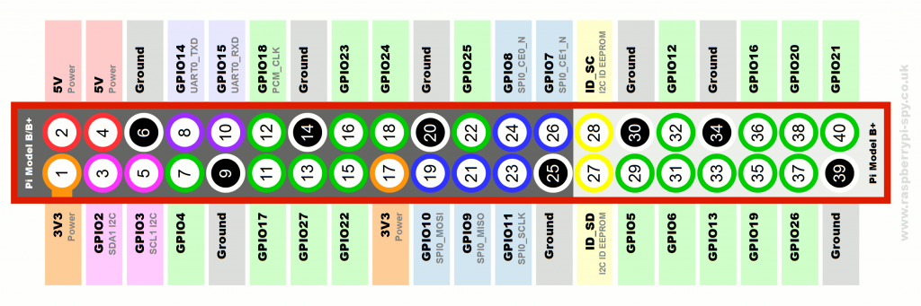
Using the GPIO Pins
The GPIO.BCM option means that you are referring to the pins by the "Broadcom SOC channel" number, these are the numbers after "GPIO" in the green rectangles around the outside of the diagram:

Slide 39
Using the GPIO Pins
This is from my home-control code:
LAMP = 22
MOTION = 23
GPIO.setup(LAMP, GPIO.OUT) # For turning on the lamp
GPIO.setup(MOTION, GPIO.IN) # For reading the motion sensor
Like the Arduino, we must set up the pins for input or output

Slide 40
Using the GPIO Pins
Reading from a GPIO pin:
# If we detect motion, print that.
if GPIO.input(MOTION):
print( "Motion detected")

Slide 41
Using the GPIO Pins
Output to GPIO:
if cmd=='LAMPON':
cmdlist["LAMPSTATUS"] = True;
GPIO.output(LAMP, True) # turn on the light

Slide 42
Programming Exercise
Write a Python program that blinks an LED at a rate of 1 second on, one second off
To do this, you’ll need to use the idle3 environment running as the superuser:
sudo idle3

Slide 43
Python File I/O
You can read and write text files in Python much as you can in other languages, and with a similar syntax.
To open a file for reading:
try:
configFile = open(configName, "r")
except IOError as err:
print(“could not open file: “ + str(err))

Slide 44
Python File I/O
To read from a file:
while 1:
line = configFile.readline()
if len(line) == 0:
break

Slide 45
Python File I/O
You can also read all lines from a file into a set, then iterate over the set:
lines = file.readlines()
for line in lines:
print(line)
file.close()

Slide 46
Python File I/O
Writing to a text file
file=open(‘test.txt’,”w”)
file.write(“This is how you create a new text file”)
file.close()

