Slide 1
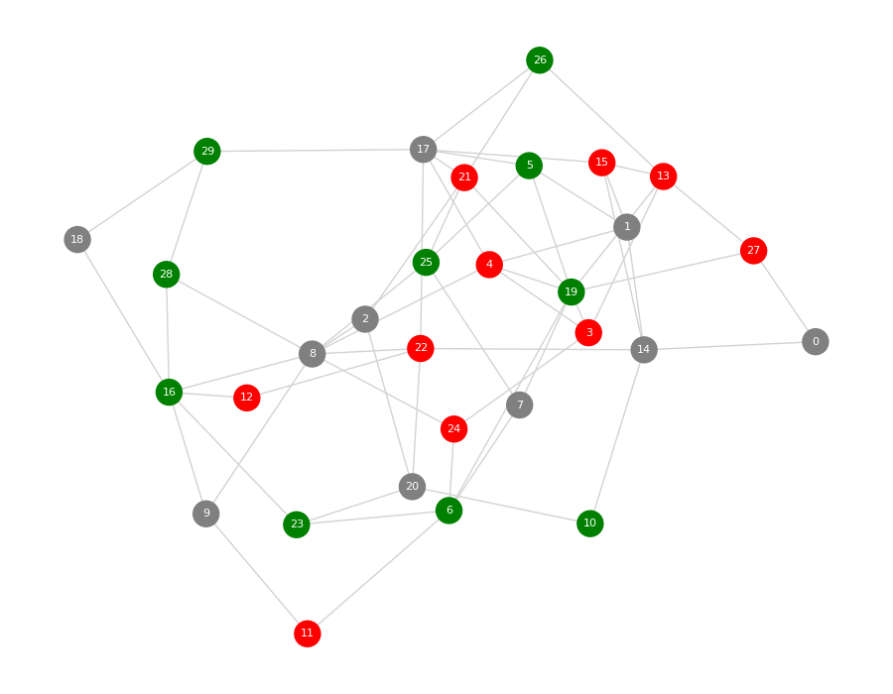
Cooperate, Compete,
or Stay Neutral
An agent-based network model of energy, survival, and inequality
Mini Project 3: Agent-Based Modeling
Local interactions only
Each node is an agent. Each edge is a relationship where two agents can interact.
Green = helpers Gray = neutral Red = aggressive
Mini Project 3 • Agent-Based Modeling • 1
Notes:
Title slide. Introduce this as a simple agent-based model where strategies create population-level results over time.

Slide 2
Problem statement & research questions
What larger patterns emerge when agents follow simple local behavior rules?
Problem statement
Research questions
We created an agent-based model to test how three individual strategies—helping, neutrality, and aggression—affect resource distribution, survival, and inequality in a connected population.
Which strategy produces the highest average energy?
Which strategy has the highest survival rate?
Does local interaction create inequality even without a central controller?
30
60
100
10
+1 / −1
3
agents
connections
steps
starting energy
income and cost
strategies
Mini Project 3 • Agent-Based Modeling • 2
Notes:
This slide explains the main project goal and questions. Emphasize that the model is local: agents only interact through network edges.

Slide 3
Model setup: a connected network of agents
The graph is the environment; strategies are the agent behaviors.
Environment
Nodes represent agents.
Edges represent relationships.
The graph is connected, so every agent is part of the population.
Agents can interact only with neighbors connected by edges.
Starting strategies
10 helpers
10 neutral
10 aggressive
Node size represents energy; at step 0, everyone starts equal.
Mini Project 3 • Agent-Based Modeling • 3
Notes:
Point out that the graph layout is just a visualization. The connections are what determine who can interact.

Slide 4
Agent rules: simple local choices
A population-level pattern emerges from repeated neighbor-to-neighbor interactions.
Helper
Neutral
Aggressive
Gives 1 energy to a connected neighbor if it has enough energy to share.
Does not give or steal. It gains income and pays survival cost.
Takes 1 energy from a connected living neighbor whenever possible.
Update sequence each step
Living agents gain +1 energy from the environment.
Living agents pay −1 energy as metabolism cost.
Each agent interacts with one living neighbor.
Agents with zero energy die and turn black in the visualization.
Key ABM idea: no global rule creates inequality. It appears from local behavior.
Mini Project 3 • Agent-Based Modeling • 4
Notes:
Explain the three strategies and the model update order. Emphasize that the model is not choosing a winner directly.

Slide 5
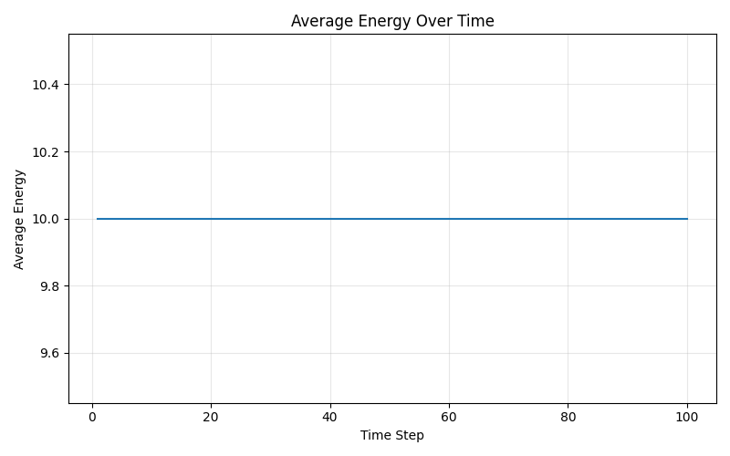
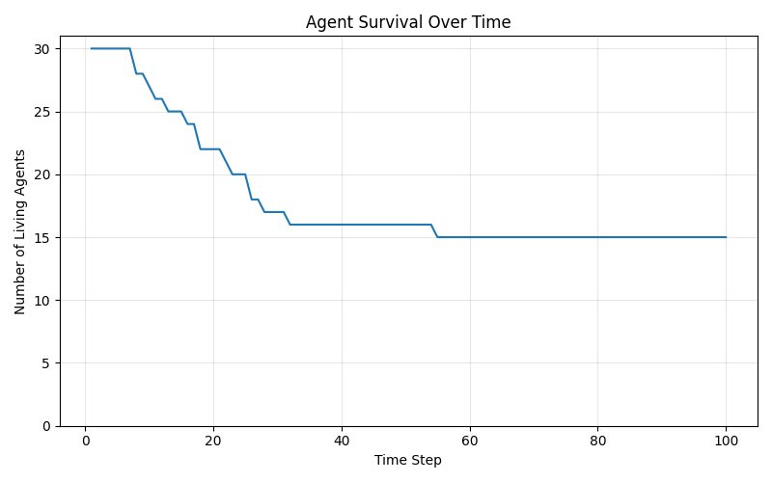
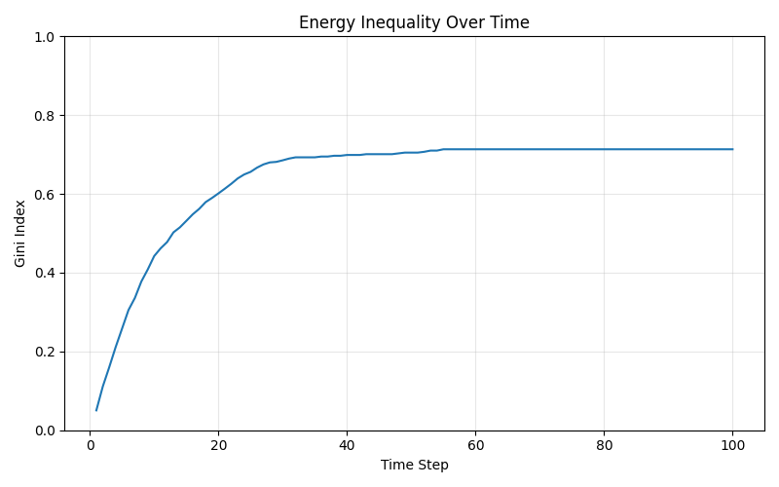
System-level measurements
The model tracks both individual survival and population-level patterns.
Average energy
Survival
Inequality
Total resources stayed constant because +1 income and −1 metabolism cancel out.
Population fell from 30 living agents to 15 living agents by the end.
The Gini index rose to 0.713, showing energy became highly concentrated.
Mini Project 3 • Agent-Based Modeling • 5
Notes:
Describe the three measurement graphs. Average energy stays flat, but survival declines and inequality rises.

Slide 6
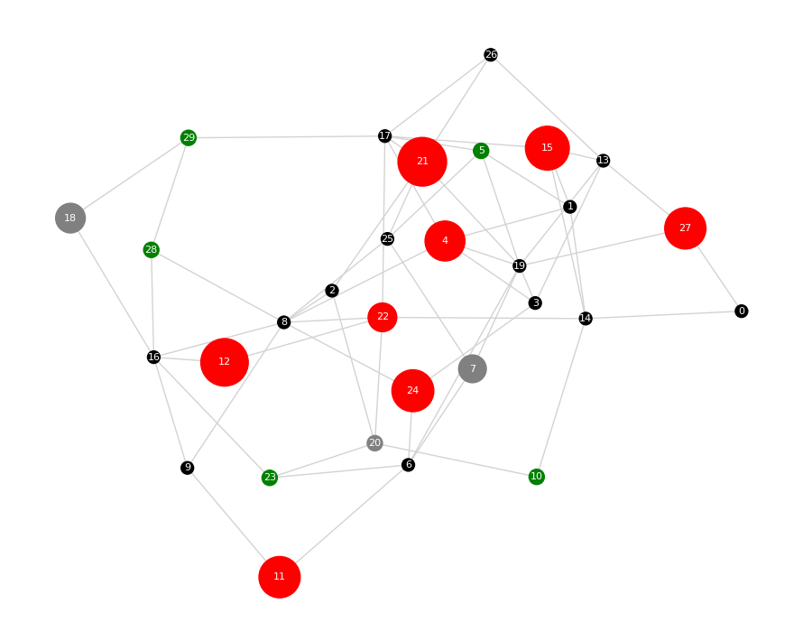
Emergence: the network starts balanced, then separates
The agents begin with equal energy, but local interactions create an unequal final state.
Step 0: equal starting point
Step 100: energy concentrated in aggressive agents
Mini Project 3 • Agent-Based Modeling • 6
Notes:
This is the key before-and-after slide. Black nodes are dead agents. Large red nodes show aggressive agents with high energy.

Slide 7
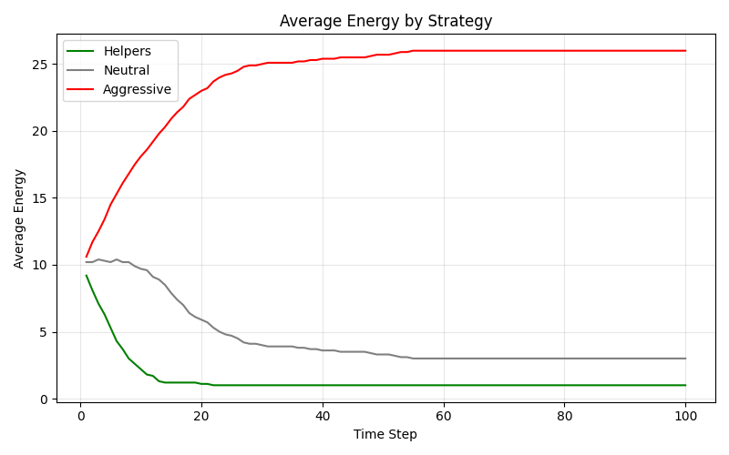
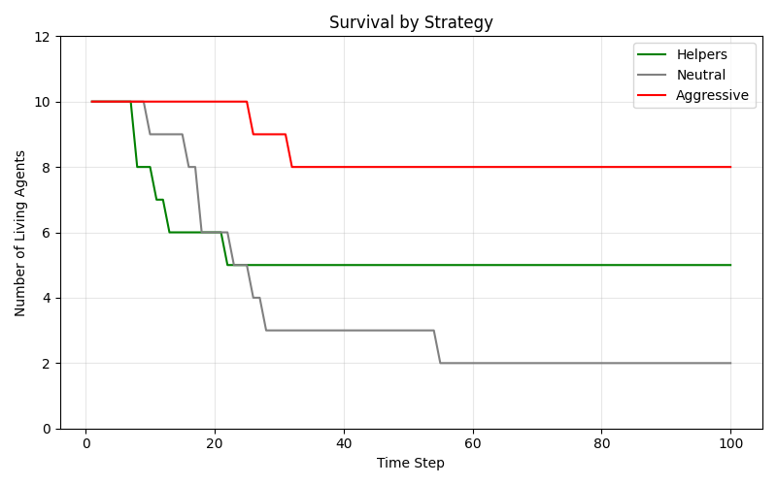
Strategy comparison: aggression wins under these rules
The strategy-level graphs show where the energy and survival advantage went.
26.0
1.0
3.0
80%
50%
20%
final avg. energy
aggressive
final avg. energy
helpers
final avg. energy
neutral
aggressive survival
helper survival
neutral survival
Mini Project 3 • Agent-Based Modeling • 7
Notes:
Explain that aggressive agents both accumulate more energy and survive at a higher rate. Neutral agents can still be targeted, so neutrality is not safe.

Slide 8
Final results
The final run demonstrates high inequality and a strong strategy advantage.
Population-level outcome
Main interpretation
15 / 30
10.00
0.713
Total energy did not disappear. It moved from many agents into a smaller number of highly successful aggressive agents.
living agents
average energy
Gini inequality
Final average energy by strategy
Survival by strategy
Helper: 1.00
Neutral: 3.00
Aggressive: 26.00
Helpers: 5 of 10 survived
Neutral: 2 of 10 survived
Aggressive: 8 of 10 survived
This is an emergent result because no global rule assigned the final inequality.
Mini Project 3 • Agent-Based Modeling • 8
Notes:
Use this slide for the clean numerical summary. The Gini index and strategy outcomes are the strongest numbers to cite.

Slide 9
Answers to the research questions
The final patterns are caused by local strategy rules, not by a central controller.
1
Which strategy produced the highest average energy?
Aggressive agents had the highest final average energy: 26.00.
2
Which strategy had the highest survival rate?
Aggressive agents had the highest survival rate: 8 of 10 survived.
3
Did local interaction create inequality?
Yes. Inequality rose to 0.713 even though the model did not contain a global inequality rule.
Limitations
One run does not prove a universal law. A stronger study would repeat runs while changing C, income, metabolism cost, and strategy ratios.
Mini Project 3 • Agent-Based Modeling • 9
Notes:
This slide directly answers the project questions and mentions limitations honestly.

Slide 10
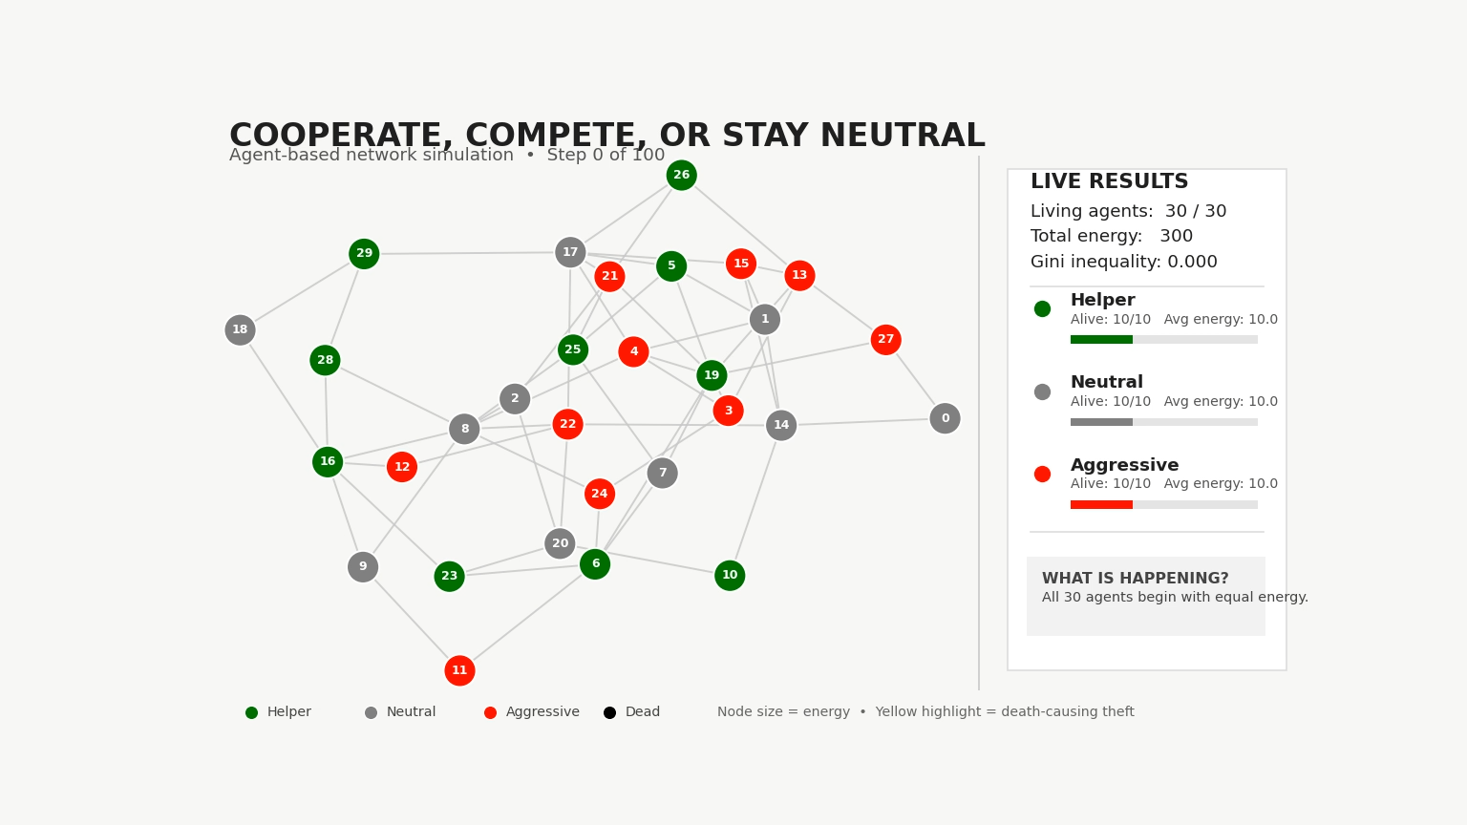
Conclusion
Simple local rules produced a clear population-level pattern.
Main takeaway
Aggressive behavior created an individual advantage, but the population-level result was high inequality and a large drop in the number of living agents.
Why this fits agent-based modeling
Agents have individual states and strategies.
Interactions are local through network edges.
The model is updated step by step over time.
A large-scale pattern emerges from small repeated decisions.
Final visual: black nodes died; large red nodes accumulated most of the energy.
Mini Project 3 • Agent-Based Modeling • 10
Notes:
End by stating that this project shows emergence: individual strategies lead to system-wide inequality and survival differences.

