Slide 1
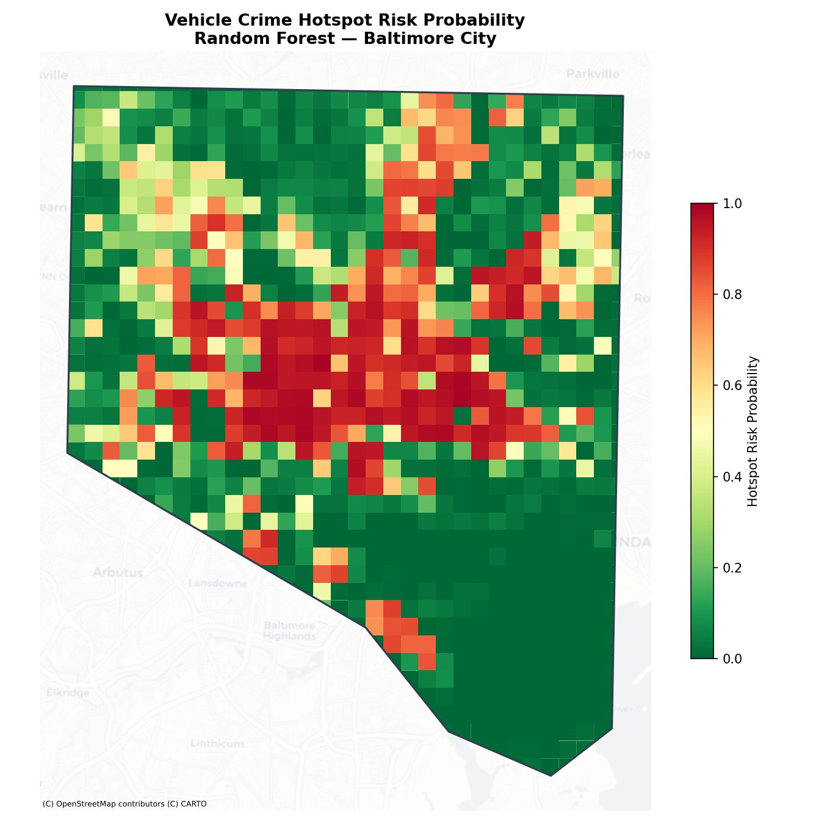
FINAL PROJECT · GIS & MACHINE LEARNING
GIS-Based Prediction of
Auto Theft & Carjacking
Hotspots in Baltimore City
Using Machine Learning — Logistic Regression, Decision Tree & Random Forest
53,264
1,022
12
95.2%
Crime Records
Grid Cells
Features
ROC-AUC
Data: Open Baltimore (ArcGIS API) · OpenStreetMap · US Census ACS 2020

Slide 2
The Problem
🚗 High Vehicle Crime
📍 Crime Clusters Spatially
Baltimore consistently ranks among the highest cities in the US for auto theft and carjacking incidents.
Vehicle crimes do not occur randomly. They concentrate in specific corridors and repeat over time.
🔮 Need Forward-Looking Tools
🗺️ Area-Level Risk Mapping
Traditional crime maps only show where crime happened. Police and planners need to know where it is likely to happen next.
This project builds a spatial risk model — similar to flood susceptibility maps — to identify high-risk grid cells before incidents spike.
Source: Baltimore Police Department (BPD) Part 1 Crime Data via Open Baltimore

Slide 3
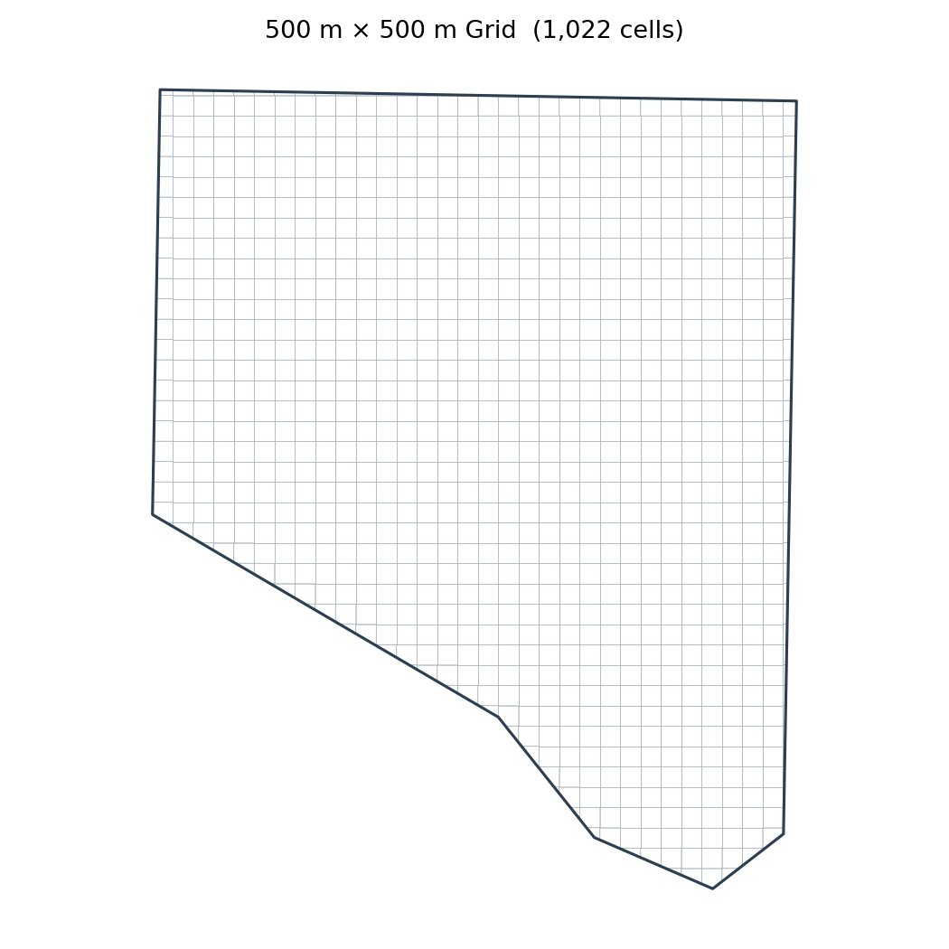
Study Area & Data Sources
Data Source | What It Provides
Open Baltimore (ArcGIS API) | 53,264 vehicle crime incidents 2015–2024
OpenStreetMap (osmnx) | Road network, intersections, POIs
US Census ACS 2020 | Population density by block group
OpenStreetMap POIs | Transit stops, parking, gas stations, shops
Baltimore DHCD (ArcGIS API) | Vacant property locations
Spatial Unit of Analysis
500 m × 500 m grid cells clipped to Baltimore City boundary
→ 1,022 grid cells · Each cell = one row in the ML dataset
Sources: Open Baltimore · OpenStreetMap · US Census Bureau · Baltimore DHCD

Slide 4
Crime Data Overview
Temporal Split:
Past Period (2015–2021) → Predictor Variables | Future Period (2022–2024) → Target Variable (hotspot label)
30,782 past incidents used to build features · 22,482 future incidents used to create hotspot labels
Source: Open Baltimore — BPD Part 1 Victim Based Crime Data (ArcGIS REST API)

Slide 5
Feature Variables (Predictors)
Feature | Description | Source
past_vehicle_crime_count | Crime incidents 2015–2021 per cell | Open Baltimore
road_density | Total road length / cell area (m/m²) | OpenStreetMap
intersection_count | Road nodes with 3+ connections per cell | OpenStreetMap
population_density | Persons per km² from Census block groups | US Census ACS 2020
transit_stop_count | Bus stops and rail stations per cell | OpenStreetMap
commercial_count | Commercial / retail land use polygons | OpenStreetMap
parking_lot_count | Parking lot features per cell | OpenStreetMap
gas_station_count | Gas station features per cell | OpenStreetMap
shopping_count | Shops and retail stores per cell | OpenStreetMap
dist_to_downtown_m | Distance from cell centroid to Inner Harbor | Calculated
centroid_x / centroid_y | Spatial coordinates of cell centroid (UTM) | Calculated
Target Variable: future_hotspot = 1 if future crime count ≥ 24 (top 25% of grid cells), else 0

Slide 6
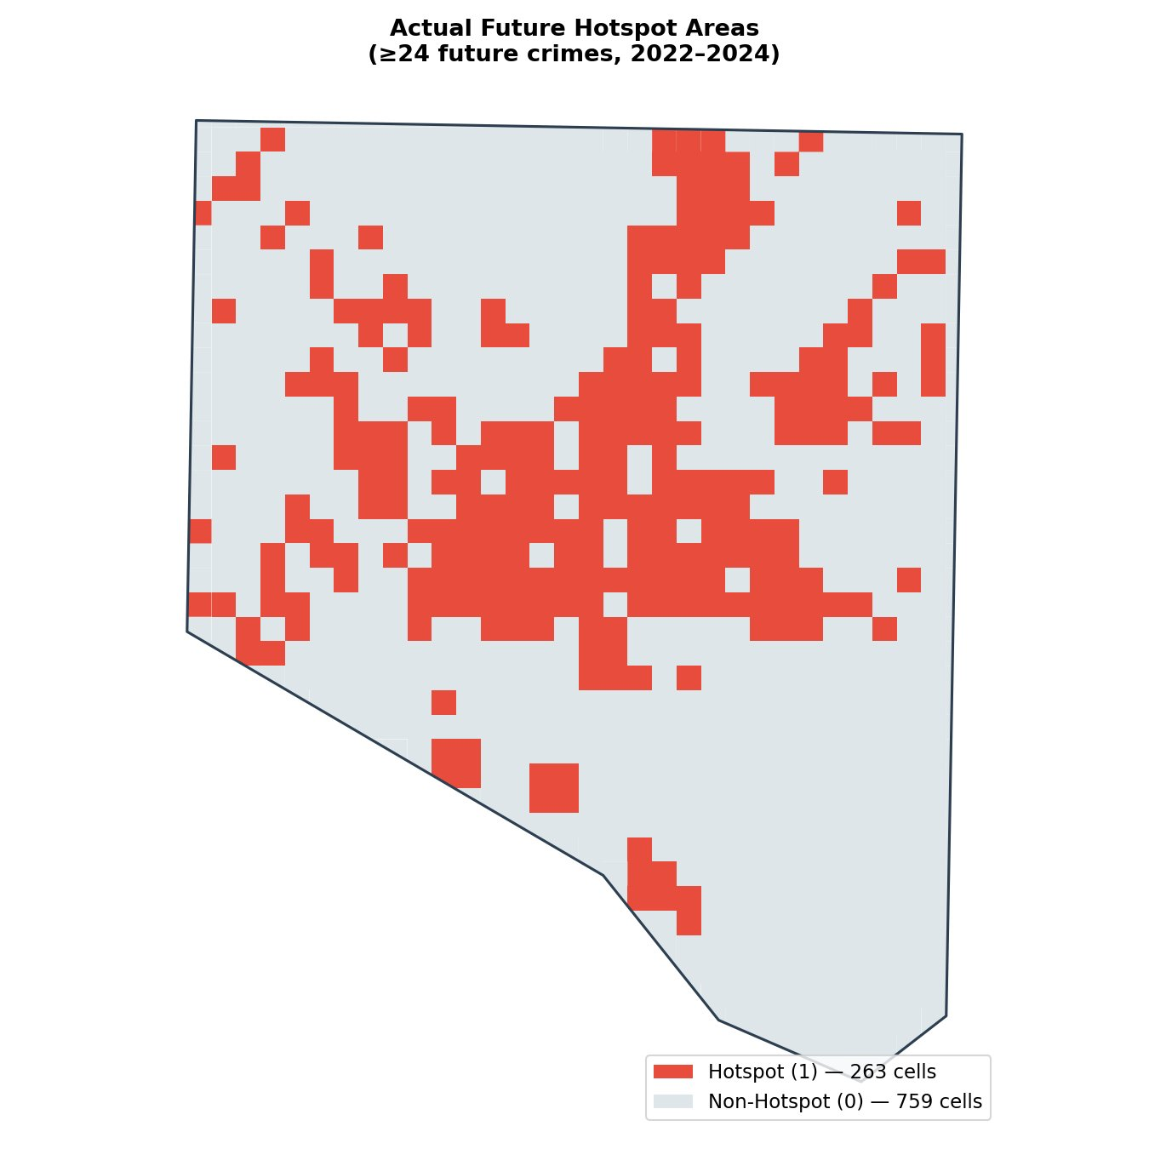
Actual Future Hotspot Areas
263
Hotspot Cells
top 25% by future crime count
759
Non-Hotspot Cells
74.3% of all cells
≥24
Crime Threshold
minimum crimes to be a hotspot
500m
Grid Cell Size
spatial resolution
Source: Open Baltimore BPD Crime Data (2022–2024) · Analysis: 500m fishnet grid

Slide 7
Why These Algorithms?
This is a binary classification problem: predict hotspot (1) or non-hotspot (0) for each 500m grid cell.
01
Logistic Regression
02
Decision Tree
03
Random Forest
Baseline Model
Interpretable Model
Final Model ★
Why chosen:
Why chosen:
Why chosen:
Provides a clear mathematical formula. Good starting point to measure if a simple linear model is enough.
Produces human-readable IF/THEN rules. Max-depth tuned using 5-fold cross-validation for best F1 score.
Ensemble of 100+ decision trees. Captures complex, non-linear interactions between spatial features. Tuned with GridSearchCV.
✓ Fast, interpretable, produces coefficients
✓ Rules are easy to explain to any audience
✓ Highest AUC, produces probability scores, handles correlated features
✗ Assumes features relate linearly to outcome
✗ Can overfit; less stable than ensemble methods
✗ Less interpretable — addressed with SHAP values
Algorithm selection: scikit-learn (Python) · Cross-validation: StratifiedKFold (5-fold) · Tuning: GridSearchCV

Slide 8
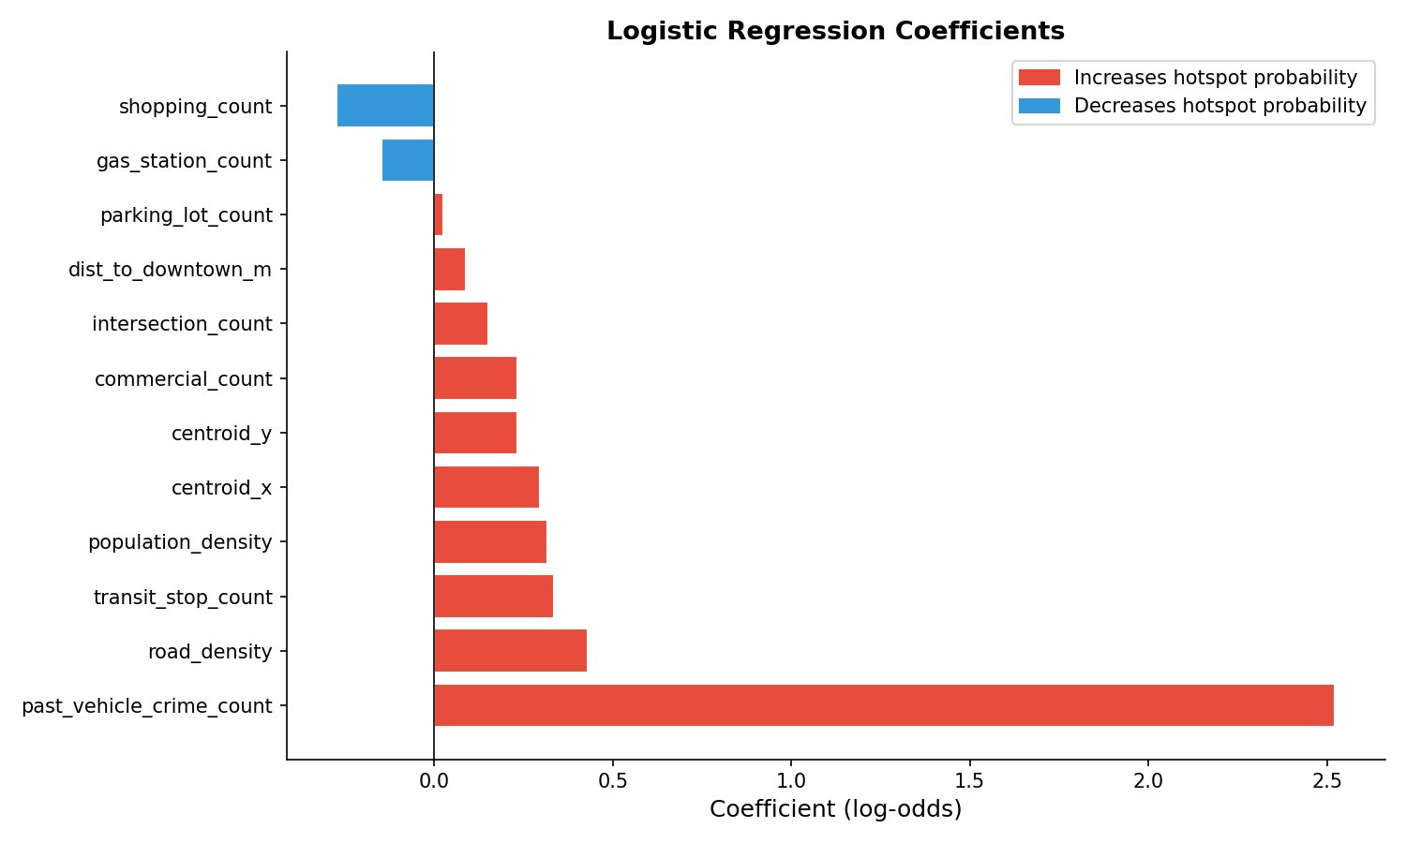
Model 1: Logistic Regression — The Formula
P(hotspot) = 1 / (1 + e^(−z))
Top Coefficients
+3.006 past_vehicle_crime_count
Strongest predictor — past crime is the biggest driver of future risk
+0.415 population_density
Denser areas have more vehicles and targets
+0.395 road_density
More roads = more vehicle movement and opportunity
+0.309 transit_stop_count
High foot traffic areas attract vehicle crime
−0.335 shopping_count
Negative — may reflect well-monitored commercial areas
Intercept: −1.118 · Model: scikit-learn LogisticRegression, class_weight='balanced', max_iter=1000

Slide 9
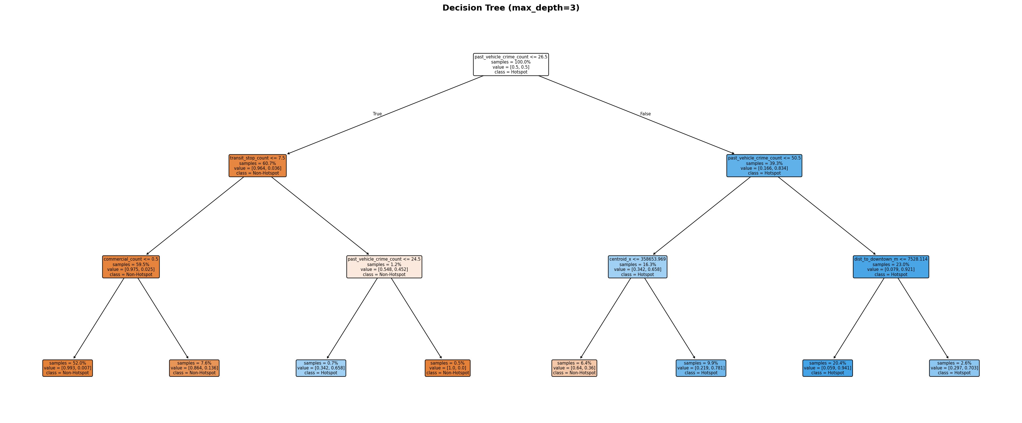
Model 2: Decision Tree — IF/THEN Rules
Key Decision Rules
If past crimes > 50
→ Almost always HOTSPOT
If past crimes 27–50
AND east of city center
→ HOTSPOT
If past crimes < 27
AND transit stops > 7
→ HOTSPOT
If past crimes < 27
AND transit stops ≤ 7
→ NOT hotspot
max_depth = 3 (tuned by 5-fold CV) · CV F1 = 0.759 · Test F1 = 0.748 · Test AUC = 0.945
Algorithm: scikit-learn DecisionTreeClassifier · Depth tuning: StratifiedKFold 5-fold CV on training set

Slide 10
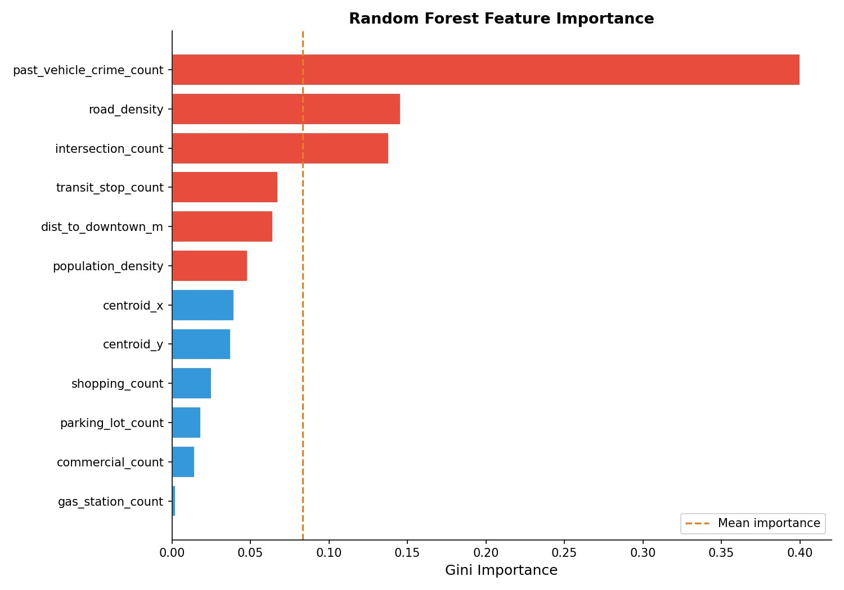
Model 3: Random Forest — Final Model
GridSearchCV Best Parameters
Parameter | Value
n_estimators | 100
max_depth | None (fully grown)
min_samples_leaf | 3
class_weight | balanced
CV folds | 5-fold stratified
CV metric | F1 score
Top Feature Contributions
past_vehicle_crime_count 40%
road_density 14.6%
intersection_count 13.8%
transit_stop_count 6.7%
dist_to_downtown_m 6.4%
Algorithm: scikit-learn RandomForestClassifier · Tuning: GridSearchCV (12 candidates, 60 fits)

Slide 11
Model Comparison — Which Performs Best?
Logistic Regression
Acc 0.879 · F1 0.792 · AUC 0.948
Decision Tree
Acc 0.848 · F1 0.748 · AUC 0.945
Random Forest ★
Acc 0.875 · F1 0.778 · AUC 0.952
Why Random Forest?
Best ROC-AUC (0.952)
Best Precision (0.718)
Produces risk probability scores
Handles non-linear patterns
GridSearchCV justified params
Highlighted cells = best value per metric · Green = LR best · Red = RF best

Slide 12
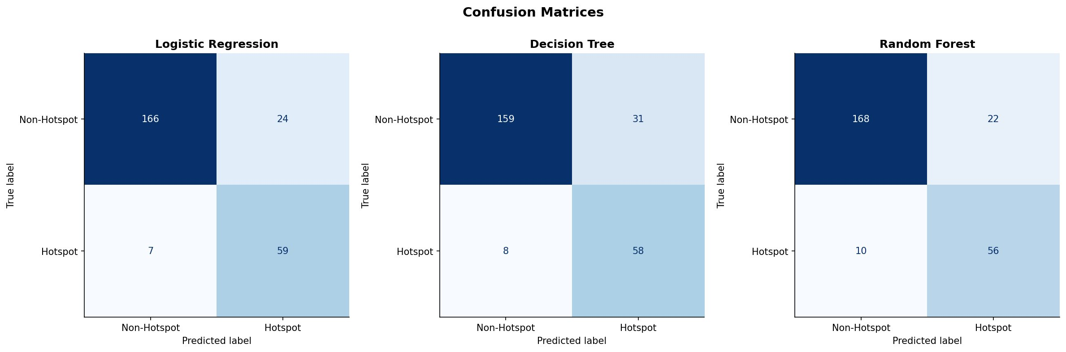
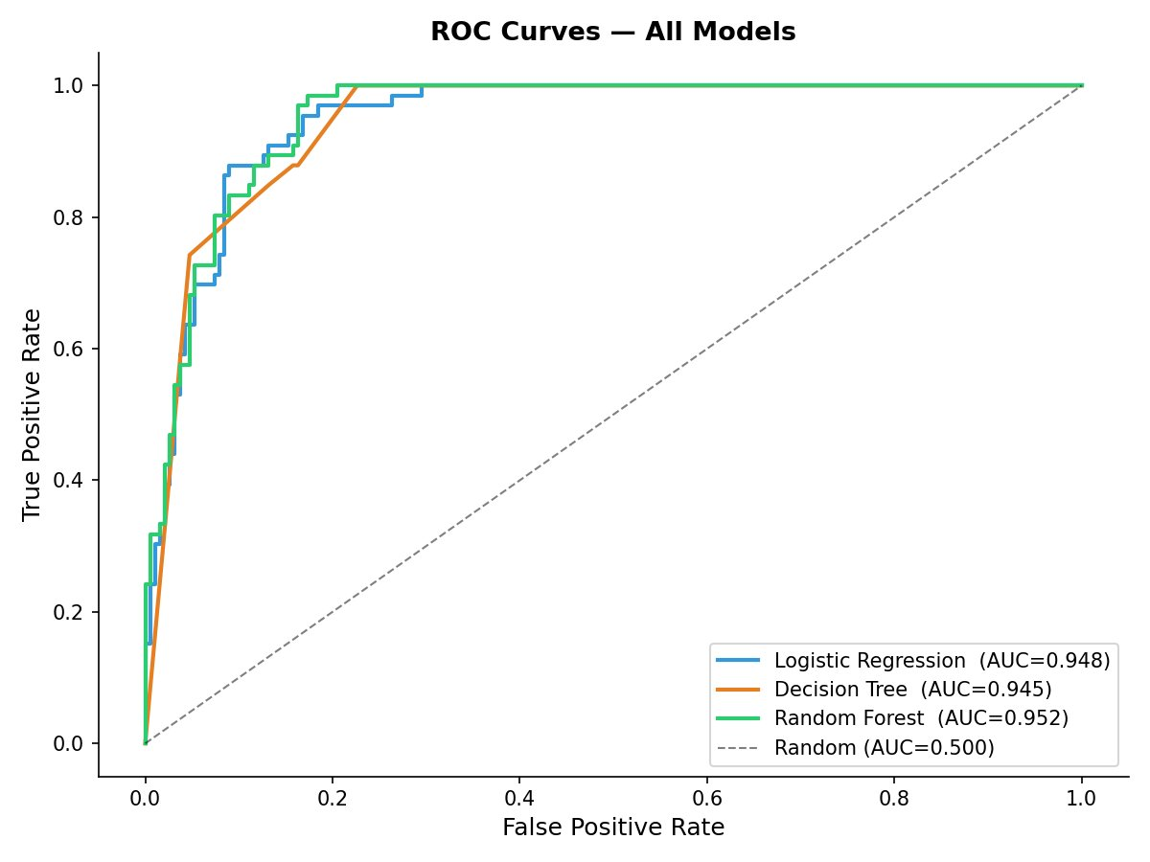
Model Accuracy in Detail
Random Forest — Test Set (256 cells)
 | Pred: Non-Hotspot | Pred: Hotspot
Actual: Non-Hotspot | 168 ✓ | 22 ✗
Actual: Hotspot | 10 ✗ | 56 ✓
✓ 168 — Correctly identified non-hotspot cells
✓ 56 — Correctly identified hotspot cells
✗ 22 — False alarms (predicted hotspot, was not)
✗ 10 — Missed hotspots (predicted safe, was hotspot)
scikit-learn confusion_matrix(), roc_auc_score() · Test set: 25% stratified split

Slide 13
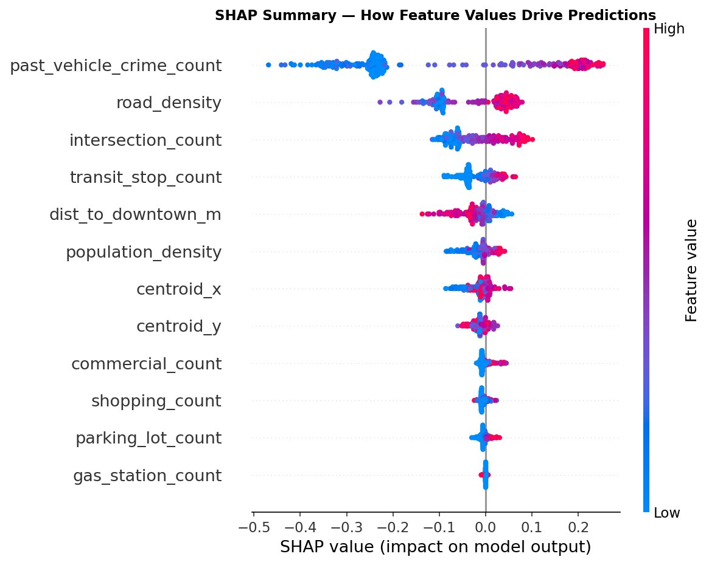
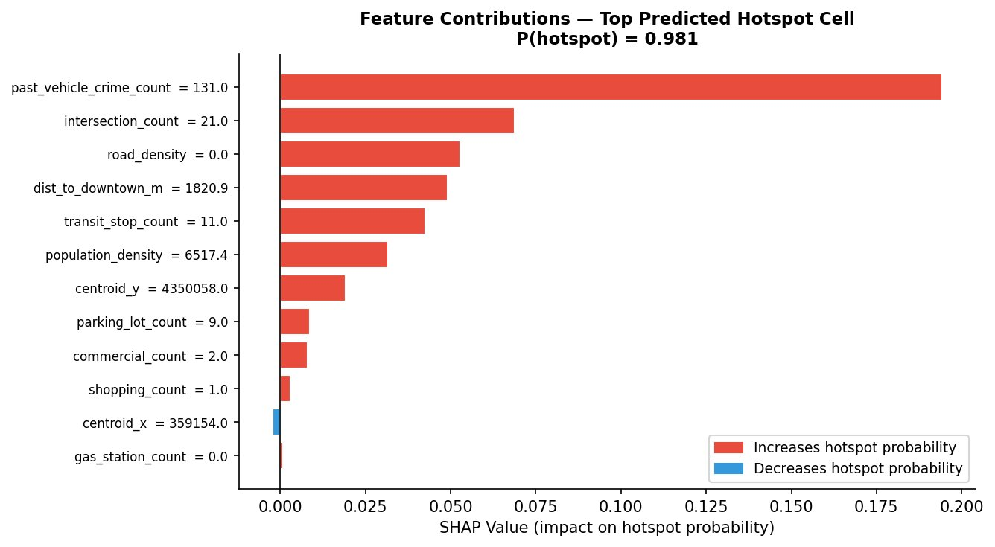
Understanding Predictions — SHAP Analysis
SHAP (SHapley Additive exPlanations) shows not just which features matter globally, but WHY the model made each individual prediction.
Left: Red dots = high feature value, Blue = low value. Right side of x-axis = pushed prediction toward hotspot.
Right: Bars show how each feature pushed the prediction for the cell with highest hotspot probability (P=0.981).
SHAP library (Lundberg & Lee, 2017) · TreeExplainer applied to Random Forest

Slide 14
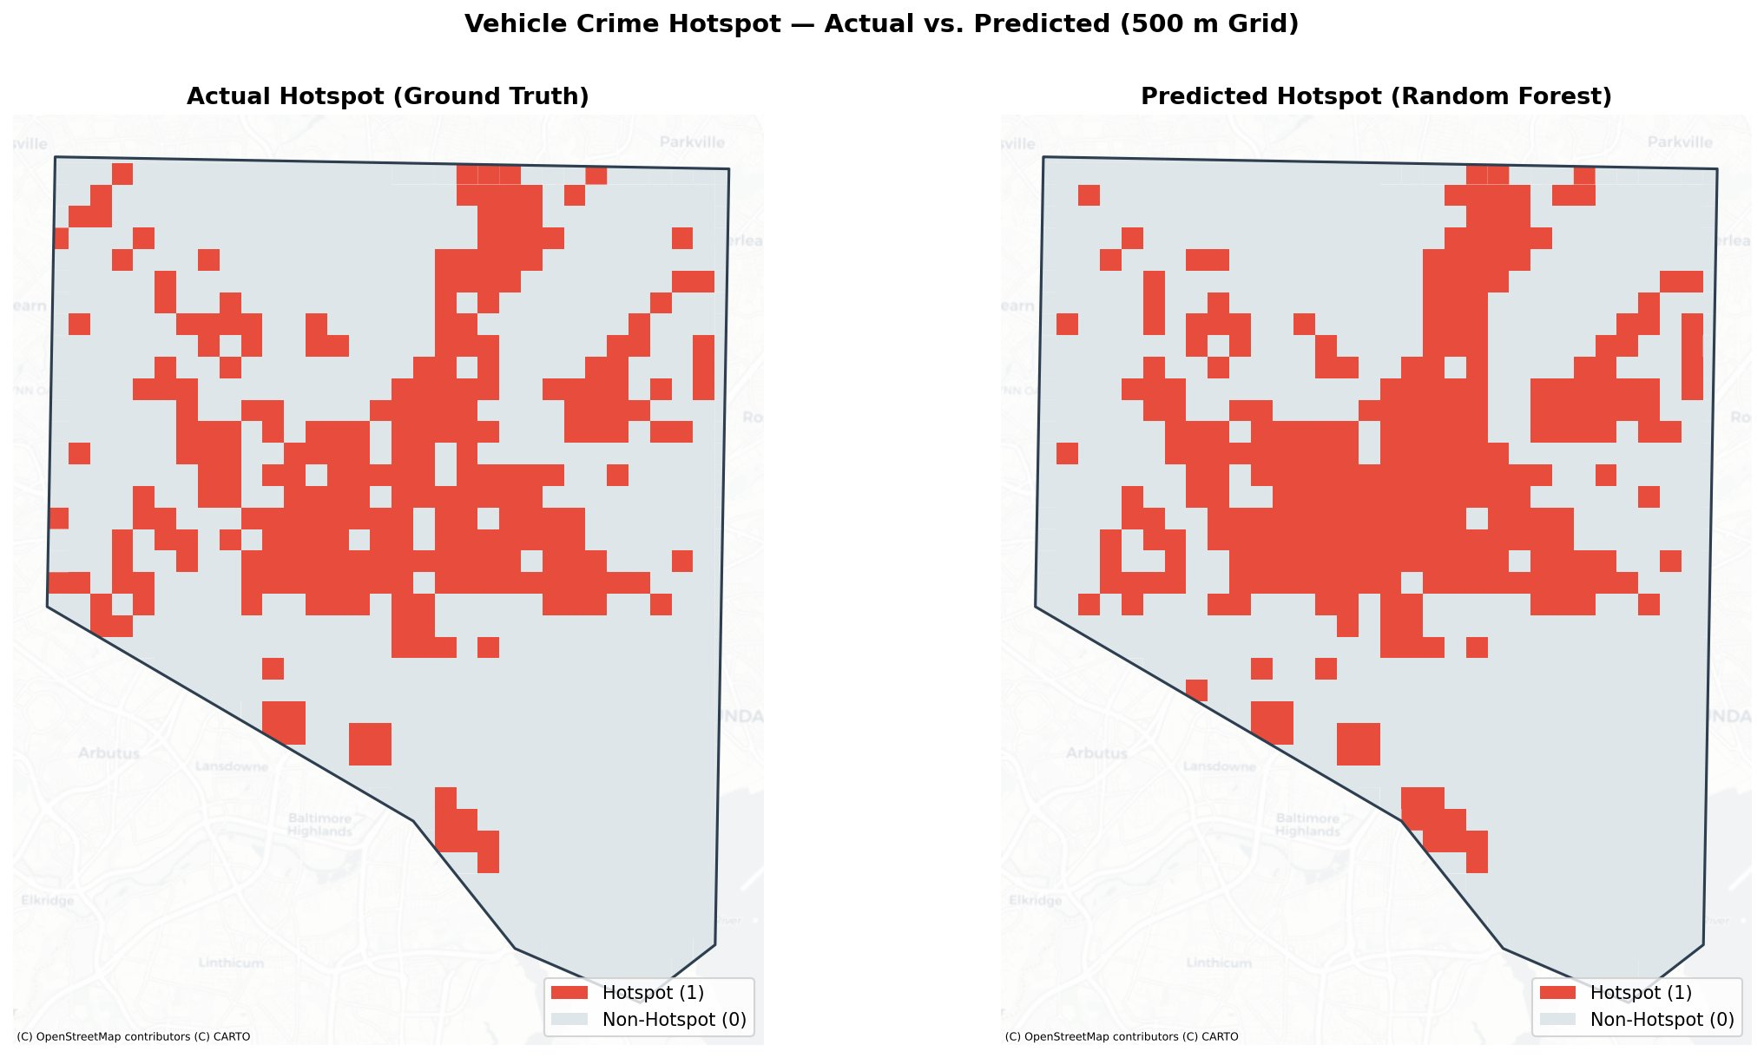
Predicted Hotspot Map — Random Forest
Hotspot (1) — ≥24 future vehicle crimes per cell
Non-Hotspot (0) — fewer than 24 future crimes
Source: Random Forest predictions on all 1,022 grid cells · Training: 2015–2021 · Target: 2022–2024

Slide 15
Vehicle Crime Risk Probability Map
Confidence Levels
P > 0.8
High confidence hotspot
Prioritize for intervention
P 0.5 – 0.8
Likely hotspot
Monitor closely
P 0.2 – 0.5
Possible risk area
Watch for emerging patterns
P < 0.2
Low risk
Likely safe area
Random Forest predict_proba() · Continuous risk score 0.0–1.0 per 500m grid cell · Red = highest risk

Slide 16
Key Findings
01
Crime Hotspots Persist Over Time
02
Road Infrastructure Drives Risk
Past vehicle crime count (2015–2021) was the single strongest predictor of future hotspots (2022–2024), contributing 40% of the Random Forest model's decision-making. Where crime happened before is where it will likely happen again.
Road density (14.6%) and intersection count (13.8%) ranked 2nd and 3rd in feature importance. Areas with dense road networks and many intersections give criminals more access and escape routes — a structural risk factor independent of socioeconomic conditions.
03
Transit Hubs and Downtown Proximity Matter
04
Random Forest Outperforms on Discrimination
Transit stop count and distance to downtown were the 4th and 5th strongest predictors. High foot traffic areas with many stopped vehicles near the city center show consistently elevated risk across all models.
Random Forest achieved the highest ROC-AUC (0.952) and Precision (0.718). Logistic Regression showed competitive F1 (0.792), suggesting past crime has a strong linear signal, but RF captures the complex interactions between road density, transit, and location.
Analysis based on 53,264 crime records · 1,022 grid cells · 12 spatial features · Open Baltimore & OSM data

Slide 17
Limitations & Responsible Use
⚠️ Area-Level Risk Only
📊 Reported Crime Bias
🔗 Association, Not Causation
This model predicts spatial risk for 500m grid cells — not where any individual will commit a crime. It should never be used to target individuals or communities.
The dataset reflects reported crimes only. Areas with lower reporting rates may appear safer than they actually are, which can skew model outputs.
Features like road density and transit stops show spatial correlation with crime — they are not proven causes. The model identifies patterns, not explanations.
🏚️ Vacant Property Data Limitation
📅 Temporal Validity
🎯 Intended Use
Baltimore DHCD vacant property data reflects current status only — historical records are removed when properties are fixed. This data was excluded to avoid misleading the model.
The model was trained on 2015–2021 data. New infrastructure, policy changes, or urban development may reduce accuracy over time. Periodic retraining is recommended.
This tool is designed for city planners, traffic safety officials, and infrastructure teams — to help prioritize lighting upgrades, parking improvements, and transit safety. Not for law enforcement targeting.
Ethical framework informed by: responsible AI principles in public safety · National Academy of Sciences crime mapping guidelines

Slide 18
Conclusion
1
A Random Forest model trained on 12 spatial features accurately identifies vehicle crime hotspot areas in Baltimore City with 87.5% accuracy and 0.952 ROC-AUC.
2
Past crime count is the strongest predictor (40%), confirming that crime hotspots are spatially persistent — infrastructure and resource decisions should reflect this.
3
Road density and intersection count follow as the 2nd and 3rd most important features, highlighting the role of street network structure in crime concentration.
4
The model outputs continuous risk probability scores per 500m cell — enabling planners to prioritize investments before incidents rise.
5
Three models were compared (Logistic Regression, Decision Tree, Random Forest). Random Forest was selected for highest AUC and Precision, with full GridSearchCV justification.
Data: Open Baltimore · OpenStreetMap · US Census ACS 2020 · Tools: Python, scikit-learn, geopandas, osmnx, SHAP

