Slide 1
Scrypt Hashing ASIC
Eric Schrock
Kyle Chynoweth

Slide 2
Scrypt Hashing
Primary purpose for mining cryptocurrency
  Hashes 80B of input into a 32B key
  Compares the key to a “target” hash
  If key is less than the target, submit confirmed hash
    This would be done by transmitting the hash data to the “blockchain”. Done through driver, not through device.
Operates in parallel with other scrypt devices via i2c

Slide 3
System Diagram

Slide 4
Architecture Diagram

Slide 5
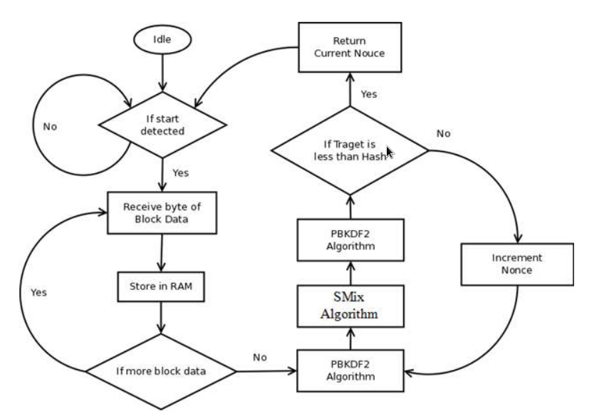
Device Operation
[insert flowchart]

Slide 6
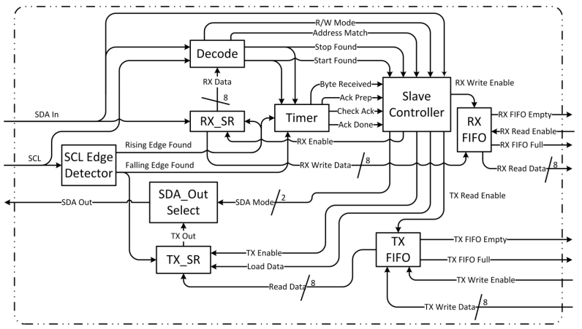
I2C Transceiver

Slide 7
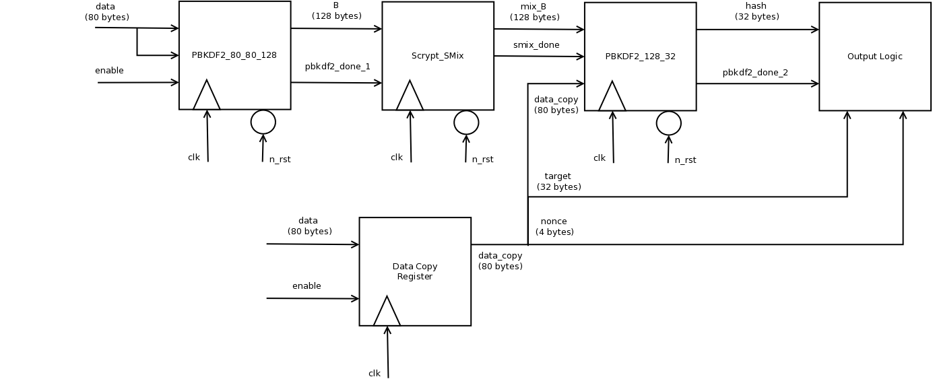
Scrypt_Top

Slide 8
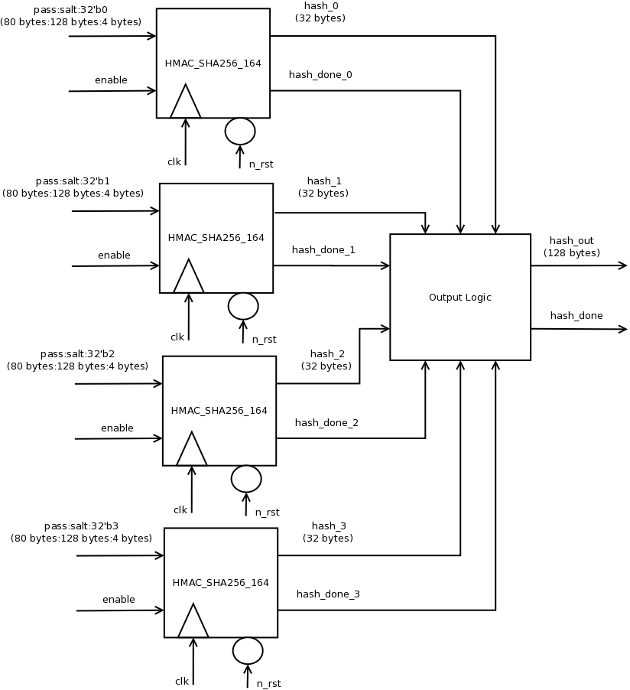
PBKDF2_80_80_128

Slide 9
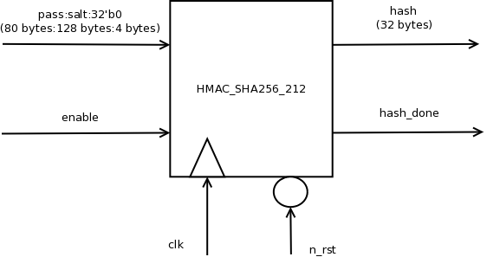
PBKDF2_80_128_32

Slide 10
HMAC_SHA256_164
HMAC_SHA256_212

Slide 11
HMAC_SHA256_32

Slide 12
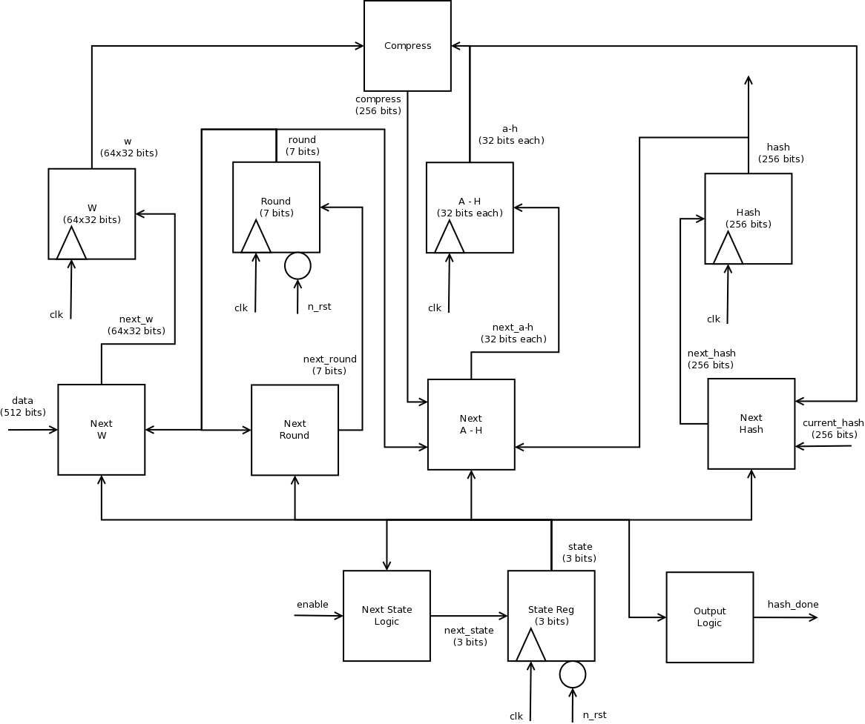
SHA256

Slide 13
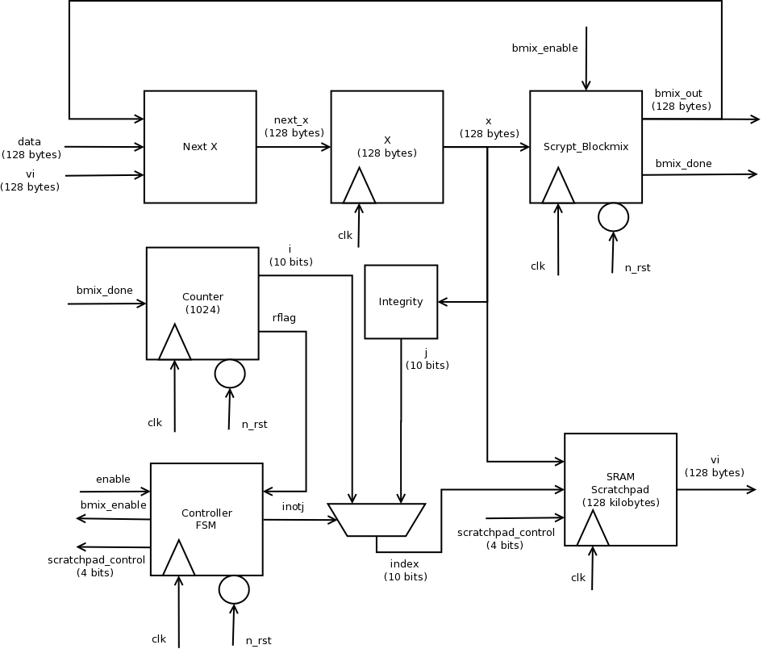
Scypt_SMix

Slide 14
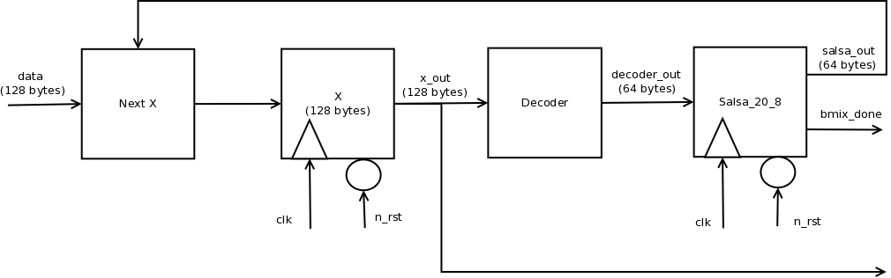
Scrypt_Blockmix

Slide 15
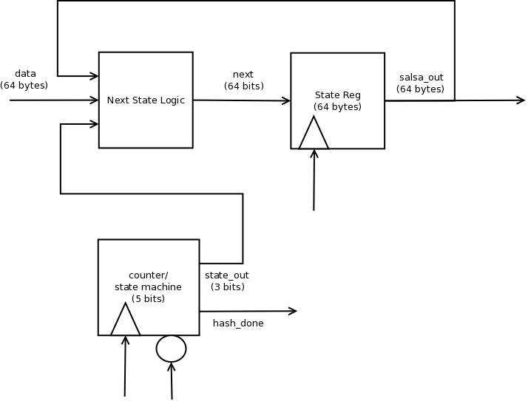
Salsa20_8

Slide 16
Budget Overview
54000000 um^2
Target frequency: 1/(6ns)
Primary area:
  SHA256 internal registers: 27 000 000
  Scrypt 128kB scratchpad: 9 600 000
Primary Timing
  SRAM -> mux -> FF: 5.5ns

