Slide 1

MACHINE LEARNING ANALYSIS OF RADIOLOGY SCANS FOR AUTOMATED DECISION SUPPORT IN LUNG CANCER DETECTION
May 8th , 2017
DAEN 690
-Lung Cancer Sleuths

Slide 2
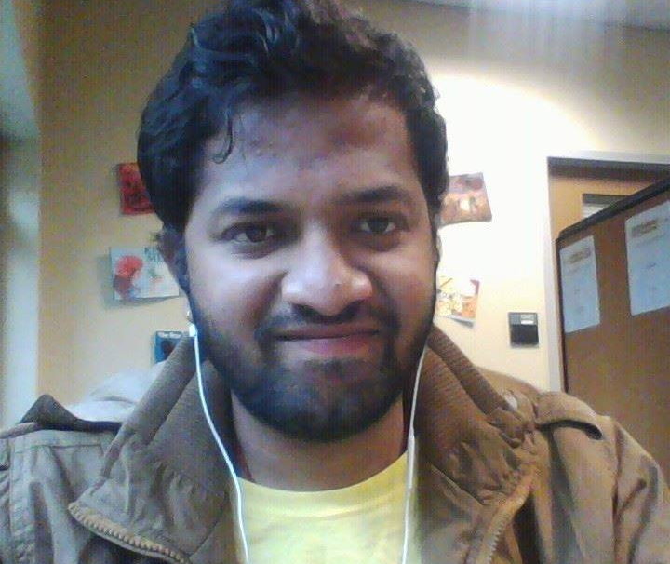
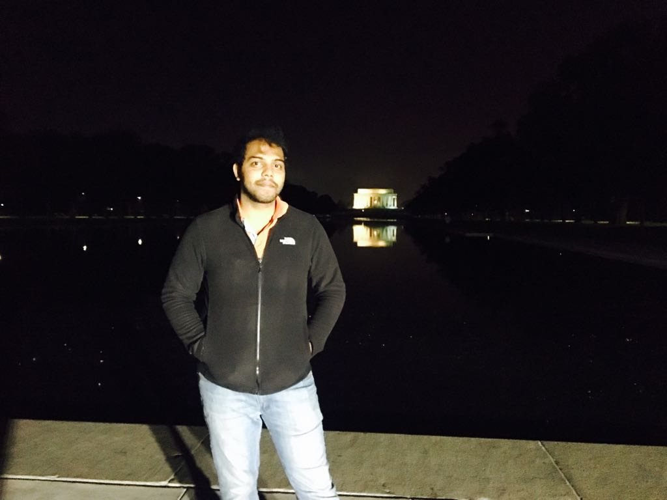
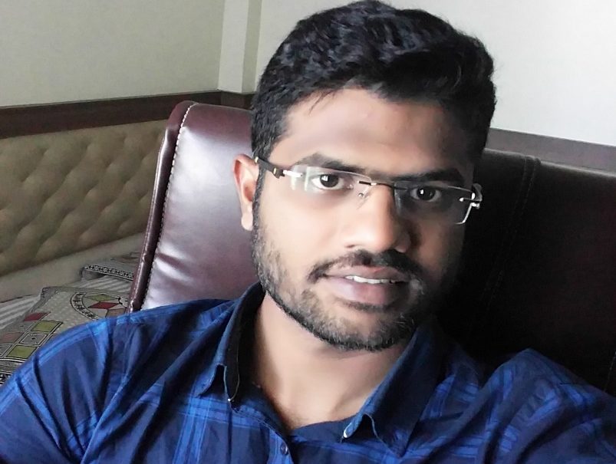
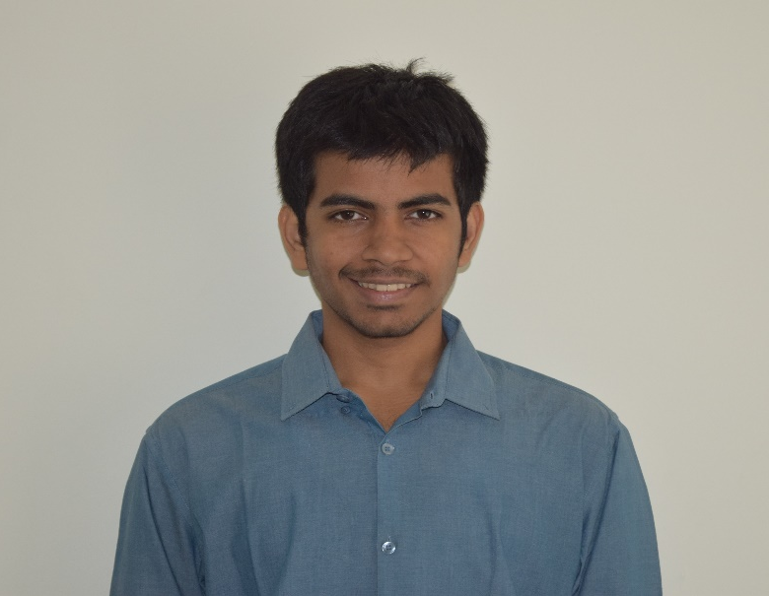
The Lung Cancer Sleuths
ANIRUDH
KC
VAMSHI
PRAGNAKAR

Slide 3
OUTLINE
DAEN 690
Introduction
Problem
Objectives
Data
Models

Slide 4
INTRODUCTION
DAEN 690
In the United States, lung cancer strikes 225,000 people every year, and accounts for $12 billion in health care costs.
Early detection is crucial to give patients the best chance at recovery and survival.
Cancer Moonshot, a new initiative to make a decade's worth of progress in cancer prevention, diagnosis, and treatment in just 5 years.
Kaggle in collaboration with Cancer Moonshot is convening the data science and medical communities to develop lung cancer detection algorithms.

Slide 5
PROBLEM?
DAEN 690
Present image assessments are identifying non cancerous lung lesions as potentially cancerous leading to
Unnecessary patient anxiety
Additional follow-up Imaging and interventional treatments
I.E the current semi automated-detection technology has a very high False positive rate

Slide 6
OBJECTIVES
DAEN 690
Using a data set of thousands of high-resolution lung scans provided by the National Cancer Institute, develop algorithms that accurately determine when lesions in the lungs are cancerous.
Build models that can act as decision support to the doctors in lung cancer detection
By this we intend to get patients earlier access to life-saving interventions, and give radiologists more time to spend with their patients.

Slide 7
DATA
DAEN 690
Data source
Provided by Kaggle as part of competition.
CT scans in DICOM(Digital Imaging and Communications in Medicine) format
Sample data
20 patient records. Approx. (1.5 GB )
Master copy
140 GB (approx. )
1596 patients records provided
1398 training data set
198 trial data set

Slide 8
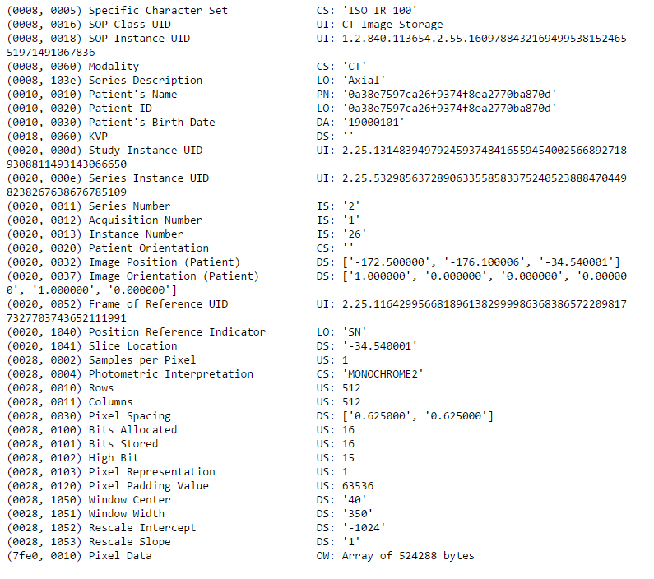
DAEN 690
Meta data included in one DICOM File.
Patient ID
Patient’s Birth date
Pixel Data
Image Position, Pixel Spacing
Rescale Intercept, Rescale slope

Slide 9
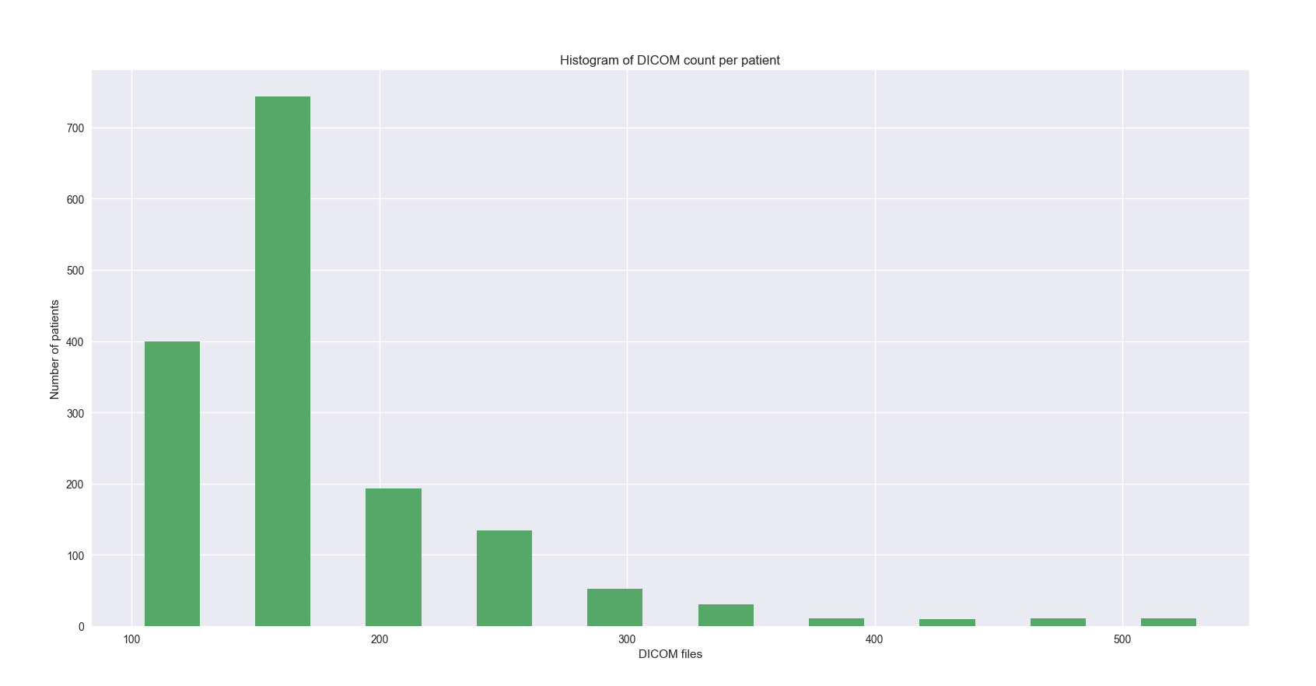
DAEN 690
Each patient scanned on different machines
Different no.of slices of CT scan for different patients
Image resolution remained same for all slices and all patients at (512X512)
A scan may have a pixel spacing of [2.5, 0.5, 0.5], which means that the distance between slices is 2.5 millimeters. For a different scan this may be [1.5, 0.725, 0.725]

Slide 10
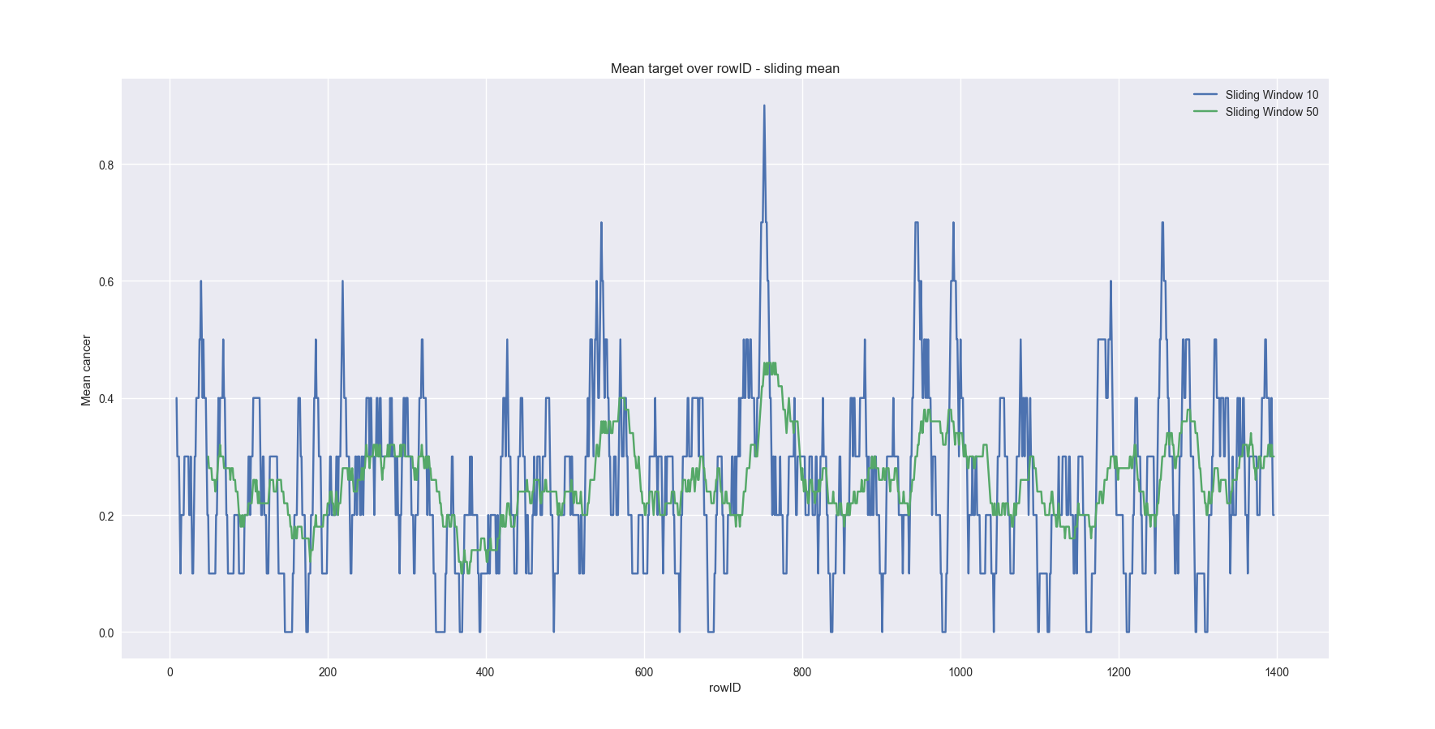
DAEN 690
Checking if there is relationship between patient ID and cancer
Number of training patients: 1398
Cancer rate: 25.91%

Slide 11
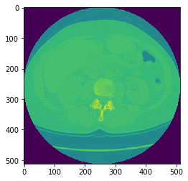
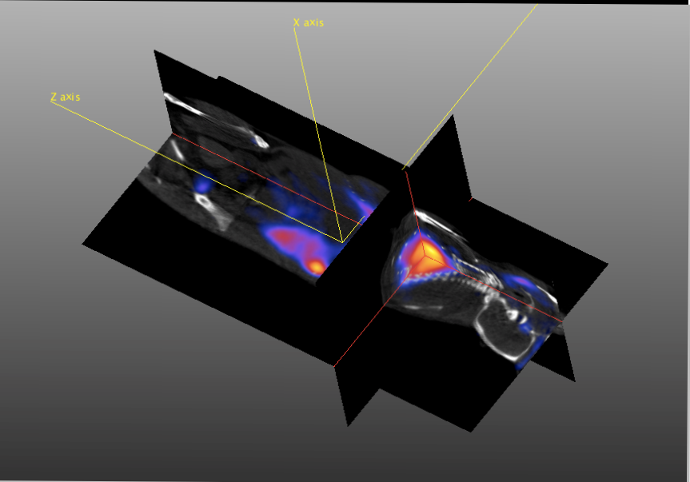
DATA PREPROCESSING
DAEN 690
(Initial image Pixel size) No . of slices
(512, 512) 134
(512, 512) 128
(512, 512) 133
(512, 512) 110
Images after resizing & Normalizing
(150,150) 20
(150,150) 20
(150,150) 20
(150,150) 20

Slide 12

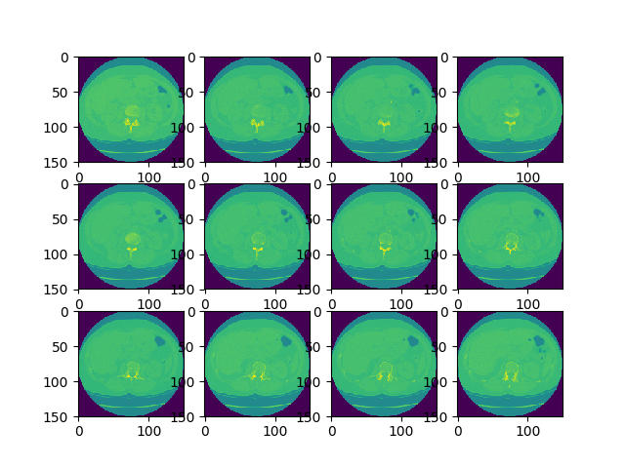



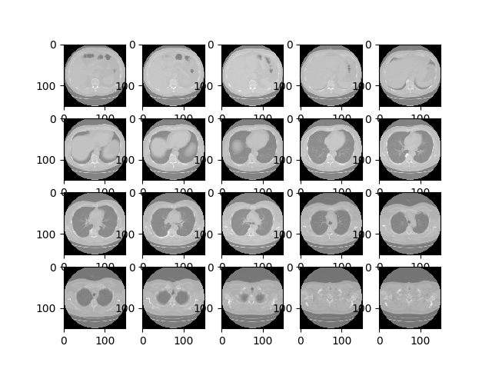

DAEN 690
Changed to greyscale in order to skip the complexities with colors during model building

Slide 13
MODELS
DAEN 690
CONVOLUTIONAL NEURAL NETWORKS
THEANOS
2D-CNN
WITHOUT MASKING
2D-CNN
WITH MASKING
TENSOR FLOW
3D-CNN
WITHOUT MASKING

Slide 14
Identify Lung tissues
Standardize the slices
Sampling

Slide 15
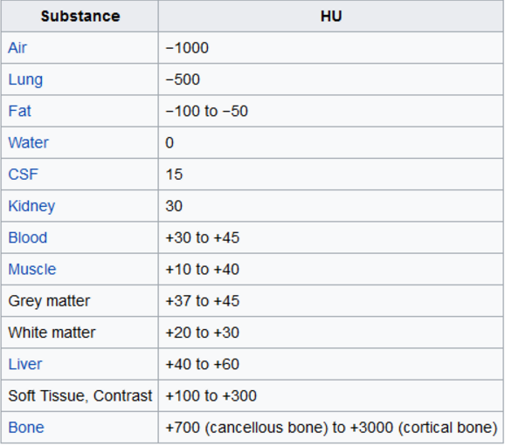
DAEN 690
Basics knowledge needed to understand CT scan and how 3D model generated
Hounsfield Unit (HU)
How to get 3D model from 2d samples provided
Segmentation

Slide 16
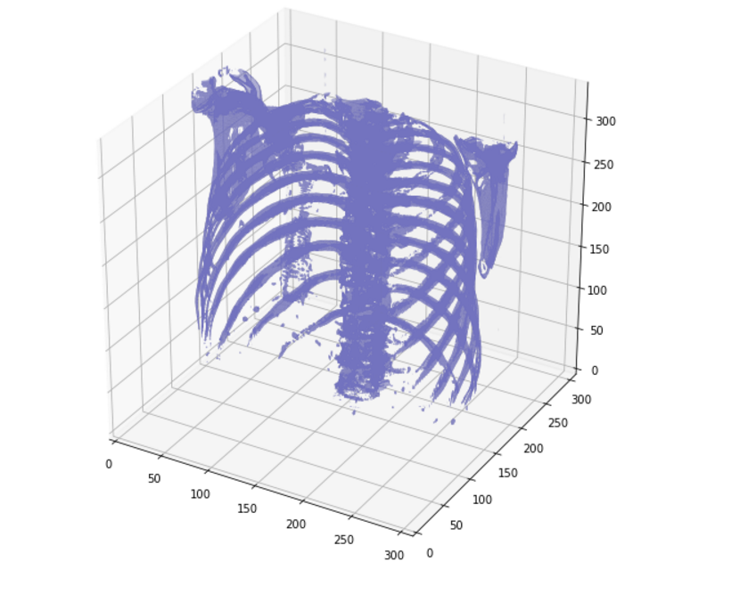
DAEN 690
Modeling the DICOM images to 3D by using HU unit

Slide 17
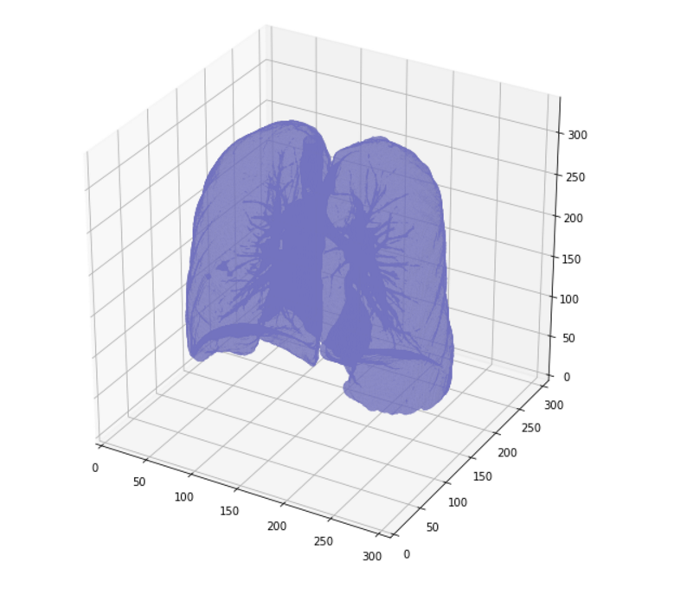
DAEN 690
Look at the insides

Slide 18
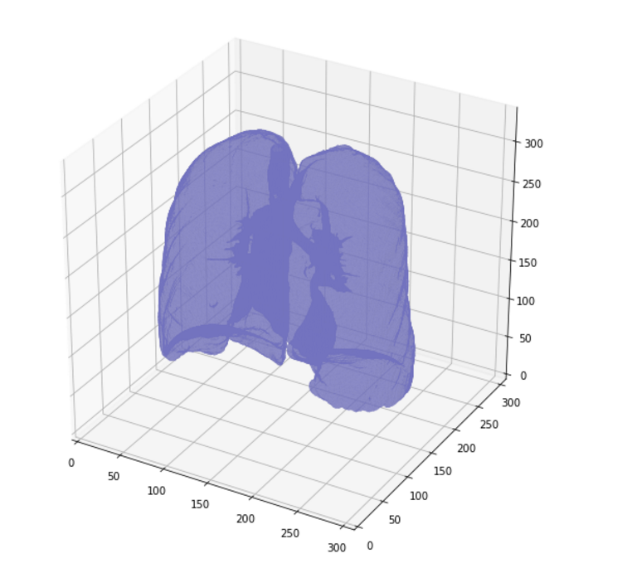
DAEN 690
Look at the inside

Slide 19
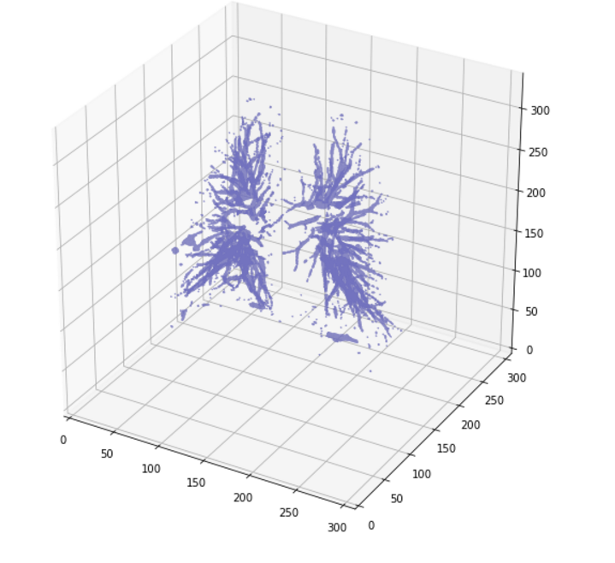
DAEN 690
This is the difference between the last 2 images and data points are extracted.

Slide 20
We would like to thank:
DAEN 690
Professor F. Brett Berlin, Term Professor DAEN 690, GMU.
For guiding us at every step for successful completion and extending full support for providing high computational resources. Without him we wouldn’t meet the deadline.
Dr. Jayshree Sarma, Interim Director, Research Computing, GMU.
For providing cluster access and for teaching us how to use the cluster efficiently for our needs. She spent hours sitting along and had been guiding us through obstacles.
Md Anindya Prodhan, Research Assistant, UVA.
For driving all the way from Charlottesville, to help us gain access to XCG, and helping us when we were struck with technical complications.

Slide 21
THANK YOU…
DAEN 690
WE ARE OPEN FOR QUESTIONS & DISCUSSION
Happy Graduation…!!!*

