Slide 1
Coding Enigma
Kristen Cunningham and scott maxa

Slide 2
History
Enigma patented in 1918
Patented by Arthur Scherbius
First sold commercially to German banks and businesses
Extended machine used for WWII
Added the plugboard
Key sheets
Issued month by month
Indicated enigma set up instructions for each day that month
Closely guarded and printed in soluble ink

Slide 3
Breaking Enigma
Polish had various techniques for cracking enigma before WWII
Keyword clues in ciphertexts
Weather Report and Heil Hitler
German Girlfriends – “Cilli”
Swearwords
Alan Turing and the Bombe
Bombe reduced the number of possible combinations
Once broken, couldn’t use some of the information

Slide 4
Navy Enigma
Navy general suspected code was broken
Navy created M4 enigma machine
February 1st 1942
M4 codenamed Shark, Triton
Allowed machine to have 4 rotors instead of three
Thin 4th rotor and thin reflector

Slide 5
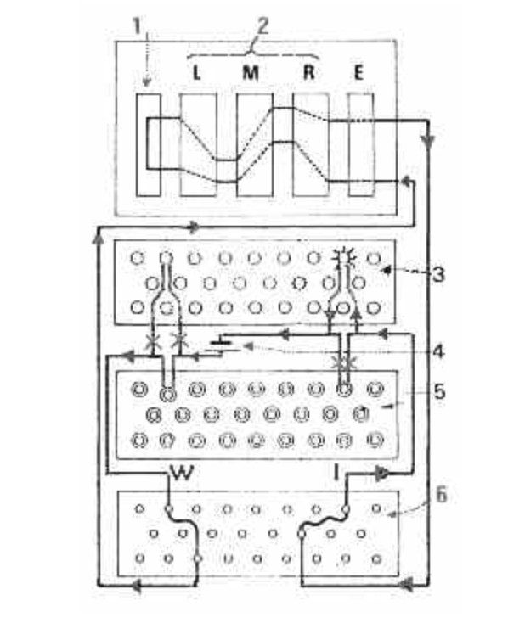
layout

Slide 6
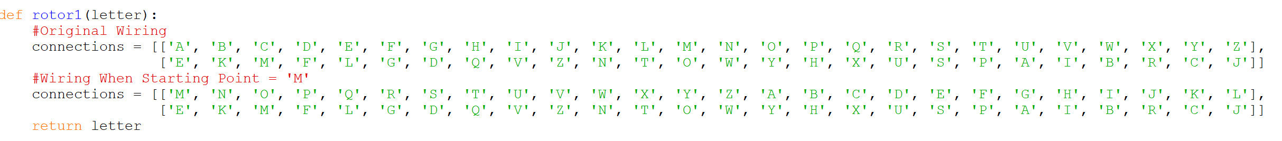
Inner Workings - Rotors
Each rotor had different wirings
Rotations
Fast rotor – each keyboard click
Medium rotor – every 26 clicks
Slow rotor – every 676 clicks
Eight Possible Rotors
Knock-out Effect

Slide 7
Inner Workings – Reflector and Plugboard
Plugboard
Additional 10 wirings
First and last step of the encryption
Reflectors
Middle stage of process
Different reflector options
Vital flaw: Made cipher unable to be same letter as plaintext

Slide 8
Implementation

Slide 9
Demo

Slide 10
TRIVIA

