Slide 1
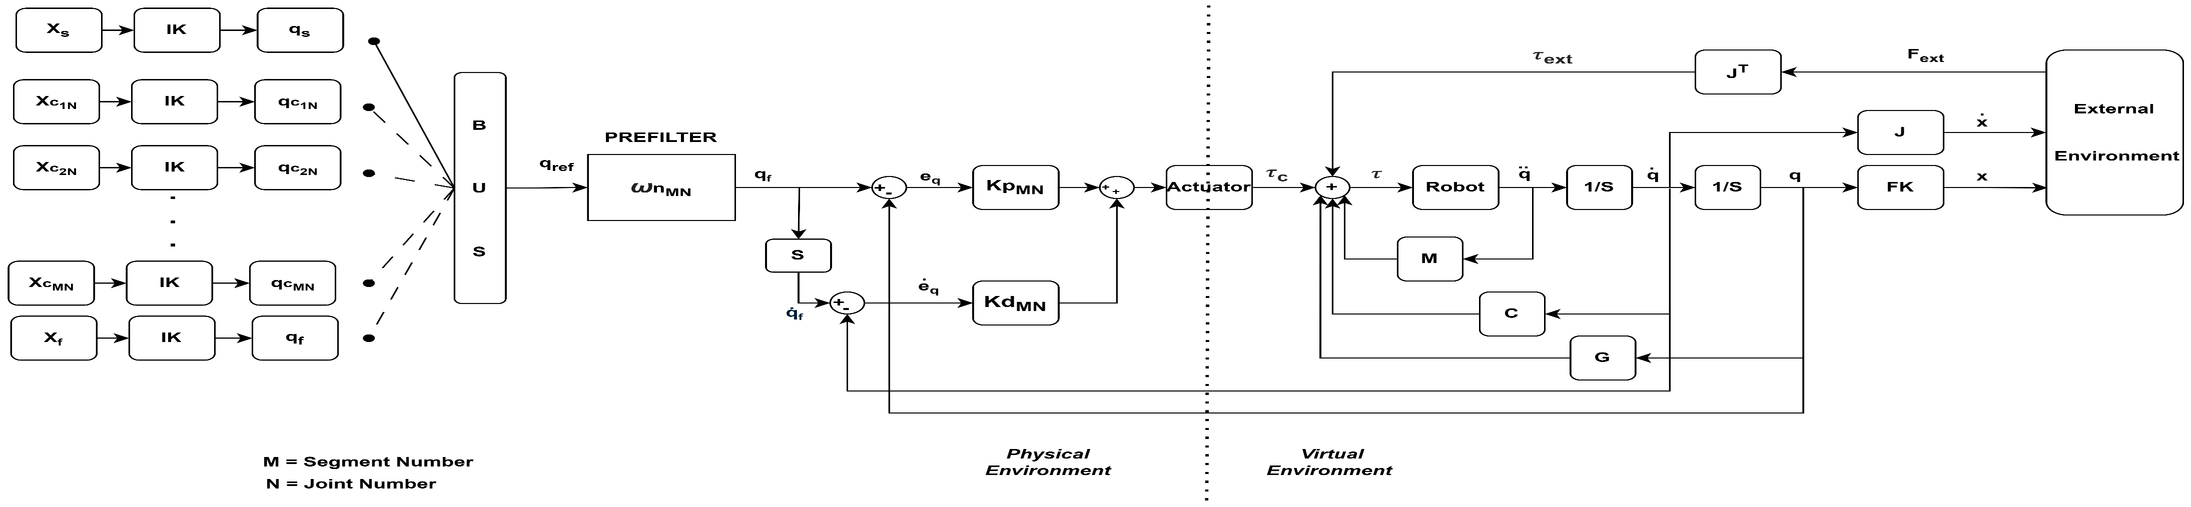
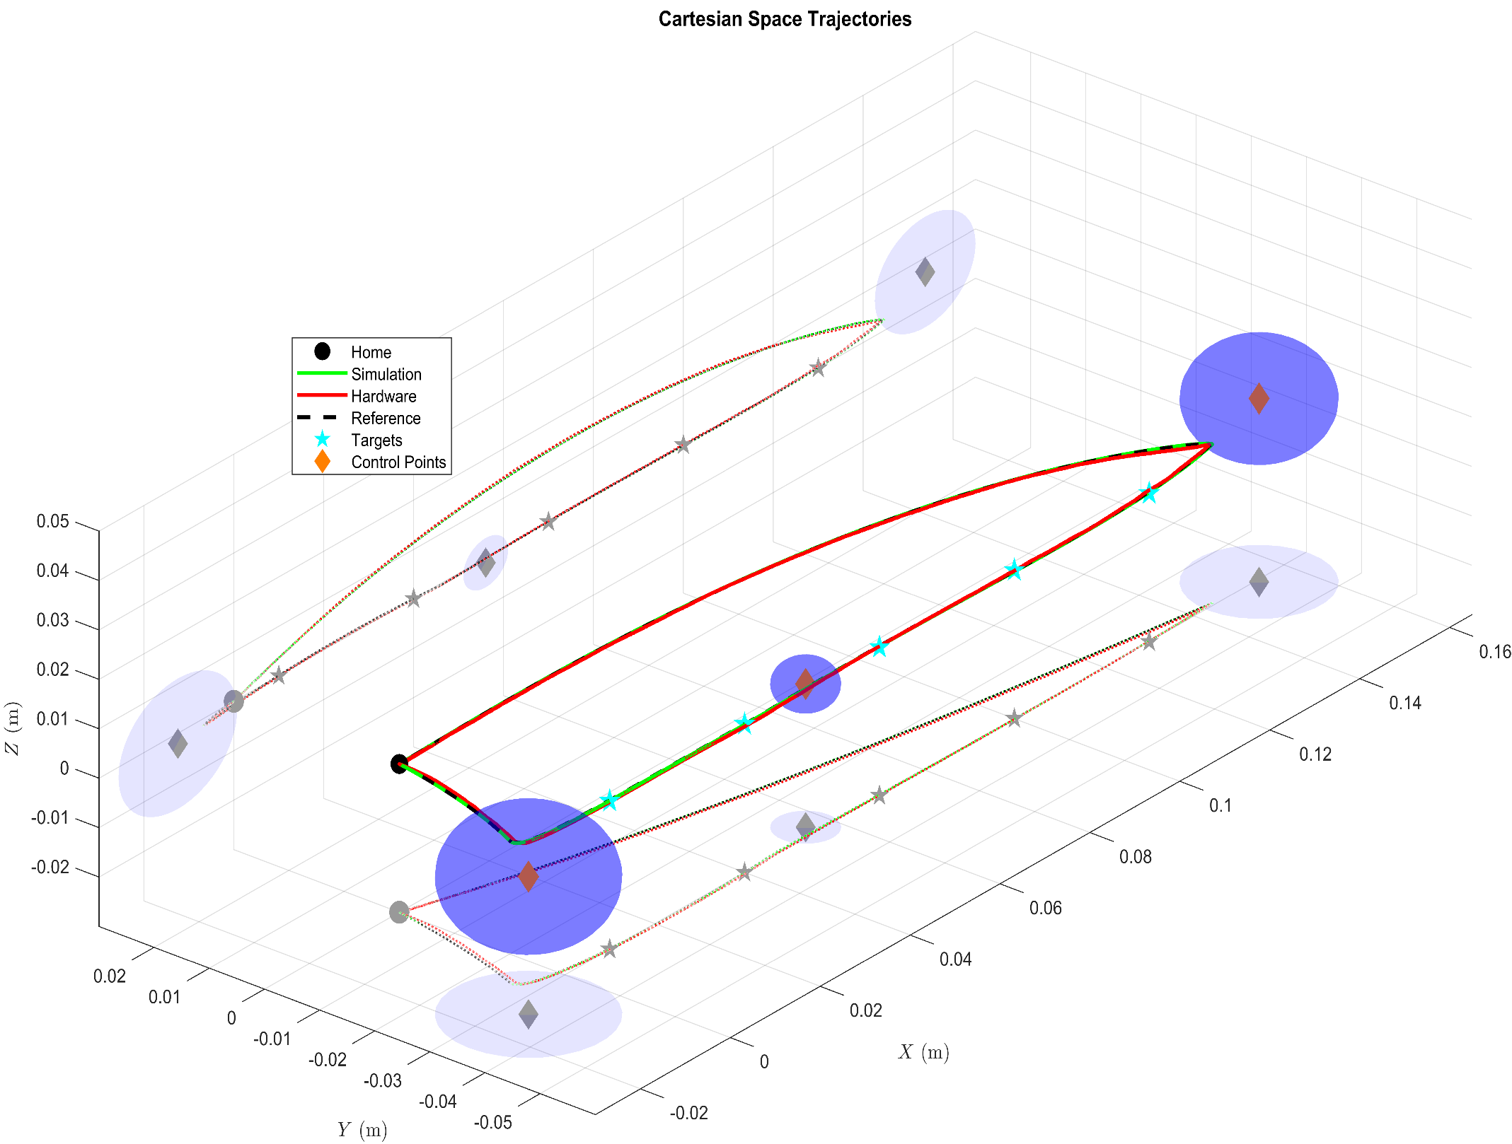
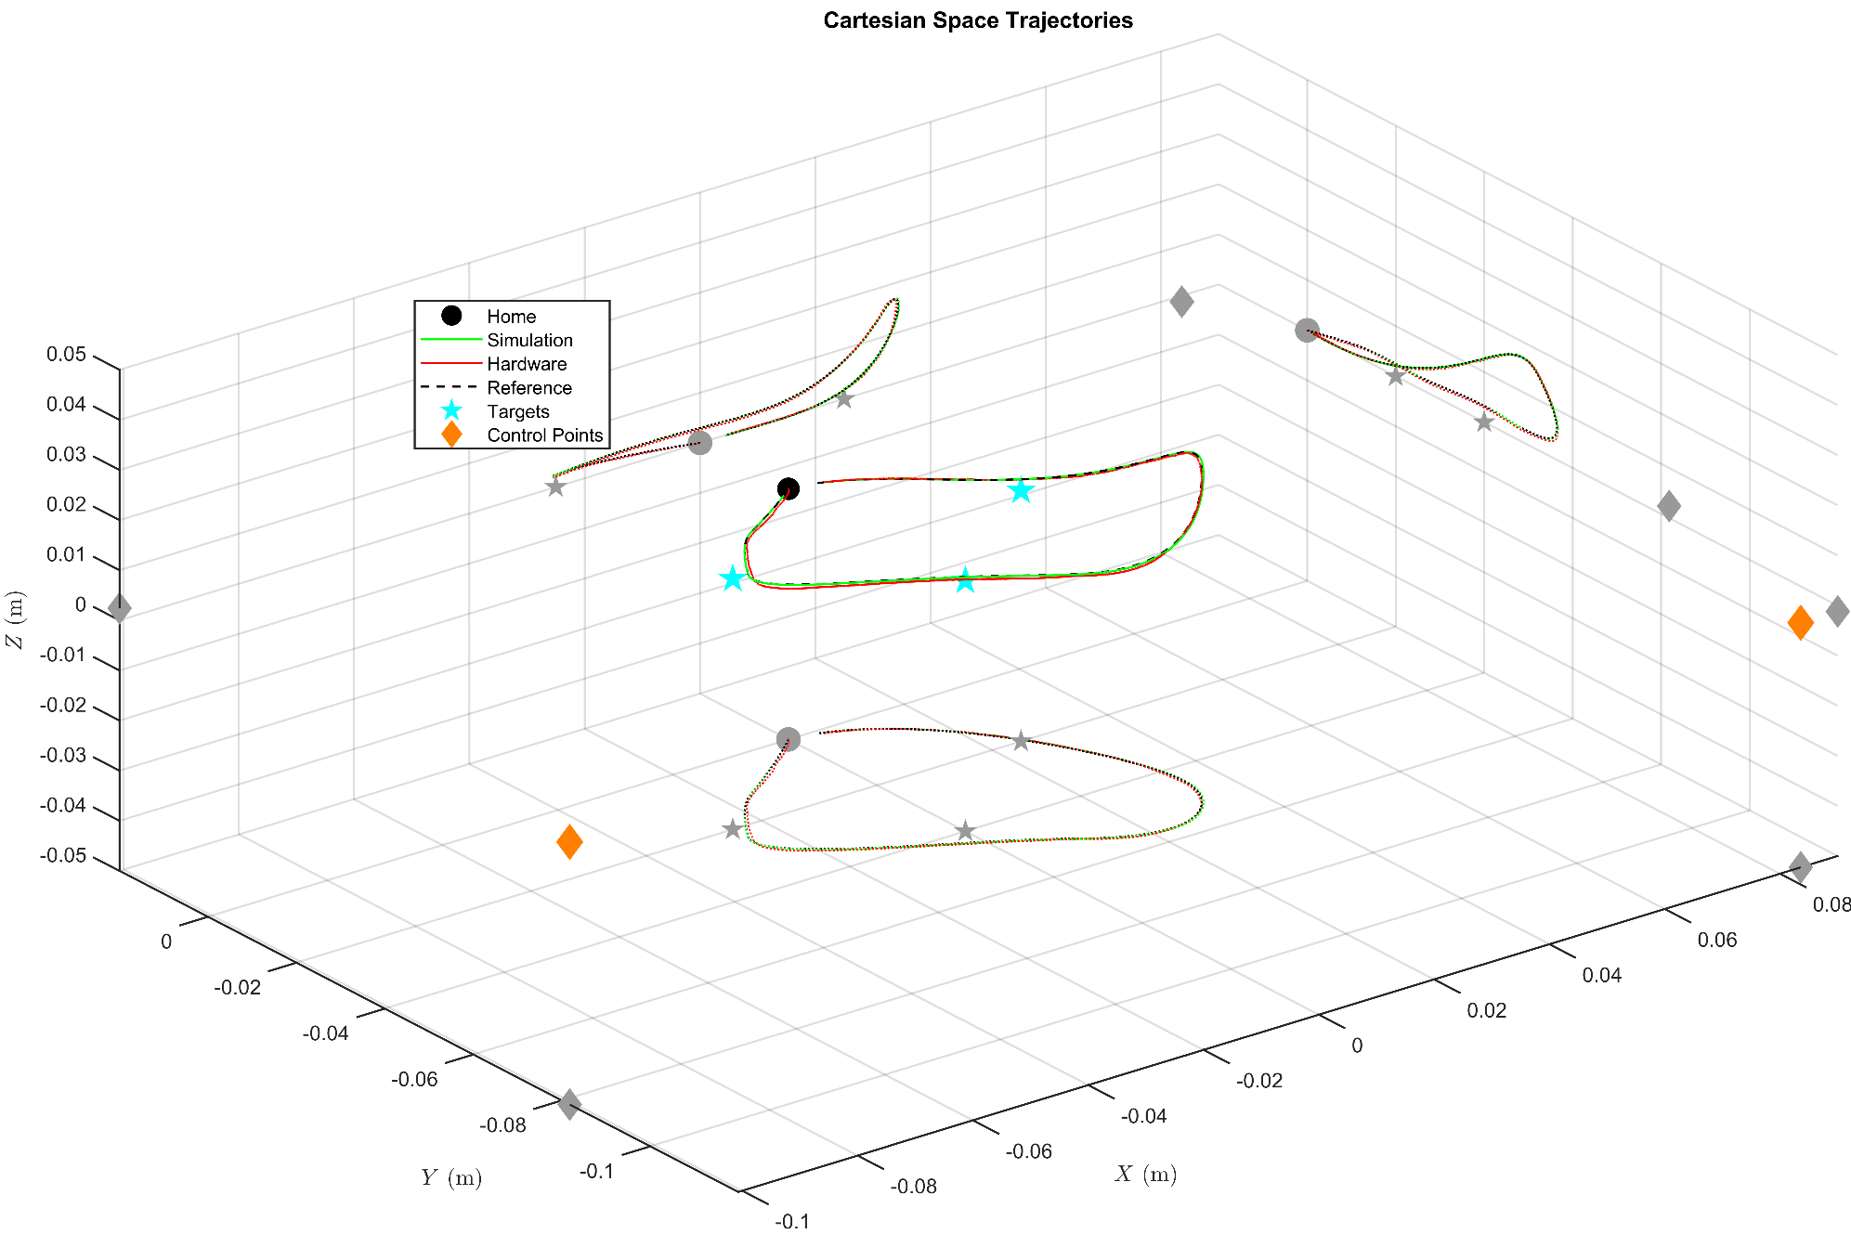
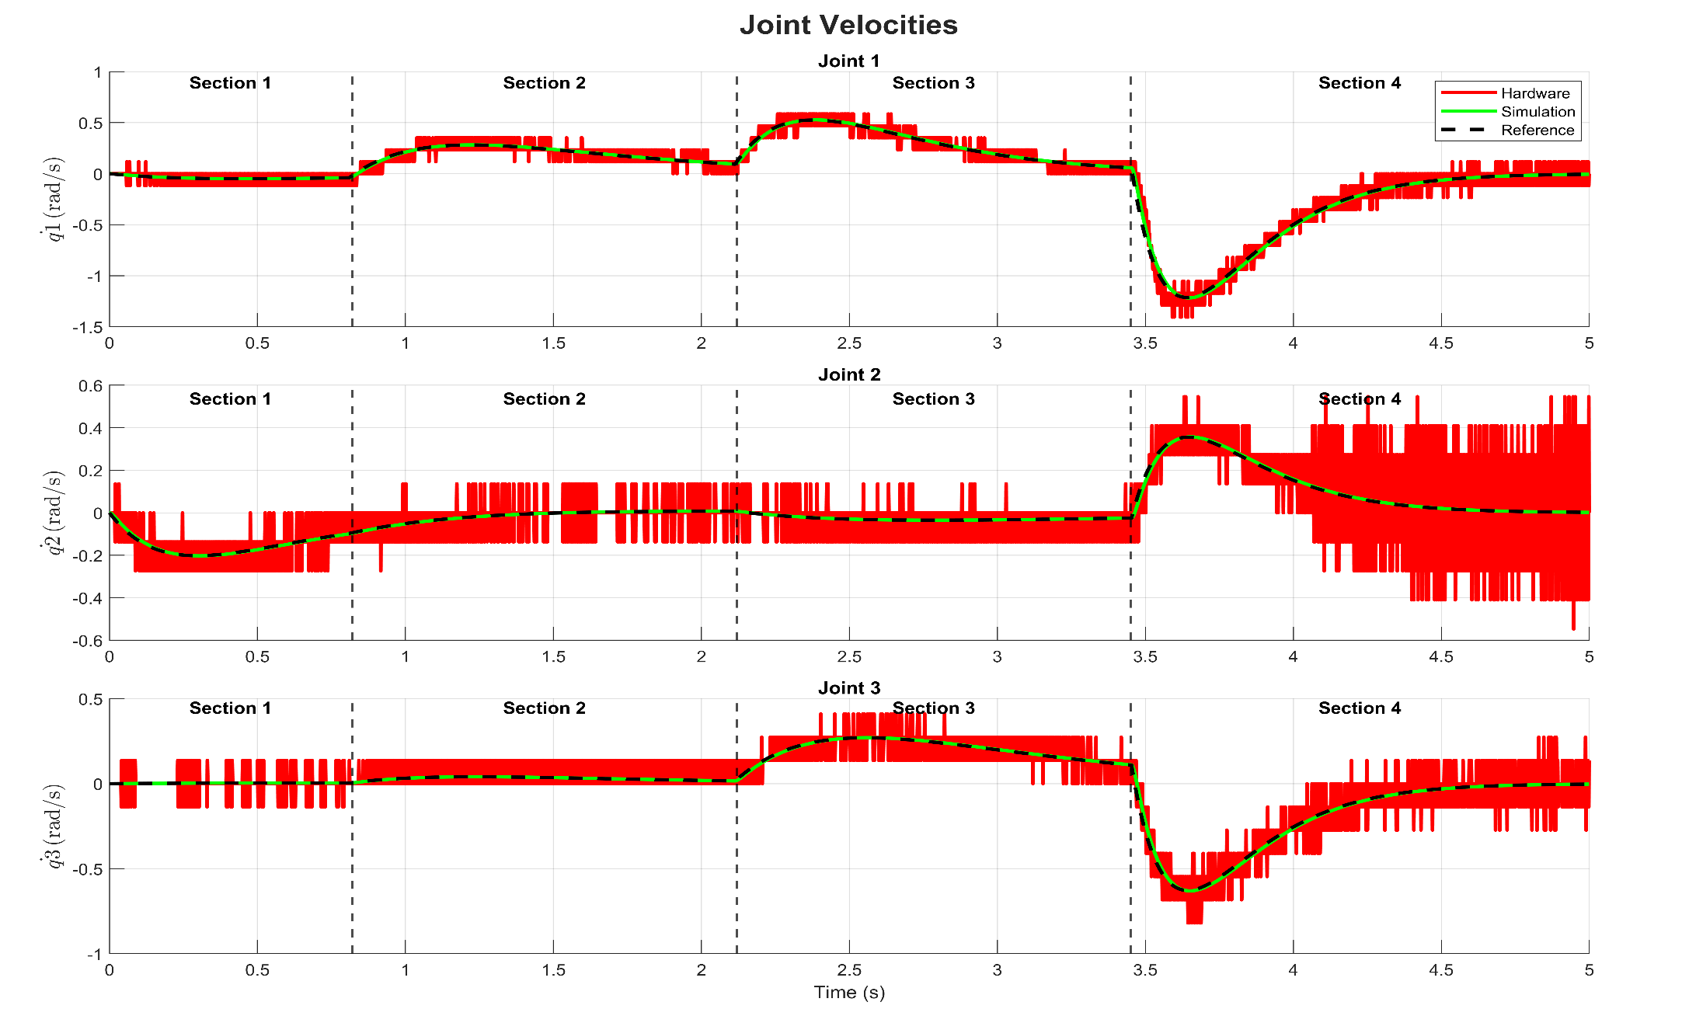
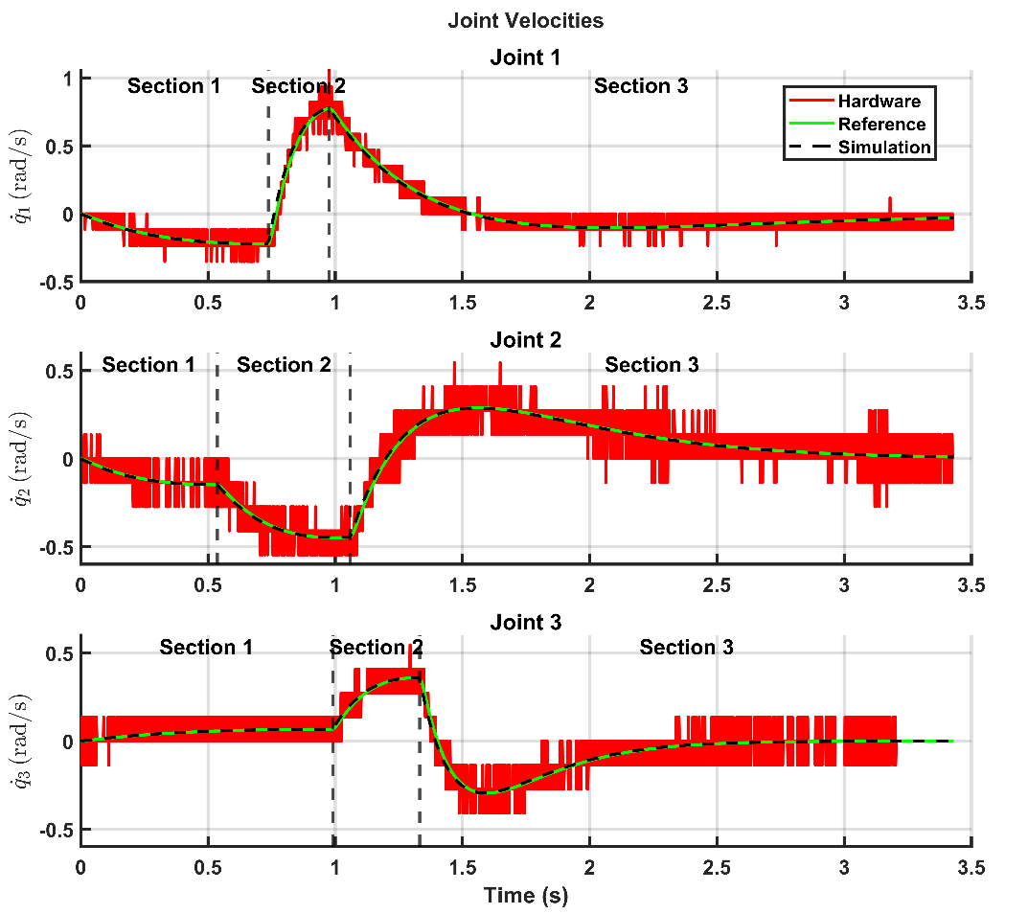
Dynamically Aware Robot Trajectory
Generation and Optimisation
Koray Can YIGIT | William HARWIN
Introduction
Materials and Methods
Hypersphere Position Switching
Maximum Velocity Switching
Conclusion
Experimental results show a significant improvement in trajectory adaptability, motion smoothness, while exploiting intrinsic dynamic properties of the robot and maintaining stable performance in unstructured environments.

