Slide 1
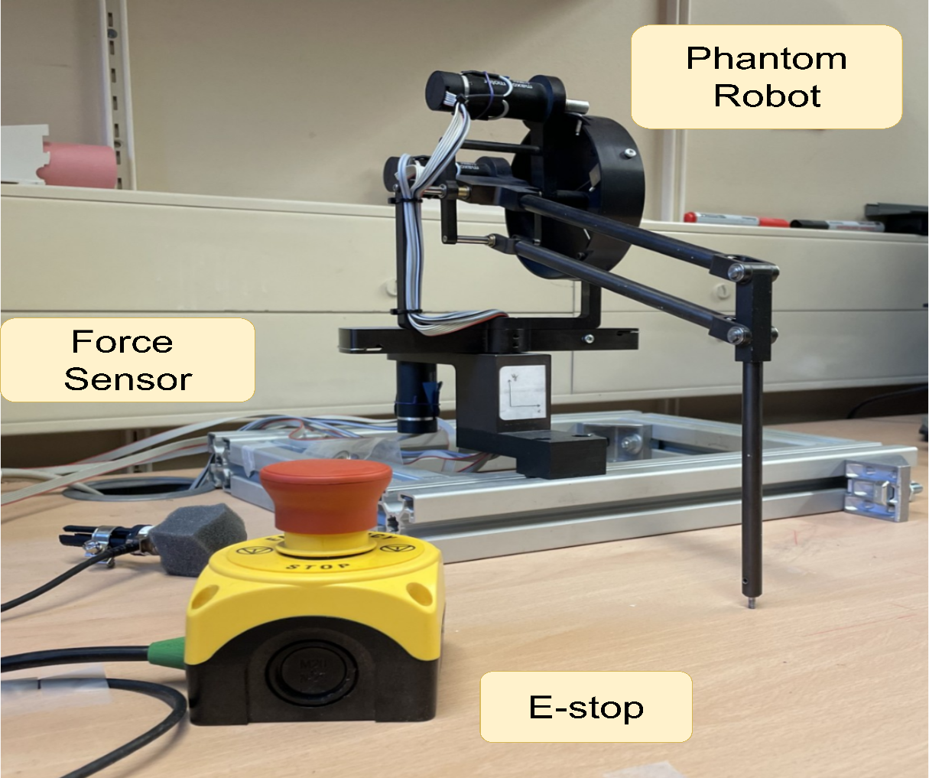
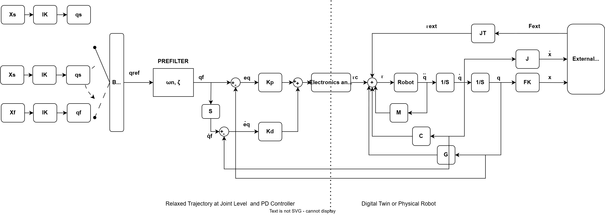
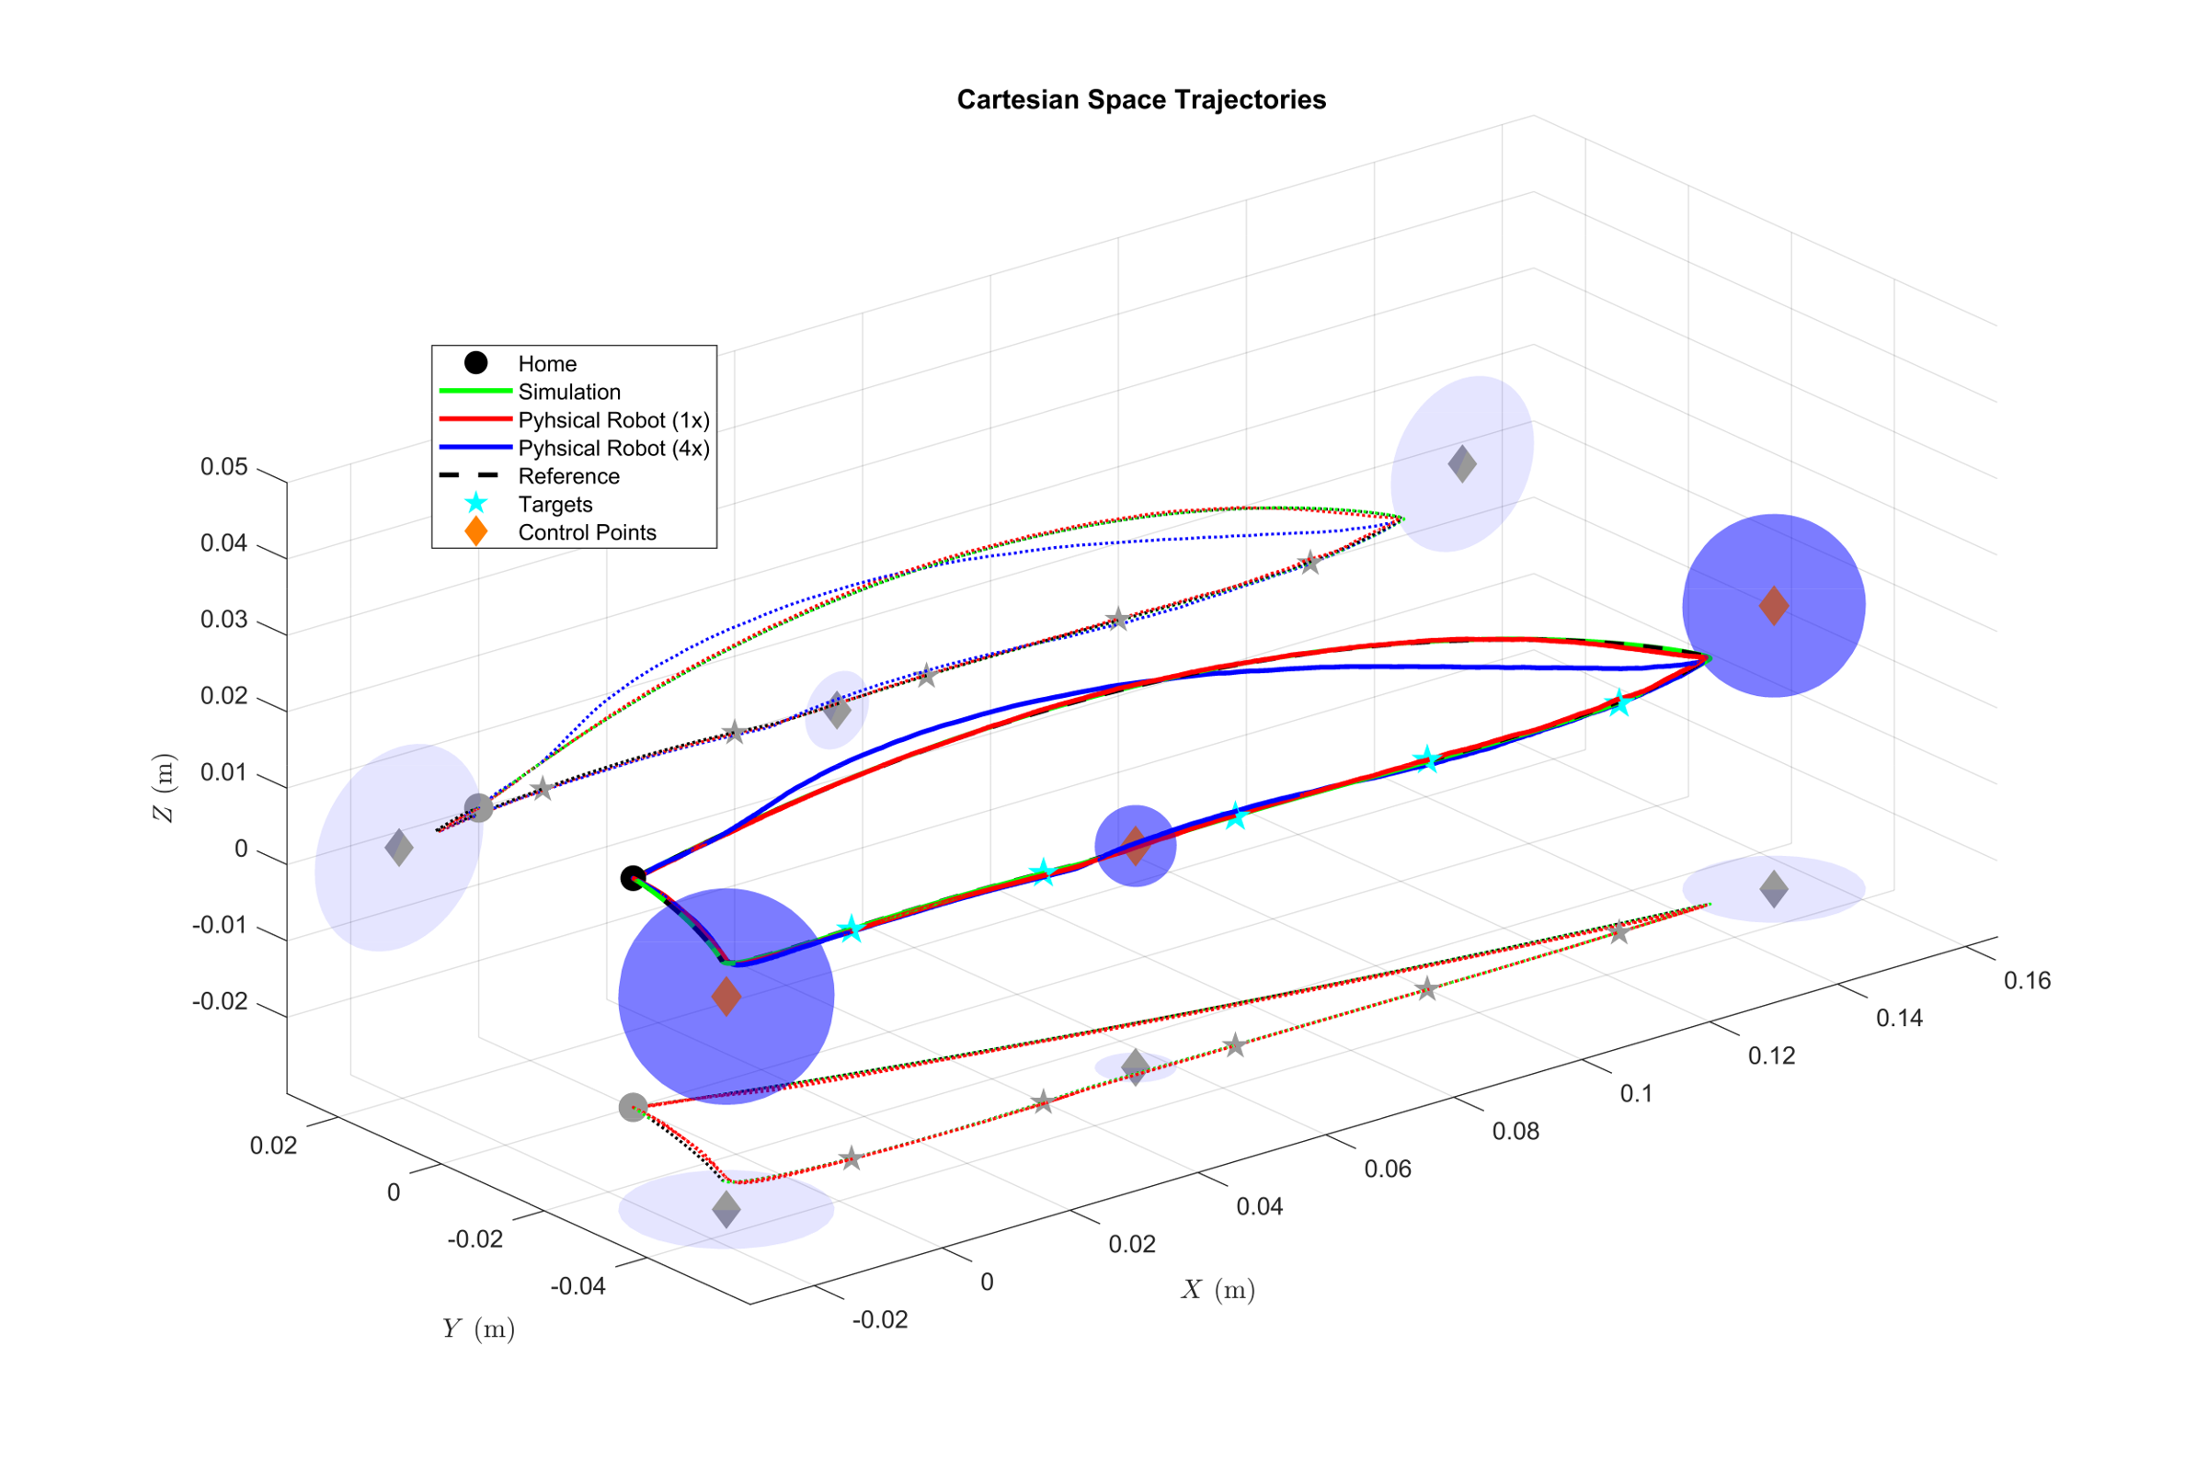
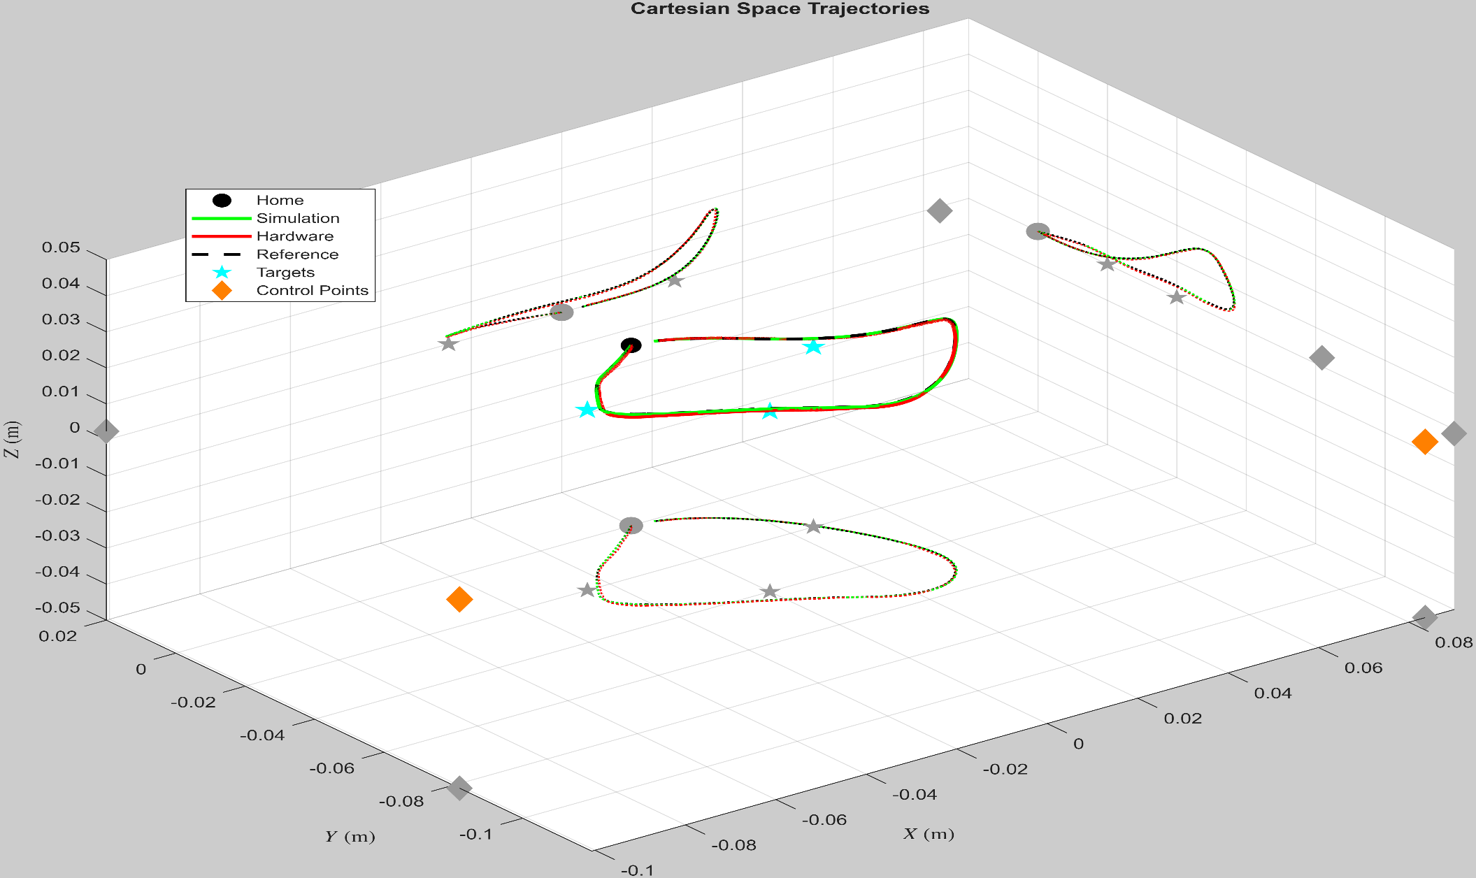
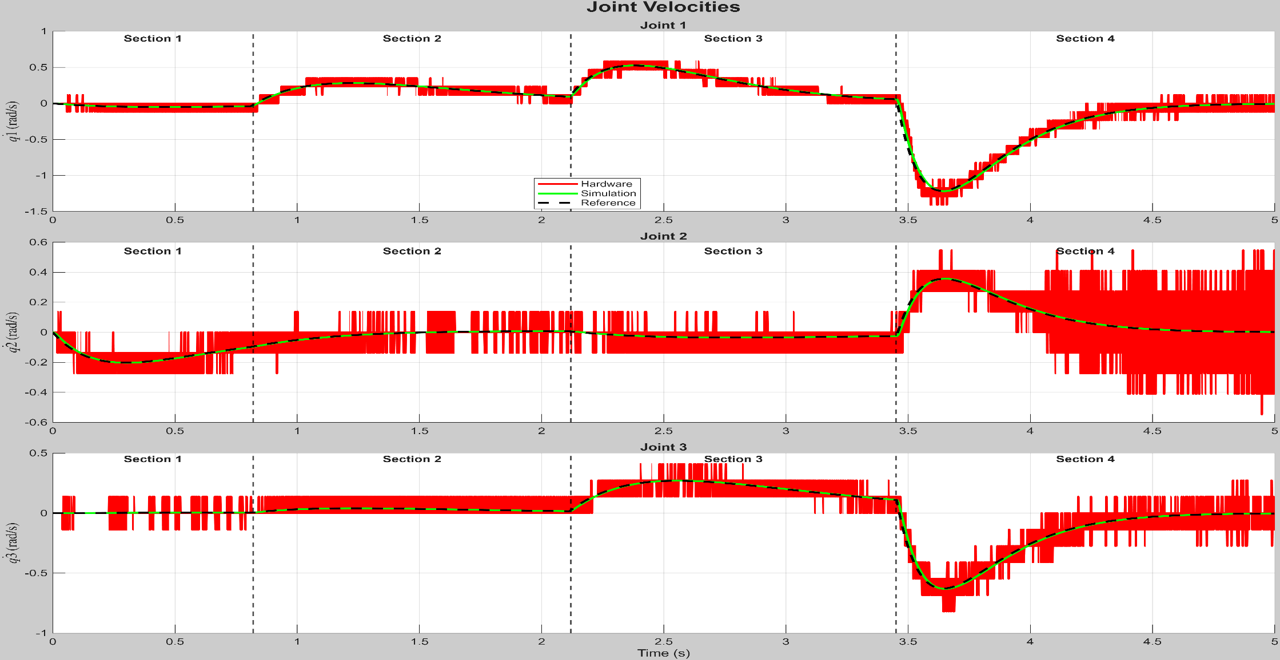
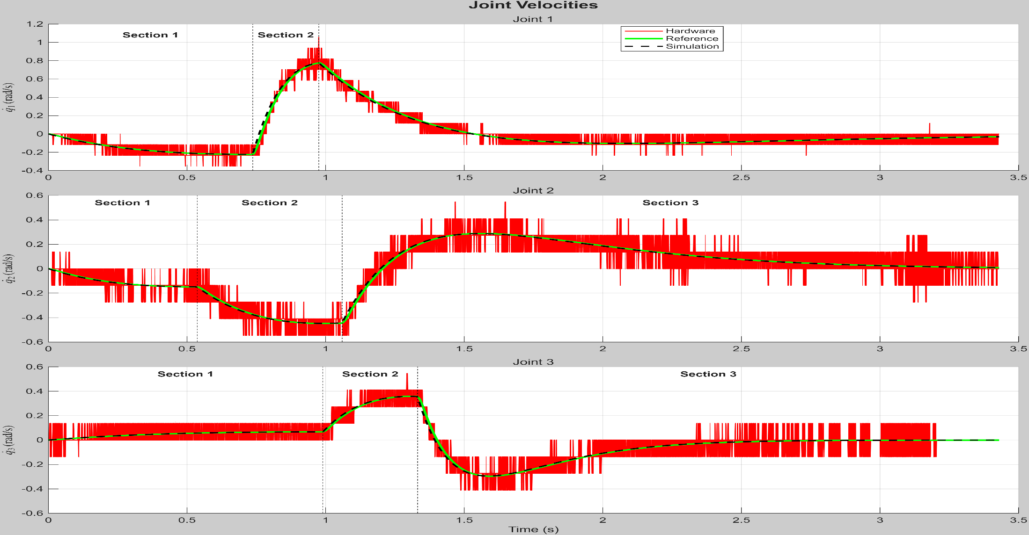
Dynamically Aware Robot Trajectory Generation and Optimisation
Koray Can YIGIT | Ozan TOKATLI | William HARWIN
Introduction
Methods and Advantages
The proposed relaxed trajectory method embeds the robot’s full closed-loop dynamics directly into the trajectory generation process.
Trajectory generation is critical to robotic motion planning, yet conventional kinematic methods often ignore robot dynamics, actuator limits, and controller effects, leading to trajectories that are infeasible in practice.
This work proposes a dynamics-aware relaxed trajectory optimization framework that explicitly incorporates robot dynamics, actuator constraints, prefilter, and PD control into trajectory generation. The method simultaneously optimizes and deforms trajectories to ensure dynamic feasibility while enabling controlled trajectory ‘speed-up’ .
The proposed relaxed trajectory method embeds the robot’s full closed-loop dynamics directly into the trajectory generation process.
Trajectory generation is performed using either hypersphere state switching or maximum-velocity switching, which regulate state transitions in joint space while preserving Cartesian path constraints
The advantages:
  fewer control points,
  efficient computation,
  continuity of position and velocity,
  simple speed adaption while preserving nominal path shape,
  explicit robot dynamics.
Figure 1: Block diagram of the system of hypersphere state switching and maximum velocity switching
Hypersphere State Switching Method
Maximum Velocity Switching Method
Figure 2: Reference, simulation and hardware trajectories, including the home position, target position, control points and the associated sphere.
Figure 4: Reference, simulation and hardware trajectories, including the home position, target position, control points.
Minimum Distance
Minimum Distance
 | Target 1 | Target 2 (m) | Target 3 (m) | Target 4 (m) | Target 5 (m)
Reference Trajectory | 0.12 mm | 0.04 | 0.21 | 0.12 | 0.25
 | Target 1 (m) | Target 2 (m) | Target 3 (m)
Reference Trajectory | 0.00311 | 0.00508 | 0.00203
Table 1: Minimum distances between reference trajectory and targets
Table 2: Minimum distances between reference trajectory and targets
Figure 3: Shows the joint velocities following optimization for the ref, sim and physical robot (x1). The observed variations result from changes in the section switching and prefilter parameters
Figure 5: The velocity switches upon reaching its maximum value
Conclusion
Experimental results show a significant improvement in trajectory adaptability, motion smoothness, while exploiting intrinsic dynamic properties of the robot and maintaining stable performance in unstructured environments.

