Slide 1
Heart Attack Risk Prediction Dataset
Group 1
Aaron, Karel, Mor, Whitney
Notes:
g

Slide 2
ABOUT
Our dataset contained data “relevant to heart health and lifestyle choices, encompassing patient-specific details such as age, gender, cholesterol levels, blood pressure, heart rate, and indicators like diabetes, family history, smoking habits, obesity, and alcohol consumption. Additionally, lifestyle factors like exercise hours, dietary habits, stress levels, and sedentary hours are included. Medical aspects comprising previous heart problems, medication usage, and triglyceride levels are considered. Socioeconomic aspects such as income and geographical attributes like country, continent, and hemisphere are incorporated. The dataset, consisting of 8763 records from patients around the globe, culminates in a crucial binary classification feature denoting the presence or absence of a heart attack risk, providing a comprehensive resource for predictive analysis and research in cardiovascular health.”
Notes:
Our data set source is Kaggle and we download a CSV file

Slide 3
Project Overview
Our project aims to provide a thorough analysis of heart attack risk factors, with the goal of characterizing potential areas for further research and intervention to bring light and to identify the risk factors in patients. By using our data tools and findings, we hope to improve the ease with which future data analysts can make conclusions on this data.

Slide 4
Ethical considerations
In our project we all made an effort to be guided by ethical considerations in regards to the data and the code we wrote.
We made sure to pull the data we had from an open source, with no conflicts in regards to legal, privacy, or other ethical concerns.
While we are using synthetic data in our project, it was treated like real data, and all patients are anonymous, only referenced by a random ID.
Using a new coding language for this project, a lot of research went into the syntax and commands to use; all code that we used or were inspired by was pulled from the data sources listed later in our presentation.

Slide 5
Dataset Glossary
Patient ID - Unique identifier for each patient
Age - Age of the patient
Sex - Gender of the patient (Male/Female)
Cholesterol - Cholesterol levels of the patient
Blood Pressure - Blood pressure of the patient (systolic/diastolic)
Heart Rate - Heart rate of the patient
Diabetes - Whether the patient has diabetes (Yes/No)
Family History - Family history of heart-related problems (1: Yes, 0: No)
Smoking - Smoking status of the patient (1: Smoker, 0: Non-smoker)
Obesity - Obesity status of the patient (1: Obese, 0: Not obese)
Alcohol Consumption - Level of alcohol consumption by the patient (None/Light/Moderate/Heavy)
Exercise Hours Per Week - Number of exercise hours per week
Diet - Dietary habits of the patient (Healthy/Average/Unhealthy)
Previous Heart Problems - Previous heart problems of the patient (1: Yes, 0: No)
Medication Use - Medication usage by the patient (1: Yes, 0: No)
Stress Level - Stress level reported by the patient (1-10)
Sedentary Hours Per Day - Hours of sedentary activity per day
Income - Income level of the patient
BMI - Body Mass Index (BMI) of the patient
Triglycerides - Triglyceride levels of the patient
Physical Activity Days Per Week - Days of physical activity per week
Sleep Hours Per Day - Hours of sleep per day
Country - Country of the patient
Continent - Continent where the patient resides
Hemisphere - Hemisphere where the patient resides No
Heart Attack Risk - Presence of heart attack risk (1: Yes, 0:)

Slide 6
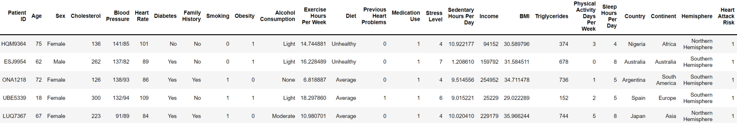
Original Structure of the Dataset

Slide 7
PROCESS AND DECISION MAKING
Brainstorm
Finalize Topic
Database
Data Collection & Cleaning
Final Review

Slide 8
TOOLS AND TECHNOLOGY USED
Polars
SQLite
QuickDBD
SQLAlchemy
Pandas

Slide 9
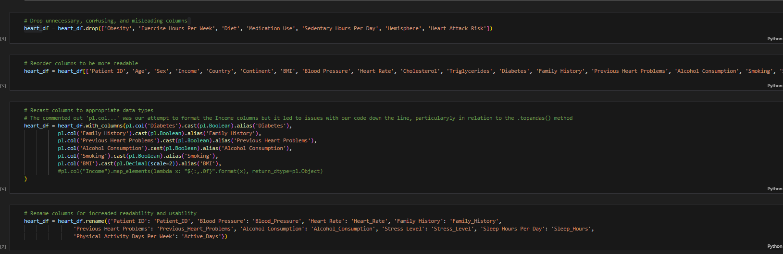
Data Cleaning/Transformation

Slide 10
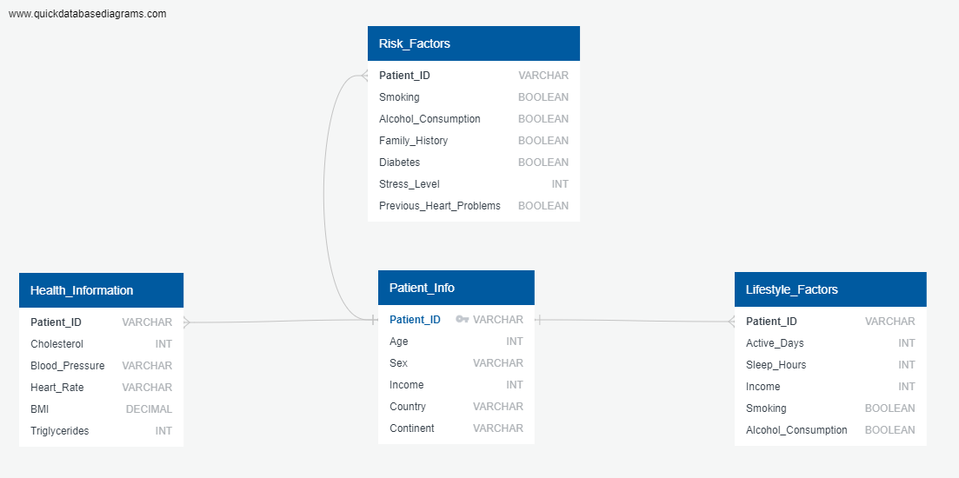
Entity-Relationship Diagram

Slide 11
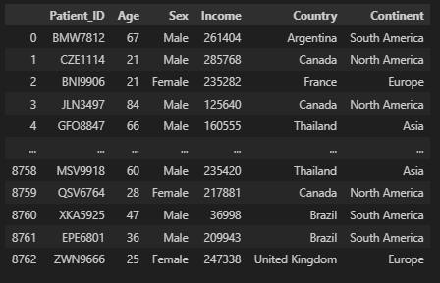
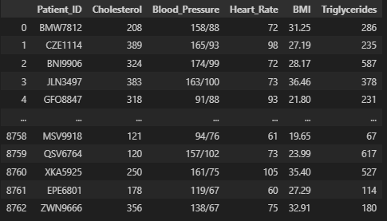
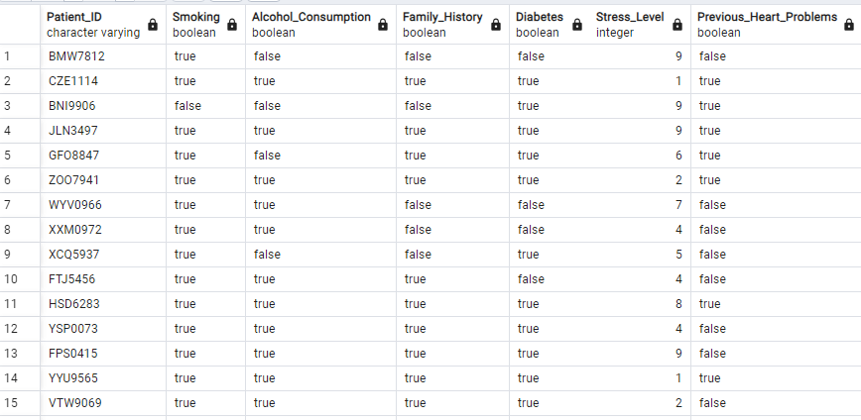
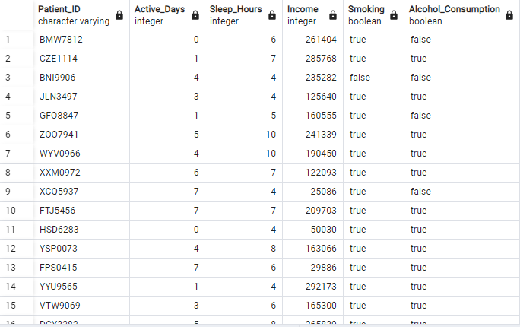
Final SQLite/SQLAlchemy Tables
Patient Info
Health Info
Risk Factors
Lifestyle Factors

Slide 12
Limitations in Coding
Polars
uses less memory
easy to use
faster
designed specifically for analyzing large data
Pandas
established community
functionality with other programs
easy for beginners

Slide 13
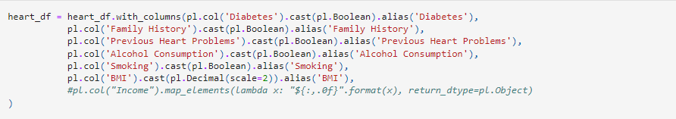
Example of Limitations in Polars

Slide 14
Limitations of Data
Verification of data:
trust in what patient says
uniformity of standards and definitions worldwide

Slide 15
Thank you

