Slide 1



DHARMSINH DESAI UNIVERSITY
NADIAD-387001, GUJARAT
ROIMA INTELLIGENCE
AHMEDABAD 380058, GUJARAT
Human Resource Management System
Developed at: Roima Intelligence, Ahmedabad
Developer: Dev Patel & Kishan Dervaliya - Department of CE, Dharmsinh Desai University
Guided By: Prof. Ami Shah(DDU) and Yash Shah(Roima Int.)

Slide 2
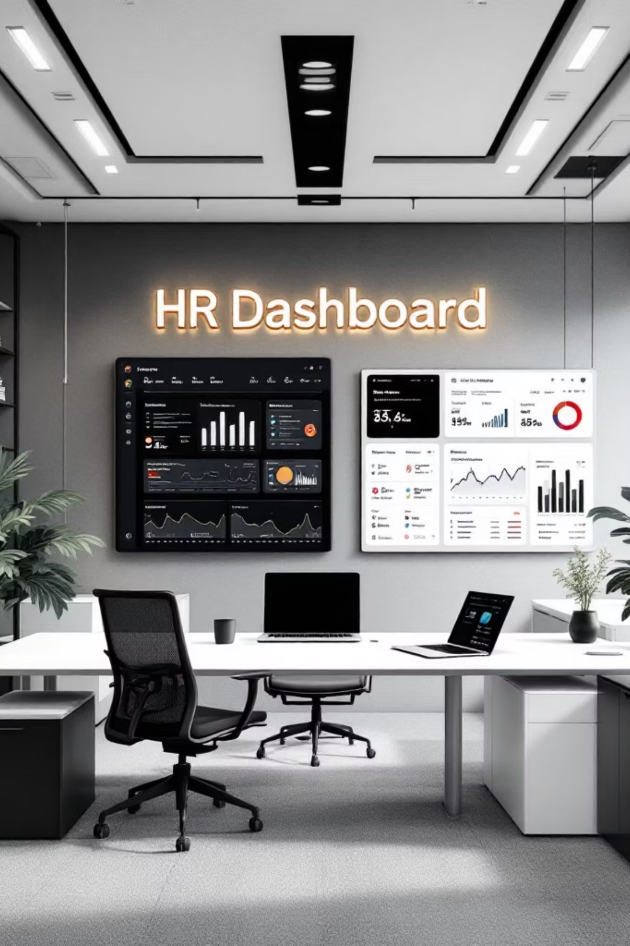
Traditional Approach
Employee record were store in physical or basic spreadsheets, making it difficult to manage.
HR tasks such as travel approval and expense submission, Job management and internal communication were handled manually through emails or forms.
Process was time consuming and prone to human errors.
Tracking employee activities and documents was not centralized, causing delays and confusion.

Slide 3
Project Overview
Purpose : Streamlining organizational operations through automation and intelligent resource management
What is HRMS?
Core Purpose
A comprehensive digital solution that modernizes internal organizational workflows, providing a unified platform for employees, managers, and HR professionals to interact seamlessly.
Create transparent, automated environment for internal operations—from travel logistics to employee engagement and resource scheduling.
Travel & Expenses
Social Engagement
Automated tracking with 10-day submission window
Achievement feed with automated celebrations
Resource Scheduling
Recruitment
Fair-rotation algorithm for office amenities
Job sharing and referral tracking system

Slide 4

Technology Stack
Spring Boot
Robust RESTful API with JWT-based authentication and Spring Security for enterprise-grade backend
React & TypeScript
Component-based UI development with type safety, Vite for fast building, and Tailwind CSS for modern design
MS SQL Server
Structured data management with complex relationship handling and recursive organizational chart support
TanStack Query
Advanced server-state management with caching, background synchronization, and infinite scrolling

Slide 5
Key Features
01
02
Travel Assignment & Logistics
Expense Submission System
HR creates travel plans with document uploads; automated SMTP notifications sent to employees
10-day validation rule enforces financial discipline; digital proof uploads with HR approval workflow
03
04
Fair-Rotation Game Scheduling
Social Achievement Feed
Round-robin algorithm ensures equitable access to office games; prevents slot hogging
Infinite scroll performance; automated birthday and anniversary posts; engagement tracking
05
06
Job Referral Module
Interactive Org Chart
Share positions with friends; track candidate status; referral bonus tracking system
Recursive hierarchy visualization; debounced search; reporting line clarity

Slide 6
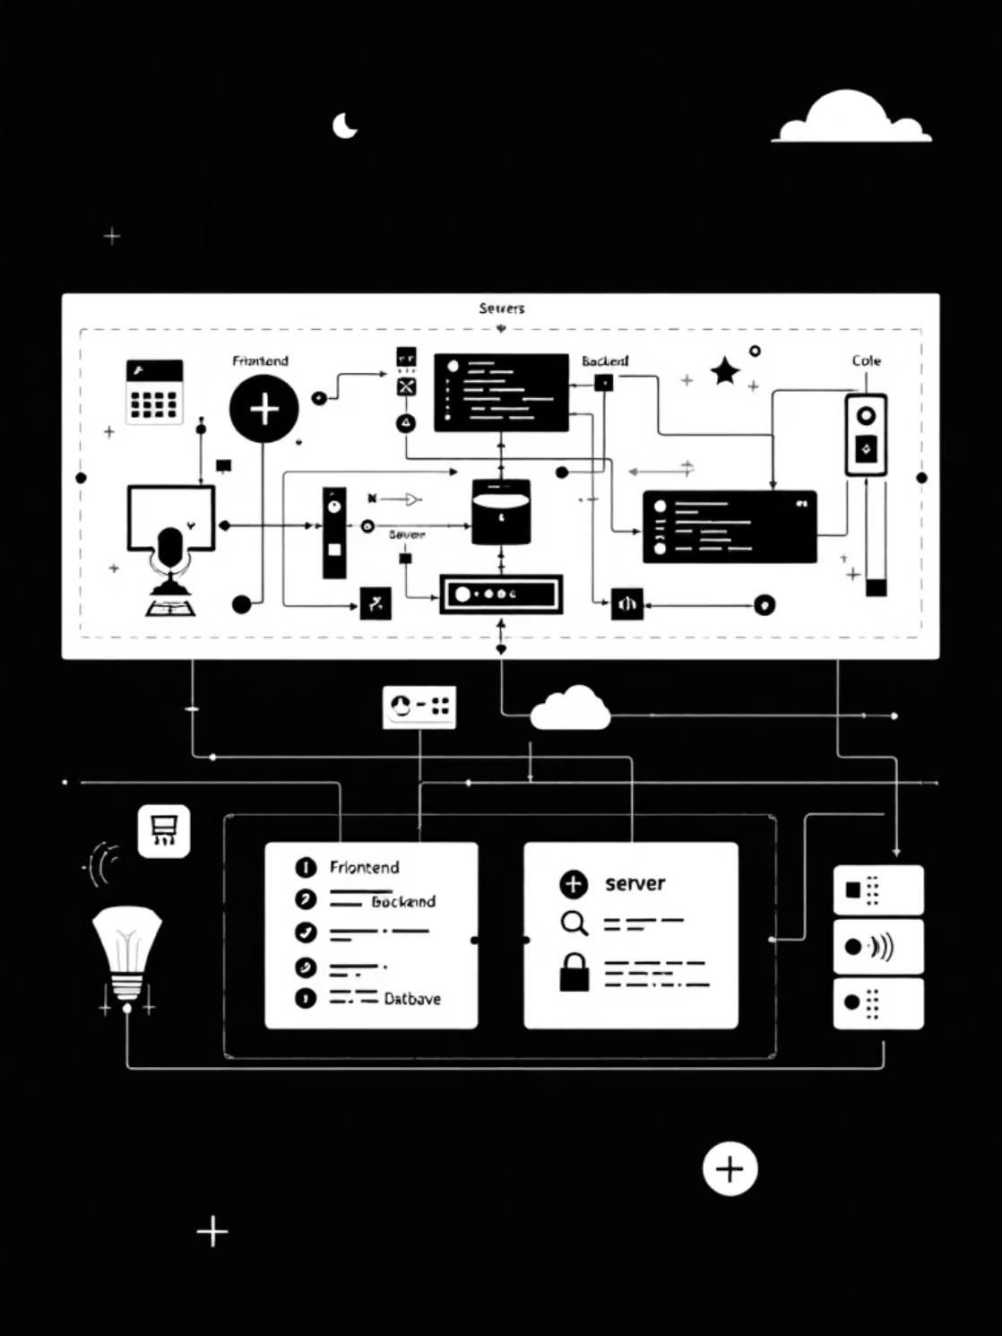
System Architecture
Decoupled Architecture
Separate frontend and backend layers communicate through RESTful APIs, ensuring maintainability and scalability.
Role-Based Access Control
JWT tokens enforce strict security—Employee, Manager, and HR roles have distinct permissions at every API endpoint.
Data Integrity
MS SQL Server handles complex relationships including recursive organizational hierarchy and transactional game bookings.

Slide 7
Implementation Highlights
01
02
03
Agile Development
Authentication
Database Design
12-week sprint-based approach with iterative module development and continuous testing
Spring Security with JWT for stateless authentication and role-based endpoint protection
Recursive organizational chart with manager-employee hierarchy and transactional relationships
04
05
Frontend State
SMTP Integration
TanStack Query for caching, infinite scrolling, and debouncing for optimal user experience
Automated email notifications for travel assignments, game bookings, and celebrations

Slide 8

Challenges & Solutions
Fair-Rotation Algorithm
Challenge: Preventing race conditions when two users book same slot simultaneously
Solution: SQL-level constraints with database transactions and queue-based logic tracking player participation
10-Day Validation
Challenge: Enforcing strict submission window across timezone differences
Solution: Precise date-logic handling between backend and frontend with automatic deadline checks
Server State Management
Challenge: Managing complex data-fetching without Redux boilerplate
Solution: TanStack Query for professional features like infinite scrolling and caching

Slide 9
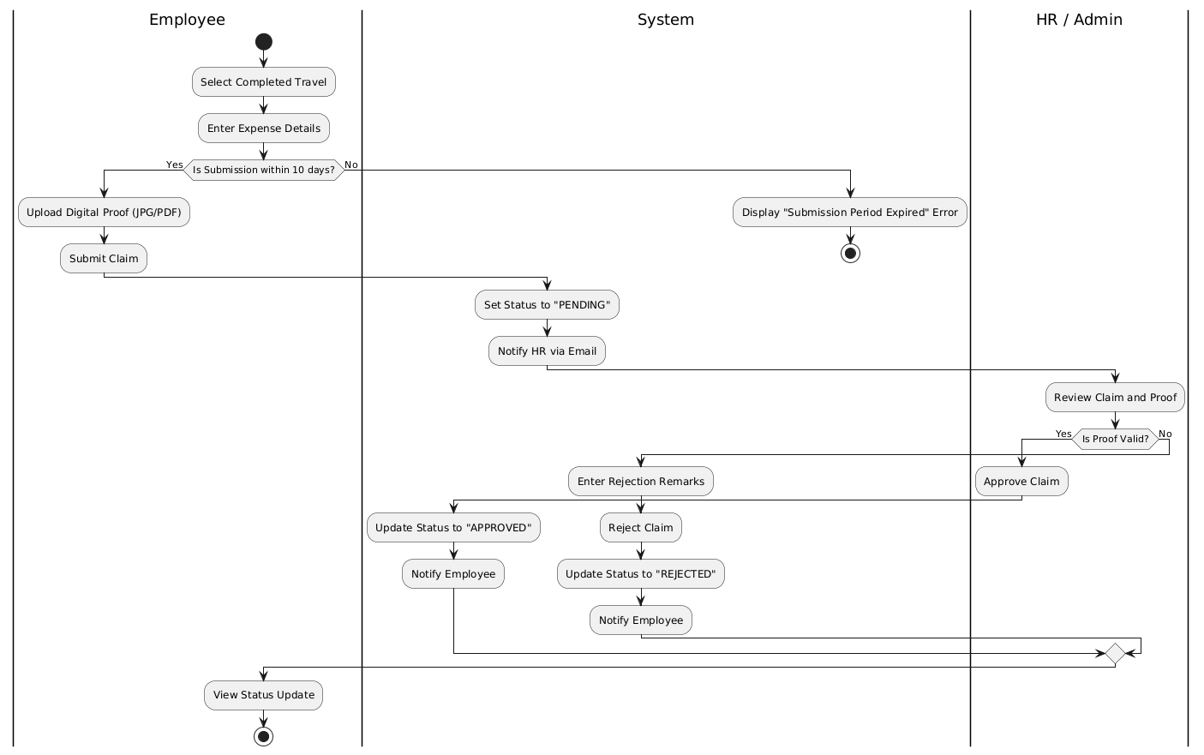
Travel & Expense Module
01
02
HR Creates Travel Plan
Automated Email Notification
Assign employees, destination, dates, upload tickets/visas
SMTP sends documents to all selected employees
03
04
Employee Submits Expense
HR Approval Workflow
10-day validation, receipt upload, automatic status update
Proof preview, approve/reject with remarks

Slide 10
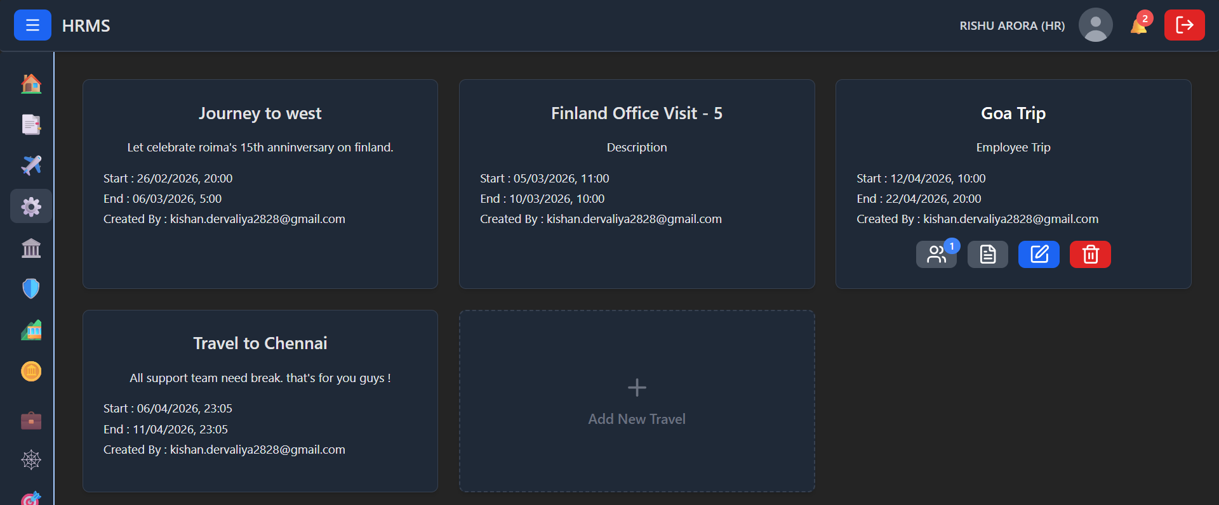
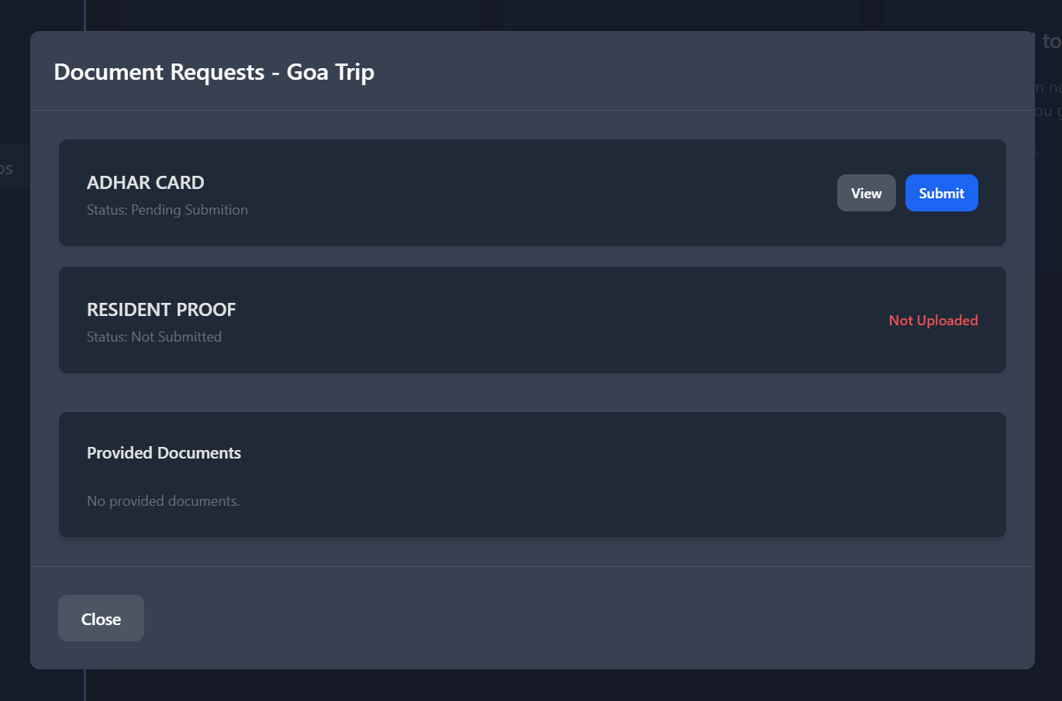
Travel & Expense Management
Travel-Document Management
Document Upload window for user to upload document related travel.
Travel Management
Grid view of travel plans showing routes, dates, and assigned team members with document tracking.

Slide 11
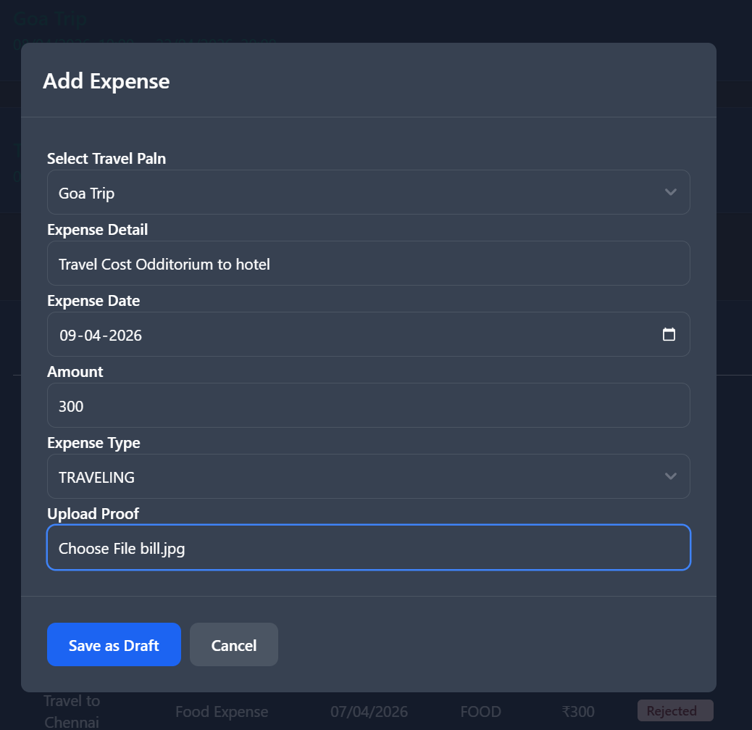
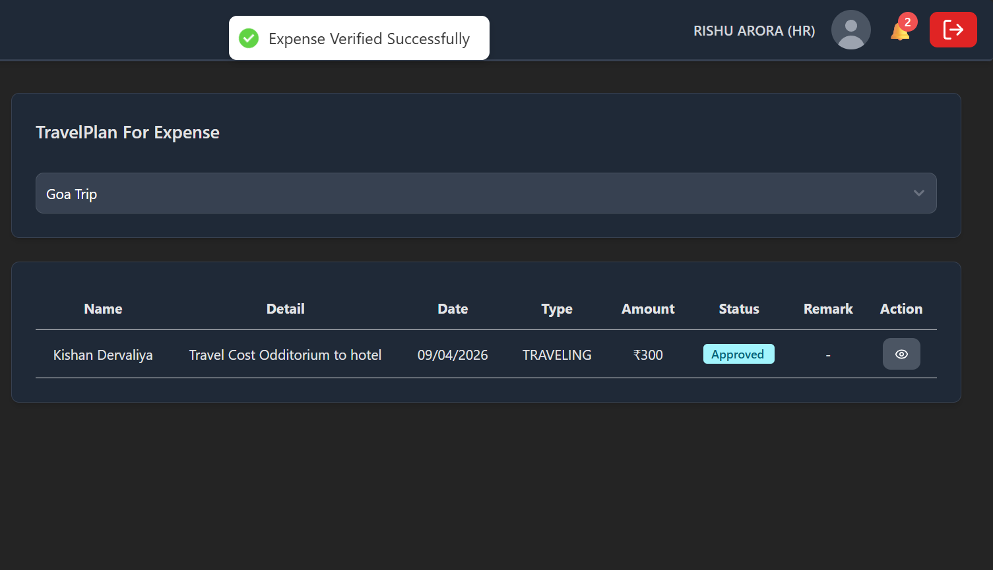
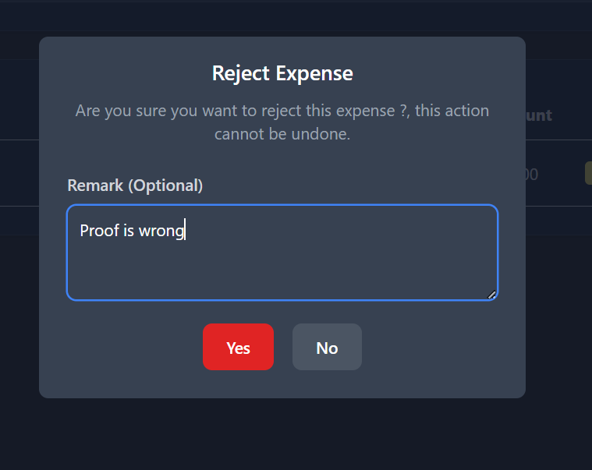
Expense Tracking System
Submit Expense Claim
Travel Plan with Expenses
HR can Reject Expense
Digital form for employees to log expenses by entering amount, date, and uploading receipt proof.
Integrated view showing travel details alongside associated expense claims and approval status.
HR can reject a expense of a particular travel if HR finds the expense proof inappropriate or.not valid reason for that expense

Slide 12
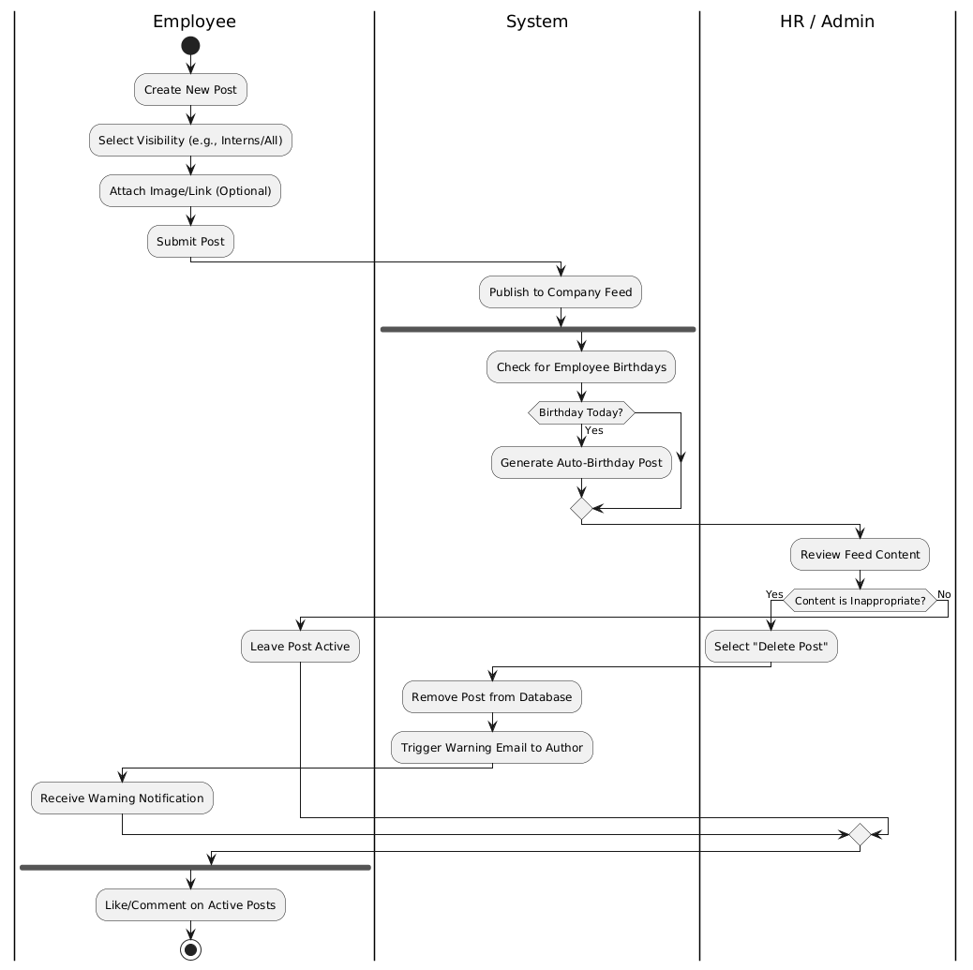
Social & Engagement Module
Achievement Feed
Automated Celebrations
System Notifications
Posts with infinite scrolling, likes, comments in reverse chronological order
Cron job generates birthday and work anniversary posts from employee profiles
Real-time alerts for likes, comments, and milestone recognitions

Slide 13
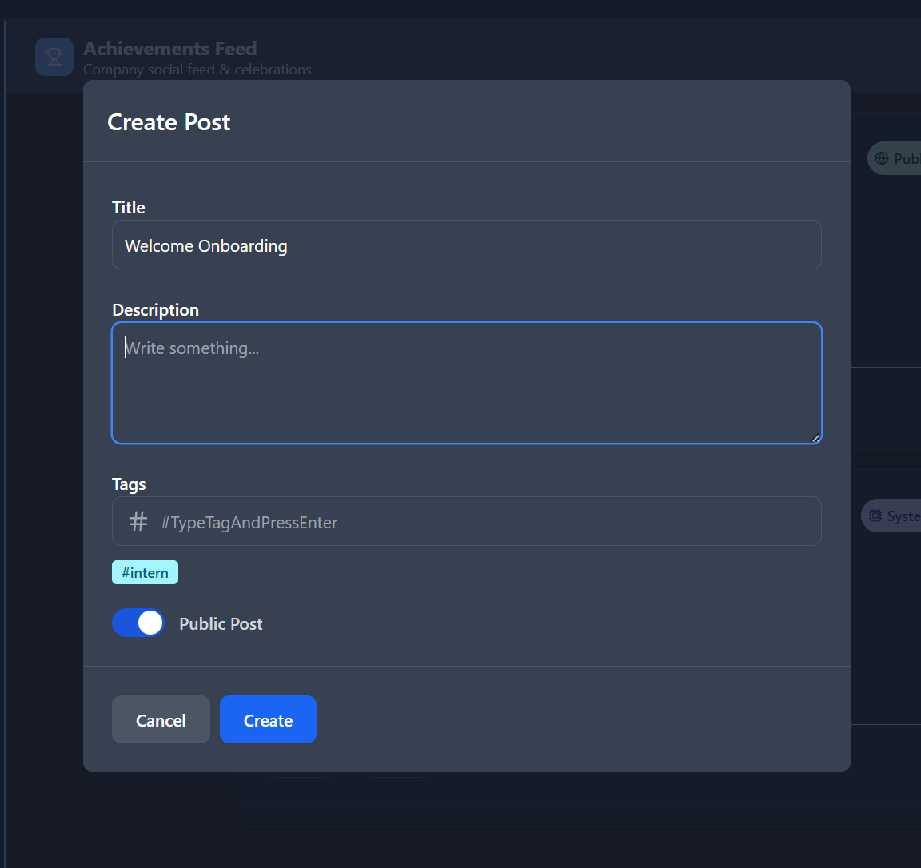
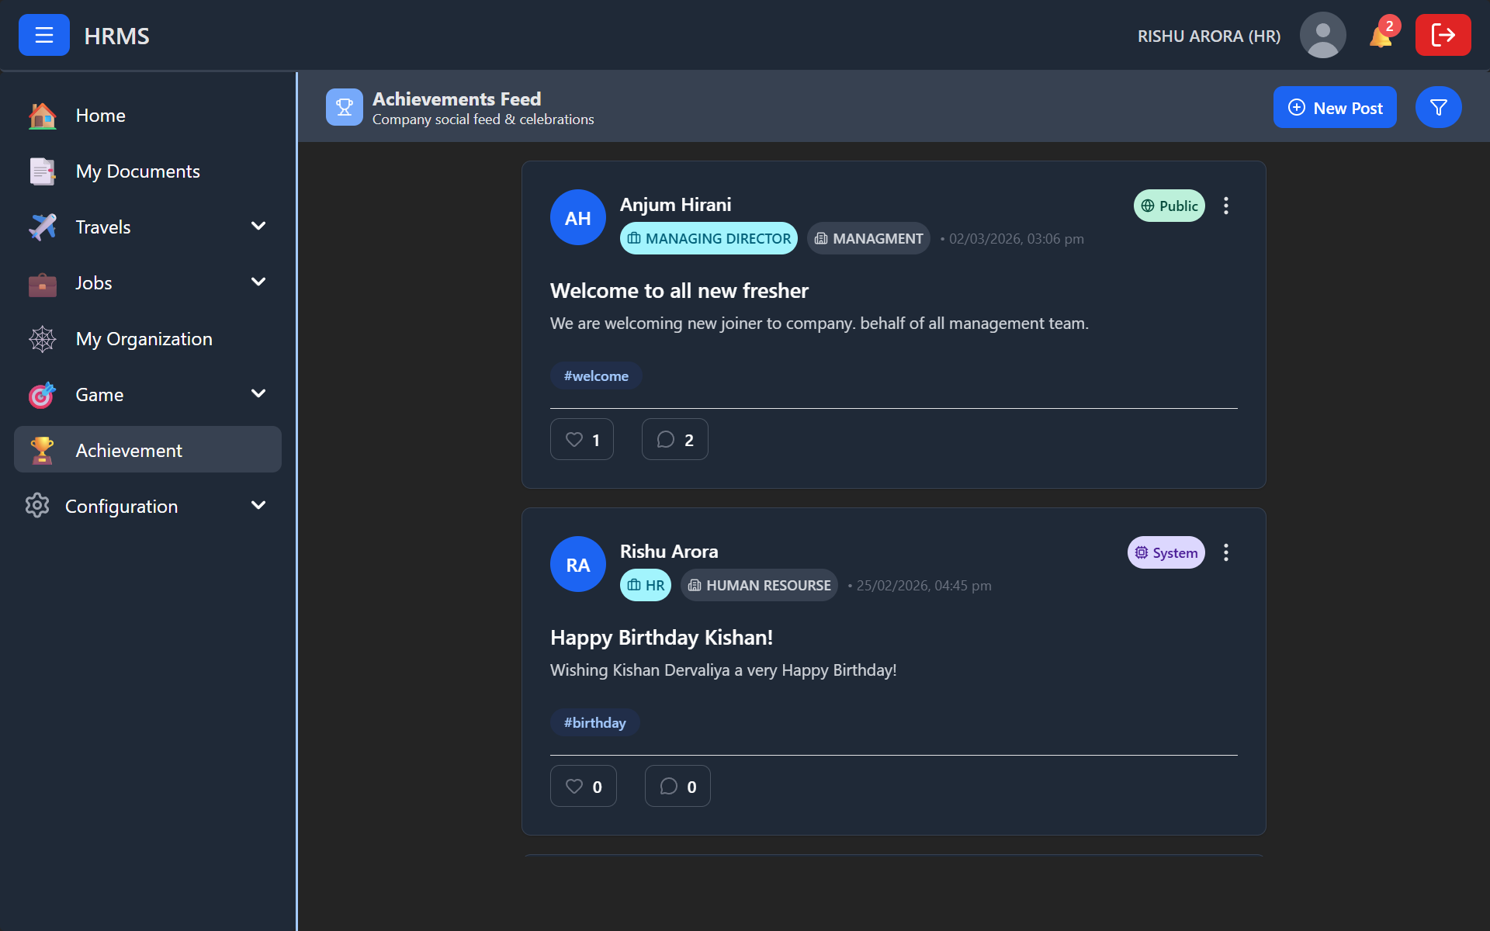
Social Engagement Platform
Create New Post
Standard modal with text area, visibility settings, and attachment option for content creation.
Company Feed
Published posts featuring images with tags for categories like Fun and Games.

Slide 14
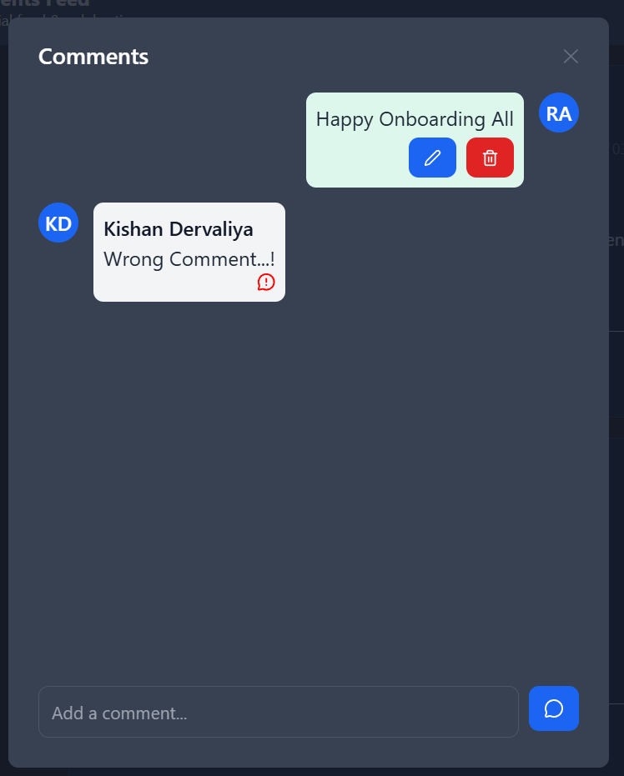
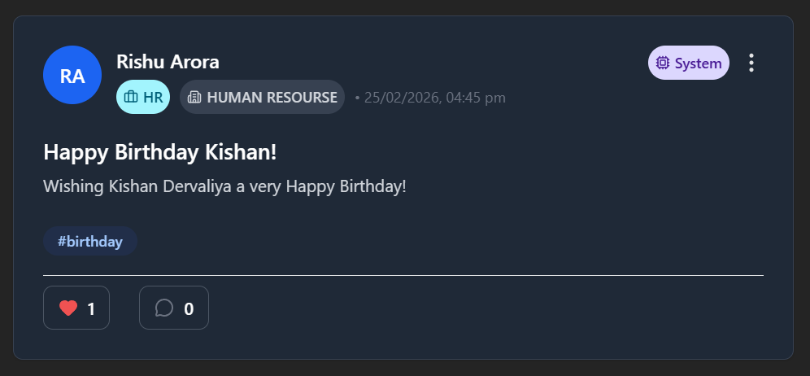
Automated Celebrations
System Generated Post
Comment Section
Automated birthday and work anniversary celebrations posted to feed with personalized messages.
Thread view under posts where users can reply, featuring likes and timestamps for engagement.

Slide 15
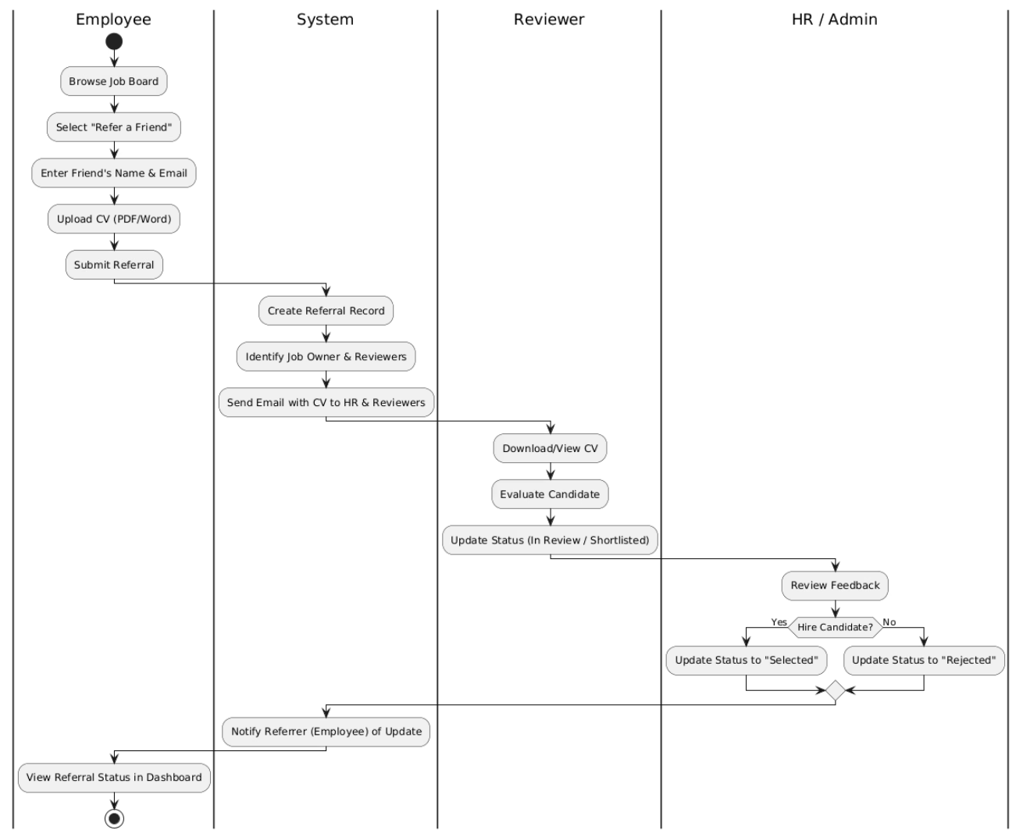




Job Module
Job Board
Share & Refer
HR posts jobs with JD PDF, salary, category
Employees share via email or upload CV
HR Review
Track Status
CV sent to assigned reviewer automatically
Referral bonuses linked to referrer

Slide 16
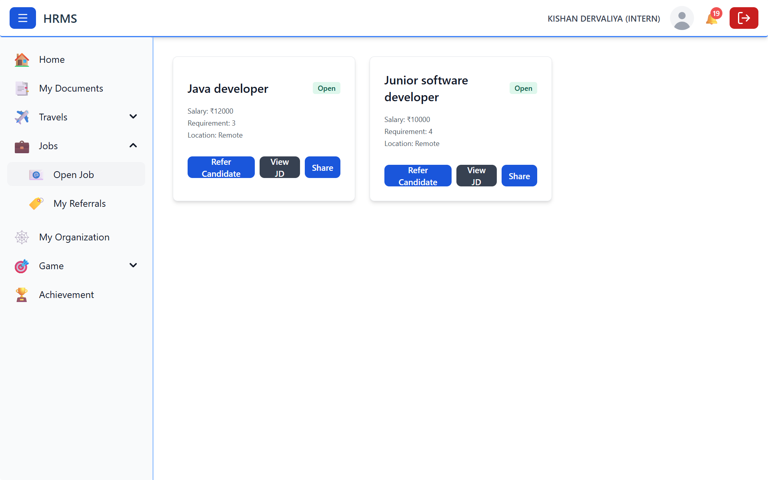
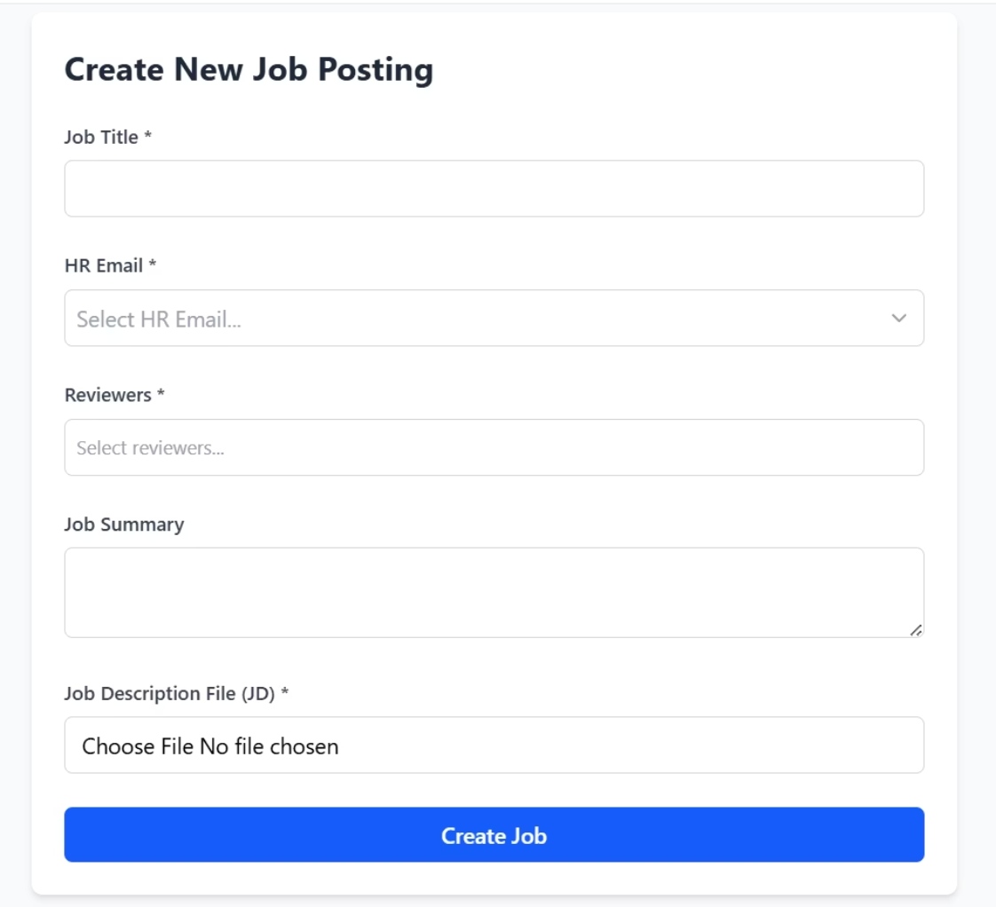
Job Board & Recruitment
Post New Job
Job Board
Form for HR to create job listings requiring title, salary, category, and job description upload.
Recruitment interface showing open and closed positions with titles, categories, and salary details.

Slide 17
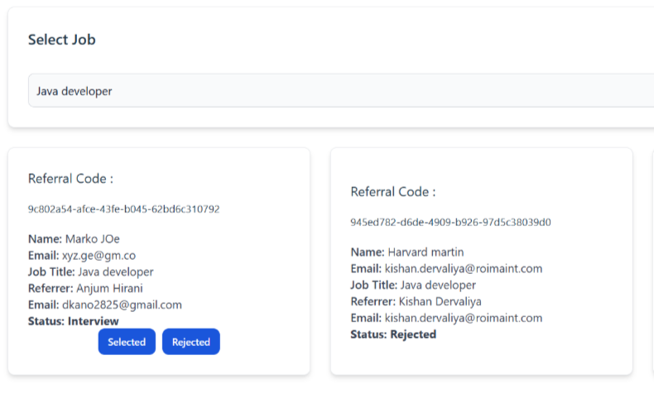
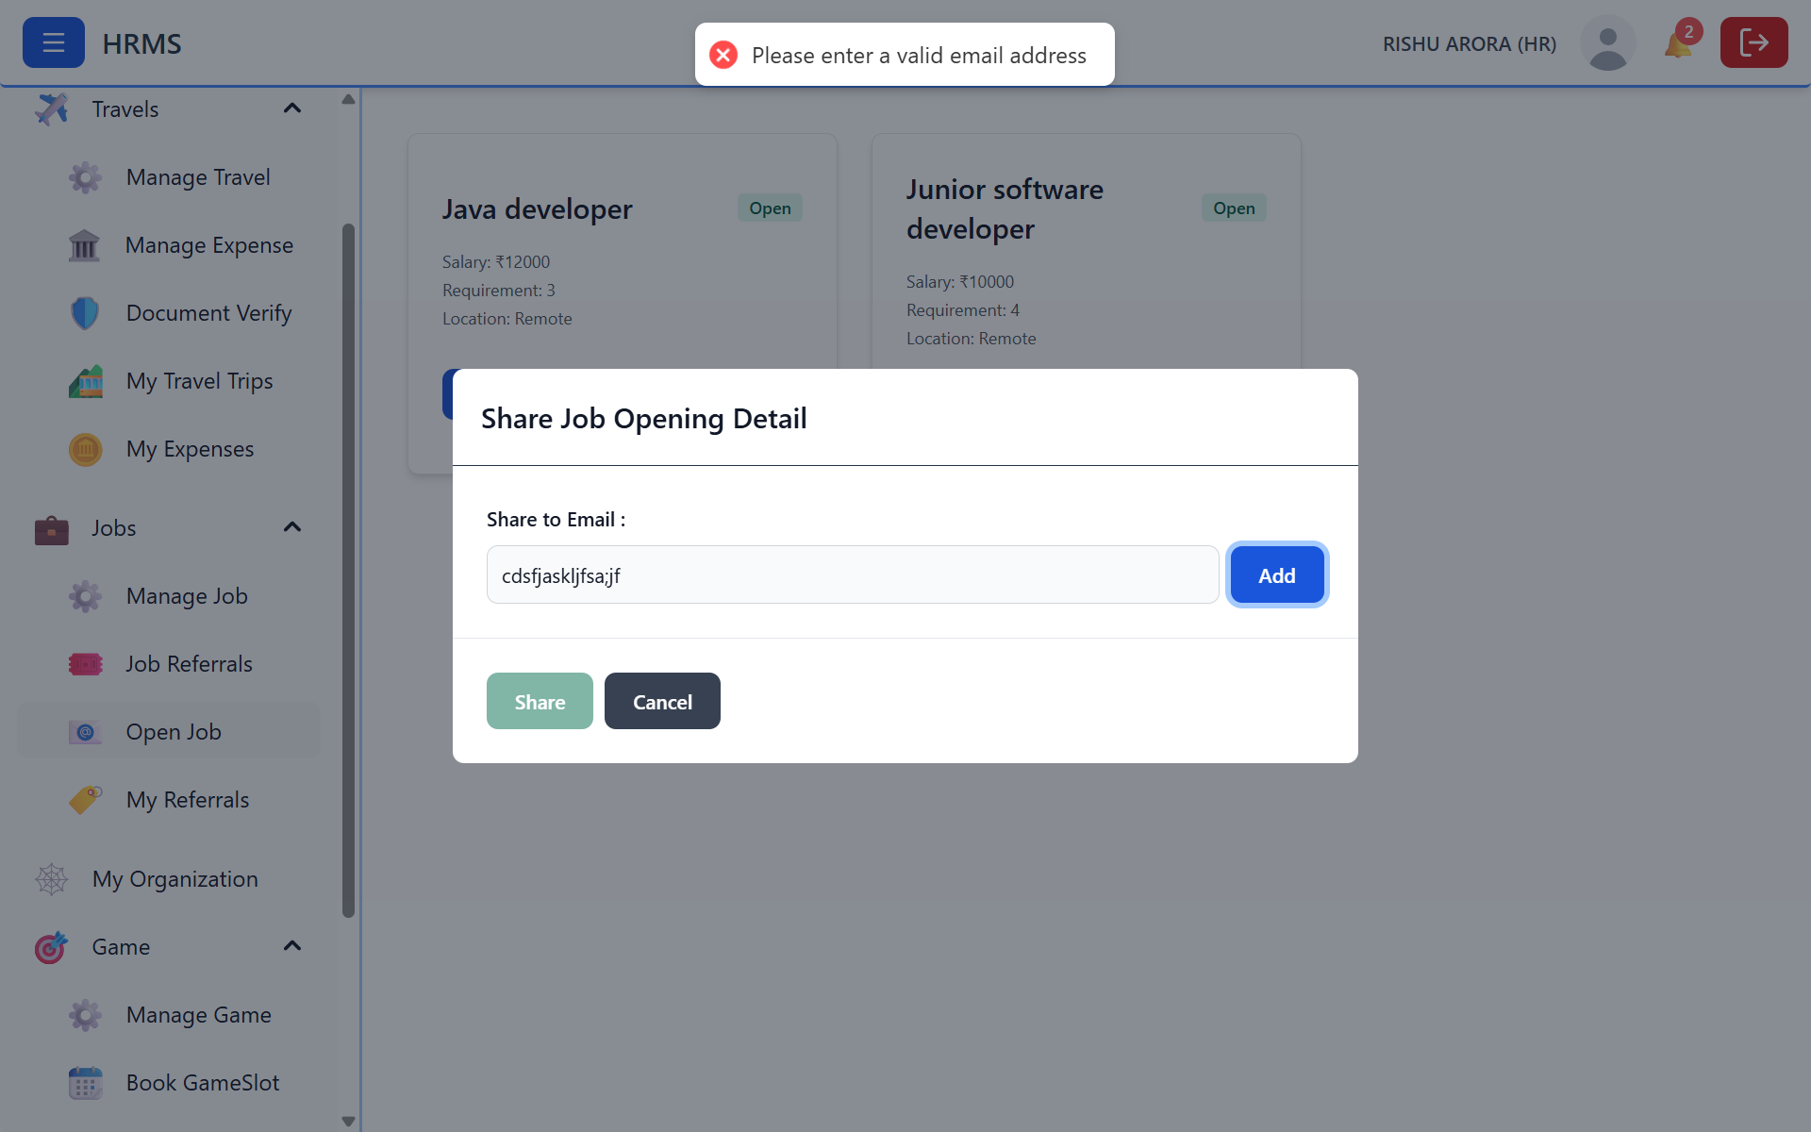
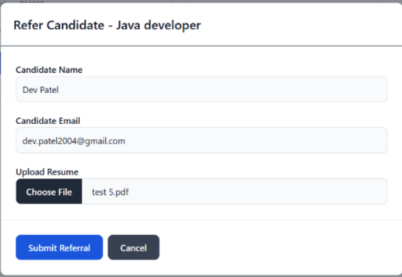
Referral Tracking System
Share Job
Referrals Tracking
Quick sharing tool allowing users to send job details to multiple recipients via email.
Table view for recruiters to monitor candidates showing CV links, status, and referral details.
Refer a Friend
Employee referral form to enter friend's details and upload resume for potential roles.

Slide 18
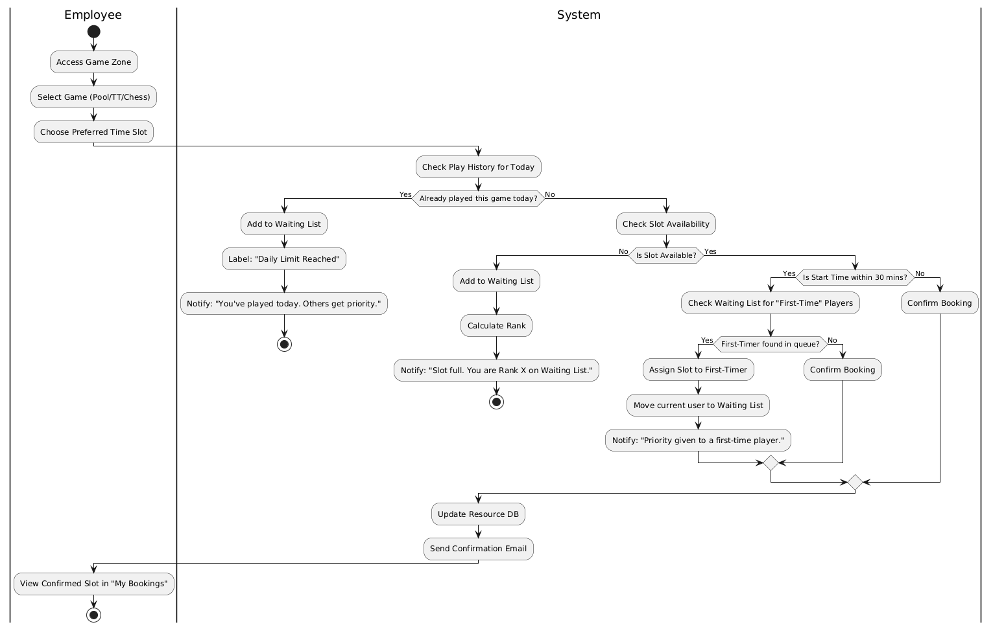
Game Scheduling Module
Fair-Rotation Algorithm
30-Minute Slots
Waiting List
Round-robin queue ensures equal opportunity, prevents slot hogging
Pool, chess, foosball booking with calendar invites
Auto-notification when slots become available

Slide 19
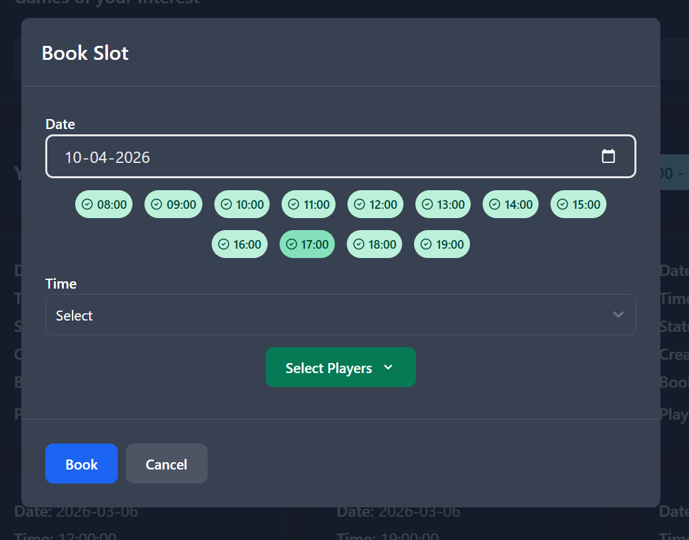
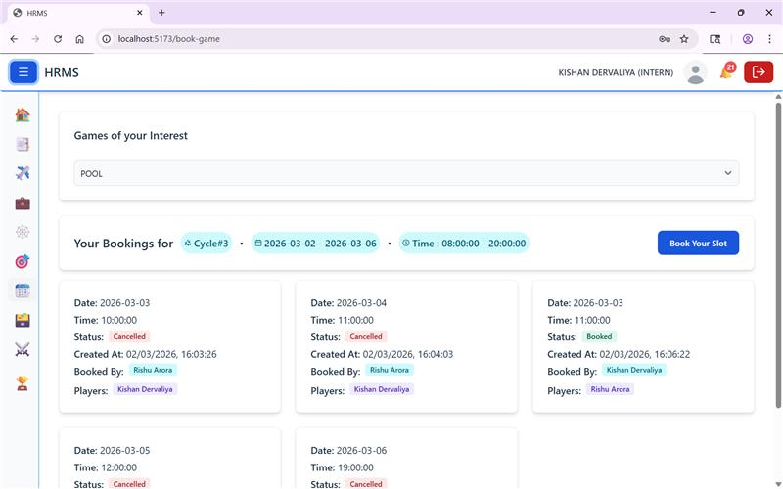
Game Zone & Scheduling
Book a Game Slot
Booking modal allowing employees to select game, date, and available time slot with automatic calendar invites.
Game Zone
Employee engagement dashboard showing upcoming bookings for pool, cards, and other games with dates and times.

Slide 20
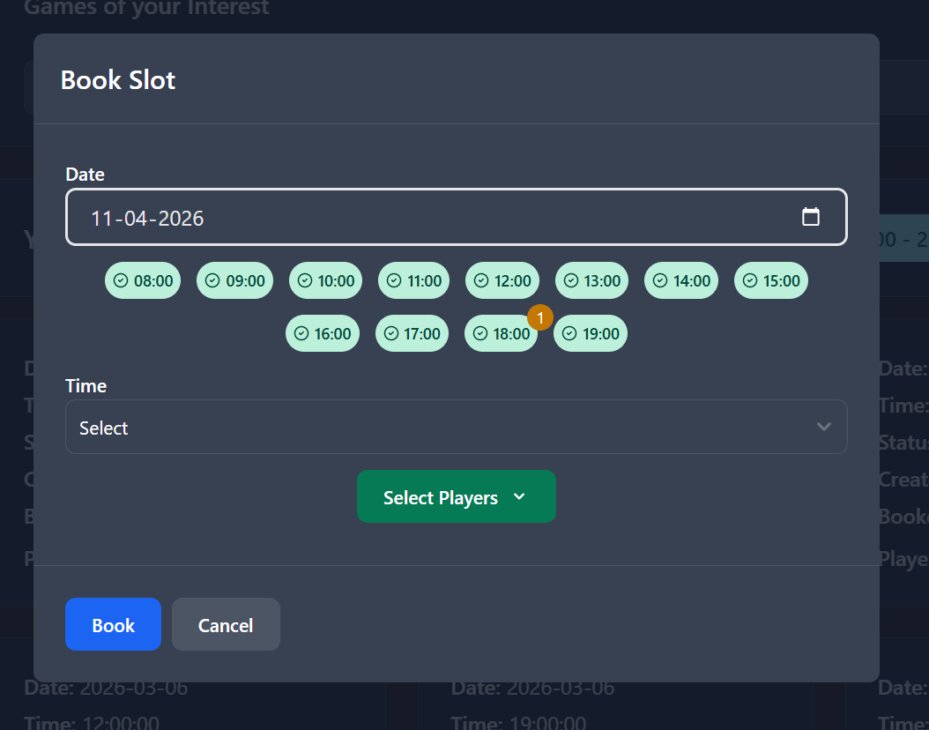
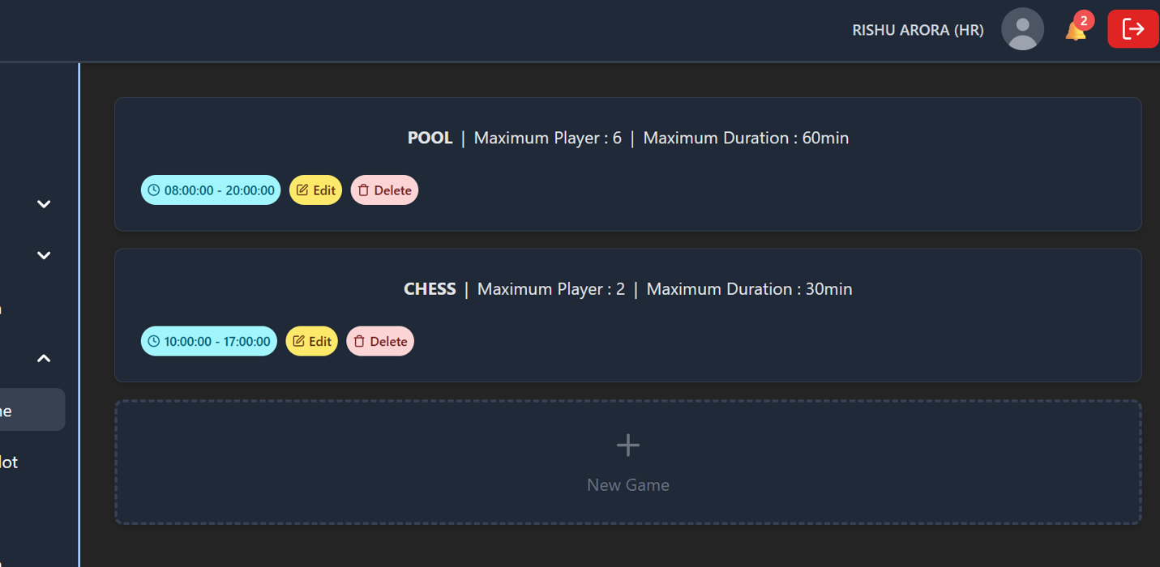
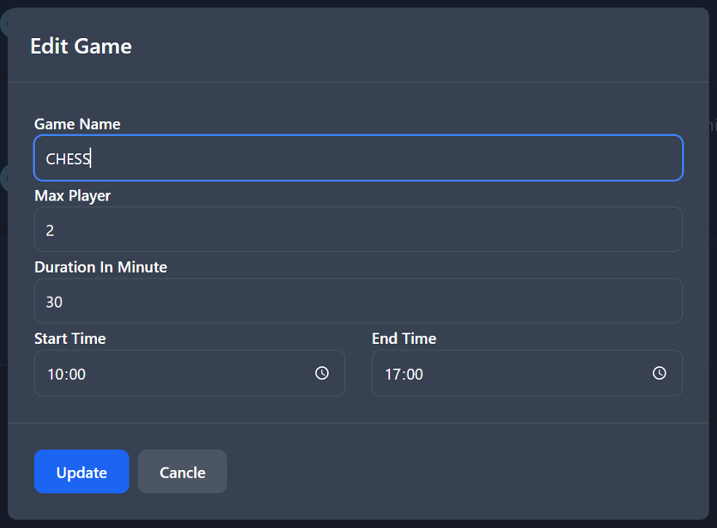
Game Management & Fairness
Waiting List
Game Types Management
Update Game Type
View showing game bookings currently on waiting list including game name, date, and requested time slots.
Administrative table listing all available office games with operating hours, slot sizes, and max players.
Configuration form to edit specific parameters of games such as duration and player limits.

Slide 21
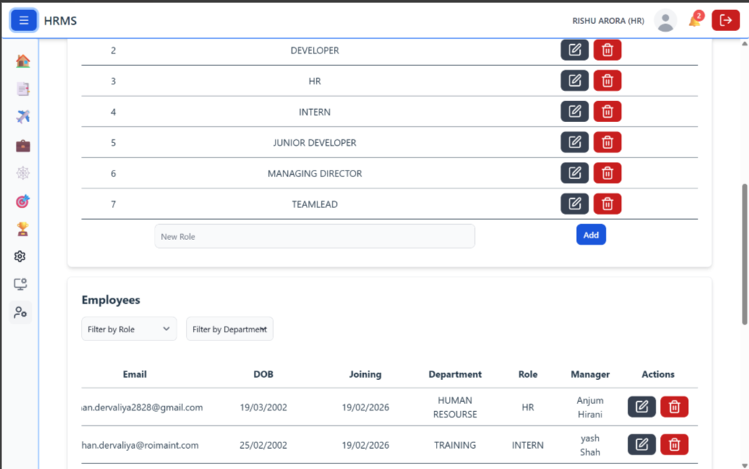
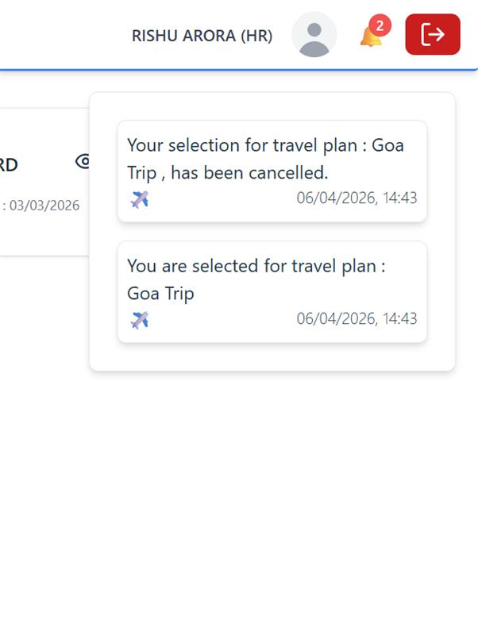
System Administration
Notifications Center
Pop-up list of recent alerts including confirmed game slots, pending job referrals, and system updates.
User Management
Master list of all organization users displaying names, emails, roles, and current positions with access control.

Slide 22
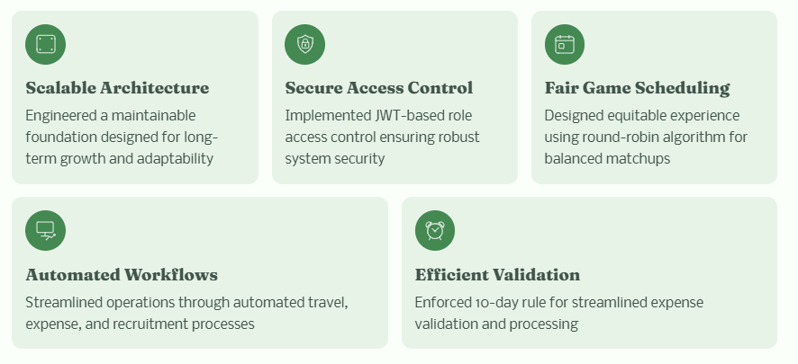
Conclusion
Built a robust, efficient system foundation that scales with growth while maintaining security and operational excellence

Slide 23
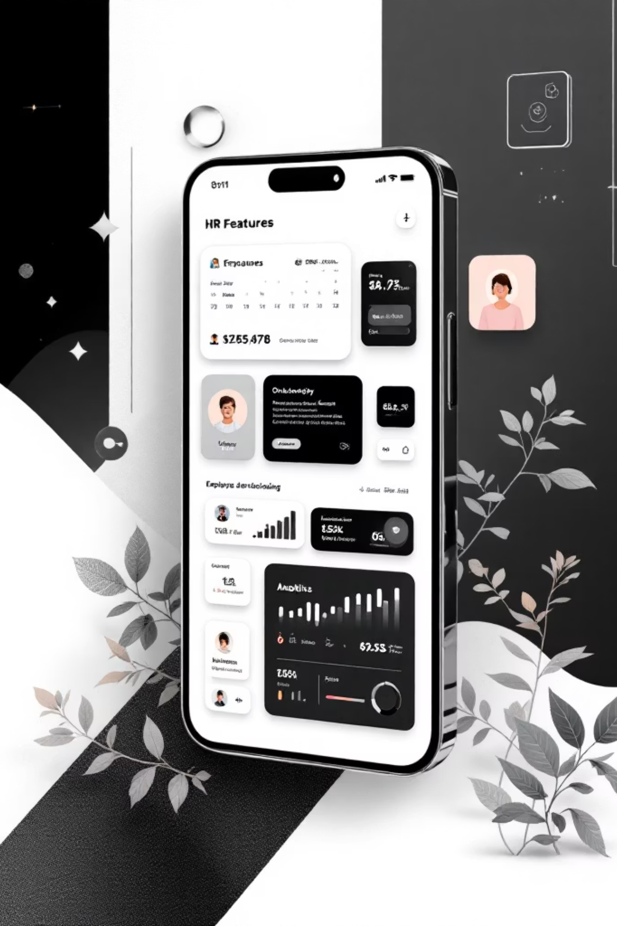



Future Enhancements
AI-Powered OCR
Automatically scan receipts to extract amounts, dates, and vendors
Mobile Application
React Native app for instant receipt capture while traveling
Analytics Dashboard
Interactive graphs for spending trends and resource usage
The modular Spring Boot and React architecture allows easy integration of advanced features, ensuring long-term scalability and adaptability to evolving organizational needs.

Slide 24
References
React (Vite + TypeScript) Documentation: Vite | Next Generation Frontend Tooling
TanStack Query (React Query) Documentation: TanStack Query
Spring Boot Documentation : Spring Boot
Spring Security Documentation : Spring Security
Azure MySQL Database Documentation : Azure Database for MySQL documentation | Microsoft Learn
Stack Overflow : Debugging and implementation help , Available at: https://stackoverflow.com

Slide 25


