Slide 1
DEEP learning project

Slide 2
PROBLEM STATEMENT:
Early detection and accurate classification of benign and malignant mouth ulcers are crucial for timely treatment and better patient outcomes. Traditional diagnosis depends on clinical expertise and biopsies, which can be invasive, time-consuming, and subjective. This project aims to use pre-trained deep learning models—EfficientViT-B0 and VGG19—for automated classification of mouth ulcers, offering faster and more reliable diagnoses.
By leveraging transfer learning, these models use features learned from large datasets, improving performance even with limited medical images. This approach reduces computational costs while enhancing accuracy for efficient, automated ulcer detection.
REFERENCE:
https://www.mdpi.com/2075-4418/13/21/3360

Slide 3
Data description
Total data contains total of 323 images, 165 benign lesions and 158 malignant lesions images.
Random 10 images from google were pulled out from google for prediction.
REFERENCE : https://data.mendeley.com/datasets/mhjyrn35p4/2

Slide 4
:
Feature | VGG19 | EfficientVit -B0
Architecture | 19-layer deep convolutional network | Compound scaling (depth, width, resolution)
Model Size | 143 million parameters | 5.3 million parameters
Inference Speed | Slower due to large size | Faster, optimized for mobile/edge
Memory Usage | High | Low
Input Image Size | 224x 224 | 224x224
Training Time | Longer | Faster
Use Case | Suitable for large datasets | Ideal for mobile apps and edge deFeature vices
Strengths | High accuracy on large, complex datasets | Good balance of efficiency and accuracy
Weaknesses | Computationally expensive, memory-heavy | Slightly lower accuracy on complex tasks

Slide 5
Model Training Process for EfficientViT-B0 and VGG19
Data Preprocessing:
Images resized to 224x224 pixels to match the input size of both models.
Normalized pixel values using mean [0.5, 0.5, 0.5] and standard deviation [0.5, 0.5, 0.5].
Model Setup:
EfficientViT-B0:
All layers frozen except the final classifier.
Pre-trained weights loaded, and only the classifier layer trained for binary classification (benign vs. malignant).
VGG19:
Last 3 layers retrained to adapt to the dataset.
Model allowed to fine-tune deeper layers, needing more computation and training data.

Slide 6
Training Configuration:
Optimizer: Adam with a learning rate of 0.001 for both models.
Loss Function: Cross-Entropy Loss for binary classification.
Batch Size: 32 images per batch.
Epochs: 20 iterations for each model.
Performance Optimization:
EfficientViT-B0 converged faster due to fewer trainable parameters.
VGG19 took more time due to retraining multiple layers, with a higher risk of overfitting on smaller datasets.
Evaluation Metrics:
Accuracy, Precision, Recall, F1-Score, and MCC used to assess performance.
EfficientViT-B0 showed superior performance across metrics, especially recall, indicating better generalization..

Slide 7
Why Adam Optimizer is Ideal for This Task
Adaptive Learning Rates: Adjusts rates for each parameter, ensuring fast convergence.
Momentum for Stability: Smooths updates to prevent oscillations during training.
Effective with Sparse Data: Performs well even when only a few weights update.
Minimal Tuning Needed: Works well with default settings, reducing hyperparameter tuning.
Best of Both Worlds: Combines momentum from SGD and adaptive rates from RMSProp.
Faster Convergence: Saves training time without compromising accuracy.
When to Use Adam vs. Others :
Use Adam: For complex models, noisy data, or when time is limited.
Use SGD: For very large datasets requiring precise tuning.
Conclusion: Adam is the optimal choice for transfer learning tasks like EfficientViT-B0 and VGG19, providing fast, stable convergence with minimal tuning.

Slide 8
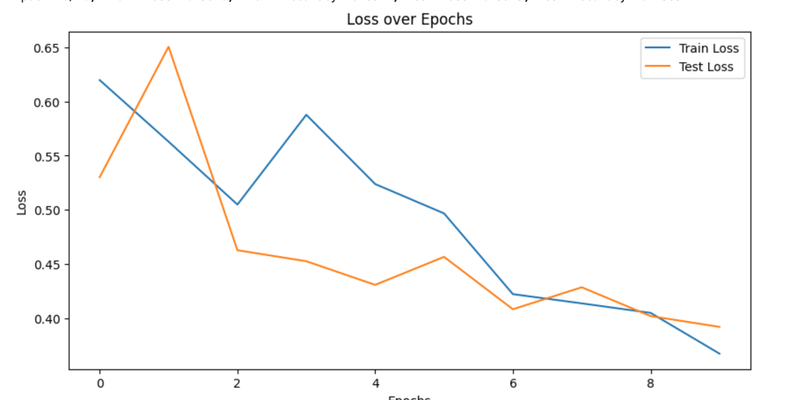
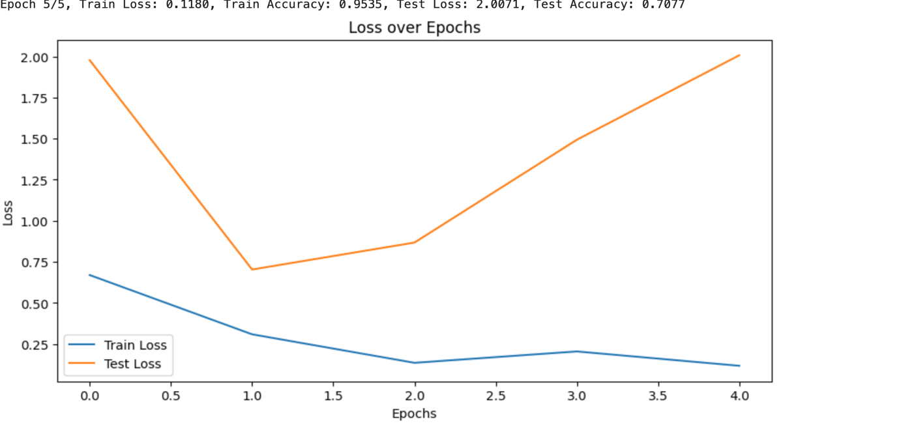
Loss Graphs for VGG19 and EfficientViT-B0:

Slide 9
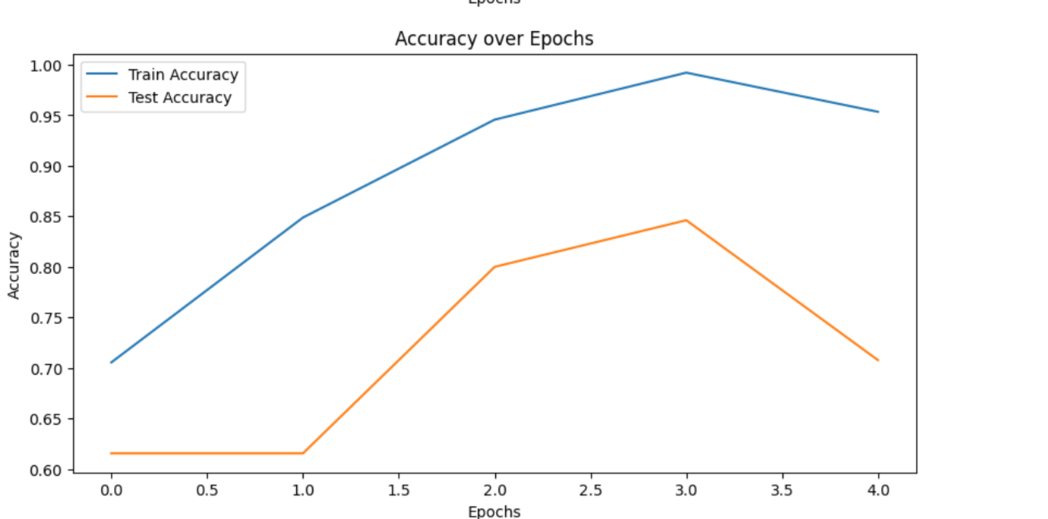
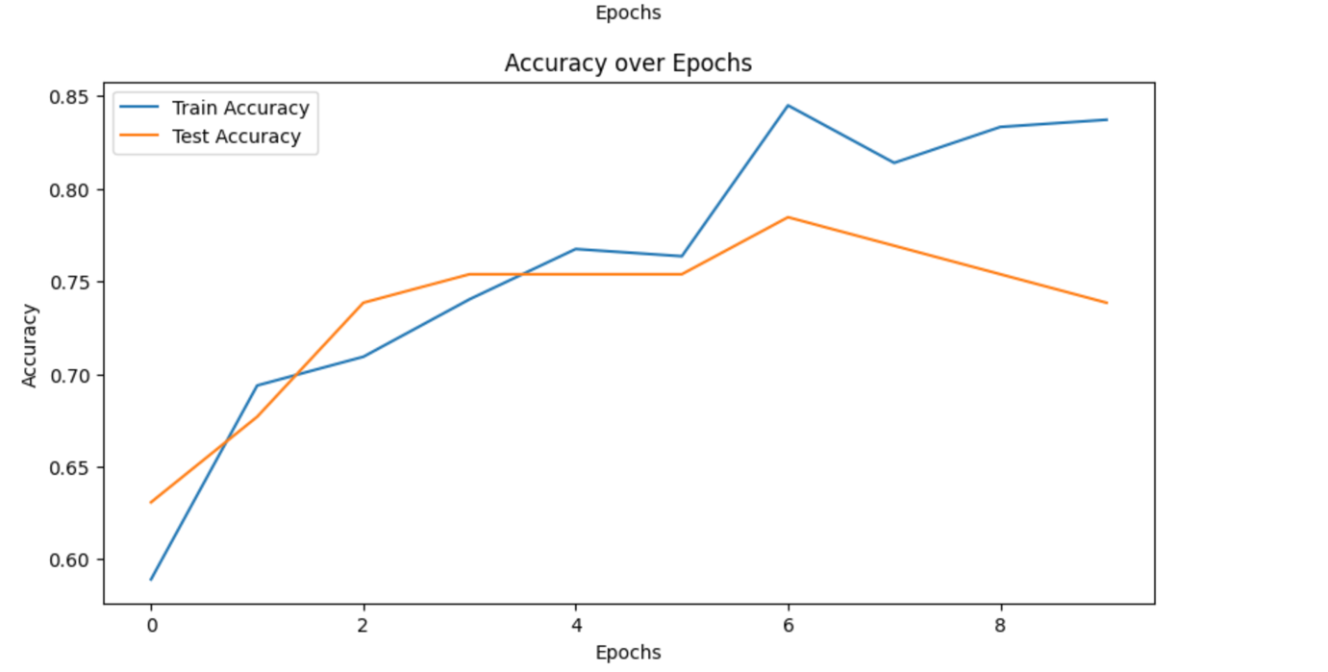
Accuracy Graphs for VGG19 and EfficientViT-B0:

Slide 10
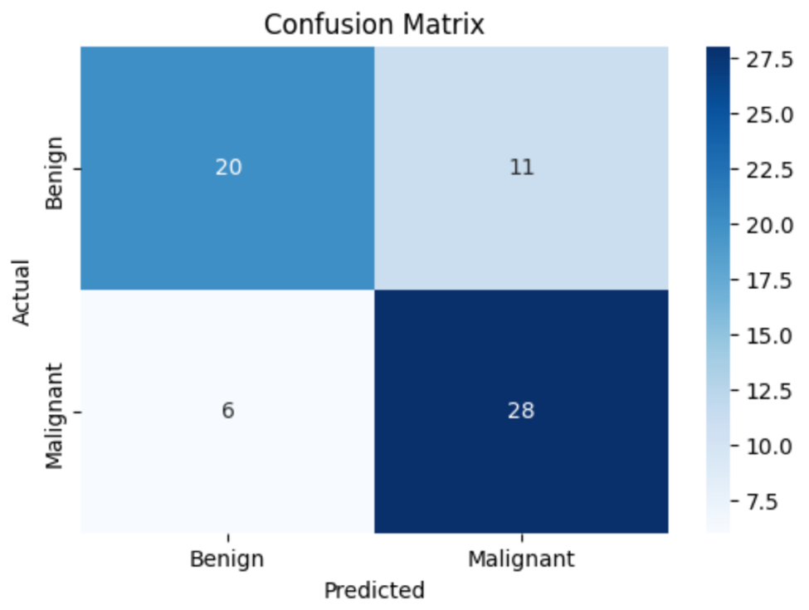
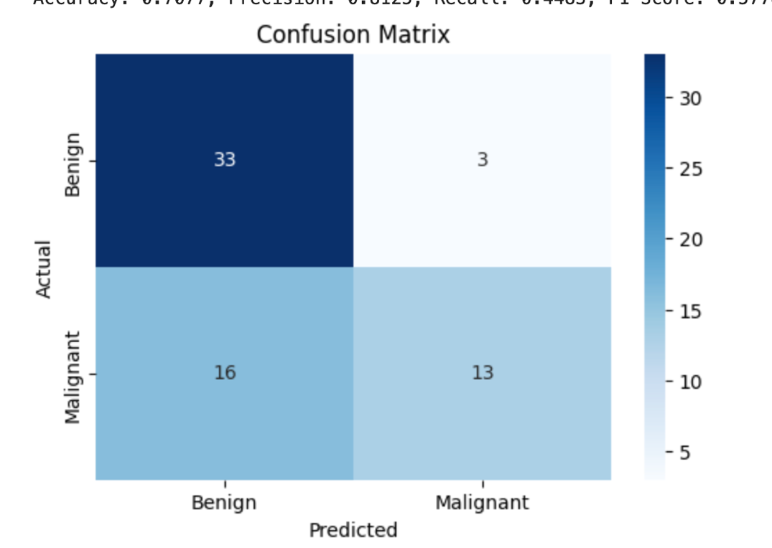
CONFUSION MATRIX FOR TWO MODELS

Slide 11
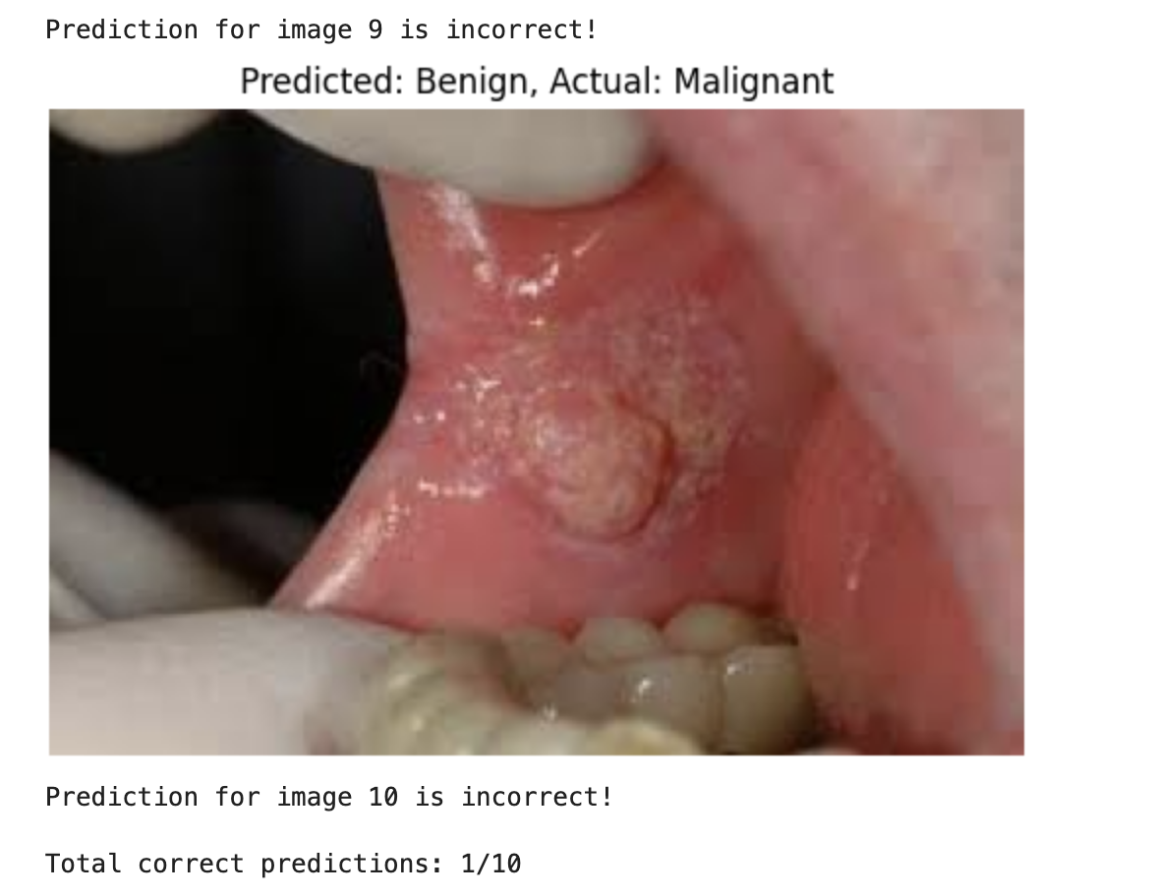
1/10 correct predictions for EfficientvitB0 model

Slide 12
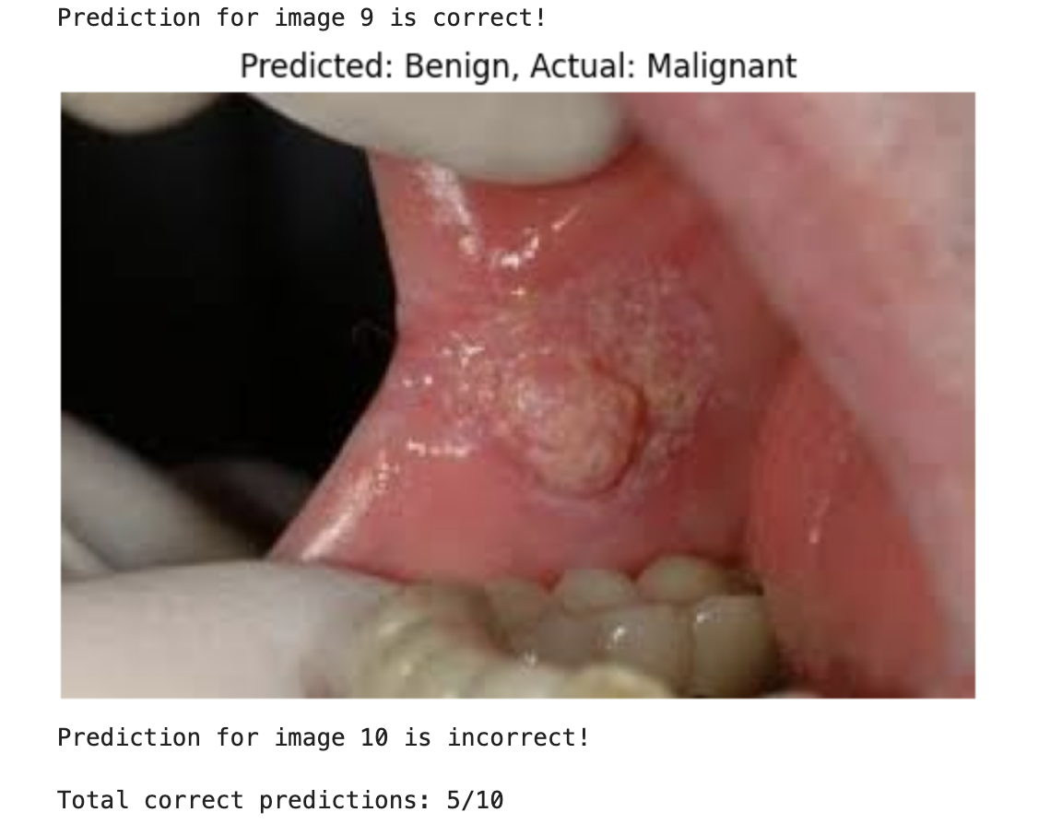
5/10 predictions for VGg 19 model

Slide 13
Feature | VGG19 | EfficientViT-B0
Accuracy | 0.7385 | 0.7077
Precision | 0.7179 | 0.8125
Recall | 0.8235 | 0.4483
F1-Score | 0.7671 | 0.5778
MCC | 0.4778 | 0.4211

Slide 14
LIMITATIONS OF MY PROJECT :
Small Dataset Size: With only 323 images, the dataset limits the models' ability to generalize, leading to potential overfitting, especially in deeper models like VGG19.
Limited Variability: Lack of diverse conditions (e.g., lighting, angle) in the dataset restricts the models’ ability to learn robust features for accurate classification.
EfficientViT-B0 Underperformance: EfficientViT-B0's simpler architecture struggles with the complexity of the dataset, resulting in lower recall and accuracy, particularly for malignant cases.
Random Image Testing: Google-sourced random images may come from different environments, causing prediction inaccuracies as the models were not trained on such uncontrolled data.

Slide 15
IMPROVEMENTS FOR MY PROJECT :
Preprocessing Enhancement: Advanced normalization and noise reduction techniques could help the models focus better on lesions, improving accuracy.
Transfer Learning: Fine-tuning the models on a larger, similar medical dataset could enhance their ability to learn more detailed features before applying them to the smaller dataset.
Exploring Other Models: Trying other architectures like ResNet or DenseNet could improve performance, especially where EfficientViT-B0 struggles.

Slide 16
REFERENCES:
https://pytorch.org/vision/stable/models.html
https://github.com/Priyanshu9898/Oral-Disease-Classification/blob/main/best_model/efficientvit_b0_oral_disease_classifier.pth
https://data.mendeley.com/datasets/mhjyrn35p4/2
https://www.mdpi.com/2075-4418/13/21/3360
https://www.geeksforgeeks.org/sklearn-classification-metrics/
https://www.geeksforgeeks.org/vgg-net-architecture-explained/
https://github.com/huggingface/pytorch-image-models

