Slide 1

A Systematically Evaluated Interpretable Enhancement to Fuzzy Q-Learning
Gaussian membership functions, eligibility traces, and adaptive exploration on CartPole-v1 Karthikeyan K | MS AI&ML, REVA University | Advisor: Dr. J. B. Simha Manuscript prepared for journal submission

Slide 2
Two Research Questions, Tested Not Assumed
• RQ1: Does combining Gaussian membership functions, Q(lambda) eligibility traces, and adaptive epsilon produce a statistically defensible improvement over classical FQL, attributable to the combination rather than any single component?
• RQ2: Do CartPole-tuned FQL-GTA hyperparameters transfer zero-shot to other control environments, or is per-environment retuning necessary?
• Both are answered empirically, including the ablation's honest statistical-power limitation and the weak zero-shot transfer result.

Slide 3
Why Fuzzy Q-Learning, When Deep RL Dominates Benchmarks?
• Deep RL policies (DQN, PPO) are opaque -- a trained network cannot be audited rule by rule, which matters in safety- and compliance-sensitive control settings.
• Classical FQL (Jouffe, 1998) is inspectable by design: every decision traces back to specific fuzzy rules and their firing strengths.
• But the classical formulation uses triangular membership functions, one-step TD updates, and fixed exploration -- design choices this study revisits directly.

Slide 4
RQ1: Primary Comparison, 30 Seeds
Agent | Final return (mean ± SD) | Solve rate | 95% CI
Baseline FQL | 265.7 ± 41.2 | 0% | [250.3, 281.1]
Improved FQL-GTA | 423.1 ± 78.7 | 40% | [393.7, 452.5]
Notes:
Paired Wilcoxon p = 3.54e-08, Cohen's d = 2.51 -- a large, statistically robust effect. The two agents use different learning rates by frozen config (baseline alpha=0.3, GTA alpha=0.2); a dedicated sweep tuning the baseline's alpha finds the best baseline still loses by a large, significant margin (d=2.50), so the result is not a learning-rate artifact.

Slide 5
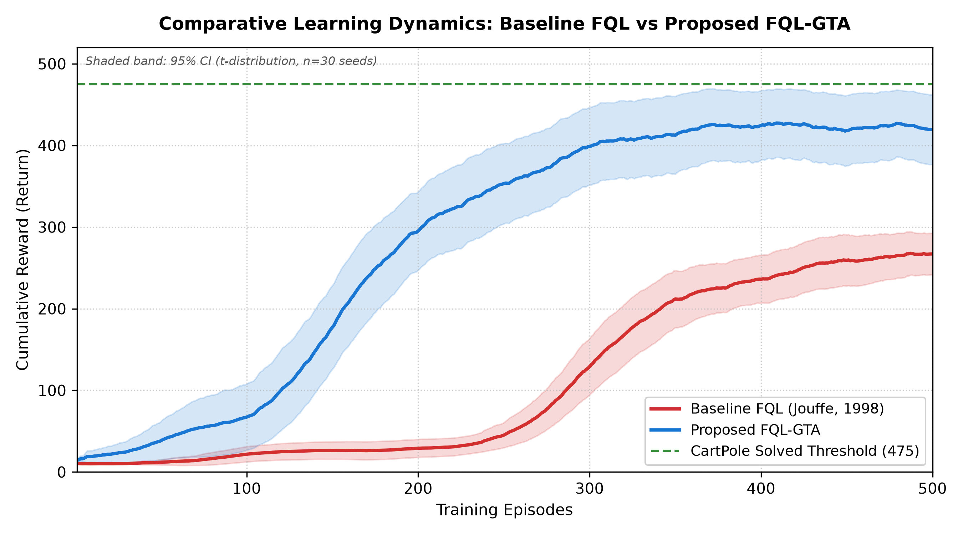
Learning Curves, All 30 Seeds
Mean ± 95% CI, 30 seeds per agent.
Notes:
FQL-GTA crosses the solve threshold mid-training in most seeds but only holds it through episode 500 in 40% -- motivating the strict final-trailing-window solve definition over first-crossing.

Slide 6
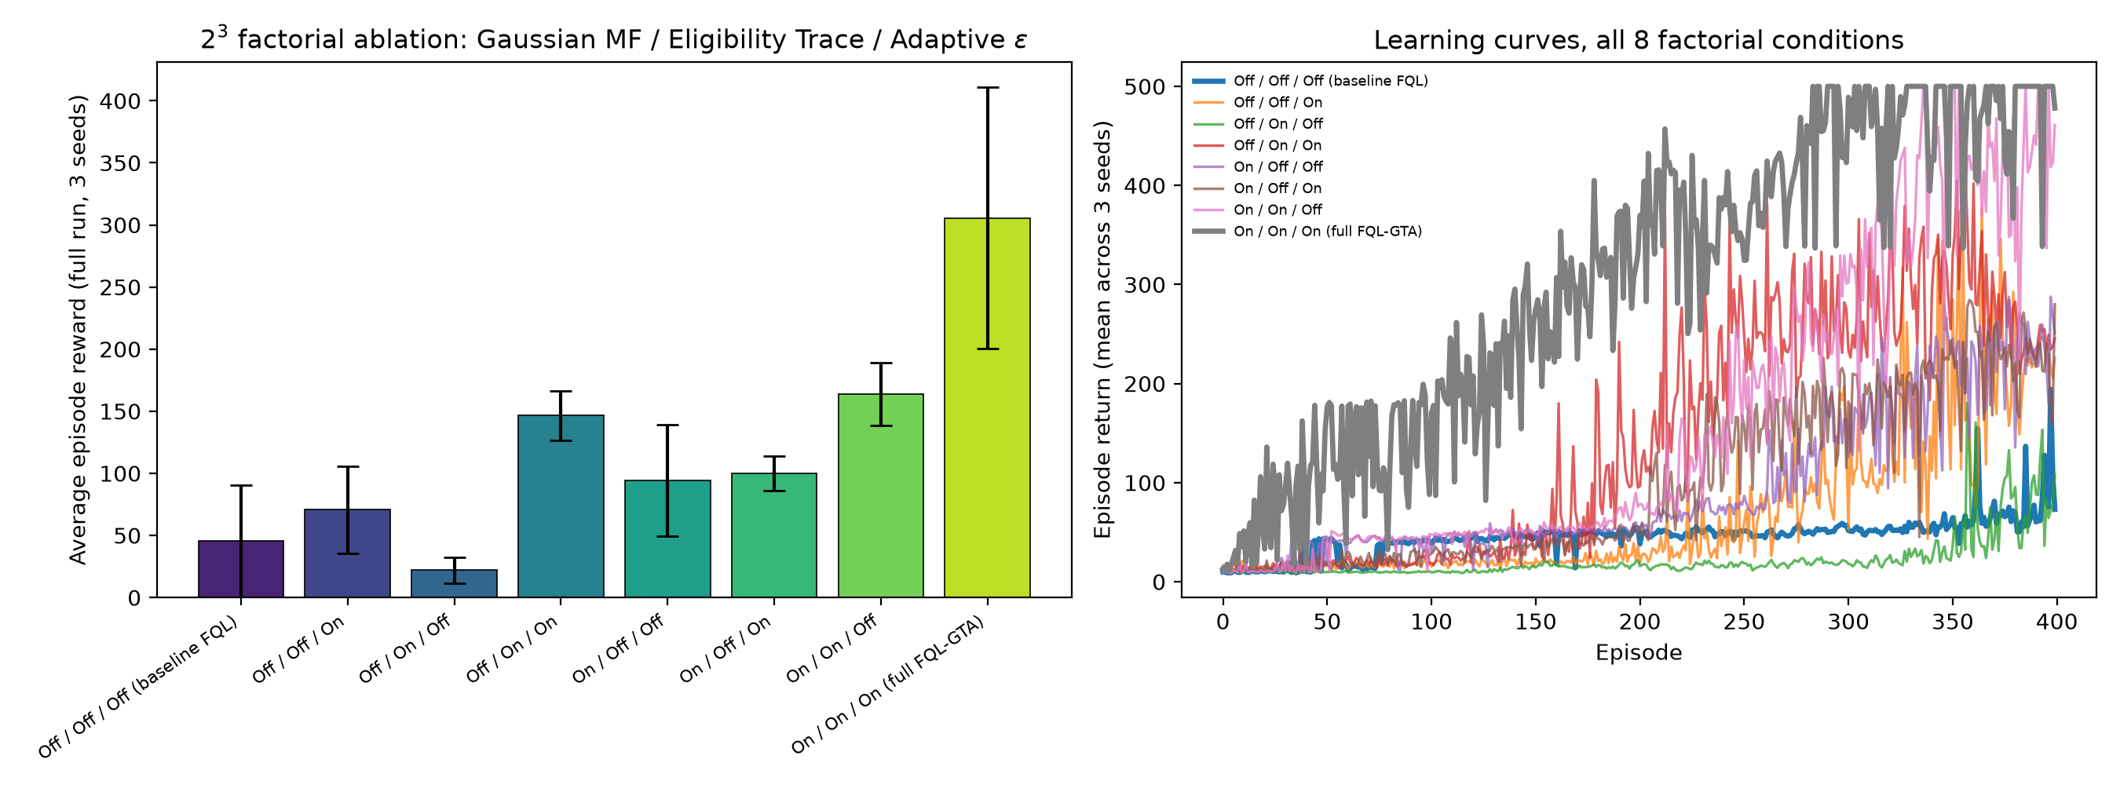
Full 2³ Factorial Ablation: No Single Component Solves It Alone
All 8 combinations of Gaussian MF / eligibility trace / adaptive epsilon, 3 seeds each.
Notes:
Best single-component condition reaches only 281 trailing-50 return; the full combination reaches a mean of 477 across its 3 seeds, but only 2 of 3 individual seeds actually cross the 475 bar -- the mean exceeds it, not every seed. A formal factorial effect analysis (next section) shows this is driven by significant Gaussian-MF x eligibility-trace and Gaussian-MF x adaptive-epsilon two-way interaction effects, with no significant three-way interaction.

Slide 7
Statistics, Including the Honest Power Limitation
• Primary comparison: Shapiro-Wilk rejects normality for both agents, so the paired Wilcoxon test (p = 3.54e-08) is the primary evidence, not the t-test.
• Ablation: a Friedman omnibus test across all 8 conditions is significant (chi-sq = 18.3, p = 0.011), confirming a real overall effect.
• But with only 3 seeds per condition, 0 of 28 Holm-corrected pairwise Wilcoxon comparisons reach significance individually -- reported plainly as a power limitation, not hidden.
• 10,000-resample bootstrap 95% CIs are reported alongside every point estimate.

Slide 8
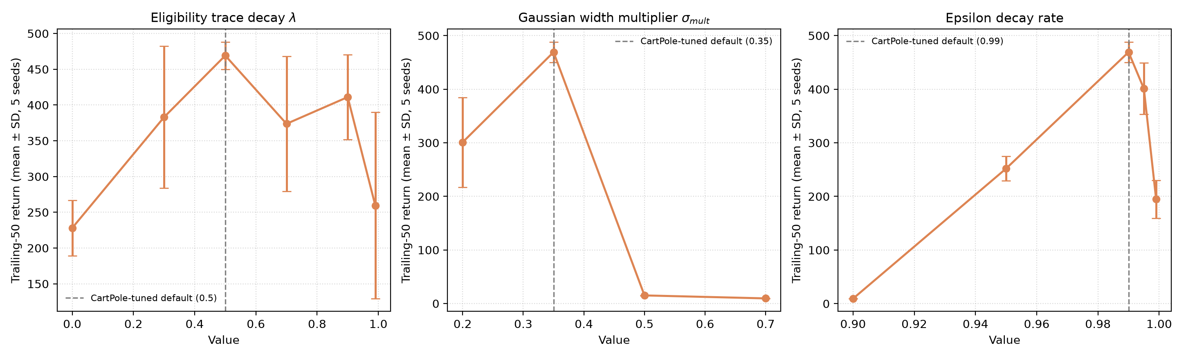
Hyperparameters Sit at Pronounced Performance Peaks
One-factor-at-a-time sweeps, CartPole-tuned default marked on each panel.
Notes:
The Gaussian width multiplier shows the sharpest cliff: values >= 0.5 collapse performance to near-random by over-activating every rule for every state.

Slide 9
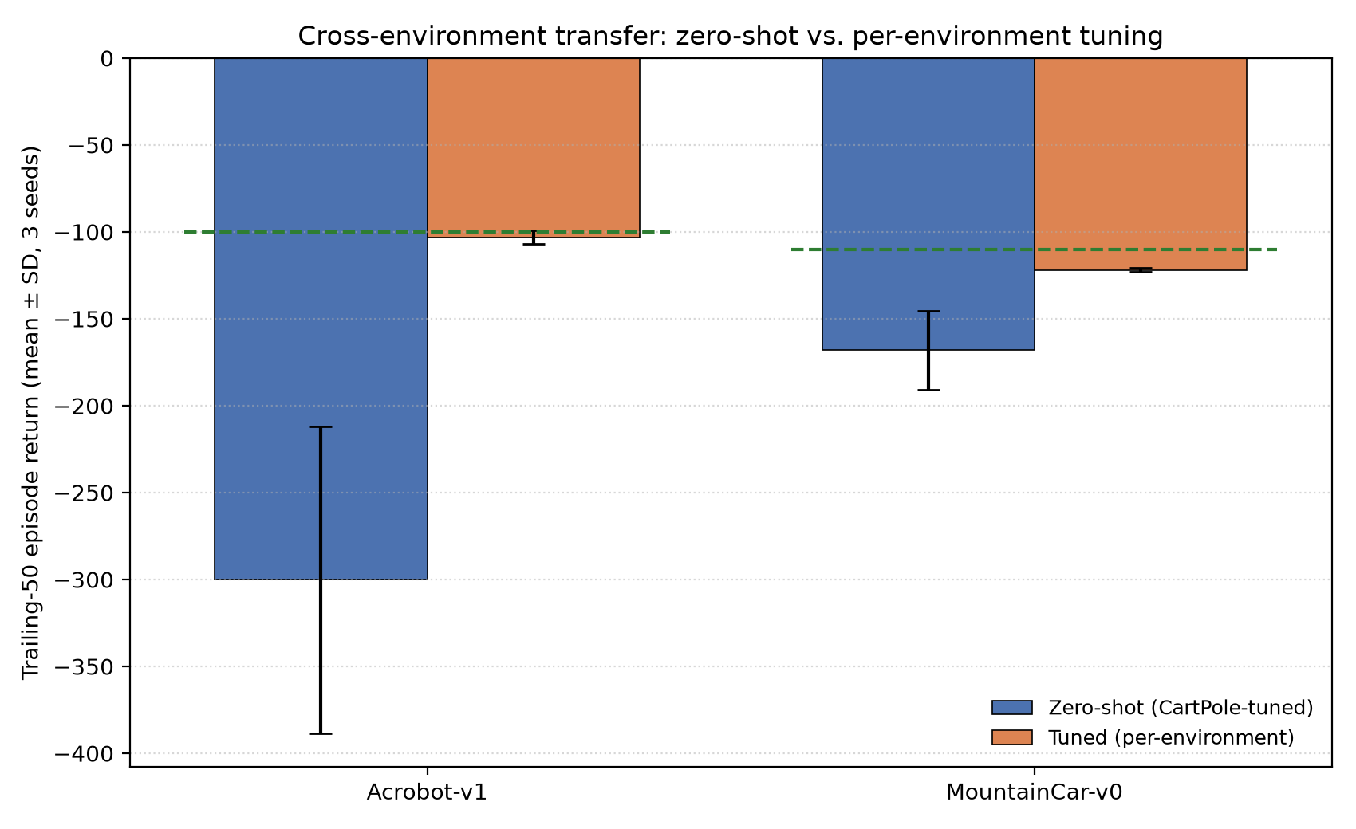
RQ2: Zero-Shot Transfer Is Weak; Retuning Recovers Most of the Gap
MountainCar-v0 and Acrobot-v1, zero-shot vs. per-environment coordinate-search tuning.
Notes:
Acrobot-v1 zero-shot trailing-50 is far below its practical solve bar; a disjoint-validation-seed coordinate search (same cost as the sensitivity sweep) nearly reaches it.

Slide 10
Against Deep-RL Baselines: A Trade, Not a Win
Method | Final return | Solve rate | Train time (s) | Parameters | Memory (KB)
Baseline FQL | 271.7 | 0% | 13.5 | 648 | 2.53
Improved FQL-GTA | 429.3 | 60% | 35.8 | 648 | 2.53
DQN (hand-rolled) | 194.3 | 0% | 173.9 | 4610 | 18.01
DQN (stable-baselines3) | 184.9 | 0% | 154.7 | 9220 | 36.02
PPO (stable-baselines3) | 496.6 | 90% | 157.2 | 9155 | 35.76
Notes:
PPO wins on final return but uses ~14x FQL-GTA's parameters and ~14x the memory. Both DQN variants under-perform FQL-GTA within this study's training budget -- a budget-dependent finding, not a general claim about DQN.

Slide 11
Interpretability: One Real Decision, Fully Traced
• Real state from a trained agent's evaluation rollout: [0.028, -0.033, 0.021, 0.025].
• 4 of 324 rules fire above 0.01 -- local specialisation, not uniform activation across the whole rule base.
• Dominant rule (index 165) fires at 44.5% strength with Q(left) = 102.65, Q(right) = 100.28.
• Blended decision: Q(left) = 98.22, Q(right) = 98.01 -> "push cart left".
• This traceability is the concrete evidence behind the paper's reframed novelty claim: not new ingredients, but a systematically evaluated, inspectable combination.

Slide 12
Conclusion
• RQ1 answered: the combination produces a large, statistically robust improvement (d = 2.51). A factorial effect analysis finds significant Gaussian-MF x eligibility-trace and Gaussian-MF x adaptive-epsilon two-way interaction effects, with no significant three-way interaction -- with the ablation's pairwise power limitation reported honestly.
• RQ2 answered: CartPole-tuned hyperparameters do not transfer zero-shot, but a lightweight, cheap coordinate search recovers most of the lost performance.
• Against deep RL: FQL-GTA trades some final performance for an order-of-magnitude smaller parameter count, faster training, and full rule-level interpretability.
• Contribution is deliberately modest: not new ingredients, but a systematically evaluated, statistically validated, reproducible enhancement to a 26-year-old method.

Slide 13
Thank You
Questions welcome. Code, configuration, results, and manuscript accompany this presentation. Manuscript prepared for journal submission. DOI: Not yet assigned.

