Slide 1

Multimodal Movie Recap
YouTube film → summary story → peak points → time index → a recap under 10 minutes
Karthikeyan K
Presenter
AI11 · Module 8 · Multimodal AI Systems: Speech, Text and Conversational Agents · Assignment 1 · Dr. J. B. Simha
Notes:
Good morning. My name is Karthikeyan K, and this is my project for Assignment 1 of Module 8, Multimodal AI Systems. The project is a multimodal movie recap system. It takes a full movie from YouTube, processes its video, its audio and its text, writes a short summary story, finds the most important moments with their exact timestamps, and cuts those moments into a recap that runs for less than ten minutes. Everything runs on a normal laptop CPU with open models.

Slide 2
Problem statement and objectives
The problem
1
Process video, audio and text in one multimodal pipeline
A feature film takes over an hour to watch. Producing a recap by hand means watching it, writing a summary and editing clips together. The goal is an AI system that does all of this automatically from a YouTube link.
2
Speech-to-text + summarisation → a concise summary story
3
Find peak points and map them to time indices in the film
4
Extract the segments (OpenCV) → recap under 10 min, scored with BLEU
Notes:
The problem is simple to state. A feature film takes more than an hour to watch, and often a viewer only wants the story: what happened, and the key scenes. Doing this by hand means watching the film, writing a summary and editing clips together. The assignment asks for an AI system that does it automatically. It has four objectives. First, build a pipeline that processes video, audio and text. Second, use speech-to-text and summarisation to produce a summary story. Third, identify peak points and map them to time indices in the original film. And fourth, extract those segments and join them into a recap under ten minutes, then evaluate the summary with BLEU.

Slide 3
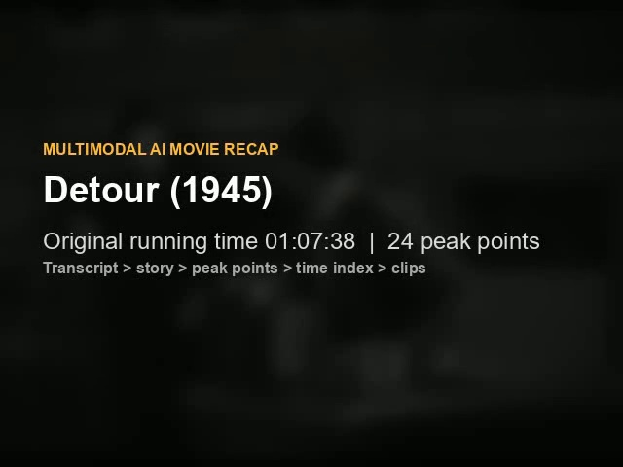
Input: Detour (1945), a public-domain film noir
Public domain: recap clips can be shared with no copyright risk
Voice-over narration: rich, clear speech for speech-to-text
Human reference: Wikipedia plot summary for BLEU
67:38
946
24
8:44
film length
transcript lines
peak points
recap length
youtube.com/watch?v=tap67KjjPu8 · original English audio track selected (upload also carries auto-dubbed tracks)
Notes:
For the input I chose Detour, a 1945 film noir by Edgar Ulmer. I chose it for three reasons. It is in the public domain, so I can share the recap clips without any copyright problem, which matters because the class discussed that recap videos can be claimed as derivative work. It has a strong plot and a lot of first-person voice-over narration, which is ideal for speech-to-text. And there is a human-written plot summary on Wikipedia, which I use as the reference for BLEU. One practical lesson came up straight away: this YouTube upload carries auto-dubbed audio tracks in several languages, so the downloader explicitly selects the original English track. The numbers on this slide are the final result: a 67-minute film, 946 transcript lines, 24 peak points, and an 8-minute-44-second recap.

Slide 4
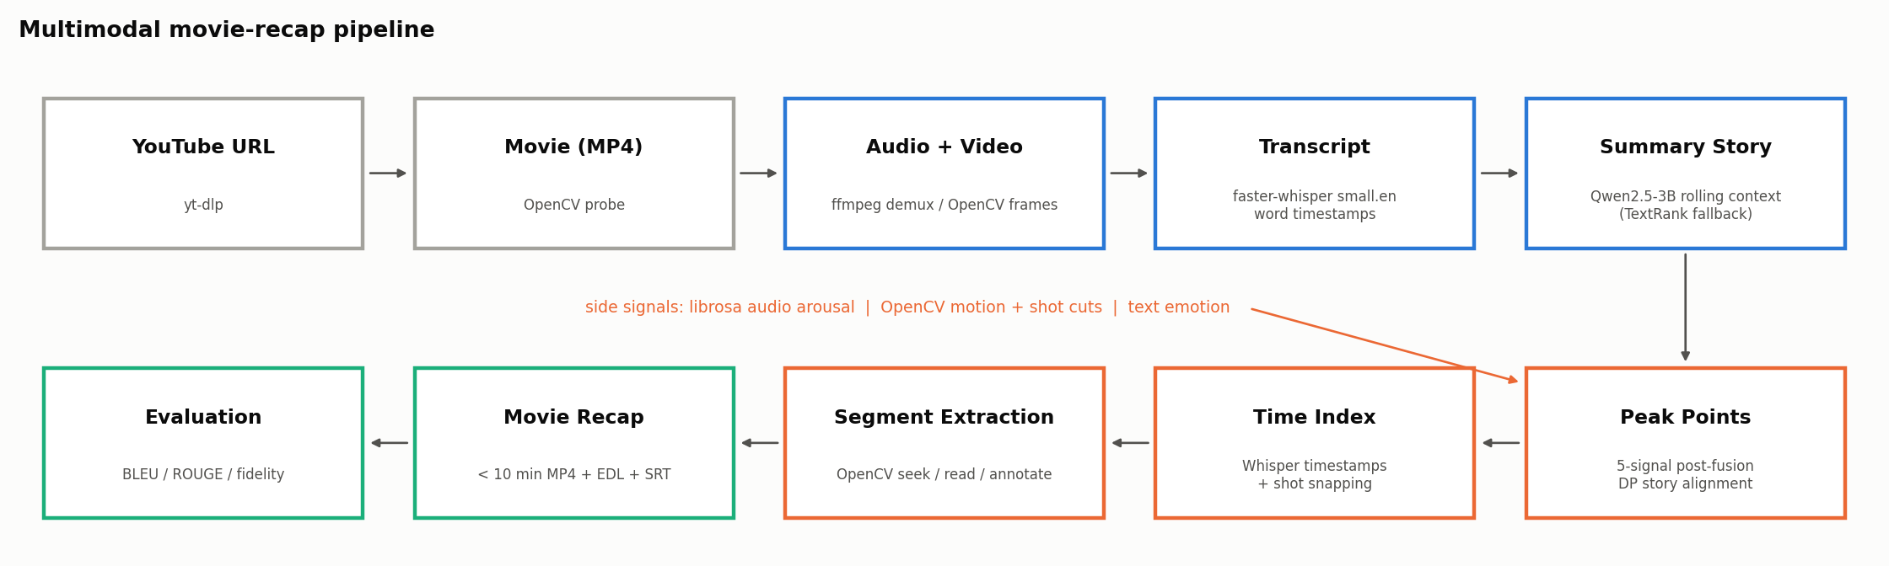
System architecture and workflow
Post-fusion: audio, video and text-emotion signals are computed independently and combined only when choosing peak points. Every stage is a separate, tested module that caches its output.
Notes:
This is the architecture, and it follows the workflow from the assignment exactly. The YouTube URL is downloaded with yt-dlp. The movie is split into audio and video. The audio becomes a timestamped transcript using Whisper. The transcript becomes a summary story using a local language model. The story is mapped to peak points, the peak points give us time indices, OpenCV extracts the segments, and the segments become the recap, which is then evaluated. The orange line in the middle is what makes it multimodal: alongside the text, the system computes audio arousal with librosa, visual motion and shot cuts with OpenCV, and emotion from the dialogue. These side signals are fused when choosing the peak points. Following what we learned in the Day 4 session, every stage is a separate module that can be tested on its own, and the modalities are combined by post-fusion.

Slide 5
Technologies, models and libraries
Ingest
Speech-to-text
yt-dlp · ffmpeg (bundled via imageio-ffmpeg)
faster-whisper small.en, int8 on CPU, word timestamps
Summary story
Embeddings
Qwen2.5-7B-Instruct via Ollama, temperature 0
sentence-transformers all-MiniLM-L6-v2
Text emotion
Audio features
DistilRoBERTa emotion classifier
librosa: RMS, onset strength, ZCR
Video
Evaluation
OpenCV: shot cuts, motion, seek / read / write
own BLEU + NLTK + sacreBLEU, ROUGE
Notes:
Here are the tools. yt-dlp and ffmpeg handle the download and the audio extraction; ffmpeg comes bundled through imageio, so no system install is needed. Speech-to-text uses faster-whisper with the small English Whisper model, quantised to eight-bit integers so it runs on a CPU. The summary uses Qwen 2.5, seven billion parameters, served locally by Ollama at temperature zero for consistent output. Sentence embeddings come from MiniLM, and emotion from a DistilRoBERTa classifier. librosa extracts the audio features, OpenCV does all the frame work, and BLEU is implemented by hand and cross-checked with NLTK and sacreBLEU. Nothing here needs a GPU or a paid API.

Slide 6
Implementation: test, cache, then integrate
1
Test each component
27 automated tests; a synthetic movie with a known cut (4 s) and loud burst (5 s), plus the two story checks
2
Cache slow stages
transcript, features, summary and peaks saved as JSON
3
One config file
models, fusion weights and the duration budget in config.yaml
Notes:
On implementation, I followed the instruction to test each component before integrating. There are twenty-seven automated tests. Many of them use a synthetic eight-second movie that I generate with a known hard cut at four seconds and a known loud burst at five seconds, so I can check that shot detection and audio arousal find exactly those moments. Others check the two story checks with hand-made transcripts. Second, the slow stages cache their results as JSON. Transcription takes about 22 minutes and the seven-billion-parameter summary about 33 minutes on my CPU, so caching lets me tune the later stages in minutes. Third, every parameter lives in one config file, so the same pipeline can run on any other film.

Slide 7
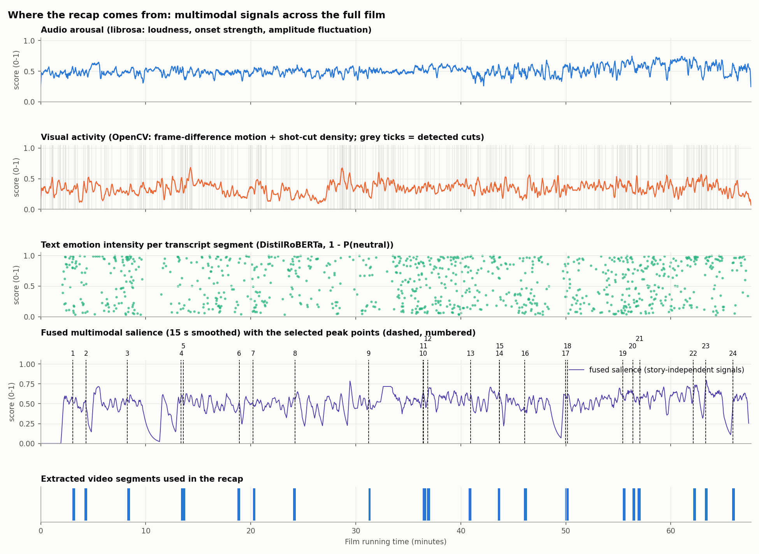
Speech-to-text and multimodal signals
Transcript
946 lines, 9k words, word timestamps; 22 min on CPU
Audio
librosa arousal: loudness, onsets, amplitude fluctuation
Video
OpenCV: 312 shot cuts + frame-difference motion
Text emotion
48% of lines non-neutral (surprise, disgust, anger lead)
Notes:
This figure shows the whole film on one time axis. The top panel is audio arousal from librosa: loudness, onset strength and how much the amplitude fluctuates. That last one comes from the class heuristic that a calm speaker has steady amplitude and an agitated one does not. The second panel is visual activity from OpenCV, with 312 detected shot cuts as grey ticks. The third panel is the emotion of every transcript line. The fourth panel fuses these signals, and the numbered dashed lines are the thirteen peak points. The bottom row shows the clips that were extracted. Notice that the peaks cover the whole story, from minute four to minute sixty-three.

Slide 8
Summary story: grounded notes, editor and two checks
1
13 chunks of ~5 min: notes "who - does what - to whom (quote)", then 2 sentences
From the generated story (24 sentences, 410 words)
02:03-07:02 Al reflects on his time at the old break at Dawn Club, missing his former life and his girlfriend Sue.
2
Editor pass: fixes roles, removes repeats, restores missing events
27:11-31:57 Al drives cautiously, suspecting he is being followed, and interacts with an officer who confirms his identity as Charles Haskell, Jr. Al finds $768 and a letter that reveals Haskell's deceitful nature, leading him to decide to investigate further.
3
Key-event check: a death or murder in the dialogue must be in the story
46:58-51:46 Vera threatens Al, forcing him to stay.
4
Character-entry check: no name before it is first spoken
61:48-67:24 Al contemplates his next move, planning to destroy evidence and flee Bakersfield to avoid being recognized, while hoping fate will spare him by not stopping him on the road.
Notes:
Now the summary. The transcript has about nine thousand words, so it is cut into thirteen chunks of about five minutes, and the model always sees the story written so far. For each chunk it first writes short event notes in the form who does what to whom, with a quote from the transcript as evidence, and only then writes two sentences from those notes. An editor pass then reads the whole draft against all the notes and fixes wrong roles and repeated events. After that come two checks that are plain rules, not model guesses. The key-event check looks for lines about a death or a murder; if the story says nothing about them, one short call adds the missing sentence. The character-entry check makes sure no character is named before their name is first spoken. My first version named Vera fourteen minutes too early and left out the climax; these checks fixed both.

Slide 9
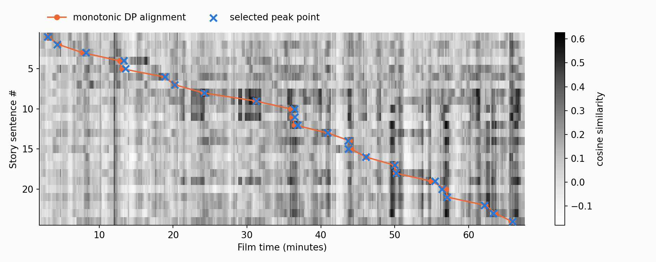
Peak-point identification: alignment + post-fusion
1 Alignment. Monotonic dynamic programming keeps story order, inside each sentence's own chunk.
2 Peak picking. Within ±45 s, the highest fused score wins; its Whisper timestamp is the time index.
Notes:
Next, the peak points. For each story sentence I need the single moment in the film that shows it. Step one is alignment. The transcript is cut into thirty-second windows, and both the sentences and the windows are embedded. A dynamic-programming alignment picks one window per sentence so that the total similarity is highest and the order stays the same as in the story. You can see it in the heatmap: the orange path climbs from top-left to bottom-right. Without that order constraint, a sentence about the ending could match an early scene just because the same name appears. Step two is peak picking. Around the aligned window, every line gets a fused score: forty percent semantic similarity, and fifteen percent each for importance in the film, emotion, audio arousal and visual activity. The highest score is the peak point.

Slide 10
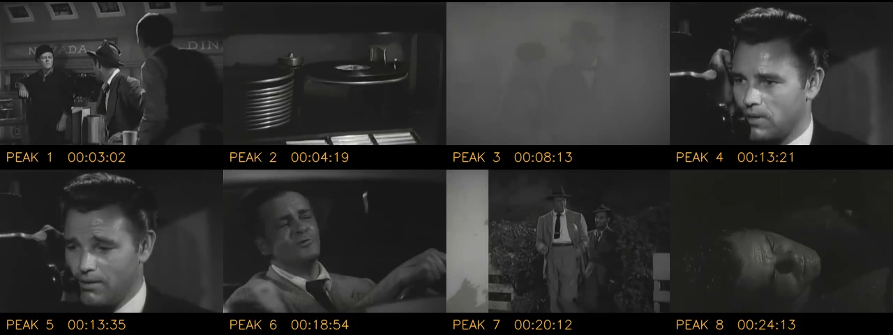
Timestamp mapping and segment extraction
Story sentence 23
Source chunk
Peak line
Time index
Film clip
Recap slot
"Al kills Vera accidentally, and now the polic…"
›
61:48-67:24
›
"And now, after killing Vera without rea…"
›
01:03:19
›
63:15-63:30
›
OpenCV seek / read / write
Clips grow with on-topic neighbouring dialogue (≤ 32 s), snap to the nearest shot cut, stay chronological and fit the budget.
Notes:
This slide shows how one sentence travels through the system. Take story sentence twenty-three: Al kills Vera accidentally, and now the police suspect him of her murder. It came from the last chunk, from one hour one minute to the end. The alignment places it in a thirty-second window, and the fusion picks the narration line, after killing Vera without really meaning to do it, at one hour three minutes nineteen seconds. That Whisper timestamp is the time index. The clip is grown with the surrounding dialogue, snapped to the nearest shot cuts, and becomes one hour three minutes fifteen to one hour three minutes thirty in the film. OpenCV seeks to that exact frame, reads the clip, and writes it into the recap. The keyframes at the bottom are the frames at the first eight peak points.

Slide 11
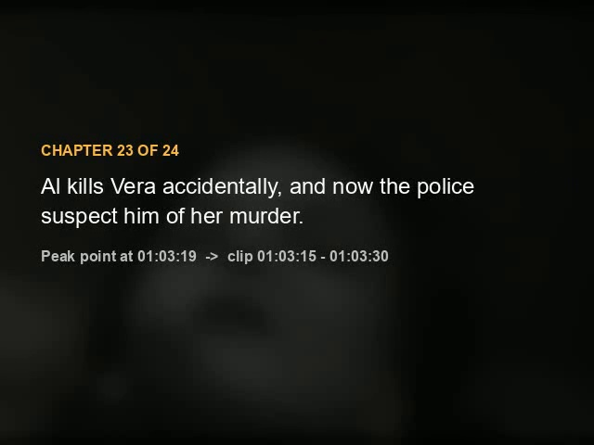
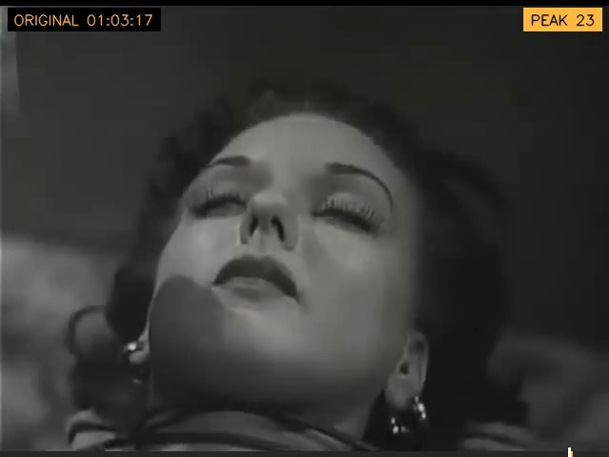
Final movie recap output
8:44
recap (< 10:00)
5.5
minutes of original footage
7.7×
Chapter card (narrated story sentence)
▶ Click to play: 21 s excerpt (chapter 23, the climax, + its clip)
outputs/detour_1945/movie_recap.mp4 · movie_recap.srt · recap_edl.csv
compression
Notes:
And this is the output. The recap is eight minutes forty-four seconds long, so it is under the ten-minute limit, and it compresses the film by a factor of about seven point seven. About five and a half minutes are original footage. Before each clip, a chapter card reads out the story sentence, using offline text-to-speech that is loudness-matched to the old soundtrack. During each clip you can see the original timecode, the peak number, a bar along the bottom showing where in the film the clip comes from, and a white flash at the exact peak moment. So the link between the summary, the peak point, the time index and the segment is visible on screen. Let me play the excerpt on this slide: it is chapter twenty-three, the climax, followed by its clip. [Click the video and let it play for about twenty seconds.]

Slide 12
Evaluation: summary vs. the human plot (BLEU)
Why BLEU is low for everyone: BLEU counts exact 4-word overlaps; independent summaries rarely share phrasing, and the story (410 words) is shorter than the 526-word reference (brevity penalty 0.76). The ranking against baselines is the meaningful signal.
Notes:
For evaluation, the summary story is compared with the Wikipedia plot using BLEU, plus ROUGE and embedding similarity, and against four baselines of the same length: an extractive TextRank summary, the first words of the transcript, evenly spaced lines and random lines. The story wins on every metric. BLEU-4 is 0.040 against at most 0.021 for the baselines, BLEU-1 is 0.41, and semantic similarity is 0.81 against at most 0.47. The absolute BLEU is low for every system, and that is expected. BLEU counts exact four-word sequences, and two people summarising the same film rarely use the same phrases. Writing two sentences per chunk brought the story close to the reference length, which raised the brevity penalty from 0.50 to 0.76. So the ranking against baselines and the semantic similarity are the meaningful signals.

Slide 13
Recap fidelity and multimodal ablation
Recap re-transcribed clip by clip
Text-only vs. multimodal peak selection
0.73
92%
Signal of chosen peaks | Text only | Fusion
Semantic | 0.87 | 0.75
Text emotion | 0.50 | 0.77
Audio arousal | 0.57 | 0.55
Visual activity | 0.38 | 0.50
mean clip BLEU (> 0.7 target)
peak lines heard in their clip
0.97
0.77
narration intelligibility
median clip BLEU
Fusion moved 13 of 24 peaks (mean 12.4 s) toward the more dramatic line in the same scene.
Notes:
BLEU on the summary does not tell us whether the recap actually contains the right scenes. So I added a fidelity check: every clip is cut out of the finished recap and transcribed again, and compared with the original transcript at the mapped timestamps. The mean clip BLEU is 0.73, above the 0.7 threshold discussed in class, and 92 percent of the peak lines are heard in their clips. The narration is recognised almost perfectly. That confirms the timestamp mapping and the audio-video sync end to end. The ablation on the right compares text-only peak selection with the multimodal fusion. Fusion moves thirteen of the twenty-four peaks toward the more dramatic line in the same scene. Emotion intensity rises from 0.50 to 0.77, at some cost in semantic similarity.

Slide 14
Model comparison: choosing the summariser
Configuration | Story | BLEU-4 | Semantic | Clip BLEU | Verdict
3B, rolling context | 26 sentences | 0.047 | 0.78 | - | Role confusion
3B, + cast list | 24 sentences | 0.050 | 0.85 | 0.70 | Names in wrong scenes
3B, + name grounding | 24 sentences | 0.040 | 0.81 | 0.74 | Copies its own sentences
7B, rolling context (run E) | 13 sentences | 0.030 | 0.86 | 0.80 | Vera named too early; no climax
7B, notes + editor + checks (chosen) | 24 sentences | 0.040 | 0.81 | 0.73 | Grounded roles, climax and ending
TextRank (extractive) | same length | 0.021 | 0.45 | - | No story; fallback only
BLEU-4 0.030 (run E) → 0.040 (chosen). Grounded notes and two rule-based checks fix the early naming of Vera and restore the climax; three role errors remain without speaker labels.
Notes:
This table summarises my experiments on the summary stage, because it has the biggest effect on quality. With the three-billion-parameter model, the story repeated itself and invented events. The seven-billion-parameter model with rolling context, run E, gave a coherent story but named Vera too early and missed the climax. The final version adds grounded notes, the editor and the two checks. It has the best BLEU-4 and ROUGE-L, and it is the only one with a correct climax. One intermediate version reached a higher plot coverage, but only with invented details, so I rejected it after checking the story against the film. Three role errors remain, because the transcript has no speaker labels. TextRank stays as the automatic fallback when no language model is available.

Slide 15
Key observations and conclusion
8:44
1
Carry the time index through every stage
chunk span → aligned window → peak line → clip → recap slot makes every claim traceable
recap from a 67:38 film, CPU only
2
Modalities complement each other
0.73
text picks the scene; audio, video and emotion pick the moment
3
Rules check the language model
clip fidelity BLEU
simple transcript checks caught a missing climax and a character named too early; BLEU needs baselines and a factual review
9 / 9
4
Next steps
speaker diarisation, CLIP frame matching, a FastAPI service
metrics where the story beats every baseline
Notes:
To conclude. The system turns a 67-minute YouTube film into an eight-minute-forty-four recap on a CPU, with open models only. The summary beats all baselines, and the recap passes an end-to-end fidelity check. Three observations stand out. First, the time index has to be carried explicitly through every stage; that is what makes the recap traceable. Second, the modalities complement each other: text chooses the scene, while audio, video and emotion choose the moment. Third, simple rule-based checks on the transcript fix errors that the language model cannot see by itself, and BLEU always needs baselines and a factual review beside it. The main limitation is role errors without speaker labels. Next steps would be speaker diarisation, a vision-language model such as CLIP, and a FastAPI service as recommended in class. Thank you; I am happy to take questions.

