Slide 1




Enterprise Innovation. Powered by Knowledge.
DELETE OR REPLACE
WITHCUSTOMER’S
LOGOIN SLIDEMASTER
Expense Tracker System
27 February 2026
Digital Transformation | Data & Analytics | Managed Services

Slide 2
Introduction
DELETE OR REPLACE
WITHCUSTOMER’S
LOGOIN SLIDEMASTER
At GyanSys, employees in the company submit reimbursement claims (travel, food, equipment, etc.), but the current process is handled via email and Excel. Build a centralized digital system to address reimbursement claims with a Multi-Level Approval System.

Slide 3
Problem Statement
DELETE OR REPLACE
WITHCUSTOMER’S
LOGOIN SLIDEMASTER
Employees in the company submit reimbursement claims (travel, food, equipment, etc.), but the current process is handled via email and Excel. This leads to:
· Lost requests
· Duplicate claims
· No approval tracking
· No audit trail
· Poor reporting visibility

Slide 4
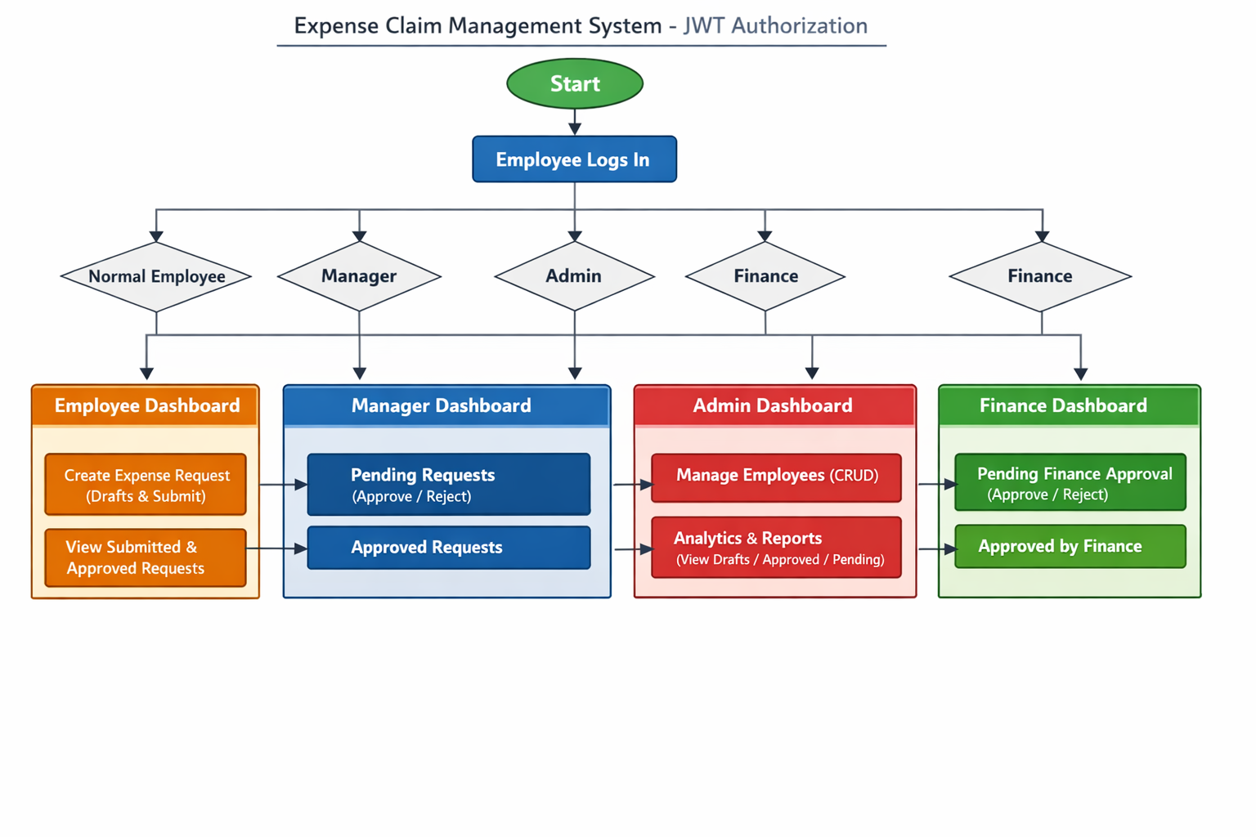
Proposed Solution

Slide 5
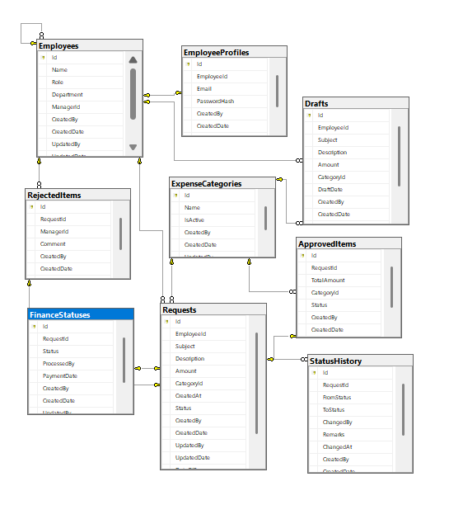
Database Design
DELETE OR REPLACE
WITHCUSTOMER’S
LOGOIN SLIDEMASTER
Total of 9 tables:
Employee Table
Drafts Table
Requests Table
Approved Items Table
Rejected Items Table
Expense Categories Table
Finance Status Table
Status History Table
Project Table

Slide 6
API Design
API is categorized into 5 main types:
Auth -- handles authentication.
Admin and Employee -- performs CRUD on employees by the admins
Reports -- generate analytic reports based on the approval history
Finance -- request approval / rejection by thefinance team
Requests -- creation of requests by the employees
Categories -- categorizing the data

Slide 7
User Interface – Front-end
Login Page
Secure login and registration options for users.
Role-based access for Employees
Dashboard Pages
Specific dashboard pages for showing the requests and approvals for each of the employee as per their role.
(Employee/ Admin/ Finance/ Manager).

Slide 8
Conclusion
DELETE OR REPLACE
WITHCUSTOMER’S
LOGOIN SLIDEMASTER
The Expense Claim & Approval Management System provides a secure, scalable, and efficient solution for managing employee reimbursement requests.By replacing manual processes with a centralized digital system, the application improves transparency, reduces errors, and ensures smooth claim processing.The system demonstrates modern web development practices and provides a strong foundation for future enhancements and enterprise deployment.

Slide 9

Thank You!
DELETE OR REPLACE
WITHCUSTOMER’S
LOGOIN SLIDEMASTER
Any Questions?

