Slide 1
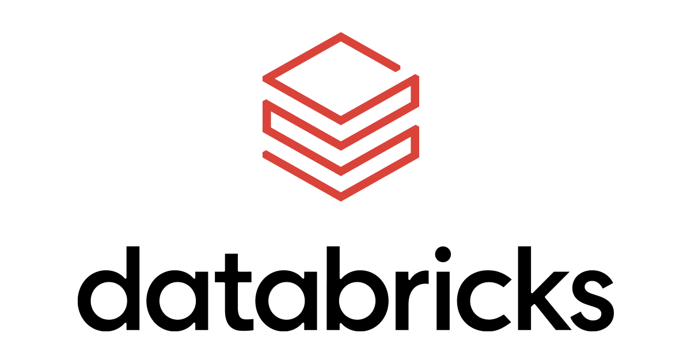

DATABRICKS

Slide 2
What is Apache Spark?
Commercial product from the creators of Apache Spark
Complete development environment forApache Spark
Numerous proprietary Spark enhancements
Ideal for Data Science team collaboration
Many development tools
Optimized for the Cloud

Slide 3

Apache Hadoop project
Notes:
Hadoop is the first big data platform, open source available.
What happened over time is, ,other services an products were added to the Hadoop.
So they broadened Hadoop to the Apache Hadoop project.
It caused a confusion, because there was a single project was named Hadoop and entire project is named Hadoop.

Slide 4
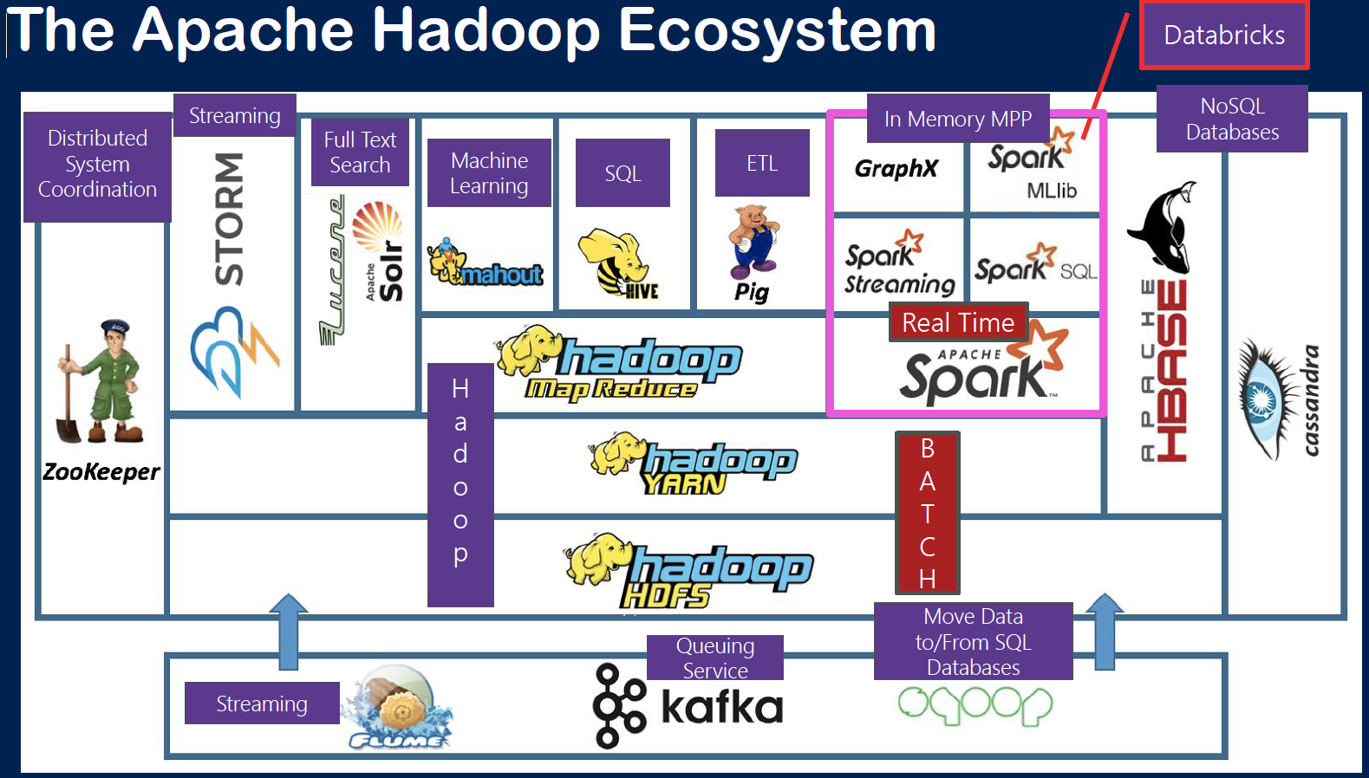
Notes:
Original project is core, now goes under the name of MapReduce
First thing at the top is that architecture that idea of spitting out partitioning and then getting results parallel processing underneath that you need something to coordinate and acquire all the resources and jobs and memory and things that are going to happen to support MapReduce that’s called YARN which stands for ‘Yet Another Resource Negotiator’ .
Underneath this is a really intriguing service which acts like just a regular file system you might be used to (folders, files, etc.) but it is little twist to it. It understands this partitioning and while it does not necessarily show it to you its partitioning the data in on the drive so that you may look at and see one big phone book file but in reality it is partitioned by last name. That’s called Hadoop File System also known as HDFS.
Maybe it is fair to say that Spark is a replacement for the Hadoop MapReduce.
MapReduce physically reads and writes to storage that’s a bottleneck (When you read and write to disk, it slow things down.)
Spark is designed from the beginning to try to work in memory as much as possible.
So if you think of everything all these partitions are pegged in the memory using a cache and will be held there as much as possible if you have enough space it will not put it back to disk it will keep it there.
That increases processing speed a lot.
Most of the functionality in Spark really focuses on its data engineering site (munging, querying facility)

Slide 5
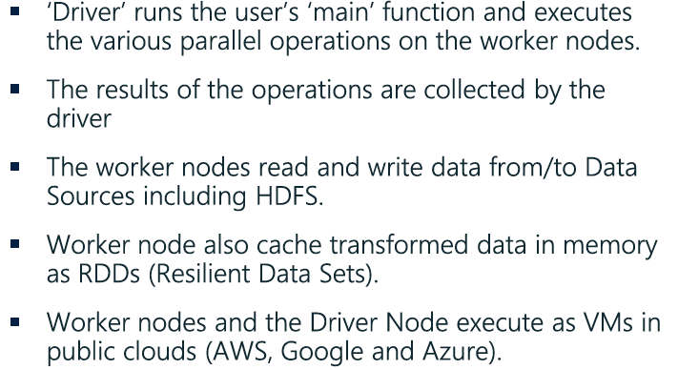
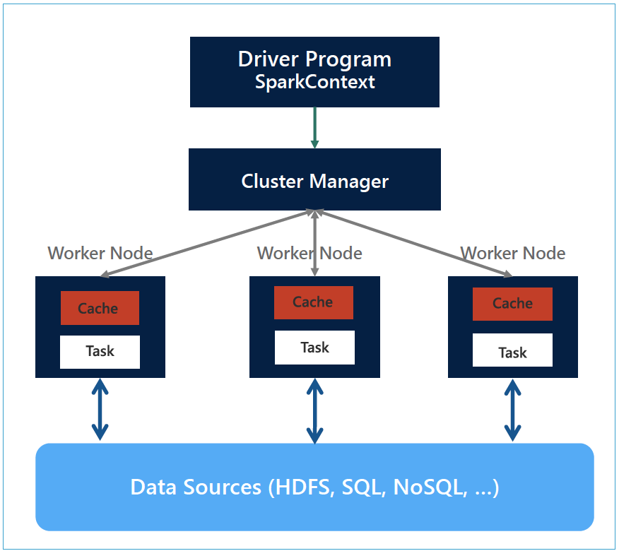
GENERAL SPARK CLUSTER ARCHITECTURE
Notes:
The most important thing here is that you have got things running in parallel.
Let’s imagine, all people are working concurrently, doing something. But at the end you got to pull it all together at the end.
The importance of that can’t be over emphasized because it has a lot of impact maybe you may even think of.
For instance there is a lot of work going on to keep the data separate. You don’t want data from one node to be shared with another node in sense that you don’t want duplication.
If a city of data is being processed on this node and it’s separated by city you need to make sure that that’s all that’s in that node.
Because if you get redundancy of the data handled by the node it’s going to give you a bad result.
Driver context is you. Context connects you into cluster manager.
Cluster manager is responsible to get the work done.
The worker nodes underneath, they are doing the actual work. Cache, keeping in the memory, going to do what’s needed give you the result back.
At the bottom you see the data sources. Spark and DataBricks get almost any data you can imagine.
Where do I store my data ? Well it’s like asking, you have got a vacuum cleaner where do I put the carpet?
Spark is a query engine. Spark is a data analytics engine, it’s meant to run queries. It isn’t a storage engine.
So it is not like a relational database you say well I’ve got it all in one right I’m storing the data and occurring it.
Data lakes kind of just the place you put the data. Spark does not care much about. Spark is just going to take the data from wherever you tell to get it. And then it ingests it and it’s processing massively in parallel.
So Spark is not same as the data. They are separate. And Spark does not care about where you put the data where it resides that’s up to you to get it in storage. So don’t confuse spark with storage and the data lake.

Slide 6
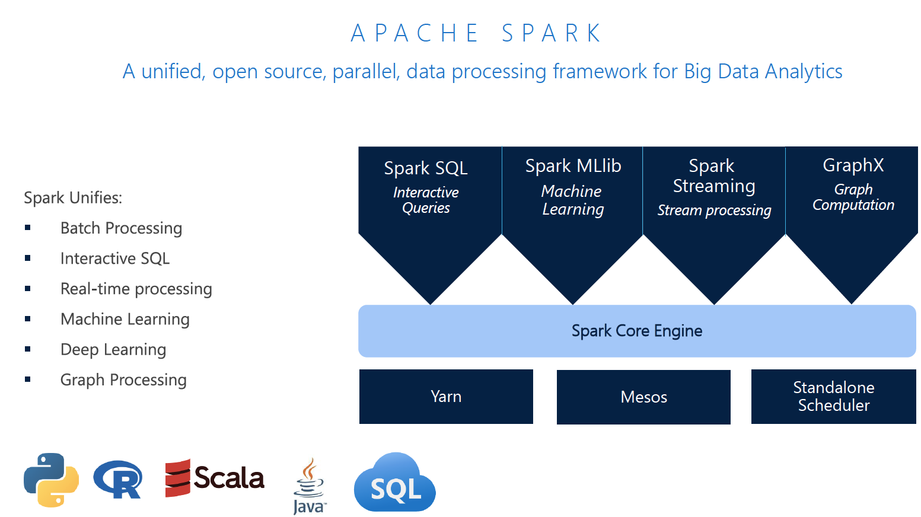
Notes:
Spark core it’s kind of the original service, it uses a data structure under it called resilient distributed dataset (RDD).
Manage these services, there is several different software system you can use.
Spark SQL: You can query spark data just as if it were database. Where it resides mind you it’s not a physical database in Spark

Slide 7
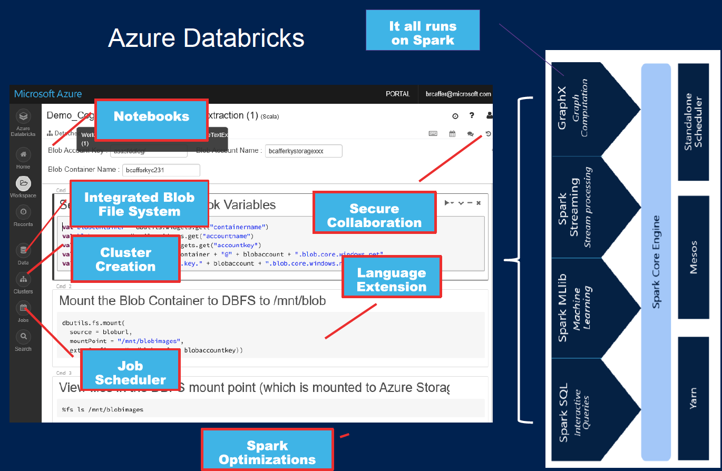
Notes:
- Cluster: is a collection of a really a virtual machines, it’s meant to execute separate processes in parallel

Slide 8
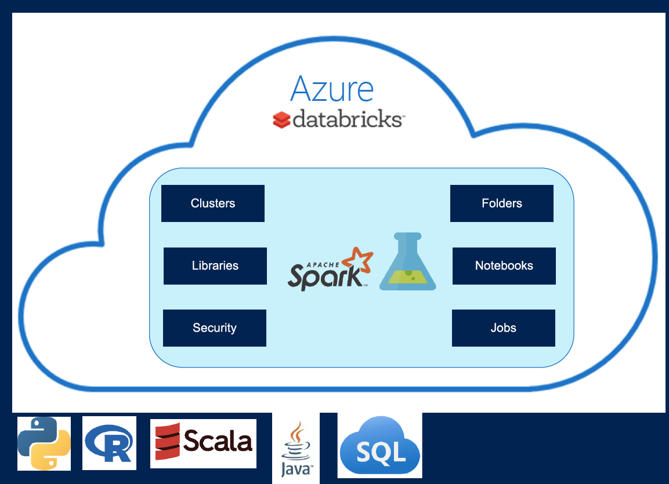

Slide 9
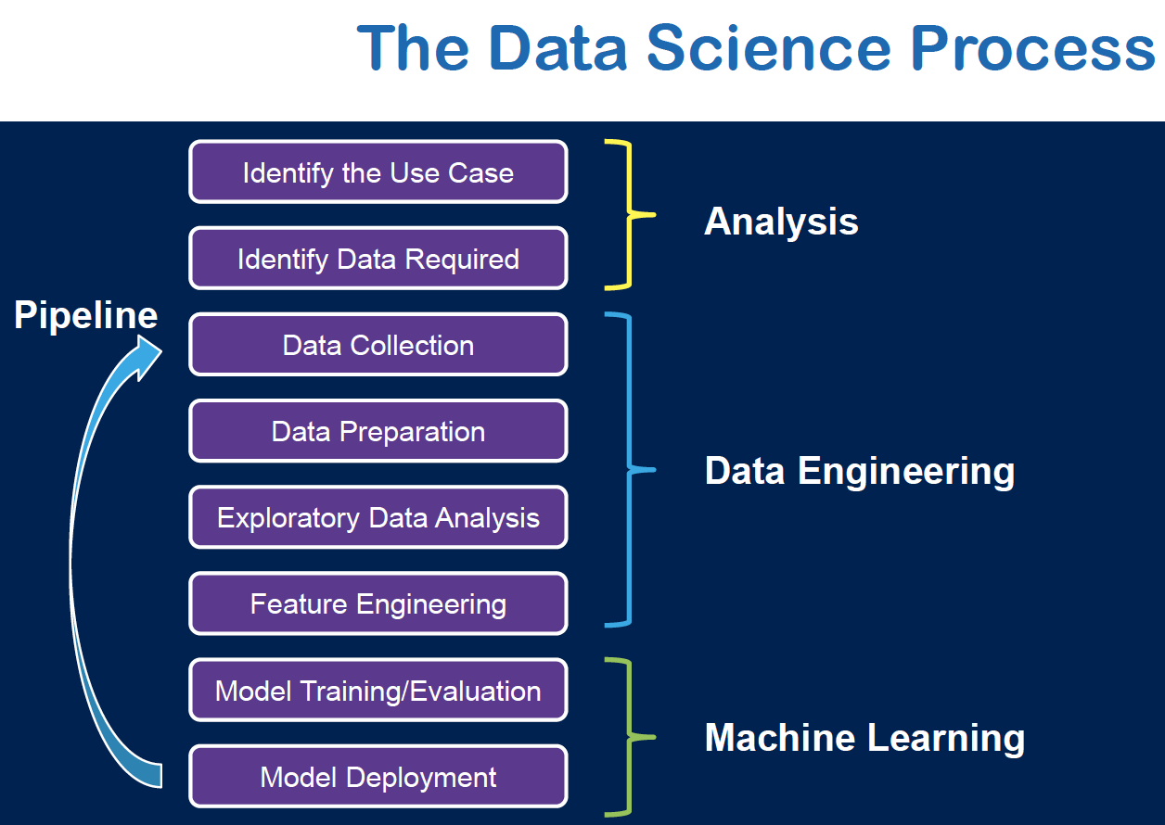

Slide 10
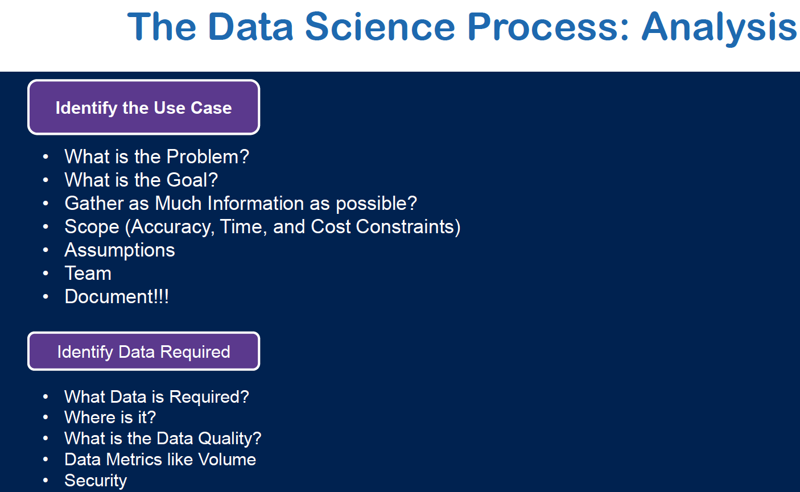

Slide 11
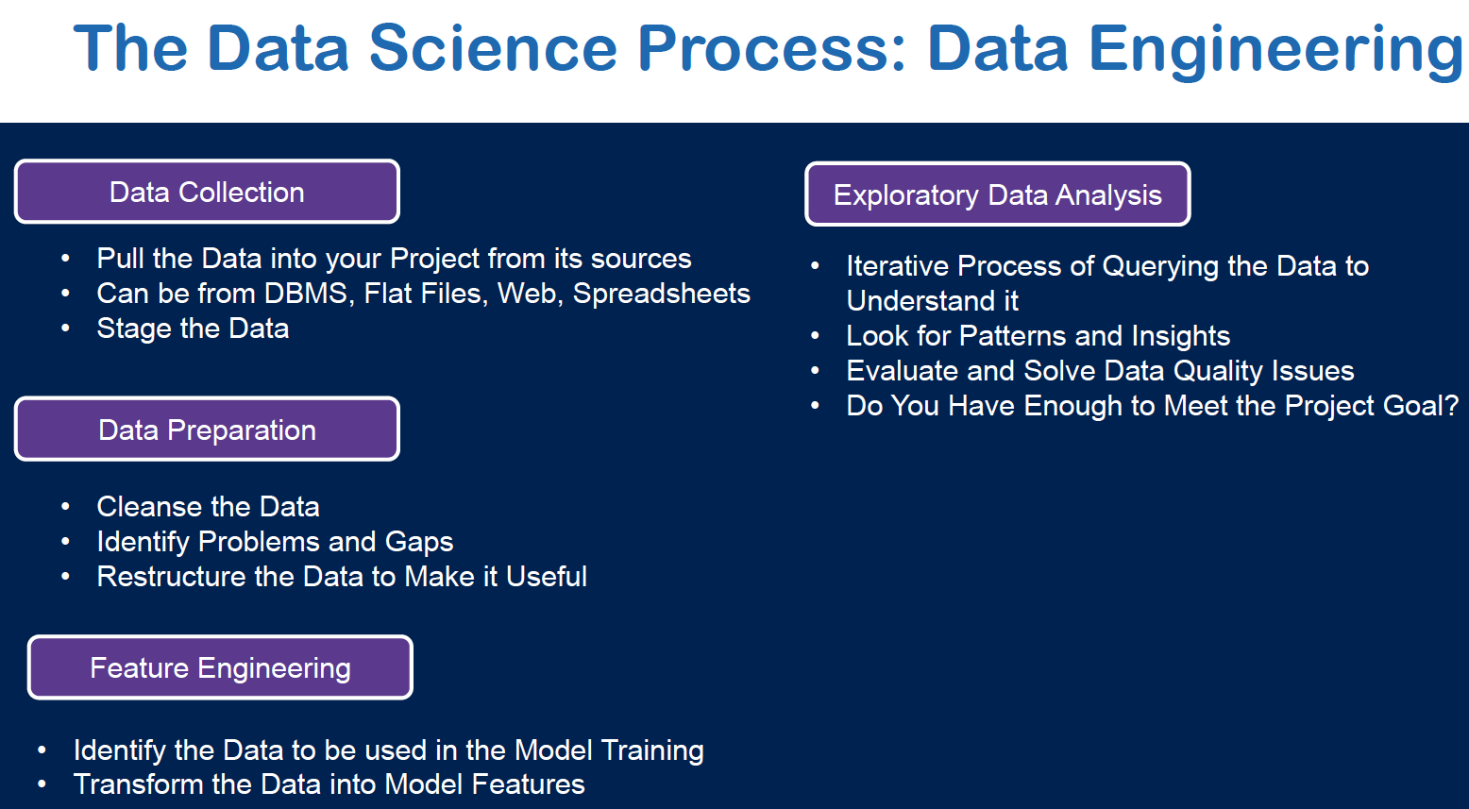

Slide 12
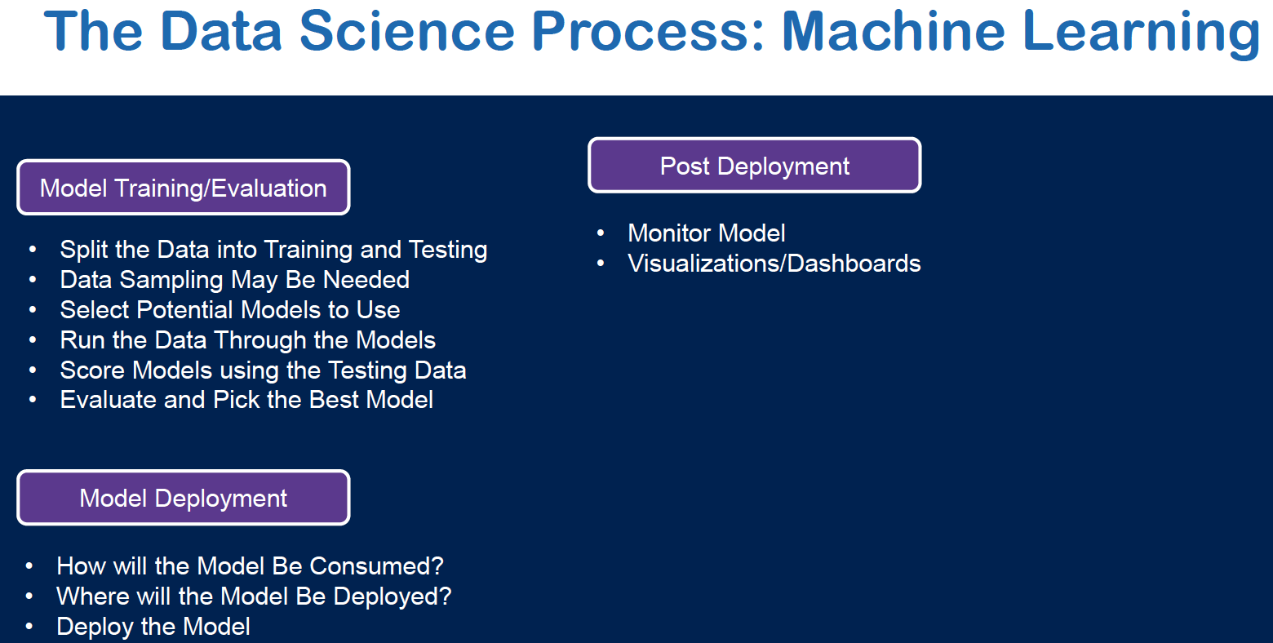

Slide 13
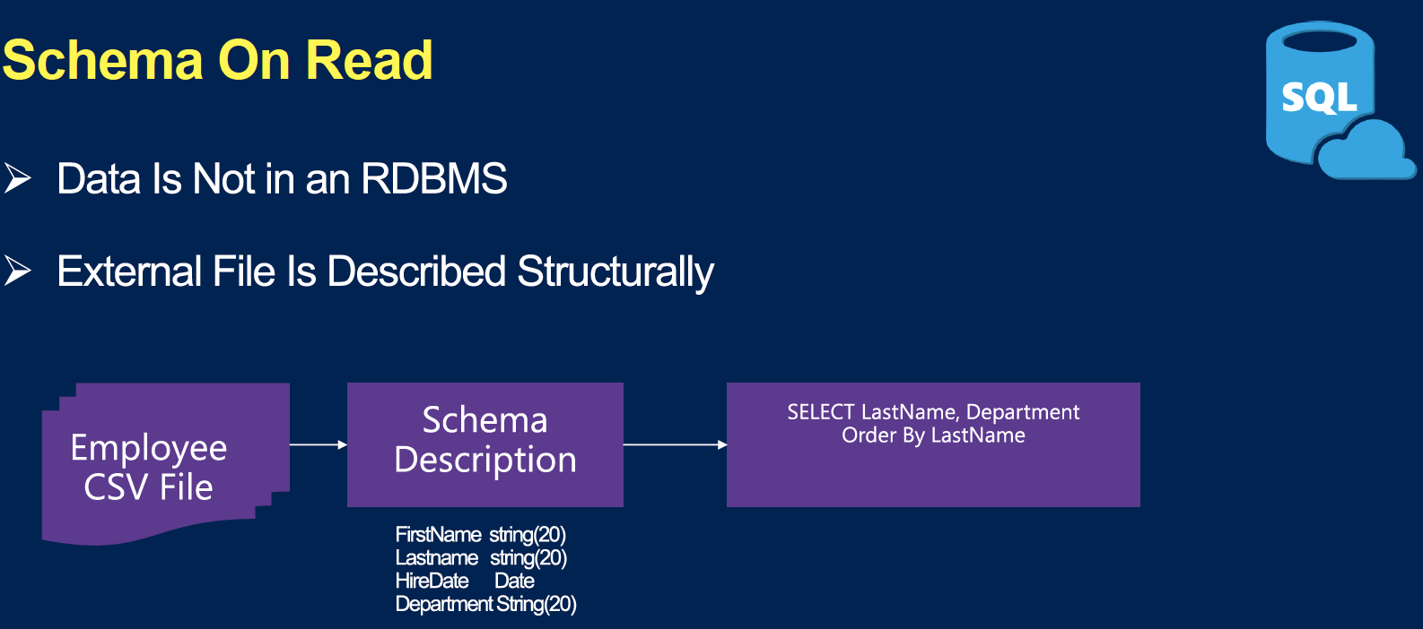
Notes:
SPARK SQL is much more than structural query language on top of Spark.
We can read data in place without loading it.
Schema on read (leave the data where is it. Point to it, read it, query, slice), don’t need to replicate the data.
We can do massive queries.

Slide 14
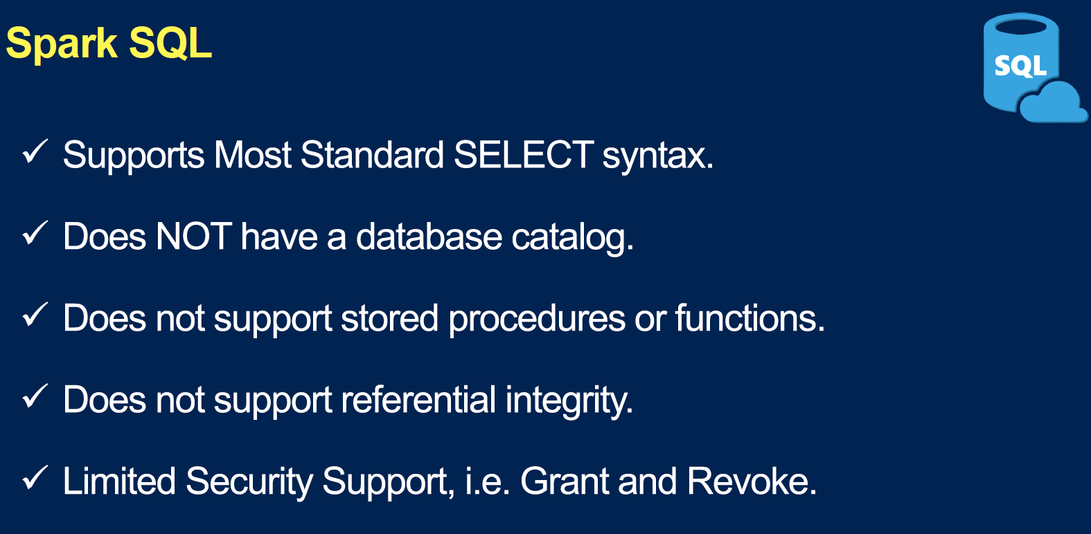

Slide 15
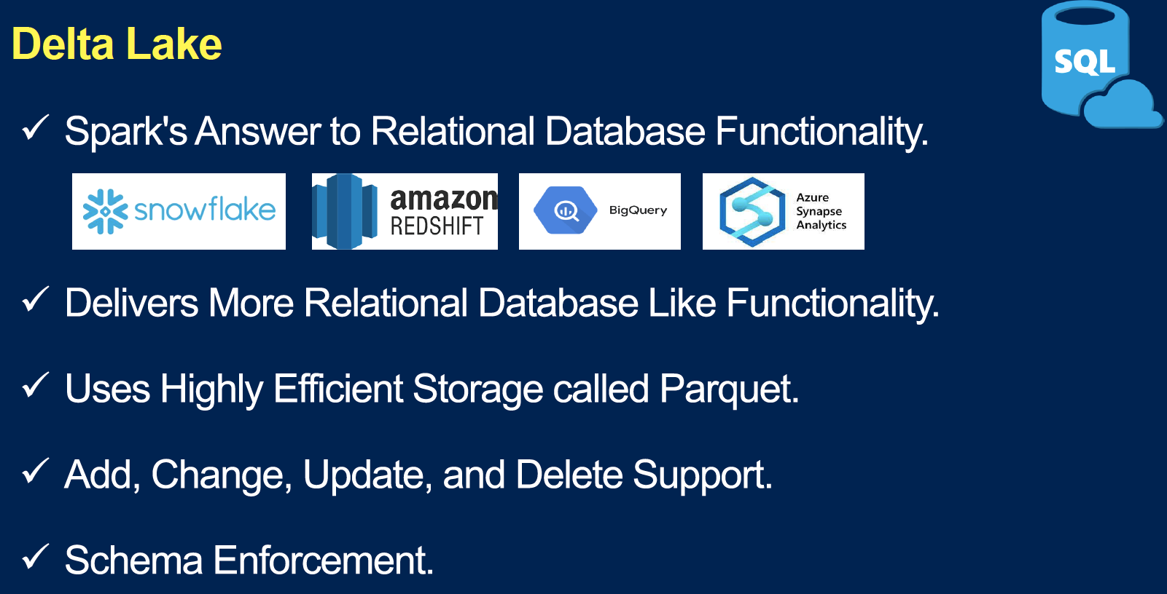

Slide 16
SAMPLE PROJECT

Slide 17
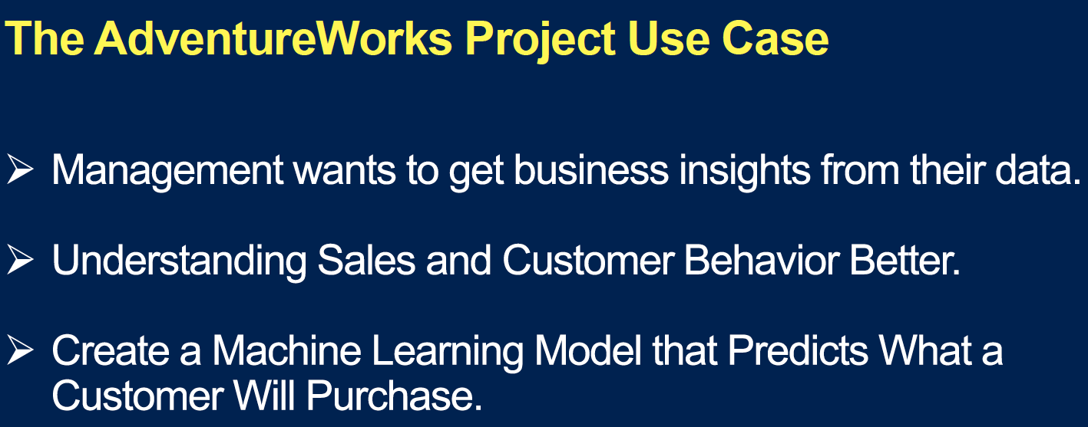

Slide 18
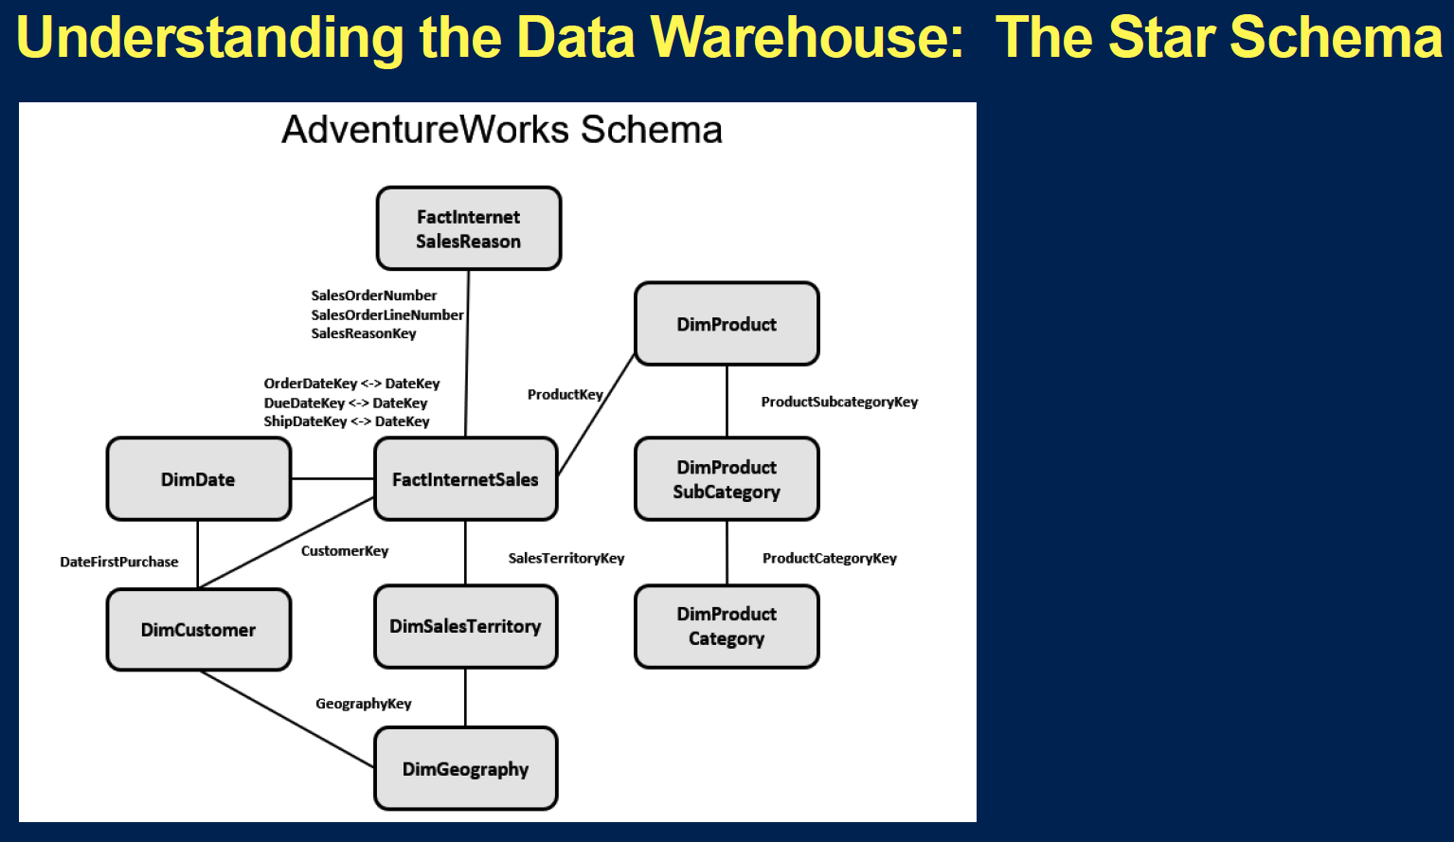

Slide 19
Reference:
Bryan Cafferky
https://www.youtube.com/channel/UCEdMzQ0m9WcZQepgizrHpMw

