Slide 1
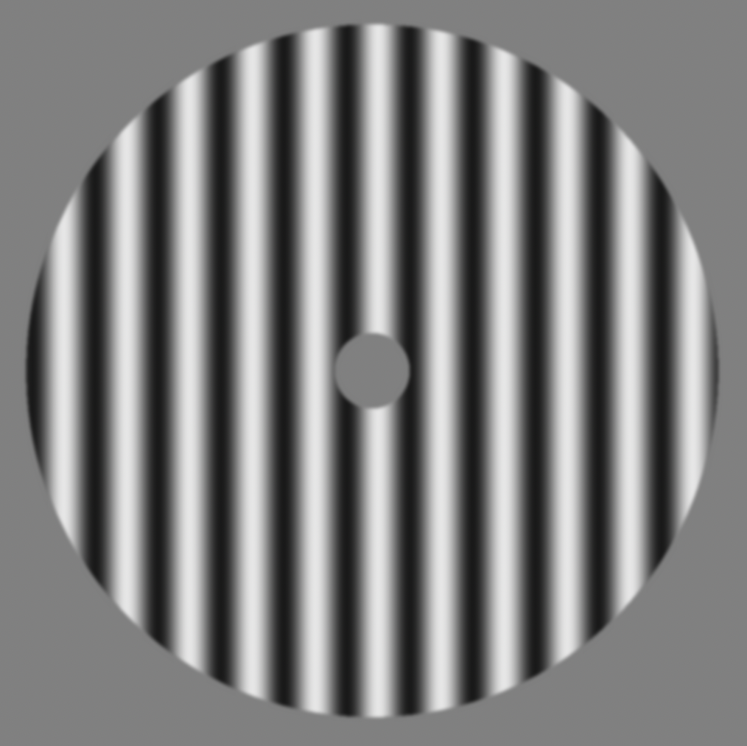
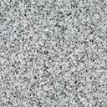

Fixation
0.3s
Stimulus
1s
Noise mask
0.3s
Delay
0.7s
Response
Within 4.5s
Feedback
1s
ITI
0.2s
3.0$°$ error
+ 94 points

