Slide 1

Note: The data and information in this document is reflective of a hypothetical situation and client. This document is to be used for KPMG Virtual Internship purposes only.
Sprocket Central Pty Ltd
Data analytics approach
[Division Name] - [Engagement Manager], [Senior Consultant], [Junior Consultant]

Slide 2
Note: The data and information in this document is reflective of a hypothetical situation and client. This document is to be used for KPMG Virtual Internship purposes only.
Agenda
Introduction
Data Exploration
Model Development
Interpretation

Slide 3
Note: The data and information in this document is reflective of a hypothetical situation and client. This document is to be used for KPMG Virtual Internship purposes only.
Introduction
Identify and Recommend Top 1000 Customer to Target from Datasets
Outline of Problem
Sprocket Central is a company that specializes in high-quality bikes and cycling accessories.
Their marketing team is looking to boost business sales by analyzing provided datasets.
Using the 3 datasets provided the aim is to analyze and recommend 1000 customers that Sprocket Central should target to drive higher value for the company.
Contents of Data Analysis
‘New’ and ‘Old’ Customer Age Distributions
Wealth segmentation by age category
Number of cars owned and not owned by state
RFM analysis and customer classification
Bike related purchases over the last 3 years by gender

Slide 4
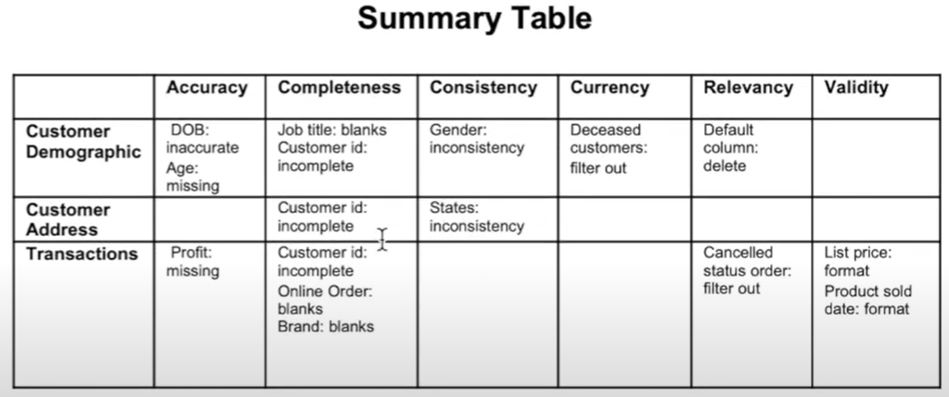
Note: The data and information in this document is reflective of a hypothetical situation and client. This document is to be used for KPMG Virtual Internship purposes only.
Data Exploration
Data Quality Assessment and ‘Clean Up’
Key Issues for Data Quality Assessment
Accuracy: Correct Values
Completeness: Data Fields with Values
Consistency: Values Free from Contradiction
Currency: Values up to date
Relevancy: Data items with Value Meta-data
Validity: Data Containing Allowable Values
Uniqueness: Records that are Duplicated

Slide 5
Note: The data and information in this document is reflective of a hypothetical situation and client. This document is to be used for KPMG Virtual Internship purposes only.
Model Development
‘New’ and ‘Old’ Customer Age Distributions
Most customers are aged between 40-49 in ‘New’. In ‘Old’ majority of customers are aged between 40-49 also.
The lowest age groups are under 20 and 80+ for both ‘New’ and ‘Old’ customer lists
The ‘New’ customer list suggests that age groups 20-29 and 40-49 are most populated
The ‘Old’ customer list suggests 20-69
There is a steep drop of customers in 30-39 ages in ‘New’.

Slide 6
Note: The data and information in this document is reflective of a hypothetical situation and client. This document is to be used for KPMG Virtual Internship purposes only.
Model Development
Existing Customer Wealth Segmentation with Age Distributions
In all age categories the largest number of customers are classified as ‘Mass Customer’
The next category is the ‘ High Net Worth’ customers
The ‘Affluent Customer’ can outperforms the ‘High Net Worth’ customer in the 20-29 age group.

Slide 7
Note: The data and information in this document is reflective of a hypothetical situation and client. This document is to be used for KPMG Virtual Internship purposes only.
Model Development
Number of cars owned and not owned by state
NSW has the largest amount of people that do not own a car. NSW seems to have a higher number of people from which data was collected.
Victoria is also split quite evenly. But both numbers are significantly lower than those of NSW.
QLD has a relatively high number of customers that own a car.

Slide 8
Note: The data and information in this document is reflective of a hypothetical situation and client. This document is to be used for KPMG Virtual Internship purposes only.
Model Development
RFM Analysis and Customer Classification
RFM analysis is used to determine which customers a business should target to increase its revenue and value.
The RFM (Recency, Frequency, and Monetary) model shows customers that have displays high levels of engagment with the business in the three categories mentioned.

Slide 9
Note: The data and information in this document is reflective of a hypothetical situation and client. This document is to be used for KPMG Virtual Internship purposes only.
Interpretation
Customer Target and Methodology
Filter through the top 1000 customers by assigning the conditions based on RFM (R_Score, F_Score, M_Score).
The 1000 customers discovered would have bought recently, they have bought very frequently in the past and tend to spend more than other customers.

Slide 10
Note: The data and information in this document is reflective of a hypothetical situation and client. This document is to be used for KPMG Virtual Internship purposes only.
Appendix

Slide 11
Note: The data and information in this document is reflective of a hypothetical situation and client. This document is to be used for KPMG Virtual Internship purposes only.
Appendix
This is an optional slide where you may place any supporting items.

