Slide 1

INFO6210 Presentation Slide Group3 Food Delivery
Group members:
Jiawei Zhao
Ke Yuan
Mengying Wang
Keyi Cao

Slide 2
Use Case Logic Analyze
How normal people use food delivery application?
3 roles: customer, deliver and restaurant

Slide 3
Use Case Logic Analyze
For customer: Open app >> Select restaurant >> Select food >> Place order >> Pay for order >> Food is delivered
For deliver: get a task >> deliver it >> get benefit from it
For restaurant: take order >> prepare food >> wait for deliver to pick up

Slide 4


Design & Build
Users: Restaurant, Customer, Deliver
Core: Order (connect everything together)
Other systems: payment, delivery(address), account info

Slide 5
ERD
Main entities: customer, restaurant, deliver, order
Account info
Other tables designed to record many-to-many relationships (order_food)

Slide 6

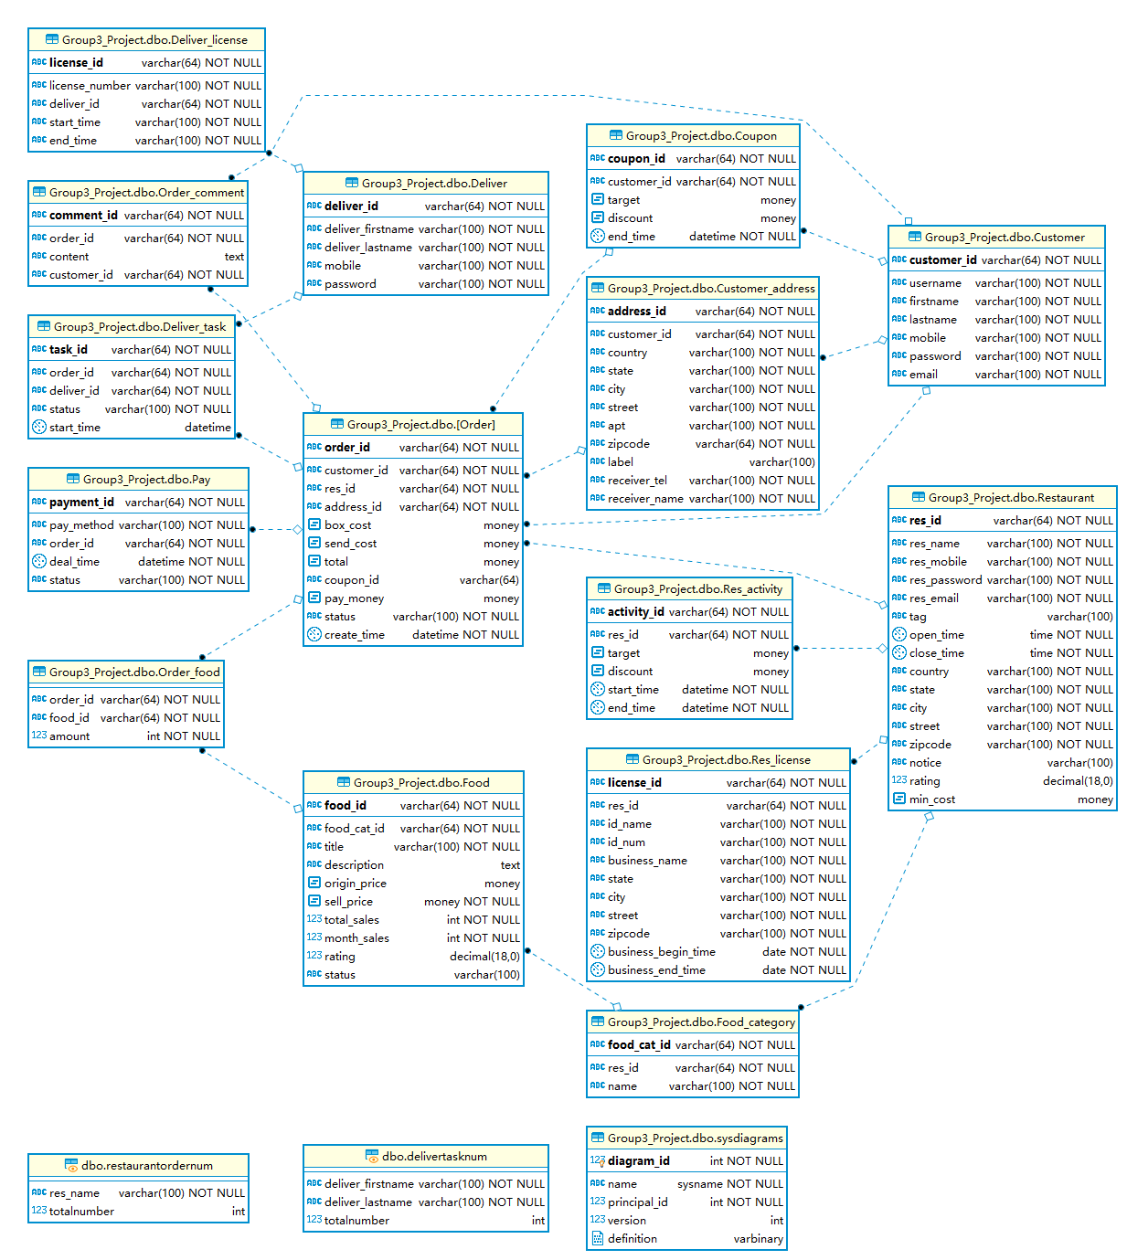



Slide 7
Two calculated column
In [Order] table, there are two calculated columns “total” and “pay_money”, which help us calculate the total money and the money after discount in an order automatically.
Both them based on a complex function

Slide 8
Table-level constraint based on function
We utilize this technology to implement a business rule: the coupon can not be used more than once if it is had been used in an successful placed order.

Slide 9
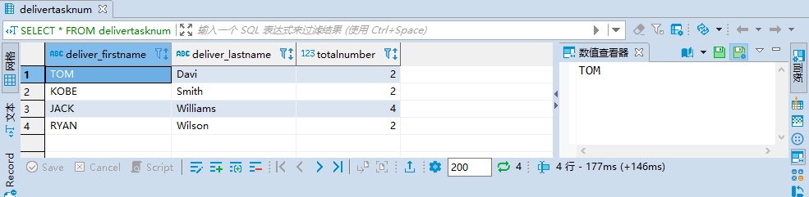
View Demo
View1:
How many tasks are finished by each deliver?

Slide 10
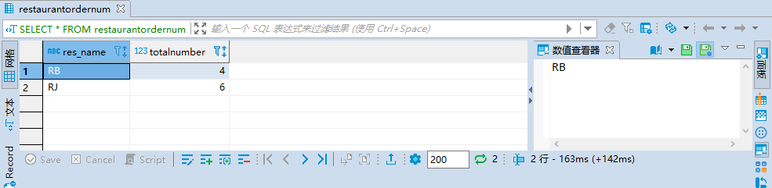
View Demo
View2:
For each restaurant, how many orders they have taken?

Slide 11
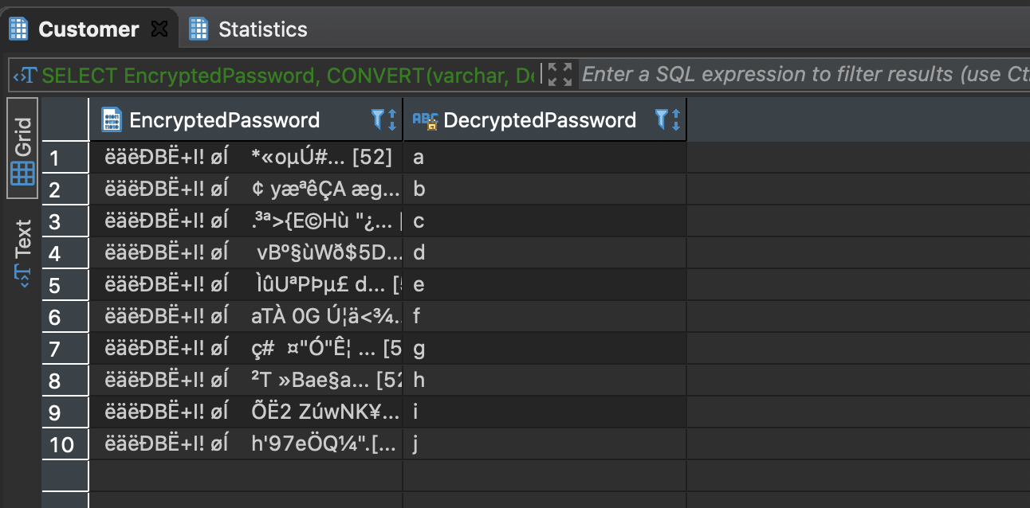
Password Encryption

Slide 12
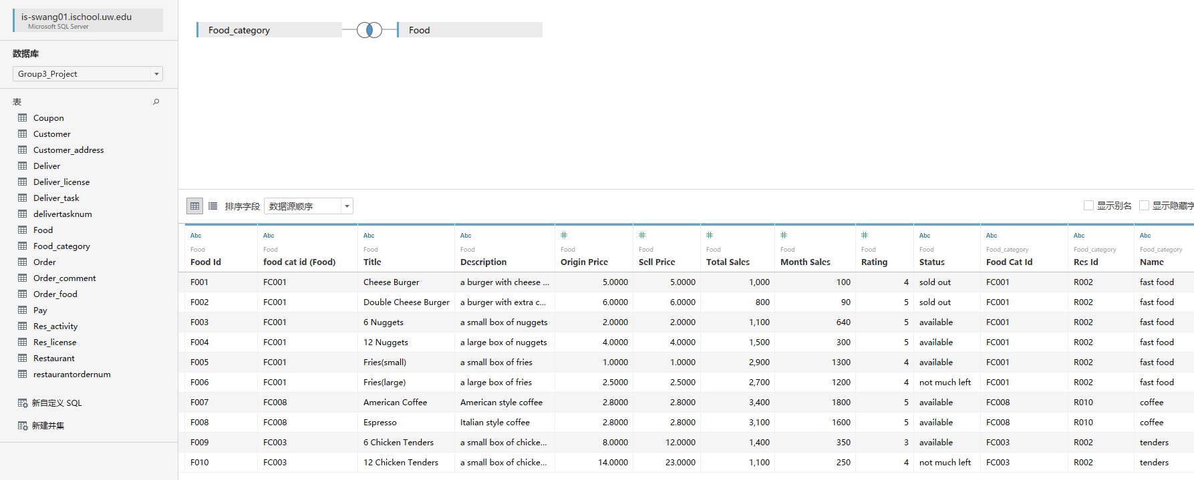
Visualized Report Demo

Slide 13
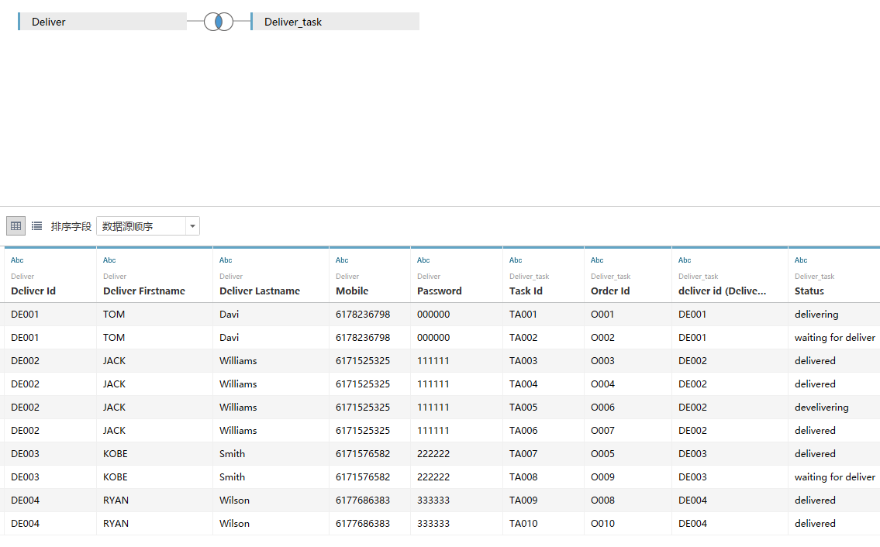
Visualized Report Demo

Slide 14
Thank you!

