Slide 1
Course Builder Tool Tutorial
TA at
Online Education Development Office (OEDO)
Center for Innovative Teaching and Learning (CITL)
Tokyo Institute of Technology, Japan

Slide 2
Contents
Tool summary
Definition of materials and outline
Materials preparation
How to fill data in macro-excel
Built course with Python

Slide 3
Tool Overview

Slide 4






Overview
Download
no-content course
Upload full- content course
Text contents HTML files
Video contents
- video URLs
- Transcript (srt files)
exported course
Assessment contents
- excel sheets
edX uploadable format

Slide 5
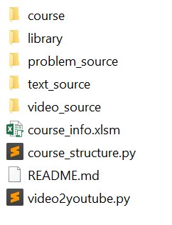
Workspace
The tool’s workspace is available on GitHub
https://github.com/TokyoTechX/edx-coursebuilder

Slide 6
Flowchart
Move content’s source file into workspace
Download workspace folder
Move text contents into workspace
Move transcript into workspace
Move assessment contents into workspace
Execute tool: run Python script
Obtain a full-content course instance
Download course instance & put it in workspace
Design course by filling metadata in “course_info.xlsm”

Slide 7
Definition of materials and outline

Slide 8
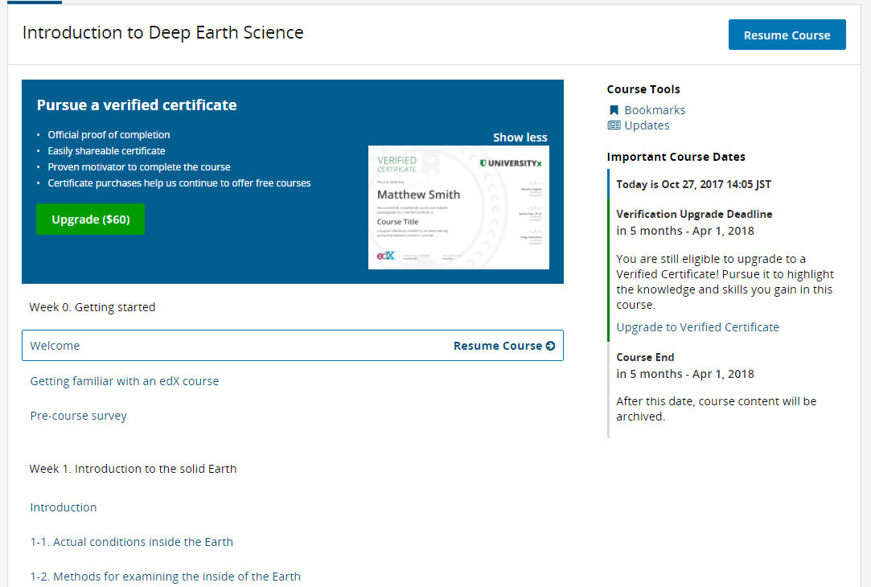
Course outline
Section
-subsection
-subsection
-subsection
Section
-subsection
-subsection
-subsection

Slide 9
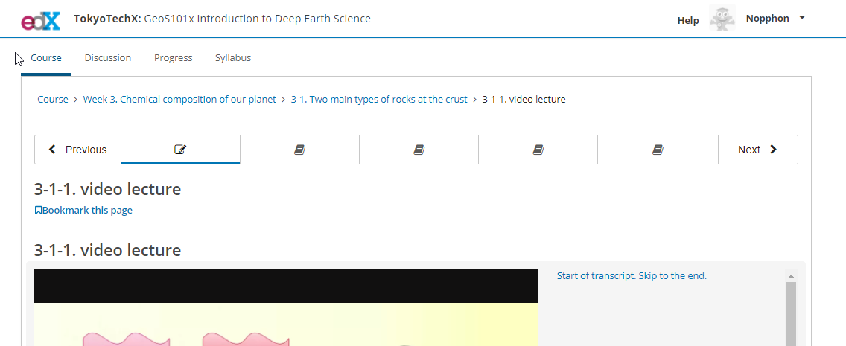
Course outline
Unit Unit Unit Unit Unit

Slide 10
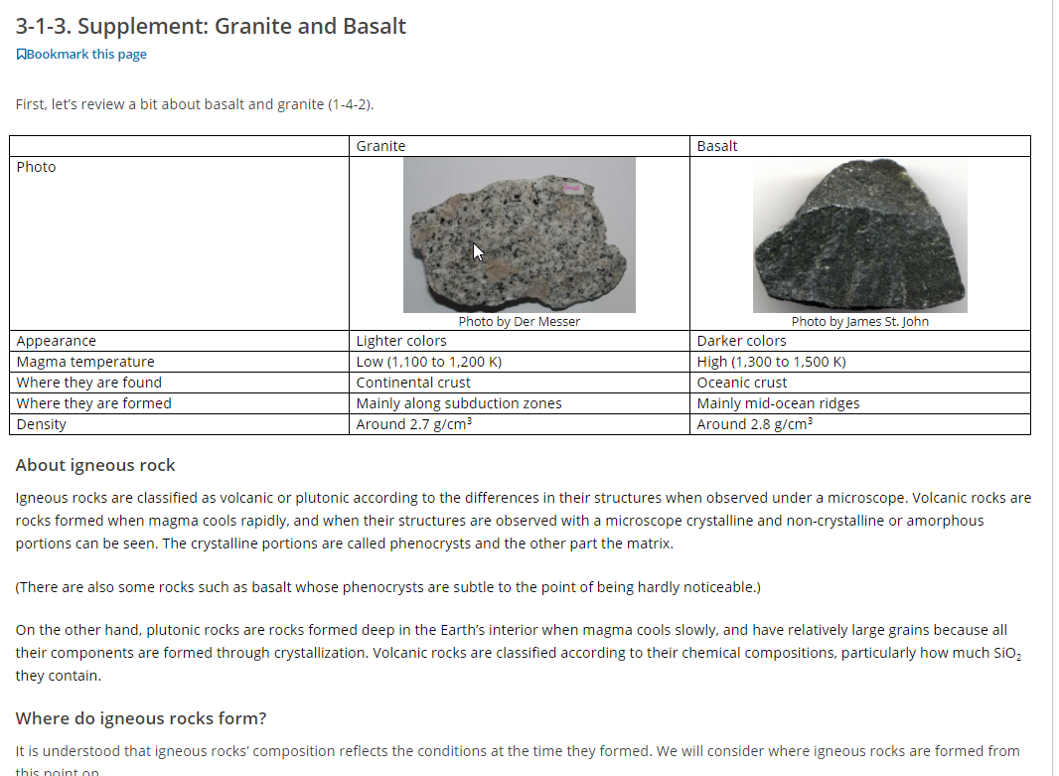
Text materials

Slide 11
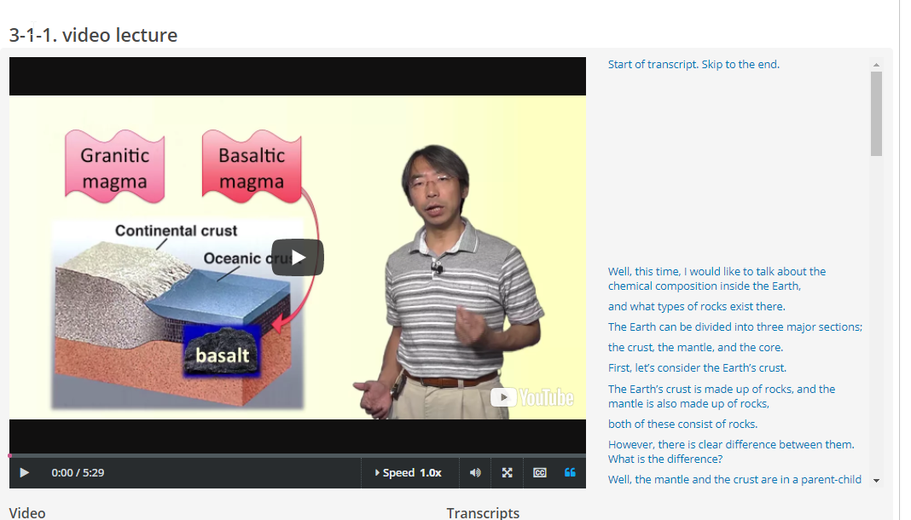
Video materials

Slide 12
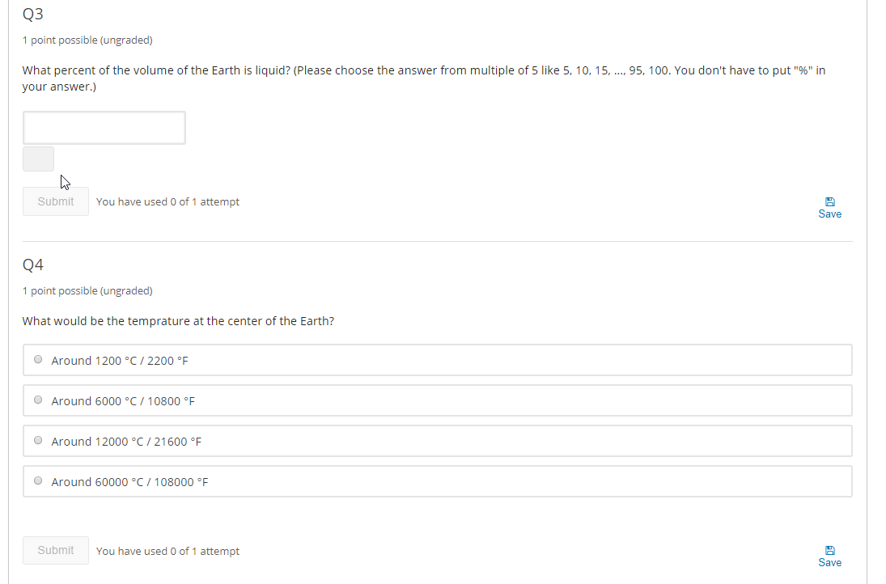
Assessment material
Fill blank
Multiple choice

Slide 13
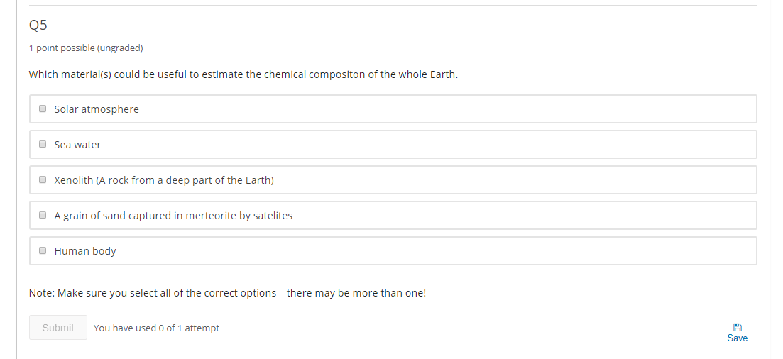
Assessment material
Checkbox

Slide 14
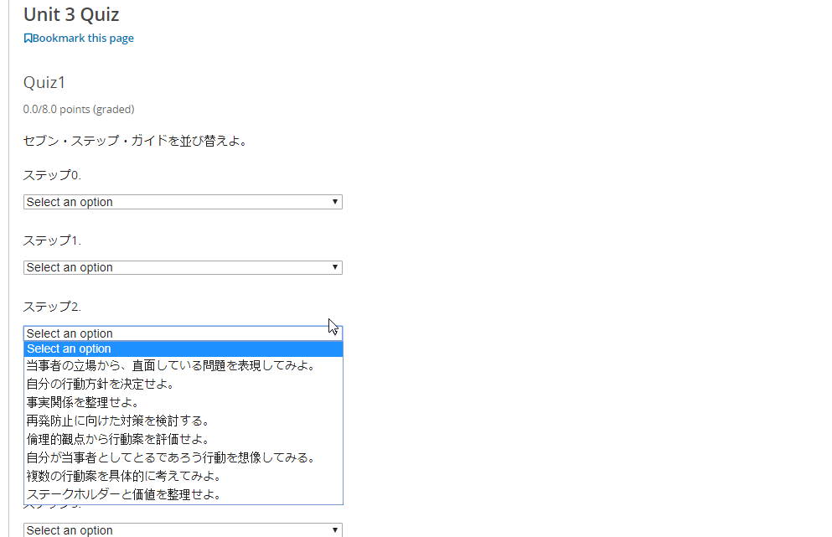
Assessment material
So far, handle only 4 types of assessment
Droplist

Slide 15
Material preparation

Slide 16
Text material preparation
Prepared in any editor (Word, WordPad, notepad, etc.)
But it needs to be converted to HTML file

Slide 17
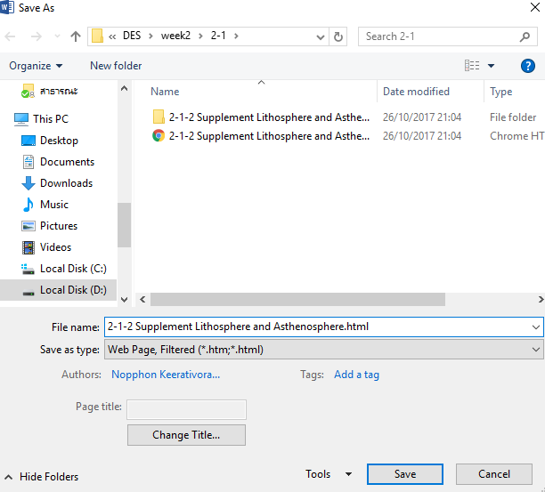
Text material preparation
- For example, Word→ HTML

Slide 18

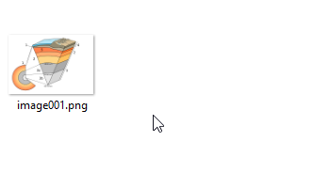
Text material preparation
- For example, Word→ HTML
HTML file
Word file
Figure folder

Slide 19
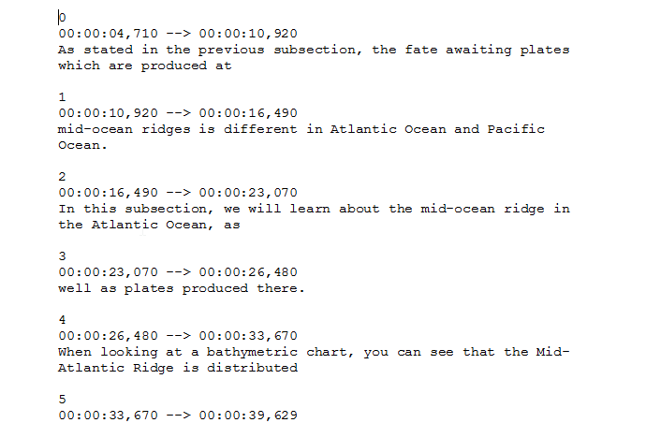
Video material preparation
Video link (Youtube)
required URL format (https://youtu.be/f4JzqlwBLO8)
Transcript (srt file) optional

Slide 20
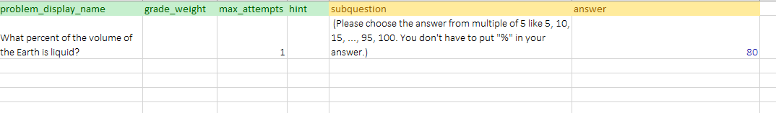
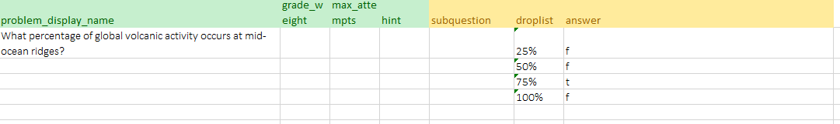
Assessment material preparation
XML format is required (but difficult)
Assessment-formatted excel file is prepared
Format.xlsx → prepared in workspace folder
Fill blank
Drop list

Slide 21
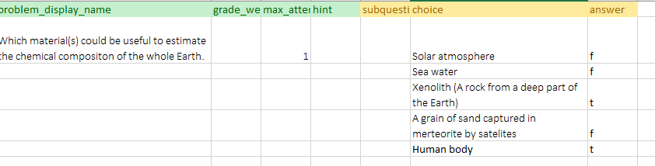
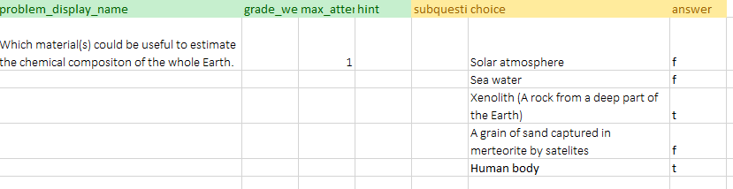
Assessment material preparation
Multiple choice
Multiple choice→ SINGLE correct answer
Checkbox →MULTI correct answer
Same excel-based structure but
checkbox

Slide 22
Assessment material preparation
Grade_weight : the number of points each problem is worth
Max_attempts : number of times a student can try to answer
Source: Problem component setting in edx.studio

Slide 23
Fill data in macro-excel

Slide 24
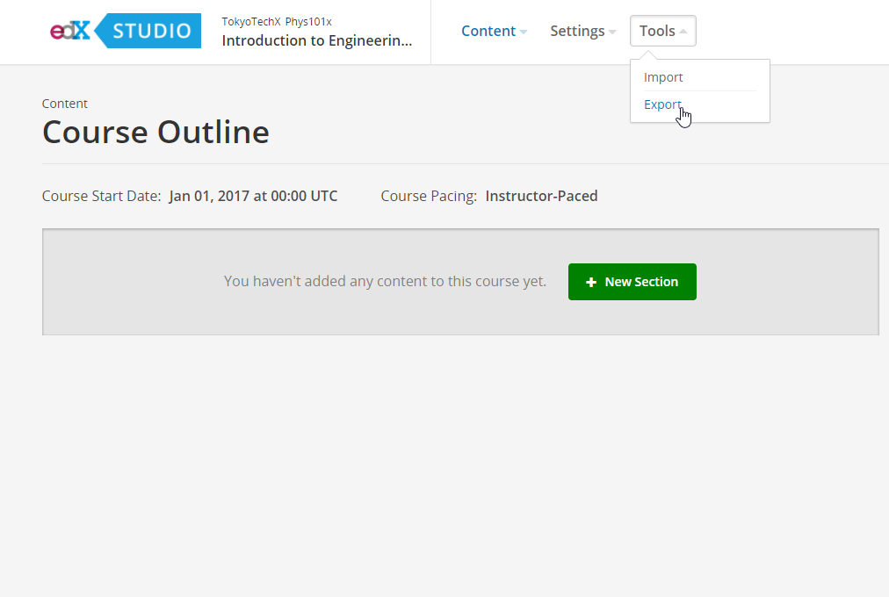

Export an empty course instance
1.Create a new course instance
2.Export course
3. Unzip and place in workspace folder(see next slide)

Slide 25
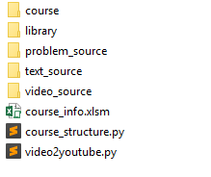
Workspace folder
Empty course (no content)
Python script’s custom-made library
Main directory of assessment file (excel)
Main directory of text file (HTML file)
Main directory of video transcript (srt file)
Excel macro: course metadata
Python script for Course builder
Python script for Batch video2Youtube upload

Slide 26
Course_info.xlsm
Sheets
coursestructure
text
video
problem
upload_list
caption_list
thumbnail_list
metada
Course builder
Batch video2Youtube upload
leave it there, no need to consider

Slide 27
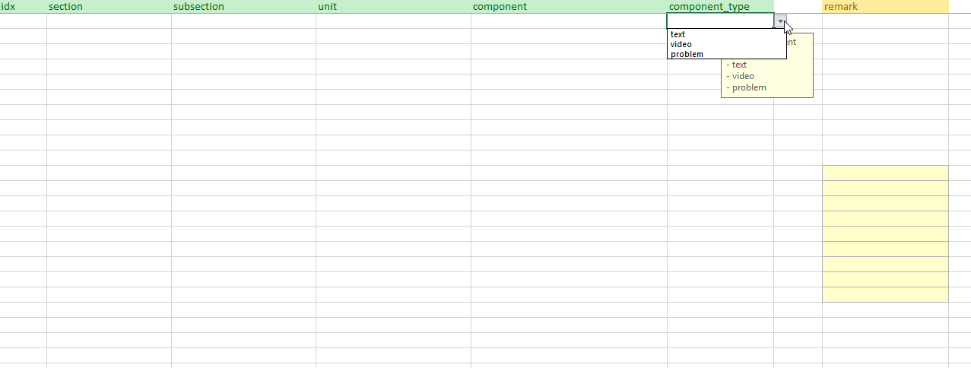
Coursestructure sheet
Course overview
Index
(unique)
Section
name
unit name
Type of material
Subsection name
materialname
For remark
(Optional)

Slide 28
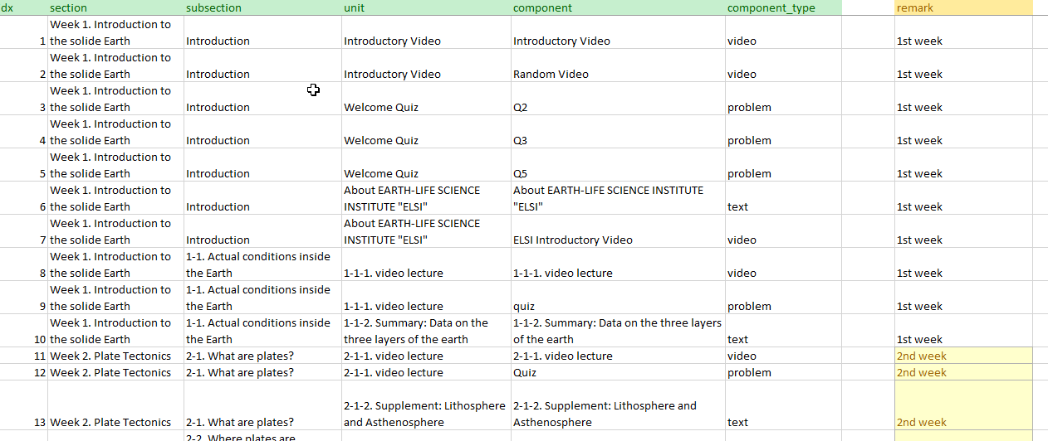
Coursestructure sheet
example

Slide 29
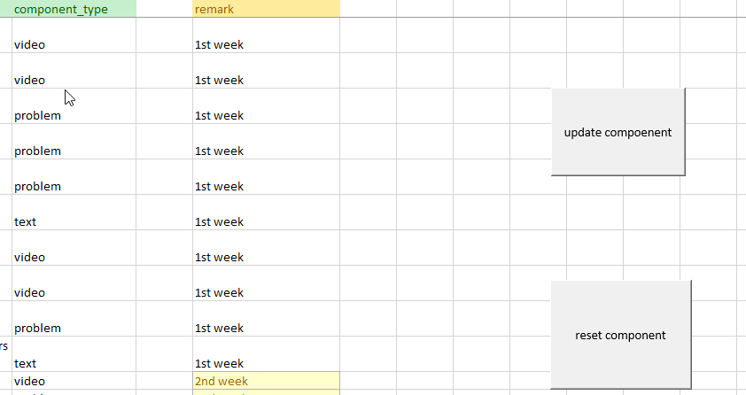
coursestructure sheet
Update/reset button
Update data into other material sheets with respect to material type
Remove data at all material sheets

Slide 30
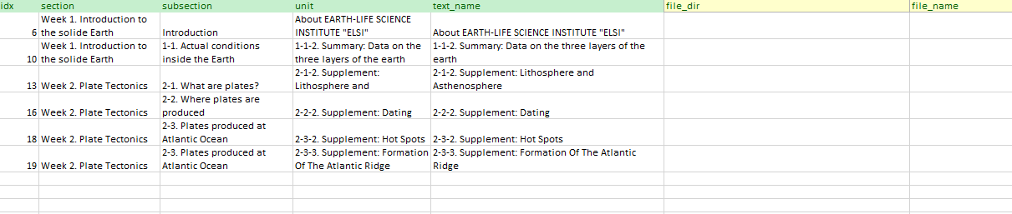
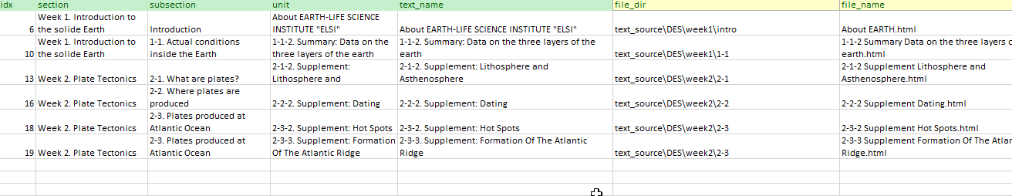
text sheet
Directory inside text_source folder
before
Directory of HTML file
HTML filename
after

Slide 31
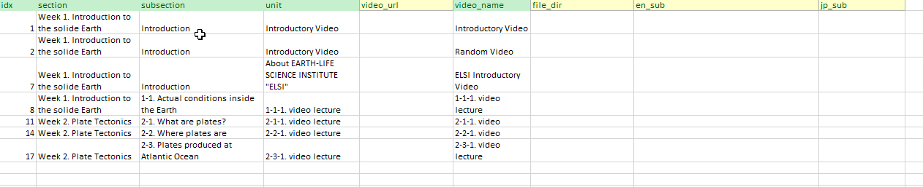
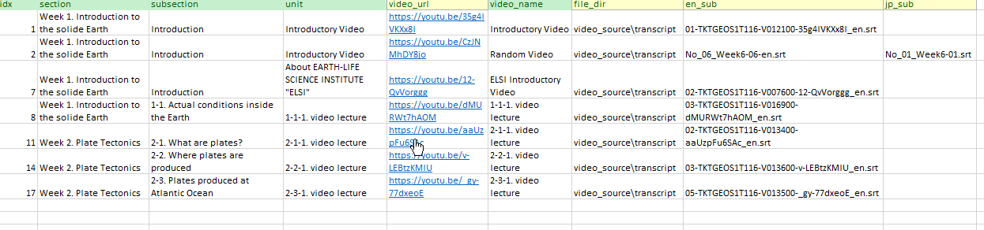
video sheet
Directory inside video_source folder
before
Optional
Youtube url
Directory of srt file
Eng srt filename
Jp srt filename
after

Slide 32
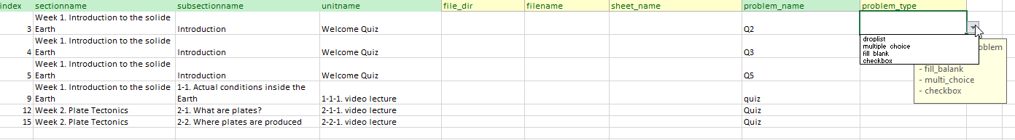
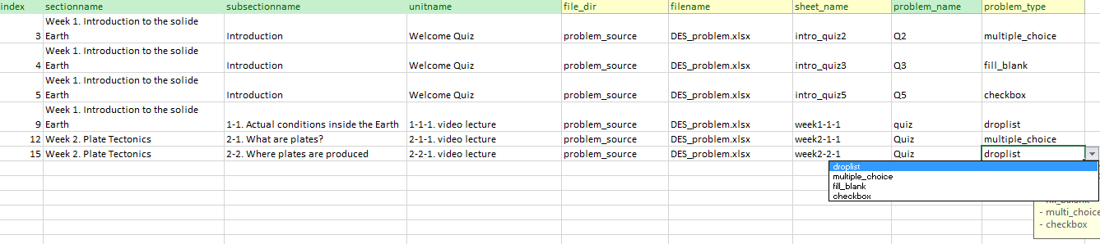
problem sheet
Directory inside text_source folder
Type of assessment
before
Directory of excel file
excel sheet name
excel filename
after

Slide 33
Built course with Python

Slide 34
Course_structure.py
Python 3
Test environment: Windows 10
Dependencies
xlrd, xlwt, lxml, pysrt

Slide 35
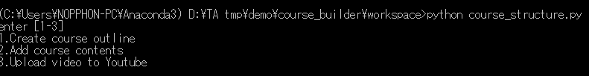
Course_structure.py
First, create course outline
Run in terminal
Select tasks
Type 1 and hit enter

Slide 36
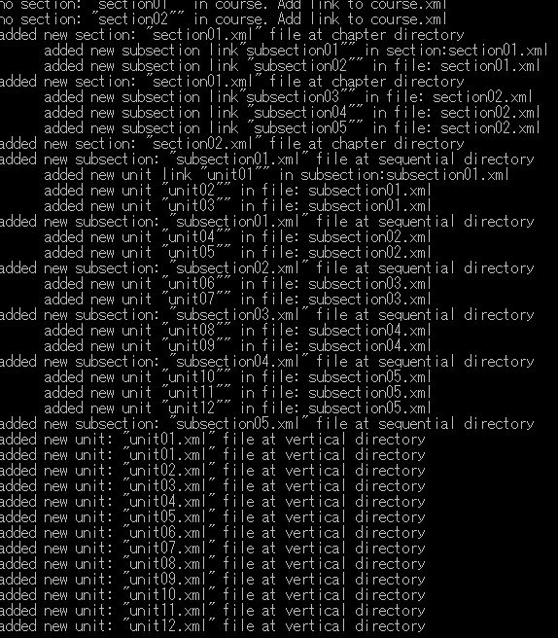
Course_structure.py
Course outline are created in course folder

Slide 37
Course_structure.py
Then, add course material
Run in terminal
Select tasks
Type 2 and hit enter

Slide 38
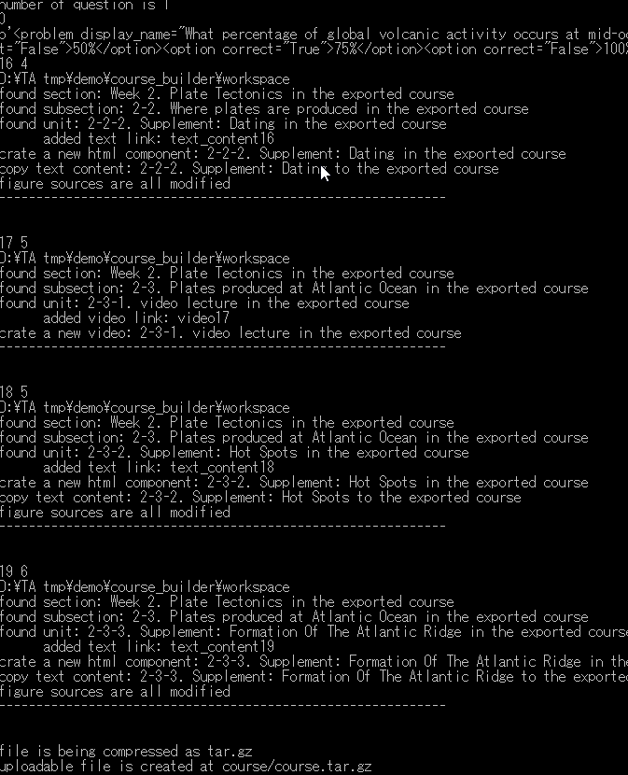
Course_structure.py
Type 1 and hit enter
Course materials are added in course folder
Ready-to-upload course (tar.gz) is created at..

Slide 39
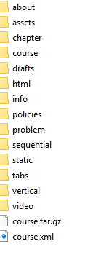
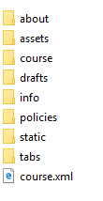
Course folder (before/after)
After
Contents-added course
Before
No-contents course
Ready-to-upload course

Slide 40
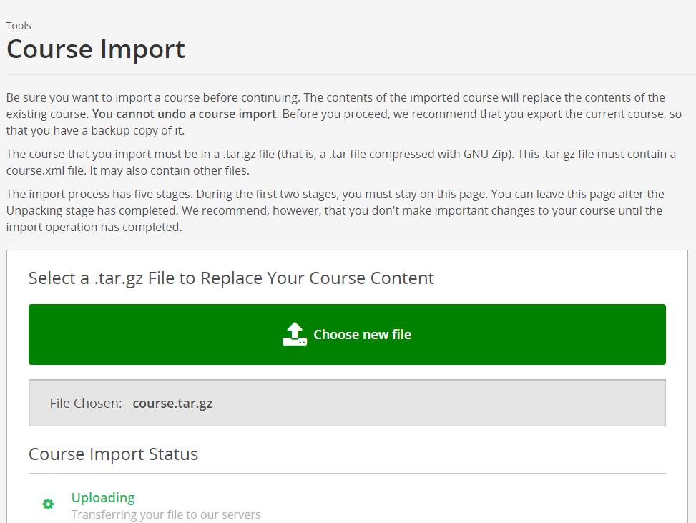
Import a modified course

Slide 41
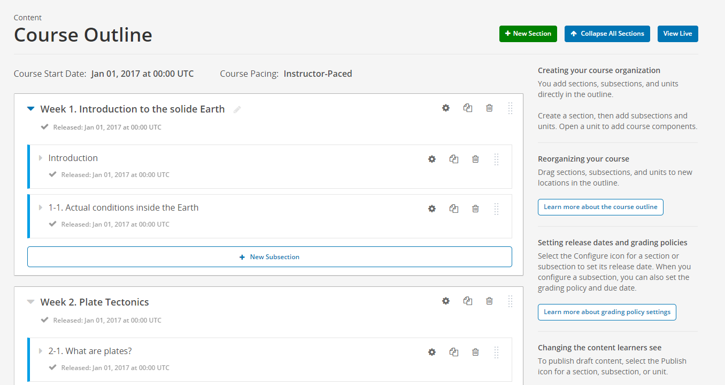
Modified course

