Slide 1
Batch video2youtube Tool Tutorial
TA at
Online Education Development Office (OEDO)
Center for Innovative Teaching and Learning (CITL)
Tokyo Institute of Technology, Japan

Slide 2
Contents
Tool overview
Register OAUTH 2.0 of YouTube API
Files preparation
Upload videos
Upload transcript (subtitle)
Upload thumbnail

Slide 3
Tool overview

Slide 4

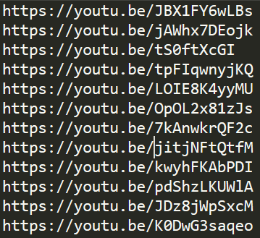
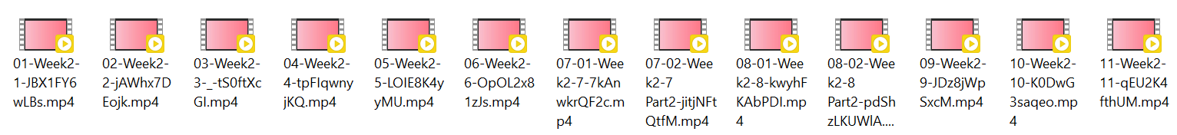
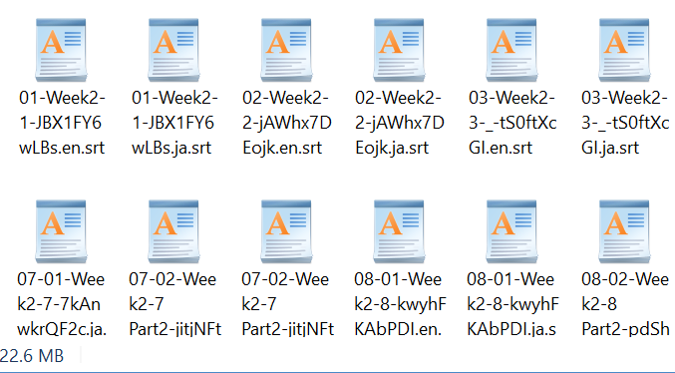
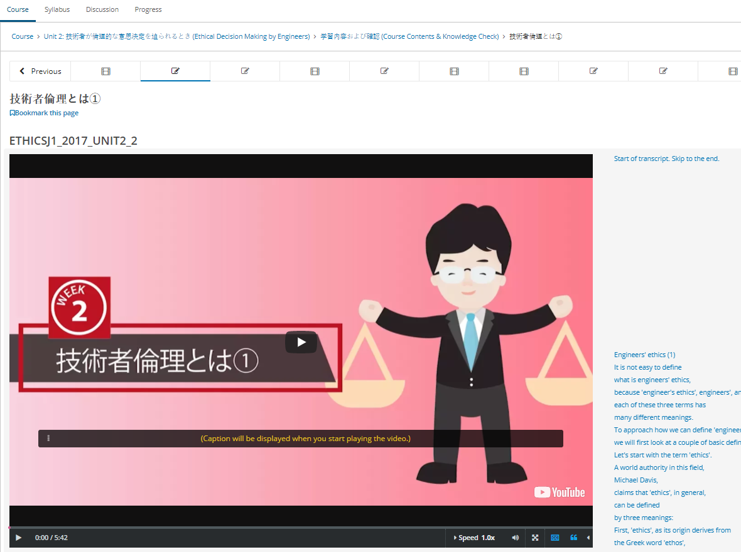
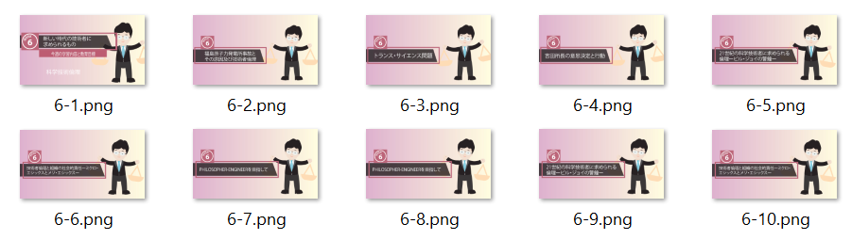
Overview of this tool
Output: return set of video URLs
Automated task
edX lecture videos
Lists of uploading contents
- Videos, transcripts, thumbnail
- Video info (name, description, etc.)
transcripts
Tool’s output will be used to create video contents in edx.studio
Thumbnail

Slide 5
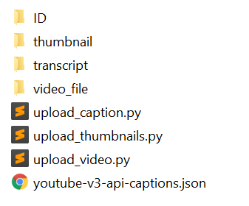
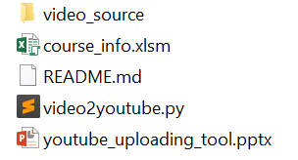
Workspace
The tool’s workspace is available on Github
https://github.com/TokyoTechX/youtube-batch-upload

Slide 6
Flowchart
Download workspace folder
Create YouTube credential file & put it in workspace
Place all video materials into workspace
Fill in video file information in macro-excel
Execute tool: run Python script
Obtain a set of video URLs

Slide 7
Register OAUTH 2.0 of YouTube API

Slide 8
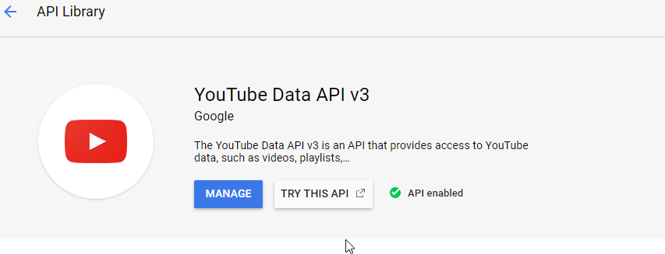
YouTube API OAUTH 2.0
Follow the link below for obtaining authorization credential
https://developers.google.com/youtube/registering_an_application
After create your credential (OAUTH 2.0 client IDs)
Enable Youtube Data API v3

Slide 9
YouTube API OAUTH 2.0
Download credential file
json file
Filename: client_secret_<code>.apps.googleusercontent.com.json
Needed for batch uploading
<code> = sequence of alphabet and number represents YouTube account

Slide 10
Files preparation

Slide 11
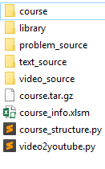
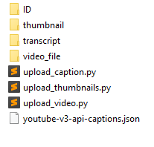
Workspace
Excel macro: course metadata
Main function for video uploading
For those who are using ‘course builder’ tool, you can use option 3 for video uploading
Copy your credential in this folder
Copy video thumbnail (image file) to this folder
Copy video transcript (srt file) to this folder
Copy video file (video file) to this folder
Python’s library
JSON file needed for transcript uploading

Slide 12
Course_info.xlsm
Sheets
coursestructure
text
video
problem
upload_list
caption_list
thumbnail_list
metada
Course builder
Batch video2Youtube upload
leave it there, no need to consider

Slide 13
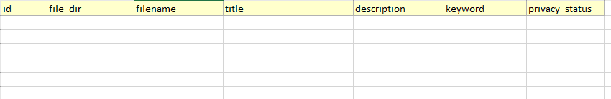

Upload_list sheet
before
Index
(unique)
video filename
Name of video
Video description
(Optional)
Keyword
(Optional)
For remark
(Optional)
Directory of video file
after

Slide 14
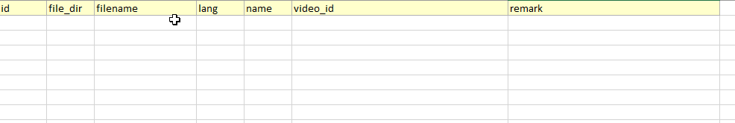
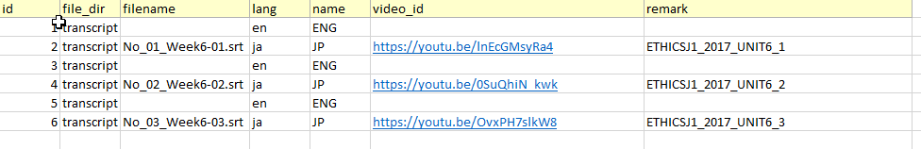
Caption_list sheet
Directory inside transcript folder
before
Index
(unique)
Name of transcript
srt filename
YouTube link
For remark
(Optional)
Directory of srt file
Language code
https://www.loc.gov/standards/iso639-2/php/code_list.php
after

Slide 15
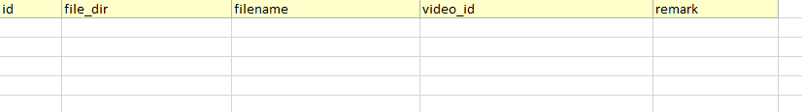

thumbnail_list sheet
before
Index
(unique)
Directory of srt file
image filename
For remark
(Optional)
YouTube link
after

Slide 16
Upload video

Slide 17
video2youtub.py (video part)
Python 3
Test environment: Windows 10
Library
Google API Client Libraries
https://developers.google.com/api-client-library/python/start/installation
Dependencies
xlrd, xlwt, http.client, httplib2

Slide 18

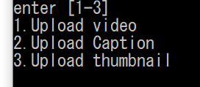
video2youtub.py (video part)
Run in terminal
Select tasks
Type 1 and hit enter

Slide 19
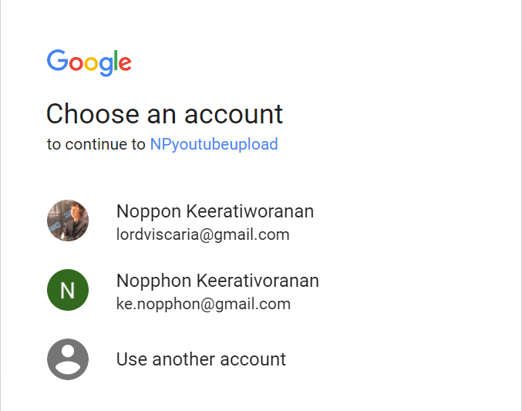
video2youtube.py (video)
Pop-up browser
Ask for sign-in to YouTube account
Name of your credential
Youtube account
Youtube account

Slide 20
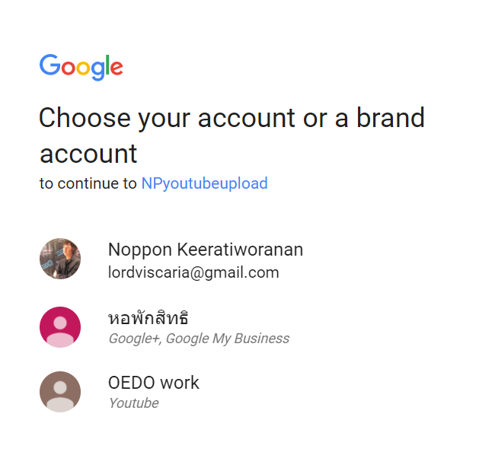
video2youtube.py (video)
Pop-up browser
Then, choosing your Channel
Name of your credential
Youtube channel
Youtube channel
Youtube channel

Slide 21
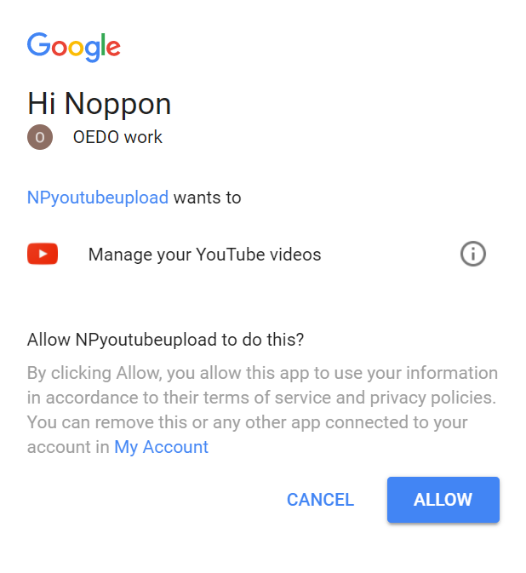

video2youtube.py (video)
Pop-up browser
Then, ask permission to use API
Selected Youtube channel
Name of your credential
JSON file for authentication is generated
Youtube will not ask your permission again as long as this file exists in workspace
If you want to access other Youtube account or channel, remove this file and run main script again

Slide 22
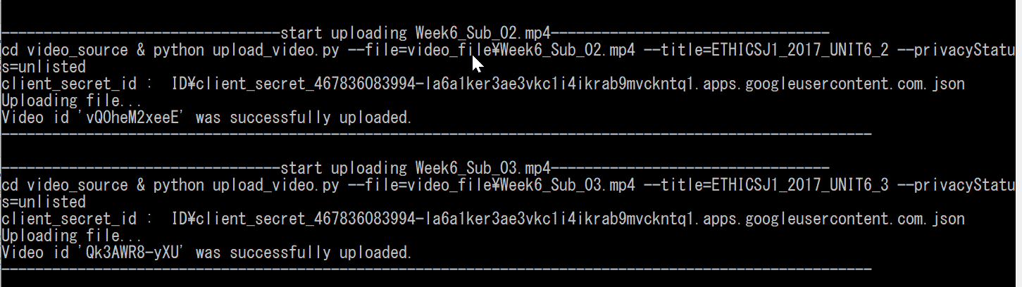

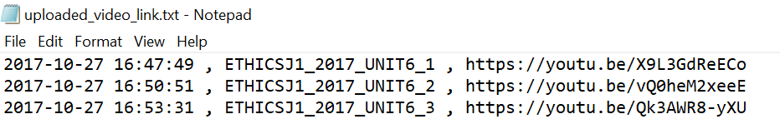
video2youtube.py (video)
Videos are being uploaded
List of YouTube video are in

Slide 23
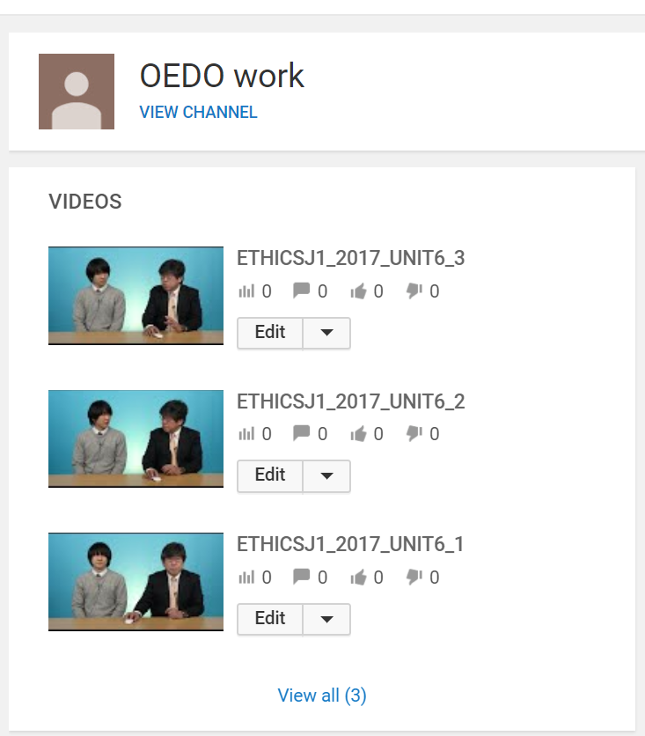
video2youtube.py (video)
Youtube channel
Videos in Youtube video dashboard

Slide 24
Upload transcript (subtitle)

Slide 25
video2youtub.py (transcript part)
Run in terminal
Select tasks
Type 3 and hit enter

Slide 26
video2youtub.py (transcript part)
Pop-up browser
Ask for sign-in to YouTube account
Name of your credential
Youtube account
Youtube account

Slide 27
video2youtub.py (transcript part)
Pop-up browser
Then, choosing your Channel
Name of your credential
Youtube channel
Youtube channel
Youtube channel

Slide 28
video2youtub.py (transcript part)
Pop-up browser
Then, ask permission to use API
Selected Youtube channel
Name of your credential
JSON file for authentication is generated
Youtube will not ask your permission again as long as this file exists in workspace
If you want to access other Youtube account or channel, remove this file and run main script again

Slide 29
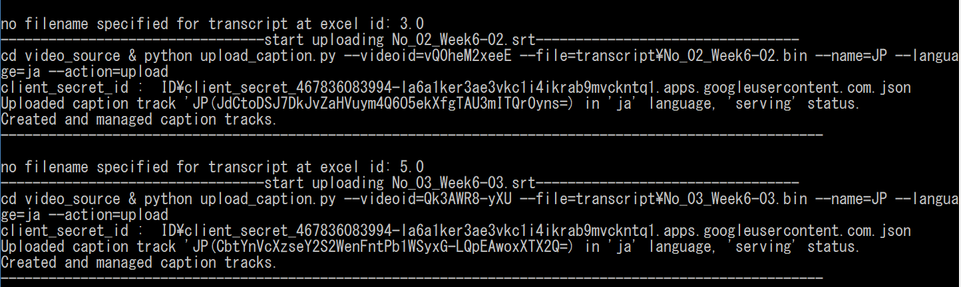
video2youtub.py (transcript part)
transcripts are being uploaded

Slide 30
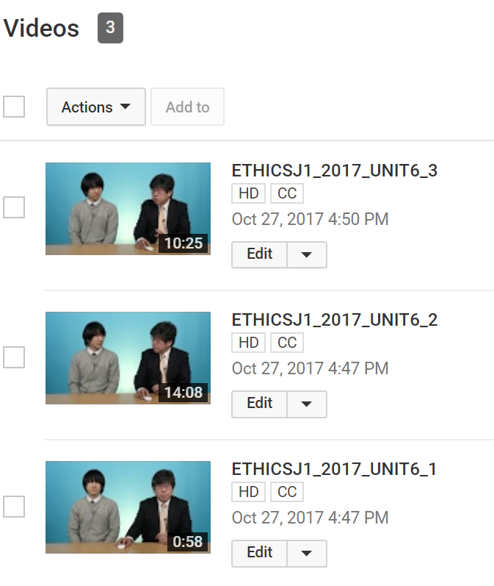
video2youtub.py (transcript part)
Transcripts are placed in selected Youtube video (see CC icon)

Slide 31
Upload thumbnail

Slide 32
video2youtub.py (thumbnail part)
Run in terminal
Select tasks
Type 3 and hit enter

Slide 33
video2youtub.py (thumbnail part)
Pop-up browser
Ask for sign-in to YouTube account
Name of your credential
Youtube account
Youtube account

Slide 34
video2youtub.py (thumbnail part)
Pop-up browser
Then, choosing your Channel
Name of your credential
Youtube channel
Youtube channel
Youtube channel

Slide 35

video2youtub.py (thumbnail part)
Pop-up browser
Then, ask permission to use API
Selected Youtube channel
Name of your credential
JSON file for authentication is generated
Youtube will not ask your permission again as long as this file exists in workspace
If you want to access other Youtube account or channel, remove this file and run main script again

Slide 36
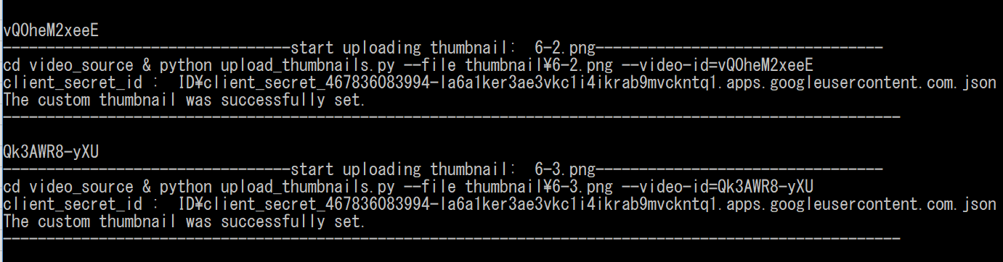
video2youtub.py (thumbnail part)
Videos are being uploaded

Slide 37
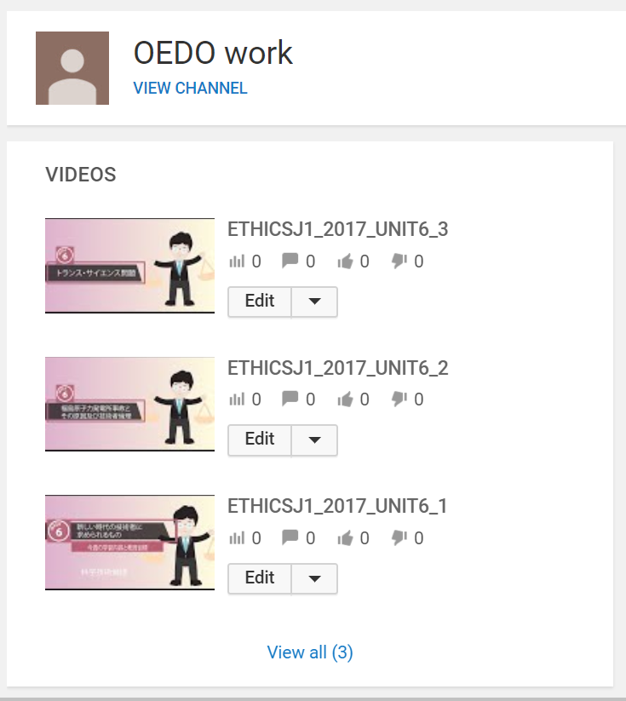
video2youtub.py (thumbnail part)
Youtube channel
Thumbnails are placed in selected Youtube video

