Slide 1
SLAM-Based Mapping Robot
Perception & Kinematics
Kinyua Seaman
SCT315-1982/2025
MSc Artificial Intelligence • Robotics Module
May 2026 • Simulation-Based Coursework

Slide 2
Problem & Approach
The SLAM Problem
A mobile robot must simultaneously:
• Build a map of an unknown environment
• Track its own position within that map
The Circular Dependency:
Accurate mapping needs a good pose estimate,
yet accurate localisation needs a good map.
Our Approach
Custom from-scratch 2D simulation in Python:
1. Differential-drive kinematics
with stochastic odometry noise (α₁–α₄)
2. 2D LiDAR ray-casting
72 rays, 2π FOV, Gaussian sensor noise
3. Log-odds occupancy grid mapping
Bresenham ray tracing, Bayesian updates
4. Proportional waypoint controller
8 waypoints, heading-gated velocity

Slide 3
System Architecture & Key Equations
Modular Design
environment.py
50×50m grid world + LiDAR ray-casting
robot.py
Differential drive kinematics + noisy odometry
slam.py
Log-odds occupancy grid + Bresenham
main.py
Simulation loop, controller, visualization
Data Flow:
Controller → Robot (true + noisy pose)
→ Environment (LiDAR from true pose)
→ SLAM (update grid with est. pose + scan)
Key Equations
Arc Motion Model (ω ≠ 0):
x' = x − (v/ω)sinθ + (v/ω)sin(θ + ωΔt)
y' = y + (v/ω)cosθ − (v/ω)cos(θ + ωΔt)
Odometry Noise (Thrun et al.):
v̂ = v + ε, ε ~ N(0, α₁v² + α₂ω²)
ω̂ = ω + ε, ε ~ N(0, α₃v² + α₄ω²)
Log-Odds Bayesian Update:
l(cell) = l(cell) + l_inv − l₀
l_occ = log(0.7/0.3) ≈ 0.847
l_free = log(0.3/0.7) ≈ −0.847
Probability Recovery:
P(occ) = 1 − 1/(1 + exp(l))

Slide 4
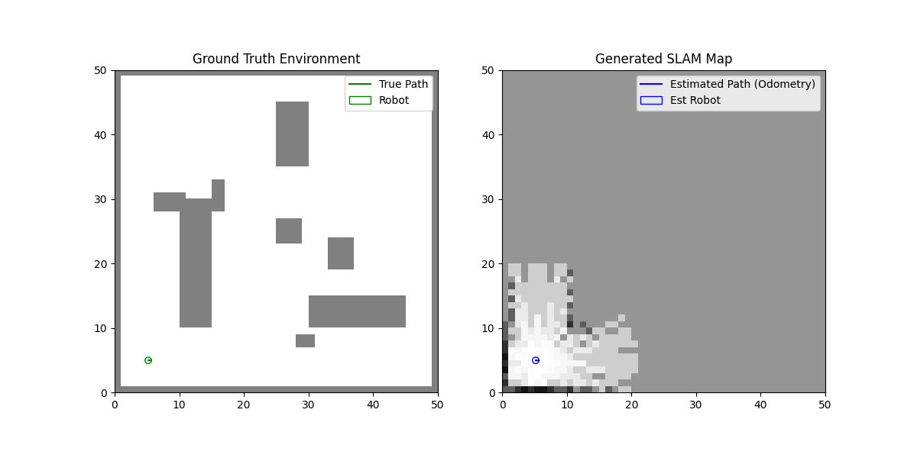
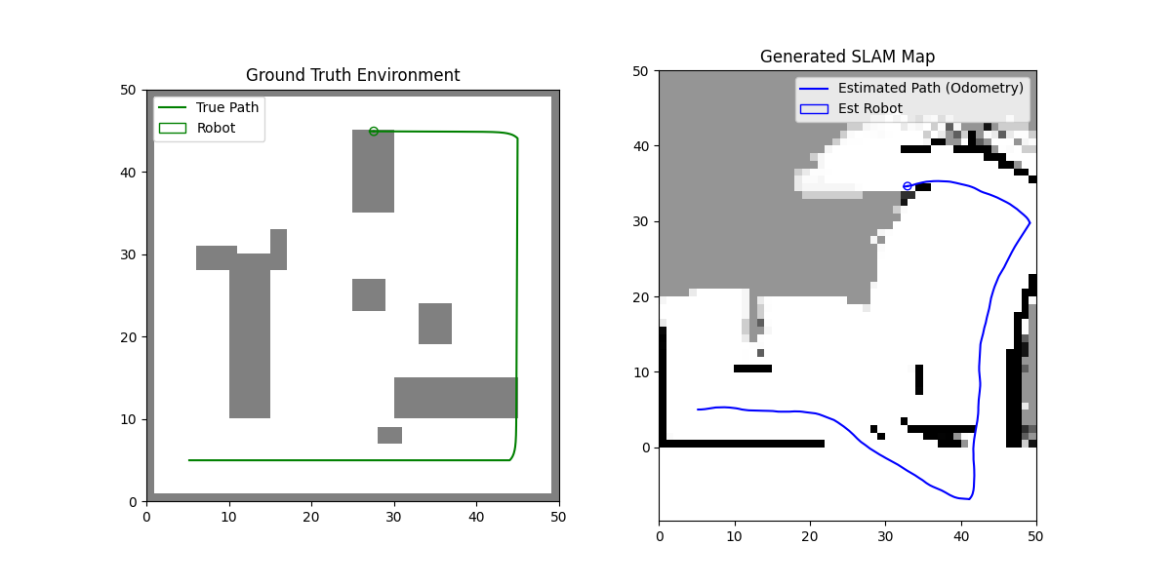
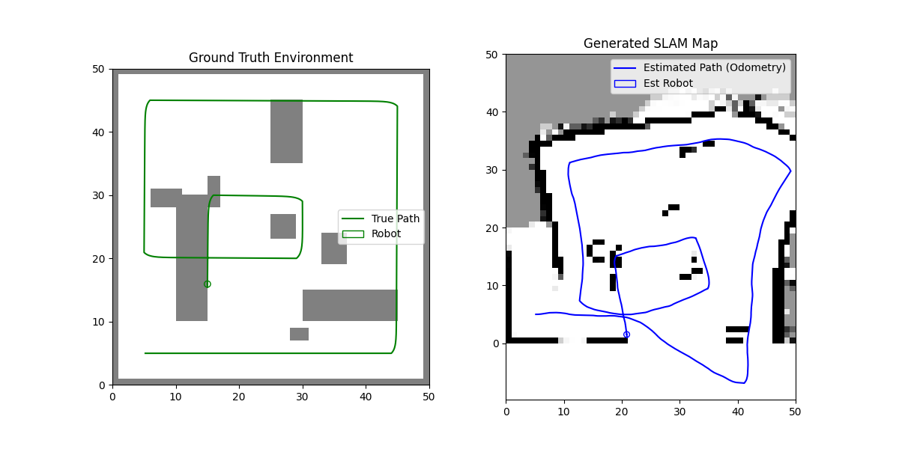
Simulation Results
Step 0 — Initial State
Step 500 — Mid-Exploration
Final Map — Completed Exploration
Key Observations
• Wall structure clearly
recognisable in SLAM map
• Odometry drift causes
progressive map distortion
• Free-space mapping is
robust via Bresenham tracing
• MSE grows monotonically
(no pose correction)

Slide 5
Conclusion & Future Work
What We Demonstrated
✓ Full-stack SLAM pipeline from first
principles (no ROS/Gazebo)
✓ Physically principled noise models
(Thrun et al. α₁–α₄ parameters)
✓ Correct sensor–map separation:
LiDAR from true pose, map from est. pose
✓ Recognisable map despite drift —
motivates need for pose correction
✓ Reproducible simulation (seed 42)
Core Takeaway:
Dead-reckoning alone is insufficient —
pose correction is essential for true SLAM.
Future Extensions
Immediate:
→ Scan matching (ICP / Correlative)
Correct pose from consecutive scans
→ Log-odds clamping (l ∈ [−5, 5])
Prevent saturation, allow dynamic maps
→ EKF integration for pose covariance
Advanced:
→ Particle filter (FastSLAM)
→ Frontier-based autonomous exploration
→ Loop closure detection
→ 3D voxel extension (OctoMap)

