Slide 1
AIBites
GCDO AICAP TEAM
Qing Wang, Chris Rayner, Huy Tran
{qing.wang1, chris.rayner, huy.tray}@ibm.com
11/11/22
@2022 IBM Corporation

Slide 2
Basic Concepts in Data Mining
Learning from Data
Qing Wang
@2022 IBM Corporation
Notes:
Good morning, Good afternoon, everyone. my name is Qing Wang, I'm now a data scientist in AICAP team. During my Ph.D. study, my research interests lie in data mining, which also you can say is learning from data. After I joined IBM research, my projects were about developing models for Watson AIOps. Today I'm gonna introduce you some basic concepts in data mining.

Slide 3
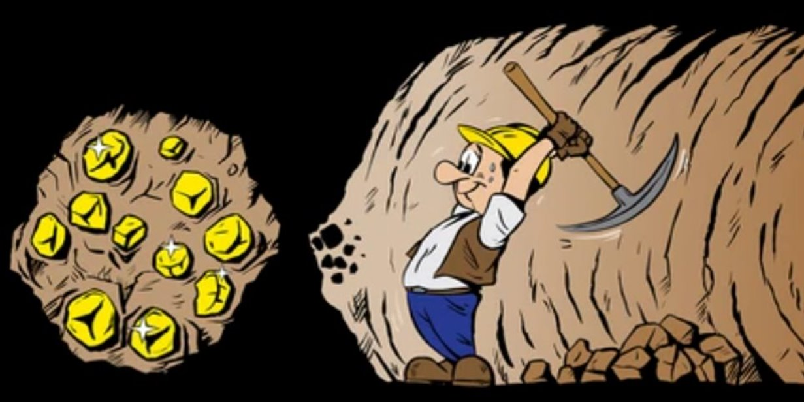

Gold Mining vs. Data Mining
@2022 IBM Corporation
Notes:
If you’ve ever been digging for gold, you’ll know that it takes a lot of time and effort to find even a small nugget. It has been estimated that to extract enough gold to make a single gold ring, you’d need to dig and sort through around twenty-six tons of rock and other stuff.
The same is true when mining data, except the gold is replaced with insights and the mining is replaced with algorithms.

Slide 4


Data Mining Definition
Data mining is the process of extracting valuable information (e.g., pattern recognition) from raw large datasets.
Data Mining
Business
Marketing
HealthCare
Security
@2022 IBM Corporation
Notes:
Data mining has been applied in a variety of industries, from marketing through to healthcare. And it also helps businesses to make better decisions. ​
​
Data mining techniques have rapidly accelerated over the last couple of decades. One of the main advantages of data mining is that it can help you to make predictions about future trends. By analyzing past data/historical data, you can build up a picture of how things might develop in the future. ​
​

Slide 5
Data Mining Process
Setting Objectives
Preparing Data
Applying Data
Evaluating Results
@2022 IBM Corporation
Notes:
Now we can think of the data mining process consisting of four basic steps.
1. setting objectives: and this is where data scientists and business stakeholders work together to define a business problem.
2. data preparation: identifying the data for the defined problem. We also need to clean it, removing any noise, such as duplicates, missing values, and outliers.
3. applying data: applying it specifically through data mining algorithms. We may looking for interesting data relationships or patterns.
4. evaluating results. This is really interpreting results that are valid, novel, useful and understandable.
Data mining works by using various algorithms and techniques to turn large volumes of data into useful information. There are many ways to do it. Let's start with kind of the most straightforward, which is association rule.

Slide 6
Frequent Pattern Mining (Association)
From Wikipedia:
Frequent pattern mining (a.k.a. association rule mining) is a rule-based machine learning method for discovering interesting relations, patterns, or co-occurrences between variables in large databases.
Support
Confidence
@2022 IBM Corporation
Notes:
Association rule or frequent pattern mining is a rule-based, and it's a method for finding relationships between variables in a given dataset.
I also list the definition of association rule from Wikipedia.
Frequent pattern mining...
There are two important parameters
support: used to find the frequent itemsets
confidence: used to generate rules.

Slide 7




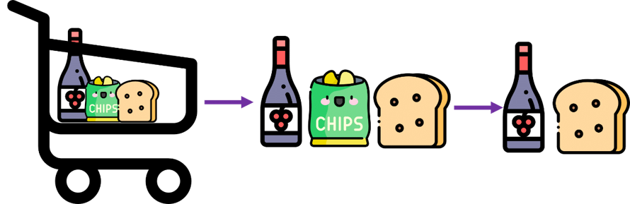
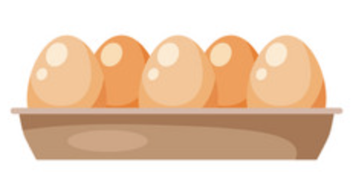
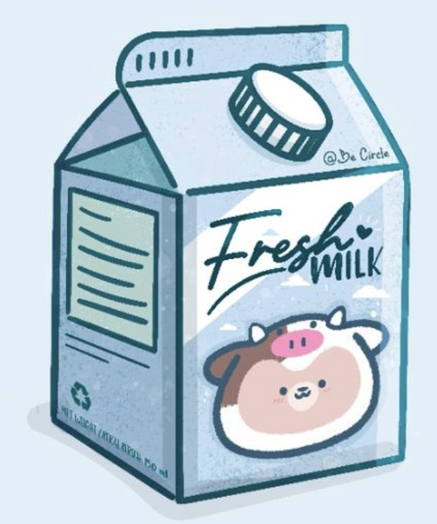
Market Basket Analysis
Hmmm, which items are frequently purchased together by my customers?​
Items
Association
Transactions
@2022 IBM Corporation
Notes:
Association rules are widely used to analyze retail transaction data. For example, when tracking people's buying habits, you might identify that a customer always buys bread and then they tend to buy grape juice.
Here I provide you a transaction table with 4 records. From the table, you can easily tell the frequent itemsets. which some items have frequent co ocurrence.

Slide 8

Market Basket Analysis
Hmmm, which items are frequently purchased together by my customers?​
Generated Rules
@2022 IBM Corporation
Notes:
And therefore, you could generate a strong rule/rules or the answers for the questioner. is that the next time they buy bread, they might also want to purchase grape juice.

Slide 9
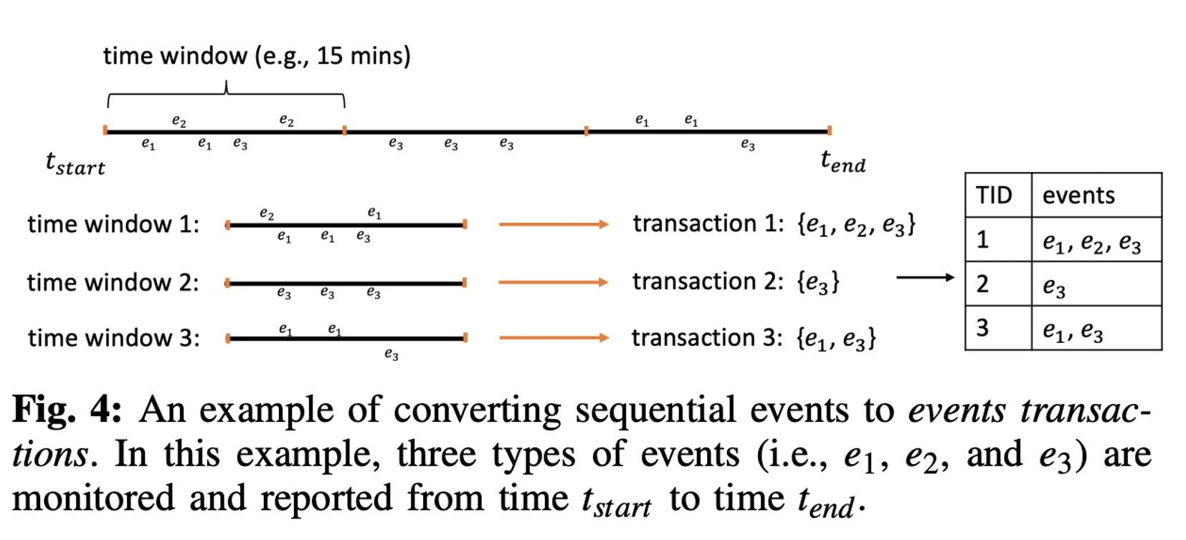
Mining Event Correlation in Watson AIOps
[1] Jinhon Hwang, Larisa Shwartz, Qing Wang, Raghav Batta, Harshit Kumar and Michael Nidd "FIXME: Enhance Software Reliability with Hybrid Approaches in Cloud", 43rd International Conference on Software Engineering (ICSE SEIP 2021).
@2022 IBM Corporation
Notes:
Also, we used association rule to mining interesting event correlation in Waston AIOps. the idea is similar, we first convert the sequential events to transactions, then we apply the association to find event correlation. if you're interested in this work, you could find more detailed information the paper we have published in 2021.

Slide 10
Thank You
@2022 IBM Corporation

