Slide 1

Florida International University
Hierarchical Multi-Label Classification of Medical Images using Bayes Decision Theory
Introduction to Machine Learning
Professor Ruogu Fang
Names: Qing Wang, Deya Banisakher, Gregory Murad Reis and Andrius Bubelis
Apr. 23rd of 2015

Slide 2
Outline
Problem
Challenges
Solution of Challenge I
Solution of Challenge II
Algorithm and Solution
Experiment
Conclusion and Future work
Q&A

Slide 3
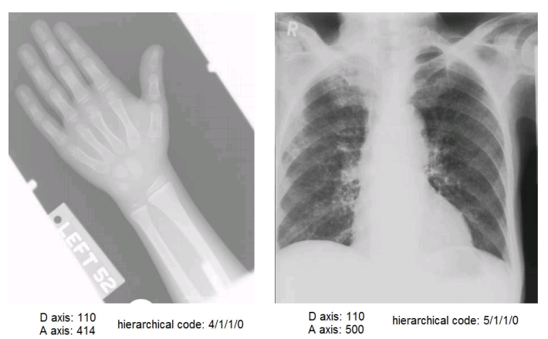
Problem
Try to solve: the medical image annotation task of ImageCLEF 2007 , and the images are labeled according to the IRMA code scheme, which is strictly hierarchical because each sub-code element is connected to only one code element.
ImageCLEF 2007A: The data set from the ImageCLEF 2007 competition.
5/ Chest
5/1 Chest; bones
5/1/1 Chest; bones; clavicle
Element to the right is a sub element of element to the left

Slide 4
Rationale
The amount of medical images produced nowadays is constantly growing.
Manual description and annotation of each image is time consuming, expensive and impractical.
This calls for development of automatic image annotation algorithms that can perform the task reliably.
Multi-Label Classification has gained significant interest in recent years.
E.g. Text Classification, image and video annotation, bioinformatics.

Slide 5
Challenge of The Problem
Challenge I:
Each X-Ray image belongs to multiple categories. For instance, the may associate with cardiovascular system, heart, aortic valve.
Challenge II:
Hierarchical relationships exist among the X-ray image categories. For example, cardiovascular system --> heart --> aortic valve
Our problem is to classify the X-ray images with multiple categories while keeping a hierarchical consistence among all categories.

Slide 6
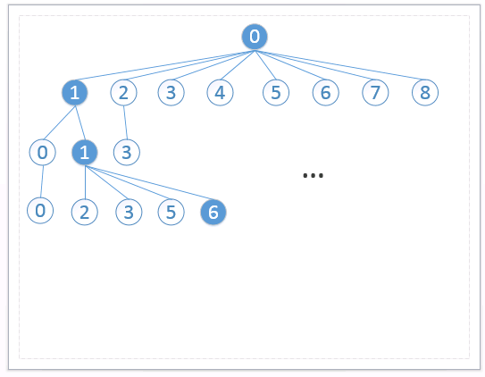



Solution of Challenge I
Multi-Label Classification
Instance from input feature space:
$$x=(x_{0},x_{1},…,x_{d−1})$$
Output class label vector:
$$y=\left(y_{0},y_{1},…,y_{N−1}\right)$$
where
$$y∈\{0,1\}$$
Multi-label classification: assigns a multi-label vector $y_{i}$ $=\left\{\begin{aligned}1 ;X∈i^{th} class \\ 0 ;\text{otherwise} \end{aligned}\right.$

Slide 7
Solution of Challenge I
Intuitive thinking: use traditional flat classification for multi-label classification.
No hierarchy constrains.
 | X Samples(#10000) | Y label(#97) | SVM models
0 | 1rt sample 2nd sample … 10000th sample | y_0 y_0 … y_0 | SVM_0
1 | 1rt sample 2nd sample … 10000th sample | y_1 y_1 … y_1 | SVM_1
96 | All training samples | y_96 | SVM_96

Slide 8
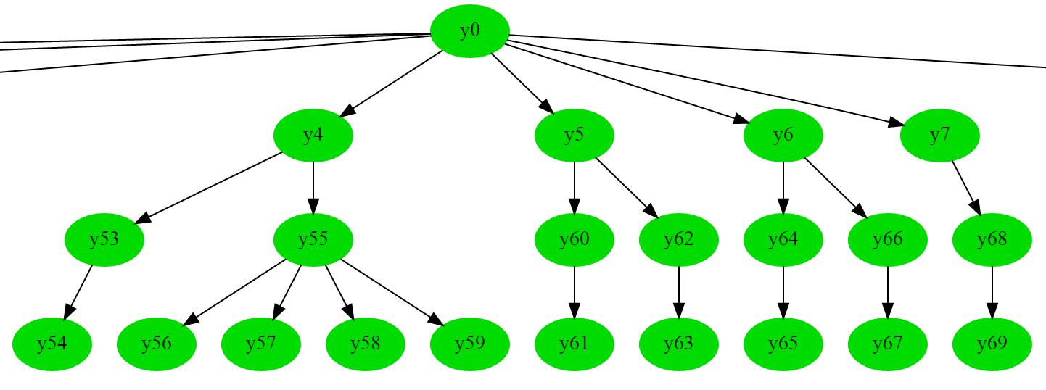
Hierarchical Model of the Used Dataset
$$y_{0}$$ | $$y_{1}$$ | $$y_{2}$$ | $$⋯$$ | $$y_{97}$$

Slide 9
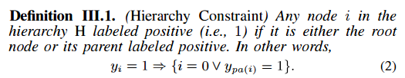
Solution of Challenge II

Slide 10

Solution of Challenge II
Intuitive thinking: use conditional probability to train our models.
 | X Samples | Y label(#97) | SVM models
0 | 1rt sample 2nd sample … 10000th sample | y_0 y_0 … y_0 | SVM_0
1 | 1rt sample with ypa(1) = 1 2nd sample with ypa(1) = 1 … | y_1 y_1 … | SVM_1
96 | All samples with ypa(96) = 1 | y_96 | SVM_96

Slide 11
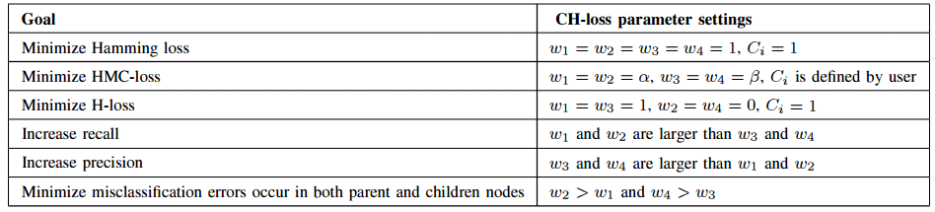
Hierarchical Loss Function
Important critics for hierarchical multi-label classification
Zero-one loss
Hamming-loss
H-loss (used on tree-structured label hierarchies; ambiguous for DAGs)
HMC-loss

Slide 12
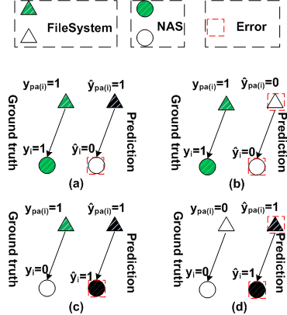
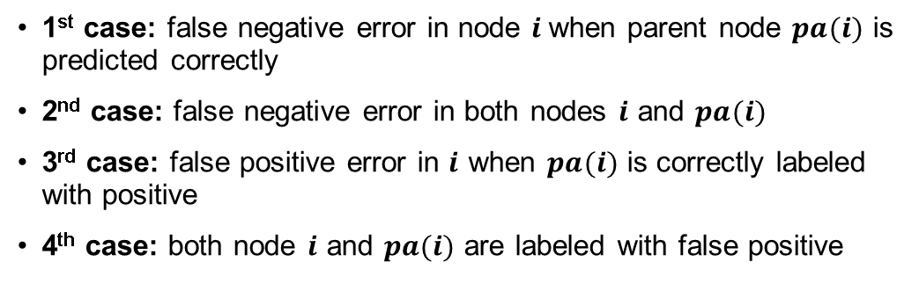
CH-Loss function
1st case: false negative error in node $i$when parent node $pa(i)$ is predicted correctly
2nd case: false negative error in both nodes $i$ and $pa(i)$
3rd case: false positive error in $i$ when $pa(i)$ is correctly labeled with positive
4th case: both node $i$ and $pa(i)$ are labeled with false positive
1st case
2nd case
CH-loss (contextual hierarchical loss):
3rd case
4th case
$$l\left(\hat{y},y\right)=w_{1}\sum_{i>0}^{N−1}{y_{i}y_{\left.pa(i\right)}}{\tilde{\hat{y}}}_{i}{\hat{y}}_{\left.pa(i\right)}C_{i}+w_{2}\sum_{i>0}^{N−1}{y_{i}y_{\left.pa(i\right)}}{\tilde{\hat{y}}}_{i}{\tilde{\hat{y}}}_{\left.pa(i\right)}C_{i}+w_{3}\sum_{i>0}^{N−1}{{\tilde{y}}_{i}y_{\left.pa(i\right)}}{\hat{y}}_{i}{\hat{y}}_{\left.pa(i\right)}C_{i}+w_{4}\sum_{i>0}^{N−1}{{\tilde{y}}_{i}{\tilde{y}}_{\left.pa(i\right)}}{\hat{y}}_{i}{\hat{y}}_{\left.pa(i\right)}C_{i}$$
the weight for the i^{th} case
the cost for different position of node in H.

Slide 13

Algorithm and Solution
Minimize the total expected contextual hierarchical loss by predicting the labels of each given X-ray.
The total expected contextual hierarchical loss is defined as follows:
P(y|x) is the probability of the label vector y given x.
Contextual hierarchical Loss

Slide 14


Algorithm and Solution
Estimate the probability P(y|x).
Obtain the best prediction of y by minimizing the expected contextual hierarchical loss above.

Slide 15



Glabel Algorithm
It can be formalized as knapsack problem, then we efficiently solve this problem by using a greedy algorithm named GLabel algorithm.

Slide 16
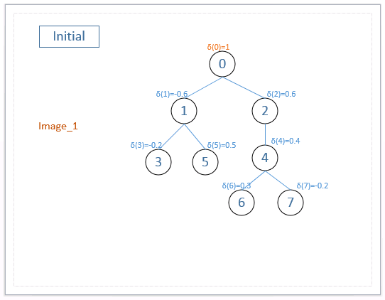
Glabel Algorithm

Slide 17
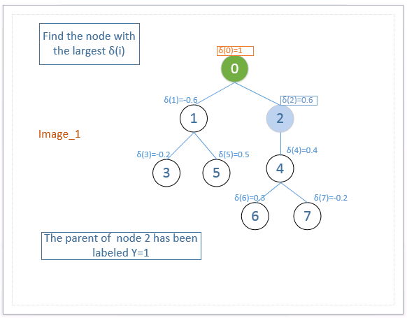
Glabel Algorithm

Slide 18
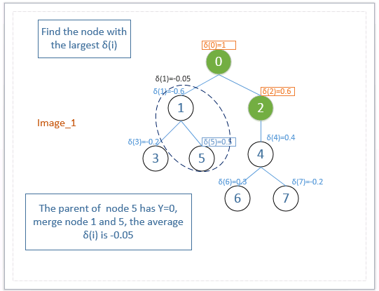
Glabel Algorithm

Slide 19
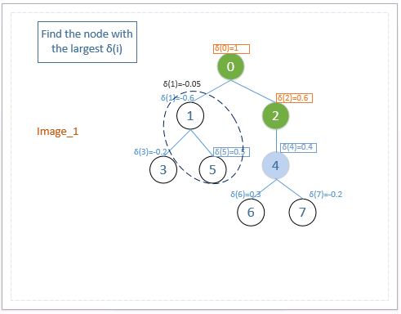
Glabel Algorithm

Slide 20
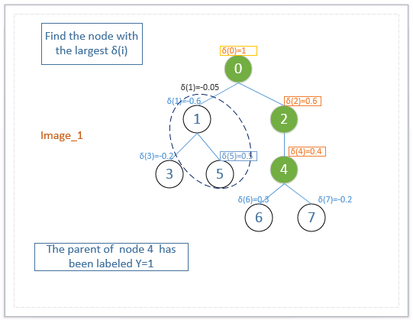
Glabel Algorithm

Slide 21
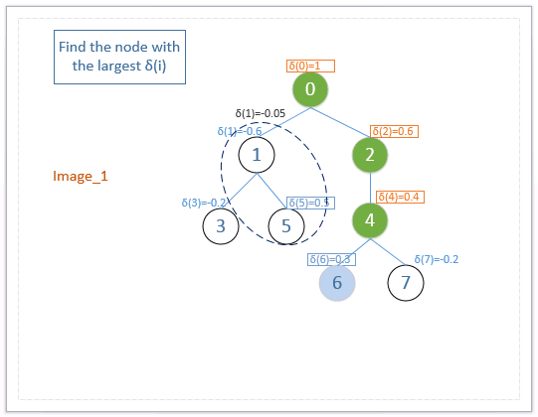
Glabel Algorithm

Slide 22
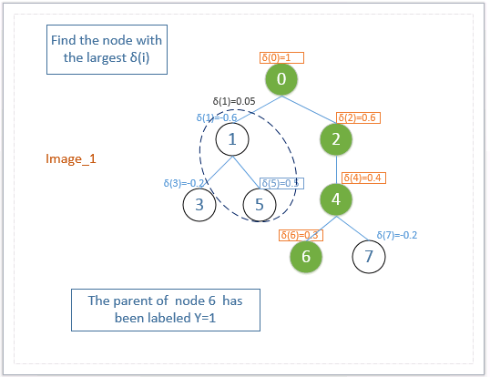
Glabel Algorithm

Slide 23
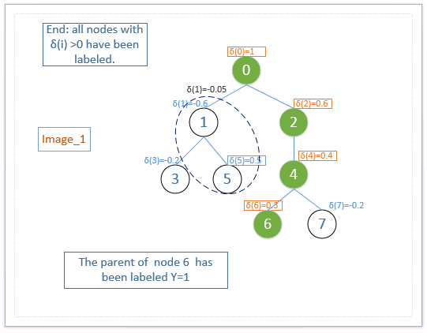
Glabel Algorithm

Slide 24
Experimentation
Set up
Platform:
System platform: Windows Server 2008 R2
Processor: Intel Xeon CPU 2.66GHz
RAM: 8.00GB
System type: 64-bit OS
Develop platform: Eclipse Luna 4.4.0

Slide 25
Experimentation
Data Set
ImageCLEF 2007A: The data set from the ImageCLEF 2007 competition.
Data Set | Training dataset | Testing dataset
# of X attribute | 80 attributes | 80 attributes
# of Y labels | 97 nodes | 97 nodes
# of samples | 10000 | 1006

Slide 26
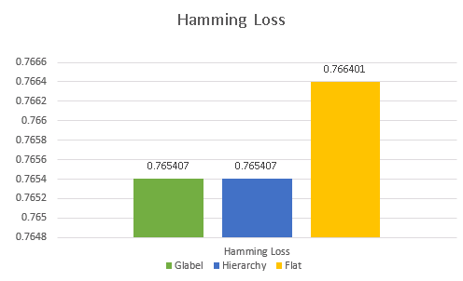
Experimentation
Hamming Loss
Settings : w₁=1.0,w₂=1.0,w₃=1.0,w₄=1.0 c_{i}=1

Slide 27
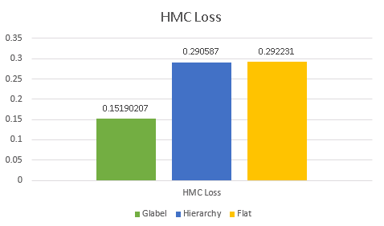
Experimentation
HMC-Loss
Settings : w₁=10.0, w₂=10.0, w₃=1.0, w₄=1.0

Slide 28
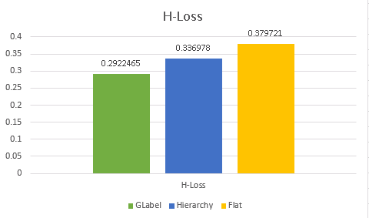
Experimentation
H-Loss
Settings : w₁=1.0, w₂=0.0, w₃=0.0, w₄=0.0 c_{i}=1

Slide 29
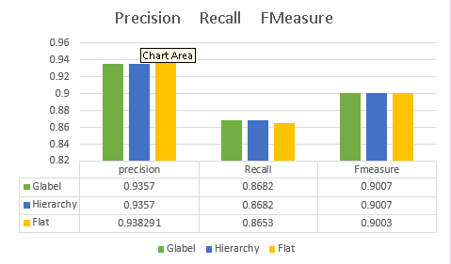
Experimentation
Precision, Recall, FMeasure
Settings : w₁=1.0,w₂=1.0,w₃=1.0,w₄=1.0 c_{i}=1

Slide 30
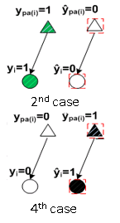
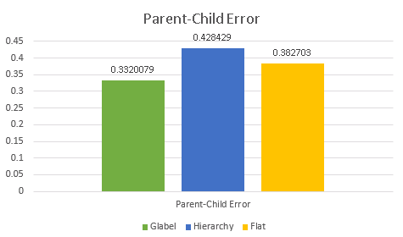
Experimentation
Parent-Child Error
Misclassification errors in both parent and child
w₁=1.0,w₂=10.0,w₃=1.0,w₄=10.0

Slide 31
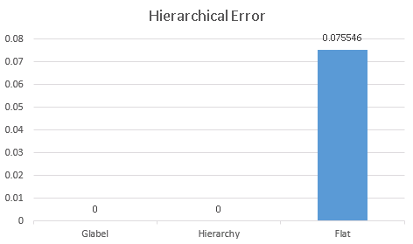
Experimentation
Hierarchical Error
w₁=1.0,w₂=10.0,w₃=1.0,w₄=10.0
The average number of violated hierarchy constraints.

Slide 32

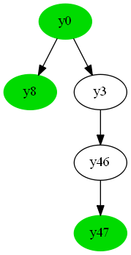

Experimentation
Ground Truth
GLabel
Flat (SVM)
Flat (SVM)
Ground truth and model predictions for 1 input instance X
Example of how flat classification
violates the hierarchical constraint

Slide 33
Conclusion and Future Work
Conclusion
Implement the Glabel algorithm.
Evaluate its performance over X-ray image data.
Solve the problem of automatic image annotation .
Future
Use PCA to extract the features of image.
Extend the tree-based hierarchy to DAG-based Hierarchy

Slide 34
Q&A

