Slide 1
Leveraging AI in IT Service Automation Modeling: from Classical AI Through Deep Learning to Combination Models
Oct 31th, 2019
Qing Wang¹, Laura Shwartz¹, Genady Ya. Grabarnik², Michael Nidd³, Jinho Hwang¹
IBM T.J. Watson Research Center, Yorktown Heights, NY 10598, USA
Dept. Math & Computer Science, St. John's University, Queens
IBM Research Zurich, 8803 Rueschlikon, Switzerland

Slide 2
Agenda
Introduction into Service Management
System Overview
Problem Definition & Methodology
Experiments
Conclusion

Slide 3
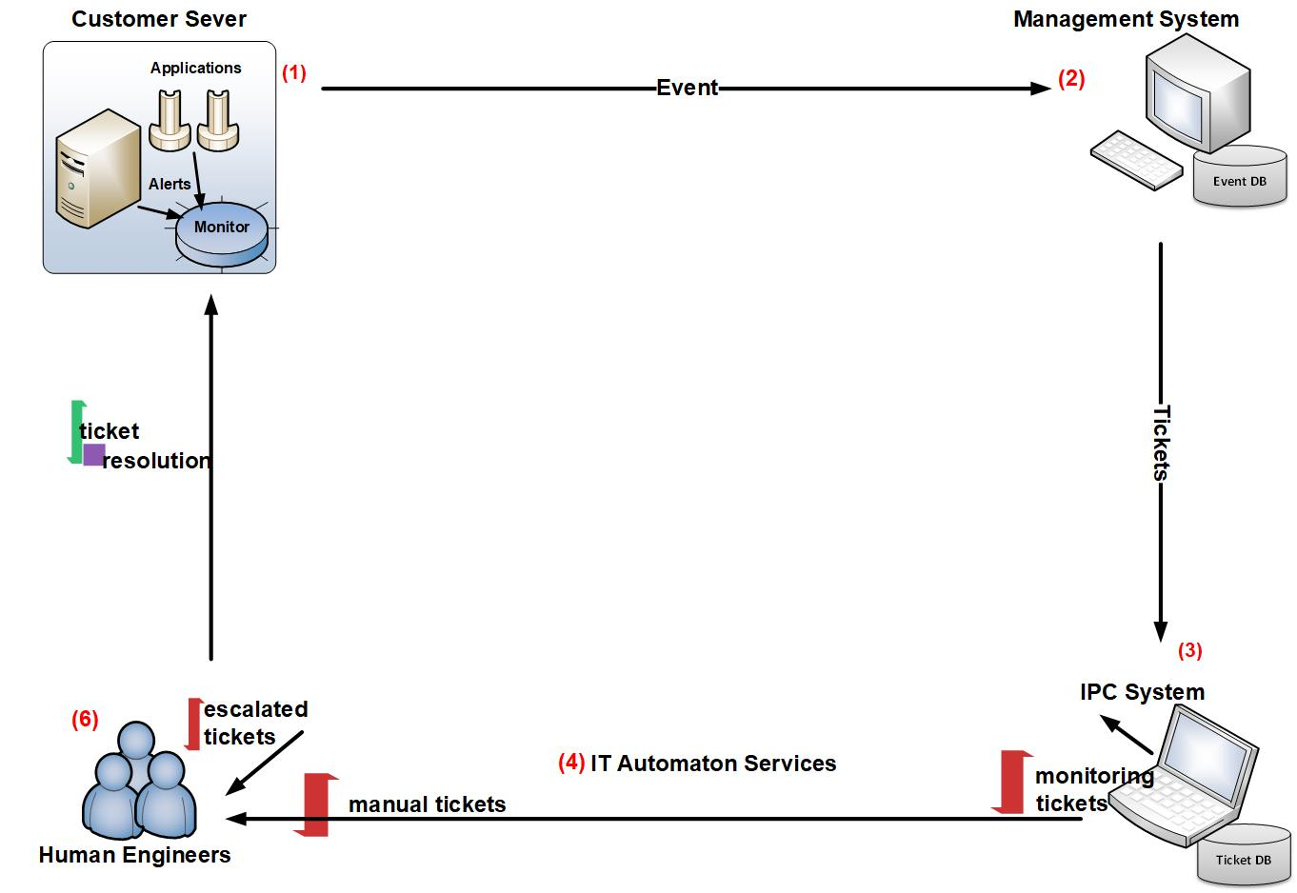
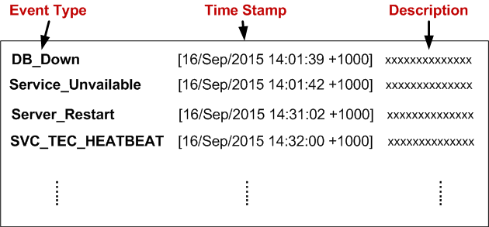
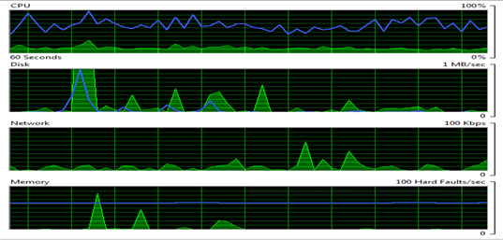
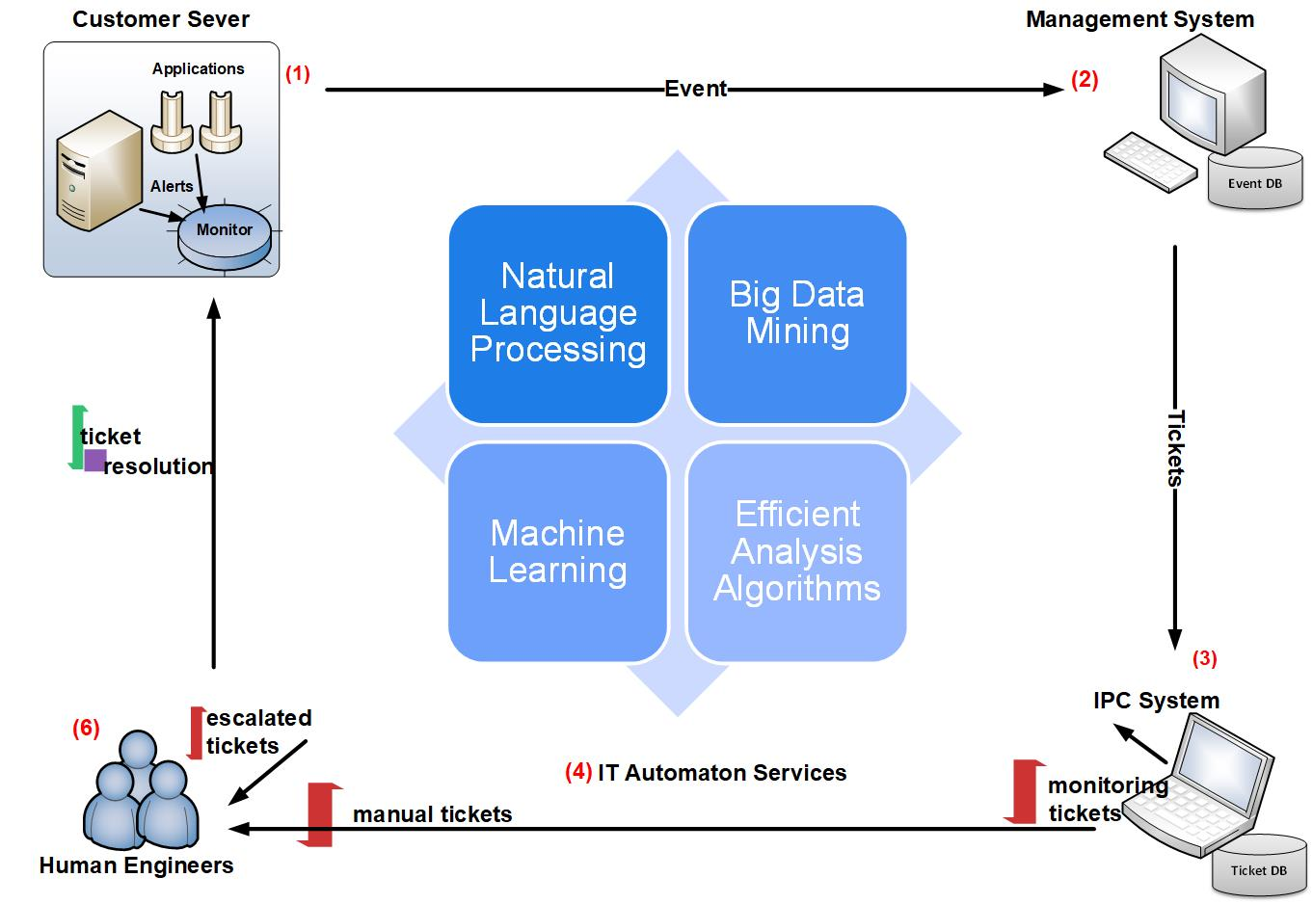
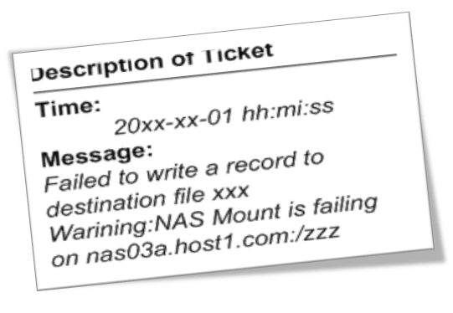
Service Management
Service Management Workflow
Problem Resolution
Problem Diagnosis
Problem Determination
labor-intensive!!!
Figure 3: A Typical Workflow of Service Management

Slide 4
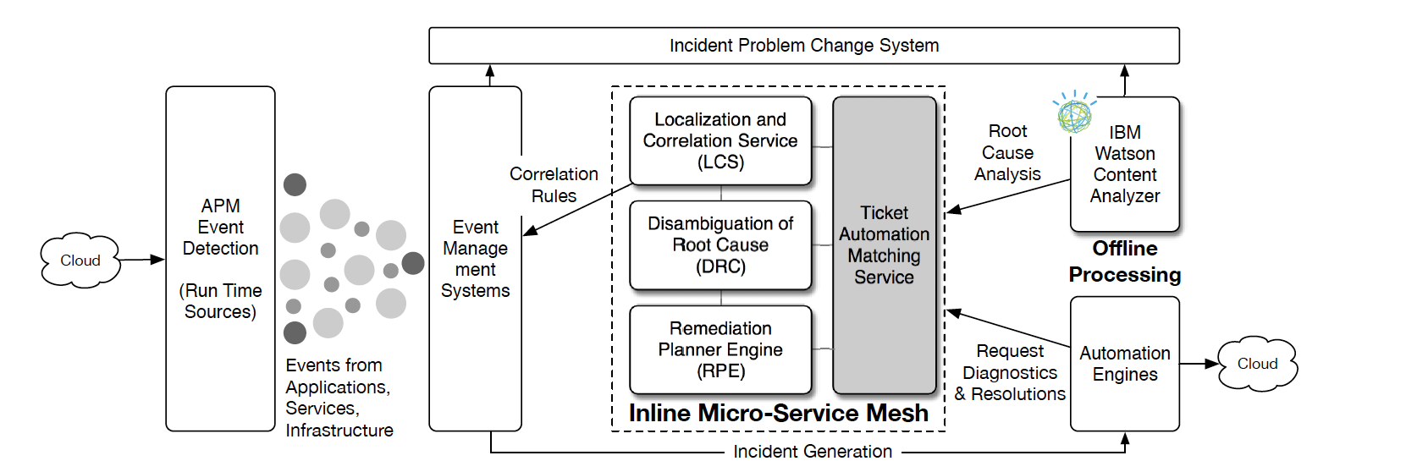
System Overview
System Architecture
Figure 4: Cognitive Event Automation System Architecture

Slide 5
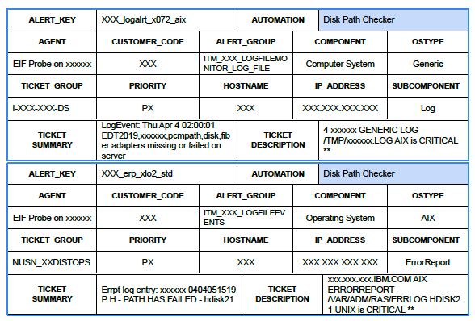
Challenges with monitoring data
Data produced by different monitors (and systems) is highly variable
New monitors are continuously added
Figure 2: Two different monitoring tickets and the same matching automation.

Slide 6
State of the art for automated resolution of the events
Automated system mostly employ regular expressions which are used as matchers to specific automation
As monitors changed and added the number of ‘matchers’ is growing.
IBM Global services have around 25,000 regular expressions within 4 years
Maintaining matchers become difficult or impossible task
Artificial intelligence techniques are introduced to choose the ‘correct’ automation for a monitoring ticket with the following challenge:
Feature selection
Deep learning models
How does the matcher service effectively achieve and maintain high accuracy on noisy tickets while automatically adapting to an introduction of a new or changed ticket contents?

Slide 7
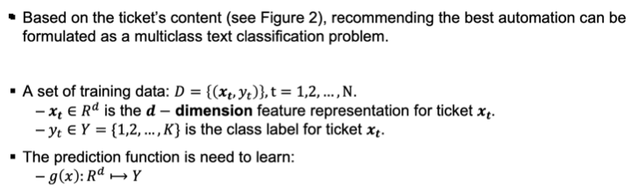
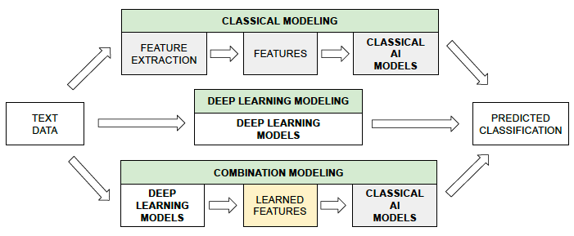
Problem Definition & Methodology
What is the best methodology for solving this challenge
Figure 5: Using modeling for the multiclass text classification: classical AI vs deep learning vs combination.

Slide 8
Classical AI models
Classical AI Models:
Classical AI models usually work with relatively low-dimension attribute spaces, necessitating well-defined and highly informative attributes as coordinates of feature vectors.
We use domain experts’ assistance to determine such attributes for the ticket dataset
Example: Support Vector Machines:
an efficient, theoretically solid and strong baseline for text classification problem
Ensemble Methods
Train multiple classifiers and apply voting to make final predictions.
More accurate than a single classifier
Bagging and Boosting
Example: Random Forests
(1) a highly accurate and robust machine learning algorithm.
(2) capable of modeling large feature spaces
(3) an ensemble of decision trees

Slide 9
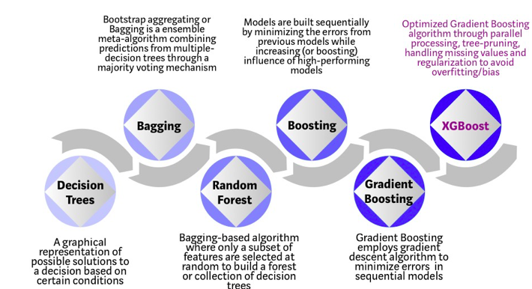
Ensemble methods
This methods require considerable effort on text preprocessing and feature extraction
Due to the nature of continuously-changing ticket records automatic feature extractors or selectors are absolutely critical

Slide 10

Deep Learning Methods
Deep Learning: Convolutional Neural Networks
have been shown to be effective in many Computer Vision and NLP tasks.
Convolution is the first layer to extract features from an input
ReLU stands for Rectified Linear Unit for a non-linear operation. The output is ƒ(x) = max(0,x). Why ReLU is important : ReLU’s purpose is to introduce non-linearity
Pooling layers section would reduce the number of parameters
Fully Connected layer, we flattened our matrix into vector and feed it into a fully connected layer like neural network
In our case the layers are
word embedding layer,
fully connected layer and
dropout layer
The introduction of a dropout layer is a regularization technique that reduces overfitting.

Slide 11
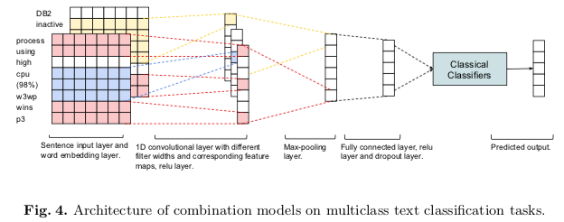
Combination Models
Combination Model
CNNs is used for learning feature representation:
convolution feature filters with varying widths captures several different semantic classes of ngrams by using different activation patterns
global maxpooling function induces behavior which separates important ngrams from the rest

Slide 12
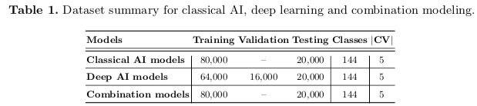
Data sets
Experimental incident data is generated by a variety of monitoring systems and stored in the Operational Data Lake.
It contains |D| = 100, 000 tickets from Jan. 2019 to Apr. 2019.
There are 114 automations (i.e., 114 classes/labels) in the dataset and a vocabulary V of size |V | = 184, 936
All incidents used in experiments are automatically resolved
After some preliminary testing, we designed our primary experiments to
Randomly initialize all word vectors with a dimension of 300
use ReLU, filter size of 4 × 5 with 64 feature maps each (for CNN only), dropout rate of 0.25, mini-batch size of 128, and epoch number of 20.

Slide 13
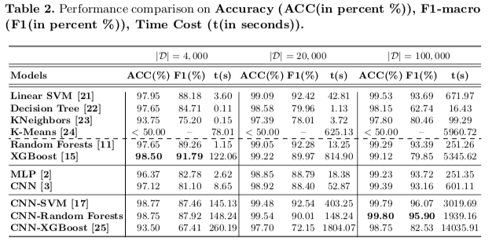
Results
The accuracy (ACC) and F1-score (F1) are widely applied metrics for evaluating multiclass classifiers.

Slide 14
Conclusion
Classical AI models perform well when the data size is small; they require handcrafted features
Deep learning models achieve a better performance when the training data is large enough
Combination models have the best performance on all dataset sizes and do not require engineered features

Slide 15
Back up

