Slide 1
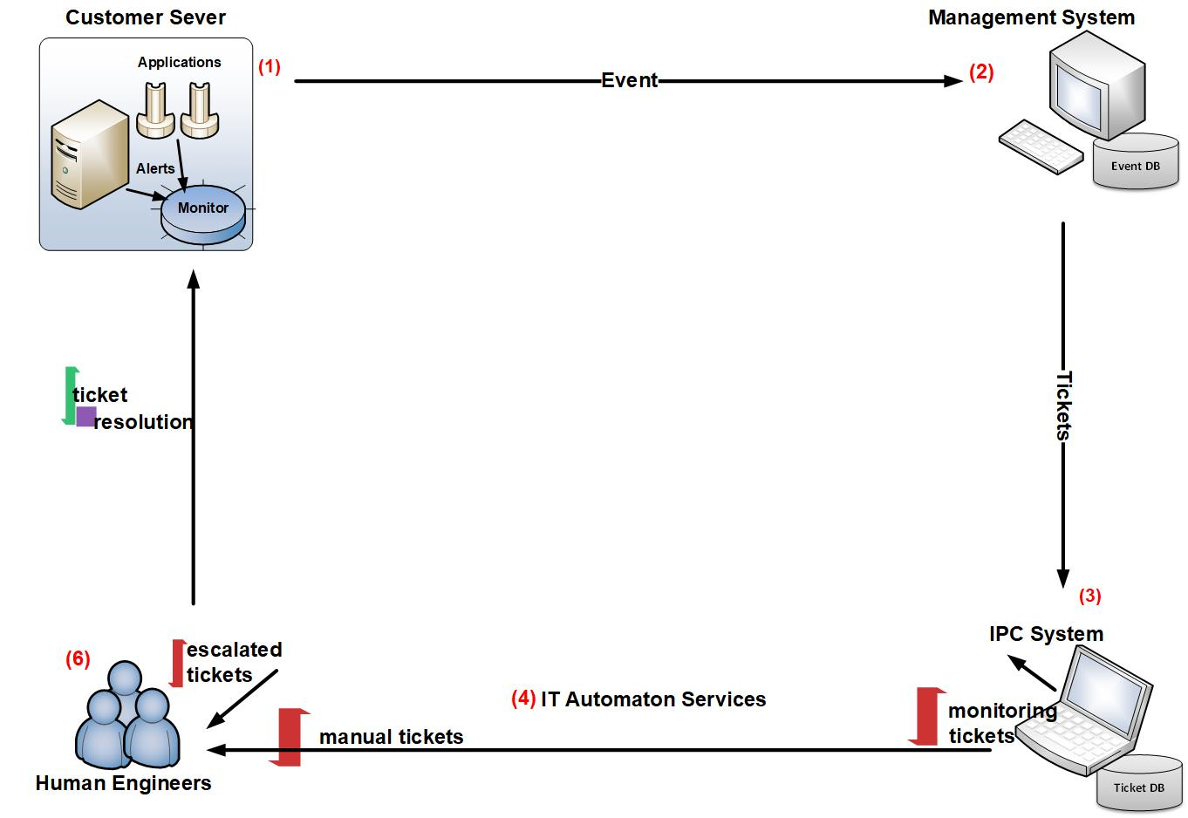
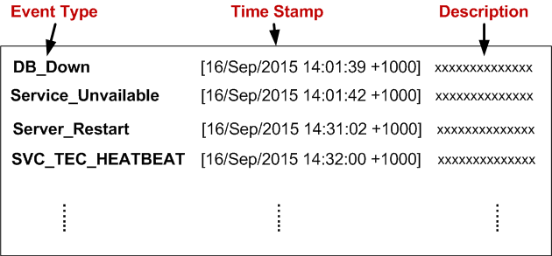
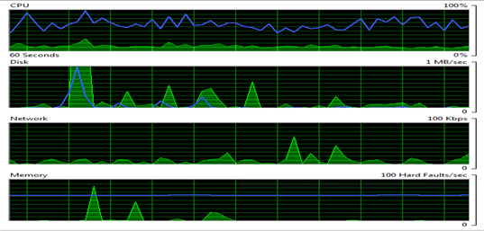
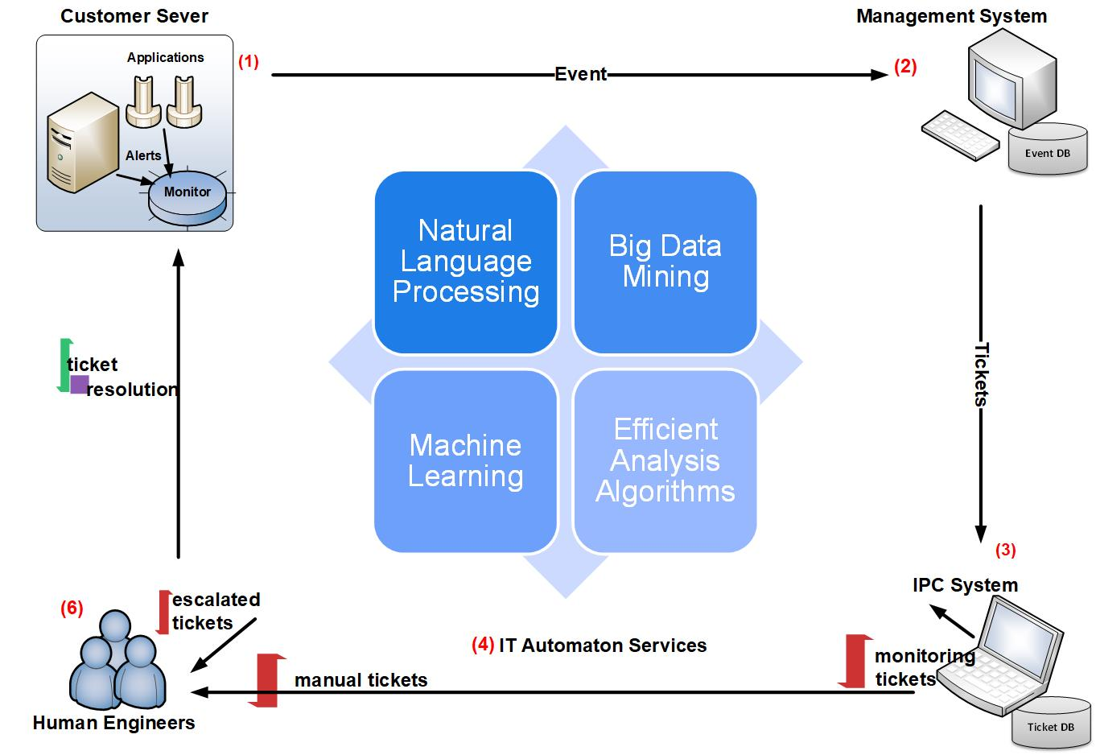
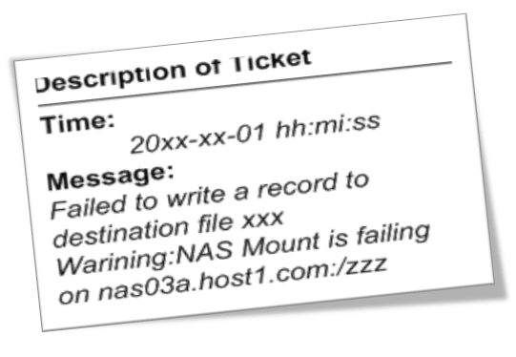
Problem Statement
A typical workflow of IT service management (ITSM) involves a mixture of human engineers, process and information technology.
Problem Resolution
Problem Diagnosis
Problem Determination
labor-intensive!!!
Figure 1: A Typical Workflow of IT Service Management
Notes:
This is a typical workflow of IT service management. It always involves a mixture of human engineers, process and information technology.
It usually includes these steps:
(1) As an anomaly detected, an event is generated by the monitoring system.
(2) event management system determines whether to create an incident ticket.
(3) These tickets are collected by IPC system, containing monitoring tickets and manual tickets directly generated by the customers.
(4) A monitoring ticket can be resolved by IT automation services. Later I will give you an overview of IT automation services.
(5)The unresolved tickets as well as the manual tickets are forwarded to human
engineers for problem determination, diagnosis, and resolution, which will cost a lot of time and are very labor-intensive.
So it is very necessary to employ intelligent techniques to maximize the automation or reduce human efforts of all the subroutine procedures in this workflow.

Slide 2


Problem Statement
IT automation services (ITAS) [1] plays an important role in IT service management.
An automation is a scripted resolution.
Problem Symptom
execute an automation
feedback (success or failure)
Problem Server I
execute an automation
feedback (success or failure)
Automation Engine
Problem Symptom
Problem Server 2
Figure 2: An overview of IT automation services.
[1] IBM Enterprise IT Automation Services. www.redbooks.ibm.com/redpapers/pdfs/redp5363.pdf.
Notes:
IT automation services (ITAS) plays an important role in IT service management. Our work is trying to optimize the procedures of IT automation services. Figure 2 shows you an overview. A monitoring ticket is generated due to the problem server, which contains the problem symptom. The automation engine will execute an automation (a scripted resolution)According to the problem symptom on the problem server. The feedback (success or failure) will be observed by the automation engine.

Slide 3
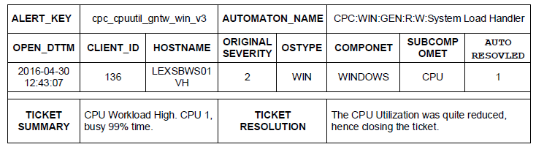
Challenges
Challenge 1: How do we appropriately solve the well-known cold-start problem [2] in IT automation services?
Challenge 2: How do we utilize the interactive feedback to adaptively optimize the recommending strategies of the enterprise automation engine to enable a quick problem determination by IT automation services?
feedback
Table 3: A sample ticket in ITSM and its corresponding automation
[2] C. Zeng, Q. Wang, S. Mokhtari, and T. Li. Online context-aware recommendation with time varying multi-armed bandit. In SIGKDD, pages 2025-2034. 2016.
Notes:
Table 3 shows a sample ticket that was successfully fixed by the automation engine. The column value of ALERT_KEY provides an initial symptom description. The automation engine will identify an existing automation (i.e., AUTOMATION_NAME). The executed feedback is recorded in the AUTORESOLVED column. It is essential to understand how the symptoms could be mapped to the corresponding scripted resolutions. This is also the initial motivation for our study. We identify three challenges.
Challenge 1: The problem is critical since every recommender system could encounter a significant number of new users/items without historical data or very few records, which makes them ineffective. In ITAS, for example, a new ticket (cannot find any matched automation), it will translate into significant human efforts.
Challenge 2: The automation engine observes the executed feedback of problem servers. However, the current recommendation strategies do not leverage these interactive information for continuous improvement.
This can be naturally modeled as a contextual multi-armed bandit problem, which has been widely applied into various interactive recommender systems.

Slide 4
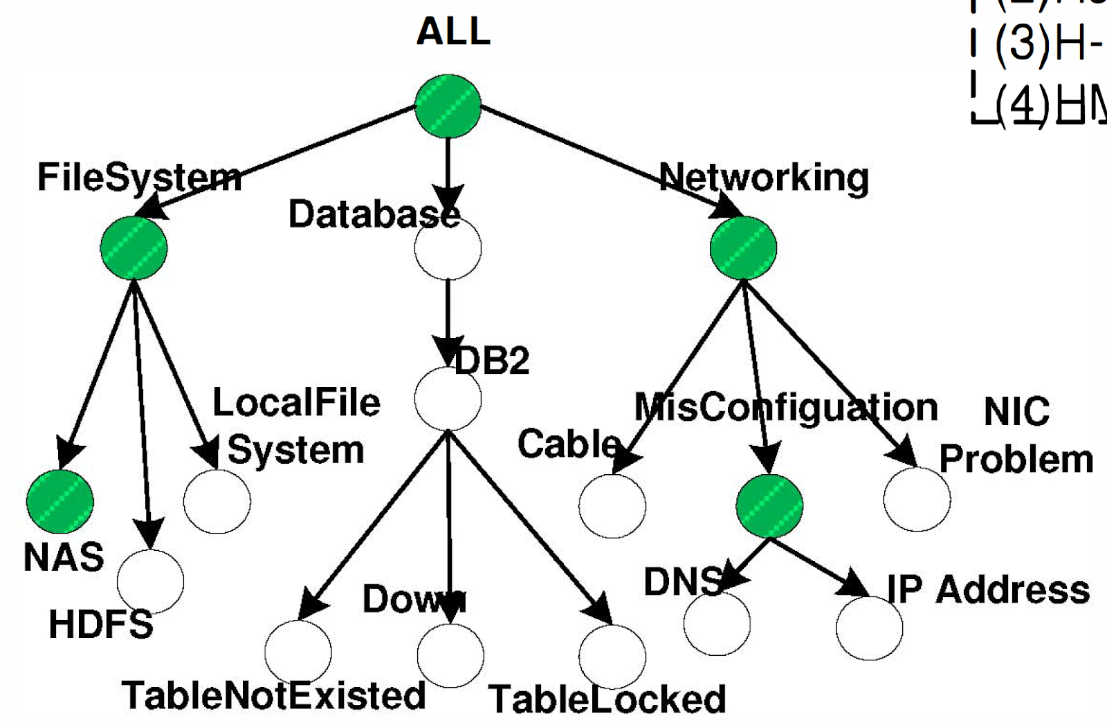
Challenges
Challenge 3: How do we efficiently improve the performance of recommendation using the explicit automation hierarchies of IT automation services [3]?
For example, a ticket is generated due to a failure of the DB2 database.
Figure 3: An example of taxonomy in IT tickets.
[3] Zeng, Chunqiu, et al. "Knowledge guided hierarchical multi-label classification over ticket data." IEEE Transactions on Network and Service Management 14.2 (2017): 246-260.
Notes:
In IT service management, domain experts usually define the taxonomy of the IT problems (see Figure 3).
Correspondingly, the automations also contain the underlying hierarchical structure.
For example, a ticket is generated due to a failure of the DB2 database. Obviously, the automations belonging to database would have higher probabilities to solve this problem compared with other categories’ automation. This cannot be solved by the traditional MAB algorithms since they assume arms are independent. Differently, we are studying the MAB problem with dependent arms. In this paper, we consider the dependencies among arms in the form of hierarchies. Which can match the feature spaces from coarse to fine along the hierachy.

Slide 5
Related Work
Multi-armed Bandit Algorithms
ɛ-greedy, UCB, Thompson sampling, LinUCB [4].
Used to balance the tradeoff between exploration and exploitation in interactive recommender systems, i.e., movies recommendation, news recommendation, etc.
Multi-armed Bandit problem with Dependent Arms [5, 6, 7, 8]
Use the taxonomy to explore the dependencies among arms in the context-free bandit setting. [6]
Learn the item hierarchy by a small number of user profiles. [7]
Propose a generative model to automatically learn the dependencies among arms. [8]
[4] Li, Lihong, et al. "A contextual-bandit approach to personalized news article recommendation” In WWW. ACM, 2010.
[5] S. Pandey, D. Agarwal, and V. Chakrabarti, D.and Josifovski. Bandits for taxonomies: A model-based approach. In SDM, pages 216-227. SIAM, 2007.
[6] S. Pandey, D. Chakrabarti, and D. Agarwal. Multi-armed bandit problems with dependent arms. In ICML, pages 721-728. ACM, 2007.
[7] Y. Yue, A. Hong, and C. Guestrin. Hierarchical exploration for accelerating contextual bandits. arXiv preprint arXiv:1206.6454, 2012.
[8] Qing Wang, Chunqiu Zeng, Wubai Zhou, Tao Li, S. S. Iyengar, Larisa Shwartz, Genady Ya. Graharnik, “Online Interactive Collaborative Filtering Using Multi-armed Bandit with Dependent Arms”, In the IEEE Transactions on Knowledge and Data Engineering (TKDE) (under revision), 2017.
Notes:
I will discuss the related work. For any recommender system, it is crucial to learn the user feedback to optimize the performance. Due to the abundant of online services, MAB algorithms have drawn a big attention.

Slide 6
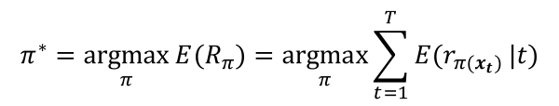
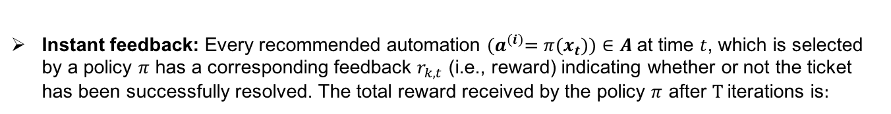
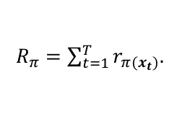
Online IT Automation Recommendation Modeling
In IT automation recommendation modeling,
Arms: $Α=\{a^{\left(1\right)}, …,a^{\left(N\right)}\}$ denotes a set of automations (i.e., scripted resolutions) feasible in ITAS.
Observed information: The contextual information (i.e., the ticket symptom) of a reported ticket at time t is represented as a feature vector $x_{t}∈\text{X}$, where X denotes the d-dimensional feature space.
Instant feedback: Every recommended automation ${(a}^{\left(i\right)}=π(x_{t}))∈A$at time $t$, which is selected by a policy $π$ has a corresponding feedback $r_{k,t}$ (i.e., reward) indicating whether or not the ticket has been successfully resolved. The total reward received by the policy $π$ after $T$ iterations is:
$R_{π}=\sum_{t=1}^{T}{r_{π(x_{t})}}$.
The goal is to identify the optimal policy $π^{∗}$ for maximizing the total reward after T iterations.
$$π^{∗}=\underset{π}{argmax}{E(R_{π})}=\underset{π}{argmax}{\sum_{t=1}^{T}{{E(r}_{π(x_{t})}}}|t)$$
Notes:
Next, How we model IT automation recommendation in the contextual bandit setting.
Each arm corresponds to an automation.
Pulling an arm indicates recommending an automation.
The reward received after pulling an arm is the feedback after recommending an automation.

Slide 7
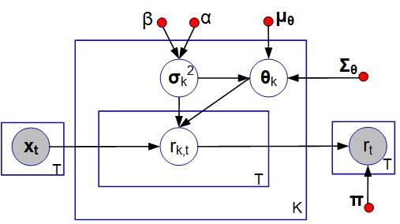
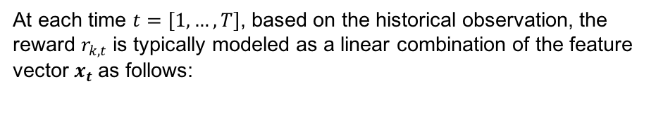


Online IT Automation Recommendation Modeling
At each time $t=\left[1,…,T\right]$, based on the historical observation, the reward $r_{k,t}$ is typically modeled as a linear combination of the feature vector $x_{t}$as follows:
aa
a d-dimension feature vector
an observation noise, ${ ξ}_{k}\sim N$($0, σ_{k}^{2}$).
$$r_{k,t}=x_{t}^{T}θ_{k}+ξ_{k}$$
a d-dimension coefficient vector
Figure 4: A graphic model of contextual MAB [8]
[8] C. Zeng, Q. Wang, S. Mokhtari, and T. Li. Online context-aware recommendation with time varying multi-armed bandit. In SIGKDD, pages 2025-2034. 2016.
Notes:
We want to maximize the total reward. Then how we model the reward. The reward is typically modeled as a linear combination of the feature vector as follows.
Xi_k is an observation noise.

Slide 8
Hierarchical IT Automation Recommendation Modeling
2. execute an automation
0. generate
3. feedback (success or failure)
Problem Server
4. feedback (success or failure)
HMAB
input
1. recommend an automation
a incident ticket
Automation Engine
5. update parameters
Notes:
Here I will discuss how we integrate the hierarchical information into the MAB setting. We proposed hierarchical multi-armed bandit algorithm and introduced it into IT automation services.
1. For an incoming ticket, HMAB will recommend an automation to automation engine which is used to execute on problem server. The feedback will used to update the parameters of HMAB.

Slide 9
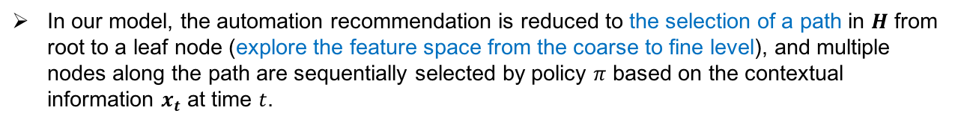
Hierarchical IT Automation Recommendation Modeling
Let $H$ denote the taxonomy. Given a node $a^{\left(i\right)}∈H$, ${pa(a}^{\left(i\right)})$ and ${ch(a}^{\left(i\right)})$ are used to represent the parent and children sets, respectively.
A leaf node of $H$ represents an automation, ${ch(a}^{\left(i\right)})$ is empty.
A non-leaf node is a category or a subcategory.
In our model, the automation recommendation is reduced to the selection of a path in $H$ from root to a leaf node (explore the feature space from the coarse to fine level), and multiple nodes along the path are sequentially selected by policy $π$ based on the contextual information $x_{t}$ at time $t$.
Notes:
Next, how we incorporate the prior knowledge of hierarchies into the bandit setting. Let H denote the taxonomy.

Slide 10
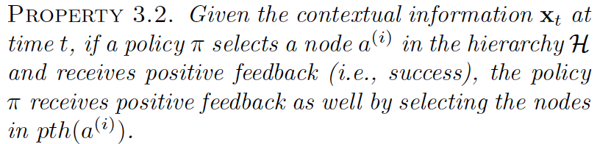
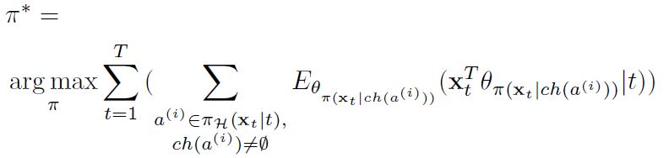
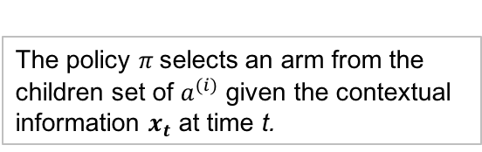
Hierarchical IT Automation Recommendation Modeling
The policy $π$selects an arm from the children set of $a^{(i)}$ given the contextual information $x_{t}$ at time t.
Notes:
We already select an automation by policy pi. Now, the problem is how to update the parameters when the model observes the feedback? The feedback will be used to update all the nodes along the selected path.

Slide 11

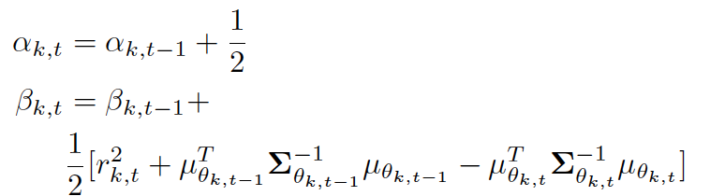
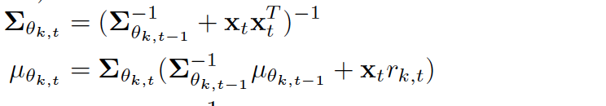
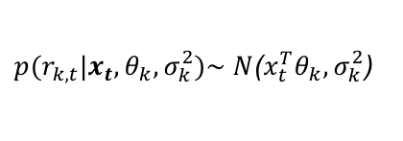
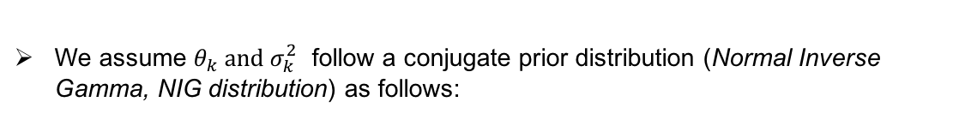
Solution and Algorithm
The reward $r_{k,t}$ depends on $x_{t},θ_{k},σ_{k}^{2}$.
${p(r}_{k,t}|x_{t},θ_{k},σ_{k}^{2})\sim N$($x_{t}^{T}θ_{k}, σ_{k}^{2}$)
We assume $θ_{k} and σ_{k}^{2}$ follow a conjugate prior distribution (Normal Inverse Gamma, NIG distribution) as follows:
After recommend an automation $a^{(p)}$ at time t, the observed feedback will be used to update the hyper parameters $α_{k,t}$, $β_{k,t}$, $μ_{θ_{k,t}}$, $Σ_{θ_{k,t}}$ of each node along the selected path $pth(a^{(p)}$).
Developing with different strategies (i.e., Thompson sampling, LinUCB), we have HMAB-TS and HMAB-LinUCB.
Notes:
The goal is to maximize the total reward after T iterations. How do we model it? From the graphical model, the reward r_k,t depends on random variable x_t , theta_k and sigma_k
Thompson sampling samples reward r based on its posterior distribution.
ucb utilize the mean of reward and variance of reward to determine which automation should be recommended.

Slide 12
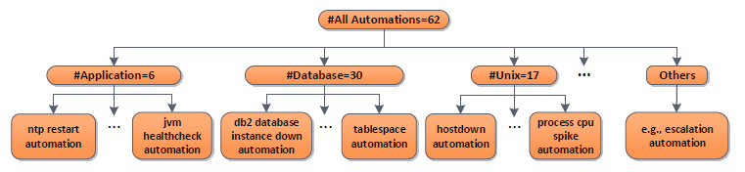
Example: Hierarchical Multi-armed Bandit Algorithm
At time t = [1,…,T]:
Level 0
Level 1
Level 2
Notes:
I will show how it works. First we select a path, then we use the feedback to update the parameters of each node along the path.

Slide 13
Example: Hierarchical Multi-armed Bandit Algorithm
At time t = [1,…,T]:
Level 0
Level 1
Level 2

Slide 14
Example: Hierarchical Multi-armed Bandit Algorithm
At time t = [1,…,T]:
Level 0
Level 1
Level 2
1 or 0

Slide 15
Example: Hierarchical Multi-armed Bandit Algorithm
At time t = [1,…,T]:
Level 0
Level 1
1 or 0
Level 2

Slide 16
Example: Hierarchical Multi-armed Bandit Algorithm
At time t = [1,…,T]:
Level 0
1 or 0
Level 1
Level 2
Notes:
I will show how it works. First we select a path, then we use the feedback to update the parameters of each node along the path.

Slide 17
Experiment
Data Set
Experimental tickets are collected by IBM Tivoli Monitoring system covering from July 2016 to March 2017 with the size of |D| = 116,429.
Each ticket is represented as a binary feature vector x with dimension 1,182.
The dataset contains 62 automations.
A three-layer hierarchy H is given by domain experts.
Evaluation Method
Replayer method. [8]
Baselines
ɛ-greedy, Thompson sampling, LinUCB
Our methods
HMAB- ɛ-greedy, HMAB-TS, HMAB-LinUCB
[8] L. Li, W. Chu, J. Langford, T. Moon, and X. Wang. An unbiased offline evaluation of contextual bandit algorithms with generalized linear models. JMLR, 26:19-36, 2012.
Notes:
Replayer method is equal to an online evaluation method.

Slide 18
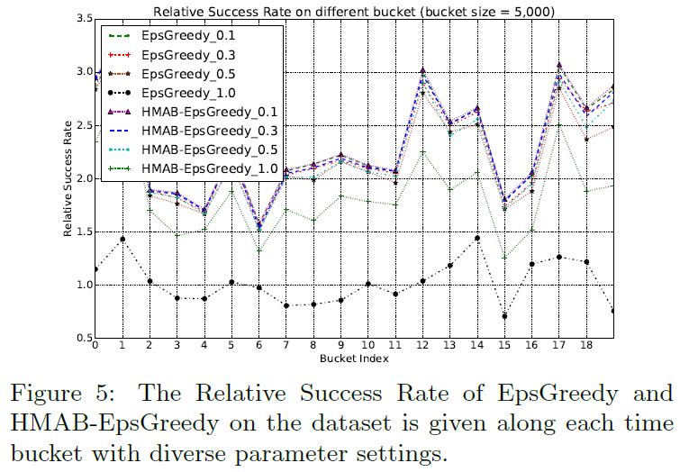
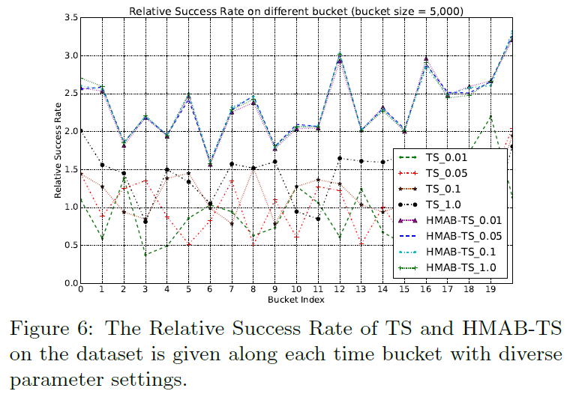
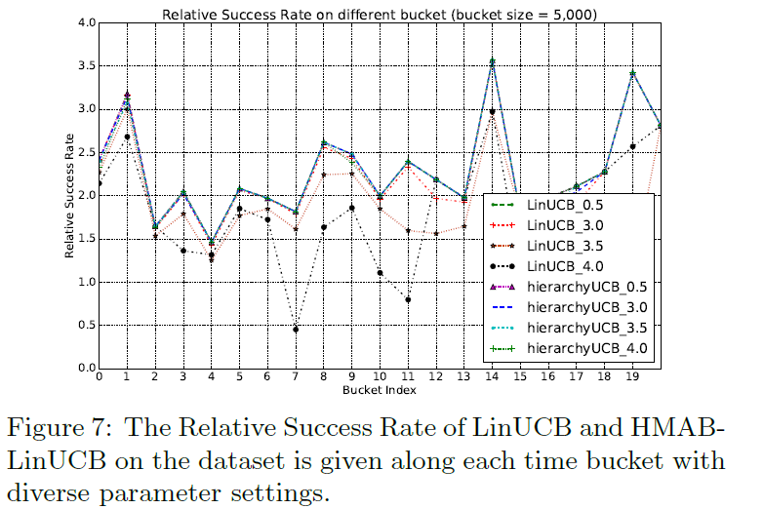
Experiment
Notes:
This is the experimental results. You can see that our proposed HMAB outperform the other corresponding baseline algorithms. The average precision of the recommendation.

Slide 19
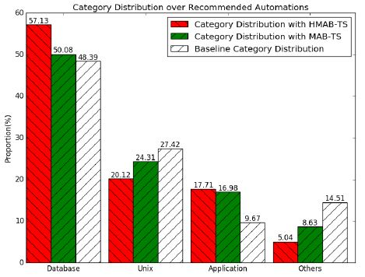
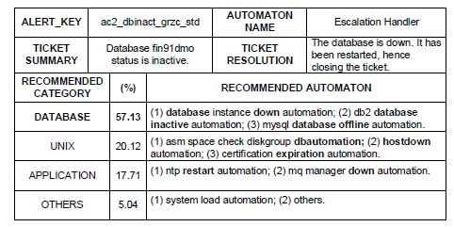
A Comparative Case Study
The recommendation for escalated tickets can be regarded as a cold-start problem due to the lack of the corresponding automations.
Figure 8: The exploration by HMAB-TS of a cold-start ticket case.
Figure 9: The comparison of category distribution on the recommended automations.
Notes:
Figure 8 presents an escalated ticket, it is a database problem. Such a problem has been repeatedly reported over time in the dataset. Since this ticket reports a database problem, intuitively the automations in the database category should have a high chance of being recommended. The category distributions of the recommended automations by our proposed HMABs and conventional MABs are provided in Figure 9, as well as the baseline category distribution, which is the prior category distribution obtained from all the automations of the hierarchy. From Figure 9, we observe that in HMAB-TS the database category has the highest percentage among all the automation categories. This shows that our proposed
HMABs can achieve better performance by making use of the predefined hierarchy.

Slide 20
Conclusion
A new online learning algorithm for IT automation recommendation
Solve the cold-start problem.
Utilize the interactive feedback for continuous improvement.
Integrate the hierarchical information to model the dependencies among arms.
The effectiveness and efficiency of our proposed methods are verified on a large dataset of tickets from IBM Global Services.
Future work
Ticket representation

Slide 21

Q & A

Slide 22

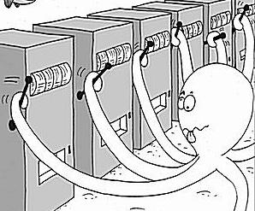
Example: News Recommendation
article 1
news article pool/candidates
reward
1.Not really!
Like it?
Observable Information
(i.e., user information, item information)
update parameters
Contextual Multi-armed Bandit
Notes:
Before, we talk about the hierarchical multi-armed bandit algorithm. Let’s first take news recommendation as an example to show how the multi-armed bandit algorithms work.
At each step, based on the current observable information, $it will$choose the best item to the user. The main objective is to maximize the total reward while balancing the trade-off between exploitation and exploration.

Slide 23

Example: News Recommendation
2.Yeah!
article 2
news article pool/candidates
reward
Like it?
Observable Information
(i.e., user information, item information)
update parameters
Contextual Multi-armed Bandit
Notes:
Before, we talk about the hierarchical multi-armed bandit algorithm. Let’s first take news recommendation as an example to show how the multi-armed bandit algorithms work.
At each step, based on the current observable information, $it will$choose the best item to the user. The main objective is to maximize the total reward in the long period while balancing the trade-off between exploitation and exploration.
During an exploitation phase, the recommender system generates the recommendation list maximizes the immediate utility for the current iteration. During exploration, the system may recommend items that do not optimize the immediate utility, but reduce the uncertainty in modeling a user’s preferences and eventually help maximize the utility over the whole session.

Slide 24



Online IT Ticket Automation Recommendation Using Hierarchical Multi-armed Bandit Algorithms
Qing Wang¹, Tao Li¹,
S. S. Iyengar¹
Larisa Shwartz²
Genady Ya. Grabanrnik³
¹School of Computing and Information Science, Florida International University Miami, FL, USA ²Cognitive Service Management, IBM T.J. Watson Research Center Yorktown Heights, NY, USA ³Dept. Math & Computer Science, St. John’s University, Queens, NY, USA
Notes:
Good morning, everyone. My name is Qing Wang, a Ph.D. student from FIU. This is a joint work with laura from IBM research center, Genady from St, john's university. Online IT Ticket Automation Recommendation using hierarchical multi-armed bandit algorithms.

Slide 25
Outline
Introduction
Problem Statement & Challenges
Related Work
Online IT Automation Recommendation Modeling
Solution and Algorithm
Experiment
Conclusion
Notes:
This is the outline of my talk. First I will give you an introduction of IT service management, problem statement and challenges in IT automation recommendation. Some related work about multi-armed bandit algorithms will be discussed. Then I will provide the mathematical formalization of IT automation recommendation. The proposed hierarchical multi-armed bandit algorithm will be provided in solution and algorithms. Last, I will show the experimental results and conclusion.

Slide 26








Introduction
IT service management (ITSM) refers to all the activities that are performed to plan, deliver, operate and control the IT services, which are provided to customers.
plan
Customizable Solution
deliver
control
Continual Optimization
operate
Automate Service Processes
Knowledge Consolidation
Many ITSM products are booming from different companies. Aiming at providing higher quality and more complex services, service providers are increasingly employing machine learning and data mining techniques to automate or optimize their services.
Notes:
Let’s first know what is IT service management and its importance in the real world.
Many ITSM products are booming from different companies, like IBM, HP, sysaid. The increasing complexity of IT environments urgently requires the use of intelligent techniques to automate or optimize their services for more efficient delivery of IT services.

