Slide 1
Biological Modeling of Neural Networks
Week 7 – part 1 :Variability
7.1 Variability of spike trains
- experiments
7.2 Sources of Variability?
- Is variability equal to noise?
7.3 Poisson Model
-Three definitions of Rate code
7.4 Stochastic spike arrival
- Membrane potential fluctuations
7.5. Stochastic spike firing
- stochastic integrate-and-fire
Week 7 – Variability and Noise:
The question of the neural code
Wulfram Gerstner
EPFL, Lausanne, Switzerland
Notes:
First Lecture: 7.1, 7.2, and 7.3 (HOMOGENEOUS Poisson Model). Dann um 9:50h vor der Pause, Exercise 1 (Poisson Model)
Second Lecture: 7.3 (INHOMOGENEOUS Poission model, Quiz 1, and three definitions of rate). Quiz 2, five minutes before the end.
Third Lecture: 7.4 Stochastic spike arrival, on the blackboard, then exericise 2

Slide 2
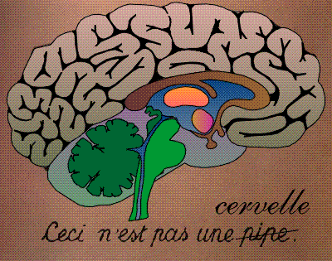
Neuronal Dynamics – 7.1. Variability
motor
cortex
frontal
cortex
visual
cortex
to motor
output

Slide 3
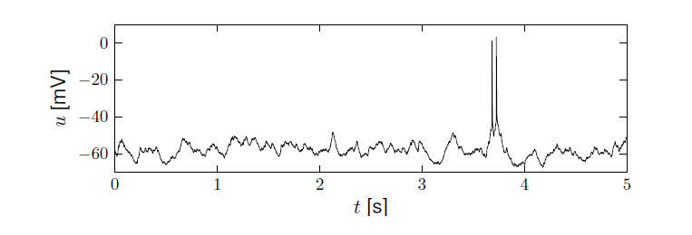
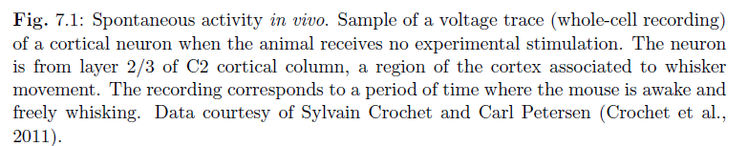
Neuronal Dynamics – 7.1 Variability in vivo
Variability
- of membrane potential?
- of spike timing?
Spontaneous activity in vivo
awake mouse, cortex, freely whisking,
Crochet et al., 2011

Slide 4
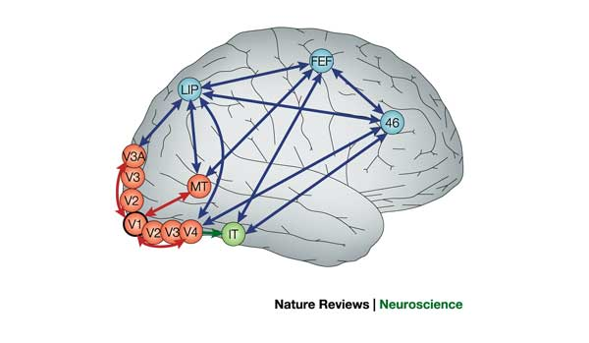
Detour: Receptive fields in V5/MT
visual
cortex
cells in visual cortex MT/V5
respond to motion stimuli

Slide 5
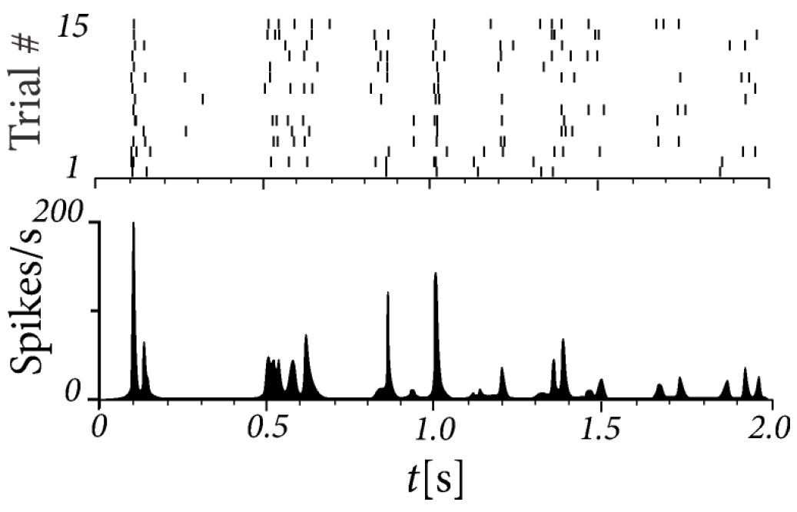
Neuronal Dynamics – 7.1 Variability in vivo
15 repetitions of the same random dot motion pattern
adapted from Bair and Koch 1996;
data from Newsome 1989

Slide 6



Human Hippocampus
Neuronal Dynamics – 7.1 Variability in vivo
Quiroga, Reddy,
Kreiman, Koch,
and Fried (2005).
Nature, 435:1102-1107.
Sidney opera
Sidney opera
Sidney opera

Slide 7
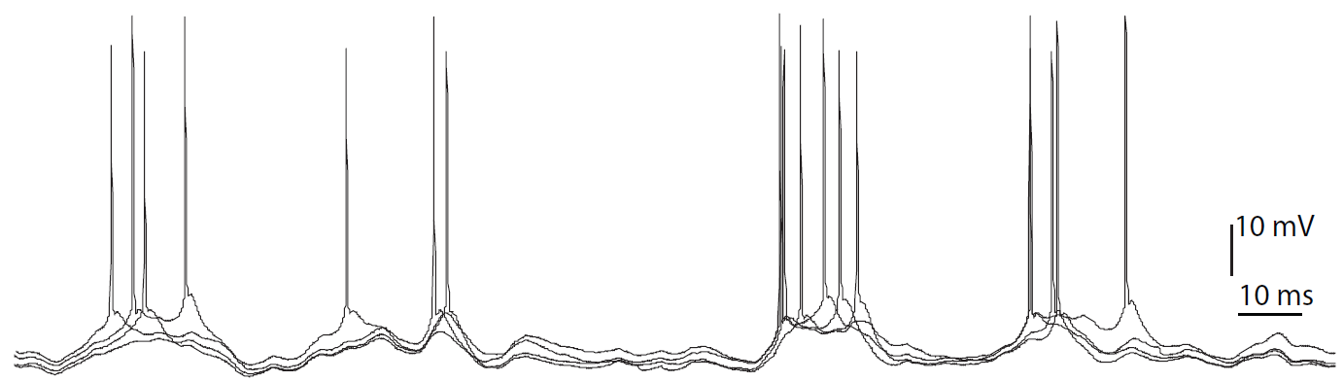
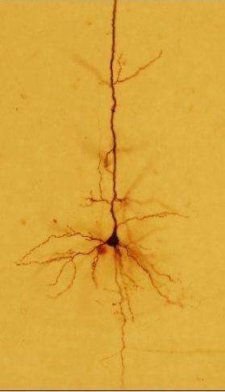
Neuronal Dynamics – 7.1 Variability in vitro
4 repetitions of the same time-dependent stimulus,
brain slice
I(t)

Slide 8
Neuronal Dynamics – 7.1 Variability
Fluctuations
of membrane potential
of spike times
In vivo data
→ looks ‘noisy’
In vitro data
→ fluctuations
fluctuations=noise?
relevance for coding?
source of fluctuations?
model of fluctuations?

Slide 9
Week 7 – part 2 : Sources of Variability
7.1 Variability of spike trains
- experiments
7.2 Sources of Variability?
- Is variability equal to noise?
7.3 Three definitions of Rate code
- Poisson Model
7.4 Stochastic spike arrival
- Membrane potential fluctuations
7.5. Stochastic spike firing
- stochastic integrate-and-fire
Biological Modeling of Neural Networks
Week 7 – Variability and Noise:
The question of the neural code
Wulfram Gerstner
EPFL, Lausanne, Switzerland

Slide 10
Neuronal Dynamics – 7.2. Sources of Variability
- Intrinsic noise (ion channels)
Finite number of channels
Finite temperature
Na⁺
K⁺

Slide 11
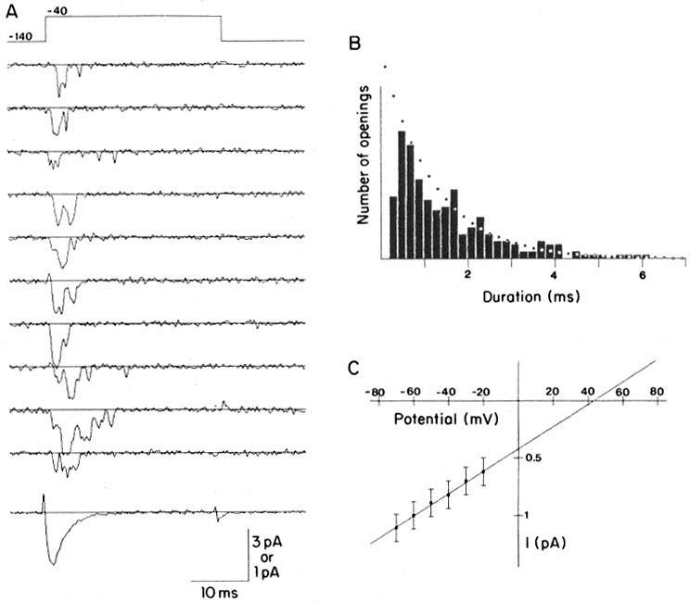
Review from 2.5 Ion channels
Na⁺
stochastic opening and closing
K⁺
Steps:
Different number
of channels
Ca²⁺
Ions/proteins
Na+ channel from rat heart (Patlak and Ortiz 1985)
A traces from a patch containing several channels.
Bottom: average gives current time course.
B. Opening times of single channel events

Slide 12
Neuronal Dynamics – 7.2. Sources of Variability
- Intrinsic noise (ion channels)
Finite number of channels
Finite temperature
Na⁺
K⁺
Network noise (background activity)
Spike arrival from other neurons
Beyond control of experimentalist
Check intrinisic noise by removing the network

Slide 13
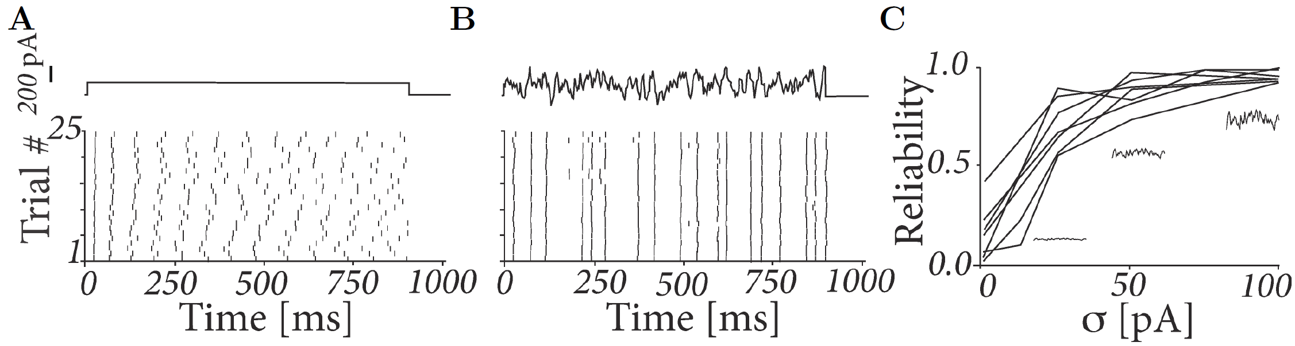
Neuronal Dynamics – 7.2 Variability in vitro
neurons are fairly reliable
I(t)
Image adapted from
Mainen&Sejnowski 1995

Slide 14
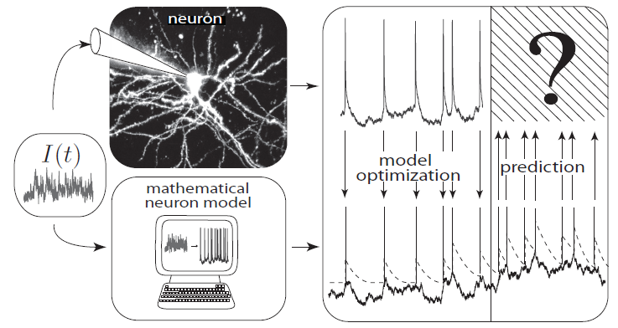
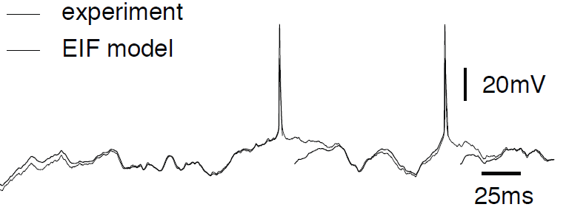
REVIEW from 1.5: How good are integrate-and-fire models?
Badel et al., 2008
Aims: - predict spike initiation times
- predict subthreshold voltage
only possible, because
neurons are fairly reliable

Slide 15
Neuronal Dynamics – 7.2. Sources of Variability
- Intrinsic noise (ion channels)
Finite number of channels
Finite temperature
Na⁺
small contribution!
K⁺
Network noise (background activity)
Spike arrival from other neurons
Beyond control of experimentalist
Check network noise by simulation!

Slide 16
Neuronal Dynamics – 7.2 Sources of Variability
The Brain: a highly connected system
Brain
High connectivity:
systematic, organized in local populations
but seemingly random
Distributed architecture
10
10 neurons
4
10 connections/neurons

Slide 17
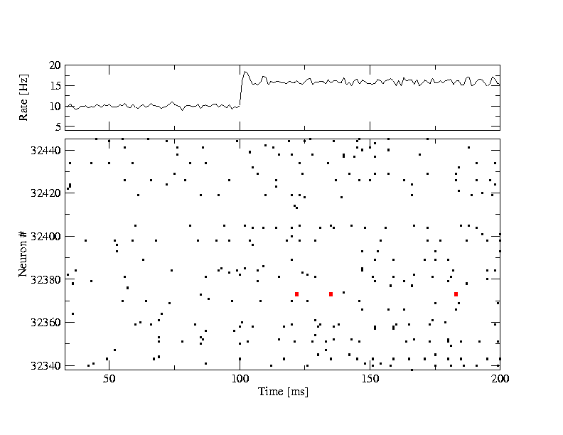
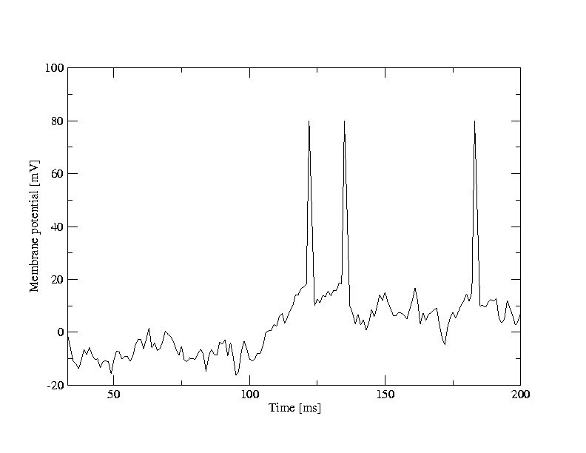
Random firing in a population of LIF neurons
A [Hz]
10
32440
Neuron #
input
-low rate
-high rate
32340
time [ms]
200
50
100
Brunel, J. Comput. Neurosc. 2000
Mayor and Gerstner, Phys. Rev E. 2005
Vogels et al., 2005
Network of deterministic
leaky integrate-and-fire:
‘fluctuations’
Population
- 50 000 neurons
- 20 percent inhibitory
- randomly connected

Slide 18
Random firing in a population of LIF neurons
A [Hz]
10
32440
Neuron #
input
-low rate
-high rate
32340
time [ms]
200
50
100
100
Neuron # 32374
u [mV]
Population
- 50 000 neurons
- 20 percent inhibitory
- randomly connected
0
50
100
time [ms]
200

Slide 19
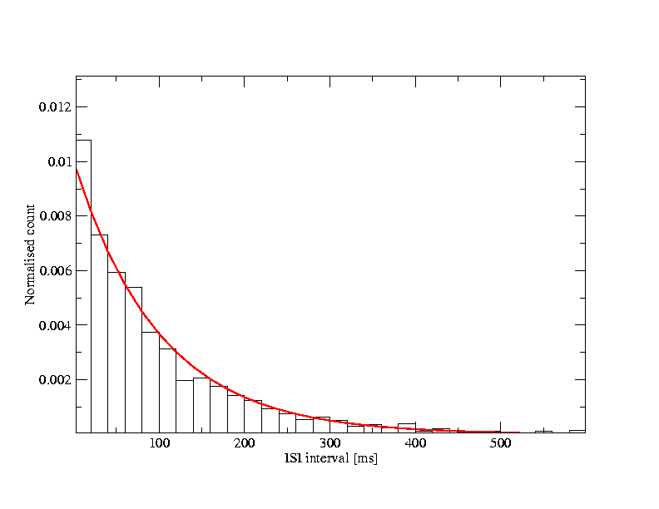
Neuronal Dynamics – 7.2. Interspike interval distribution
- Variability of interspike intervals (ISI)
here in simulations,
but also in vivo
100
u [mV]
ISI
ISI distribution
0
100
100
t [ms]
500
50
100
time [ms]
200
Variability of spike trains:
broad ISI distribution
Brunel,
J. Comput. Neurosc. 2000
Mayor and Gerstner,
Phys. Rev E. 2005
Vogels and Abbott,
J. Neuroscience, 2005

Slide 20
Neuronal Dynamics – 7.2. Sources of Variability
- Intrinsic noise (ion channels)
In vivo data
→ looks ‘noisy’
In vitro data
→small fluctuations
→nearly deterministic
Na⁺
small contribution!
K⁺
Network noise
big contribution!

Slide 21
Neuronal Dynamics – Quiz 7.1.
A- Spike timing in vitro and in vivo
[ ] Reliability of spike timing can be assessed by repeating several times the same stimulus
[ ] Spike timing in vitro is more reliable under injection of constant current than with fluctuating current
[ ] Spike timing in vitro is more reliable than spike timing in vivo
B – Interspike Interval Distribution (ISI)
[ ] An isolated deterministic leaky integrate-and-fire neuron driven by a constant current can have a broad ISI
[ ] A deterministic leaky integrate-and-fire neuron embedded into a randomly connected network of integrate-and-fire neurons can have a broad ISI
[ ] A deterministic Hodgkin-Huxley model as in week 2 embedded into a randomly connected network of Hodgkin-Huxley neurons can have a broad ISI

Slide 22
Week 7 – part 3 : Poisson Model – rate coding
7.1 Variability of spike trains
- experiments
7.2 Sources of Variability?
- Is variability equal to noise?
7.3 Poisson Model
- Poisson Model
- 3 definitions of rate coding
7.4 Stochastic spike arrival
- Membrane potential fluctuations
7.5. Stochastic spike firing
- stochastic integrate-and-fire
Biological Modeling of Neural Networks
Week 7 – Variability and Noise:
The question of the neural code
Wulfram Gerstner
EPFL, Lausanne, Switzerland

Slide 23
Neuronal Dynamics – 7.3 Poisson Model
Homogeneous Poisson model: constant rate
Blackboard:
Poisson model
Probability of finding a spike
stochastic spiking → Poisson model

Slide 24
Neuronal Dynamics – 7.3 Interval distribution
?
Probability of firing:
(i) Continuous time
(ii) Discrete time steps
prob to ‘survive’
Blackboard:
Poisson model

Slide 25
Exercise 1.1 and 1.2: Poisson neuron
Start 9:50 - Next lecture at 10:15
s
Poisson rate
stimulus
1.1. - Probability of NOT firing during time t?
1.2. - Interval distribution p(s)?
1.3.- How can we detect if rate switches from
(1.4 at home:)
-2 neurons fire stochastically (Poisson) at 20Hz.
Percentage of spikes that coincide within +/-2 ms?)

Slide 26
Week 7 – part 3 : Poisson Model – rate coding
7.1 Variability of spike trains
- experiments
7.2 Sources of Variability?
- Is variability equal to noise?
7.3 Poisson Model
- Poisson Model
- 3 definitions of rate coding
7.4 Stochastic spike arrival
- Membrane potential fluctuations
7.5. Stochastic spike firing
- stochastic integrate-and-fire
Biological Modeling of Neural Networks
Week 7 – Variability and Noise:
The question of the neural code
Wulfram Gerstner
EPFL, Lausanne, Switzerland

Slide 27
Neuronal Dynamics – 7.3 Inhomogeneous Poisson Process
rate changes
Probability of firing
Survivor function
Interval distribution

Slide 28
Neuronal Dynamics – Quiz 7.2.
A Homogeneous Poisson Process:
A spike train is generated by a homogeneous Poisson process with rate 25Hz with time steps of 0.1ms.
[ ] The most likely interspike interval is 25ms.
[ ] The most likely interspike interval is 40 ms.
[ ] The most likely interspike interval is 0.1ms
[ ] We can’t say.
B Inhomogeneous Poisson Process:
A spike train is generated by an inhomogeneous Poisson process with a rate that oscillates periodically (sine wave) between 0 and 50Hz (mean 25Hz). A first spike has been fired at a time when the rate was at its maximum. Time steps are 0.1ms.
[ ] The most likely interspike interval is 25ms.
[ ] The most likely interspike interval is 40 ms.
[ ] The most likely interspike interval is 0.1ms.
[ ] We can’t say.
Notes:
This worked very well. Students were REALLY suprised that the most likely interval is the shortest one (in both cases)

Slide 29
Neuronal Dynamics – 7.3. Three definitions of Rate Codes
3 definitions
Temporal averaging
Averaging across repetitions
Population averaging (‘spatial’ averaging)

Slide 30
Neuronal Dynamics – 7.3. Rate codes: spike count
Variability of spike timing
trial 1
rate as a (normalized) spike count:
single neuron/single trial:
temporal average
T=1s
Brain
stim

Slide 31
Neuronal Dynamics – 7.3. Rate codes: spike count
single neuron/single trial:
temporal average
Variability of interspike intervals (ISI)
measure regularity
100
u [mV]
ISI
ISI distribution
0
100
100
t [ms]
500
50
100
time [ms]
200

Slide 32
Neuronal Dynamics – 7.3. Spike count: FANO factor
trial 1
trial 2
trial K
Fano factor
T
Brain
stim

Slide 33
Neuronal Dynamics – 7.3. Three definitions of Rate Codes
3 definitions
Temporal averaging (spike count)
ISI distribution (regularity of spike train)
Fano factor (repeatability across repetitions)
Averaging across repetitions
Population averaging (‘spatial’ averaging)
Problem: slow!!!

Slide 34
Neuronal Dynamics – 7.3. Three definitions of Rate Codes
3 definitions
Temporal averaging
Averaging across repetitions
Population averaging
Problem: slow!!!

Slide 35
Neuronal Dynamics – 7.3. Rate codes: PSTH
Variability of spike timing
trial 1
trial 2
trial K
Brain
stim

Slide 36
Neuronal Dynamics – 7.3. Rate codes: PSTH
Averaging across repetitions
single neuron/many trials:
average across trials
t
K repetitions
Stim(t)
PSTH(t)
K=50 trials

Slide 37
Neuronal Dynamics – 7.3. Three definitions of Rate Codes
3 definitions
Temporal averaging
Averaging across repetitions
Population averaging
Problem: not useful for animal!!!

Slide 38
Neuronal Dynamics – 7.3. Rate codes: population activity
population of neurons
with similar properties
neuron 1
neuron 2
Neuron K
Brain
stim

Slide 39
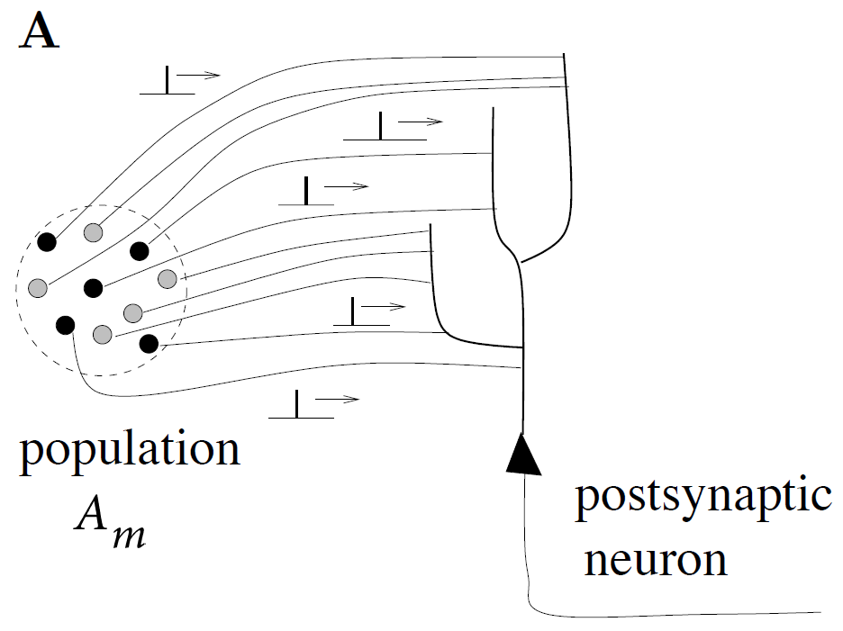
Neuronal Dynamics – 7.3. Rate codes: population activity
population activity - rate defined by population average
t
t
‘natural readout’
population
activity

Slide 40
Neuronal Dynamics – 7.3. Three definitions of Rate codes
Three averaging methods
over time
over repetitions
over population (space)
Too slow
for animal!!!
single neuron
single neuron
Not possible
for animal!!!
many neurons
‘natural’

Slide 41
Neuronal Dynamics – 7.3 Inhomogeneous Poisson Process
t
A(t)
I(t)
n_{sp}
T
population
activity
inhomogeneous Poisson model consistent with rate coding

Slide 42
Neuronal Dynamics – Quiz 7.3.
Rate codes. Suppose that in some brain area we have a group of 500 neurons. All neurons have identical parameters and they all receive the same input. Input is given by sensory stimulation and passes through 2 preliminary neuronal processing steps before it arrives at our group of 500 neurons. Within the group, neurons are not connected to each other. Imagine the brain as a model network containing 100 000 nonlinear integrate-and-fire neurons, so that we know exactly how each neuron functions.
Experimentalist A makes a measurement in a single trial on all 500 neurons using a multi-electrode array, during a period of sensory stimulation.
Experimentalist B picks an arbitrary single neuron and repeats the same sensory stimulation 500 times (with long pauses in between, say one per day).
Experimentalist C repeats the same sensory stimulation 500 times (1 per day), but every day he picks a random neuron (amongst the 500 neurons).
All three determine the time-dependent firing rate.
[ ] A and B and C are expected to find the same result.
[ ] A and B are expected to find the same result, but that of C is expected to be different.
[ ] B and C are expected to find the same result, but that of A is expected to be different.
[ ] None of the above three options is correct.
Start at 10:50,
Discussion at 10:55
Notes:
The 5 minutes of discussion were really great, because students did have different opinions and arguments.

Slide 43
Neuronal Dynamics: Computational Neuroscience of Single Neurons
Week 7 – part 4 :Stochastic spike arrival
7.1 Variability of spike trains
- experiments
7.2 Sources of Variability?
- Is variability equal to noise?
7.3 Three definitions of Rate code
- Poisson Model
7.4 Stochastic spike arrival
- Membrane potential fluctuations
7.5. Stochastic spike firing
- stochastic integrate-and-fire
Week 7 – Variability and Noise:
The question of the neural code
Wulfram Gerstner
EPFL, Lausanne, Switzerland

Slide 44
Neuronal Dynamics – 7.4 Variability in vivo
Spontaneous activity in vivo
Variability
of membrane potential?
awake mouse, freely whisking,
Crochet et al., 2011

Slide 45
Random firing in a population of LIF neurons
A [Hz]
10
32440
Neuron #
input
-low rate
-high rate
32340
time [ms]
200
50
100
100
Neuron # 32374
u [mV]
Population
- 50 000 neurons
- 20 percent inhibitory
- randomly connected
0
50
100
time [ms]
200

Slide 46
Neuronal Dynamics – 7.4 Membrane potential fluctuations
from neuron’s point
of view:
stochastic spike arrival
Pull out one neuron
‘Network noise’
big contribution!

Slide 47
Neuronal Dynamics – 7.4. Stochastic Spike Arrival
Blackboard
now!
Total spike train of K presynaptic neurons
spike train
Pull out one neuron
Probability of spike arrival:
Take
expectation

Slide 48
Neuronal Dynamics – Exercise 2.1 NOW
Passive membrane
A leaky integrate-and-fire neuron without threshold (=passive membrane) receives stochastic spike arrival, described as a homogeneous Poisson process.
Calculate the mean membrane potential. To do so, use the above formula.
Start at 11:35,
Discussion at 11:48

Slide 49
Neuronal Dynamics – Quiz 7.4
A linear (=passive) membrane has a potential given by
Suppose the neuronal dynamics are given by
[ ] the filter f is exponential with time constant
[ ] the constant a is equal to the time constant
[ ] the constant a is equal to
[ ] the amplitude of the filter f is proportional to q
[ ] the amplitude of the filter f is q

Slide 50
Neuronal Dynamics – 7.4. Calculating the mean
mean: assume Poisson process
use for exercise
rate of inhomogeneous
Poisson process

Slide 51
Biological Modeling and Neural Networks
Week 7 – part 5 : Stochastic spike firing in integrate-and-fire models
7.1 Variability of spike trains
- experiments
7.2 Sources of Variability?
- Is variability equal to noise?
7.3 Three definitions of Rate code
- Poisson Model
7.4 Stochastic spike arrival
- Membrane potential fluctuations
7.5. Stochastic spike firing
- Stochastic Integrate-and-fire
Week 7 – Variability and Noise:
The question of the neural code
Wulfram Gerstner
EPFL, Lausanne, Switzerland

Slide 52
Neuronal Dynamics – 7.5. Fluctuation of current/potential
Synaptic current pulses of shape α
EPSC
I
Passive membrane
→ Fluctuating potential
I(t)
Fluctuating input current

Slide 53
Neuronal Dynamics – 7.5. Fluctuation of potential
for a passive membrane, we can analytically predict the mean of membrane potential fluctuations
Passive membrane
Passive membrane
=Leaky integrate-and-fire
without threshold
ADD THRESHOLD
→ Leaky Integrate-and-Fire

Slide 54
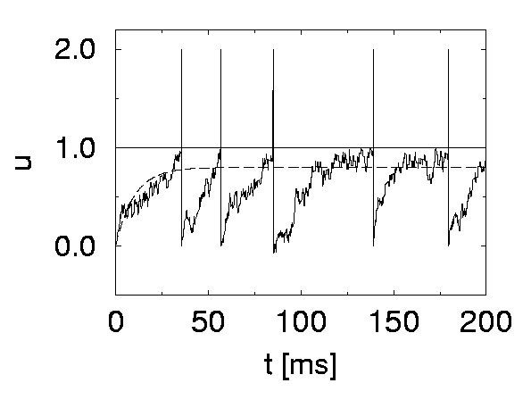
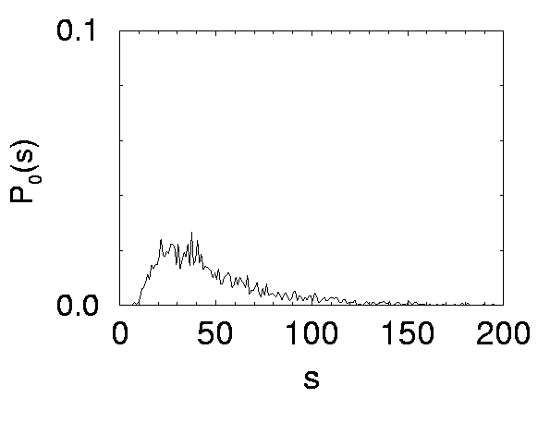
Neuronal Dynamics – 7.5. Stochastic leaky integrate-and-fire
noisy input/ diffusive noise/
stochastic spike arrival
u(t)
subthreshold regime:
- firing driven by fluctuations
- broad ISI distribution
- in vivo like
ISI distribution

Slide 55
Neuronal Dynamics week 5– References and Suggested Reading
Reading: W. Gerstner, W.M. Kistler, R. Naud and L. Paninski,
Neuronal Dynamics: from single neurons to networks and models of cognition. Ch. 7,8: Cambridge, 2014
OR W. Gerstner and W. M. Kistler, Spiking Neuron Models, Chapter 5, Cambridge, 2002
-Rieke, F., Warland, D., de Ruyter van Steveninck, R., and Bialek, W. (1996). Spikes - Exploring the neural code. MIT Press.
-Faisal, A., Selen, L., and Wolpert, D. (2008). Noise in the nervous system. Nat. Rev. Neurosci., 9:202
-Gabbiani, F. and Koch, C. (1998). Principles of spike train analysis. In Koch, C. and Segev, I., editors,
Methods in Neuronal Modeling, chapter 9, pages 312-360. MIT press, 2nd edition.
Softky, W. and Koch, C. (1993). The highly irregular firing pattern of cortical cells is inconsistent with temporal integration of random epsps. J . Neurosci., 13:334-350.
Stein, R. B. (1967). Some models of neuronal variability. Biophys. J., 7:37-68.
Siegert, A. (1951). On the first passage time probability problem. Phys. Rev., 81:617{623.
Konig, P., et al. (1996). Integrator or coincidence detector? the role of the cortical neuron revisited. Trends Neurosci, 19(4):130-137.
THE END

Slide 56
Biological Modeling and Neural Networks
Week 7 – part 5 : Stochastic spike firing in integrate-and-fire models
7.1 Variability of spike trains
- experiments
7.2 Sources of Variability?
- Is variability equal to noise?
7.3 Three definitions of Rate code
- Poisson Model
7.4 Stochastic spike arrival
- Membrane potential: mean value
7.5. Stochastic spike firing
- Integrate-and-fire
7.6 Subthreshold and superth.
7.7. Calculate fluctuations
Week 7 – Variability and Noise:
The question of the neural code
Wulfram Gerstner
EPFL, Lausanne, Switzerland

Slide 57
Neuronal Dynamics – 7.4. Fluctuation of current/potential
fluctuating input current
I(t)
Random spike arrival
fluctuating potential

Slide 58
stochastic spike arrival in I&F – interspike intervals
I
ISI distribution

Slide 59
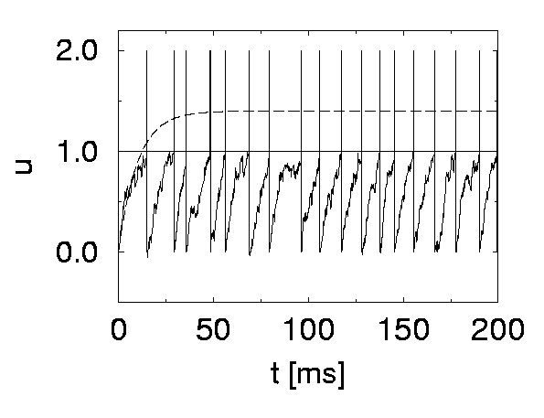
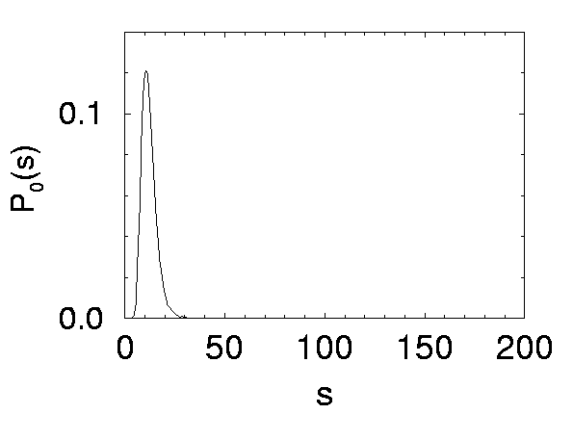
LIF with Diffusive noise (stochastic spike arrival)
Superthreshold vs. Subthreshold regime

Slide 60
Neuronal Dynamics – 5.4b. Fluctuation of potential
Stochastic spike arrival:
for a passive membrane, we can analytically predict the amplitude of membrane potential fluctuations
Passive membrane
Leaky integrate-and-fire
in subthreshold regime
fluctuating potential

Slide 61
Neuronal Dynamics – review: Fluctuations of potential
I(t)
Fluctuating input current
I
Passive membrane
→ Fluctuating potential

Slide 62
Neuronal Dynamics – 7.5. Stochastic leaky integrate-and-fire
effective noise current
I
u(t)
LIF
noisy input/
diffusive noise/
stochastic spike
arrival

Slide 63
Neuronal Dynamics – 7.5. Stochastic leaky integrate-and-fire
noisy input/ diffusive noise/
stochastic spike arrival
u(t)
subthreshold regime:
- firing driven by fluctuations
- broad ISI distribution
- in vivo like
ISI distribution

Slide 64
Neuronal Dynamics – 7.5 Variability in vivo
Spontaneous activity in vivo
membrane potential
most of the time subthreshold
awake mouse, freely whisking,
spikes are rare events
Crochet et al., 2011

Slide 65
Biological Modeling and Neural Networks
Week 7 – part 5 : Stochastic spike firing in integrate-and-fire models
7.1 Variability of spike trains
7.2 Sources of Variability?
- Is variability equal to noise?
7.3 Three definitions of Rate cod
7.4 Stochastic spike arrival
- Membrane potential: mean value
7.5. Stochastic spike firin
7.6 Subthreshold and superth.
7.7. Calculate fluctuations
- autocorrelation of membrane pot.
- standard deviation of membr. Pot.
- autocorrelation of Poisson
Week 7 – Variability and Noise:
The question of the neural code
Wulfram Gerstner
EPFL, Lausanne, Switzerland

Slide 66
Neuronal Dynamics – 7.7 Variability in vivo
Spontaneous activity in vivo
Variability
of membrane potential?
awake mouse, freely whisking,
Crochet et al., 2011
Subthreshold regime

Slide 67
Neuronal Dynamics – 7.7. Fluctuations of potential
Synaptic current pulses of shape α
EPSC
I
Passive membrane
→ Fluctuating potential
I(t)
Fluctuating input current

Slide 68
Neuronal Dynamics – 7.7. Fluctuations of potential
Input: step + fluctuations

Slide 69
Neuronal Dynamics – 7.7. Calculating autocorrelations
Autocorrelation
Mean:
rate of homogeneous
Poisson process

Slide 70
Neuronal Dynamics – 7.7. Autocorrelation of Poisson
math detour
now!
Probability of spike
in step n AND step k
spike train
Probability of spike in time step:
Autocorrelation (continuous time)

Slide 71
Neuronal Dynamics – 7.7. Fluctuation of potential
for a passive membrane, we can analytically predict the amplitude of membrane potential fluctuations
Passive membrane
Leaky integrate-and-fire
in subthreshold regime
fluctuating potential

