Slide 1
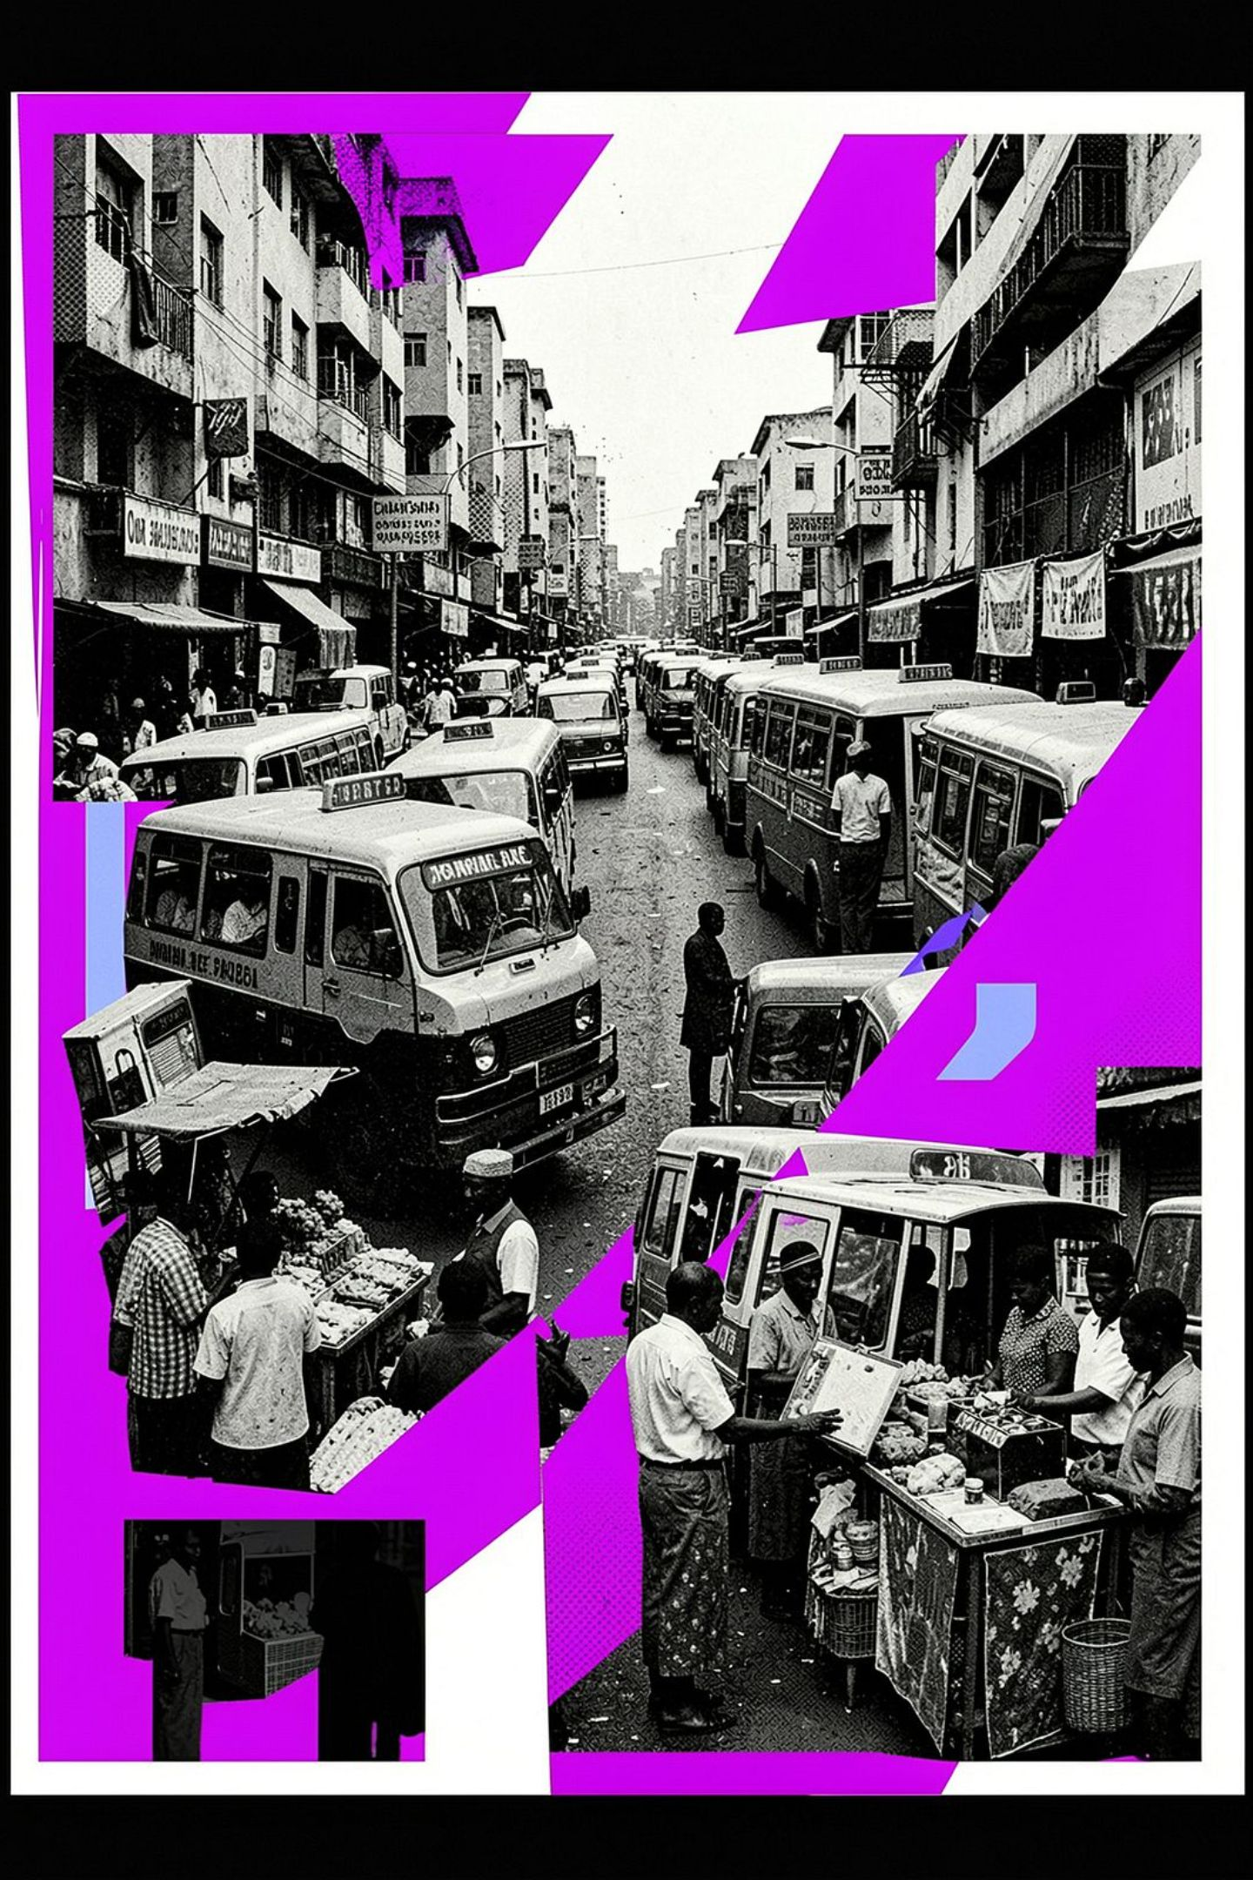
Mzansi Escape
Navigate South Africa's Daily Challenges. Survive. Escape. Thrive.

Slide 2
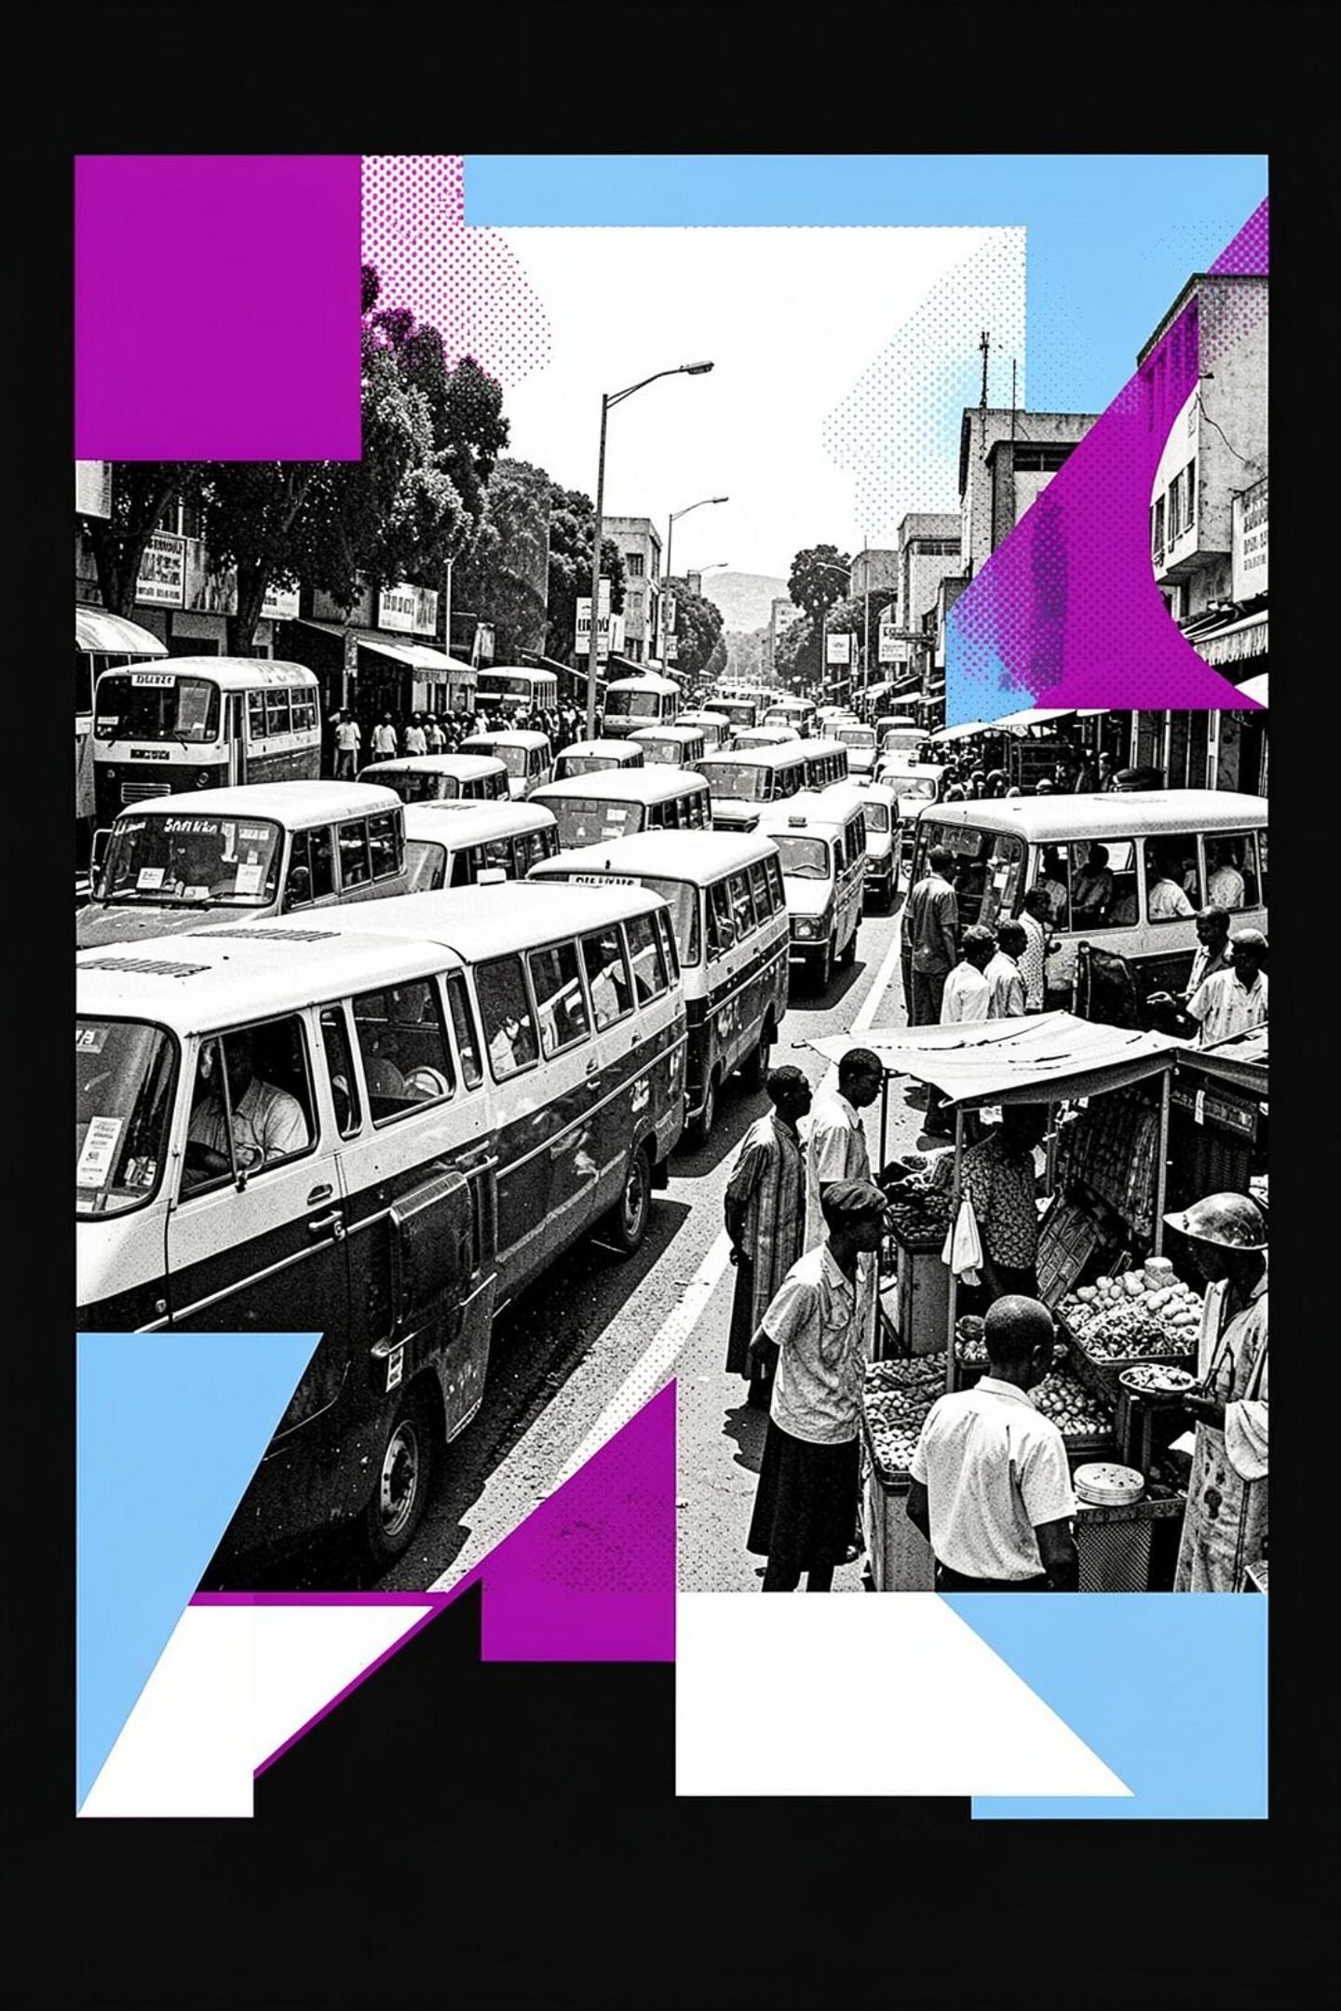
The Game
Genre
Third-person action/adventure
Setting
Iconic South African urban environments
Core Loop
Explore → Identify Hazards → Navigate → Survive
Tone
Grounded realism with authentic SA culture and humour

Slide 3
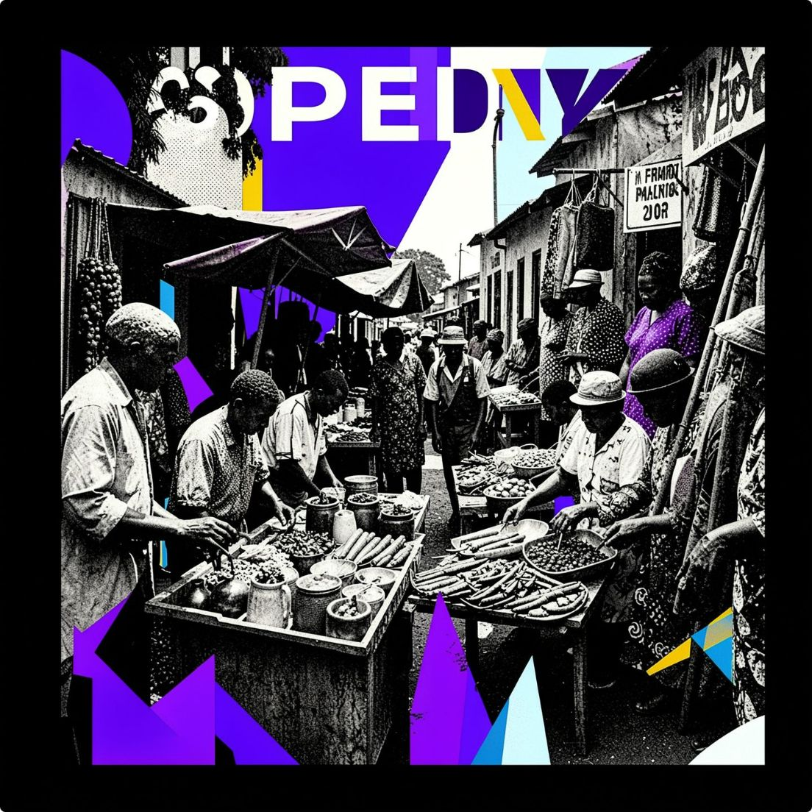
Why Mzansi React?
Real Stories, Real Streets
Authentic Hazards
Navigate challenges inspired by actual daily life: taxis, potholes, load-shedding — nothing is made up.
Experience real South African urban life through interactive storytelling that puts you in the thick of it.
Culture at Every Corner
Celebrate SA culture through authentic dialogue, sounds, and environments that feel like home.

Slide 4
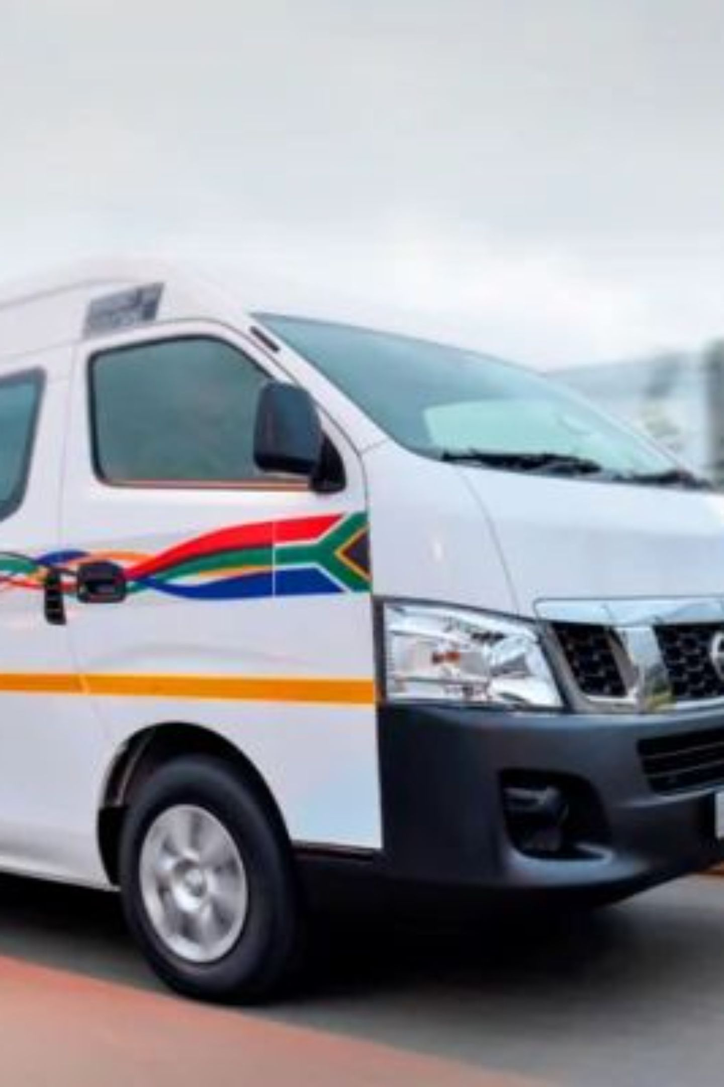



Level 1: Johannesburg Street Run
Location
Hazards
Johannesburg streets
Speeding taxis, hooting sounds, potholes
Challenge
Cultural Touch
Navigate between moving minibus taxis to reach safety
Toyota Quantum taxis, Soweto towers, local shops

Slide 5
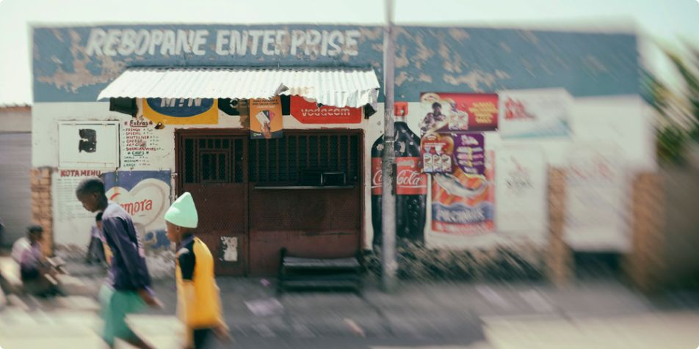
Level 2: Inner-City Residential
01
Location
Johannesburg residential streets
02
Challenge
Avoid cars on the wrong lane of the highway — chaos is the only constant.
03
Hazards
Unpredictable vehicle traffic coming from every direction
04
Cultural Touch
Spaza shops, billboards, and the iconic Soweto towers on the horizon

Slide 6
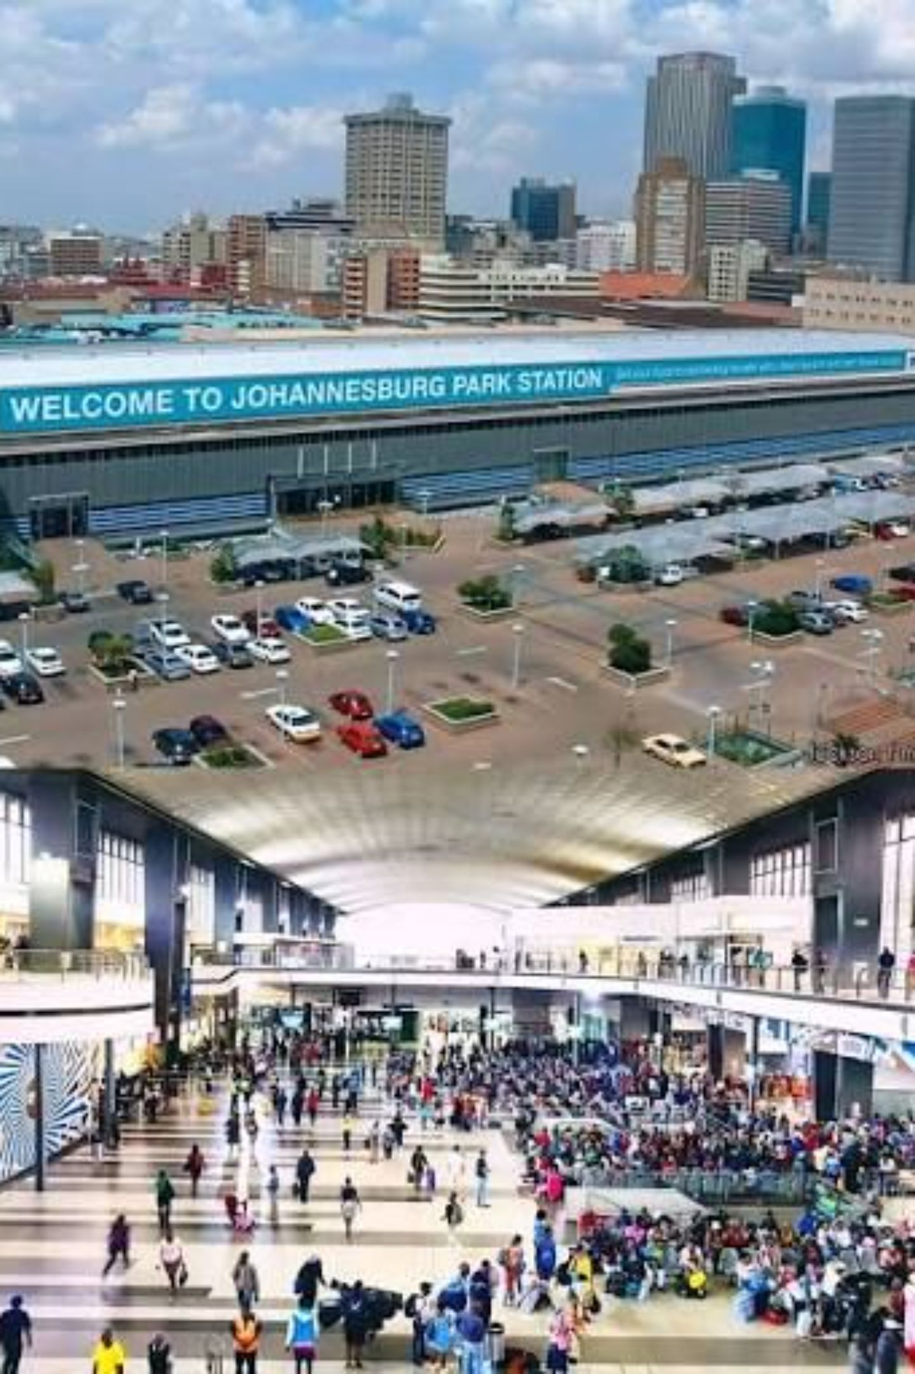



Level 3: Parkstation Escape
Location
Johannesburg Parkstation — the heart of CBD chaos
Challenge
Collect coins scattered across the station to buy a bus ticket to Cape Town
Hazards
Evade pharas (street criminals) while collecting — one wrong move and it's over

Slide 7
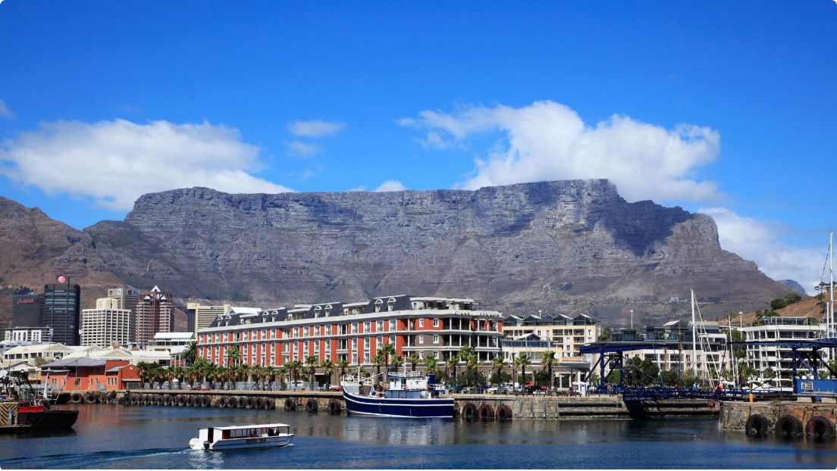

Level 4: Cape Town Water Crisis
The Mother City is running dry. Can you fix it before Day Zero hits?
1
2
3
Location
Challenge
Cultural Touch
Cape Town streets with Table Mountain looming in the background
Complete mini-games to fix the water shortage before the supply bar empties
Water scarcity reality — South Africa's Day Zero crisis brought to life

Slide 8
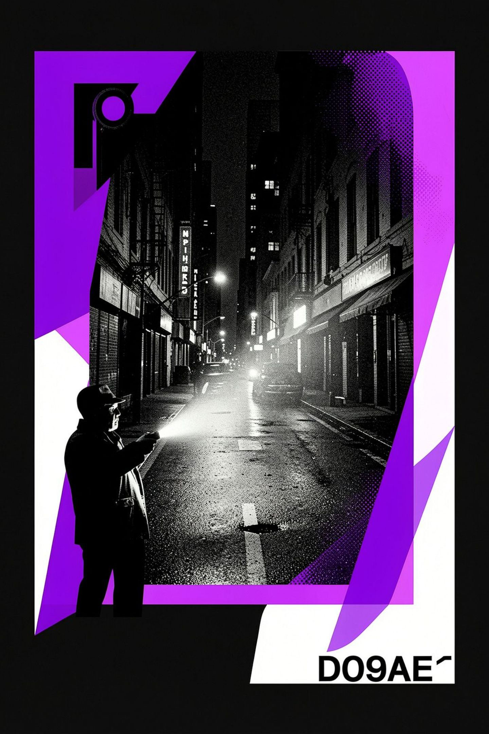
Level 5: Load-Shedding Darkness
Location
Hazards
Cape Town at night — pitch black, no power, no mercy
Evade pharas while navigating pitch-black streets with only a torch to guide you
Challenge
Cultural Touch
Restore power through mini-games in complete darkness
South Africa's electricity crisis — Stage 6 load-shedding brought to life

Slide 9
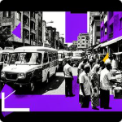
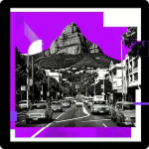
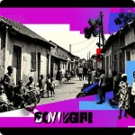
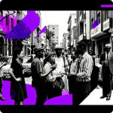
The Pillars of Mzansi React
Navigation
Hazard Avoidance
Clear linear paths through complex, chaotic environments that reward sharp instincts and quick thinking.
Time-based, environmental, and moving obstacles that keep every second tense and unpredictable.
Cultural Immersion
Narrative
Authentic SA sounds, visuals, language, and humour woven into every corner of every level.
Story beats and NPC dialogue that build real meaning — these aren't just levels, they're lives.

Slide 10
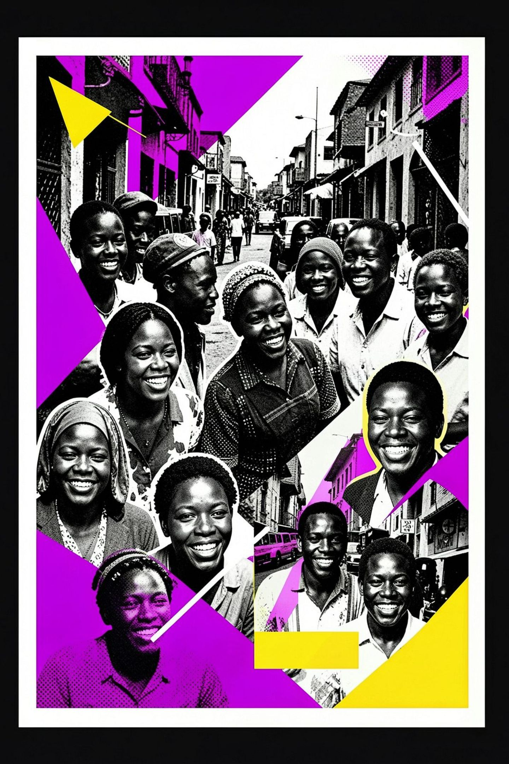
Your South African Adventure Awaits!
Dive into the vibrant, challenging, and authentic streets of South Africa. Navigate daily hazards, immerse yourself in rich culture, and experience a game unlike any other.

