Slide 1
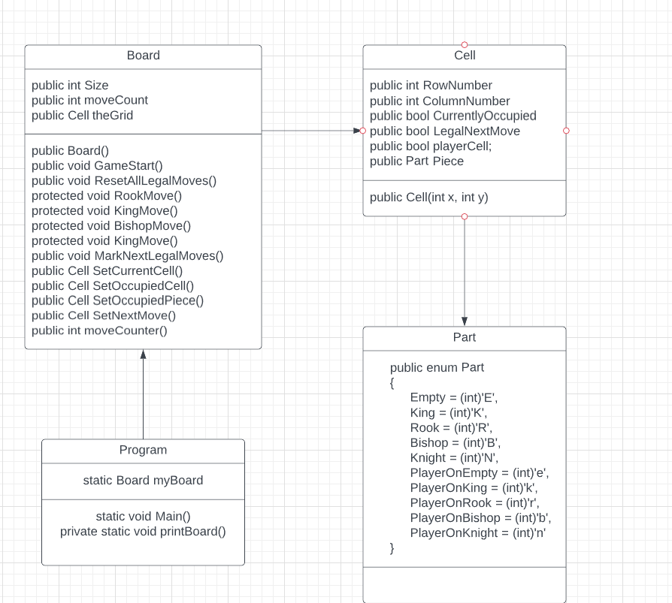
Class Diagram

Slide 2
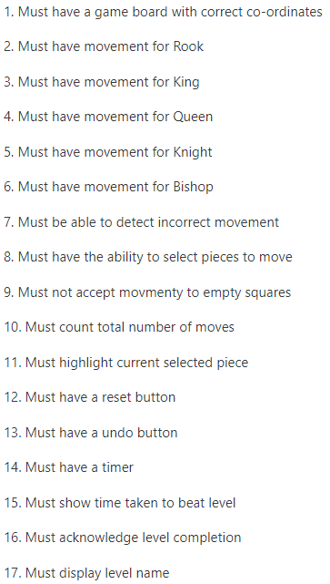
Must haves
I had 16 must have features

Slide 3
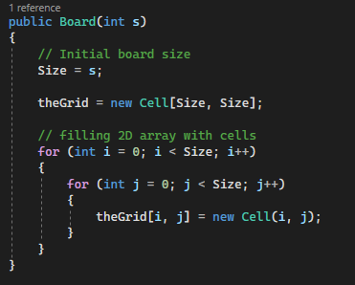
Must have a game board with correct co-ordinates
Created a 2D array that starts at 0,0
and creates a grid of a set Size

Slide 4
Must have movement for Rook

Slide 5
Must have movement for King

Slide 6
Must have movement for Queen

Slide 7
Must have movement for Knight

Slide 8
Must have movement for Bishop

Slide 9
Must be able to detect incorrect movement

Slide 10
Must have the ability to select pieces to move

Slide 11
Must not accept movement to empty squares

Slide 12
Must count total number of moves

Slide 13
Must highlight current piece

Slide 14
Must have reset button

Slide 15
Must have undo button

Slide 16
Must have timer

Slide 17
Must show time taken to beat level

Slide 18
Must acknowledge level completion

Slide 19
Must display level name

