Slide 1
Expected marks Part A
37/37

Slide 2
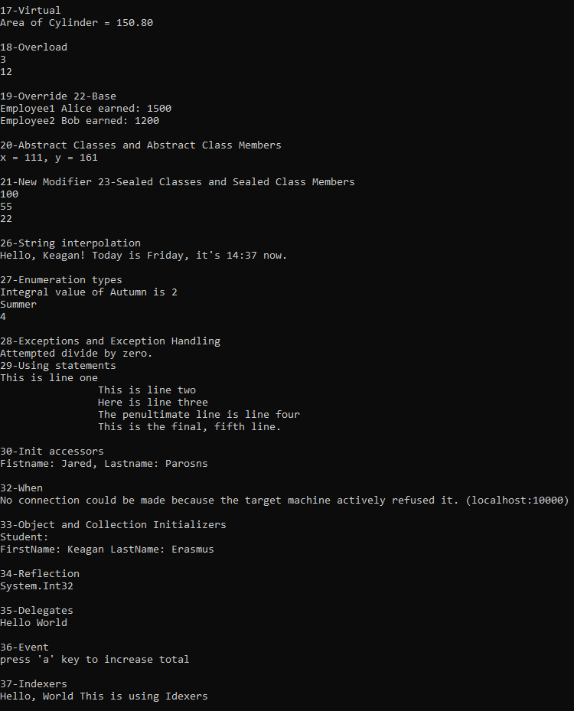
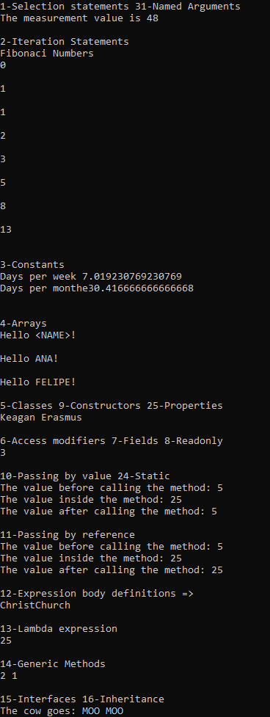
All Outputs

Slide 3


1 Selection statements, 31 Named Arguments

Slide 4


2 Iteration Statement

Slide 5



3 Constants

Slide 6


4 Arrays

Slide 7

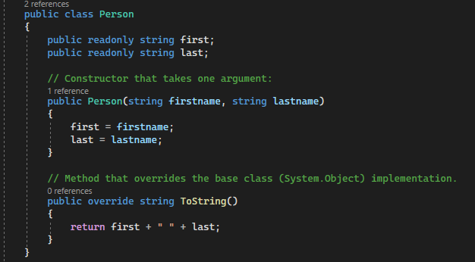
5 Classes, 9 Constructors, 25 Properties

Slide 8

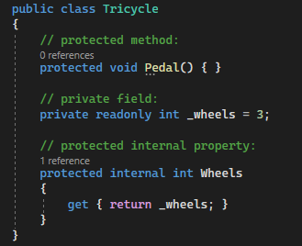
6 Access modifiers, 7 Fields, 8 Readonly

Slide 9


10 Passing by value, 24 Static

Slide 10


11 Passing by reference

Slide 11

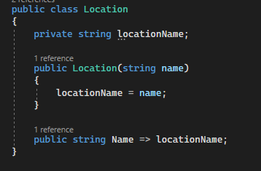
12 Expression body definitions =>

Slide 12

13 Lambda expressions

Slide 13

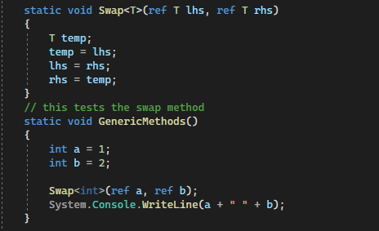
14 Generic Methods

Slide 14
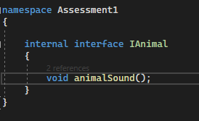

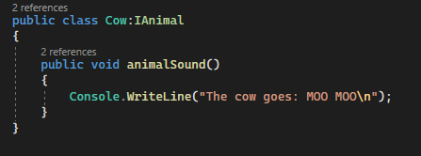
15 Interfaces, 16 Inheritance

Slide 15
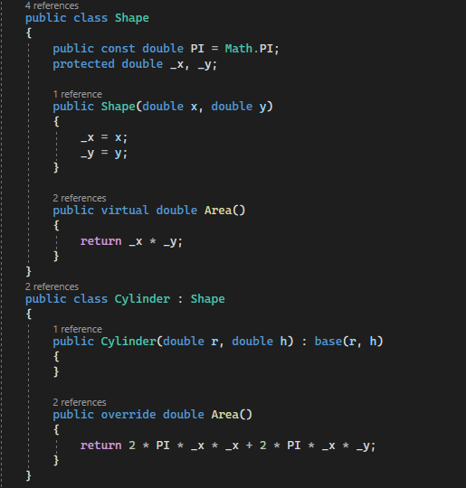

17 Virtual

Slide 16

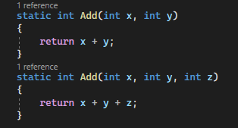
18 Overload

Slide 17

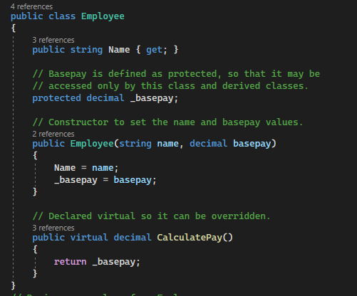
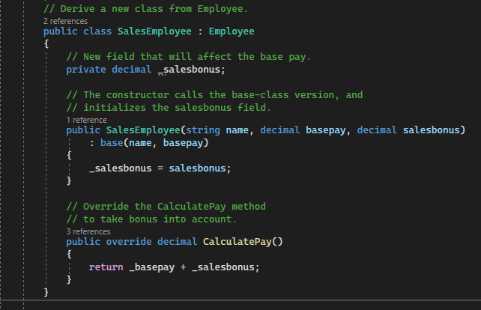
19 Override, 22 Base

Slide 18
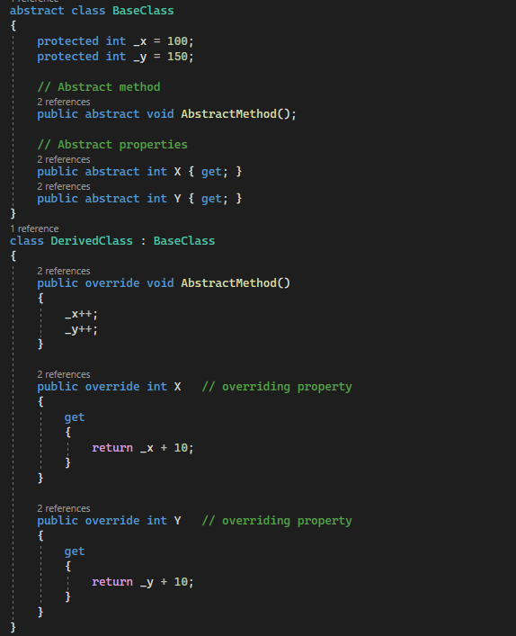

20 Abstract Classes and Abstract Class Members

Slide 19

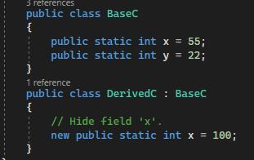
21 New Modifier, 23 Sealed Classes and Sealed Class Members

Slide 20

26 $ - string interpolation

Slide 21

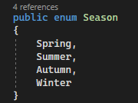
27 Enumeration types

Slide 22
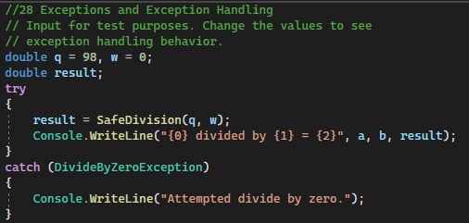

28 Exceptions and Exception Handling

Slide 23

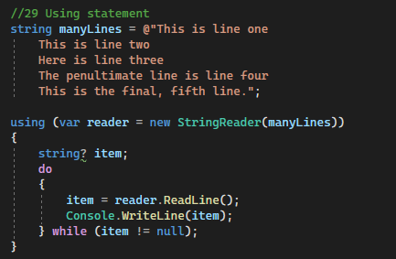
29 Using statements

Slide 24
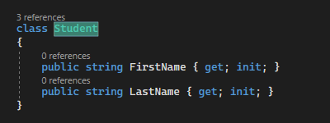

30 Init accessors

Slide 25

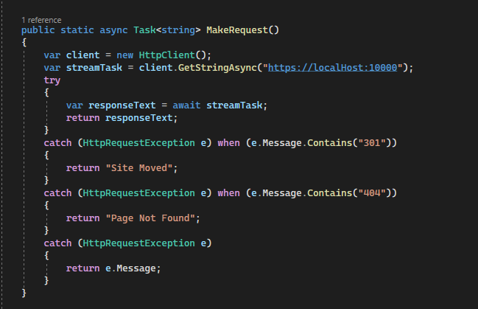
32 When

Slide 26

33 Object and Collection Initializers

Slide 27

34 Reflection

Slide 28
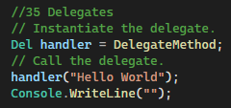

35 Delegates

Slide 29
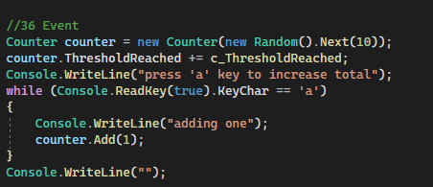
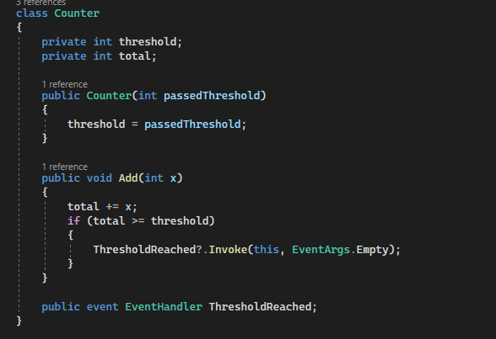
36 Events

Slide 30

37 Indexers

